Slide 1
RSE and Health Education 2020

Slide 2
What we are going to look at today….
The background to the statutory guidance, the key themes and why it is needed.
What it includes.
Potential issues.
Resources to help – briefing sheet, summary sheet, action plan & parental consultation letter.
Planning – what might it look like?

Slide 3
Background and key points
A significant and important piece of legislation (not just because it is ‘statutory’- over a decade of campaigning for statutory PSHE (nearly made statutory in 2010) this compulsory content covers approx. 80% of taught PSHE so a huge move towards this, significant political ‘hot-potato’- 11,186 online and emailed responses to the consultation and 29,000 signatures in response to two petitions Citizens Go (against teaching of LGBT) and Justice UK (parental rights to educate their children in line with their religious beliefs) so 40,000 compared to 15,000 for Ofsted’s new framework.
Sex and relationships education required improvement in over a third of schools. In primary schools this was because too much emphasis was placed on friendships and relationships, leaving pupils ill-prepared for physical and emotional changes during puberty, which many begin to experience before they reach secondary school. In secondary schools it was because too much emphasis was placed on ‘the mechanics’ of reproduction and too little on relationships, sexuality, the influence of pornography on students’ understanding of healthy sexual relationships, dealing with emotions and staying safe.
Lack of high-quality, age-appropriate sex and relationships education in more than a third of schools is a concern as it may leave children and young people vulnerable to inappropriate sexual behaviours and sexual exploitation. This is because they have not been taught the appropriate language or developed the confidence to describe unwanted behaviours or know where to go to for help.
Not yet good enough: personal, social, health and economic education in schools; Personal, social and health education in English schools in 2013

Slide 4
Background and key points
The guiding principles for this compulsory legislation - keeping children safe in an increasingly complex world both on and offline and to foster respect for others and difference.
Change from SRE to RSE to promote the fundamental role of relationships.
LGBT – centre and front of legislation. If message not delivered correctly this could be huge issue for schools. i.e. what does this look like in reality.
Specific statutory guidance around parental consultation -generally for new RSE policy and specific around what is taught Y5/6. but important clarification of consultation in that it is not a parental veto. Supporting guidance for school leaders.
DGAT policy development – Church of England Charter/Valuing All God’s Children.

Slide 5
church of England Guidance
A CHARTER FOR FAITH SENSITIVE AND INCLUSIVE RELATIONSHIPS EDUCATION, RELATIONSHIPS AND SEX EDUCATION (RSE) AND HEALTH EDUCATION (RSHE)
We commit:
To work in partnership with parents and carers. This will involve dialogue with parents and carers through all stages of policy development as well as discussing the resources used to teach their children and how they can contribute at home. It must, however, be recognised that the law specifies that what is taught and how it is taught is ultimately a decision for the school.
That RSHE will be delivered professionally and as an identifiable part of PSHE. It will be led, resourced and reported to parents in the same way as any other subject. There will be a planned programme delivered in a carefully sequenced way. Staff will receive regular training in RSHE and PSHE. Any expert visitors or trainers invited into the school to enhance and supplement the programme will be expected to respect the schools published policy for RSHE.
That RSHE will be delivered in a way that affords dignity and shows respect to all who make up our diverse community. It will not discriminate against any of the protected characteristics in the Equality Act and will be sensitive to the faith and beliefs of those in the wider school community. RSHE will seek to explain fairly the tenets and varying interpretations of religious communities on matters of sex and relationships and teach these viewpoints with respect. It will value the importance of faithfulness as the underpinning and backdrop for relationships. It will encourage pupils to develop the skills needed to disagree without being disagreeable, to appreciate the lived experience of other people and to live well together.
That RSHE will seek to build resilience in our pupils to help them form healthy relationships and to keep themselves safe. It will give pupils opportunities to reflect on values and influences including their peers, the media, the internet, faith and culture that may have RSHE is used to indicate either Relationships Education, Relationships and Sex Education and Health Education as determined by the school context since, after consultation with parents and carers primary schools may decide to include elements of sex education in their curriculum.

Slide 6
church of England GUIDANCE
A CHARTER FOR FAITH SENSITIVE AND INCLUSIVE RELATIONSHIPS EDUCATION, RELATIONSHIPS AND SEX EDUCATION (RSE) AND HEALTH EDUCATION (RSHE)
We commit:
That RSHE will promote healthy resilient relationships set in the context of character and virtue development. It will reflect the vision and associated values of the school, promote reverence for the gift of human sexuality and encourage relationships that are hopeful and aspirational. Based on the school’s values it will seek to develop character within a moral framework based on virtues such as honesty, integrity, self-control, courage, humility, kindness, forgiveness, generosity and a sense of justice but does not seek to teach only one moral position.
That RSHE will be based on honest and medically accurate information from reliable sources of information, including about the law and legal rights. It will distinguish between different types of knowledge and opinions so that pupils can learn about their bodies and sexual and reproductive health as appropriate to their age and maturity.
To take a particular care to meet the individual needs of all pupils including those with special needs and disabilities. It will ensure that lessons and any resources used will be accessible and sensitive to the learning needs of the individual child. We acknowledge the potential vulnerability of pupils who have special needs and disabilities (SEND) and recognise the possibilities and rights of SEND pupils to high quality relationships and sex education.
To seek pupils’ views about RSHE so that the teaching can be made relevant to their lives. It will discuss real life issues relating to the age and stage of pupils, including friendships, families, faith, consent, relationship abuse, exploitation and safe relationships online. This will be carefully targeted and age appropriate based on a teacher judgment about pupil readiness for this information in consultation with parents and carers.

Slide 7
The Relationships Education, Relationships and Sex Education and Health Education (England) Regulations 2019, made under sections 34 and 35 of the Children and Social Work Act 2017, make Relationships Education compulsory for all pupils receiving primary education and Relationships and Sex Education (RSE) compulsory for all pupils receiving secondary education.4 They also make Health Education compulsory in all schools except independent schools.

Slide 8
How do the statutory changes fit in with non statutory PSHE?
The statutory guidance outlines what schools must cover (though not everything that schools should cover) in PSHE from 2020. The Department for Education (DfE) says: ‘All elements of PSHE are important and the government continues to recommend PSHE be taught in schools’.
Schools should not just ‘teach to the guidance’, but see it as the basic requirement which forms part of broader PSHE education. Most schools are well on the way to delivering these commitments and should build on, rather than unpick, what they’re already doing well. The new requirements are about raising and ‘levelling up’ of PSHE standards across all schools in a way that does not cause undue burden on workload and resources.
PSHE education needs regular curriculum time like any other subject. ‘Drop down’ or ‘off timetable’ days can enhance a timetabled programme of regular, planned lessons but are not an appropriate or effective alternative to one.

Slide 9
How do the statutory changes fit in with non statutory PSHE?
Schools should tailor their programme to the needs of pupils and communities in order to be effective. There is no ‘one-size-fits-all solution’.
Statements are for the end of primary school and how then these are mapped is going to be highly important.
The PSHE Co-ordinator will need to work closely with colleagues in related curriculum areas to ensure Relationships Education, RSE and Health Education programmes complement, and do not duplicate, content covered in national curriculum subjects such as citizenship, science, computing and PE. It is important to check prior knowledge and build this into the planning process to ensure a smooth transition between primary and secondary.
Schools do not need to have a policy for Health Education, or for broader PSHE education but a RSE policy that includes (or links to) your PHSE policy and includes specific information on Health Education ensures clarity in all statutory and non-statutory areas.

Slide 10
Equality act & send
Schools are required to comply with relevant requirements of the Equality Act 2010.
Under the provisions of the Equality Act, schools must not unlawfully discriminate against pupils because of their age, sex, race, disability, religion or belief, gender reassignment, pregnancy or maternity, marriage or civil partnership11, or sexual orientation (collectively known as the protected characteristics). Schools must also make reasonable adjustments to alleviate disadvantage and be mindful of the SEND Code of Practice when planning for these subjects.
There is provisions within the Equality Act allow schools to take positive action, where it can be shown that it is proportionate, to deal with particular disadvantages affecting one group because of a protected characteristic.

Slide 11
LGBTQIA+

Slide 12
LGBTQIA+
L - Lesbian. Lesbian is a term used to refer to homosexual females. G - Gay. Gay is B - Bisexual. Bisexual is when a person is attracted to two sexes/genders. an umbrella term for transgender and transsexual people.
T - Trans. Trans isa term used to refer to homosexuality, a homosexual person, or a homosexual male. Q - Queer/Questioning. Queer is an umbrella term for all of those who are not heterosexual and/or cisgender (denoting or relating to a person whose sense of personal identity and gender corresponds with their birth sex). Questioning is when a person isn't 100% sure of their sexual orientation and/or gender, and are trying to find their true identity. I - Intersex. Intersex is when a person has an indeterminate mix of primary and secondary sex characteristics. A - Asexuality. Asexuality is when a person experiences no (or little, if referring to demisexuality or grey-asexuality) sexual attraction to people. + - The "+" symbol simply stands for all of the other sexualities, sexes, and genders that aren't included in these few letters

Slide 13
Lesbian, Gay, Bisexual and Transgender (LGBT)
In teaching Relationships Education and RSE, schools should ensure that the needs of all pupils are appropriately met, and that all pupils understand the importance of equality and respect. Schools must ensure that they comply with the relevant provisions of the Equality Act 2010, (please see The Equality Act 2010 and schools: Departmental advice), under which sexual orientation and gender reassignment are amongst the protected characteristics.
Schools should ensure that all of their teaching is sensitive and age appropriate in approach and content. At the point at which schools consider it appropriate to teach their pupils about LGBT, they should ensure that this content is fully integrated into their programmes of study for this area of the curriculum rather than delivered as a stand- alone unit or lesson. Schools are free to determine how they do this, and we expect all pupils to have been taught LGBT content at a timely point as part of this area of the curriculum.

Slide 14
Sex education (Primary)
Sex education is not compulsory in primary schools.
The content set out in the guidance covers everything that primary schools should teach about relationships and health, including puberty. The national curriculum for science also includes subject content in related areas, such as the main external body parts, the human body as it grows from birth to old age (including puberty) and reproduction in some plants and animals. It will be for primary schools to determine whether they need to cover any additional content on sex education to meet the needs of their pupils. Many primary schools already choose to teach some aspects of sex education and will continue to do so, although it is not a requirement.
It is important that the transition phase before moving to secondary school supports pupils’ ongoing emotional and physical development effectively. The department continues to recommend therefore that all primary schools should have a sex education programme tailored to the age and the physical and emotional maturity of the pupils. It should ensure that both boys and girls are prepared for the changes that adolescence brings and – drawing on knowledge of the human life cycle set out in the national curriculum for science - how a baby is conceived and born.
As well as consulting parents more generally about the school’s overall policy, primary schools should consult parents before the final year of primary school about the detailed content of what will be taught. This process should include offering parents support in talking to their children about sex education and how to link this with what is being taught in school. Meeting these objectives will require a graduated, age-appropriate programme of sex education.

Slide 15
Engaging with parents
The PSHE Association has published a guide with practical advice for primary schools on engaging with parents about PSHE education – including a template letter and parent workshop plan – on how to positively communicate with parents about statutory Relationships Education in particular, as well as an overview of statutory requirements regarding withdrawal of pupils from sex education.
DfE ‘Parental Engagement on Relationships Education’ guidance: The DfE also published parental engagement guidance for schools in October 2019. It includes relevant information, advice, tips and case studies on effective parental engagement.
DfE guidance for parents: The Department for Education has published a useful list of FAQs for parents on the new RSE/Relationships Education requirements, and new guides for parents on Relationships Education, RSE and Health Education.

Slide 16
Engaging with parents
Key DfE requirements: The DfE is clear that schools should publish relevant policies online, and ensure parents are consulted and examples of resources shared.
The DfE says about parents and curriculum content:
‘What is taught, and how, is ultimately a decision for the school and consultation does not provide a parental veto on curriculum content’.
There have been challenges from a vocal minority of parents to some schools’ commitment to equality and diversity, including LGBT+ inclusion.
The National Association of Head Teachers (NAHT) has produced a useful policy update on schools’ commitments under the Equality Act.

Slide 17
Right to be excused from sex education (commonly referred to as the right to withdraw !!)
Primary schools that choose to teach sex education must allow parents a right to withdraw their children. Unlike sex education in RSE at secondary, in primary schools, headteachers must comply with a parent’s wish to withdraw their child from sex education beyond the national curriculum for science.
Primary schools that decide to teach sex education need to define anything they choose to teach other than that covered in the science curriculum in their RSE policy as well as advise parents of their right to withdraw their child from this education.

Slide 18
Relationships Education (Primary)
The focus in primary school should be on teaching the fundamental building blocks and characteristics of positive relationships, with particular reference to friendships, family relationships, and relationships with other children and with adults. The main areas are:
Families and people that care for me
Caring Friendships
Respectful Relationships
Online Relationships
Being Safe

Slide 19
Families and people who care for me
Pupils should know:
that families are important for children growing up because they can give love, security and stability
the characteristics of healthy family life, commitment to each other, including in times of difficulty, protection and care for children and other family members, the importance of spending time together and sharing each other’s lives
that others’ families, either in school or in the wider world, sometimes look different from their family, but that they should respect those differences and know that other children’s families are also characterised by love and care
that stable, caring relationships, which may be of different types, are at the heart of happy families, and are important for children’s security as they grow up
that marriage represents a formal and legally recognised commitment of two people to each other which is intended to be lifelong
how to recognise if family relationships are making them feel unhappy or unsafe, and how to seek help or advice from others if needed

Slide 20
Caring friendships
Pupils should know:
how important friendships are in making us feel happy and secure, and how people choose and make friends
the characteristics of friendships, including mutual respect, truthfulness, trustworthiness, loyalty, kindness, generosity, trust, sharing interests and experiences and support with problems and difficulties
that healthy friendships are positive and welcoming towards others, and do not make others feel lonely or excluded
that most friendships have ups and downs, and that these can often be worked through so that the friendship is repaired or even strengthened, and that resorting to violence is never right
how to recognise who to trust and who not to trust, how to judge when a friendship is making them feel unhappy or uncomfortable, managing conflict, how to manage these situations and how to seek help or advice from others, if needed

Slide 21
Respectful relationships
Pupils should know:
the importance of respecting others, even when they are very different from them (for example, physically, in character, personality or backgrounds), or make different choices or have different preferences or beliefs
practical steps they can take in a range of different contexts to improve or support respectful relationships
the conventions of courtesy and manners
the importance of self-respect and how this links to their own happiness
that in school and in wider society they can expect to be treated with respect by others, and that in turn they should show due respect to others, including those in positions of authority
about different types of bullying (including cyberbullying), the impact of bullying, responsibilities of bystanders (primarily reporting bullying to an adult) and how to get help
what a stereotype is, and how stereotypes can be unfair, negative or destructive
the importance of permission-seeking and giving in relationships with friends, peers and adults

Slide 22
Online relationships
Pupils should know:
that people sometimes behave differently online, including by pretending to be someone they are not
that the same principles apply to online relationships as to face-to-face relationships, including the importance of respect for others online including when we are anonymous
the rules and principles for keeping safe online, how to recognise risks, harmful content and contact, and how to report them
how to critically consider their online friendships and sources of information including awareness of the risks associated with people they have never met
how information and data is shared and used online

Slide 23
Being safe
Pupils should know:
what sorts of boundaries are appropriate in friendships with peers and others (including in a digital context)
about the concept of privacy and the implications of it for both children and adults; including that it is not always right to keep secrets if they relate to being safe
that each person’s body belongs to them, and the differences between appropriate and inappropriate or unsafe physical, and other, contact
how to respond safely and appropriately to adults they may encounter (in all contexts, including online) whom they do not know
how to recognise and report feelings of being unsafe or feeling bad about any adult
how to ask for advice or help for themselves or others, and to keep trying until they are heard,
how to report concerns or abuse, and the vocabulary and confidence needed to do so
where to get advice, for example family, school or other sources

Slide 24
Physical health and mental wellbeing
The aim of teaching pupils about physical health and mental wellbeing is to give them the information that they need to make good decisions about their own health and wellbeing. It should enable them to recognise what is normal and what is an issue in themselves and others and, when issues arise, know how to seek support as early as possible from appropriate sources. Teachers should be clear that mental wellbeing is a normal part of daily life, in the same way as physical health.
Areas covered includes:
Mental Wellbeing
Internet Safety and Harms
Physical Health and Fitness
Healthy Eating
Drugs, Alcohol and Tobacco
Health and Prevention
Basic First Aid
Changing Adolescent Body

Slide 25
Mental wellbeing
Pupils should know:
that mental wellbeing is a normal part of daily life, in the same way as physical health
that there is a normal range of emotions (e.g. happiness, sadness, anger, fear, surprise, nervousness) and scale of emotions that all humans experience in relation to different experiences and situations
how to recognise and talk about their emotions, including having a varied vocabulary of words to use when talking about their own and others’ feelings
how to judge whether what they are feeling and how they are behaving is appropriate and proportionate
the benefits of physical exercise, time outdoors, community participation, voluntary and service-based activity on mental wellbeing and happiness
simple self-care techniques, including the importance of rest, time spent with friends and family and the benefits of hobbies and interests
isolation and loneliness can affect children and that it is very important for children to discuss their feelings with an adult and seek support
that bullying (including cyberbullying) has a negative and often lasting impact on mental wellbeing
where and how to seek support (including recognising the triggers for seeking support), including whom in school they should speak to if they are worried about their own or someone else’s mental wellbeing or ability to control their emotions (including issues arising online)
it is common for people to experience mental ill health. For many people who do, the problems can be resolved if the right support is made available, especially if accessed early enough.

Slide 26
Internet safety and harms
Pupils should know:
that for most people the internet is an integral part of life and has many benefits
about the benefits of rationing time spent online, the risks of excessive time spent on electronic devices and the impact of positive and negative content online on their own and others’ mental and physical wellbeing
how to consider the effect of their online actions on others and know how to recognise and display respectful behaviour online and the importance of keeping personal information private
why social media, some computer games and online gaming, for example, are age restricted
that the internet can also be a negative place where online abuse, trolling, bullying and harassment can take place, which can have a negative impact on mental health
how to be a discerning consumer of information online including understanding that information, including that from search engines, is ranked, selected and targeted
where and how to report concerns and get support with issues online

Slide 27
Physical health and fitness
Pupils should know:
the characteristics and mental and physical benefits of an active lifestyle
the importance of building regular exercise into daily and weekly routines and how to achieve this; for example walking or cycling to school, a daily active mile or other forms of regular, vigorous exercise
the risks associated with an inactive lifestyle (including obesity)
how and when to seek support including which adults to speak to in school if they are worried about their health

Slide 28
Healthy eating
Pupils should know:
what constitutes a healthy diet (including understanding calories and other nutritional content)
the principles of planning and preparing a range of healthy meals
the characteristics of a poor diet and risks associated with unhealthy eating (including, for example, obesity and tooth decay) and other behaviours (e.g. the impact of alcohol on diet or health)
Drugs, alcohol and tobacco
Pupils should know:
the facts about legal and illegal harmful substances and associated risks, including smoking, alcohol use and drug-taking

Slide 29
Health and prevention
Pupils should know:
how to recognise early signs of physical illness, such as weight loss, or unexplained changes to the body
about safe and unsafe exposure to the sun, and how to reduce the risk of sun damage, including skin cancer
the importance of sufficient good quality sleep for good health and that a lack of sleep can affect weight, mood and ability to learn
about dental health and the benefits of good oral hygiene and dental flossing, including regular check-ups at the dentist
about personal hygiene and germs including bacteria, viruses, how they are spread and treated, and the importance of handwashing
the facts and science relating to allergies, immunisation and vaccination

Slide 30
Basic first aid
Pupils should know:
how to make a clear and efficient call to emergency services if necessary
concepts of basic first-aid, for example dealing with common injuries, including head injuries
Changing adolescent body
Pupils should know:
key facts about puberty and the changing adolescent body, particularly from age 9 through to age 11, including physical and emotional changes
about menstrual wellbeing including the key facts about the menstrual cycle

Slide 31
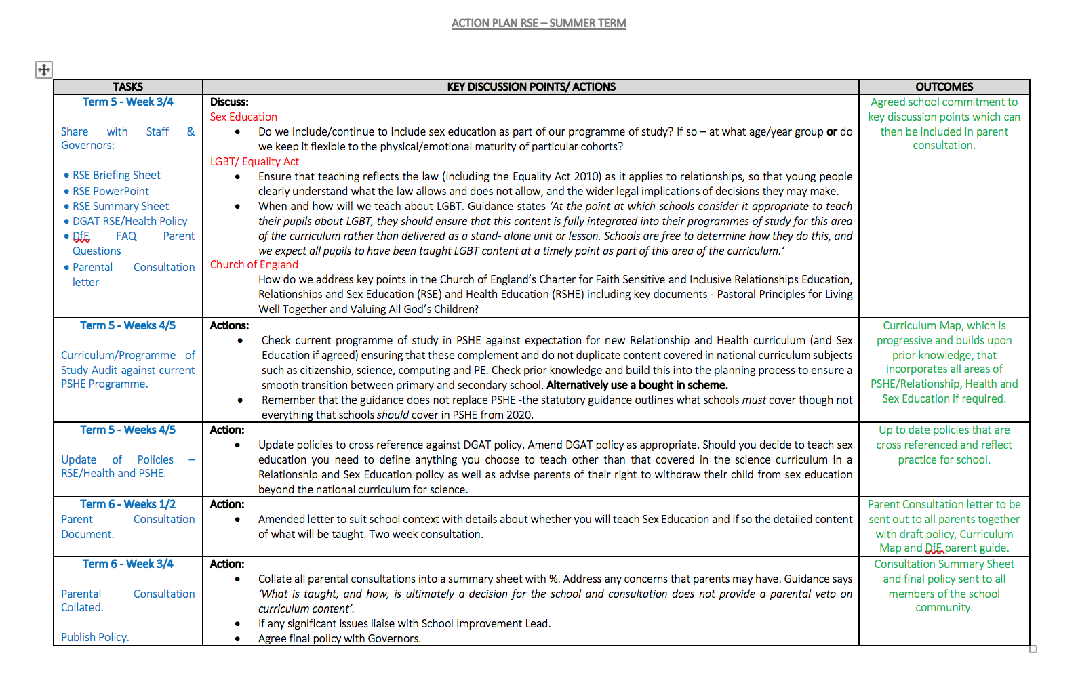

Slide 32
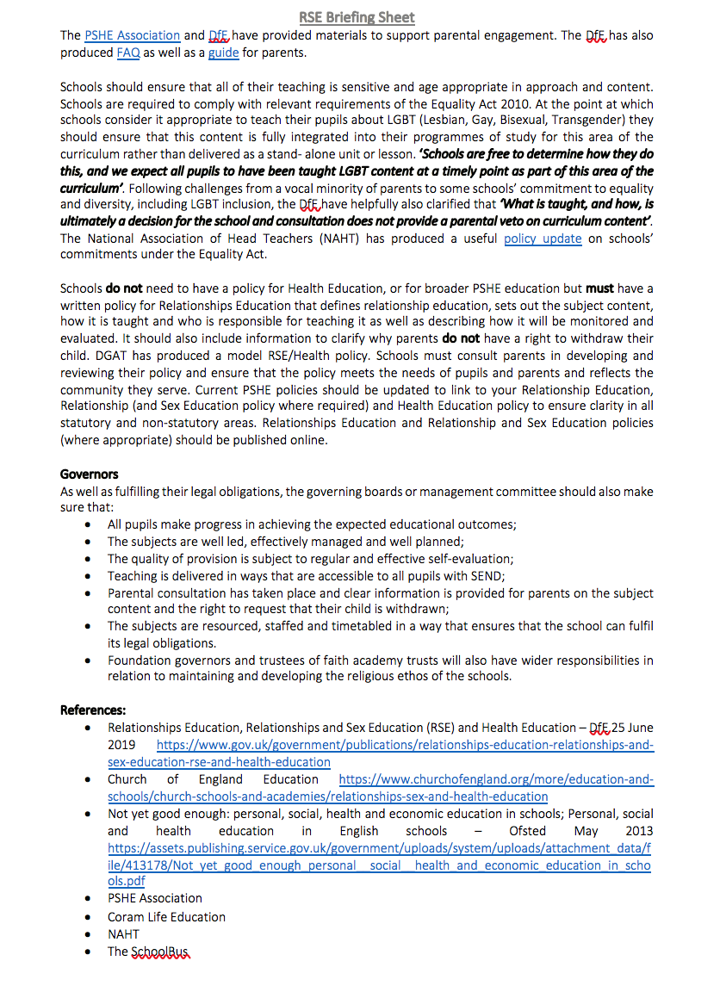

Slide 33
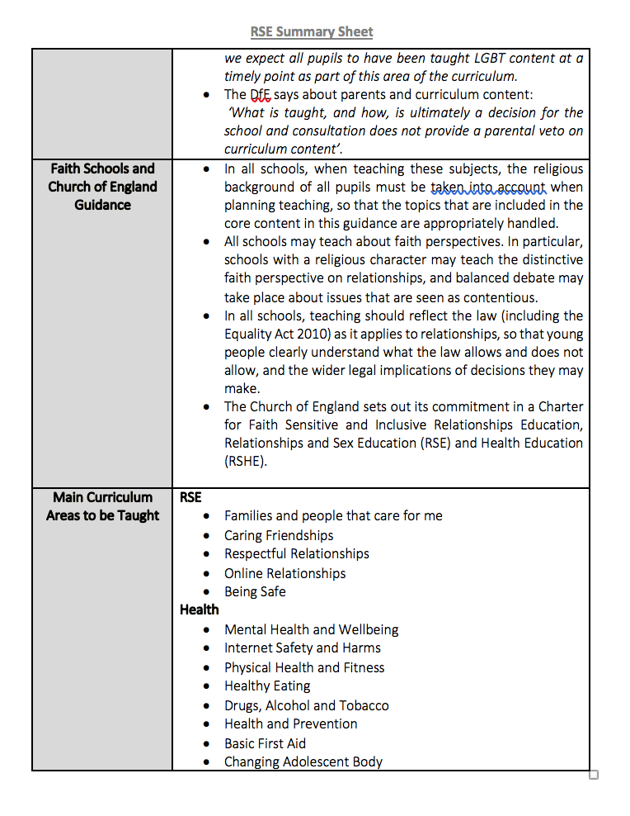

Slide 34
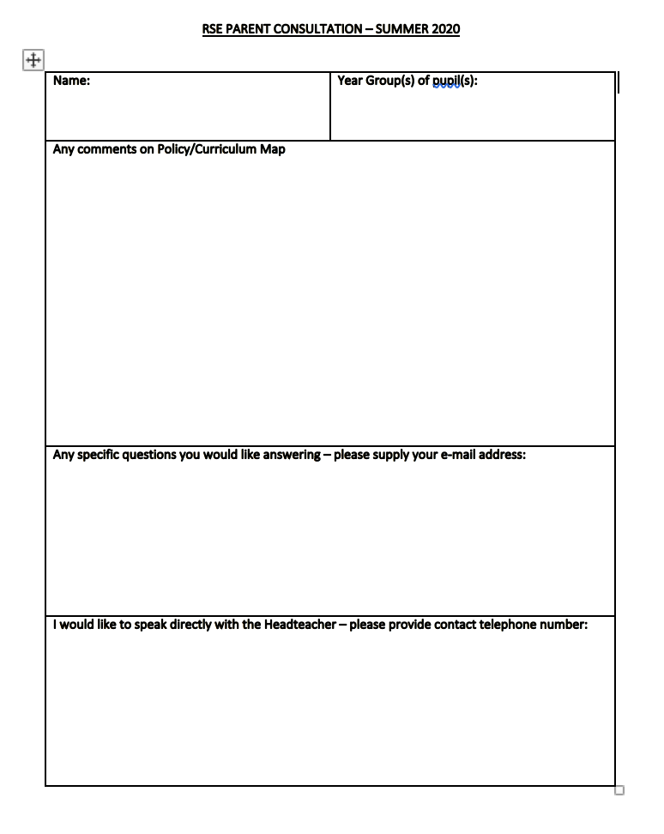

Slide 35
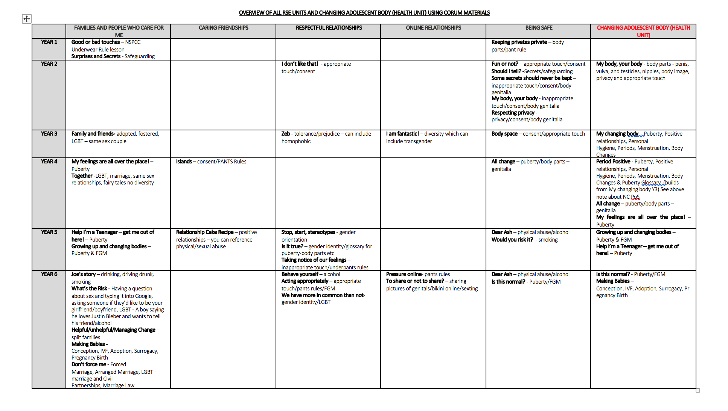

Slide 36
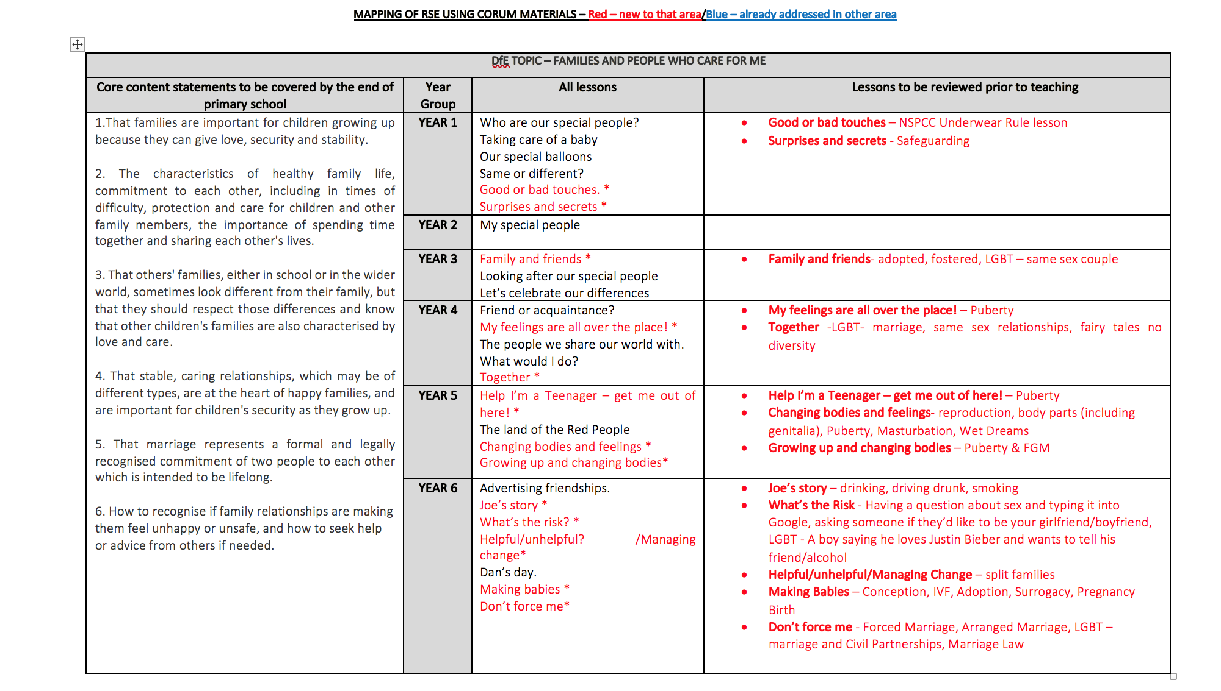

Slide 37
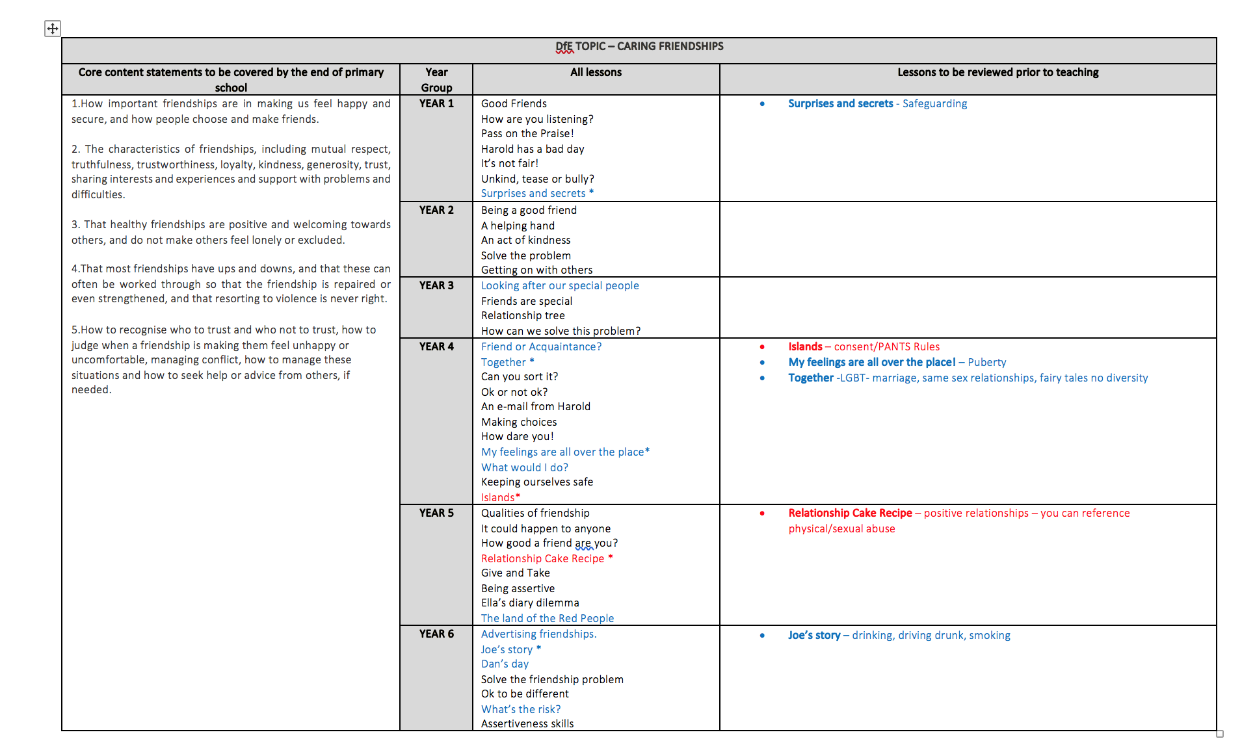

Slide 38
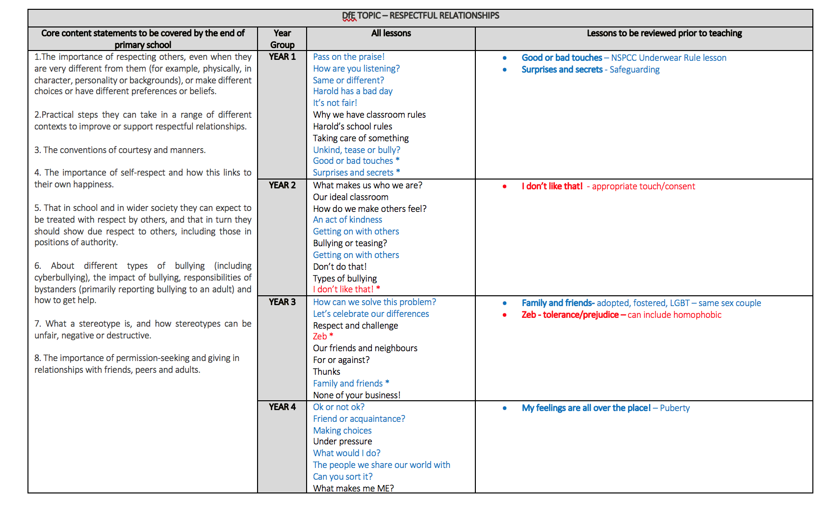
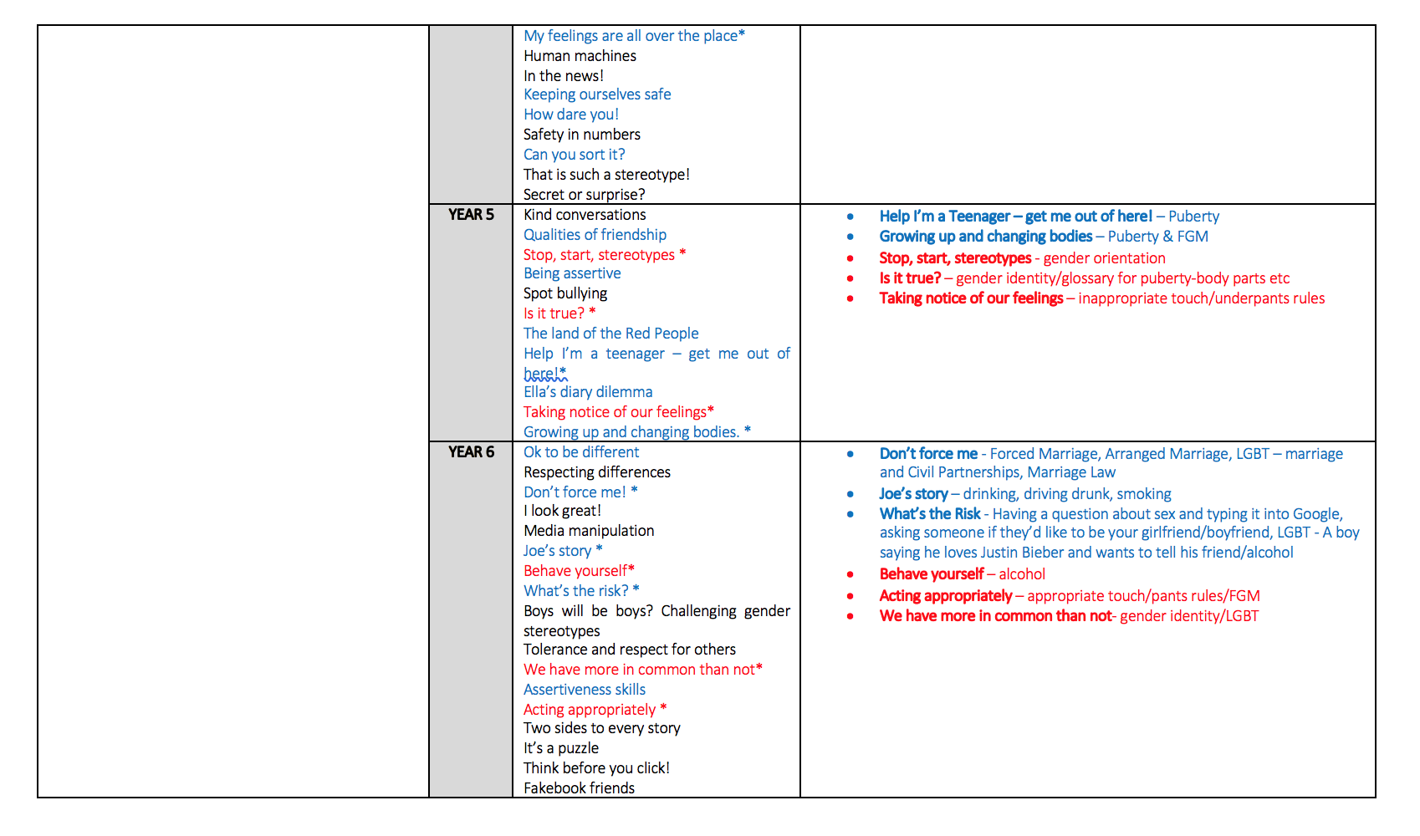

Slide 39
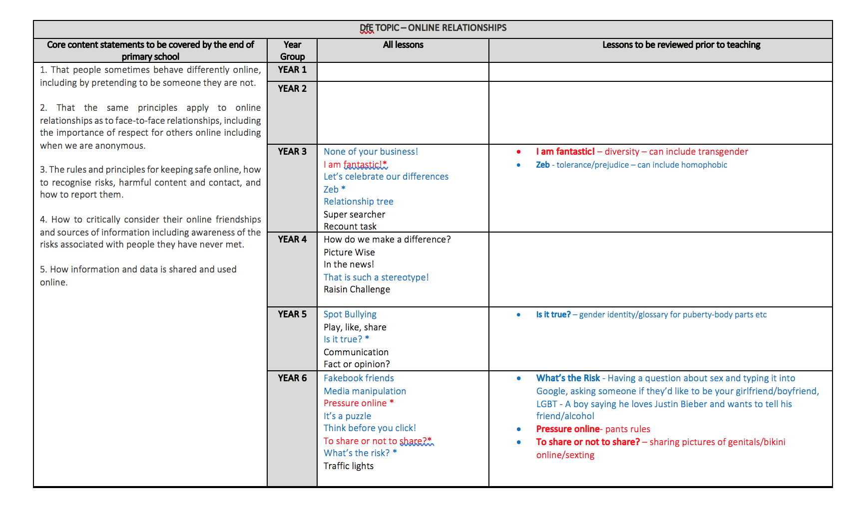

Slide 40
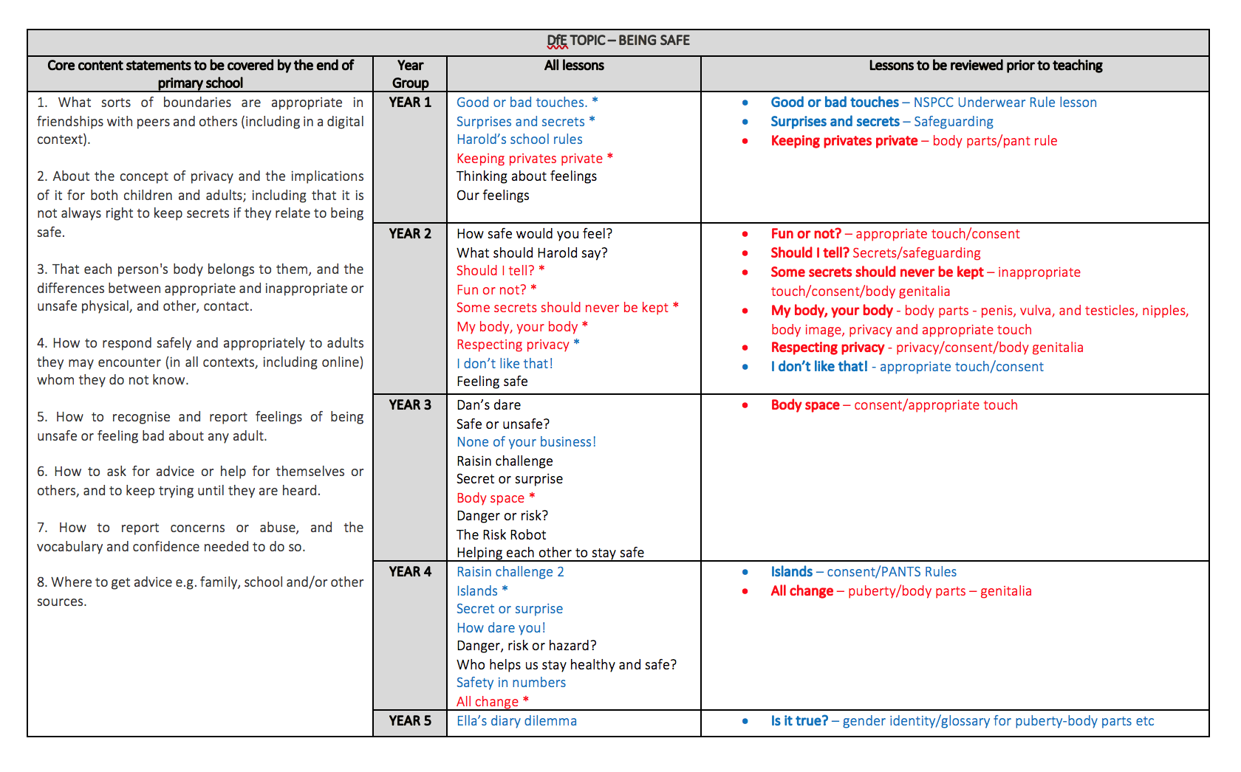
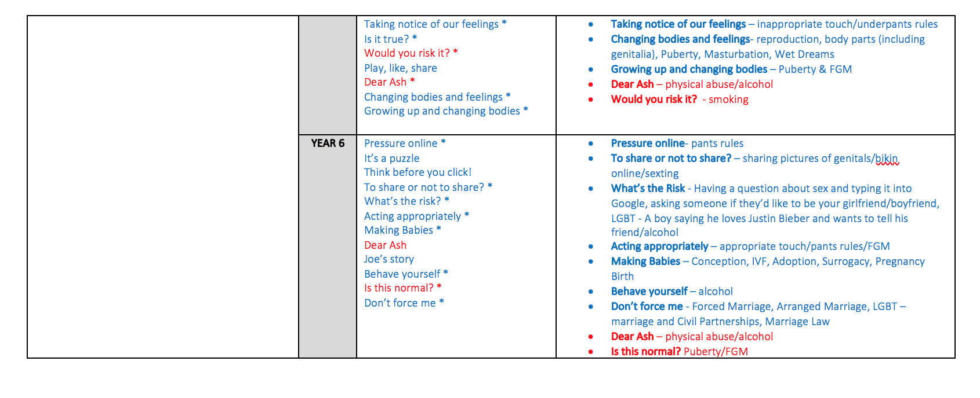

Slide 41
