Slide 1
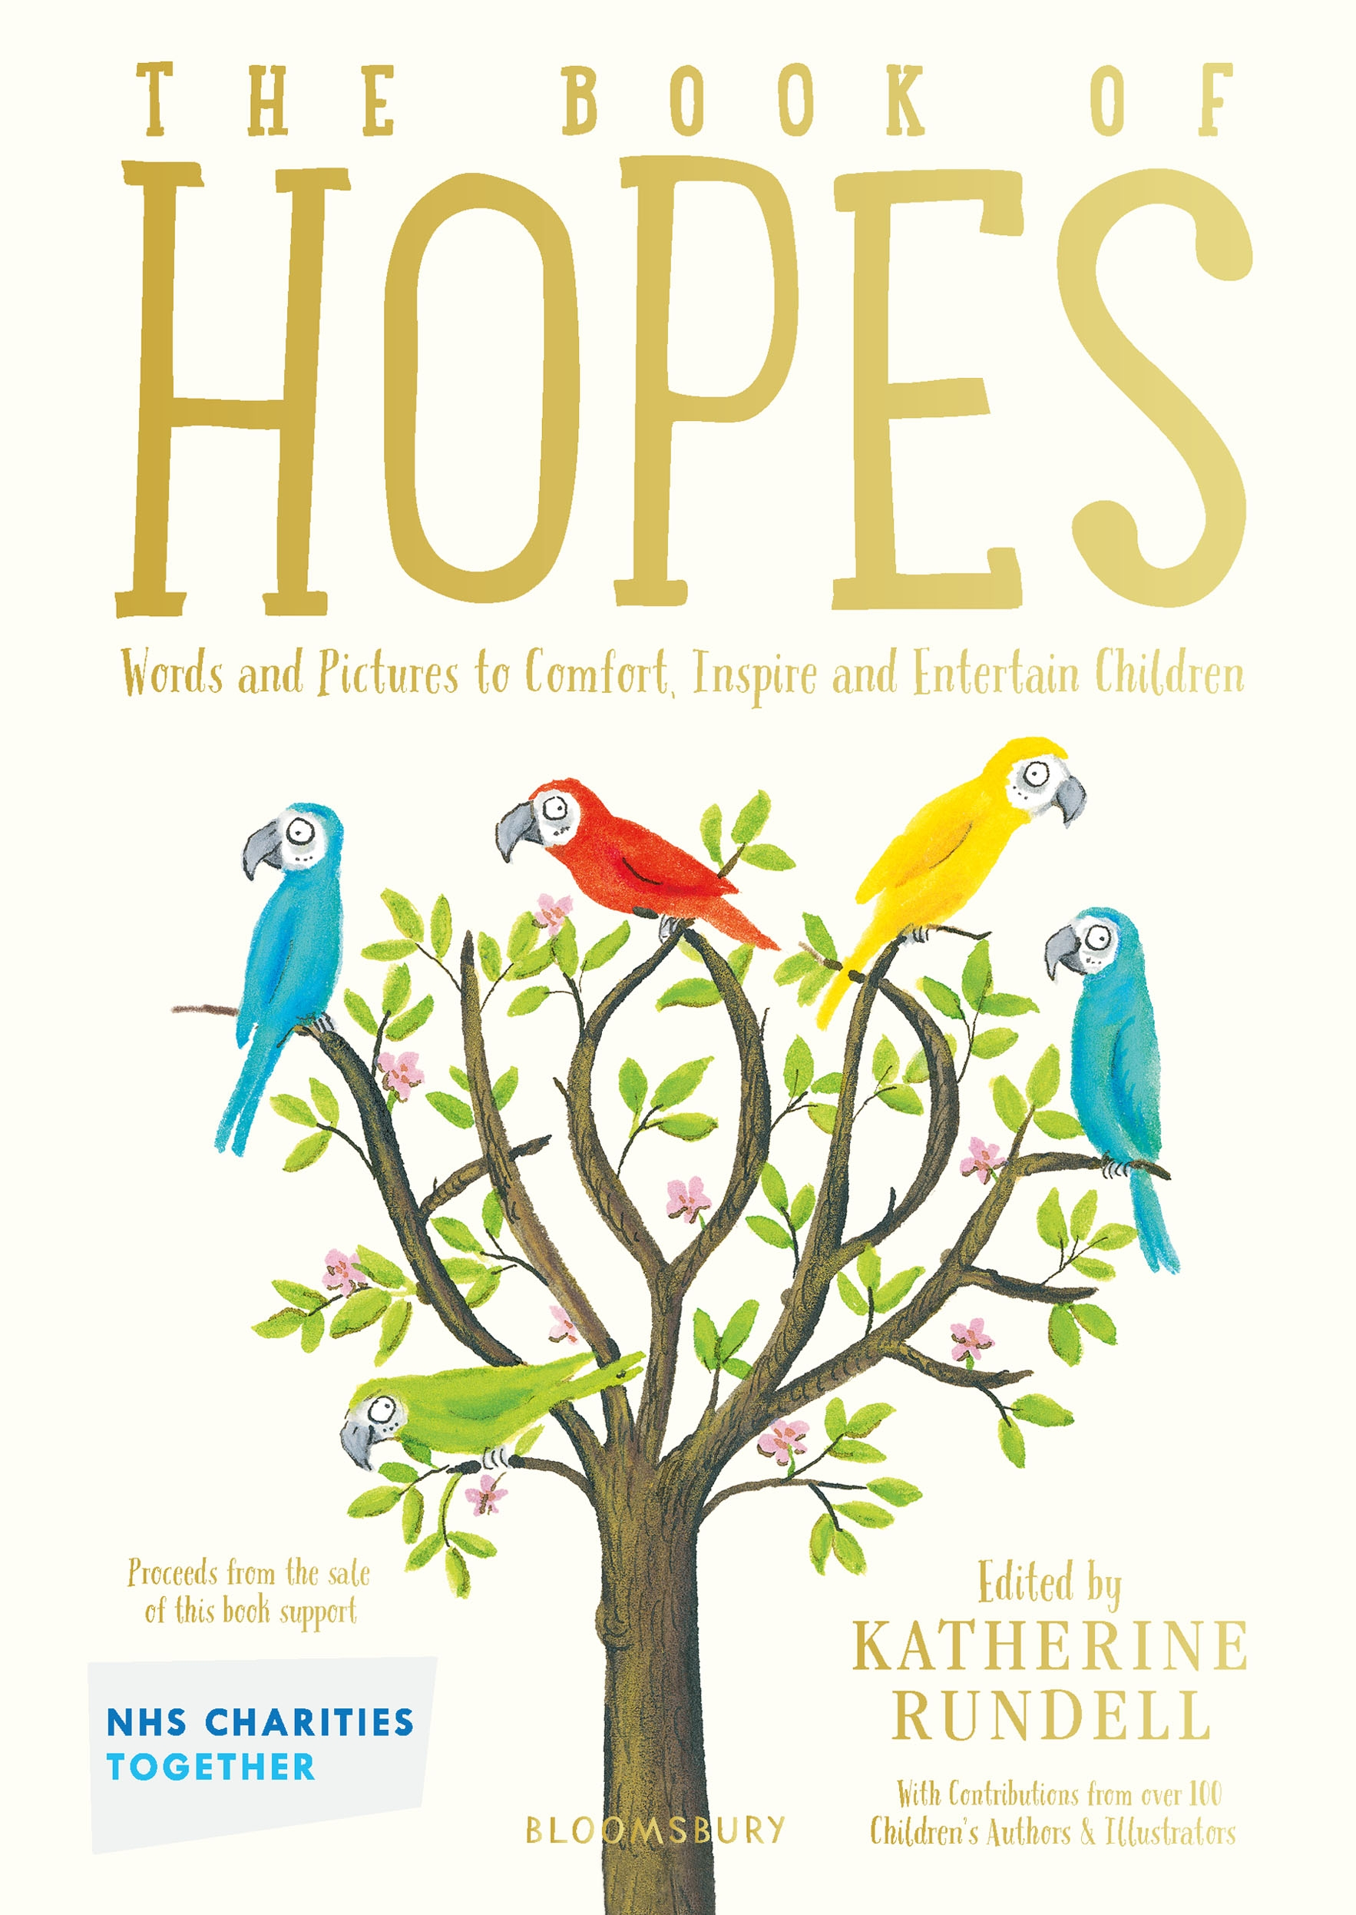
Hope
Wellbeing and literacy activities
Key Stage 1
© National Literacy Trust 2020
The Book of Hopes: Words and Pictures to Comfort, Inspire and Entertain Children, edited by Katherine Rundell, published by Bloomsbury Publishing

Slide 2
What is Hope?
What does hope mean?
What is the difference between hope and happiness?
What keeps you hopeful when you are sad?
Has there been a time during lockdown when you have felt hopeful?
What did you hope for?
How does hoping make you feel?
© National Literacy Trust 2020
The Book of Hopes: Words and Pictures to Comfort, Inspire and Entertain Children, edited by Katherine Rundell, published by Bloomsbury Publishing

Slide 3
What is Hope?
A sense or a feeling that things could change or get better
A sense that, although things may not turn out how we want them to, we will find a way to cope
© National Literacy Trust 2020
The Book of Hopes: Words and Pictures to Comfort, Inspire and Entertain Children, edited by Katherine Rundell, published by Bloomsbury Publishing

Slide 4
The Hope Tree, Axel Scheffler
The World Through a Window, Lauren Child
(pages xii and xv, literacytrust.org.uk/book-hopes)
What do you see in these pictures?
How is the person feeling?
How do you know?
Why are they feeling that way?
Where are they?
Does the title give you any clues about this picture?
What are the characters thinking? (You could draw thought bubbles to show this)
How does the picture make you feel?
© National Literacy Trust 2020
The Book of Hopes: Words and Pictures to Comfort, Inspire and Entertain Children, edited by Katherine Rundell, published by Bloomsbury Publishing

Slide 5
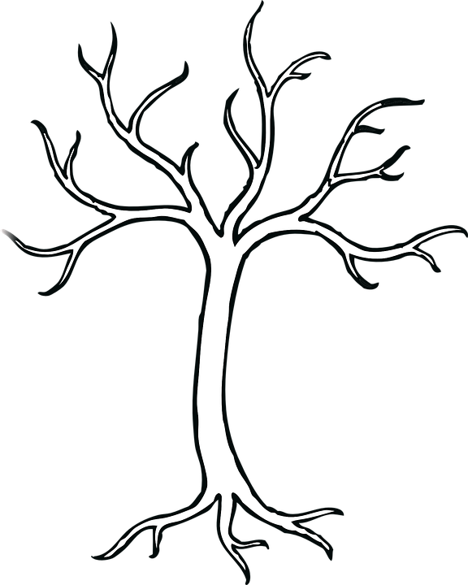
Making our Tree of Hopes
Cut out your leaf or bird
Write what makes you feel hopeful
Decorate
Stick it up in the Tree of Hopes
We can come back to the Tree of Hopes when we feel that times are difficult
© National Literacy Trust 2020
The Book of Hopes: Words and Pictures to Comfort, Inspire and Entertain Children, edited by Katherine Rundell, published by Bloomsbury Publishing

Slide 6
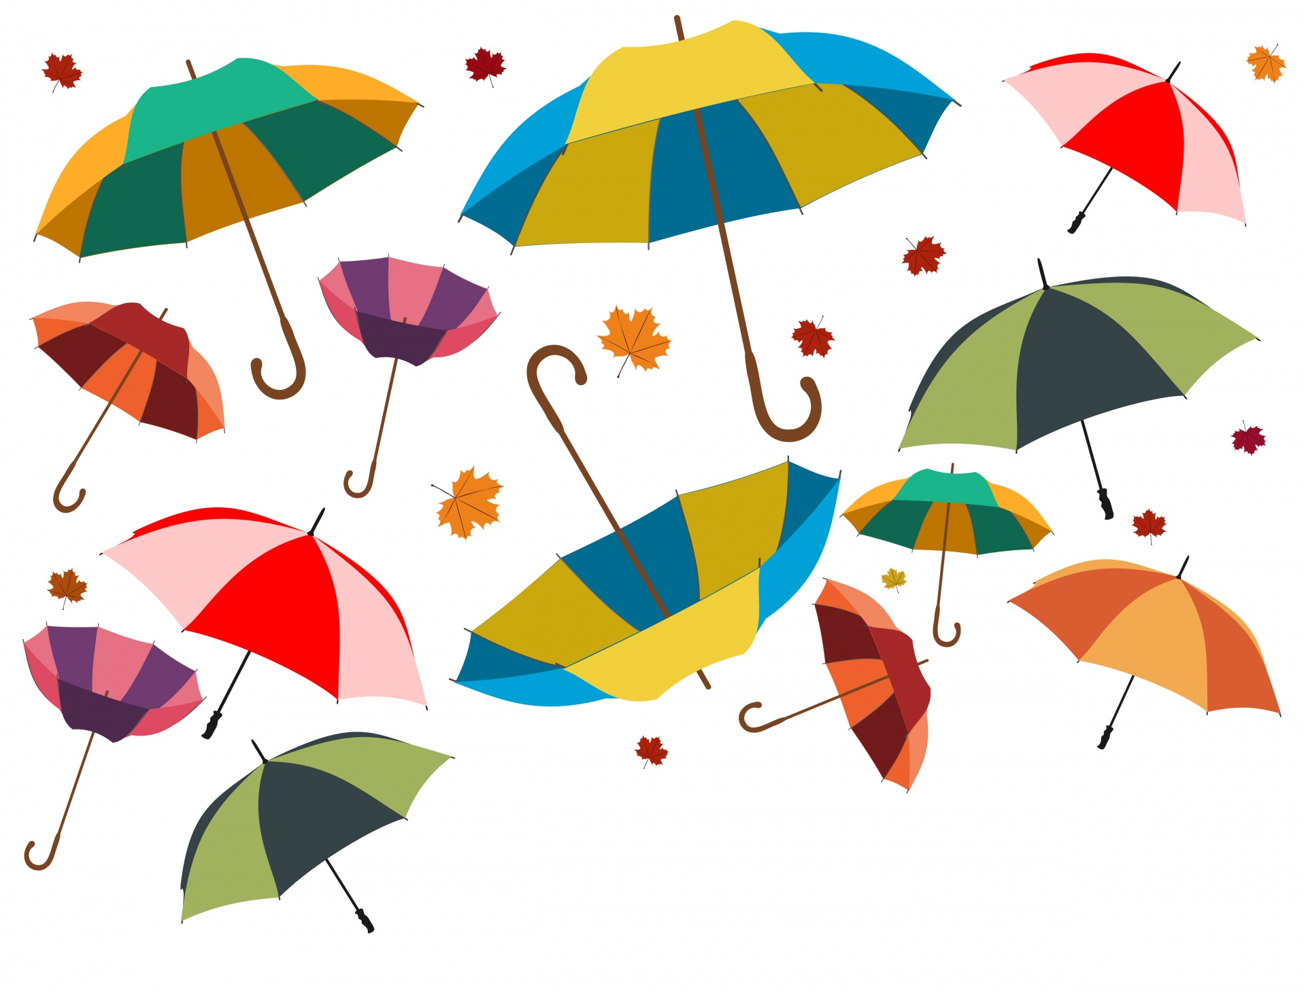
Mr Umbo’s Umbrellas by Patience Agbabi
The Book of Hopes
literacytrust.org.uk/bookofhopes
Page 27
© National Literacy Trust 2020
The Book of Hopes: Words and Pictures to Comfort, Inspire and Entertain Children, edited by Katherine Rundell, published by Bloomsbury Publishing

Slide 7
Mr Umbo’s Umbrellas by Patience Agbabi
What was the poem about?
Are there any parts you particularly liked?
Are there any pictures that come to mind when you hear the poem?
© National Literacy Trust 2020
The Book of Hopes: Words and Pictures to Comfort, Inspire and Entertain Children, edited by Katherine Rundell, published by Bloomsbury Publishing

Slide 8
Mr Umbo’s Umbrellas by Patience Agbabi
Are there new words you didn’t understand?
Are there words from different countries and languages?
Where is Mr Umbo from and where is he going?
How might Mr Umbo feel in the poem?
© National Literacy Trust 2020
The Book of Hopes: Words and Pictures to Comfort, Inspire and Entertain Children, edited by Katherine Rundell, published by Bloomsbury Publishing

Slide 9
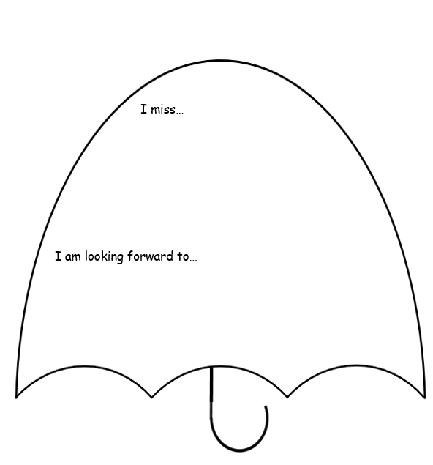
Making hopeful umbrellas
Write one thing you miss about lockdown, or from before lockdown
Write one thing you are looking forward to about coming back to school, or lockdown being over
Decorate your umbrella in colours that make you feel happy
© National Literacy Trust 2020
The Book of Hopes: Words and Pictures to Comfort, Inspire and Entertain Children, edited by Katherine Rundell, published by Bloomsbury Publishing

Slide 10
‘Hopework’
Interview members of your family:
“What makes you feel hopeful?”
Record the answers (audio or written)
© National Literacy Trust 2020
The Book of Hopes: Words and Pictures to Comfort, Inspire and Entertain Children, edited by Katherine Rundell, published by Bloomsbury Publishing

Slide 11
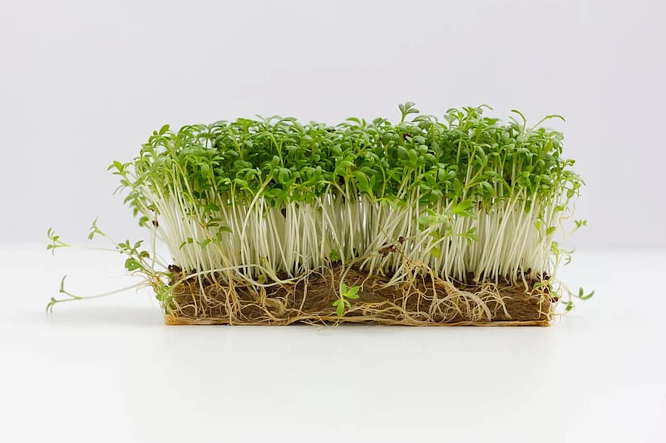
Seeds of hope
Step 1
Line the tray and water it
Step 2
Scatter your cress seeds
Step 3
Make a label, and write your name and a message of hope
© National Literacy Trust 2020
The Book of Hopes: Words and Pictures to Comfort, Inspire and Entertain Children, edited by Katherine Rundell, published by Bloomsbury Publishing

