Slide 1
Connectedness
Wellbeing and literacy activities
Key Stage 1
© National Literacy Trust 2020
The Book of Hopes: Words and Pictures to Comfort, Inspire and Entertain Children, edited by Katherine Rundell, published by Bloomsbury Publishing

Slide 2
Connecting with each other
What does “connecting” with someone mean?
How do you connect with your friends?
How do you connect with your family? Is it different?
Why is connecting with each other important?
© National Literacy Trust 2020
The Book of Hopes: Words and Pictures to Comfort, Inspire and Entertain Children, edited by Katherine Rundell, published by Bloomsbury Publishing

Slide 3
Connecting with each other
How did it feel during lockdown when you couldn’t see your friends?
Did you find other ways of connecting with people when you couldn’t see them?
How does it feel now we are back at school?
© National Literacy Trust 2020
The Book of Hopes: Words and Pictures to Comfort, Inspire and Entertain Children, edited by Katherine Rundell, published by Bloomsbury Publishing

Slide 4
Say something nice by A. F. Harrold
The Book of Hopes
literacytrust.org.uk/bookofhopes
Page 36
© National Literacy Trust 2020
The Book of Hopes: Words and Pictures to Comfort, Inspire and Entertain Children, edited by Katherine Rundell, published by Bloomsbury Publishing

Slide 5
Say something nice by A. F. Harrold
What was the poem about?
Are there any parts you liked?
What made the poem funny?
Why is it hard to say nice things sometimes?
How does it feel when someone says something nice to you?
© National Literacy Trust 2020
The Book of Hopes: Words and Pictures to Comfort, Inspire and Entertain Children, edited by Katherine Rundell, published by Bloomsbury Publishing

Slide 6
Say something nice by A. F. Harrold
Surprise “something nice” notes
Do they have a cool party trick?
Are they kind to their little siblings?
Can they speak another language?
Are they really good at something?
Did you see them doing something helpful for someone else?
Do they have a nice smile or a confident walk?
What would you like to hear if you were sad?
© National Literacy Trust 2020
The Book of Hopes: Words and Pictures to Comfort, Inspire and Entertain Children, edited by Katherine Rundell, published by Bloomsbury Publishing

Slide 7
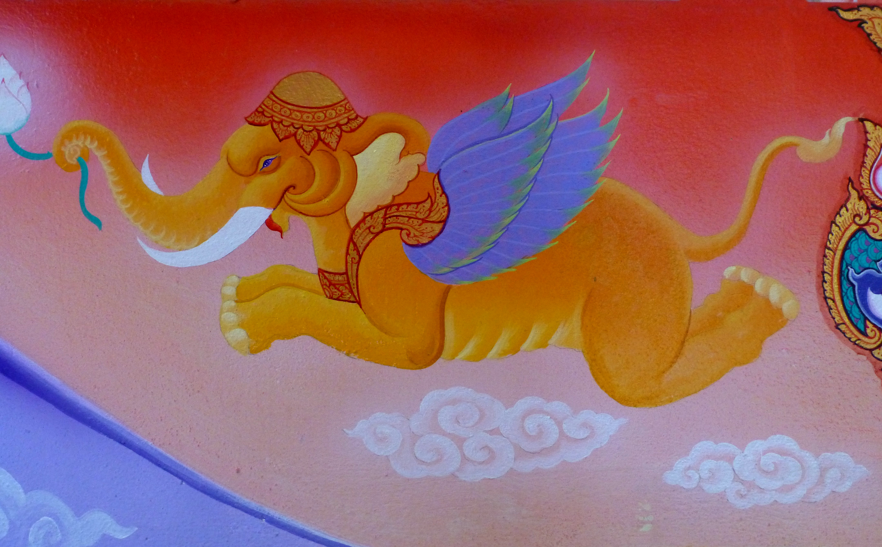
The Store Full of Magical Things
by Rutendo Tavengerwei
The Book of Hopes
literacytrust.org.uk/bookofhopes
Page 317
© National Literacy Trust 2020
The Book of Hopes: Words and Pictures to Comfort, Inspire and Entertain Children, edited by Katherine Rundell, published by Bloomsbury Publishing

Slide 8
The Store Full of Magical Things
by Rutendo Tavengerwei
What was the poem about?
Were there any parts you liked?
Are there any pictures that come to mind when you hear the poem?
What magical things were in the store?
© National Literacy Trust 2020
The Book of Hopes: Words and Pictures to Comfort, Inspire and Entertain Children, edited by Katherine Rundell, published by Bloomsbury Publishing

Slide 9
The Store Full of Magical Things
by Rutendo Tavengerwei
Where do you think the store is?
Who is the person the poet is sending the smile to?
What other magical things might be in the store?
What would you like to send or receive from the store of magical things? Who would you send it to?
© National Literacy Trust 2020
The Book of Hopes: Words and Pictures to Comfort, Inspire and Entertain Children, edited by Katherine Rundell, published by Bloomsbury Publishing

Slide 10
The Store Full of Magical Things
by Rutendo Tavengerwei
Writing our own poems
What magical things are in your store?
Who would you like to send them to?
© National Literacy Trust 2020
The Book of Hopes: Words and Pictures to Comfort, Inspire and Entertain Children, edited by Katherine Rundell, published by Bloomsbury Publishing

Slide 11
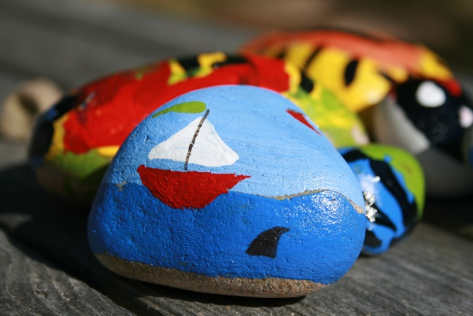
The Store Full of Magical Things
by Rutendo Tavengerwei
Our own store of magical things
© National Literacy Trust 2020
The Book of Hopes: Words and Pictures to Comfort, Inspire and Entertain Children, edited by Katherine Rundell, published by Bloomsbury Publishing

Slide 12
?
Asking for help
© National Literacy Trust 2020
The Book of Hopes: Words and Pictures to Comfort, Inspire and Entertain Children, edited by Katherine Rundell, published by Bloomsbury Publishing

Slide 13
…
Alone time
© National Literacy Trust 2020
The Book of Hopes: Words and Pictures to Comfort, Inspire and Entertain Children, edited by Katherine Rundell, published by Bloomsbury Publishing

