Slide 1
Self-efficacy
Wellbeing and literacy activities
Key Stage 1
© National Literacy Trust 2020
The Book of Hopes: Words and Pictures to Comfort, Inspire and Entertain Children, edited by Katherine Rundell, published by Bloomsbury Publishing

Slide 2
Self-belief
What does “self-belief” mean?
Why is it important to believe in ourselves?
Has there been a time during lockdown when you felt helpless or like you couldn’t change anything?
How do you help yourself feel better when you are sad?
© National Literacy Trust 2020
The Book of Hopes: Words and Pictures to Comfort, Inspire and Entertain Children, edited by Katherine Rundell, published by Bloomsbury Publishing

Slide 3
Self-belief
Has there ever been a time when you have found something very difficult and given up?
Have you ever found something very difficult but tried it anyway?
How did that feel?
© National Literacy Trust 2020
The Book of Hopes: Words and Pictures to Comfort, Inspire and Entertain Children, edited by Katherine Rundell, published by Bloomsbury Publishing

Slide 4
First Flight by Katie & Kevin Tsang
The Book of Hopes
literacytrust.org.uk/bookofhopes
Page 276
© National Literacy Trust 2020
The Book of Hopes: Words and Pictures to Comfort, Inspire and Entertain Children, edited by Katherine Rundell, published by Bloomsbury Publishing

Slide 5
First Flight by Katie & Kevin Tsang
What was the story about?
Are there any parts you liked?
Were there any pictures in your mind as you heard the story?
© National Literacy Trust 2020
The Book of Hopes: Words and Pictures to Comfort, Inspire and Entertain Children, edited by Katherine Rundell, published by Bloomsbury Publishing

Slide 6
First Flight by Katie & Kevin Tsang
Did the baby dragon give up flying when she fell down the first time?
How do you think the baby dragon felt when she couldn’t fly at first?
What did the baby dragon think to herself when she was trying to fly?
What helped baby dragon to fly in the end?
© National Literacy Trust 2020
The Book of Hopes: Words and Pictures to Comfort, Inspire and Entertain Children, edited by Katherine Rundell, published by Bloomsbury Publishing

Slide 7
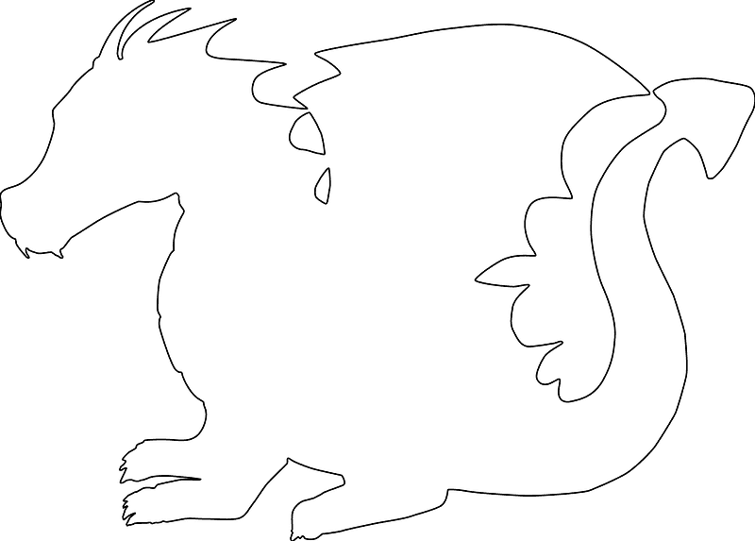
First Flight by Katie & Kevin Tsang
I can do this
I believe in myself
I can make a difference
I am proud of myself for trying
I’ve got this
Anything is possible
I am an original
I matter
Self belief mottos
© National Literacy Trust 2020
The Book of Hopes: Words and Pictures to Comfort, Inspire and Entertain Children, edited by Katherine Rundell, published by Bloomsbury Publishing

Slide 8
The Demon Goal Keeper by Alex Wheatle
The Book of Hopes
literacytrust.org.uk/bookofhopes
Page 256
© National Literacy Trust 2020
The Book of Hopes: Words and Pictures to Comfort, Inspire and Entertain Children, edited by Katherine Rundell, published by Bloomsbury Publishing

Slide 9
The Demon Goal Keeper by Alex Wheatle
What was the poem about?
Were there any parts you liked?
Are there any words you don’t understand?
© National Literacy Trust 2020
The Book of Hopes: Words and Pictures to Comfort, Inspire and Entertain Children, edited by Katherine Rundell, published by Bloomsbury Publishing

Slide 10
The Demon Goal Keeper by Alex Wheatle
How did the person in the poem feel at the beginning of the poem? Why?
What did they want to do when they went to see the manager?
What happened next? What did they do every night after school?
© National Literacy Trust 2020
The Book of Hopes: Words and Pictures to Comfort, Inspire and Entertain Children, edited by Katherine Rundell, published by Bloomsbury Publishing

Slide 11
The Demon Goal Keeper by Alex Wheatle
How did they feel during the semi-final game?
How did they feel at the end of the poem?
What do you think happens next?
© National Literacy Trust 2020
The Book of Hopes: Words and Pictures to Comfort, Inspire and Entertain Children, edited by Katherine Rundell, published by Bloomsbury Publishing

Slide 12
The Demon Goal Keeper by Alex Wheatle
Second verse
Rhyme: clown/town
Half-rhyme: pound
Rhymes
First verse
Rhyme: heat/feet
Half-rhyme: week
© National Literacy Trust 2020
The Book of Hopes: Words and Pictures to Comfort, Inspire and Entertain Children, edited by Katherine Rundell, published by Bloomsbury Publishing

