Slide 1
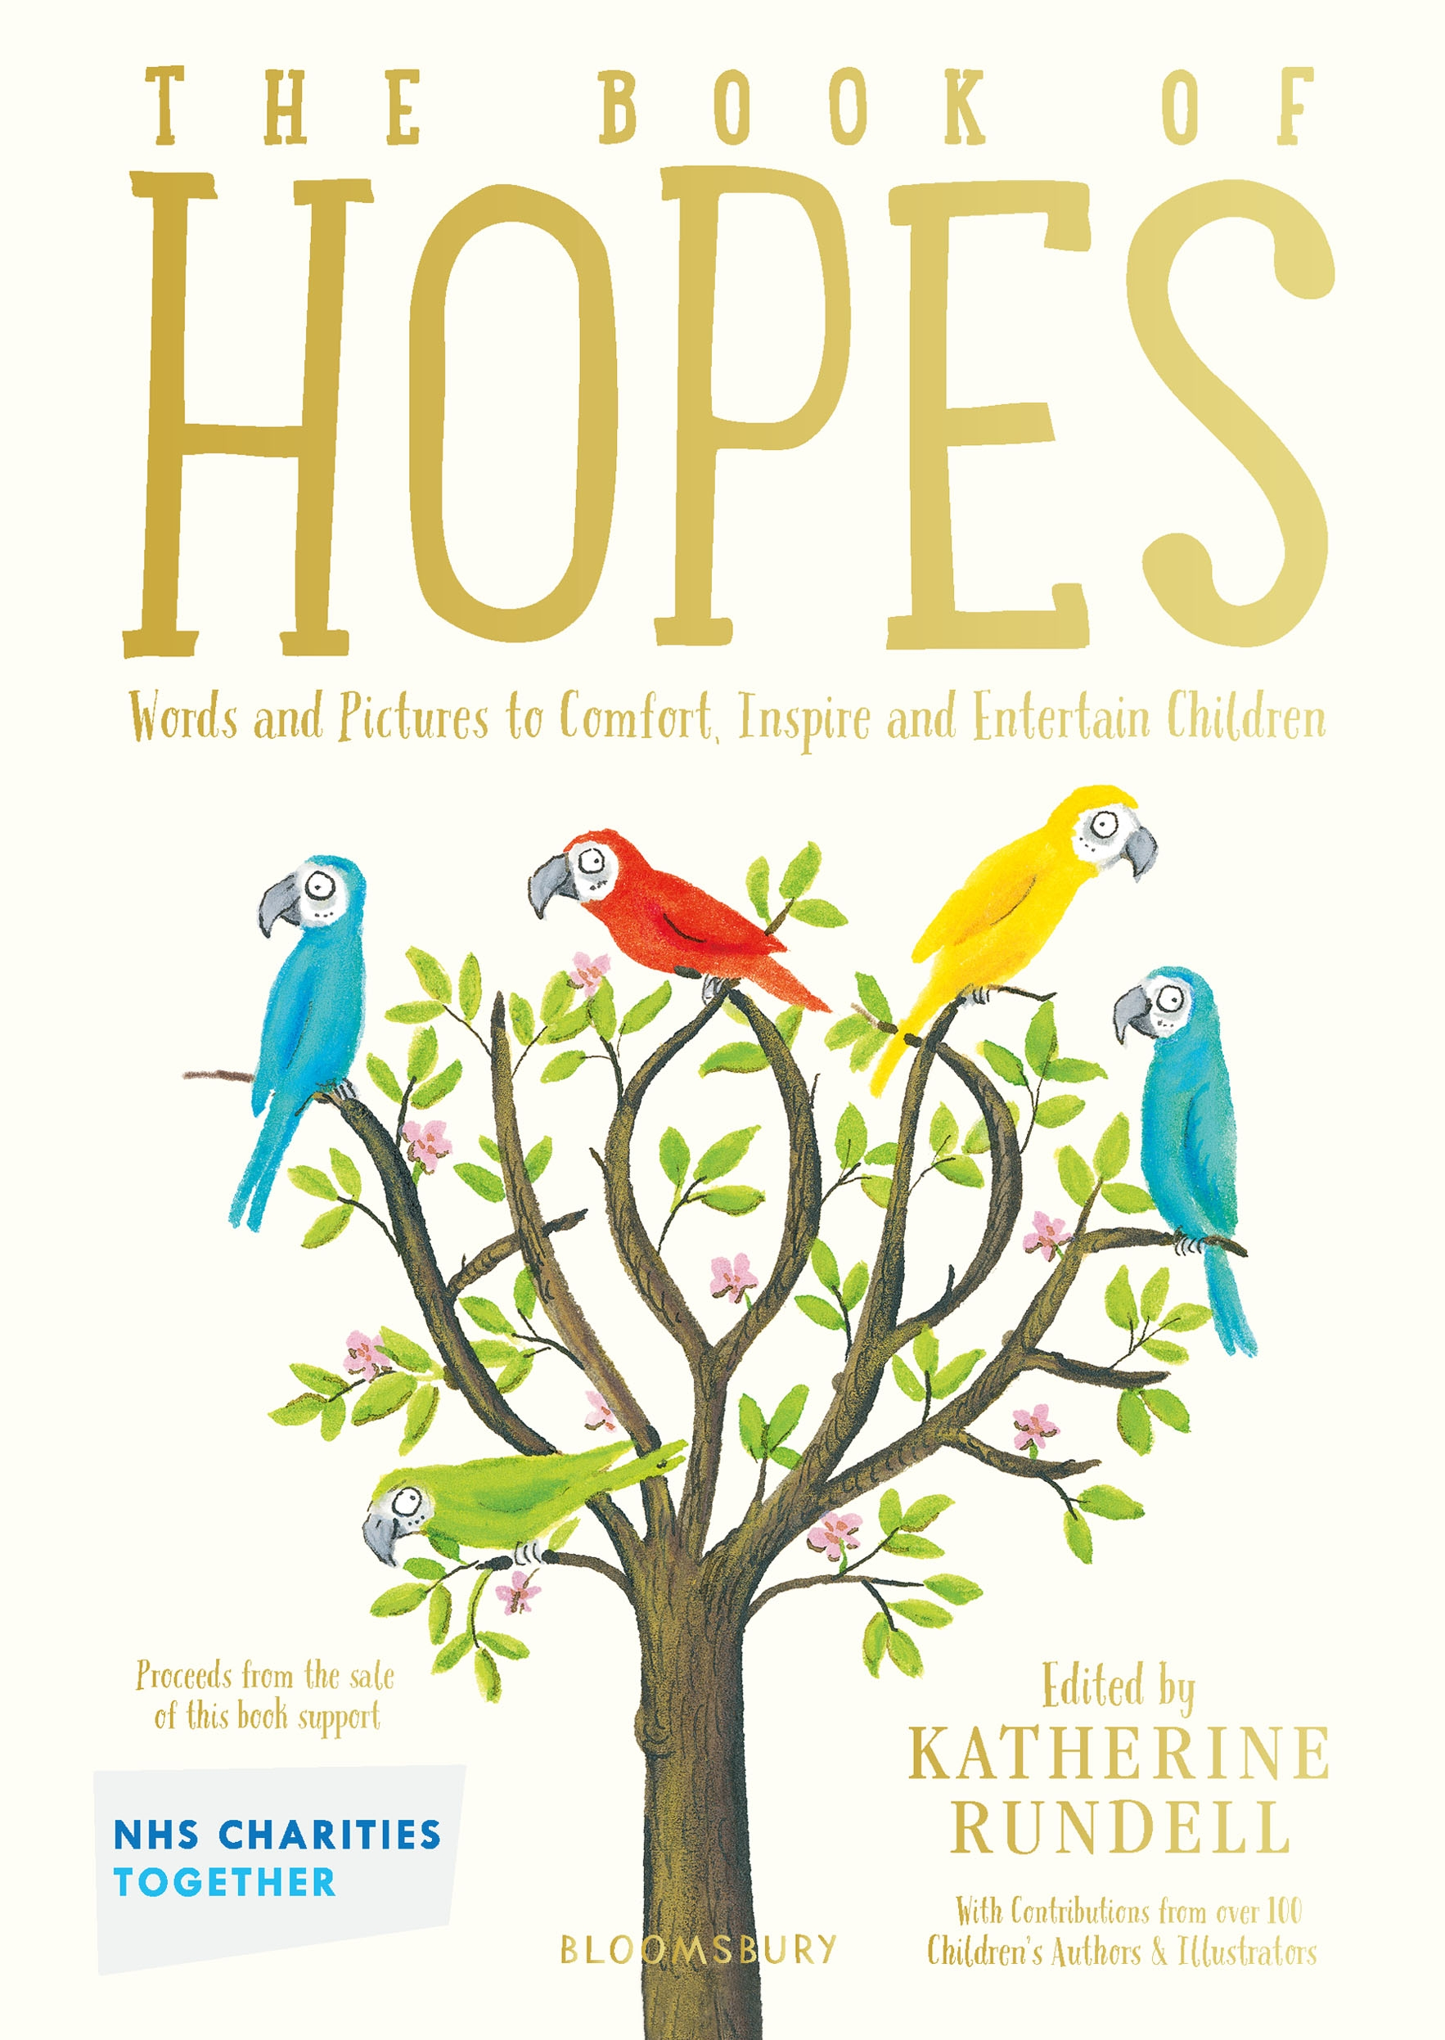
Gratitude
Wellbeing and literacy activities
Key Stage 1
© National Literacy Trust 2020
The Book of Hopes: Words and Pictures to Comfort, Inspire and Entertain Children, edited by Katherine Rundell, published by Bloomsbury Publishing

Slide 2
Gratitude
What does “gratitude” mean?
Gratitude is a feeling of thankfulness for what we have.
Focusing on what we are grateful for can make us feel better when we are going through a difficult time.
© National Literacy Trust 2020
The Book of Hopes: Words and Pictures to Comfort, Inspire and Entertain Children, edited by Katherine Rundell, published by Bloomsbury Publishing

Slide 3
Gratitude
Why is it important to focus on the good things in our lives?
How might this help us when times are tough?
Is it always easy to be grateful?
© National Literacy Trust 2020
The Book of Hopes: Words and Pictures to Comfort, Inspire and Entertain Children, edited by Katherine Rundell, published by Bloomsbury Publishing

Slide 4
Connecting with each other
Was there a time during lockdown when you felt thankful for something?
Is there something you feel thankful for now you are back at school?
© National Literacy Trust 2020
The Book of Hopes: Words and Pictures to Comfort, Inspire and Entertain Children, edited by Katherine Rundell, published by Bloomsbury Publishing

Slide 5
Connecting with each other
How do we show our gratitude?
How does saying “thank you” make you feel?
How does it make others feel?
© National Literacy Trust 2020
The Book of Hopes: Words and Pictures to Comfort, Inspire and Entertain Children, edited by Katherine Rundell, published by Bloomsbury Publishing

Slide 6
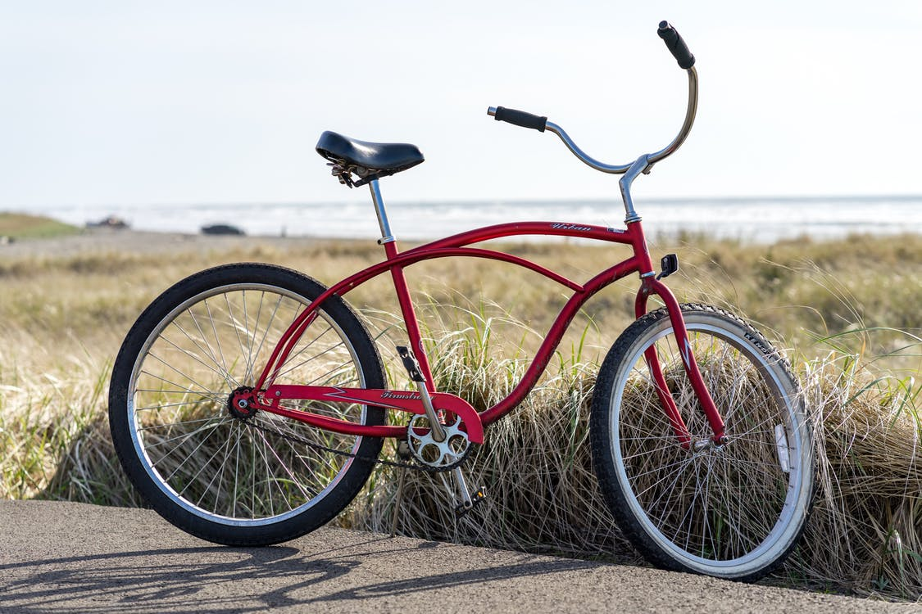
The Best Feeling Ever by Fleur Hitchcock
The Book of Hopes
literacytrust.org.uk/bookofhopes
Page 305
© National Literacy Trust 2020
The Book of Hopes: Words and Pictures to Comfort, Inspire and Entertain Children, edited by Katherine Rundell, published by Bloomsbury Publishing

Slide 7
The Best Feeling Ever by Fleur Hitchcock
What was the story about?
Are there any parts you liked?
Were there any pictures in your mind as you heard the story?
What did the main character in the story want for their birthday?
What did they get instead?
© National Literacy Trust 2020
The Book of Hopes: Words and Pictures to Comfort, Inspire and Entertain Children, edited by Katherine Rundell, published by Bloomsbury Publishing

Slide 8
The Best Feeling Ever by Fleur Hitchcock
How might it feel to really want a pony but get a bike instead?
Has something similar ever happened to you?
What happened to change the main character’s mind at the end of the story?
What do you think the title of the story means?
What is the “best feeling ever” that they are talking about?
© National Literacy Trust 2020
The Book of Hopes: Words and Pictures to Comfort, Inspire and Entertain Children, edited by Katherine Rundell, published by Bloomsbury Publishing

Slide 9
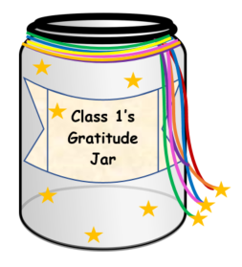
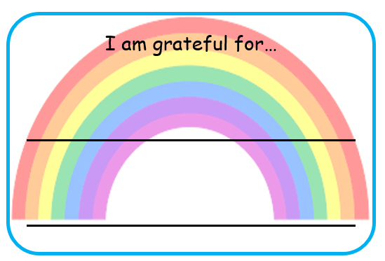
Gratitude jar
© National Literacy Trust 2020
The Book of Hopes: Words and Pictures to Comfort, Inspire and Entertain Children, edited by Katherine Rundell, published by Bloomsbury Publishing

Slide 10
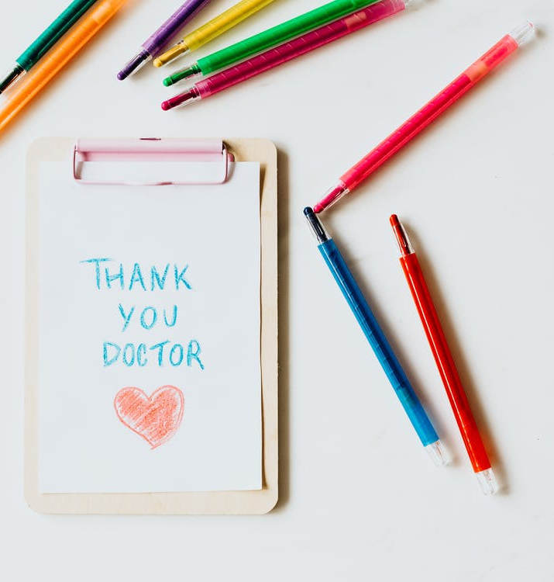
Thank you notes
Has someone…
comforted you when you’ve been sad?
given you a gift?
been a good friend to you?
taken you out on a nice walk?
helped you with your homework?
played games with you?
lent you a toy or book?
cooked you a meal or a treat?
read you a story?
said something nice to you?
made you laugh?
© National Literacy Trust 2020
The Book of Hopes: Words and Pictures to Comfort, Inspire and Entertain Children, edited by Katherine Rundell, published by Bloomsbury Publishing

Slide 11
Thank you notes
Dear____________________________________,
Thank you for ___________________________________________
It made me feel _________________________________________
From___________________________________________
© National Literacy Trust 2020
The Book of Hopes: Words and Pictures to Comfort, Inspire and Entertain Children, edited by Katherine Rundell, published by Bloomsbury Publishing

