Slide 1
Mathematics guidance:
Key stage 1 and 2
Non-statutory guidance for the national curriculum in England
Introduction

Slide 2
Introduction
This publication provides non-statutory guidance from the Department for Education. It has been produced to help teachers and schools make effective use of the National Curriculum to develop primary school pupils’ mastery of mathematics. (p.4)

Slide 3
Aims of the publication
This publication aims to:
bring greater coherence to the national curriculum by exposing core concepts in the national curriculum and demonstrating progression from year 1 to year 6.
summarise the most important knowledge and understanding within each year group and important connections between these mathematical topics.

Slide 4
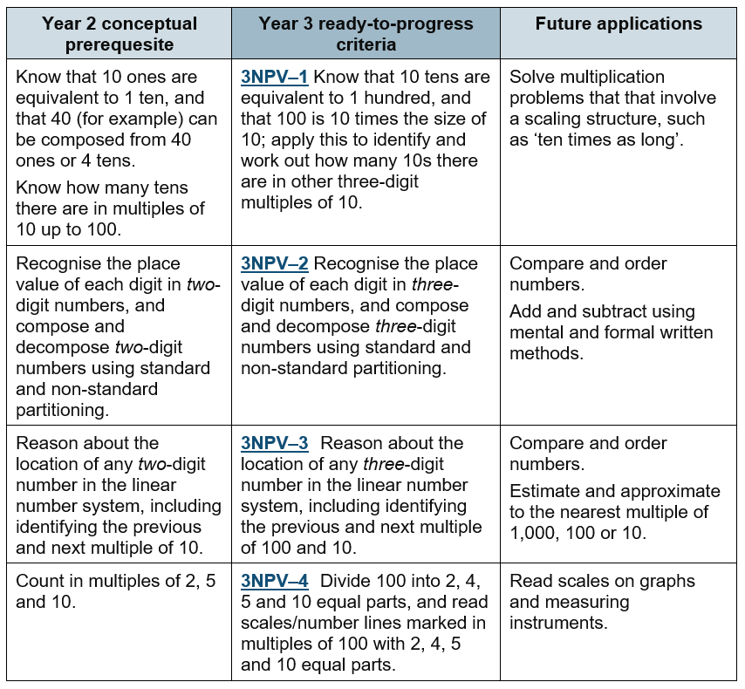
Ready to Progress Criteria
The Ready to Progress Criteria are central to the guidance. They prioritise core concepts and exemplify coherence and clear progression through the National Curriculum.
The final column is not the next year group but general future applications.

Slide 5

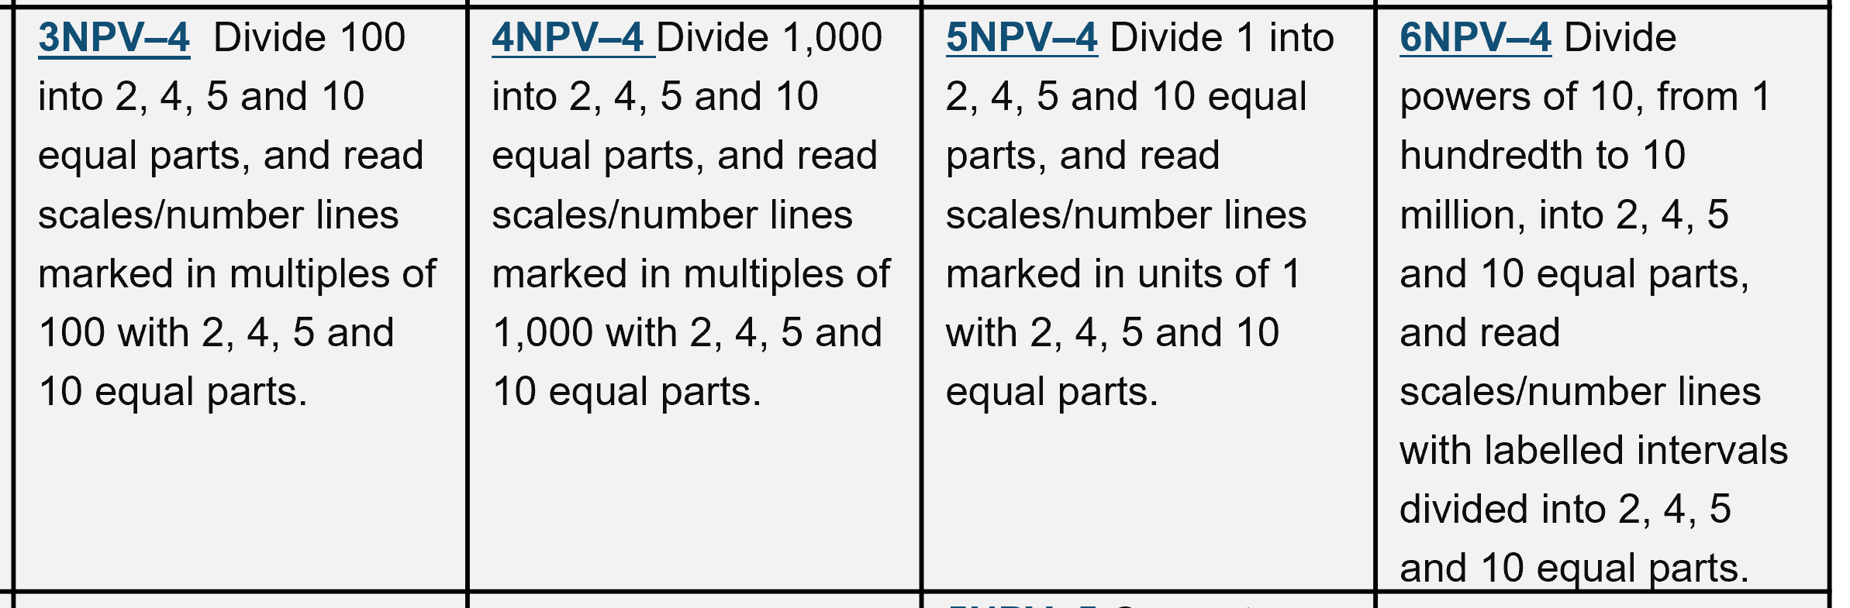
Strand | Year 1 | Year 2 | Year 3 | Year 4 | Year 5 | Year 6
NPV | 1NPV–1 Count within 100, forwards and backwards, starting with any number. |  | 3NPV–1 Know that 10 tens are equivalent to 1 hundred, and that 100 is 10 times the size of 10; apply this to identify and work out how many 10s there are in other three-digit multiples of 10. | 4NPV–1 Know that 10 hundreds are equivalent to 1 thousand, and that 1,000 is 10 times the size of 100; apply this to identify and work out how many 100s there are in other four-digit multiples of 100. | 5NPV–1 Know that 10 tenths are equivalent to 1 one, and that 1 is 10 times the size of 0.1. Know that 100 hundredths are equivalent to 1 one, and that 1 is 100 times the size of 0.01. Know that 10 hundredths are equivalent to 1 tenth, and that 0.1 is 10 times the size of 0.01. | 6NPV–1 Understand the relationship between powers of 10 from 1 hundredth to 10 million, and use this to make a given number 10, 100, 1,000, 1 tenth, 1 hundredth or 1 thousandth times the size (multiply and divide by 10, 100 and 1,000).
 |  | 2NPV–1 Recognise the place value of each digit in two-digit numbers, and compose and decompose two-digit numbers using standard and non-standard partitioning. | 3NPV–2 Recognise the place value of each digit in three-digit numbers, and compose and decompose three-digit numbers using standard and non-standard partitioning. | 4NPV–2 Recognise the place value of each digit in four-digit numbers, and compose and decompose four-digit numbers using standard and non-standard partitioning. | 5NPV–2 Recognise the place value of each digit in numbers with up to 2 decimal places, and compose and decompose numbers with up to 2 decimal places using standard and non-standard partitioning. | 6NPV–2 Recognise the place value of each digit in numbers up to 10 million, including decimal fractions, and compose and decompose numbers up to 10 million using standard and non-standard partitioning.
 | 1NPV–2 Reason about the location of numbers to 20 within the linear number system, including comparing using < > and = | 2NPV–2 Reason about the location of any two-digit number in the linear number system, including identifying the previous and next multiple of 10. | 3NPV–3 Reason about the location of any three-digit number in the linear number system, including identifying the previous and next multiple of 100 and 10. | 4NPV–3 Reason about the location of any four-digit number in the linear number system, including identifying the previous and next multiple of 1,000 and 100, and rounding to the nearest of each. | 5NPV–3 Reason about the location of any number with up to 2 decimals places in the linear number system, including identifying the previous and next multiple of 1 and 0.1 and rounding to the nearest of each. | 6NPV–3 Reason about the location of any number up to 10 million, including decimal fractions, in the linear number system, and round numbers, as appropriate, including in contexts.
An example of a set of RTP Criteria. Are these sufficiently included in your school curriculum, how is fluency developed?
NPV |  |  | 3NPV–4 Divide 100 into 2, 4, 5 and 10 equal parts, and read scales/number lines marked in multiples of 100 with 2, 4, 5 and 10 equal parts. | 4NPV–4 Divide 1,000 into 2, 4, 5 and 10 equal parts, and read scales/number lines marked in multiples of 1,000 with 2, 4, 5 and 10 equal parts. | 5NPV–4 Divide 1 into 2, 4, 5 and 10 equal parts, and read scales/number lines marked in units of 1 with 2, 4, 5 and 10 equal parts. | 6NPV–4 Divide powers of 10, from 1 hundredth to 10 million, into 2, 4, 5 and 10 equal parts, and read scales/number lines with labelled intervals divided into 2, 4, 5 and 10 equal parts.
 |  |  |  |  | 5NPV–5 Convert between units of measure, including using common decimals and fractions.

Slide 6
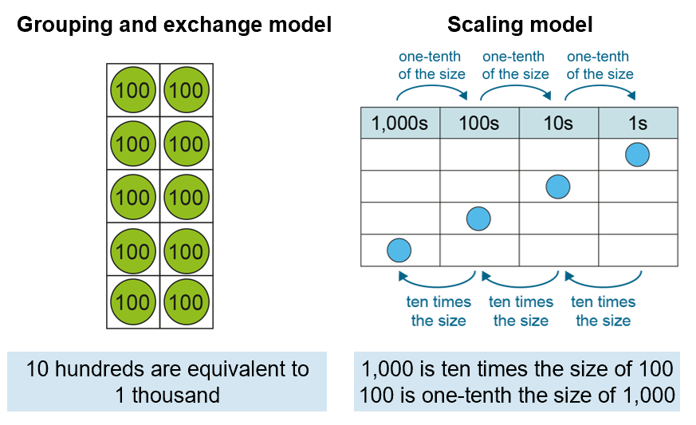
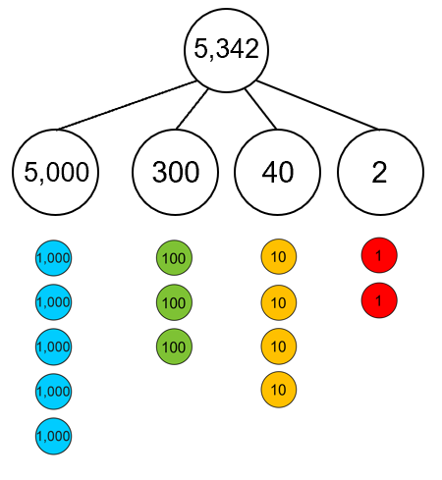
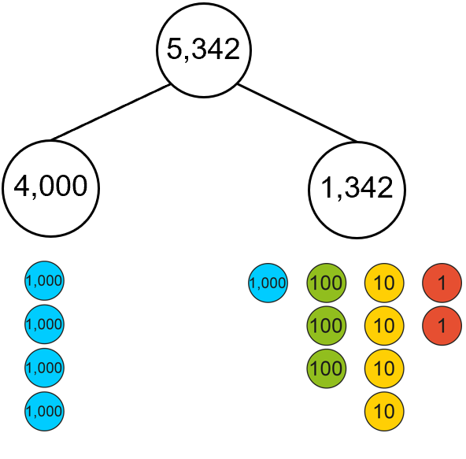
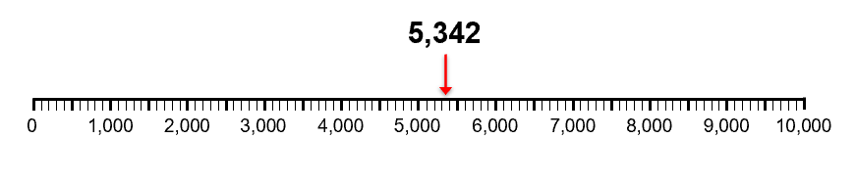
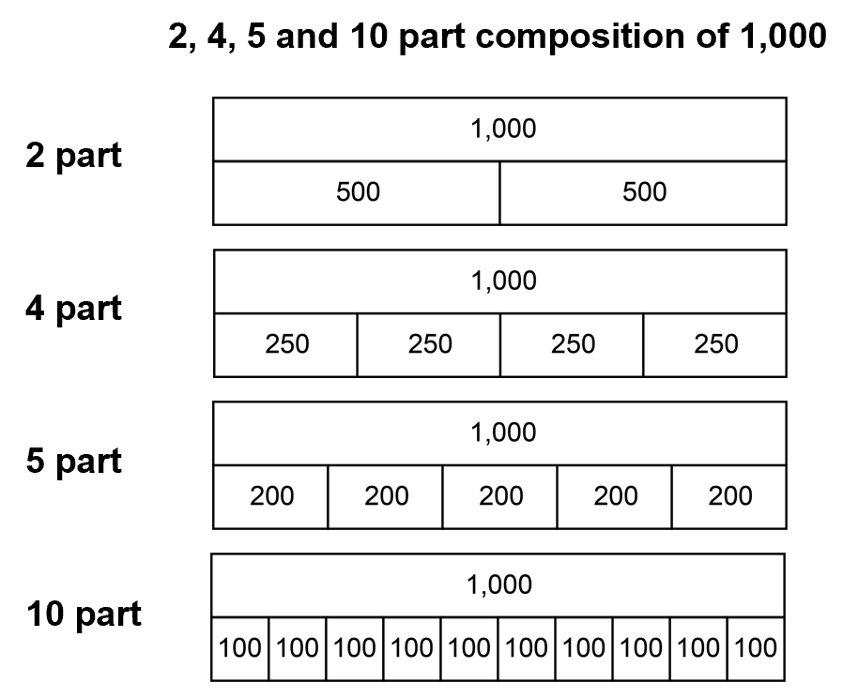
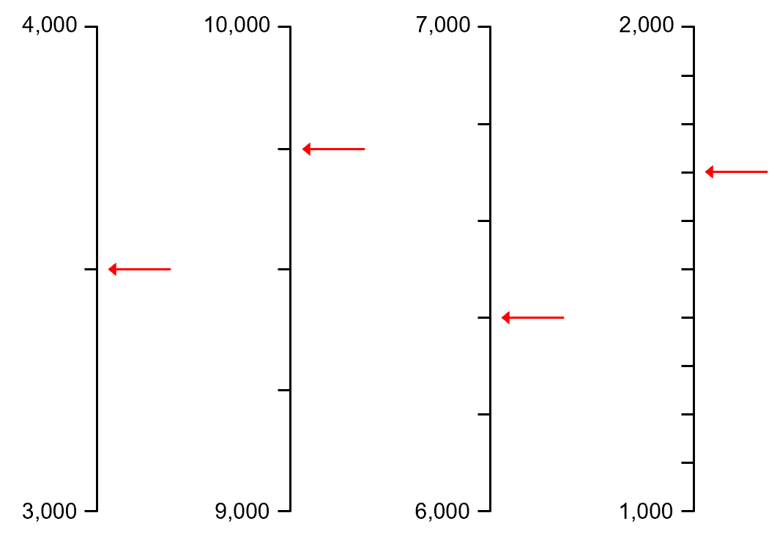
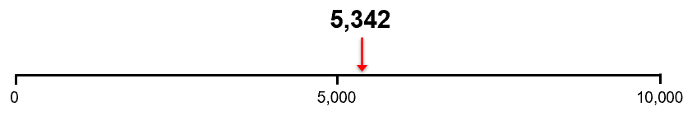
Number and place value in KS2: 4 aspects to understand
NPV1:
Relationship between adjacent place value units
NPV2:
Standard and non-standard partitioning
NPV3:
Place in linear number system
NPV4:
Common partitions of place value units
The Guidance brings greater coherence and consistency to the National Curriculum POS statements.

Slide 7
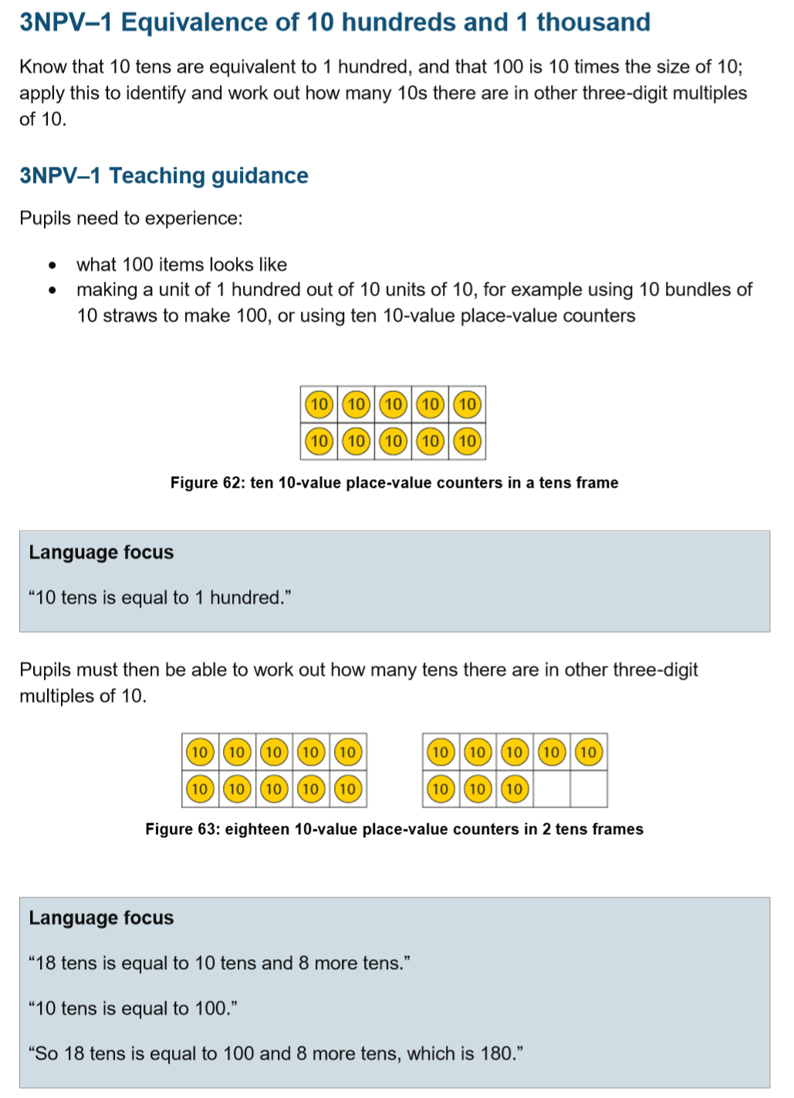
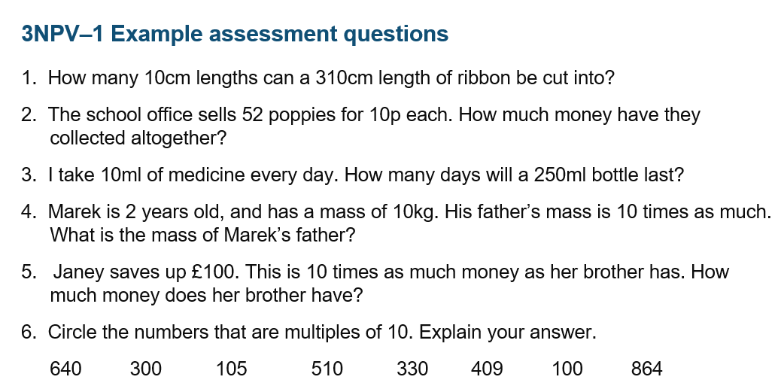
Year group chapters – supporting teacher subject knowledge

Slide 8
Mathematics guidance:
Key stage 1 and 2
Non-statutory guidance for the national curriculum in England
Representations

Slide 9
Representations in the document
A core set of representations have been selected to expose
important mathematical structures and ideas, and make
them accessible to pupils. Consistent use of the same
representations across year groups help to connect prior
learning to new learning. (p5)

Slide 10
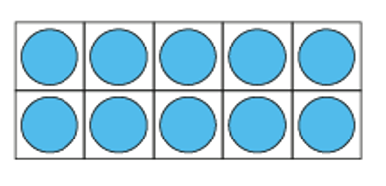
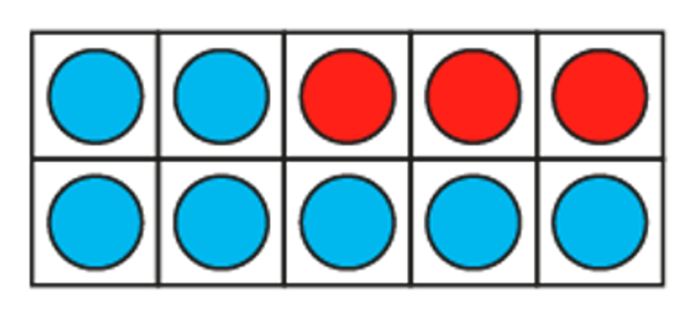
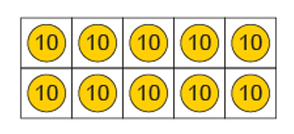
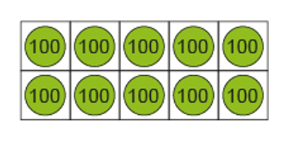
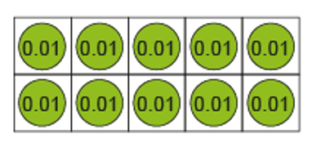
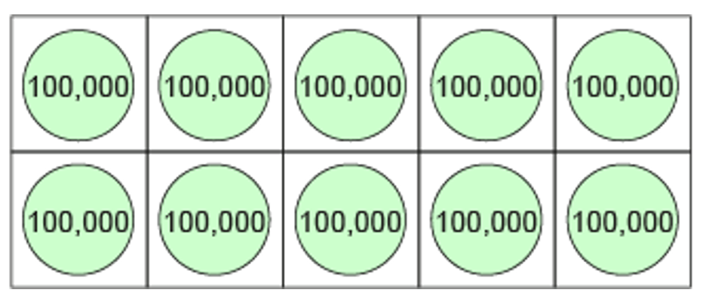
The tens frame Y1 to Y6 (some examples)
How are tens frames used in your schools?
Is there clarity in progression?
What strategies will you put in place to ensure continuity and progression and maximise the impact of tens frames in exposing mathematical structure and relationships?
Year 3
Year 1
Year 2
Year 4
Year 5
Year 6
10 hundreds is equivalent to 1 000
10 hundredths are equivalent to 1 tenth
Ten 100,000 are equivalent to 1 million

Slide 11
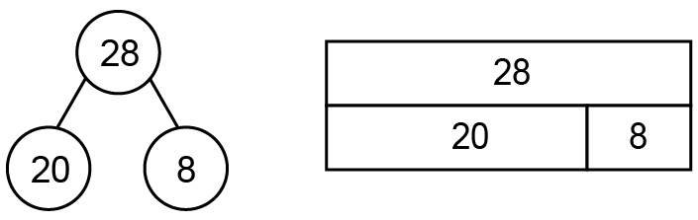
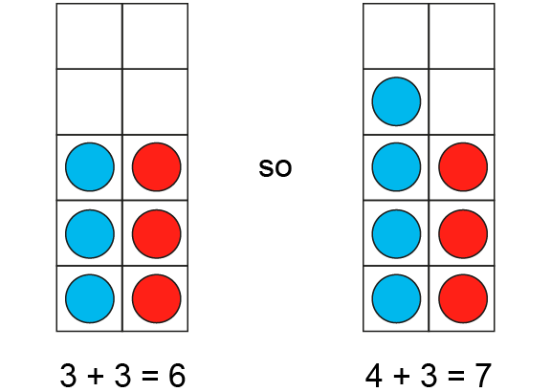
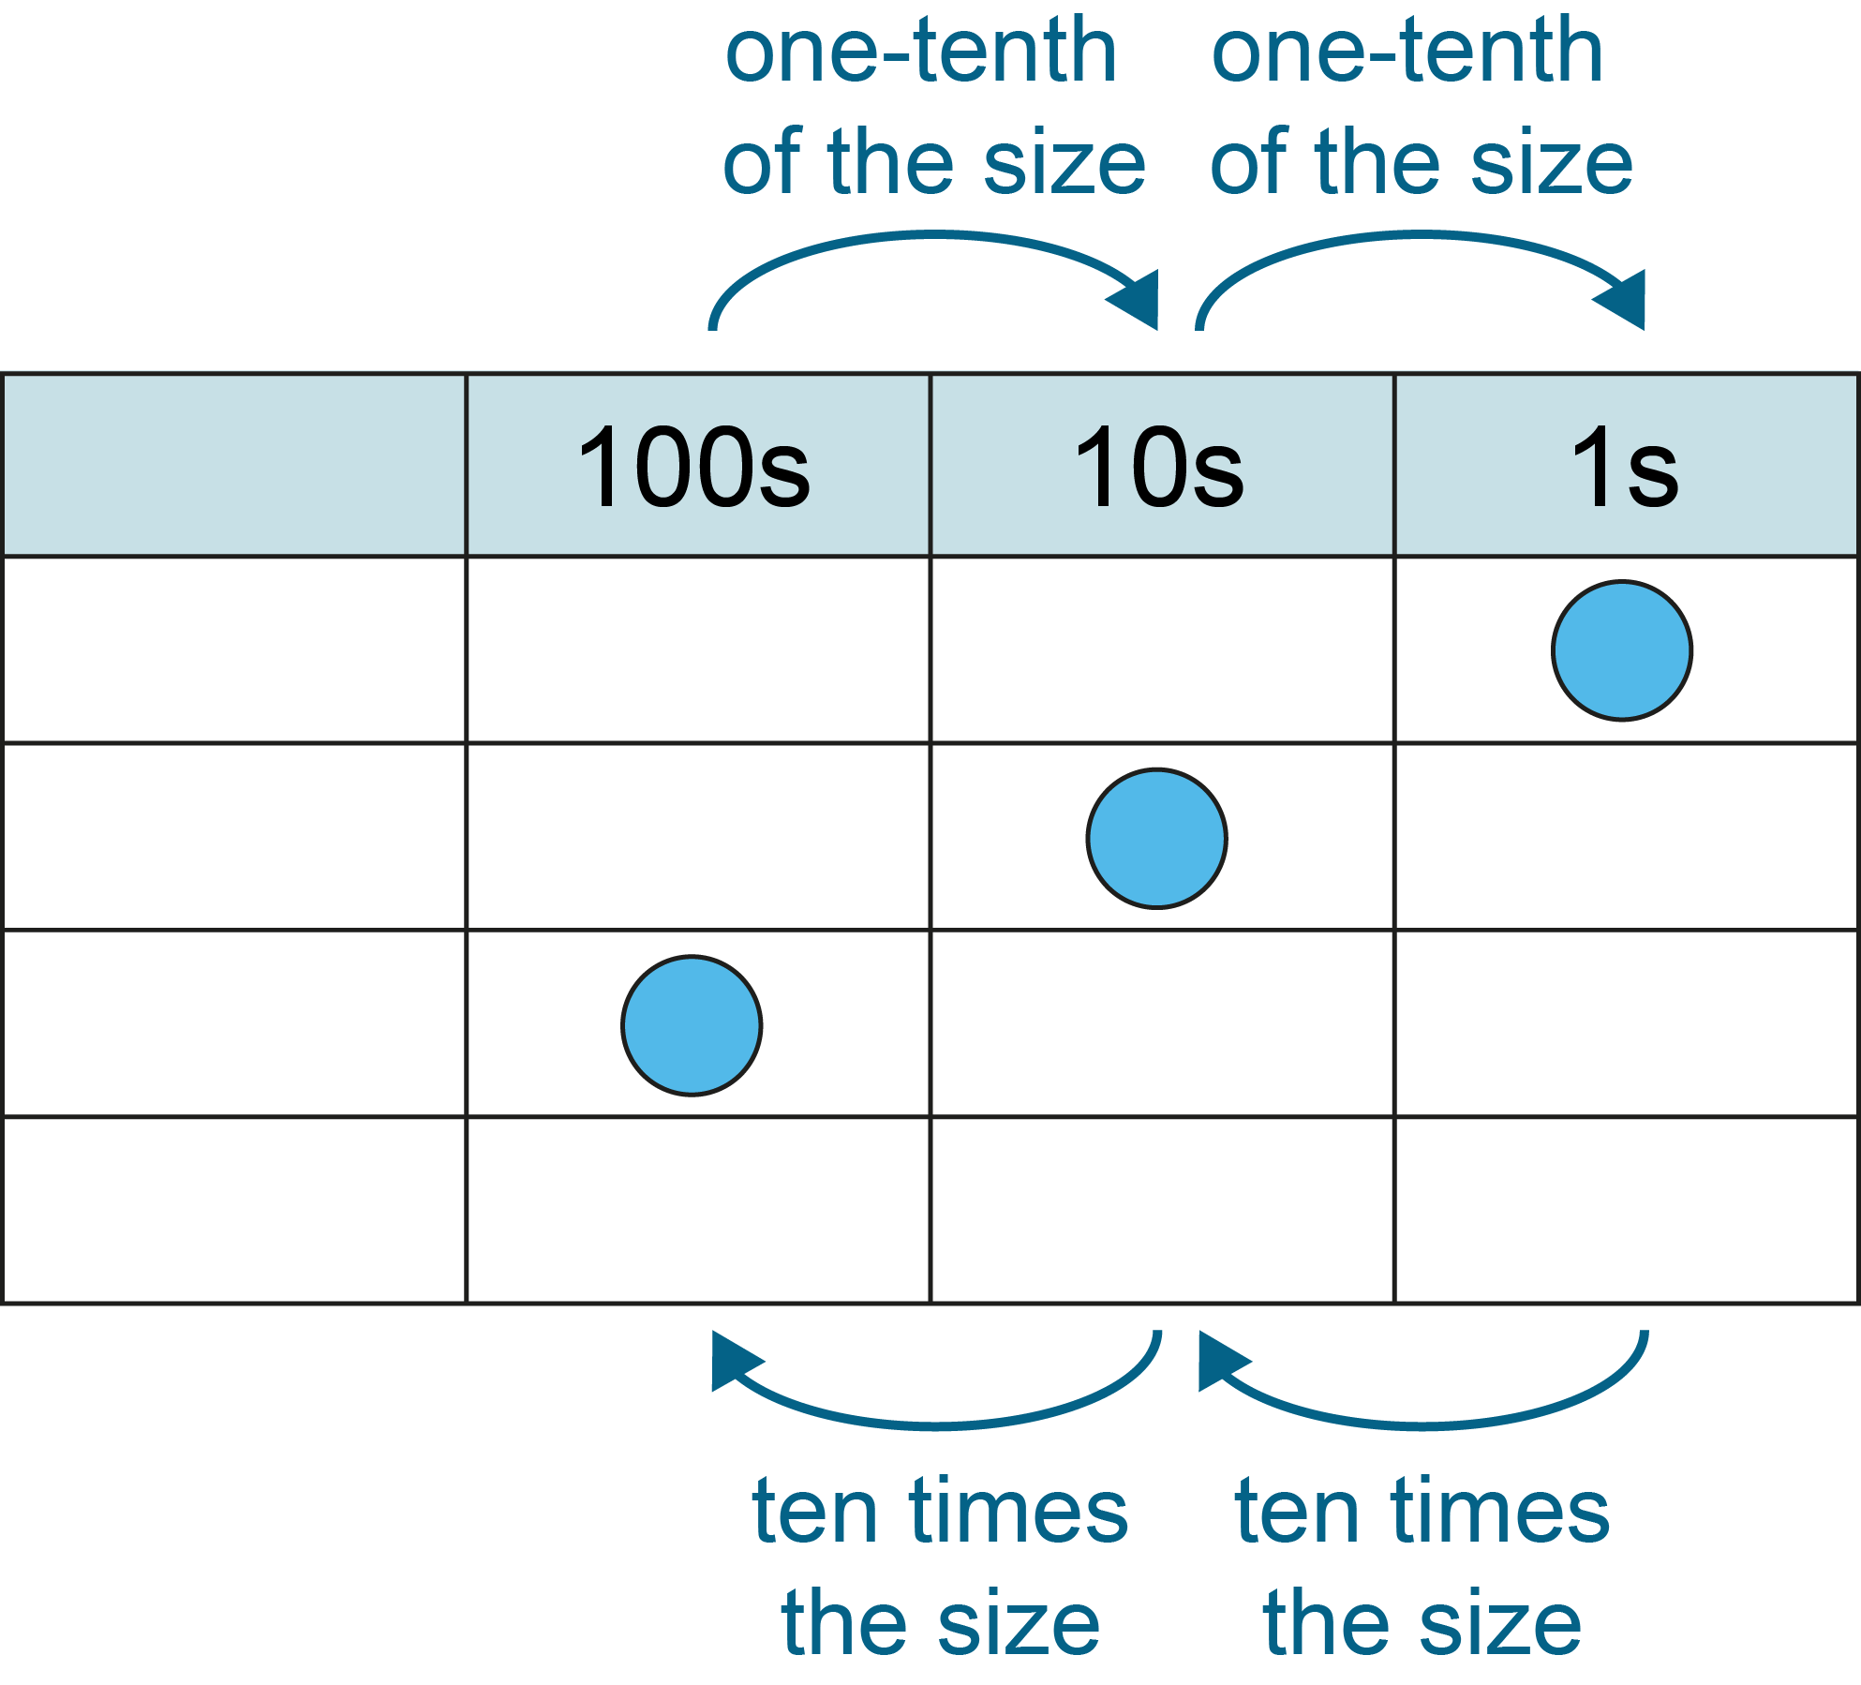
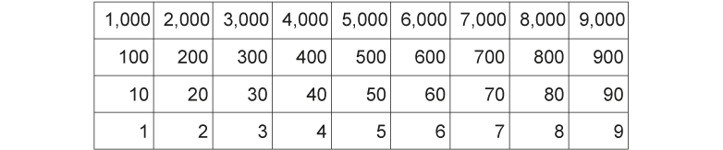
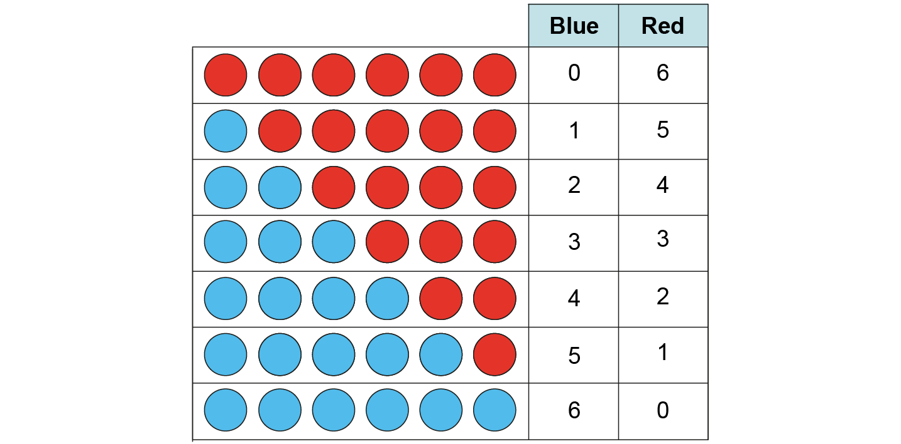

Some Core Representations
10 frames to see additive relationships
Do you have a set of core representations that are used consistently through your school?
Are teachers confident in their intended purpose?
Each Year Group chapter of the NC guidance exemplifies core representations and their purpose
Number lines to develop understanding of ordinal relationships
Place Value charts – understanding multiplicative relationships
Gattegno Chart to develop understanding of place value and the structure of the number system
Tables to organise and systematise
Unitising images

Slide 12
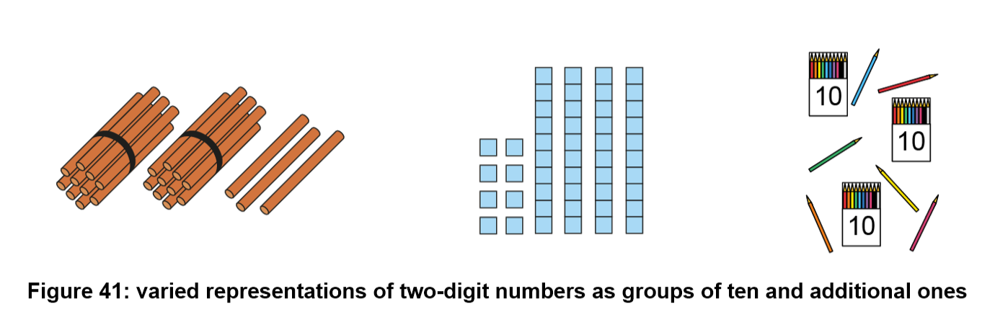
Multiple Representations
The use of multiple representations lies at the heart of conceptual variation, a powerful strategy for developing deep understanding and fluency.
Notice the variation in not only the different medium for representing tens and ones, but also the different arrangement of tens and ones.

Slide 13
Mathematics guidance:
Key stage 1 and 2
Non-statutory guidance for the national curriculum in England
Language

Slide 14
Language Structures
The development and use of precise and accurate language in mathematics is important, so the guidance includes ‘Language focus’ features. These provide suggested sentence structures for pupils to use to capture, connect and apply important mathematical ideas.
Language focus “The whole is divided into 3 equal parts. Each part is one-third of the whole.”

Slide 15
Mathematics guidance:
Key stage 1 and 2
Non-statutory guidance for the national curriculum in England
Making Connections

Slide 16
Making Connections is strong throughout the document
Making connections

Slide 17
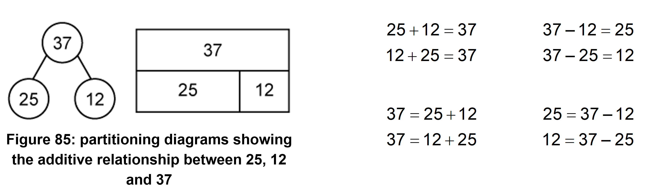
A strong emphasis on making connections by exposing mathematical relationships
2 relationships, not 4 operations: Additive relationships

Slide 18
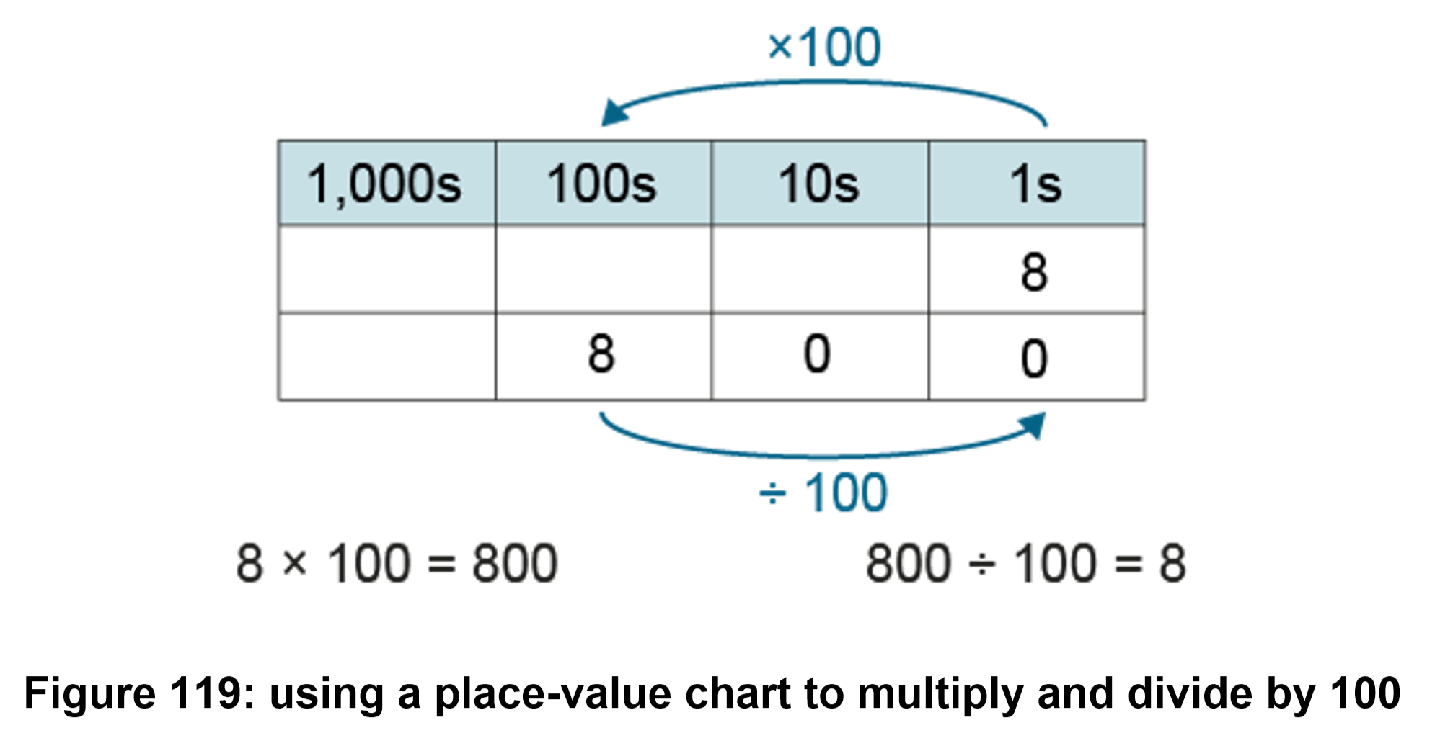
2 relationships, not 4 operations: Multiplicative Relationships

Slide 19
Use of the guidance
To support:
long-term planning
medium-term planning
short-term planning
transition conversations between adjacent year groups

Slide 20
Mathematics guidance:
Key stage 1 and 2
Non-statutory guidance for the national curriculum in England
Assessment

Slide 21
Assessment
Example assessment questions are provided for each ready
to progress criterion. These questions demonstrate the
depth and breadth of understanding that pupils need to be
ready to progress to the next year group. (p7)

Slide 22
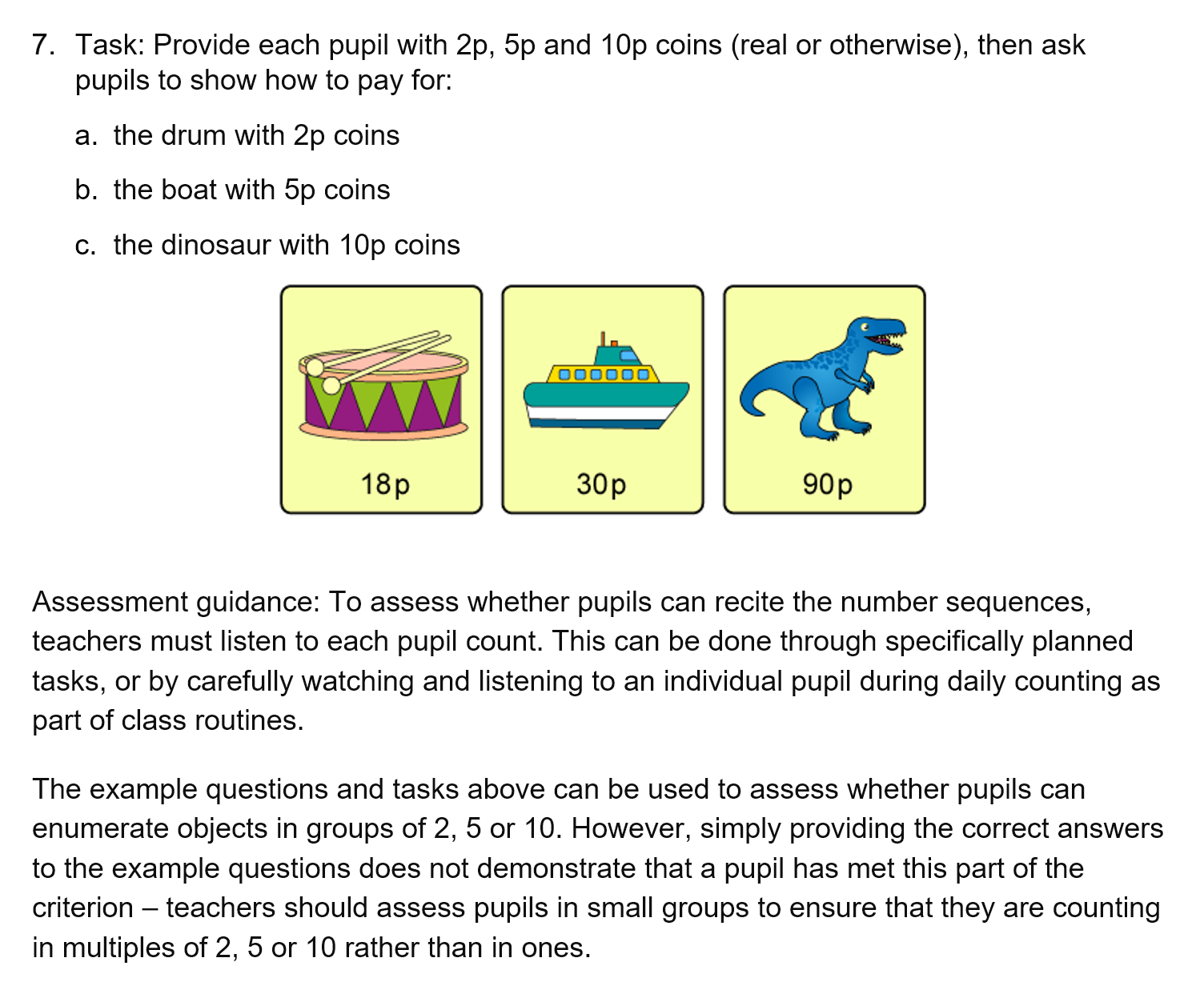
Year 1
Many of Y1 questions are tasks rather than written questions and the teacher is advised to assess through observations in small groups.

Slide 23
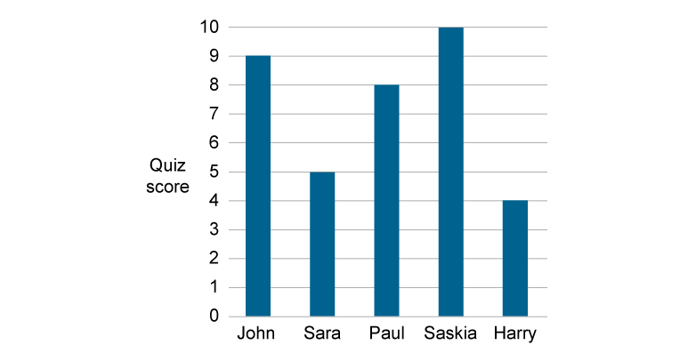
2AS–2 Solve comparative addition and difference problems
The bar chart shows how many points some pupils scored in a quiz.
I have £19 and want to buy a game which costs £25. How much more money do I need?
Felicity has 34 marbles and Dan has 30 marbles. What is the difference between the number of marbles they have?
It takes me 20 minutes to walk to school. So far I have been walking for 12 minutes. How much longer do I have to walk for?
Liam is 90cm tall. Karim is 80cm tall. How much taller is Liam than Karim?
  How many more points did John score than Sara?
  How many fewer points did Harry score than Saskia?
  What is the difference between Saskia’s score and Paul’s score?
Note the range of questions. and variation.

Slide 24
Mathematics guidance:
Key stage 1 and 2
Non-statutory guidance for the national curriculum in England
Covid Recovery

Slide 25
Curriculum Prioritisation and Covid Recovery
The difference was
that teachers began
focusing on the
things that needed to
be learned rather than
going through a large
amount of curriculum.
The students’
performance actually
went up in the final
exams.
John Hattie was the
adviser for the New
Zealand Qualifications
Authority during the
period following the
Christchurch earthquake in 2011, when schools were
closed for an
extended period.

Slide 26
Mathematics guidance:
Key stage 1 and 2
Non-statutory guidance for the national curriculum in England
Getting Started

Slide 27

Getting stated
Review curriculum map and highlight the RTP criteria maybe start with just one strand.
What representations are used, is there consistency across year groups?
Read the relevant section in the year group chapter for your new set of planning.
Consider how to use the RTP criteria to support Covid curriculum recovery.
Get involved with your maths hub.
https://www.ncetm.org.uk/in-the-classroom/support-for-schools-addressing-ongoing-coronavirus-impact/support-with-2020-dfe-guidance/

Slide 28
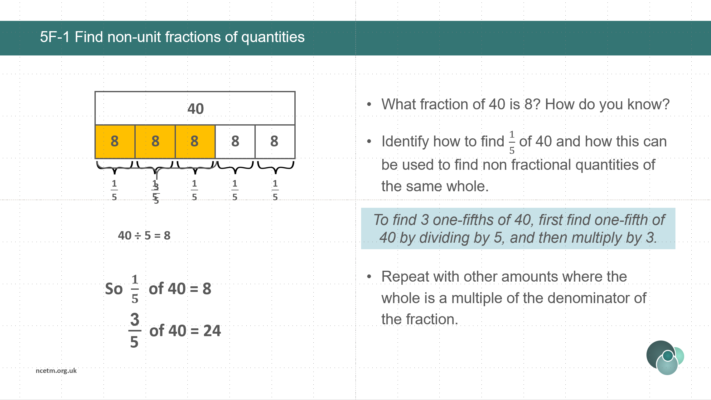
Ready-to-progress criteria resources
There is a set of resources for each of the RTP criteria their main intention is for use with small groups of children who require additional review, practice and consolidation. They can also be incorporated into main teaching activity.

Slide 29
Mathematics guidance:
Key stage 1 and 2
Non-statutory guidance for the national curriculum in England
Research and Evidence

Slide 30

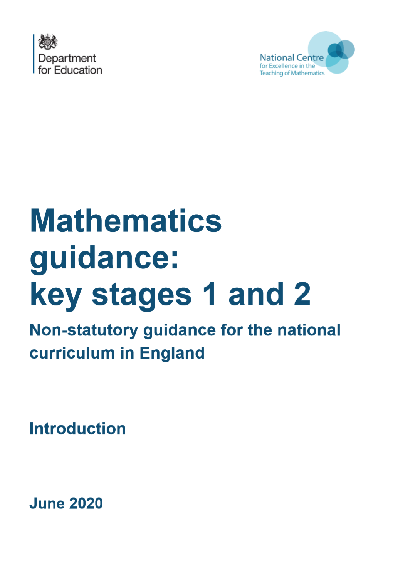
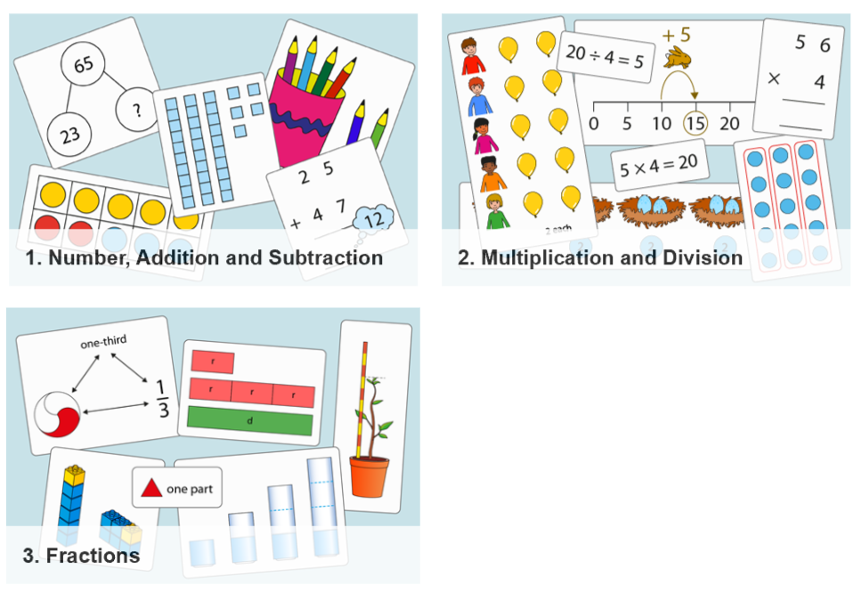

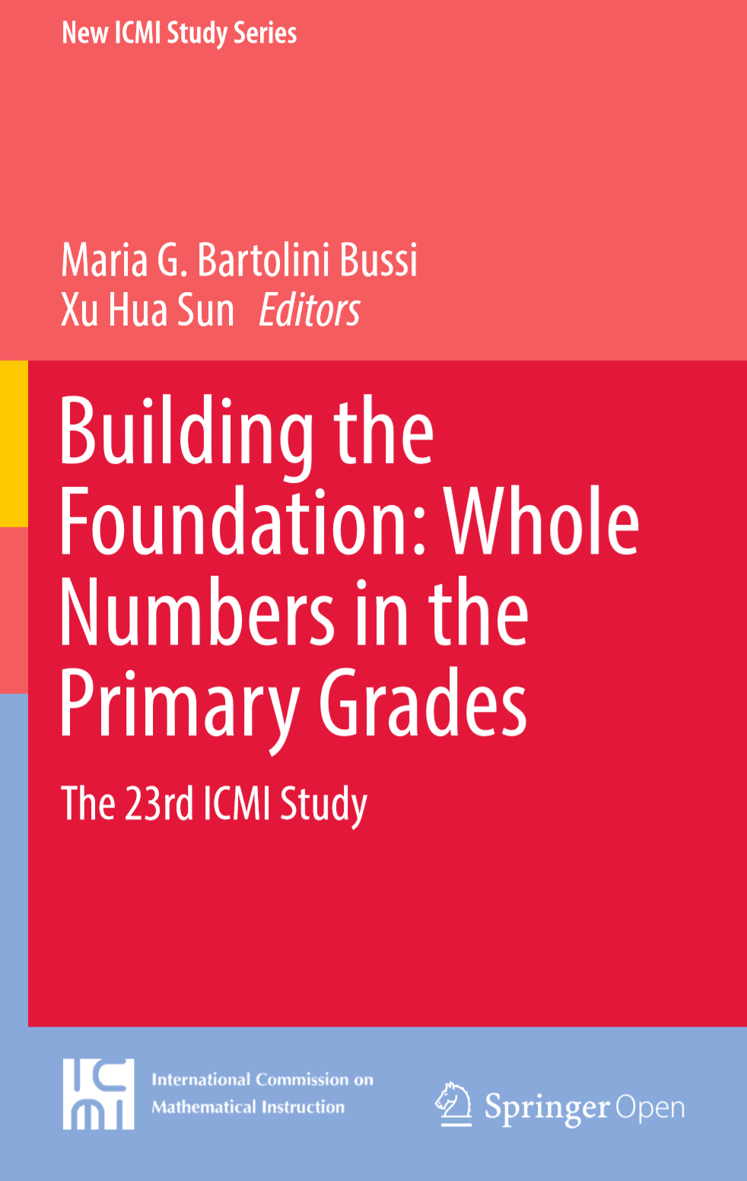
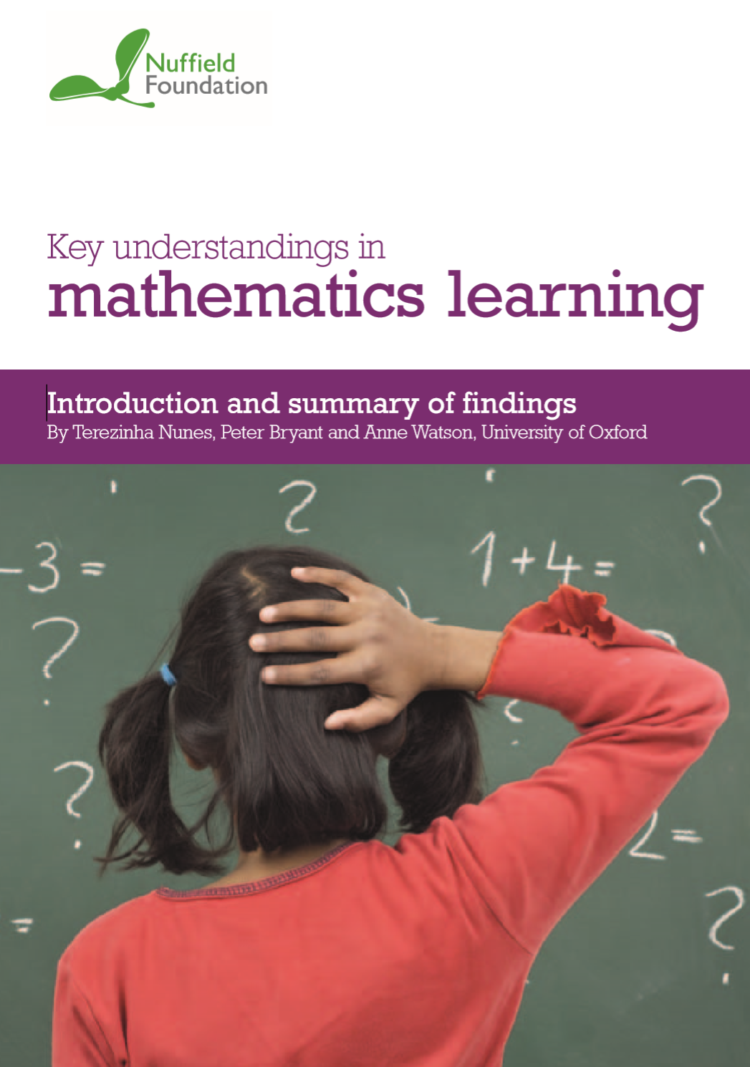
key inputs
Curricula of High Performing Jurisdictions

