Slide 1
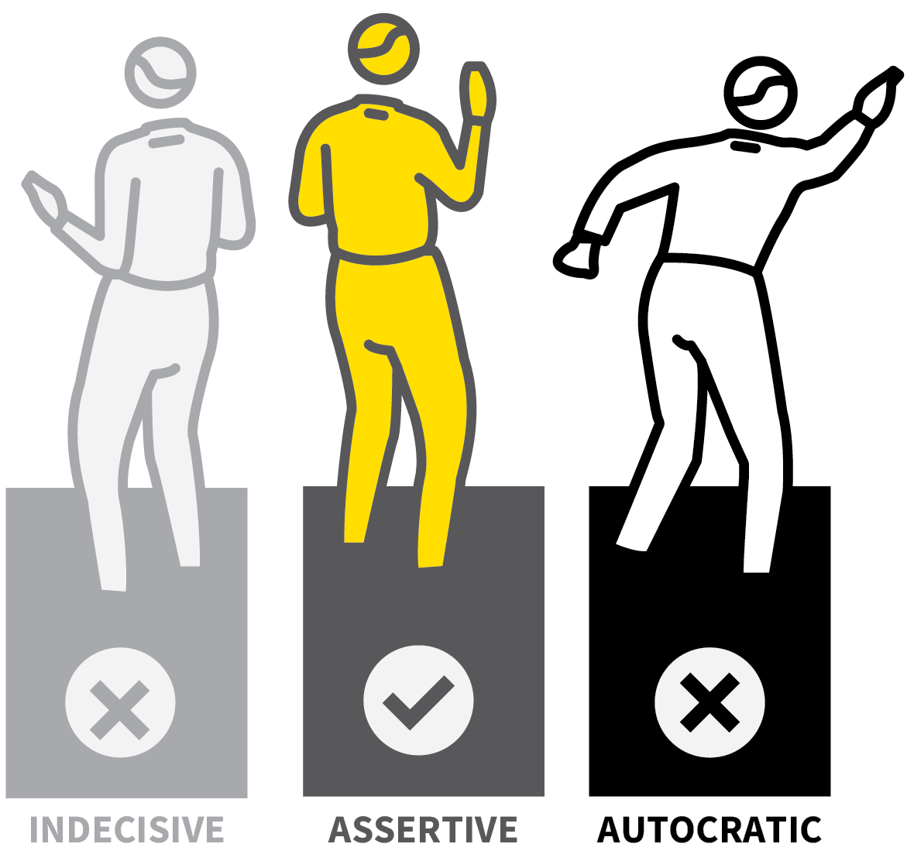
John Catt Educational
BEHAVIOUR & RELATIONSHIPS
TEACHING
WALKTHRUs
PRESENTATION
SLIDES
TOM SHERRINGTON & OLIVER CAVIGLIOLI
POSITIVE RELATIONSHIPS
ESTABLISH YOUR EXPECTATIONS
SIGNAL, PAUSE, INSIST
POSITIVE FRAMING
REHEARSE ROUTINES
CHOICES & CONSEQUENCES

Slide 2

POSITIVE RELATIONSHIPS
SERIES
BEHAVIOUR & RELATIONSHIPS
1
ESTABLISH NORMS AROUND CLEAR ROLES AND BOUNDARIES
2
COMMUNICATE KINDNESS
3
LEARN NAMES AND USE THEM
4
COMBINE ASSERTIVENESS WITH WARMTH
5
ALWAYS BE THE ADULT

Slide 3

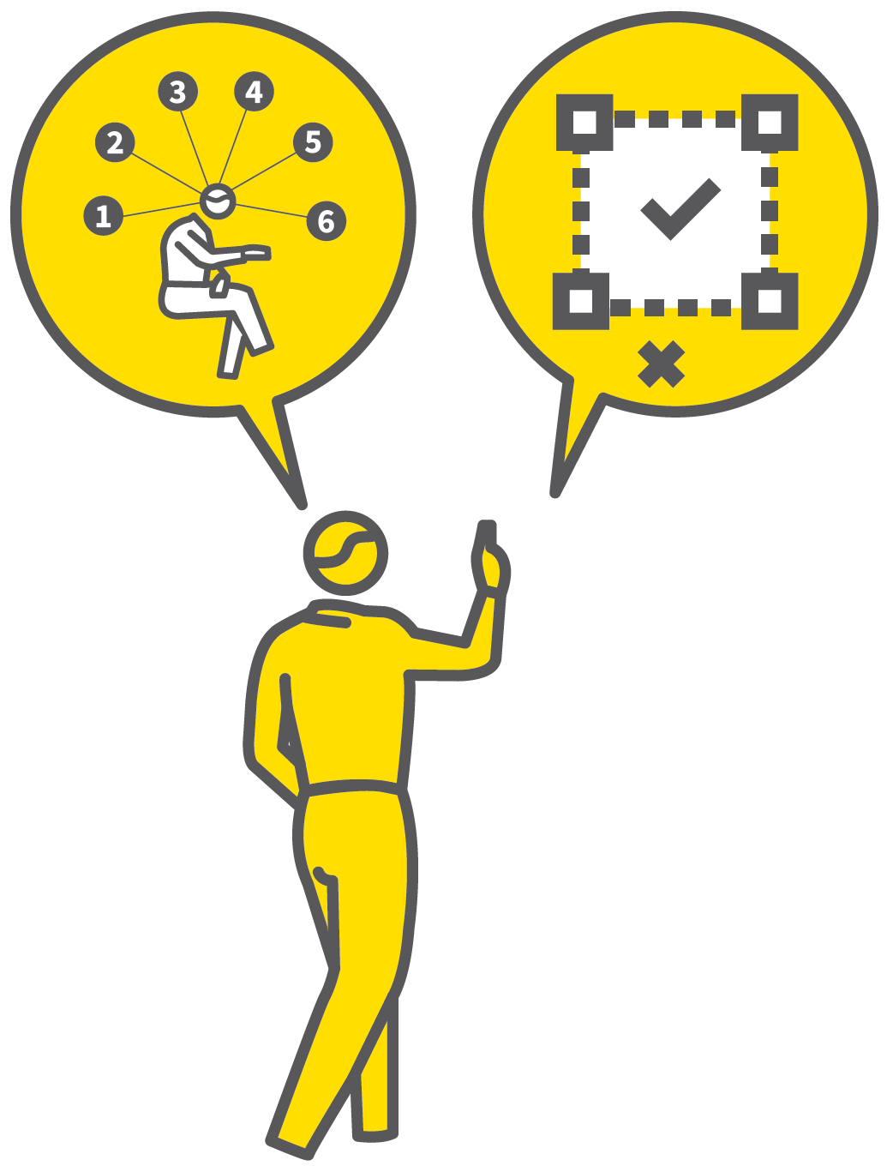
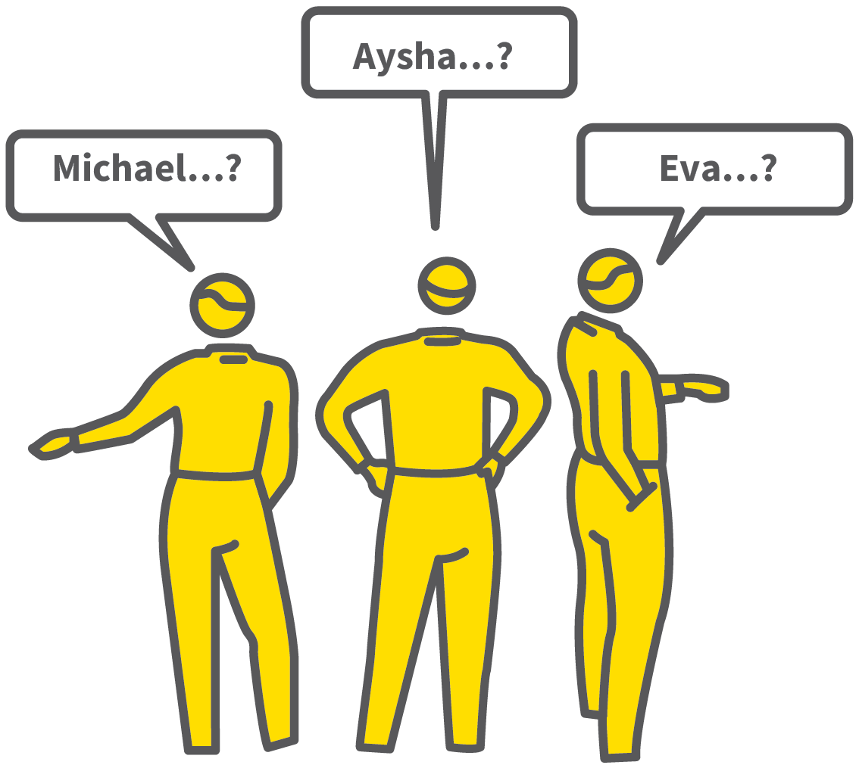
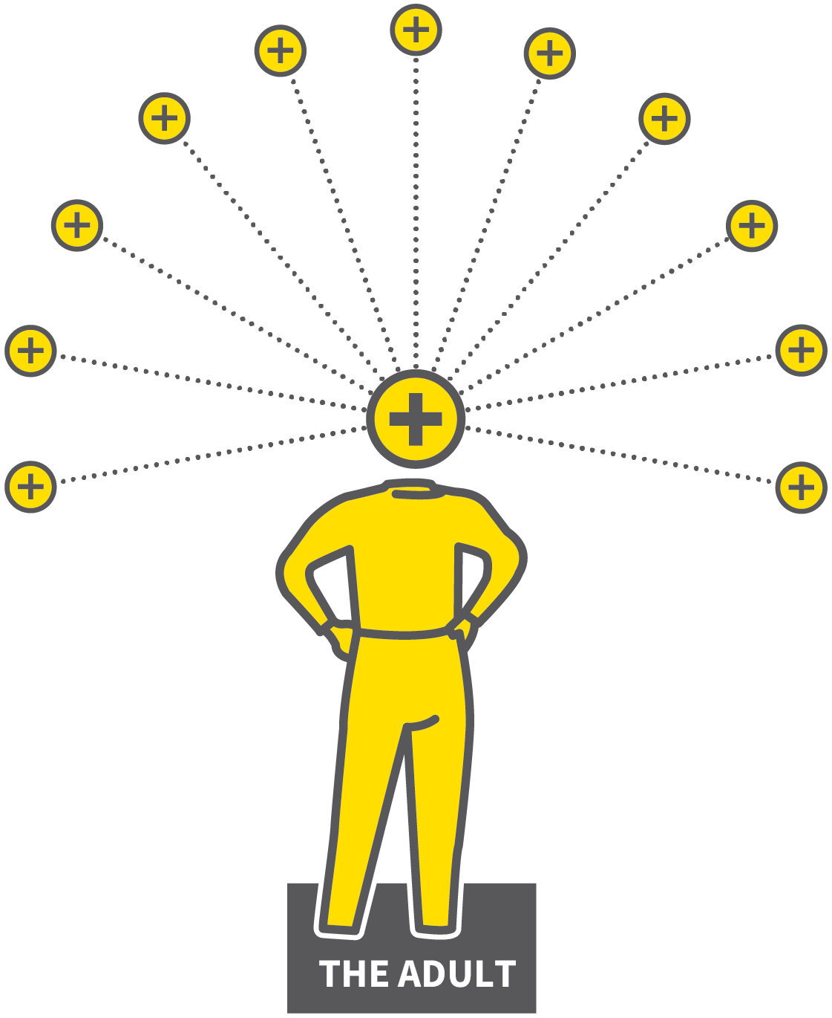

POSITIVE RELATIONSHIPS
1
2
3
4
5
ESTABLISH NORMS AROUND CLEAR ROLES AND BOUNDARIES
COMMUNICATE KINDNESS
LEARN NAMES AND USE THEM
COMBINE ASSERTIVENESS WITH WARMTH
ALWAYS BE THE ADULT
Everyone has the right to feel safe, respected and valued; to feel they belong.
Focus on learning, free from distractions or emotional threats.
Communicate trustable feedback that students will act on.
Aligned to very different roles and responsibilities.

Slide 4
POSITIVE RELATIONSHIPS
1
2
3
4
5
ESTABLISH NORMS AROUND CLEAR ROLES AND BOUNDARIES
Teachers have role-authority alongside a duty of care.
Relationships with students should focus on the share purpose of achieving learning.
Once students understand the boundaries, they accept them as norms within which everyone co-exists happily.

Slide 5
POSITIVE RELATIONSHIPS
1
2
3
4
5
COMMUNICATE KINDNESS
All positive relationships have kindness in common.
Kindness in all interactions.
Keep kindness at the forefront especially if you have challenging situations to deal with.

Slide 6
POSITIVE RELATIONSHIPS
1
2
3
4
5
LEARN NAMES AND USE THEM
Take time to learn names early on with a new class.
Use a seating plan to reference as you ask questions.
Better if you can say “Michael, what do you think?” or “Aysha, let's have you facing this way thanks”.

Slide 7
POSITIVE RELATIONSHIPS
1
2
3
4
5
COMBINE ASSERTIVENESS WITH WARMTH
Possible to be very strict if needed, strongly enforcing a boundary, at the same time as being warm, kind and caring.
Be firm when needed, consistently and fairly.
Also communicate that students are valued and respected.

Slide 8
POSITIVE RELATIONSHIPS
1
2
3
4
5
ALWAYS BE THE ADULT
However inappropriately students behave, remain as calm and rational as possible.
Respond using adult language and
Positive Framing.
Don’t resort to sarcasm, idle threats or
personal remarks.

Slide 9
POSITIVE RELATIONSHIPS
1
2
3
4
5
ESTABLISH NORMS AROUND CLEAR ROLES AND BOUNDARIES
COMMUNICATE KINDNESS
LEARN NAMES AND USE THEM
COMBINE ASSERTIVENESS WITH WARMTH
ALWAYS BE THE ADULT
Everyone has the right to feel safe, respected and valued; to feel they belong.
Focus on learning, free from distractions or emotional threats.
Communicate trustable feedback that students will act on.
Aligned to very different roles and responsibilities.

Slide 10

1
2
3
4
5
6
POSITIVE
RELATIONSHIPS
ESTABLISH YOUR EXPECTATIONS
SIGNAL,
PAUSE,
INSIST
POSITIVE
FRAMING
REHEARSE ROUTINES
CHOICES & CONSEQUENCES
NEXT UP
ESTABLISH YOUR
EXPECTATIONS

Slide 11
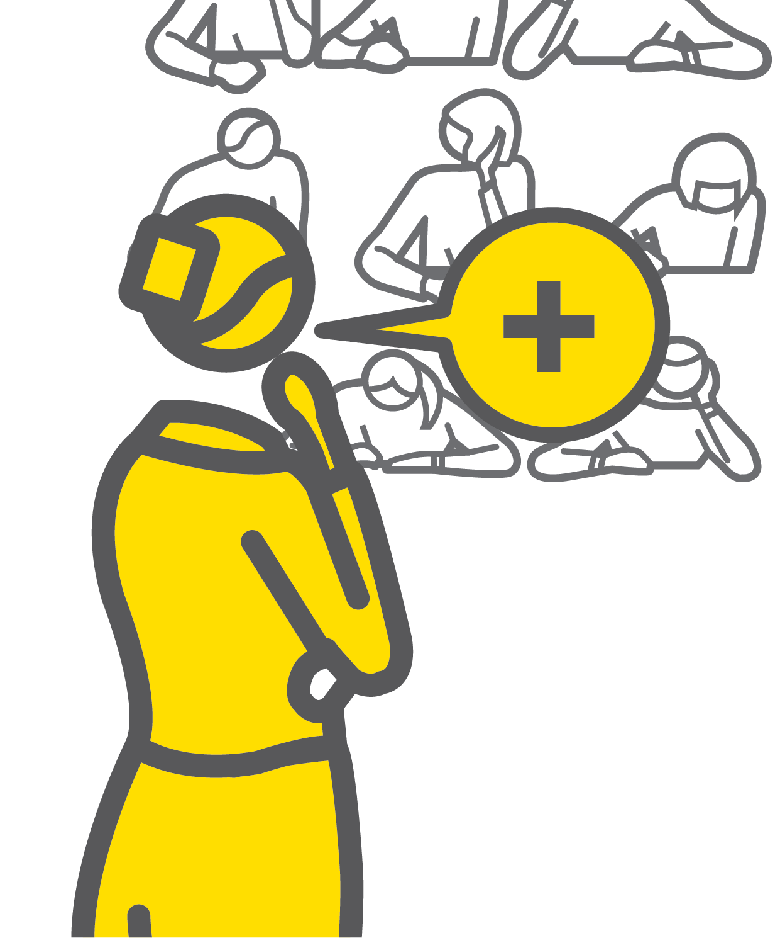
ESTABLISH YOUR
EXPECTATIONS
SERIES
BEHAVIOUR & RELATIONSHIPS
1
DECIDE YOUR EXPECTATIONS
2
COMMUNICATE YOUR EXPECTATIONS
3
REINFORCE YOUR EXPECTATIONS
4
REDIRECT, CORRECT OR CHALLENGE
5
SUSTAIN YOUR EXPECTATIONS

Slide 12
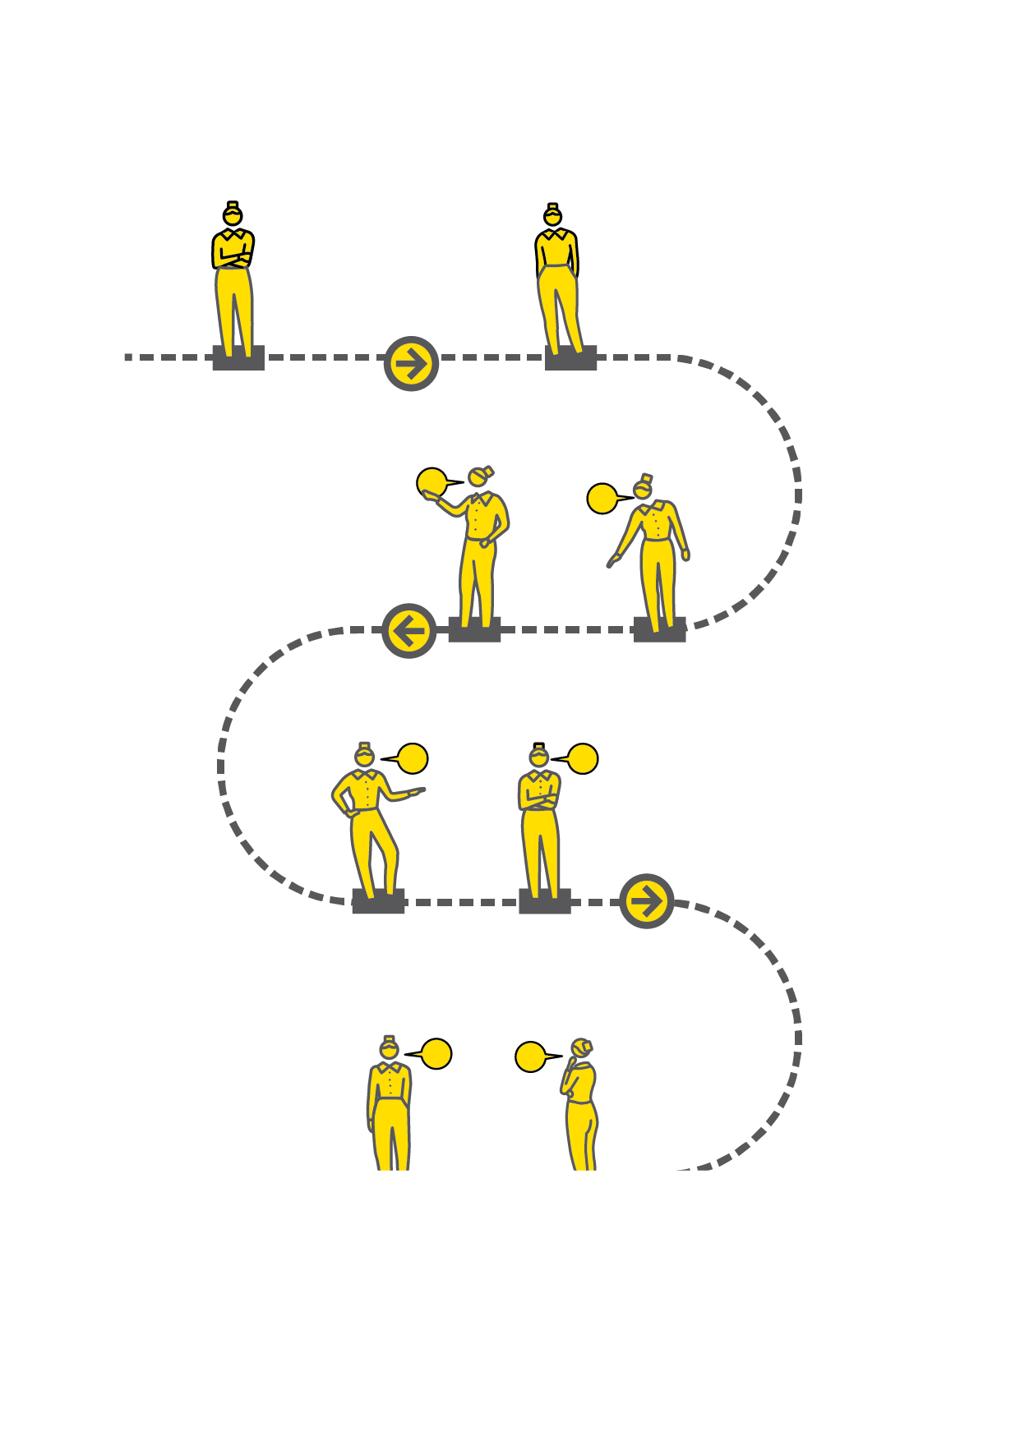

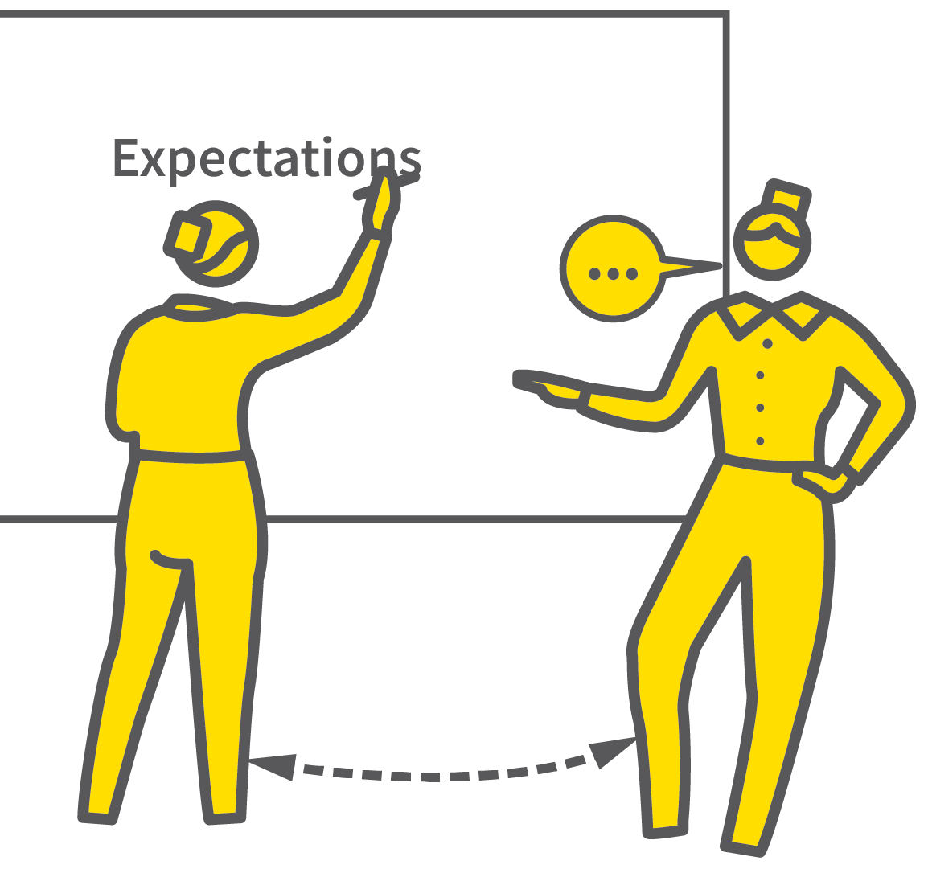
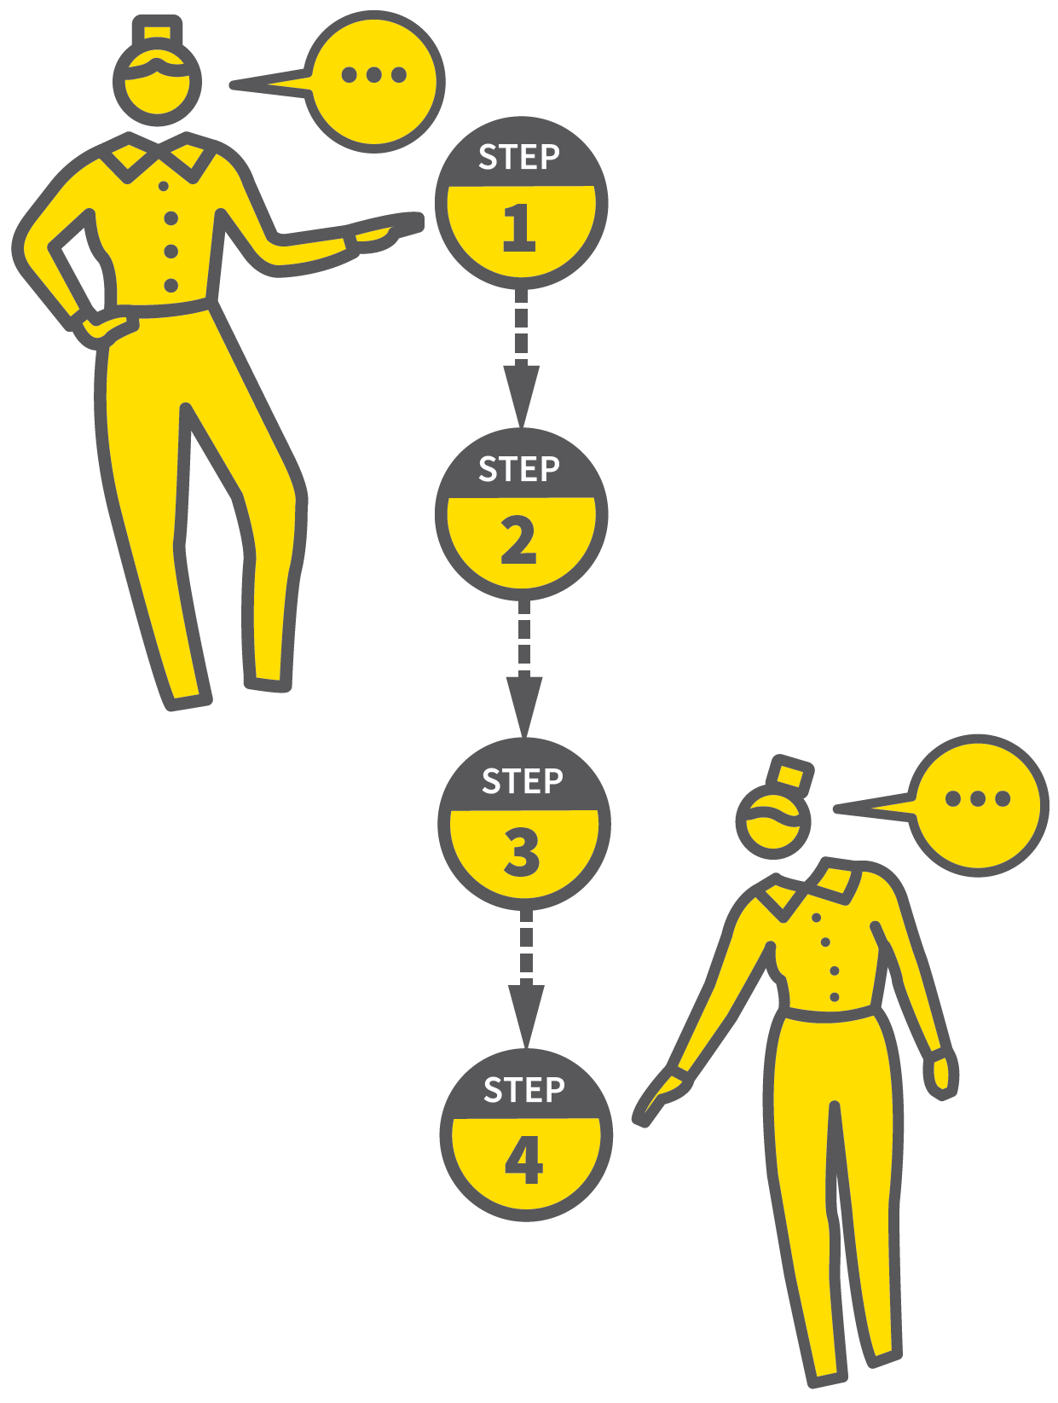
ESTABLISH YOUR EXPECTATIONS
1
2
3
4
5
DECIDE YOUR EXPECTATIONS
COMMUNICATE YOUR EXPECTATIONS
REINFORCE YOUR EXPECTATIONS
REDIRECT, CORRECT OR CHALLENGE
SUSTAIN YOUR EXPECTATIONS
“You establish what you establish” Bill Rogers.
If you tolerate low standards, you have established that this is the norm so this is what you will get.
If you establish that you will take action, students learn to function with your higher expectations.
Whatever you establish becomes the norm; “What you permit, you promote”.

Slide 13
ESTABLISH YOUR EXPECTATIONS
1
2
3
4
5
DECIDE YOUR EXPECTATIONS
Determine exactly what your expectations are for every aspect of running your lessons:
which equipment to bring
how to enter and move between tasks
how to listen when others are talking
how to ask and answer questions
how work should be set out.

Slide 14
ESTABLISH YOUR EXPECTATIONS
1
2
3
4
5
COMMUNICATE YOUR EXPECTATIONS
Talk through your expectations with each class.
Use visual reminders for clarification.
Use a ‘checking for understanding’ process to ensure your students know what you mean
Walk through routines rehearsing how they work.

Slide 15
ESTABLISH YOUR EXPECTATIONS
1
2
3
4
5
REINFORCE YOUR EXPECTATIONS
Follow through, routinely and positively.
If you weaken commitment to your own
expectations, this undermines their value.
Use positive framing to restate your
expectations.

Slide 16
ESTABLISH YOUR EXPECTATIONS
1
2
3
4
5
REDIRECT, CORRECT OR CHALLENGE
When expectations are not met, use positive correction to redirect.
e.g. If you have asked for silence, it must be truly silent.
e.g. If people are talking, make sure they have stopped before you try to talk.
Be very precise and direct.

Slide 17
ESTABLISH YOUR EXPECTATIONS
1
2
3
4
5
SUSTAIN YOUR EXPECTATIONS
It is easier to sustain high expectations if they become part of a set of routines.
Routines need to be rehearsed multiple times before becoming literally routine.

Slide 18
ESTABLISH YOUR EXPECTATIONS
1
2
3
4
5
DECIDE YOUR EXPECTATIONS
COMMUNICATE YOUR EXPECTATIONS
REINFORCE YOUR EXPECTATIONS
REDIRECT, CORRECT OR CHALLENGE
SUSTAIN YOUR EXPECTATIONS
“You establish what you establish” Bill Rogers.
If you tolerate low standards, you have established that this is the norm so this is what you will get.
If you establish that you will take action, students learn to function with your higher expectations.
Whatever you establish becomes the norm; “What you permit, you promote”.

Slide 19
1
2
3
4
5
6
POSITIVE
RELATIONSHIPS
ESTABLISH YOUR EXPECTATIONS
SIGNAL, PAUSE,
INSIST
POSITIVE
FRAMING
REHEARSE ROUTINES
CHOICES & CONSEQUENCES
NEXT UP
SIGNAL, PAUSE, INSIST

Slide 20
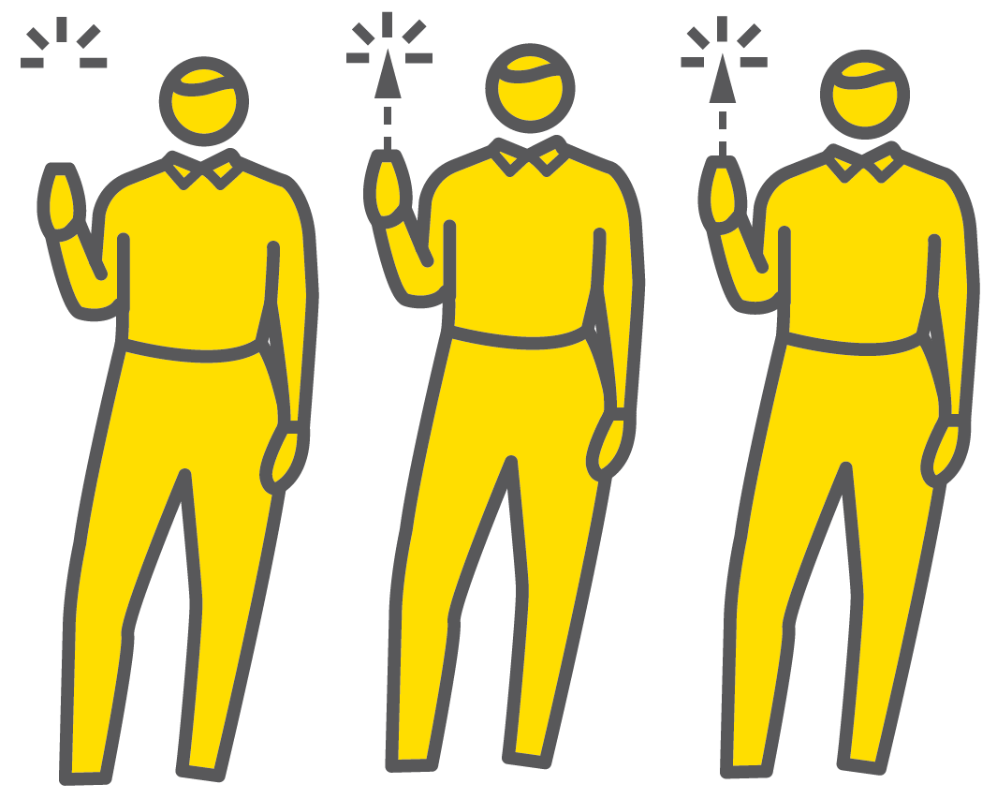
SIGNAL, PAUSE, INSIST
SERIES
BEHAVIOUR & RELATIONSHIPS
1
CHOOSE A SIGNAL
2
REHEARSE THE SIGNAL
3
GIVE THE SIGNAL
4
PAUSE
5
INSIST

Slide 21


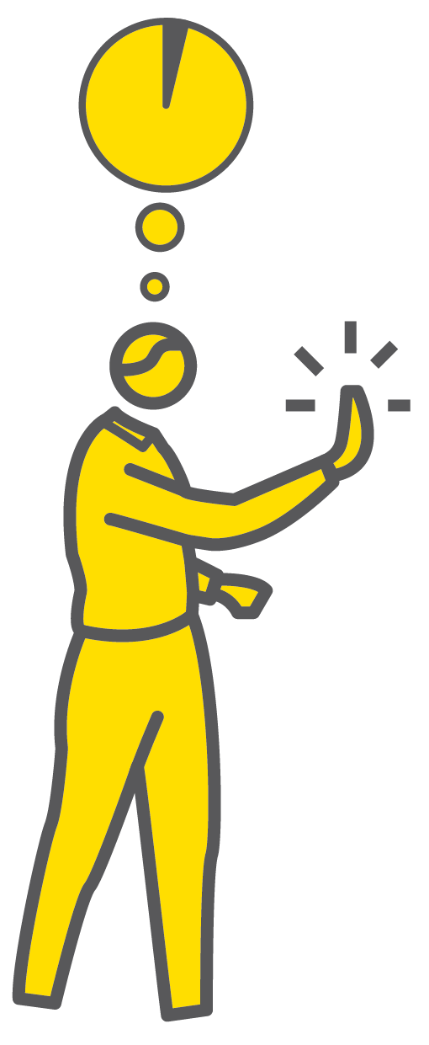

SIGNAL, PAUSE, INSIST
1
2
3
4
5
CHOOSE A SIGNAL
REHEARSE THE SIGNAL
GIVE THE SIGNAL
PAUSE
INSIST
This is a routine teachers will use several times a lesson.
Relying on using your voice to talk over the noise of a chatting class is hard to sustain
The signal-pause-insist routine allows teachers to move from one lesson n phase to another calmly and efficiently.
The more you insist on the response, the more embedded it becomes.

Slide 22
SIGNAL, PAUSE, INSIST
1
2
3
4
5
CHOOSE A SIGNAL
Select a clear and easily reproduced signal. This might be:
a raised hand
“3-2-1 and listening” to enter and move between tasks
two sharp claps
using a small bell
It doesn’t matter as long as it can be used freely and repeatedly.

Slide 23
SIGNAL, PAUSE, INSIST
1
2
3
4
5
REHEARSE THE SIGNAL
Introduce the signal to each class soon after meeting them.
Practise the process of stopping and starting an activity using the signal.
Make it clear what the signal is and what you want them to do on hearing it.

Slide 24
SIGNAL, PAUSE, INSIST
1
2
3
4
5
GIVE THE SIGNAL
When you want to move from student activity to teacher input, stop what you are doing and give the agreed signal.
Stand facing the class, scanning the room to make eye contact with everyone.

Slide 25
SIGNAL, PAUSE, INSIST
1
2
3
4
5
PAUSE
Give students a short moment to adjust;
it’s not instantaneous.
Wait without speaking to allow this transition to happen naturally.
Hold eye contact all the time.
When ready, affirm their positive response with a simple “thank you”.

Slide 26
SIGNAL, PAUSE, INSIST
1
2
3
4
5
INSIST
Before moving on be sure that everyone has given you the agreed response.
If you can’t get a 100% response through body language and eye contact, use low level reminders.
You might need a more-strict response or to rehearse the signal for attention routine again.

Slide 27
SIGNAL, PAUSE, INSIST
1
2
3
4
5
CHOOSE A SIGNAL
REHEARSE THE SIGNAL
GIVE THE SIGNAL
PAUSE
INSIST
This is a routine teachers will use several times a lesson.
Relying on using your voice to talk over the noise of a chatting class is hard to sustain
The signal-pause-insist routine allows teachers to move from one lesson n phase to another calmly and efficiently.
The more you insist on the response, the more embedded it becomes.

Slide 28
1
2
3
4
5
6
POSITIVE
RELATIONSHIPS
ESTABLISH YOUR EXPECTATIONS
SIGNAL,
PAUSE,
INSIST
POSITIVE
FRAMING
REHEARSE ROUTINES
CHOICES & CONSEQUENCES
NEXT UP
POSITIVE
FRAMING

Slide 29

POSITIVE
FRAMING
SERIES
BEHAVIOUR & RELATIONSHIPS
1
ESTABLISH YOUR EXPECTATIONS
2
AFFIRM POSITIVE RESPONSES FIRST
3
FRAME CORRECTION AS POSITIVE REINFORCEMENT
4
GIVE THE BENEFIT OF THE DOUBT
5
ASSUME CONFUSION OVER DEFIANCE

Slide 30
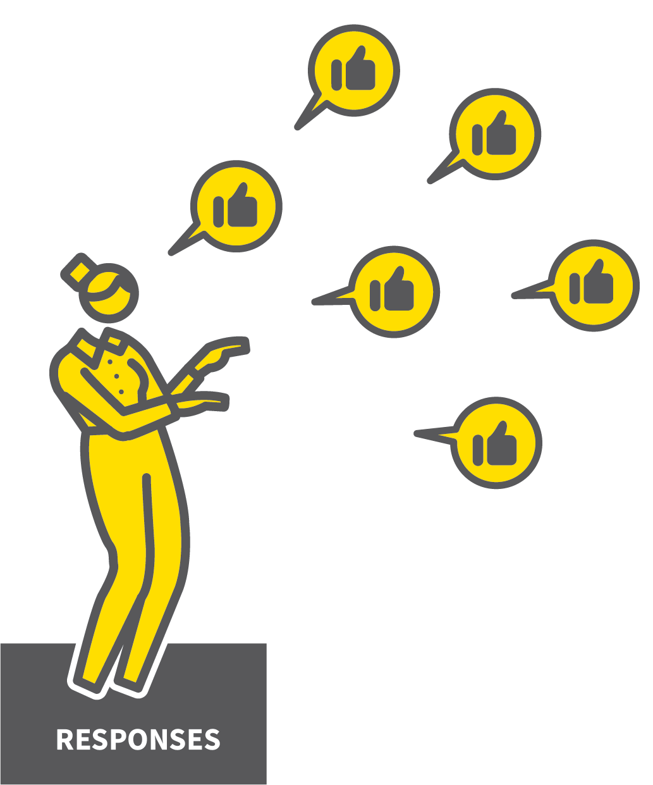
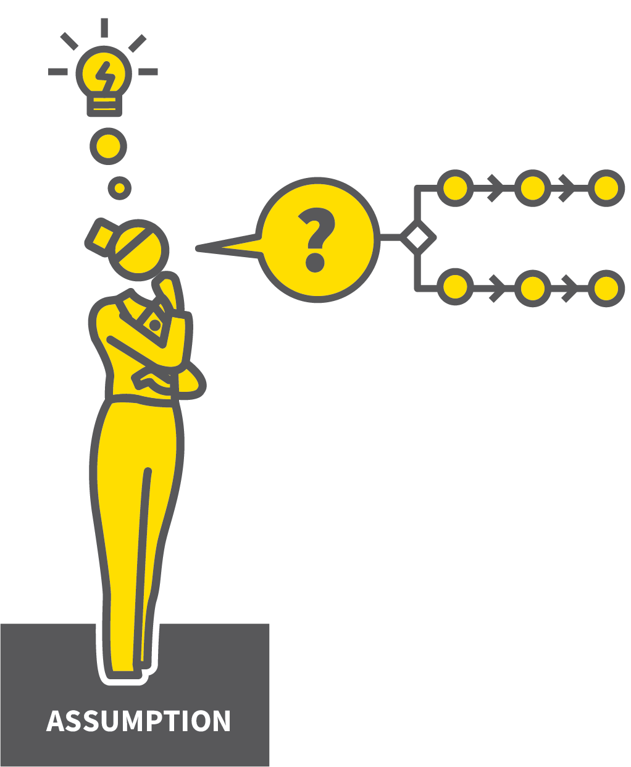
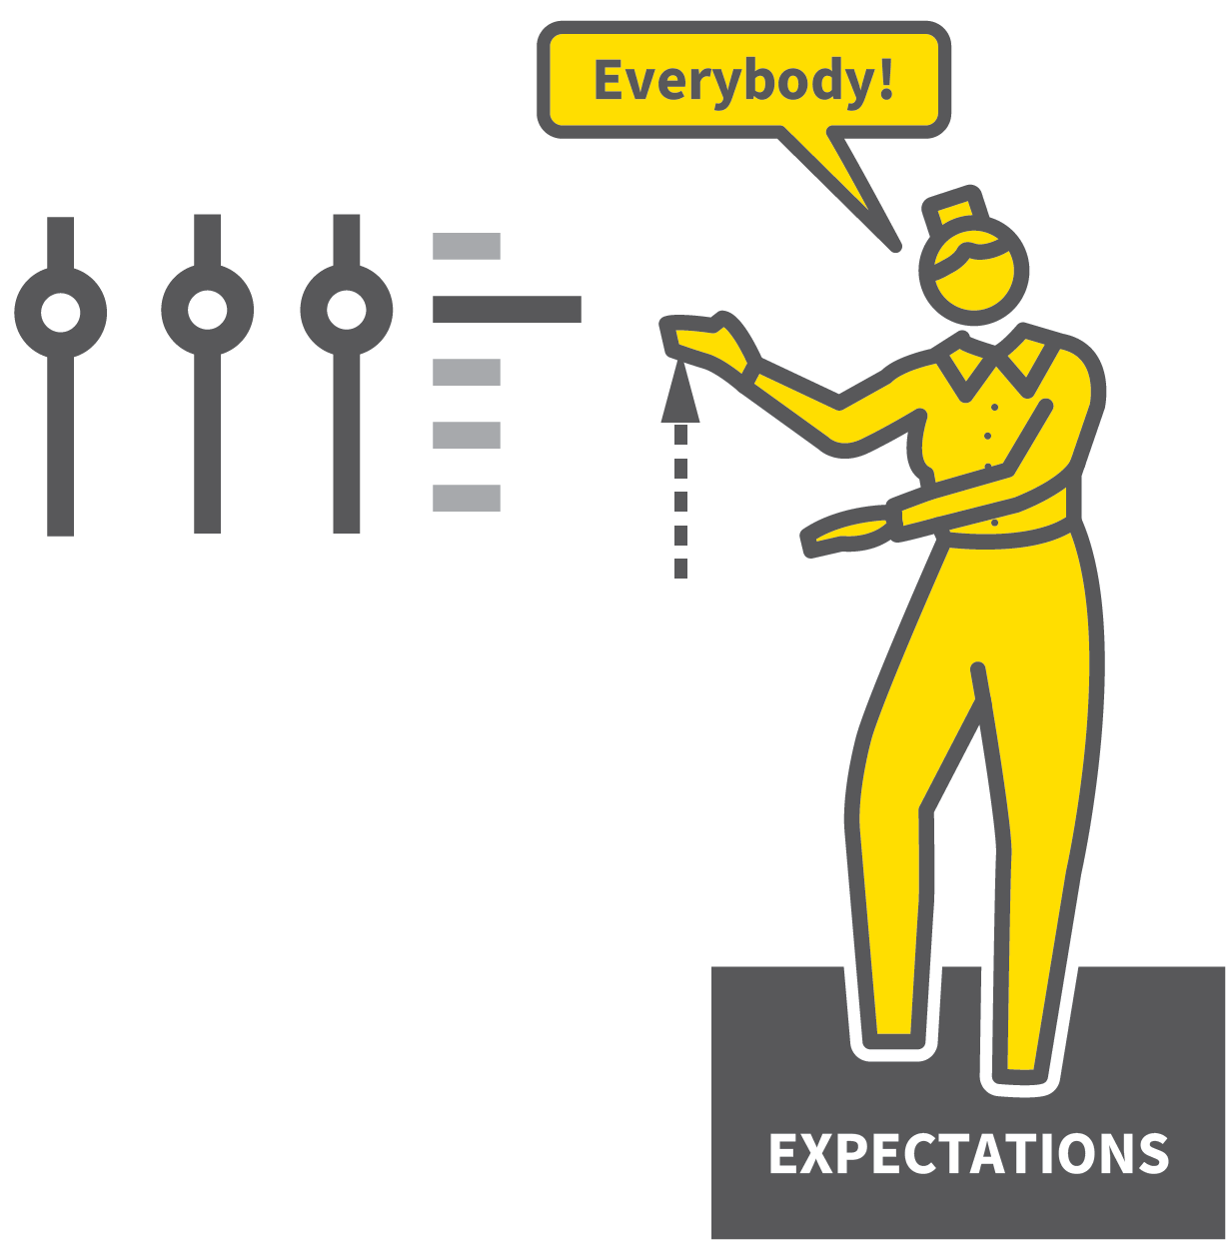

POSITIVE FRAMING
1
2
3
4
5
ESTABLISH YOUR EXPECTATIONS
AFFIRM POSITIVE RESPONSES FIRST
FRAME CORRECTION AS POSITIVE REINFORCEMENT
GIVE THE BENEFIT OF THE DOUBT
ASSUME CONFUSION OVER DEFIANCE
A technique for establishing and maintaining high expectations through the use of positive reinforcement, encouragement and affirmative language.
Instead of negative moaning or challenges that might be interpreted as personal criticism or arbitrary and unjust, teachers frame corrective directions through a positive frame.

Slide 31
POSITIVE FRAMING
1
2
3
4
5
ESTABLISH YOUR EXPECTATIONS
Go through the process of establishing
expectations first.
Students need to know what the expectations are before they can then be re-affirmed through the framing technique.

Slide 32
POSITIVE FRAMING
1
2
3
4
5
AFFIRM POSITIVE RESPONSES FIRST
Give positive affirmation to students who meet the expectations before dealing with any who don’t.
“Well done to this table; you’re ready to learn and listening”.
“So many excellent homework responses today. Well done people!”

Slide 33
POSITIVE FRAMING
1
2
3
4
5
FRAME CORRECTION AS POSITIVE REINFORCEMENT
Frame corrective responses by reasserting what you want, not describing their
behaviour.
Instead of “Sean and Mo, stop talking and turn around” say “Sean, Mo... I’d like you both looking this way and listening thanks”.

Slide 34
POSITIVE FRAMING
1
2
3
4
5
GIVE THE BENEFIT OF THE DOUBT
Assume students’ best intentions and
emphasise what you want to happen.
Teacher: Louise, I need you focused on the task now. Thank you.
Louise: But I wasn’t talking.
Teacher: OK, maybe you weren’t but I need you focused and working hard now. Thank you.

Slide 35
POSITIVE FRAMING
1
2
3
4
5
ASSUME CONFUSION OVER DEFIANCE
Feign confusion instead of issuing
a challenge.
“I wonder if this group did not quite hear the instructions?”
“There seems to be some confusion about our expectations here — can we just check we’ve all understood the routine?”

Slide 36
POSITIVE FRAMING
1
2
3
4
5
ESTABLISH YOUR EXPECTATIONS
AFFIRM POSITIVE RESPONSES FIRST
FRAME CORRECTION AS POSITIVE REINFORCEMENT
GIVE THE BENEFIT OF THE DOUBT
ASSUME CONFUSION OVER DEFIANCE
A technique for establishing and maintaining high expectations through the use of positive reinforcement, encouragement and affirmative language.
Instead of negative moaning or challenges that might be interpreted as personal criticism or arbitrary and unjust, teachers frame corrective directions through a positive frame.

Slide 37
1
2
3
4
5
6
POSITIVE
RELATIONSHIPS
ESTABLISH YOUR EXPECTATIONS
SIGNAL,
PAUSE,
INSIST
POSITIVE
FRAMING
REHEARSE ROUTINES
CHOICES & CONSEQUENCES
NEXT UP
REHEARSE
ROUTINES

Slide 38
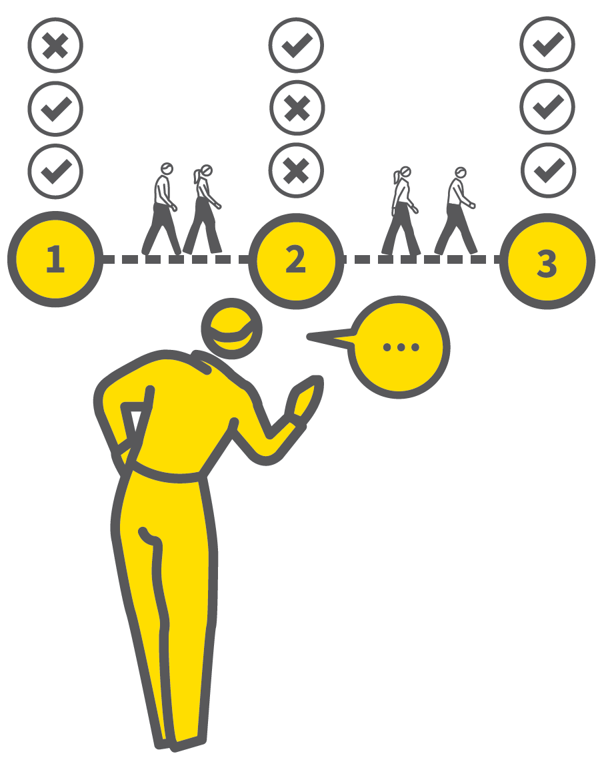
REHEARSE
ROUTINES
SERIES
BEHAVIOUR & RELATIONSHIPS
1
DESIGN YOUR ROUTINES
2
WALK THROUGH EACH ROUTINE
3
TEACH THE SIGNALS
4
MAKE ROUTINES ROUTINE
5
REFRESH OR REBOOT

Slide 39





REHEARSE ROUTINES
1
2
3
4
5
DESIGN
REHEARSE
SIGNAL
MAKE ROUTINE
REFRESH OR REBOOT
DESIGN YOUR ROUTINES
WALK THROUGH EACH ROUTINE
TEACH THE SIGNALS
MAKE ROUTINES ROUTINE
REFRESH OR REBOOT
Routines are the bedrock of a positive behaviour management system.
If everyone knows what to do and what happens in various situations, then it allows the focus to be on learning.
Establish them and rehearse them so that they are known, understood and enacted consistently.

Slide 40
REHEARSE ROUTINES
1
2
3
4
5
DESIGN YOUR ROUTINES
Work out what you want students to do in every common situation they encounter:
arriving to class
entering and getting equipment ready
moving from a teacher-led phase to a
groupwork phase
Describe each routine in as few steps as
possible.
DESIGN

Slide 41
REHEARSE ROUTINES
1
2
3
4
5
WALK THROUGH EACH ROUTINE
Teach each routine explicitly and walk through it.
Treat it like a rehearsal where you review
the performance and then repeat it with
improvements.
Establish a high standard early on otherwise it will be harder to address later.
REHEARSE

Slide 42
REHEARSE ROUTINES
1
2
3
4
5
TEACH THE SIGNALS
Students need to know when to enact a given routine.
Some might be automatic.
Some might need to be signalled by the teacher.
When a signal is needed, teach the signal,
test it and reinforce it consistently.
SIGNAL

Slide 43

REHEARSE ROUTINES
1
2
3
4
5
MAKE ROUTINES ROUTINE
Stick to the details of a routine so that they become automatic and do not require much reinforcement.
Feels artificial at first but persist with routines so that they become the norm.
MAKE ROUTINE

Slide 44
REHEARSE ROUTINES
1
2
3
4
5
REFRESH OR REBOOT
Reinforce routines using Positive Framing and Choices & Consequences
Some enforcement fatigue is normal.
If a routine has lapsed, reboot it, re-setting the expectations, running through explicit
rehearsal.
Can be a better option than issuing
consequences to multiple students.
REFRESH OR REBOOT

Slide 45
REHEARSE ROUTINES
1
2
3
4
5
DESIGN
REHEARSE
SIGNAL
MAKE ROUTINE
REFRESH OR REBOOT
DESIGN YOUR ROUTINES
WALK THROUGH EACH ROUTINE
TEACH THE SIGNALS
MAKE ROUTINES ROUTINE
REFRESH OR REBOOT
Routines are the bedrock of a positive behaviour management system.
If everyone knows what to do and what happens in various situations, then it allows the focus to be on learning.
Establish them and rehearse them so that they are known, understood and enacted consistently.

Slide 46
1
2
3
4
5
6
POSITIVE
RELATIONSHIPS
ESTABLISH YOUR EXPECTATIONS
SIGNAL,
PAUSE,
INSIST
POSITIVE
FRAMING
REHEARSE ROUTINES
CHOICES & CONSEQUENCES
NEXT UP
CHOICES &
CONSEQUENCES

Slide 47
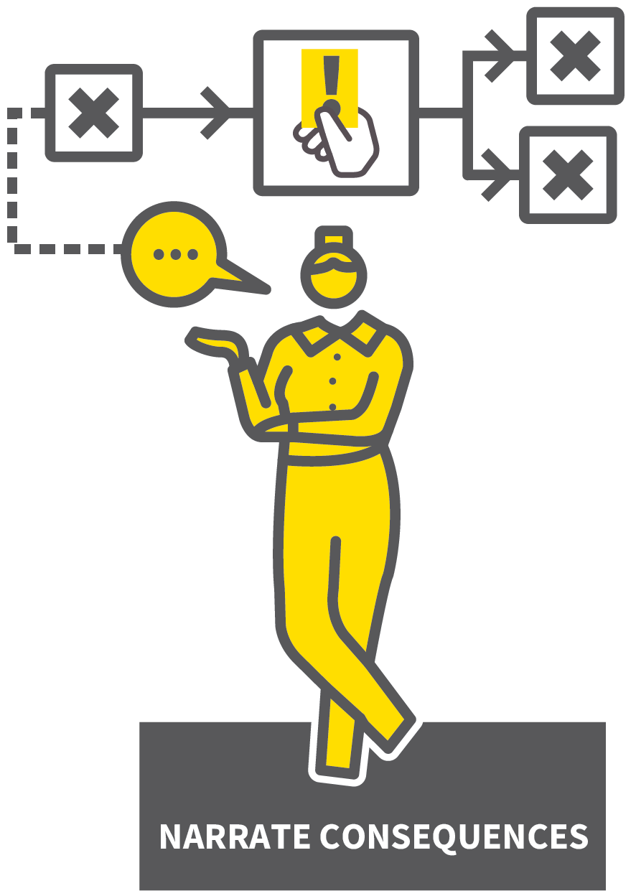
CHOICES &
CONSEQUENCES
SERIES
BEHAVIOUR & RELATIONSHIPS
1
ESTABLISH THE RANGE OF FORMAL CONSEQUENCES
2
USE ASSERTIVE CHOICE DIRECTION
3
NARRATE THE CONSEQUENCES
4
MAINTAIN THE PRINCIPLE OF CERTAINTY OVER SEVERITY
5
USE CONSEQUENCES JUDICIOUSLY

Slide 48
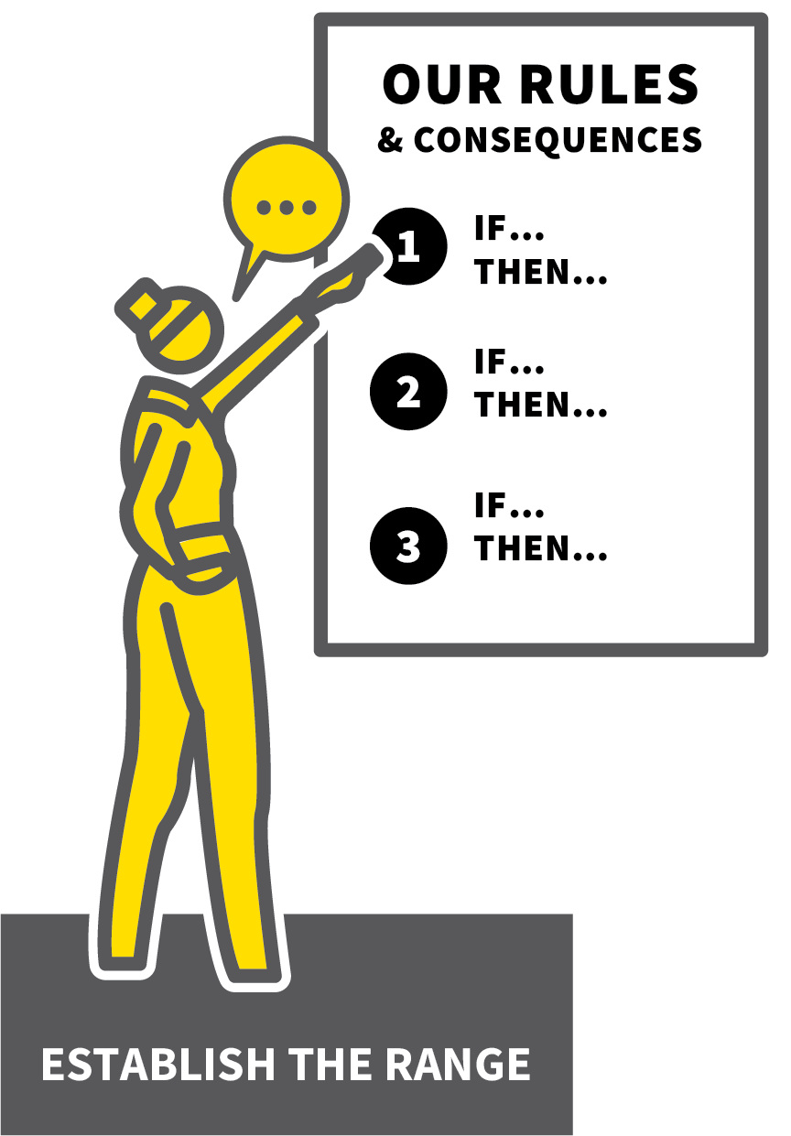
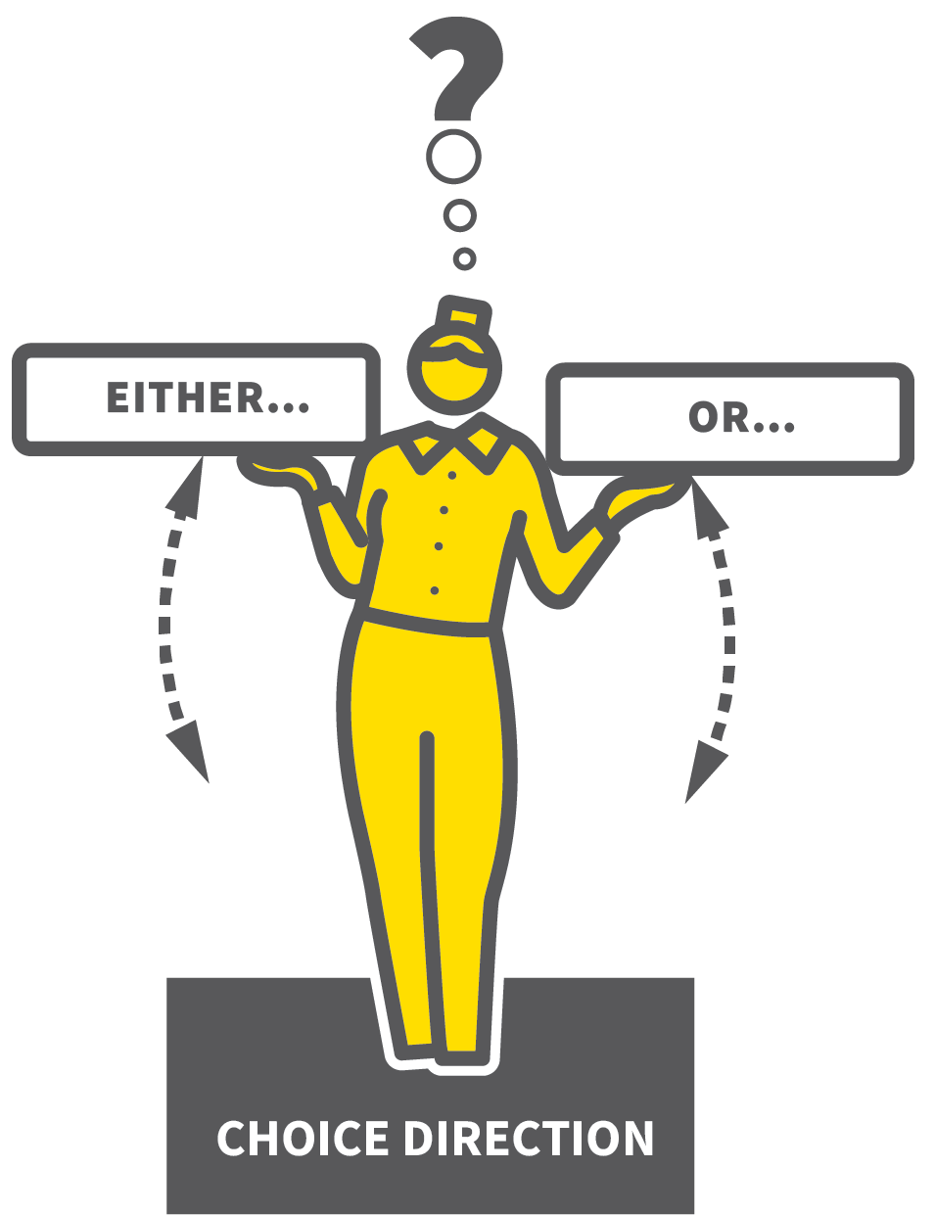

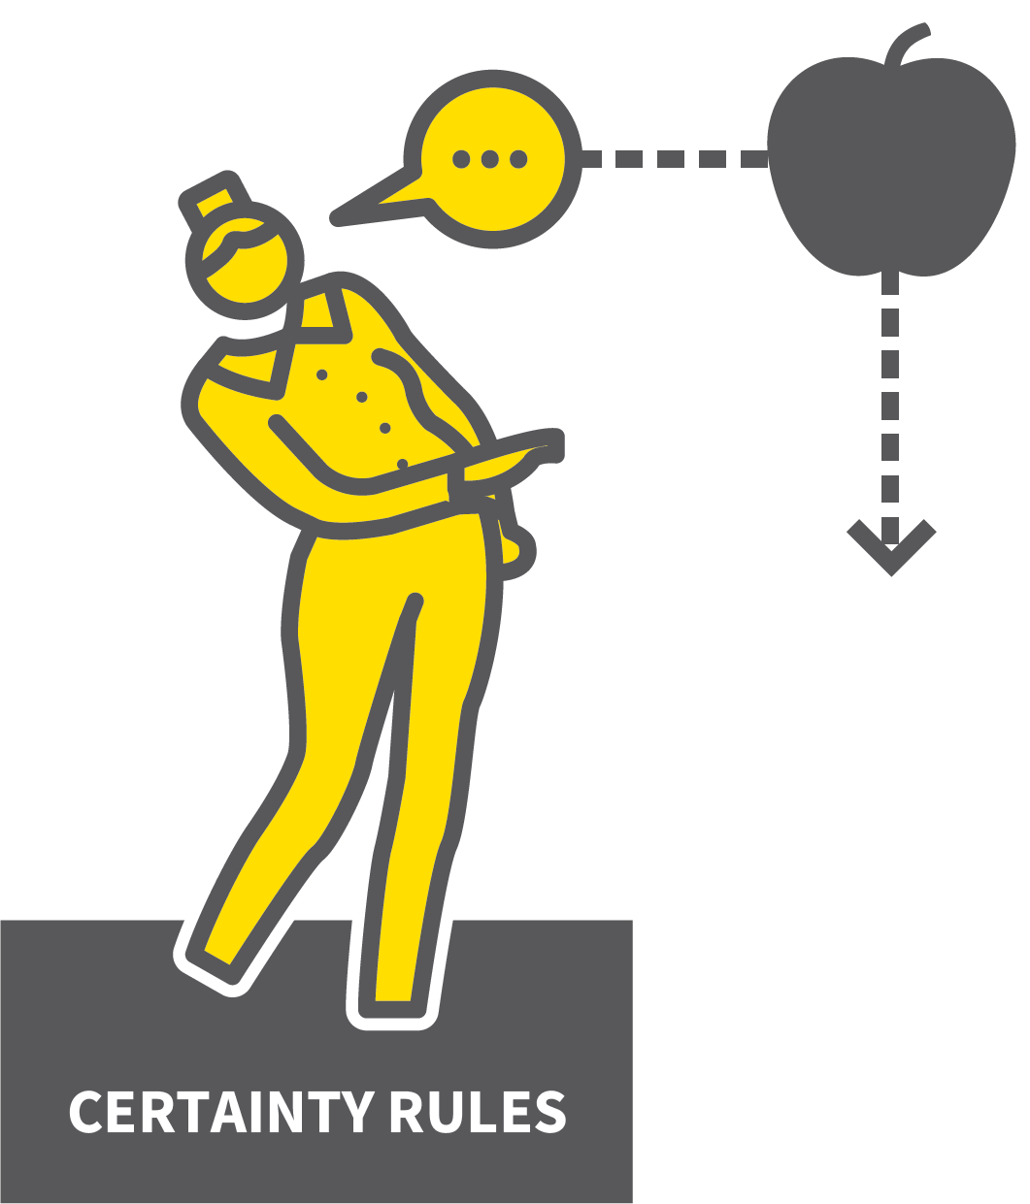
CHOICES & CONSEQUENCES
1
2
3
4
5
ESTABLISH THE RANGE OF FORMAL CONSEQUENCES
USE ASSERTIVE CHOICE DIRECTION
NARRATE THE CONSEQUENCES
MAINTAIN THE PRINCIPLE OF CERTAINTY OVER SEVERITY
USE CONSEQUENCES JUDICIOUSLY
In most settings, there will be a set of rules and agreed consequences for various levels of inappropriate behaviour.
Regardless of how strict a behaviour system might be, the teacher in the classroom has to use the system effectively to secure excellent behaviour.
Place the emphasis on students making the right choices in full knowledge of the consequences of the choices they make.

Slide 49
CHOICES & CONSEQUENCES
1
2
3
4
5
ESTABLISH THE RANGE OF FORMAL CONSEQUENCES
All students must know the range of
consequences.
Make it clear when any warnings will be given and the behaviours for which detentions or other consequences will be set.
Consequences for serious misdemeanours must be crystal clear.

Slide 50
CHOICES & CONSEQUENCES
1
2
3
4
5
USE ASSERTIVE CHOICE DIRECTION
The principle: if students choose to
misbehave, they choose to receive the
consequence.
Reinforce through the language of choice
direction:
“James, either face forwards, concentrating on your work, or do a detention.”
“Amira, either follow the safety rules or you will receive a call home.”

Slide 51
CHOICES & CONSEQUENCES
1
2
3
4
5
NARRATE THE CONSEQUENCES
When setting a consequence, explain why.
“Rachel, you’ve continued to talk after the warning, which disrupts our learning, so you now have a detention after school.”
“Sadiq, you have arrived late to class so that is an automatic demerit as you know.”

Slide 52
CHOICES & CONSEQUENCES
1
2
3
4
5
MAINTAIN THE PRINCIPLE OF CERTAINTY OVER SEVERITY
Students must all believe that certain
behaviours will definitely lead to
consequences; that detentions or other
consequences issued, will happen; that you mean what you say.
If consequences issued do not happen, it
undermines you.

Slide 53
CHOICES & CONSEQUENCES
1
2
3
4
5
USE CONSEQUENCES JUDICIOUSLY
Fairness is important so be as consistent as possible when giving consequences.
If you use consequences inconsistently,
it undermines you.
If you give out consequences too liberally,
it can create a negative culture.

Slide 54
CHOICES & CONSEQUENCES
1
2
3
4
5
ESTABLISH THE RANGE OF FORMAL CONSEQUENCES
USE ASSERTIVE CHOICE DIRECTION
NARRATE THE CONSEQUENCES
MAINTAIN THE PRINCIPLE OF CERTAINTY OVER SEVERITY
USE CONSEQUENCES JUDICIOUSLY
In most settings, there will be a set of rules and agreed consequences for various levels of inappropriate behaviour.
Regardless of how strict a behaviour system might be, the teacher in the classroom has to use the system effectively to secure excellent behaviour.
Place the emphasis on students making the right choices in full knowledge of the consequences of the choices they make.

