Slide 1
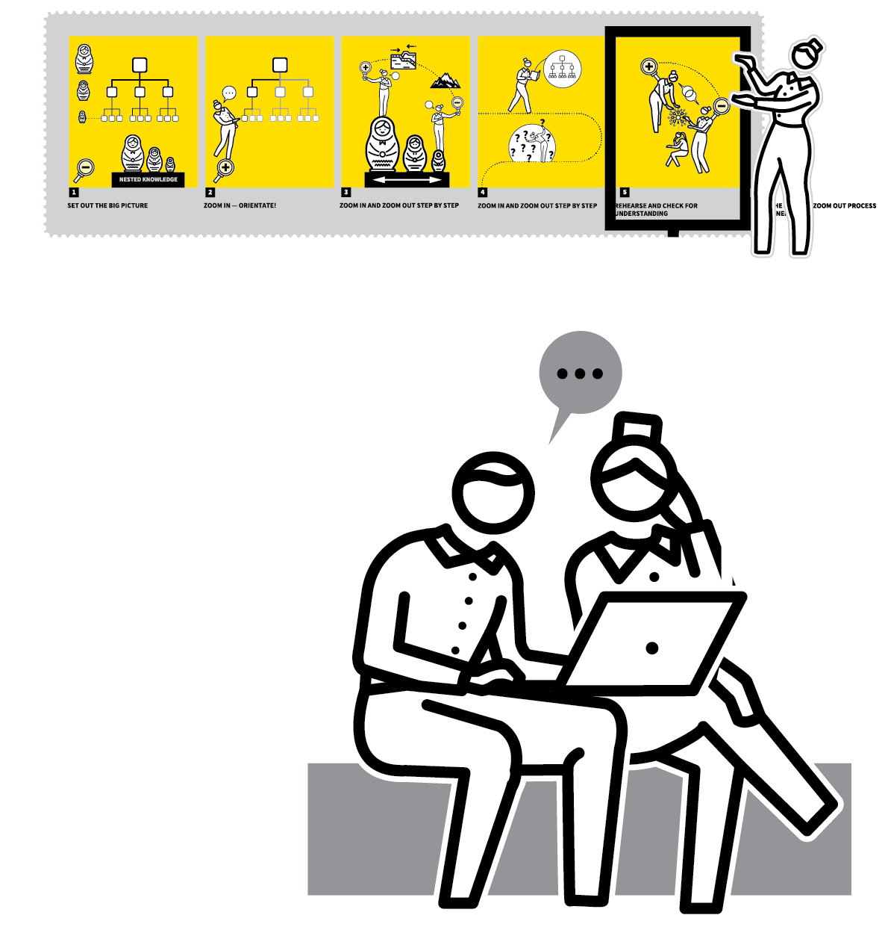
John Catt Educational
HOW?
TEACHING
WALKTHRUs
PRESENTATION
SLIDES
TOM SHERRINGTON & OLIVER CAVIGLIOLI
A | D | A | P | T
INSTRUCTIONAL COACHING
OBSERVATIONS
UNSEEN OBSERVATIONS
RUNNING CPD CYCLES
SOLVE THE LEARNING PROBLEMS

Slide 2
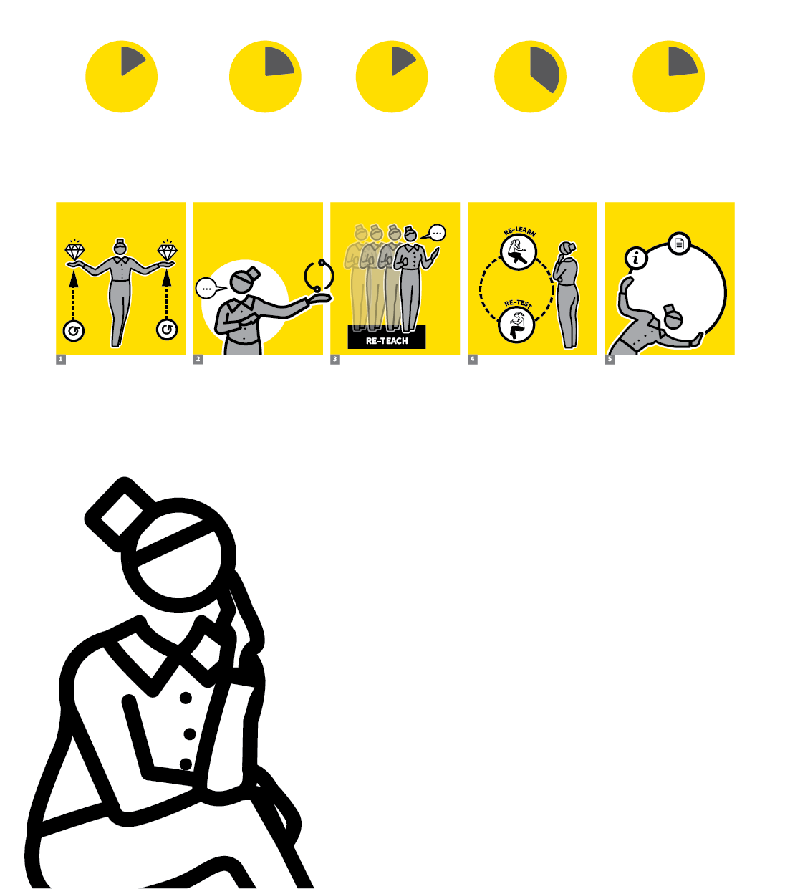

A | D | A | P | T
SECTION
HOW?
1
ATTEMPT
2
DEVELOP
3
ADAPT
4
PRACTISE
5
TEST

Slide 3
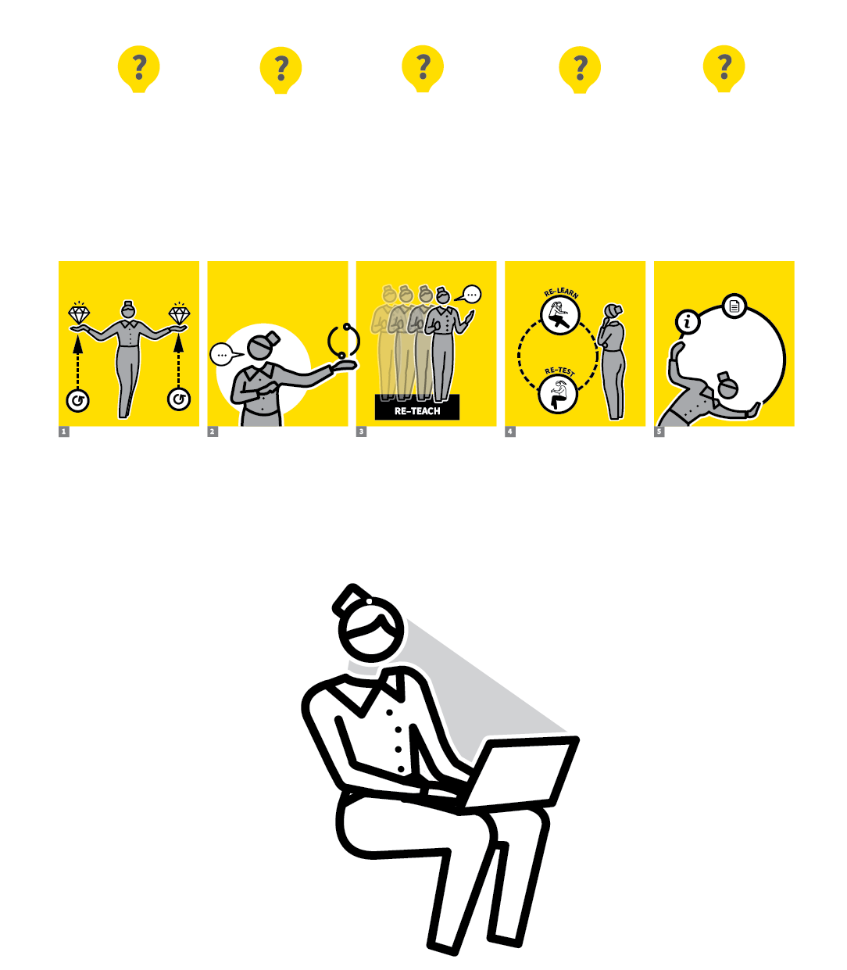

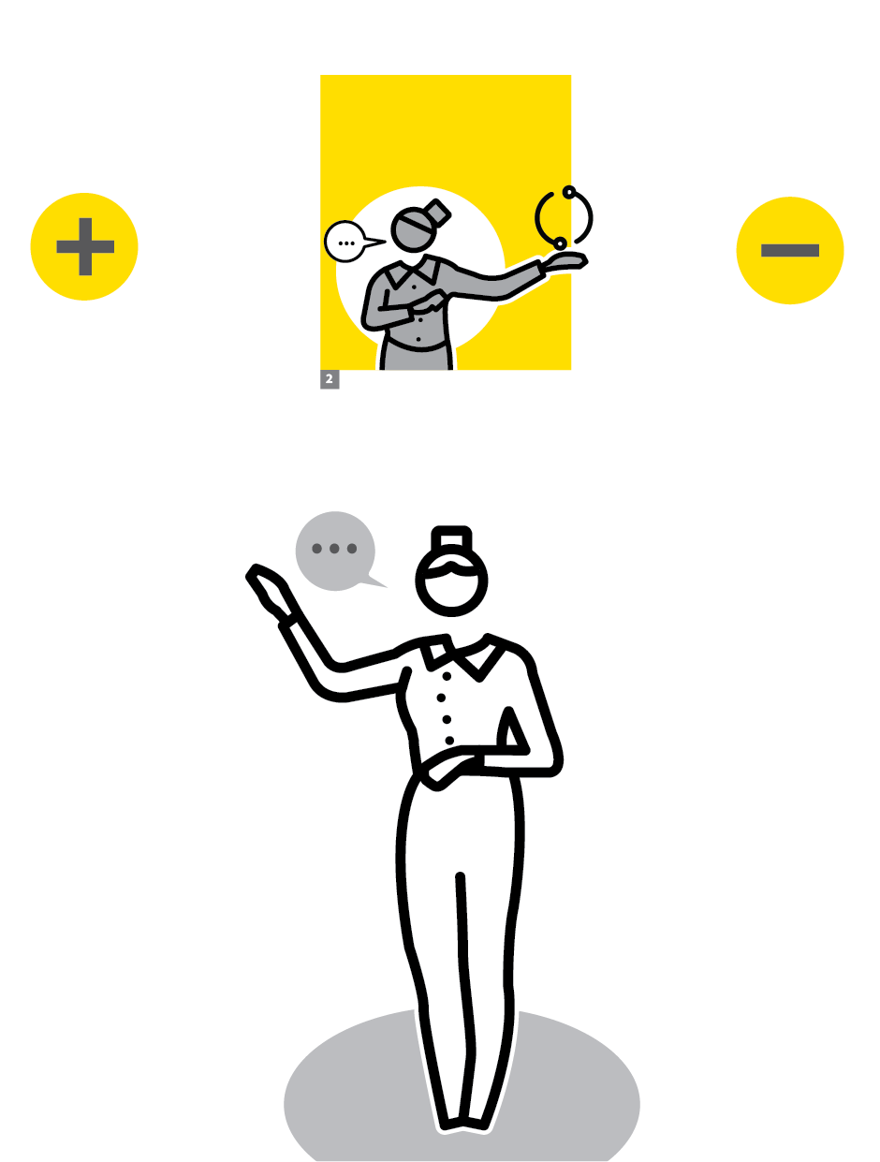
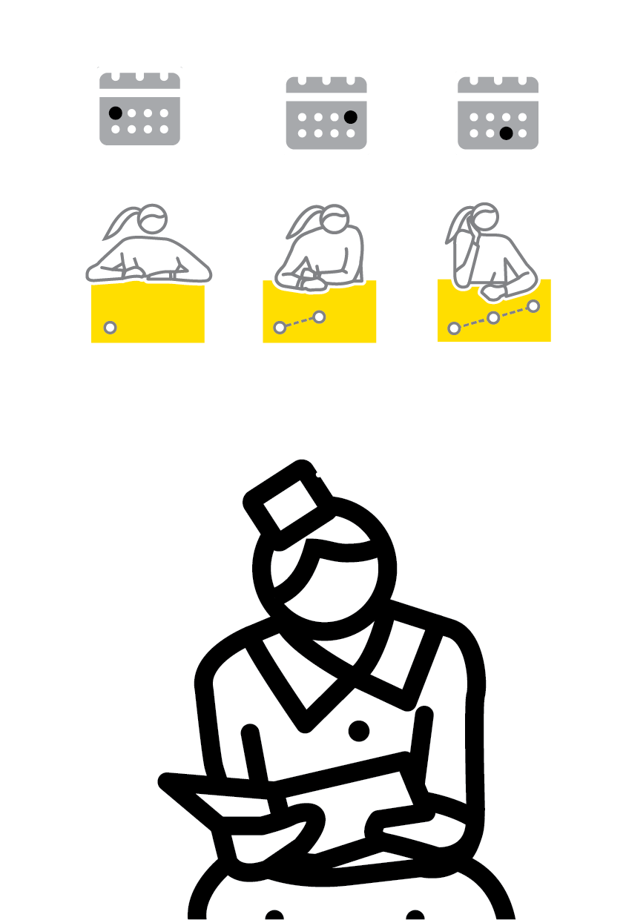

A | D | A | P | T
1
2
3
4
5
ATTEMPT
DEVELOP
ADAPT
PRACTISE
TEST
WalkThrus are designed to be deliberately generic and context free.
The intention is that teachers adapt them.
Our A|D|A|P|T approach is central to the concept of instructional coaching; taking ideas and applying them in context.
It is only ever a reference point for reflection or to support coaching and feedback discussions.

Slide 4
A | D | A | P | T
1
2
3
4
5
ATTEMPT
Run through the five steps and attempt to apply them to your context.
You might do this as a mental WalkThru
process; you might try it out in a real
classroom context to establish whether
the steps make sense.

Slide 5
A | D | A | P | T
1
2
3
4
5
DEVELOP
Add additional details to the steps so that they are more fine-grained:
more precise and more detailed
­— in relation to your subject content or the make-up of a specific class.

Slide 6
A | D | A | P | T
1
2
3
4
5
ADAPT
Change the WalkThru so that it works better for you.
Change the order; spend longer on certain steps than others; create more loops back to the beginning; link to other strategies more directly.
Call them different names.

Slide 7
A | D | A | P | T
1
2
3
4
5
PRACTISE
Put your adapted WalkThru into action.
If you are going to embed it into your routine practice, you will need to practise the steps, evaluating their success as you go.

Slide 8
A | D | A | P | T
1
2
3
4
5
TEST
To evaluate your impact you may gain
insights from your subjective sense of how things feel.
For a more rigorous analysis you will also need to test it in a systematic, objective manner.
The quality of student work?
Outcomes of assessments?

Slide 9
A | D | A | P | T
1
2
3
4
5
ATTEMPT
DEVELOP
ADAPT
PRACTISE
TEST
WalkThrus are designed to be deliberately generic and context free.
The intention is that teachers adapt them.
Our A|D|A|P|T approach is central to the concept of instructional coaching; taking ideas and applying them in context.
It is only ever a reference point for reflection or to support coaching and feedback discussions.

Slide 10

1
2
3
4
5
6
A|D|A|P|T
INSTRUCTIONAL
COACHING
OBSERVATIONS
UNSEEN
OBSERVATIONS
RUNNING
CPD CYCLES
SOLVE THE
LEARNING
PROBLEMS
NEXT UP
INSTRUCTIONAL
COACHING

Slide 11
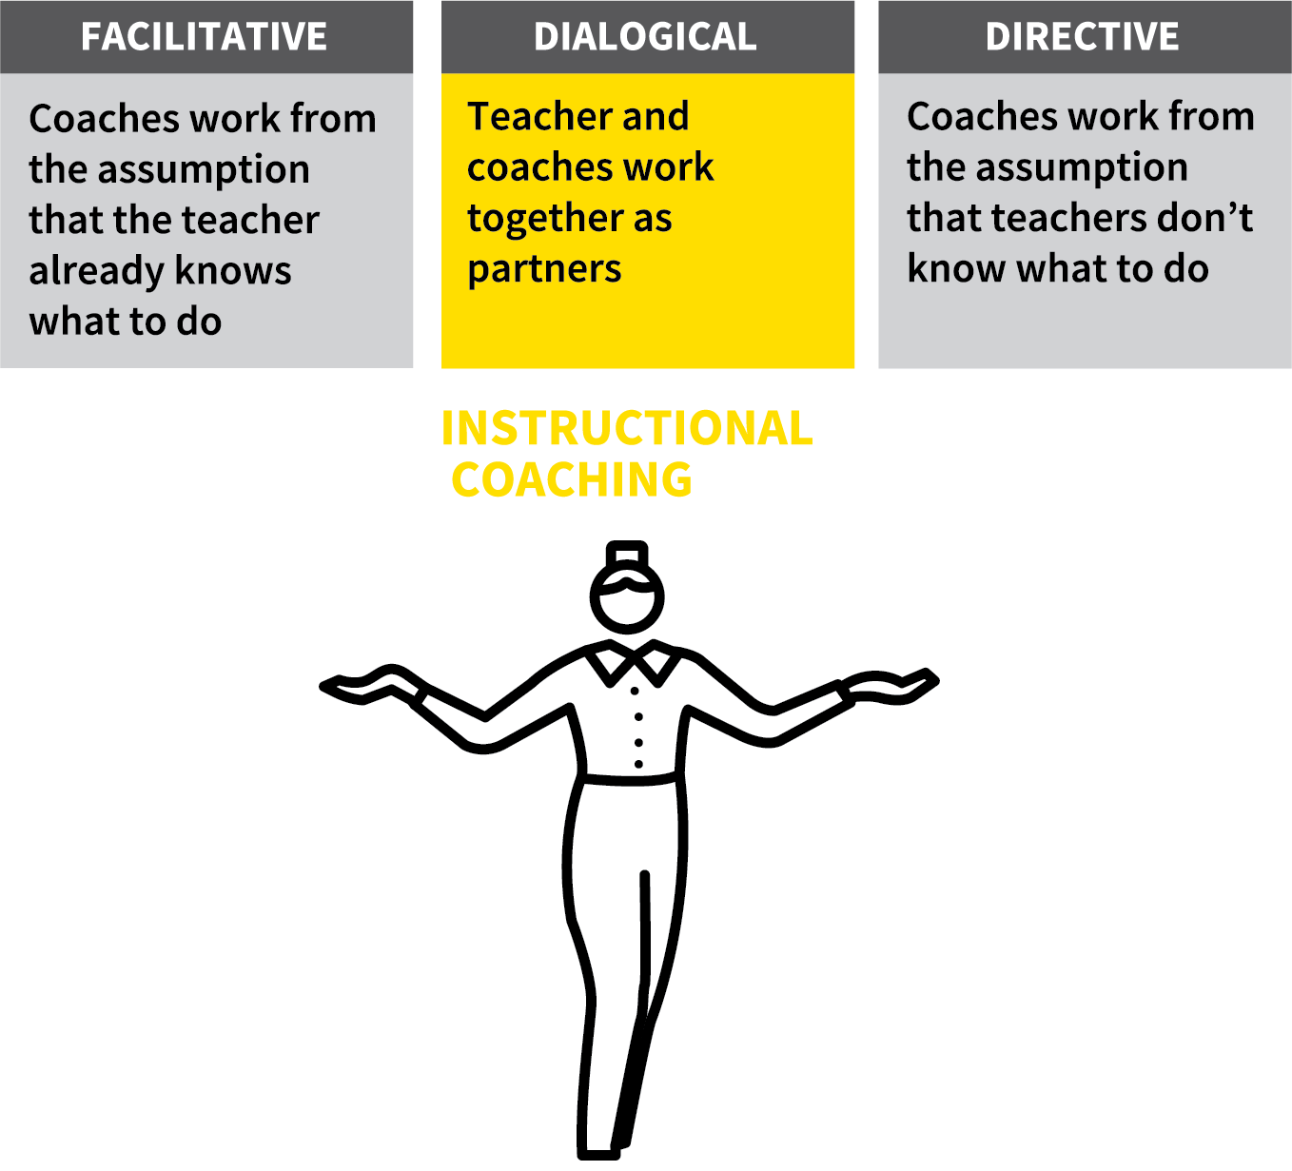
INSTRUCTIONAL COACHING
SECTION
HOW?
1
THE RESEARCH CASE
2
THE APPROACH
3
THE ORIGINS
4
INSTRUCTIONAL COACHES
5
THE WALKTHRU FIT

Slide 12

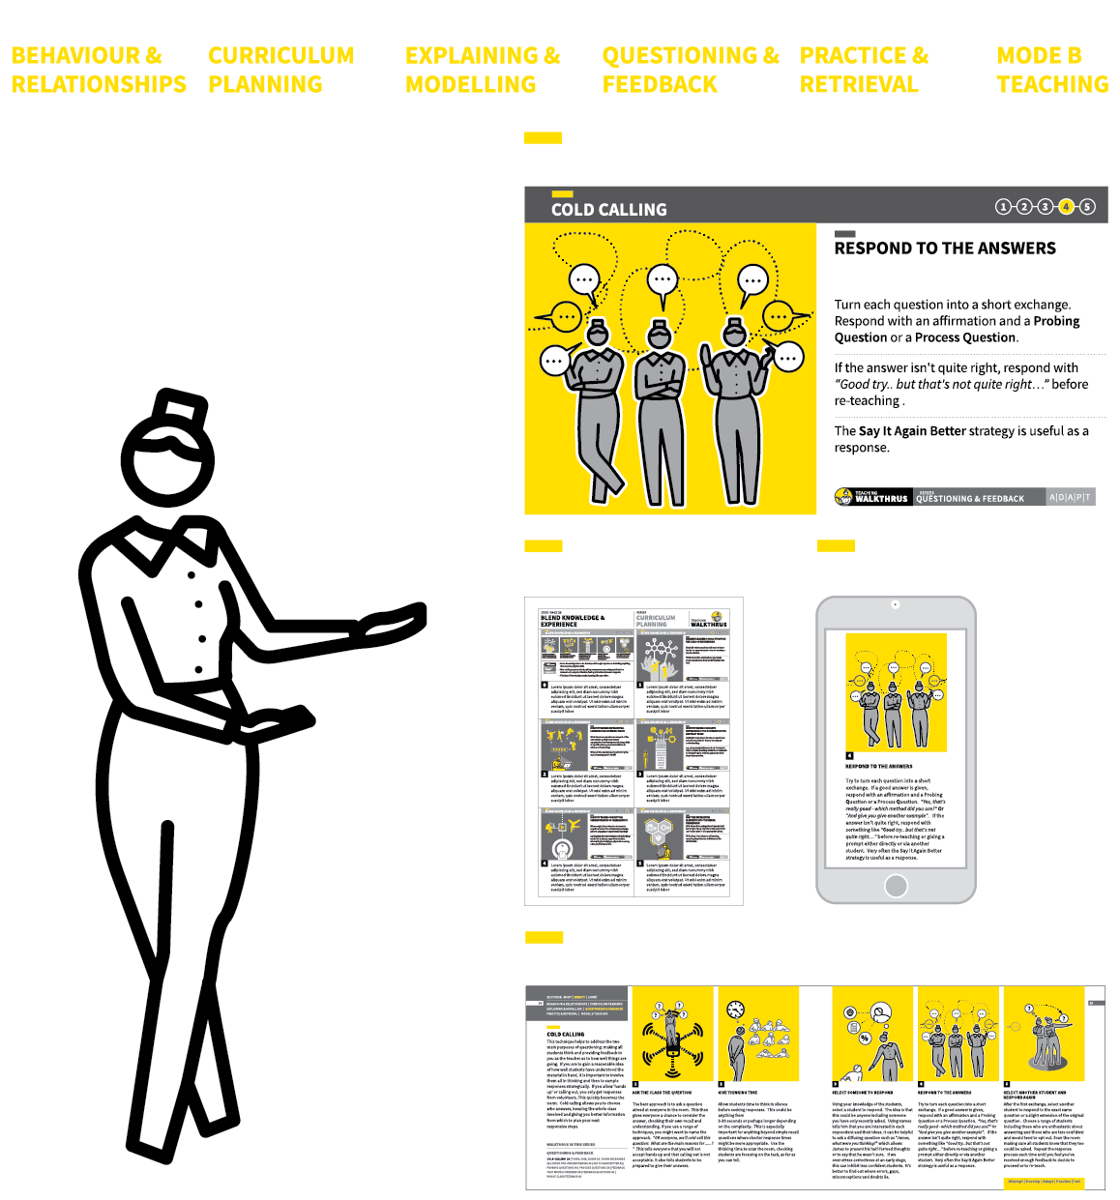
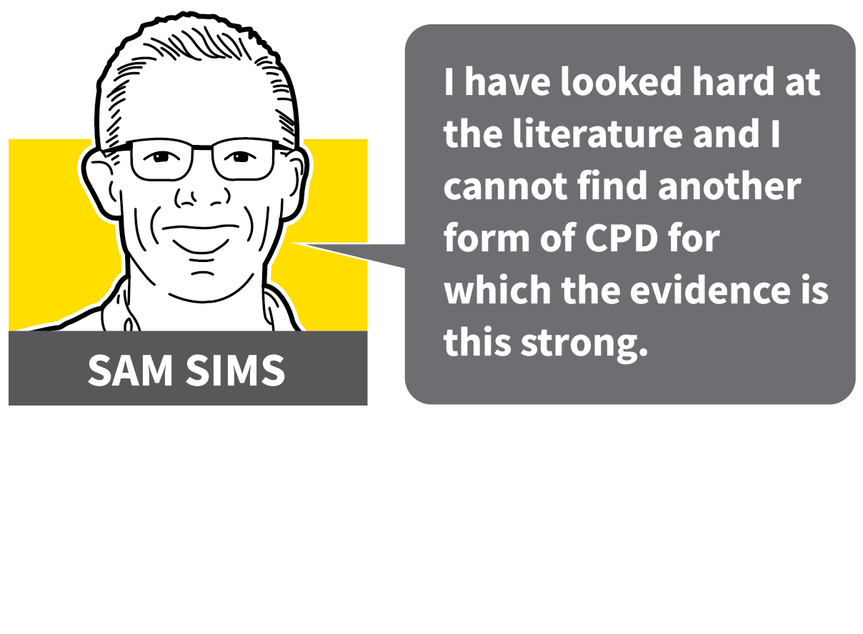
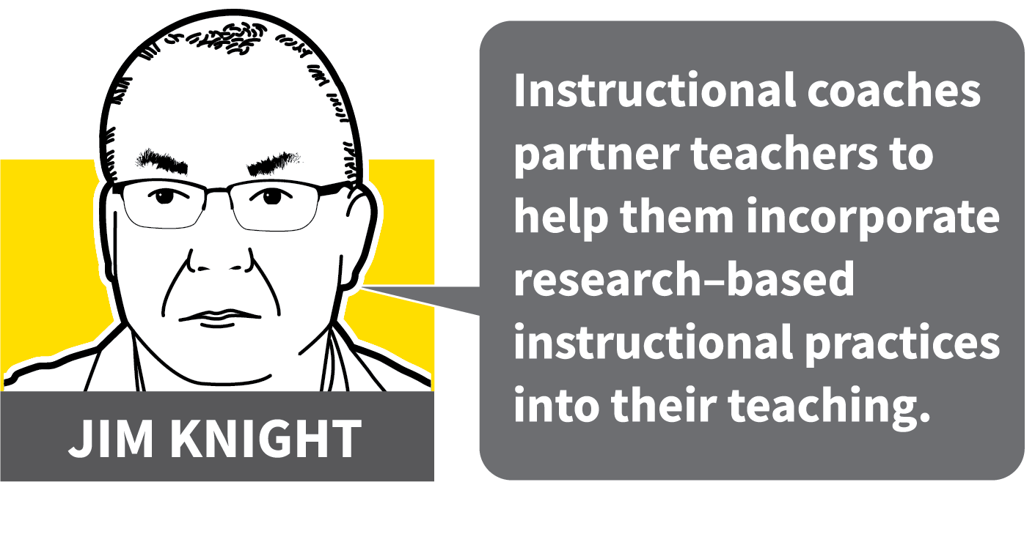
INSTRUCTIONAL COACHING
1
2
3
4
5
THE RESEARCH CASE
THE APPROACH
THE ORIGINS
INSTRUCTIONAL COACHES
THE WALKTHRU FIT
The limitations of the life coaching model for classroom teachers has been recognised by teachers and researchers.
Instructional Coaching starts from the premise that the coach has technical knowledge to improve the skills of the teacher being coached.
This process involves communicating such knowledge. WalkThrus do this very effectively and avoid teachers wasting time in reinventing the wheel.

Slide 13
INSTRUCTIONAL COACHING
1
2
3
4
5
THE RESEARCH CASE
Strength 1: Evidence from replicated randomised controlled trials
Strength 2: Evidence from meta-analysis
Strength 3: Evidence from A-B testing
Strength 4: Evidence from systematic research programmes

Slide 14
INSTRUCTIONAL COACHING
1
2
3
4
5
THE APPROACH
The life coaching model has predominated. But it’s been shown to have less impact than marketed — notably in skill development.
To adopt the sports coaching model lessens the important area of teacher agency.
Instructional coaching combines the benefits of both: teacher agency and expert technical knowledge.

Slide 15
INSTRUCTIONAL COACHING
1
2
3
4
5
THE ORIGINS
Jim Knight has been working with schools, using Instructional Coaching, for over twenty years. He is a global leader in this area.
The hallmark of Instructional Coaching is the high level of knowledge and practical skill of the coach.
Instructional coaches transfer research into classroom strategies. They read the evidence and demonstrate the techniques.

Slide 16
INSTRUCTIONAL COACHING
1
2
3
4
5
INSTRUCTIONAL COACHES
Instructional Coaches “run the risk of being inefficient if they don’t have a repertoire of effective practices to share with teachers” warns Jim Knight.
Additionally, they should prepare “one-page summaries of the teaching practices they share to make it easier for people to learn quickly”.
To achieve this, they should “read, reread, and read again the instructors’ manuals or research articles about the interventions”.

Slide 17
INSTRUCTIONAL COACHING
1
2
3
4
5
THE WALKTHRU FIT
With Jim Knight’s words ringing in our ears, we have created what Instructional Coaches need and avoid them reinventing the wheel.
Both teachers and coaches can have ready access to easy-to-understand information in book and digital visual formats.
Trainers can also use trainer notes to support them as they use the WalkThru presentation slides for in-house training sessions.

Slide 18
INSTRUCTIONAL COACHING
1
2
3
4
5
THE RESEARCH CASE
THE APPROACH
THE ORIGINS
INSTRUCTIONAL COACHES
THE WALKTHRU FIT
The limitations of the life coaching model for classroom teachers has been recognised by teachers and researchers.
Instructional Coaching starts from the premise that the coach has technical knowledge to improve the skills of the teacher being coached.
This process involves communicating such knowledge. WalkThrus do this very effectively and avoid teachers wasting time in reinventing the wheel.

Slide 19
1
2
3
4
5
6
A|D|A|P|T
INSTRUCTIONAL
COACHING
OBSERVATIONS
UNSEEN
OBSERVATIONS
RUNNING
CPD CYCLES
SOLVE THE
LEARNING
PROBLEMS
NEXT UP
OBSERVATIONS

Slide 20
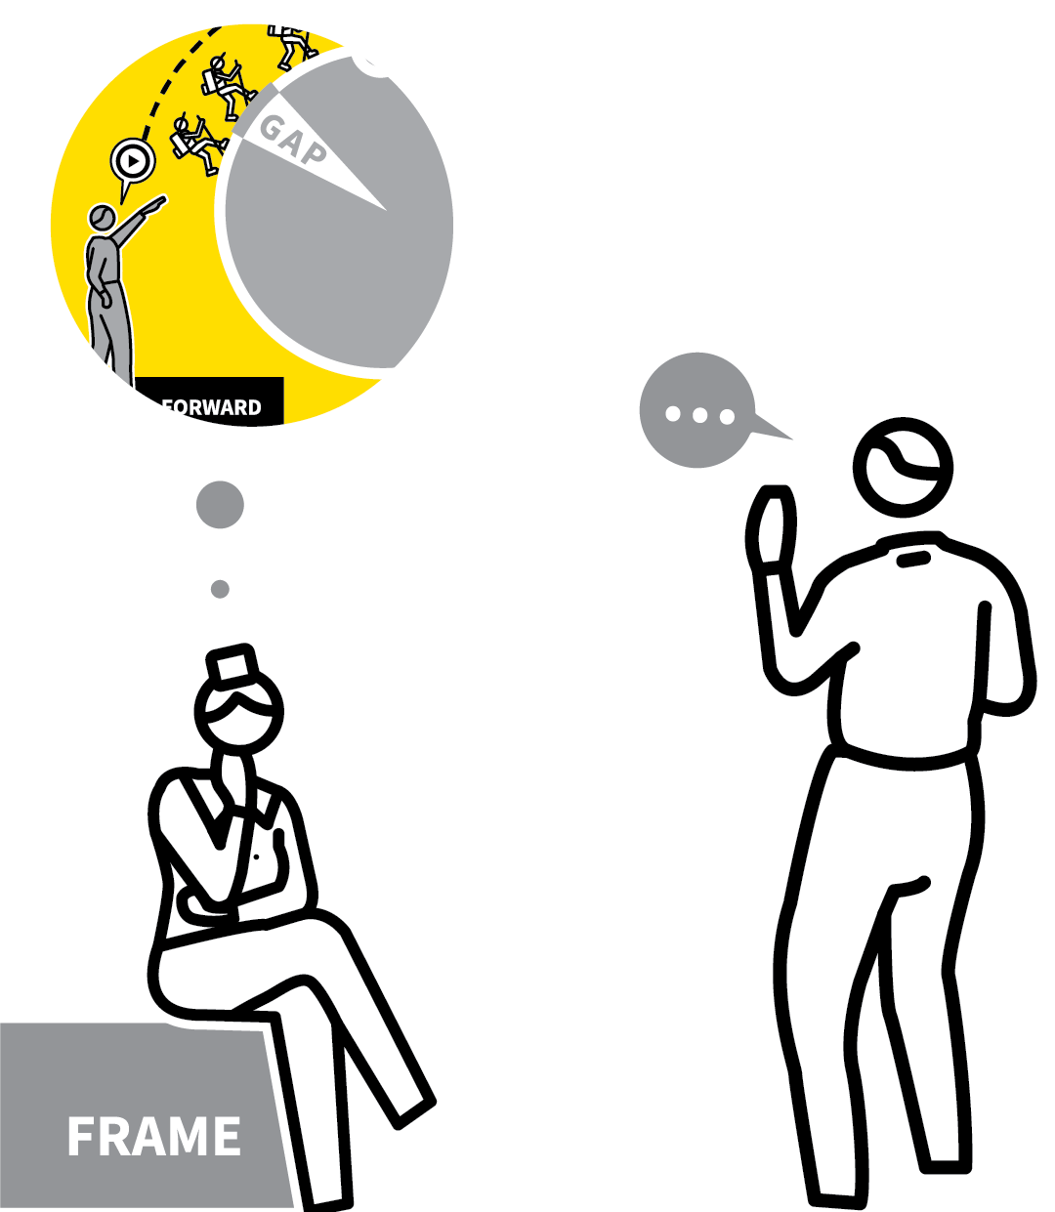
OBSERVATIONS
SECTION
HOW?
1
SELECT A WALKTHRU
2
TALK THROUGH THE WALKTHRU
3
OBSERVE THROUGH THE FRAME OF THE WALKTHRU
4
REVIEW WITH THREE POINT COMMUNICATION
5
PLAN AND AGREE NEXT MOVES

Slide 21
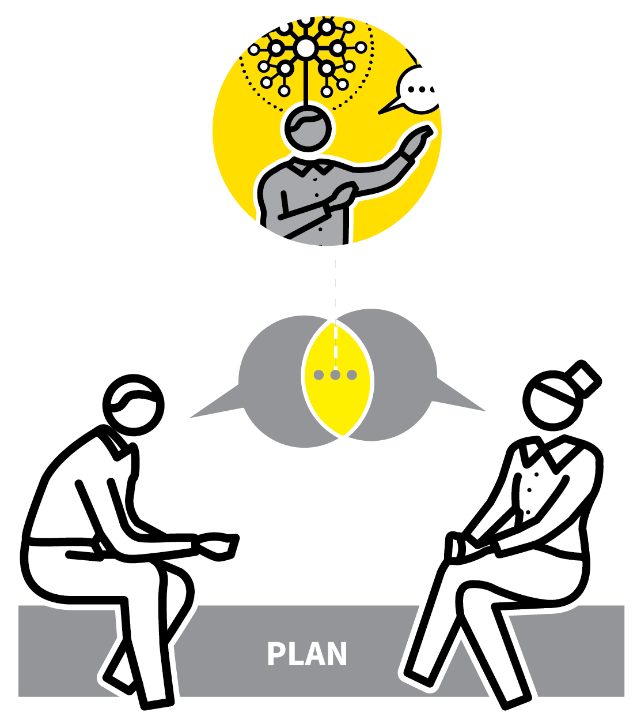

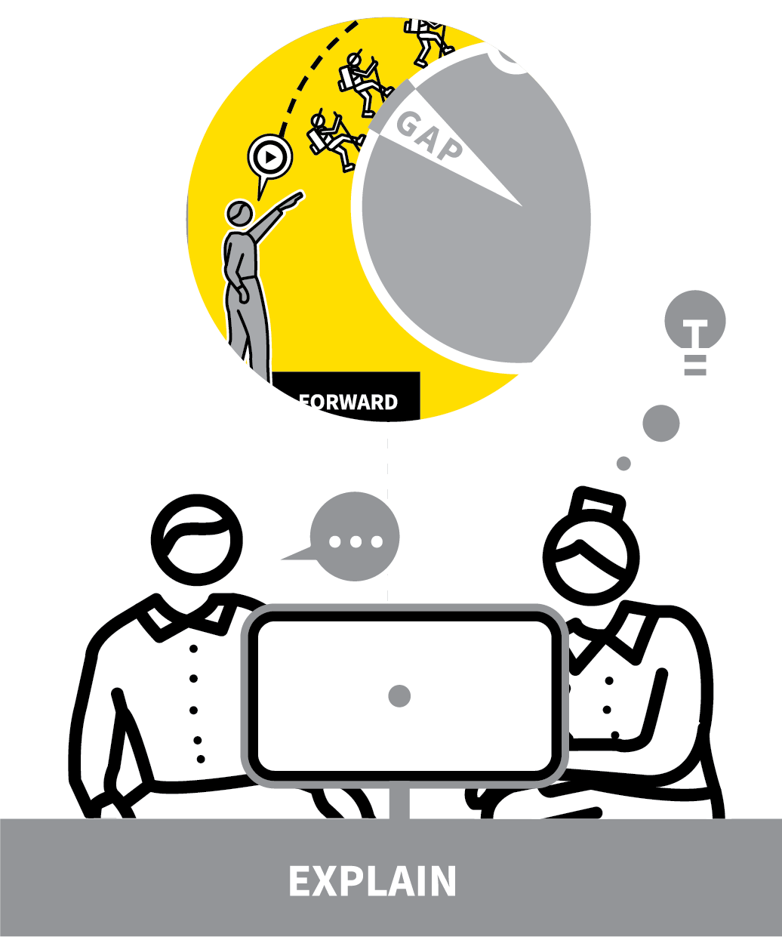
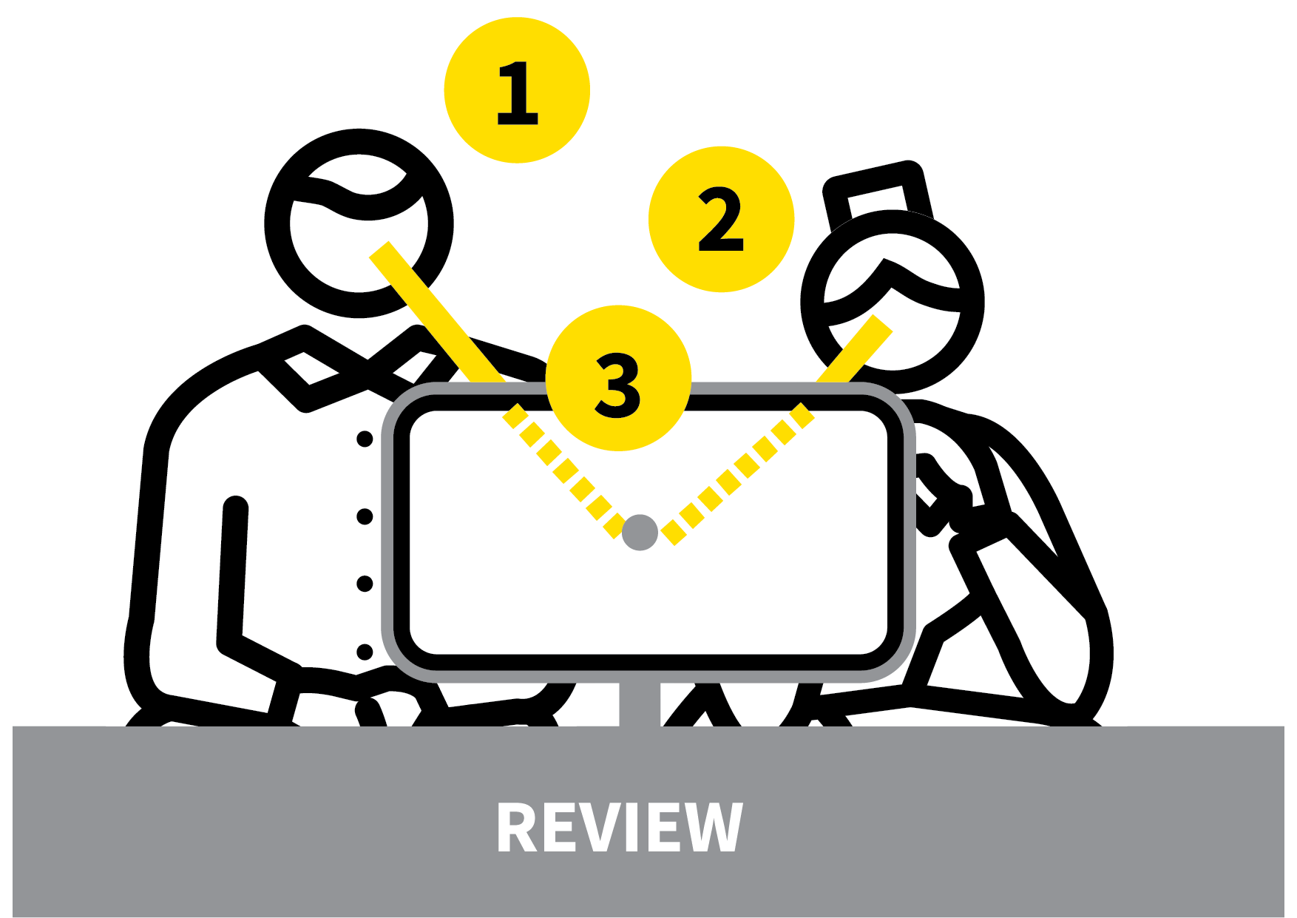
OBSERVATIONS
1
2
3
4
5
SELECT A WALKTHRU
TALK THROUGH THE WALKTHRU
OBSERVE THROUGH THE FRAME OF THE WALKTHRU
REVIEW WITH THREE POINT COMMUNICATION
PLAN AND AGREE NEXT MOVES
Being coached is an act of faith — trust is paramount.
The building of a shared understanding of the selected WalkThru with teacher and observer is critical for coaching success.
In the process of studying and explaining the technique step by step, the teacher rapidly learns to internalise the actions needed for success.
Familiarity builds from the very first glance.

Slide 22
OBSERVATIONS
1
2
3
4
5
SELECT A WALKTHRU
Select a WalkThru.
Reading through and selecting a WalkThru positively advances your learning.
Looking and imagining yourself walking through the steps helps assimilate the
information in body and mind.
This ‘embodied cognition’ helps in learning a new skill.

Slide 23
OBSERVATIONS
1
2
3
4
5
TALK THROUGH THE WALKTHRU
As you explain your choice of technique to your coach, you explain it in your own words, furthering your familiarity
Your coach observer — respecting your choice — becomes more familiar with its details.
Arriving at this shared understanding
reinforces your learning and gives confidence that the observation will be framed through this sequence.

Slide 24
OBSERVATIONS
1
2
3
4
5
OBSERVE THROUGH THE FRAME OF THE WALKTHRU
As you execute the technique, you have
reassurance that your observer will be
viewing the scene and your actions through the frame of your selected WalkThru.
There will be no surprise ‘gotcha!’ moments.
Your coach has their perceptions shaped in a behavioural structure; you can expect precise and concrete feedback that directly relates to the five steps.

Slide 25
OBSERVATIONS
1
2
3
4
5
REVIEW WITH THREE POINT COMMUNICATION
With the WalkThru placed in front of you both, you and your coach observer sit side by side, not face to face.
This allows the coach to make their feedback directly to the WalkThru, not to your face, putting distance between them, the messenger, and their message.
Three Point Communication maintains an
objective perspective; keeping the accent on the teaching not the teacher.

Slide 26
OBSERVATIONS
1
2
3
4
5
PLAN AND AGREE NEXT MOVES
You and your coach may continue working on the specific skill of this WalkThru. In this case, you will design adaptations based on the feedback, and prepare to be ready for the next observation and feedback cycle.
Or, you may decide to move onto a new
WalkThru, in which case you repeat the
process once more.
In general, there will be several cycles as you fine-tune your execution and move the skill rapidly into automatic mode.

Slide 27
OBSERVATIONS
1
2
3
4
5
SELECT A WALKTHRU
TALK THROUGH THE WALKTHRU
OBSERVE THROUGH THE FRAME OF THE WALKTHRU
REVIEW WITH THREE POINT COMMUNICATION
PLAN AND AGREE NEXT MOVES
Being coached is an act of faith — trust is paramount.
The building of a shared understanding of the selected WalkThru with teacher and observer is critical for coaching success.
In the process of studying and explaining the technique step by step, the teacher rapidly learns to internalise the actions needed for success.
Familiarity builds from the very first glance.

Slide 28
1
2
3
4
5
6
A|D|A|P|T
INSTRUCTIONAL
COACHING
OBSERVATIONS
UNSEEN
OBSERVATIONS
RUNNING
CPD CYCLES
SOLVE THE
LEARNING
PROBLEMS
NEXT UP
UNSEEN
OBSERVATIONS

Slide 29
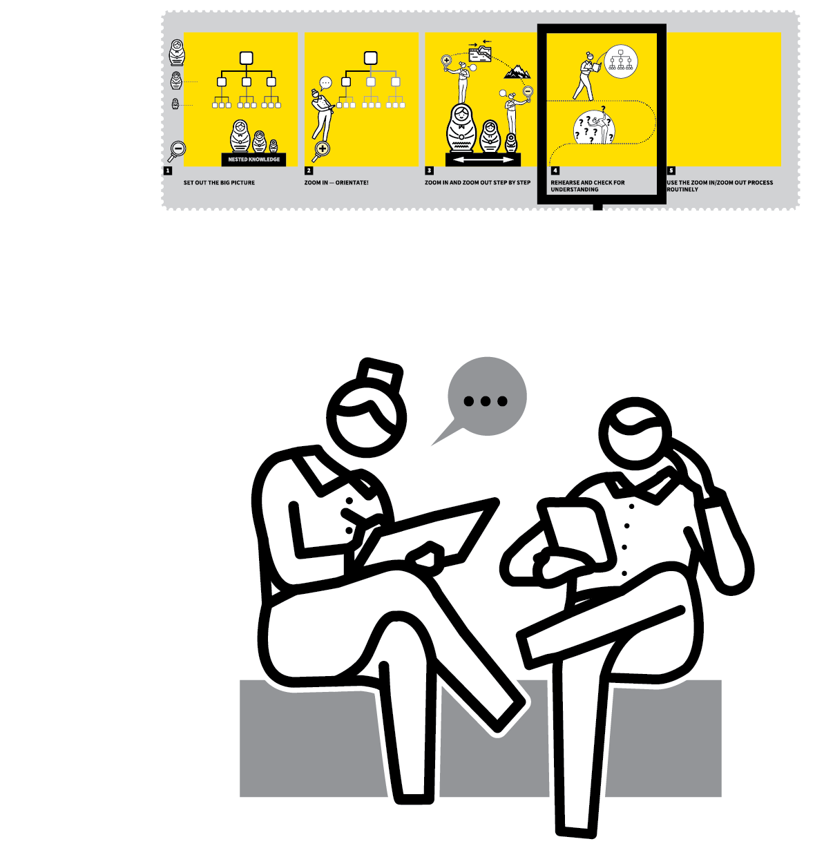
UNSEEN OBSERVATIONS
SECTION
HOW?
1
AGREE A WALKTHRU WITH A PARTNER
2
TALK THROUGH YOUR CONTEXT FOR THE WALKTHRU
3
EXECUTE YOUR WALKTHRU PLANS — UNSEEN BY AN OBSERVER
4
REVIEW, WITH PARTNER, YOUR EXECUTION OF THE WALKTHRU
5
PLAN FURTHER ADAPTATIONS BASED ON YOUR REFLECTION AND DISCUSSIONS

Slide 30

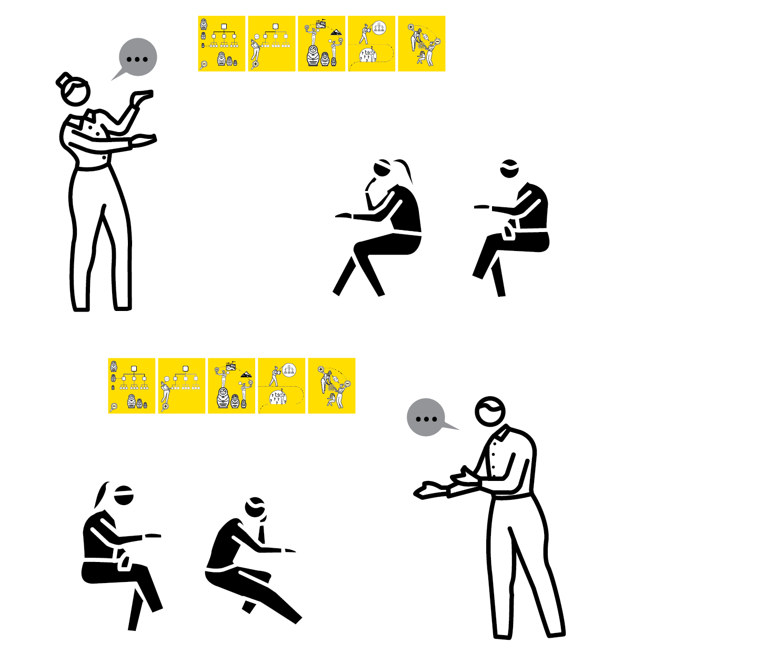
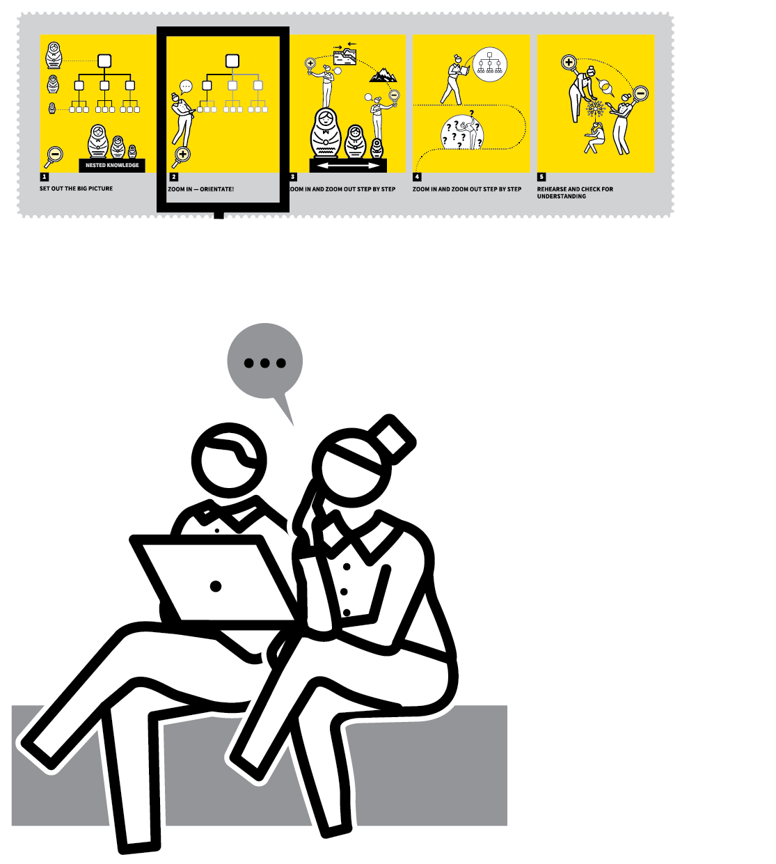
UNSEEN OBSERVATIONS
1
2
3
4
5
AGREE A WALKTHRU WITH A PARTNER
TALK THROUGH YOUR CONTEXT FOR THE WALKTHRU
EXECUTE YOUR WALKTHRU PLANS — UNSEEN BY AN OBSERVER
REVIEW, WITH PARTNER, YOUR EXECUTION OF THE WALKTHRU
PLAN FURTHER ADAPTATIONS BASED ON YOUR REFLECTION AND DISCUSSIONS
Researcher Matt O’Leary created Unseen Observations as he was acutely aware of how observers alter the dynamics of a classroom.
All the important features of observations take place — planning, discussing, reviewing and back to planning — but without an observer present.
Teachers plan and review anytime before and after the targeted lesson, often at the start and end of a normal teaching day.

Slide 31
UNSEEN OBSERVATIONS
1
2
3
4
5
AGREE A WALKTHRU WITH A PARTNER
Select a WalkThru technique you both want to learn. Your colleague doesn’t have to teach the same subject or age phase.
Read through the WalkThru several times,
imagining yourself in the place of the
illustrated teacher figures.
Acknowledge that this is your first rehearsal, albeit an internal, mental one.

Slide 32
UNSEEN OBSERVATIONS
1
2
3
4
5
TALK THROUGH YOUR CONTEXT FOR THE WALKTHRU
When meeting up — maybe on the morning of the Unseen Observation — talk through the A | D | A | P | T process.
Explain any small changes you’ve thought of. Similarly, listen to your colleague’s
explanations and question the reasoning if you think it helpful.
Meet at the end of the day for a review of how the WalkThru went.

Slide 33
UNSEEN OBSERVATIONS
1
2
3
4
5
EXECUTE YOUR WALKTHRU PLANS — UNSEEN BY AN OBSERVER
Have a normal teaching day.
At the lesson you have targeted to trial the WalkThru technique, simply execute the five steps you have already studied and mentally rehearsed.

Slide 34
UNSEEN OBSERVATIONS
1
2
3
4
5
REVIEW, WITH PARTNER, YOUR EXECUTION OF THE WALKTHRU
Meet your colleague and each talk through the WalkThru and its execution.
Compare your anticipated impact — including the contextual tweaks — with what actually happened.
Explore these discrepancies to highlight any faulty reasoning in your plans.
Use the behavioural descriptors and visuals of the WalkThru to frame the conversation around actions and how they can be specifically improved.

Slide 35
UNSEEN OBSERVATIONS
1
2
3
4
5
PLAN FURTHER ADAPTATIONS BASED ON YOUR REFLECTION AND DISCUSSIONS
When both of you have reviewed your WalkThru execution, focus on co-planning
improvements.
Use what you learn from your evaluation of your previous planning and its execution to highlight areas that could benefit from some amendments.
These will form the basis of your next Unseen Observation, maybe in the following week.

Slide 36
UNSEEN OBSERVATIONS
1
2
3
4
5
AGREE A WALKTHRU WITH A PARTNER
TALK THROUGH YOUR CONTEXT FOR THE WALKTHRU
EXECUTE YOUR WALKTHRU PLANS — UNSEEN BY AN OBSERVER
REVIEW, WITH PARTNER, YOUR EXECUTION OF THE WALKTHRU
PLAN FURTHER ADAPTATIONS BASED ON YOUR REFLECTION AND DISCUSSIONS
Researcher Matt O’Leary created Unseen Observations as he was acutely aware of how observers alter the dynamics of a classroom.
All the important features of observations take place — planning, discussing, reviewing and back to planning — but without an observer present.
Teachers plan and review anytime before and after the targeted lesson, often at the start and end of a normal teaching day.

Slide 37
1
2
3
4
5
6
A|D|A|P|T
INSTRUCTIONAL
COACHING
OBSERVATIONS
UNSEEN
OBSERVATIONS
RUNNING
CPD CYCLES
SOLVE THE
LEARNING
PROBLEMS
NEXT UP
RUNNING
CPD CYCLES

Slide 38

RUNNING
CPD CYCLES
SECTION
HOW?
1
MAP OUT THE CYCLES
2
IDENTIFY PRIORITIES BASED ON STUDENTS' NEEDS
3
REFLECT AND REVIEW
4
DELIVER INPUTS: SEEK EVIDENCE; MODEL STRATEGIES
5
PLAN NEXT STEPS

Slide 39

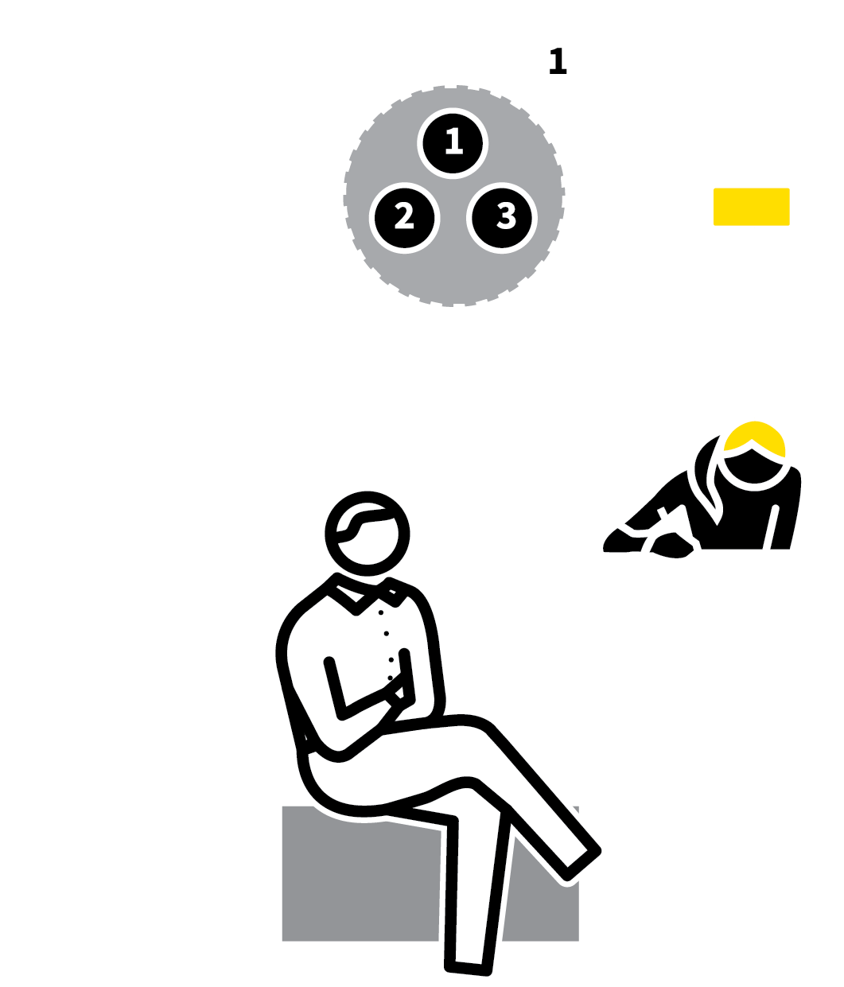

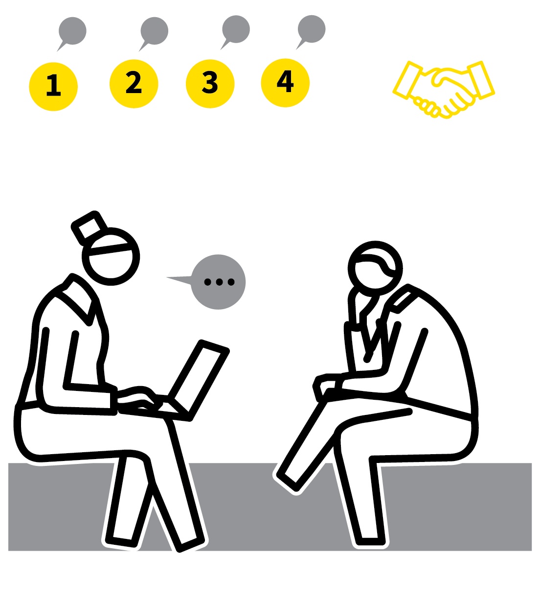
RUNNING CPD CYCLES
1
2
3
4
5
MAP OUT THE CYCLES
IDENTIFY PRIORITIES BASED ON STUDENTS’ NEEDS
REFLECT AND REVIEW
DELIVER INPUTS: SEEK EVIDENCE; MODEL STRATEGIES
PLAN NEXT STEPS
The research into effective professional learning supports the importance of having a rhythm of regular sessions, ideally with an iterative cyclical structure.
This allows: reflection on problems and successes; exploration of new ideas and strategies; action planning for the next cycle.
It’s important for strategies to be supported by a conceptual model so the reasons for them are understood.

Slide 40
RUNNING CPD CYCLES
1
2
3
4
5
MAP OUT THE CYCLES
Map out when each session will take place so everyone can visualise successive cycles of review, input and action planning.
In any session it is important to know when the next one will be so that participants can put a timeframe around their professional learning process.
Without this, sessions can fall into the ‘hit and hope’ trap reducing their impact.

Slide 41
RUNNING CPD CYCLES
1
2
3
4
5
IDENTIFY PRIORITIES BASED ON STUDENTS’ NEEDS
Focus activities around the learning challenges that students face, rather than teachers’ preferences and personal needs, in order to maximise the impact.
Use assessment information to highlight the key curriculum areas where groups of
individuals experience challenges.
During sessions keep focused on how to
address those specific problems.

Slide 42
RUNNING CPD CYCLES
1
2
3
4
5
REFLECT AND REVIEW
Begin each session reviewing progress since the last one, discussing in pairs or trios, allowing everyone to contribute.
Identify where improvements are being made and air ongoing challenges.
Sharing both elements helps teachers with problem-solving thinking, gaining peer
support through shared experience.
The spirit of this process should be open and honest.

Slide 43
RUNNING CPD CYCLES
1
2
3
4
5
DELIVER INPUTS: SEEK EVIDENCE; MODEL STRATEGIES
Useful new learning in a CPD session will have these features:
Relevance to the learning challenges teachers are seeking to tackle.
An evidence base from research or
assessment information.
Active modelling, putting strategies in the
context people are working in.
Opportunities to debate, question and
challenge.

Slide 44
RUNNING CPD CYCLES
1
2
3
4
5
PLAN NEXT STEPS
Before each session ends, teachers should consider their next steps.
Make a commitment to this so that the next cycle will be approached with a sense of purpose and the appropriate level of intensity.
Remain focused on a few tightly defined areas rather than seeking to attempt too much.
Peer observation and other feedback
elements should be planned into the cycle as far as possible.

Slide 45
RUNNING CPD CYCLES
1
2
3
4
5
MAP OUT THE CYCLES
IDENTIFY PRIORITIES BASED ON STUDENTS’ NEEDS
REFLECT AND REVIEW
DELIVER INPUTS: SEEK EVIDENCE; MODEL STRATEGIES
PLAN NEXT STEPS
The research into effective professional learning supports the importance of having a rhythm of regular sessions, ideally with an iterative cyclical structure.
This allows: reflection on problems and successes; exploration of new ideas and strategies; action planning for the next cycle.
It’s important for strategies to be supported by a conceptual model so the reasons for them are understood.

Slide 46
1
2
3
4
5
6
A|D|A|P|T
INSTRUCTIONAL
COACHING
OBSERVATIONS
UNSEEN
OBSERVATIONS
RUNNING
CPD CYCLES
SOLVE THE
LEARNING
PROBLEMS
NEXT UP
SOLVE THE
LEARNING
PROBLEMS

Slide 47
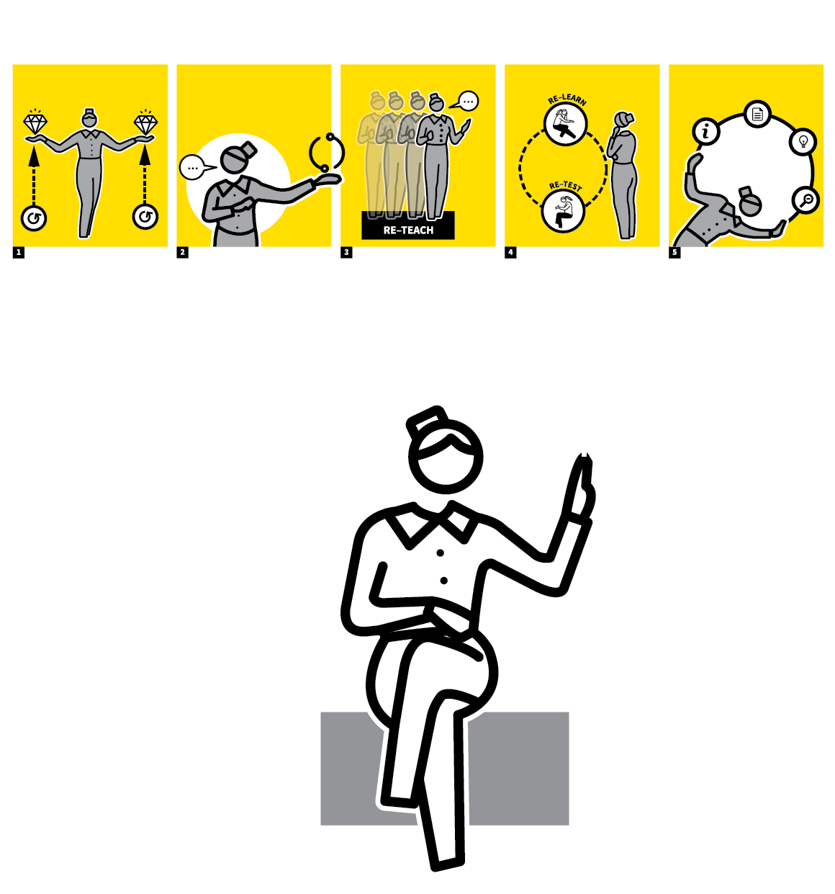
SOLVE THE
LEARNING PROBLEMS
SECTION
HOW?
1
REVIEW STUDENT PERFORMANCE
2
IDENTIFY PRECISE POINTS WHERE STUDENTS STRUGGLE OR CAN IMPROVE
3
CONSIDER STRATEGIES THAT BRIDGE THESE GAPS
4
SELECT WALKTHRUs RELEVANT TO DELIVERING THE STRATEGIES
5
APPLY THE A|D|A|P|T PROCESS

Slide 48
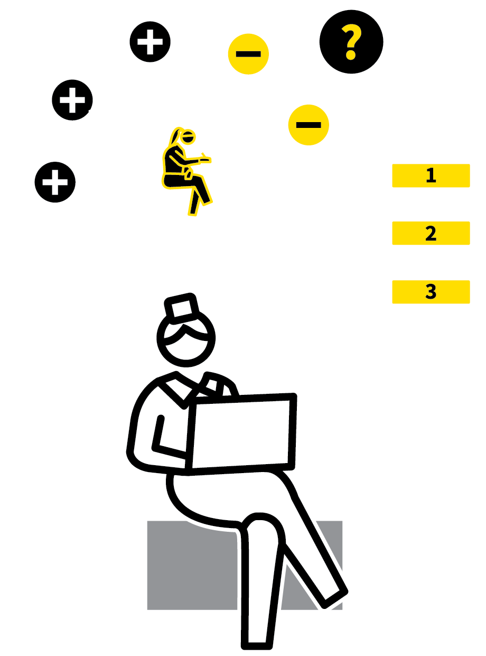


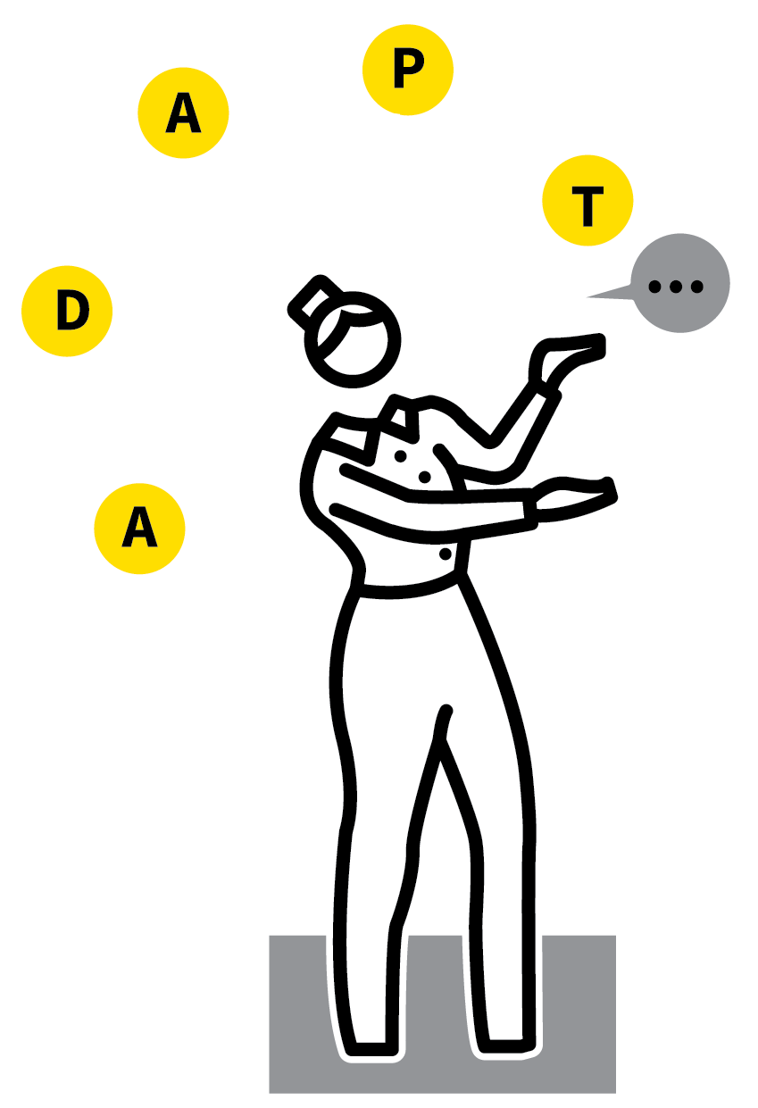
SOLVE THE LEARNING PROBLEMS
1
2
3
4
5
REVIEW STUDENT PERFORMANCE
IDENTIFY PRECISE POINTS WHERE STUDENTS STRUGGLE OR CAN IMPROVE
CONSIDER STRATEGIES THAT BRIDGE THESE GAPS
SELECT WALKTHRUs RELEVANT TO DELIVERING THE STRATEGIES
APPLY THE A|D|A|P|T PROCESS
The WalkThrus focus on strategies that commonly offer solutions to tackling students’ learning problems.
This emphasis is more productive and healthy compared to focusing directly on teachers’ performance.
In any class there will be students who find it more difficult than others, who do not score full marks. What are the problems they experience? This is where to begin when looking for strategies.

Slide 49
SOLVE THE LEARNING PROBLEMS
1
2
3
4
5
REVIEW STUDENT PERFORMANCE
Formative assessments, reviews of student work and formal summative test information will point to the areas where students experience the greatest success and the greatest challenges.
Use this information to consider what might need to be done or improved in terms of the way lessons are planned and executed.

Slide 50
SOLVE THE LEARNING PROBLEMS
1
2
3
4
5
IDENTIFY PRECISE POINTS WHERE STUDENTS STRUGGLE OR CAN IMPROVE
The more precise teachers can be, the more accurate the selection of strategies can be.
Learning problems might relate to: recall and understanding of key concepts
fluency in applying knowledge
recognising what is being asked from the questions
physical dexterity and confidence with
procedures and skills.

Slide 51
SOLVE THE LEARNING PROBLEMS
1
2
3
4
5
CONSIDER STRATEGIES THAT BRIDGE THESE GAPS
Match strategies to the learning problems, e.g.
Habits and routines | Behaviour and
Relationships
Fluency and recall | Weekly and Monthly Review
Quality of performance | Independent Practice
It is rarely a case of introducing a new
element into a teacher’s practice. It is more likely to be a question of increasing the
intensity.

Slide 52
SOLVE THE LEARNING PROBLEMS
1
2
3
4
5
SELECT WALKTHRUs RELEVANT TO DELIVERING THE STRATEGIES
Use the menu of options from the WalkThrus to identify specific sets of steps to take in addressing the students’ learning problems.
It is better to focus on one of these at a time.
Consider using the Instructional Coaching and Unseen Observation approaches.

Slide 53
SOLVE THE LEARNING PROBLEMS
1
2
3
4
5
APPLY THE A|D|A|P|T PROCESS
For any WalkThru use the A|D|A|P|T process.
Attempt | Have a go to see how it works initially
Develop | Add additional steps for more precision
Adapt | Make sense of the WalkThru for the subject or class context
Practise | Take time to rehearse each of the steps, overcoming initial challenges and increasing fluency
Test | Evaluate the impact of any WalkThru using objective information. Are the learning problems being solved?

Slide 54
SOLVE THE LEARNING PROBLEMS
1
2
3
4
5
REVIEW STUDENT PERFORMANCE
IDENTIFY PRECISE POINTS WHERE STUDENTS STRUGGLE OR CAN IMPROVE
CONSIDER STRATEGIES THAT BRIDGE THESE GAPS
SELECT WALKTHRUs RELEVANT TO DELIVERING THE STRATEGIES
APPLY THE A|D|A|P|T PROCESS
The WalkThrus focus on strategies that commonly offer solutions to tackling students’ learning problems.
This emphasis is more productive and healthy compared to focusing directly on teachers’ performance.
In any class there will be students who find it more difficult than others, who do not score full marks. What are the problems they experience? This is where to begin when looking for strategies.

