Slide 1
Trust Staff Safeguarding Update
September 2024

Slide 2
Aims for this update training
To raise awareness of key safeguarding issues and changes in KCSIE 24
To ensure knowledge of your personal responsibilities:
  How to respond when you have a concern
  How to record your concern
  Who you need to pass this information to
To ensure you are confident in following safeguarding procedures.
Safeguarding training can be difficult to hear – make sure you look after yourself…

Slide 3
Statutory Requirements
This training will support you in fulfilling your safeguarding responsibilities in accordance with DfE statutory guidance Working Together to Safeguard Children and Keeping Children Safe in Education.
All staff will understand the importance of a child-centred approach to safeguarding and consider at all times, what is in the best interest of the child.
All staff will understand the role they play in identifying concerns, sharing information and taking prompt action.
All staff will know how to identify concerns early, provide help for children, promote children’s welfare and prevent concerns from escalating.
All staff will understand and know how to effectively follow the systems within their school or college which support safeguarding.
Remember …
Safeguarding and promoting the welfare of children is everyone’s responsibility, and all professionals should ensure that their approach is child-centred, considering the best interests of the child at all times. Everyone who comes into contact with children has a role to play in identifying concerns, sharing information and taking prompt action.

Slide 4
Key information
‘Keeping children safe in education 2024’ (KCSIE) is statutory guidance from the DfE which schools must have regard to while carrying out their duties to safeguard and promote the welfare of children. This is statutory guidance. From 1 September 2024, this guidance replaces the previous version of KCSIE released in 2023.
This guidance is applicable to all schools and colleges.
Working together to Safeguard Children was also updated this year. Much of the changes to the guidance have been to ensure that these two documents closely align.
The Trust Safeguarding policy, Code of Conduct as well as other associated documents have been updated in response to this latest guidance.
All staff are also expected to have read and signed to say that they have understood these key documents. HT’s are required to complete the Trust compliance form by 16.9.24 to confirm this action has been completed.

Slide 5
Key information
Part one of KCSIE covers what staff need to know, do, and look out for in relation to safeguarding, including if they have concerns related to a child, a member of staff, or their setting’s safeguarding practices. All staff are expected to read Part 1, and Annex B.
Staff are required to sign to say that they have read and understood this at the beginning of the academic year. HT’s then confirm via the compliance form that this action has been completed so that the DCEO can report to the trustee that the compliance actions have been completed.
Safeguarding and promoting the welfare of children is everyone’s responsibility, and Trust schools should make sure their approach to safeguarding is child-centred, meaning that they should consider, at all times, what is in the best interest of the child. Professional curiosity leading all concerns and discussions about the child.

Slide 6
Key information
Teachers, including headteachers, have a specific responsibility to safeguard children’s wellbeing and maintain public trust in the teaching profession as part of their professional duties, in line with the ‘Teachers’ Standards’.
Every school has a DSL, and deputy DSL’s who will lead on safeguarding and support staff with their duties.
The DCEO has executive responsibility for Safeguarding across the Trust. Mrs Charlotte Rawlings, Vice Chair of Trustees is the trustee responsible for Safeguarding.

Slide 7

Before we focus on our safeguarding training…
What are your core values?
Why do you do this role?
Notes:
Ask staff to reflect on the two questions – talk to the person next to them.
Take feedback on each question for 5 mins.
DSL: Remind staff it is important to strip back to ‘why we are here’ as a reminder that promoting the welfare of children is taking time to pause, reflect and act.
Remember: everyone has a role to play in identifying concerns, sharing information and taking prompt action.
Activity: What does safeguarding children look like here? Use 5 words to describe the ethos of this school? How does it feel to be in this school?
Record on flip chart or other and keep to revisit at end of training when looking at school’s safeguarding culture.

Slide 8
Safer working practices
Trust code of conduct must be read and followed at all times.
Staff behaviour must be professional at all times – including dress, language and online communication
Staff should not be in personal communication with pupils, this includes texting, messaging, social networking sites etc.
Report any situation where a pupil or parent comes to depend on you for support or may have developed an infatuation. Discuss with your DSL/HT
Staff should not offer lifts outside agreed requirements of their role
Out of school contact must be planned and agreed with senior staff and parents. Appropriate social contact will be easily recognised and openly acknowledged.
Staff are in a position of trust and the power and age difference means they are not “friends” with pupils.

Slide 9
What staff should know and do
Teachers, including headteachers and the school effectiveness team, have a specific responsibility to safeguard children’s wellbeing and maintain public trust in the teaching profession as part of their professional duties.
Every school should also have a DSL, who will:
Support staff to carry out their safeguarding duties.
Liaise closely with other services, e.g. children’s social care services (CSCS).
Advise on the response to safeguarding concerns.
Staff need to be aware of the systems and procedures in place that support safeguarding, including the child protection and safeguarding policy, behaviour policy, staff code of conduct, response to children who are absent from education, and the role and identity of the DSL and any deputies.
Staff and governors should receive appropriate safeguarding training, including in relation to online safety which, amongst other things, includes and understanding of the expectations, applicable roles and responsibilities in relation to filtering and monitoring.

Slide 10
What staff should know and do
Staff should also be aware of:
Their local early help process and understand their role within this.
How to make a referral to children and social care for assessments under the Children Act 1989.
How to build trusted relationships with pupils that facilitate communication.
What to do if a child reports that they are being abused, exploited or neglected, including how to maintain an appropriate level of confidentiality – this means only involving those who need to be involved. Staff should never promise a child they will not tell anyone about the report of abuse. Staff should be able to reassure victims that they are being taken seriously and that they will be supported and kept safe.
The fact that children may not feel ready or know how to tell someone that they are being abused, exploited, or neglected, and/or they may not recognise their experiences as harmful, e.g. due to feeling embarrassed, humiliated, or threatened. This can be exacerbated by factors such as vulnerability, SEND, sexual orientation and language barriers. Staff should still maintain professional curiosity and speak to the DSL if they have concerns.

Slide 11
KCSIE 2024 - what’s new ?
There is no consultation on the changes to KCSIE this year. Call for evidence for 2025 supersedes this.
Information has been added to the definition of safeguarding
Suspensions and exclusions are a factor that should be considered when looking at early help
All staff should be aware of the indicators of exploitation
Schools remain responsible for the safeguarding of pupils in alternative provision
DSLs should keep records of decisions made regarding safeguarding concerns
Disclaimers have been added to highlight guidance that is under review
Changes have been made to reflect the latest version of ‘Working Together to Safeguard Children’

Slide 12
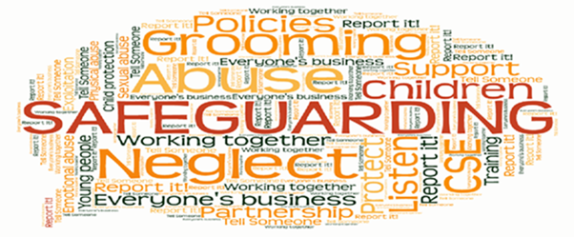
Safeguarding definition KCSiE 2024
Providing help and support to meet the needs of children as soon as problems emerge
Protecting children from maltreatment, whether that is within or outside the home, including online
Preventing impairment of children’s mental and physical health or development
Ensuring that children grow up in circumstances consistent with the provision of safe and effective care
Taking action to enable all children to have the best outcomes
Notes:
This is the statutory definition of safeguarding.
Point 1: providing help – education settings and staff particularly important as in a privileged position to identify and support
Point 2: protecting – child protection, protecting children from risk of harm
Point 3: preventing – ALL – universal
Point 4: ensuring – ALL - universal
Point 5: Do something – this may be short term, long term, or periods of – safeguarding continuum.

Slide 13

What do we mean by ‘Significant Harm’?
It is:
ill-treatment or impairment of health or development including for example impairment suffered from seeing or hearing the ill-treatment of another;
As a result of:
a single traumatic event
witnessing domestic violence or an awareness of domestic violence within their home environment
the cumulative effect of significant events, both acute and long-standing, or
the damaging impact of neglect which interrupt and change or damage the child's physical and psychological development.
Notes:
The Children Act 1989 introduced Significant Harm as the threshold that justifies compulsory intervention in family life in the best interest of children.
Although there is no absolute criteria for determining whether or not harm is “significant”, local authorities such as social services, police, education and health agencies work with family members to assess the child, and a decision is made based on their professional judgement using the gathered evidence.
Any concerns raised that might meet the threshold of significant harm must be reported immediately to a DSL and the person raising the concern should expect to know the outcome the same working day (before the child is sent home) whenever possible.
Harm can be determined “significant” by “comparing a child’s health and development with what might be reasonably expected of a similar child”.
This includes harm that occurs inside or outside the home, including online.

Slide 14

Categories of Abuse
Physical abuse
‘It does happen here’
Neglect
Child Abuse
Sexual abuse
Emotional abuse
Notes:
Activity:
Ask the audience what the 4 categories of abuse are – then show them on the slide – each category will ‘fly in’ as you move through the slide.
In groups, identify the indicators of the different types of abuse and neglect - you could do it as a flipchart activity or post it note… but make it interactive.
Groups to move around every 2-3 min and add to each page
Feedback to whole group
Notes for DSLs to aid discussion:
Smacking – as a ‘reasonable form of chastisement’ is an accepted defense in law but may not involve use of a belt, strap or other instrument or leave marks as this would constitute abuse. Note: illegal in Wales and Scotland.
Safeguarding issues – All staff should have an awareness of safeguarding issues that can put children at risk of harm. Annex B contains important information about specific forms of abuse and s/g issues and anyone who work directly with children should read it.
What signs may you see that a child is at risk? Acknowledge how some signs of abuse are more visible than others; there are different degrees of severity, some happen in a continuum, yet all constitute abuse.
We have a duty to challenge signs of neglect. Cycle of neglect over time, from one generation to another. This is why sharing concerns is so important and thinking of the context for that child; building jigsaw puzzle pieces to form whole picture. What is the experience of this child? We must not allow acts of omission to continue un-checked.
As staff we need to be mindful:
How easy it can be to ignore or minimise the persistent signs as/if individually they resonate with our own (not persistent) experiences? – healthy to challenge unconscious bias.
The fact that it is evident that parents love their children too can cloud the issue. Neglect by parents is very often nothing to do with lack of love for their children.

Slide 15
Definitions and indicators of abuse
Neglect
The persistent failure to meet a child’s basic physical and/or psychological needs, likely to result in the serious impairment of the child’s health or development.
Neglect may occur during pregnancy, e.g. as a result of maternal substance abuse.
Neglect may involve a parent failing to:
Provide adequate food, clothing and shelter (including exclusion from home or abandonment).
Protect a child from physical and emotional harm or danger.
Ensure adequate supervision (including the use of inadequate caregivers).
Ensure access to appropriate medical care or treatment.
Respond to a child’s basic emotional needs.

Slide 16
Definitions and indicators of abuse
Physical abuse
A form of abuse which may involve hitting, shaking, throwing, poisoning, burning or scalding, drowning, suffocating or otherwise causing physical harm to a child. Physical harm may also be caused when a parent fabricates the symptoms of, or deliberately induces, illness in a child.
Emotional abuse
The persistent emotional maltreatment of a child such as to cause severe and adverse effects on the child’s emotional development. It may involve conveying to a child that they are worthless or unloved, inadequate, or valued only if they meet the needs of another person.
It may include not giving the child opportunities to express their views, deliberately silencing them or ‘making fun’ of what they say or how they communicate. It may include limiting a child’s exploration and social interactions and causing children to feel frightened or in danger. It includes the exploitation and corruption of a child.
Some level of emotional abuse is present in all other types of maltreatment but may occur on its own.

Slide 17
Definitions and indicators of abuse
Sexual abuse
Sexual abuse involves forcing or enticing a child to take part in sexual activities, whether or not the child is aware of what is happening.
The activities may involve physical contact, both over and under clothing, and penetrative and non-penetrative acts.
They may also include non-contact activities, such as involving children in looking at, or in the production of, sexual images, watching sexual activities, encouraging children to behave in sexually inappropriate ways, or grooming a child in preparation for abuse.
Sexual abuse can take place online, and technology can be used to facilitate offline abuse.
Sexual abuse is not solely perpetrated by adult males. Women can also commit acts of sexual abuse, as can other children.
Child-on-child abuse is a separate safeguarding issue – all staff should be aware of what this involves and of the Trust’s Child protection and Safeguarding policy.

Slide 18
Adverse Childhood Experiences (ACE’s)
What a child experiences is fundamental to their mental health and emotional wellbeing in childhood, adolescence and adulthood. Adverse childhood experiences ((ACE’s) is the term to describe highly stressful and potentially traumatic events or situations that occur during childhood or adolescence.
Impact of lockdowns meant that children and young people were at increased risk with exposure to ACE and violence because of time at home. This is having significant impact now.

Slide 19
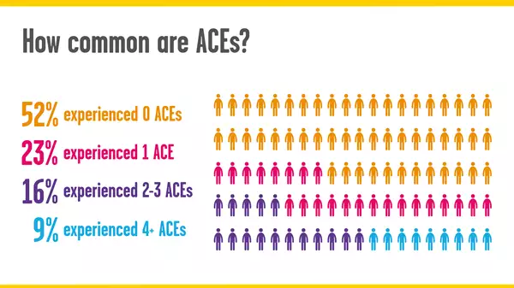
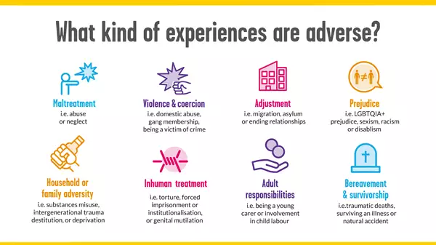
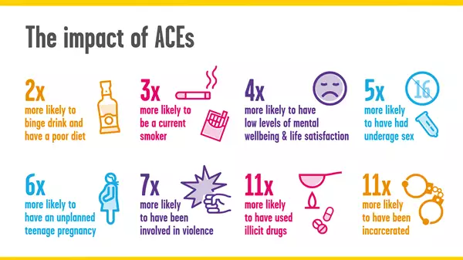
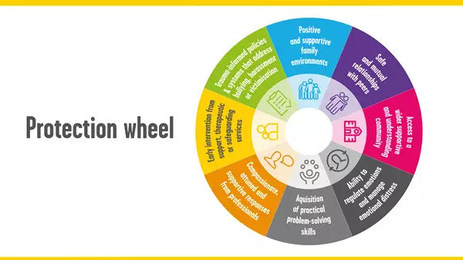
Notes:
ACES:
Emotional Abuse
Physical Abuse
Sexual Abuse
Emotional Neglect
Physical Neglect
Parental Separation/Loss
Domestic Violence
Family Member with an addiction
Family Member with mental ill health
Family Member in prison
Poverty
Parental split
Surveys with adults have found that compared to people with no ACEs, those with 4 or more ACEs are more likely to;
have been in prison
have committed violence in the last 12 months
Unintended teen pregnancy
have health-harming behaviours (high-risk drinking, smoking, drug use), leading to;
Diabetes, heart disease and cancers

Slide 20
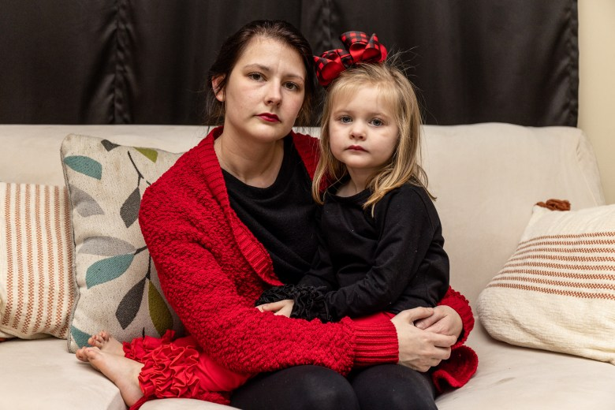
All staff should be aware of the indicators of exploitation
The DfE has renamed the ‘Abuse and neglect’ section of KCSIE to ‘Abuse, neglect and exploitation’. This section now clarifies that all staff should be aware of the indicators of abuse, neglect and exploitation.
What you would consider to be indicators of exploitation ?
Notes:
Small group discussion

Slide 21

Indicators of Exploitation – you may have considered…
Skipping school
Staying out late or overnight
Unexplained gifts/new possessions
Drugs and alcohol misuse
Secretive behaviour
Inappropriate or sexualised behaviour
Friendship or relationships with older adults
Significant changes in mood or behaviour changes in appearance (clothes, hygiene, etc).
Becoming withdrawn or isolated, poor mental health/self-harm etc.
Lots of time spent on social media talking to ‘friends’ they haven’t met or that you don’t know.
Unexplained injuries
They own a second mobile phone from which they are receiving a high volume of calls or need to leave urgently after receiving a text/call
Notes:
What signs and risk may we see? Split into groups to discuss for each sector. Answers will ‘fly in’ so reveal after feedback.
Feedback
For example:
unexplained changes in behaviour or personality
becoming withdrawn
becoming uncharacteristically aggressive
seeming anxious
lacks social skills and has few friends, if any
poor bond or relationship with a parent
knowledge of adult issues inappropriate for their age
running away or going missing – from home, care, education
always choosing to wear clothes which cover their body.

Slide 22
Child Criminal and Sexual Exploitation (CCE and CSE)
Both CCE and CSE are forms of abuse that occur where an individual or group
takes advantage of an imbalance in power to coerce, manipulate or deceive a child into
taking part in sexual or criminal activity. It may involve an exchange for something the victim needs or
wants, and/or for the financial advantage or increased status of the perpetrator or facilitator and/or through violence or the threat of violence. CSE and CCE can affect children, both male and female and can include children who have been moved (commonly referred to as trafficking) for the purpose of exploitation.
Child Criminal Exploitation does not always involve physical contact; it can also occur through the use of technology.
Notes:
DSL may wish to undertake further staff training for CCE and CSE available via Practice reflection tool - Tackling Child Exploitation (researchinpractice.org.uk)

Slide 23

The Jay Review November 2023 extract
Report Foreward by Jay Review of Criminally Exploited Children
The facts of criminal exploitation paint a stark picture: tens of thousands of children and young people across the country are controlled and manipulated by criminal gangs, while countless more are at risk. The toll on these young lives is immeasurable, leading to serious physical harm, long-term trauma and criminalisation.
Children are paying with their freedom, their childhoods and their lives.
Notes:
DSL to add throughout the Review, witnesses emphasised the vital role for schools as an essential protective factor in children’s/yp’s lives. School provides structure, trusted relationships, an environment to deliver targeted support and early identification of potential risk. This is why a whole school approach to safeguarding is a key golden thread to effective practice to provide help and support as soon as problem emerges, protecting children/yp and taking action. (refer back to Slide safeguarding definition.)

Slide 24
Some statistics
7,432 referrals relating to children in 2023 were made to the National Referral Mechanism (NRM), the framework for identifying and referring potential victims of modern slavery and criminal exploitation, an increase of 45% since 2021.The most common reason for referral (42%) was for criminal exploitation, with1,280 related to county lines.
14,420 children in need assessments in England recorded criminal exploitation as a risk of harm, an increase from 10,140 in 2022.
Over the five years between April 2018 and March 2023, 568 young people aged 16-24 were violently killed in England and Wales and 24 in Scotland. The vast majority were killed by being stabbed.
Over the same period in England and Wales there were 19,399 cautions or convictions of children under 18 for possession of a knife or offensive weapon in addition to 20,973 drug offences. The 2020 Child Safeguarding Practice Review Panel examination of 21 cases involving death or serious harm to children who were being criminally exploited found that 81% of incidents involved a knife.
There is significant overlap with child sexual exploitation – in 2021-22 there were16,000instances in which sexual exploitation was identified.
Notes:
County lines: is a form of criminal exploitation. It is when criminals befriend children, either online or offline, and then manipulate them into drug dealing. The ‘lines’ refer to mobile phones that are used to control a young person who is delivering drugs, often to towns outside their home county.
Children as young as 7 are targeted – primary school children are seen as easy targets because they’re less likely to get caught. Grooming might start with them being asked to ‘keep watch’ but soon escalates to them being forced to stash weapons, money, or become drug couriers. Young people aged 14-17 are most likely to be targeted by criminal groups.

Slide 25
Witness accounts illustrated how poverty lowers the threshold for exploitation, as even minor financial debts can become entry points for exploitation. In one example, a child could not afford school lunch and was bought a Subway sandwich; this debt became the gateway to them being exploited.
There is no one type of child who becomes exploited, there is no single path through which children fall victim to exploitation. Throughout the Review, we heard a multiplicity of ways in which children’s vulnerabilities had been used by perpetrators to identify and groom them into criminality. However, once grooming has begun it follows a typical pattern. The process of exploitation unfolds through a series of incremental steps, marked by a mix of incentives, coercion and threats. The Children’s Society explains the cycle of exploitation through stages of 'target', 'test', 'trap', which provides a useful approach to understand children’s experiences. Exploiters will look for a mix of vulnerability, skill, ability, cooperation to engage, willingness to take risks and maintain their involvement through incentives, threats and violence.

Slide 26
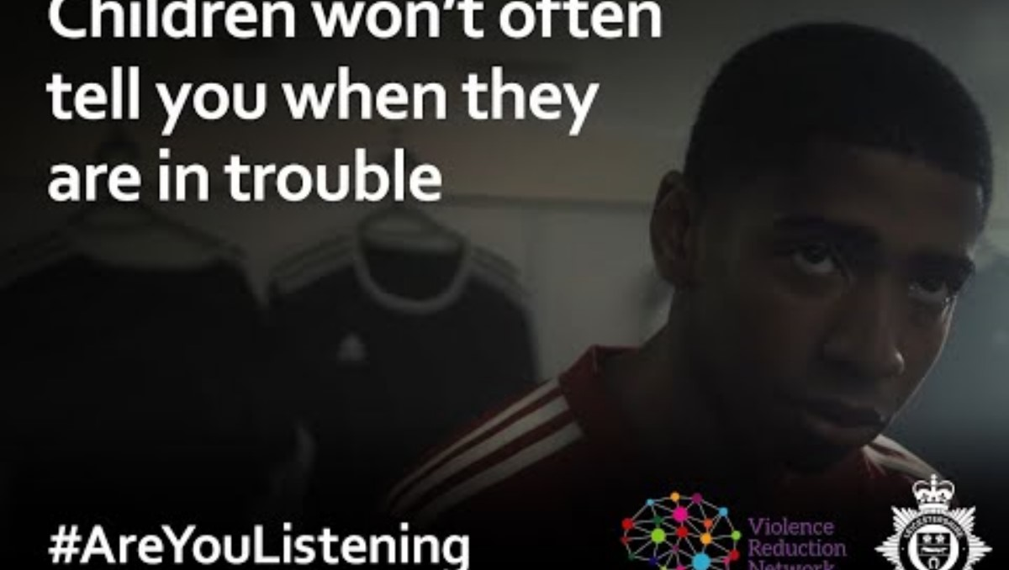
https://youtu.be/S_Ny_aOWI-k

Slide 27
Suspensions and exclusions are a factor that should be considered when looking at early help
KCSIE has a list of factors that staff should be particularly alert to that may make a pupil in particular need of early help.
The DfE has added the following factor to KCSIE 2024: “Has experienced multiple suspensions, is at risk of being permanently excluded from schools, colleges and in alternative provision or a pupil referral unit.”
Do you consider this when you are making a decision about suspension in school ? Have you considered what might be driving this behaviour ?

Slide 28
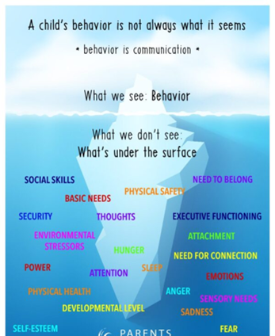
Pupil Voice: recognising the meaning of behaviour
Serious Case Review’s (SCRs) highlighted the voice of the child frequently going unheard. Crucially, ‘hearing’ involves not only listening but also observing, as children usually find it hard to disclose abuse directly and often communicate their distress through their behaviour rather than what they say.
A recurring theme in the SCRs was the need for practitioners to be alert to what a child/young person’s behaviour might be signalling.
In the SCRs that featured intrafamilial child sexual abuse, few children had disclosed the abuse until they were moved to a place of safety. But children in 80% had expressed their distress through disruptive, aggressive, challenging or sexualised behaviour.

Slide 29
Schools remain responsible for the safeguarding of pupils in alternative provision
Have you undertaken the required checks in line with DGAT’s expectations ?
Can you evidence these checks ?
Are you sure that the provision selected is meeting the pupil’s needs ?
How do you check attendance whilst at APS ? Should be coded B as dual registered.
How are you reviewing the impact of this provision for the pupil ?

Slide 30
A reminder from our January update about APS …
Leaders should ensure that they have visited and ensured that they have checked thoroughly any alternative provision they are electing to use to support the education of any pupil. You need to have your information about the checks you have undertaken to share with the inspector.
Similarly, to other risk assessments you undertake, you will want to be assured that all the employment checks you would undertake have been carried out and you have a letter from the leaders confirming this. APS do not need to be on the school’s SCR.
Guidance from QAL shared last year reminds leaders about the checks that they should undertake. Please review this.
Inspectors will evaluate the extent to which these placements are safe and effective in promoting pupils’ progress. They will normally visit a sample of the alternative providers used and, if required, may speak to local authorities, other agencies and parents/carers to gather evidence. Inspectors will want to understand how providers ensure that pupils who attend multiple settings or part time are kept safe when they are not on site for the whole school day.

Slide 31
DSLs should keep records of decisions made regarding safeguarding concerns
Further guidance has been added to KCSIE 2024 regarding the records DSLs need to keep about safeguarding concerns. As well as keeping detailed, accurate, secure written records of all concerns, DSLs should also record discussions and decisions made including the rationale for those decisions. Records should also show instances where referrals were or were not made to other agencies, e.g. Prevent.
Do your Safeguarding records indicate why you made a decision ?

Slide 32
Recording your concern
Staff should maintain an attitude of ‘it could happen here’ where safeguarding is concerned and always act in the best interests of the child. Concerns about a child’s welfare should be acted on immediately. Where a child is suffering, or is likely to suffer, from harm, a referral to children’s social care services (CSCS), and the police if appropriate, should be made immediately.
What to do if you have a concern …
Report immediately to the DSL or Deputy DSL if they are not on site.
Write it down - time, day, date & sign – using your own school agreed electronic system CPOMS or My Concern
Keep it confidential
Do not ask leading questions or conduct an investigation this is the DSL’s role.
Clear records are essential and will also help schools respond to any complaints.

Slide 33
Record Keeping
All concerns discussions and decisions made and the reasons for those decisions should be recorded in writing.
This will also help if /when responding to any complaints about the way a chase has been handled by the school or college.
Information should be kept confidentially on the school’s electronic system. It is good practise to keep referrals in a separate file for each child not family files.

Slide 34
Record Keeping
Records should include:
A clear and comprehensive summary of the concern
Details of how the concern was followed up and resolved, and
A note of any action taken, decisions reached and the outcome.
Your report should be factual recording what was said to you. It should not contain opinion, or anecdotal evidence.
Your records should also show:
The clear chronology,
You should be storing all appropriate other information such as MARF’s referrals, social care reports and any other reports.

Slide 35

Prevent - updated 2024
Updated duty to reflect more precisely the requirements for each sector. Separate section for education now.
Please complete the updated prevent training with all staff in the autumn term. Link in following slide. Expectation training updated every three years.

Slide 36
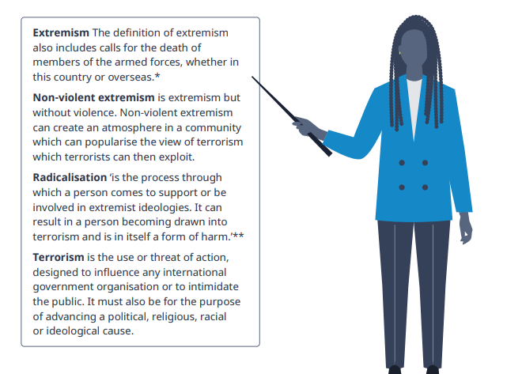
Radicalisation and Extremism
Make sure any concerns you may have about a child in regard to extreme or radical views or beliefs are recorded using your school's electronic system and shared with the DSL as a matter of urgency who will ensure that the right next steps are taken.
Prevent training link

Slide 37

Some other reminders

Slide 38
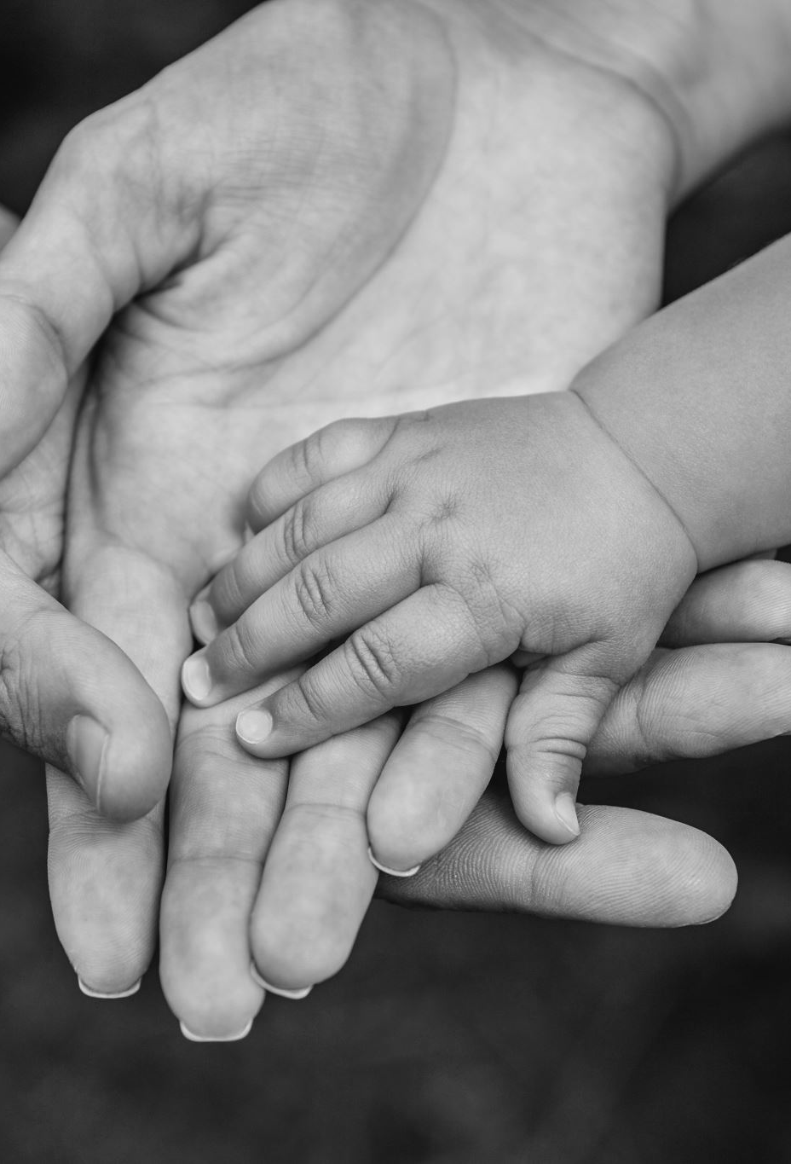
Harms threshold and low-level concern
Harms threshold:
Behaved in a way that has harmed a child, or may have harmed a child and/or
Possibly committed a criminal offence against or related to a child, and/or
Behaved towards a child or children in a way that indicates he or she may pose a risk of harm to children and/or,
Behaved or may have behaved in a way that indicates they may not be suitable to work with children.
Low-level concern:
Is inconsistent with the staff code of conduct, including inappropriate conduct outside of work, and
Does not meet the harms threshold or is otherwise not serious enough to consider a referral to the LADO.
Examples: being overfriendly with children, having favourites, engaging with a child one-to-one in a secluded area or behind a closed door, humiliating children.
Notes:
DSL remind staff of expectations to report and self-report and how to do this and where to find the Staff code of conduct/behaviour policy. The importance of a culture of openness, trust and transparency.
Staff should be mindful of ‘grooming’ behaviour, normalising behaviour, imbalance of power, be professionally curious and use whistleblowing procedure if feeling school doesn’t have a clear procedure for managing allegations and concerns.

Slide 39
Allegations Management
Concerns about the conduct of an adult (including low-level)
If staff have allegations or concerns about another member of staff (including supply staff, volunteers and contractors) posing a risk of harm to children, this should be referred .
Report immediately to the Headteacher (or Chair of Governors if about the HT who will refer to the DCEO.
Write it down - time, date and sign
Do not talk to the person concerned
Keep it confidential
If staff have concerns about safeguarding practices within their school, staff should raise the issue with the SLT or follow other whistleblowing channels if necessary in line with Trust policy.

Slide 40
Scenario – what should you do ?
Jamie, 39, is a teaching colleague at your school. You have worked together in the same school for over 10 years and have always got on well; socialising on occasions outside of school. One afternoon, after school has finished, and the pupils have left, you are walking past his classroom and decide to pop in to catch up about how the day has gone before you head home. He’s not there but his laptop is switched on the desk at the front and you notice that the screen is still on, and there is clearly some pornography visible on the screen. A split second later he walks back in the classroom behind you, and looks a bit flustered / embarrassed, as he has clearly noticed that you have seen the laptop screen. You think you’d better mention it and say “don’t you that’s pretty inappropriate mate?”. He immediately agrees, and laughs out loud and tells you that he’s organizing his mates stag do, and says “one of the lads in the group chat just sent a link saying something like ‘check this out for one of the stag activities’ or something like that, and so I clicked on it and then that went and popped up on my screen!” He says he can’t believe one of his mates would do that to him, especially as he’s a teacher! You agree that his mate shouldn’t be doing that kind of thing and then leave the room. You’ve known Jamie a long time though and you know he’s a ‘decent bloke’, and he clearly seems a bit embarrassed by it so you don’t say anything further and then leave the room.
Notes:
Should report it to the Headteacher/DSL. Ideally you should also tell the teacher to self refer. HT should inform the LADO and take advice.

Slide 41
Monitoring and Filtering
DFE updated their monitoring and filtering standards in May 24 . Our check list has been updated to reflect this.
Have you completed your annual cyber security training ?
Are you confident about what to look out for when you are working online and when you need to report ?
Are you aware who you need to report to in your school ?
Notes:
they witness or suspect unsuitable material has been accessed
they can access unsuitable material
they are teaching topics which could create unusual activity on the filtering logs
there is failure in the software or abuse of the system
there are perceived unreasonable restrictions that affect teaching and learning or administrative tasks
they notice abbreviations or misspellings that allow access to restricted material

Slide 42
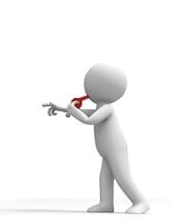
Whistleblowing – encouraged and expected
Staff must feel confident to raise a concern about potential failures in the school’s safeguarding regime and know that such concerns will be taken seriously.
  Whistleblowing policy – Trust Policy on the website.
Where a staff member feels unable to raise an issue with their employer, or feels that their genuine concerns are not being addressed, other whistleblowing channels may be open to them:
  NSPCC whistleblowing advice line
  DfE whistleblowing advice for employees
Notes:
A strong culture of safeguarding starts with that ability to remain open-minded. Staff should be encouraged to not only provide that professional challenge, but to share their concerns. Whistleblowing should not be a taboo, instead it should be expected.
All staff and volunteers should feel able to raise concerns about poor or unsafe practice and potential failures in the school and know that such concerns will be taken seriously by the senior leadership team.
As a whistleblower you’re protected by law – you should not be treated unfairly or lose your job because you ‘blow the whistle’
You can raise your concern at any time about an incident that happened in the past, is happening now, or you believe will happen in the near future.
When might you whistleblow?
Your school doesn’t have clear s/g procedures to follow
You think your concern won’t be dealt with properly or may be covered up
You’ve raised a concern but it hasn’t been acted upon
Remind staff about where to find the W/B policy and ensure staff know the details of NSPCC helpline (staffroom?)
Secondary whistleblowing channels should be shared with staff for anyone wanting to whistleblow outside of the school.

Slide 43
A child’s centred approach:
Pupil voice
Curriculum
Pupils feel safe
A culture of listening to children
Know your school, know your community
The school’s systems and processes:
A whole-school approach
Timeliness of actions
Early help / support
Working with other agencies
Record keeping
Culture of openness and transparency
Culture of ‘speaking up’ & whistleblowing
Oversight and scrutiny
Visitors procedure
Our school safeguarding culture
Staff knowledge and skills:
Staff understand risks
It can/does happen here
Whole picture - information sharing
Professional disagreement
Professional challenge
Professional curiosity
Tenacity
Notes:
Use 5 words to describe the safeguarding ethos of this school? How does it feel to be in this school?
Consider the different elements which contribute to robust safeguarding ethos
Do we have it right? Can we improve?
Note for DSLs to aid explanation of each bullet point:
The school’s systems and processes:
Whole-school approach to safeguarding: sfg is integrated and embedded through the school’s aims and values, systems and processes. This means leaders ensure that safeguarding and child protection are at the forefront and underpin all aspects of the school. We often refer to sfg as the ‘golden thread’ which is present throughout rather than being one aspect of the school.
Timeliness of staff reporting their concerns to the DSL and the DSL referring to MASH
A clear offer of early help - In cases of incidents between children, including online, support is always considered for the perpetrators as well as the victims of the abuse.
Recording keeping: records should include:
a clear and comprehensive summary of the concern;
details of how the concern was followed up and resolved;
a note of any action taken, decisions reached and the outcome.
Transparent working culture of speaking up is championed and modelled, whistleblowing is encouraged and welcome, the school is reflective where a concerns is raised about the safeguarding practice.
Strong oversight and scrutiny – the governing body acts as a critical friend and hold leaders into account.
Visitors procedures – remind all staff the need to challenge anyone who is not wearing a lanyard.
2. A child-centred approach: ultimately, all systems, processes and policies operate with the best interests of children at their core.
The child’s wishes and feelings taken into account when determining what action to take + systems in place for children to express their views and give feedback – best interests of the child at heart
Pupil voice is sought and recorded, for example on safeguarding concern forms.
Curriculum: children are taught about safeguarding, including online safety
Children are protected and feel safe: Those who are able to communicate know how to complain and understand the process for doing so. Systems are in place, and are well promoted, easily understood and easily accessible for children to report abuse. Children know their concerns are treated seriously.
Additionally to pupil voice, there is a clear culture of active listening to children, not just within the context of a disclosure but in all interactions ie use of the TED method Tell me Explain Describe. An example of this: “How was your weekend” rather than “Did you have a good weekend?” implying that the staff is expecting the child to answer ‘yes’.
Know your school and the community it sits in; what are the local challenges, how safe are public areas?
3. Staff knowledge and skills
Safeguarding training for staff, including online safety training, is integrated, aligned and considered as part of the whole school safeguarding approach
As a result, staff understand the indicators that may suggest that a child is suffering or is at risk of suffering abuse, neglect or harm. This includes
the risk of abuse and neglect in the home as well as
risks outside the home such as sexual and/or criminal exploitation, radicalisation, bullying and children going missing
Risks associated with using technology, including social media, of bullying, grooming, exploiting, radicalising or abusing children
Fostering an attitude of ‘it can/does happen here’
Information sharing
Quick search in KCSIE 24 on sharing, share and shared = approx.138 times
Of course GDPR is important, when it comes to safeguarding KCSIE is clear: we share, internally and externally.
Staff who work closely with children should be aware of the concerns recorded by the school (or other agencies), in line with recent clarification in KCSiE (Annex C):
The DSL should … help promote educational outcomes by sharing the information about the welfare, safeguarding and child protection issues that children, including children with a social worker, are experiencing, or have experienced, with teachers and school and college leadership staff.
If not sharing due to confidentiality issues, then the school ought to consider formal process.
Encourage professional disagreement and where required, professional challenge – ref: case resolution protocol. Terminology “pass on” vs “reporting” a concern: in our school, we don’t pass on concern like a hot potato for someone else to deal with: we report concerns and we are persistent in ensuring the situation improves for the child. We remain concerned until we’re no longer concerned (even when a social worker is working with the family).
Professional curiosity – at every level. This has been reinforced in KCSiE: All staff should be aware that children may not feel ready or know how to tell someone that they are being abused, exploited, or neglected, and/or they may not recognise their experiences as harmful. For example, children may feel embarrassed, humiliated, or being threatened. This could be due to their vulnerability, disability and/or sexual orientation or language barriers.
Tenacity – this isn’t the same as being nosey: we understand our responsibility in ensuring the best outcomes for our children.

Slide 44
Training
Training logs are kept by each school to record the safeguarding training each member of staff has received across the year. The template for this is provided by the Trust and sent out in the summer.
Training is not an annual event but an ongoing event across the year.
This session is part of your ongoing safeguarding training. We have also provided a quiz to be used across the year to check your understanding.
Additional sites that may be helpful to support your ongoing learning include
GCSP
LGFL
If there is any aspect of your safeguarding knowledge that you feel you require additional support with, then it is your responsibility to ask your DSL for additional training.

Slide 45

Above all else..
Remember to be professionally curious - piece together the jigsaw.

