Slide 1

John Catt Educational
QUESTIONING & FEEDBACK
TEACHING
WALKTHRUs
PRESENTATION
SLIDES
TOM SHERRINGTON & OLIVER CAVIGLIOLI
COLD CALLING
THINK, PAIR, SHARE
SHOW-ME BOARDS
CHECK FOR UNDERSTANDING
SAY IT AGIN BETTER
PROBING QUESTIONS
PROCESS QUESTIONS
FEEDBACK THAT MOVES FORWARD
FEEDBACK AS ACTIONS
WHOLE-CLASS FEEDBACK

Slide 2


COLD CALLING
SERIES
EXPLAINING & MODELLING
1
ASK THE CLASS THE QUESTION
2
GIVE THINKING TIME
3
SELECT SOMEONE TO RESPOND
4
RESPOND TO THE ANSWERS
5
SELECT ANOTHER STUDENT AND RESPOND AGAIN

Slide 3

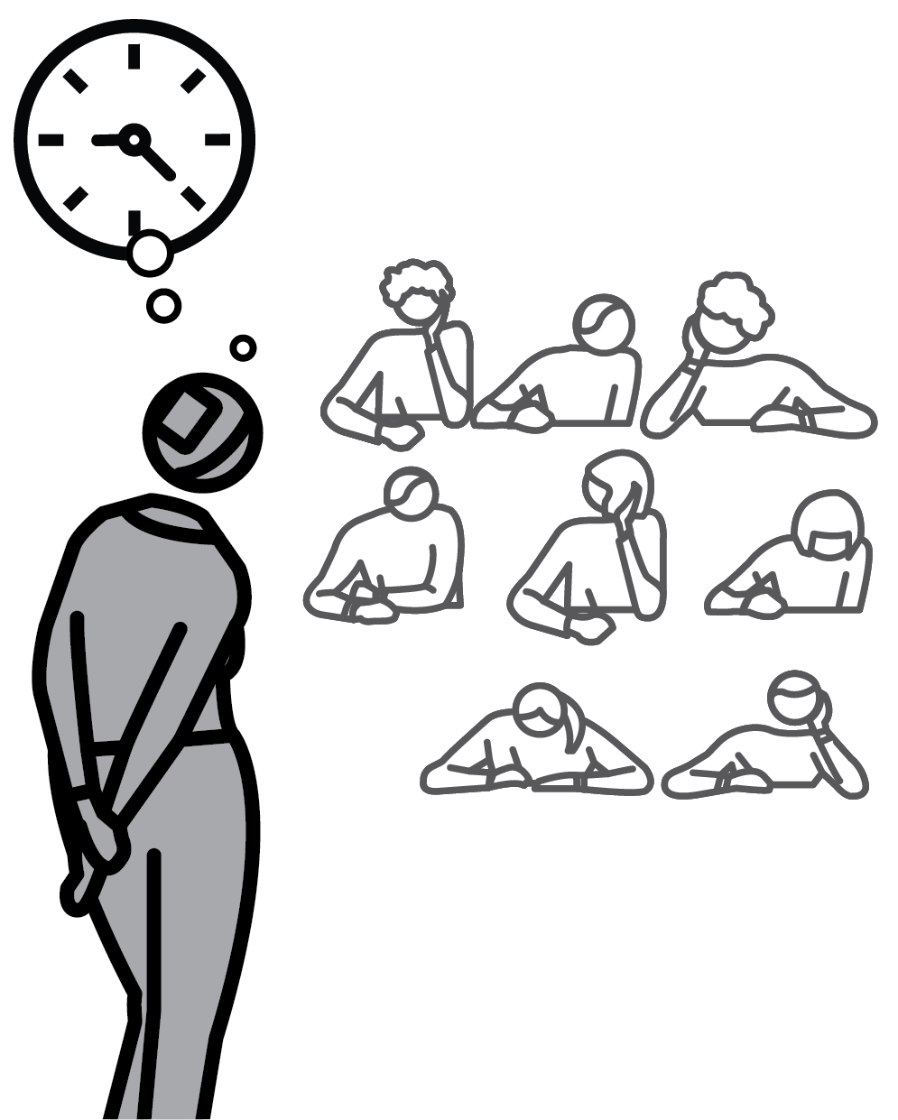
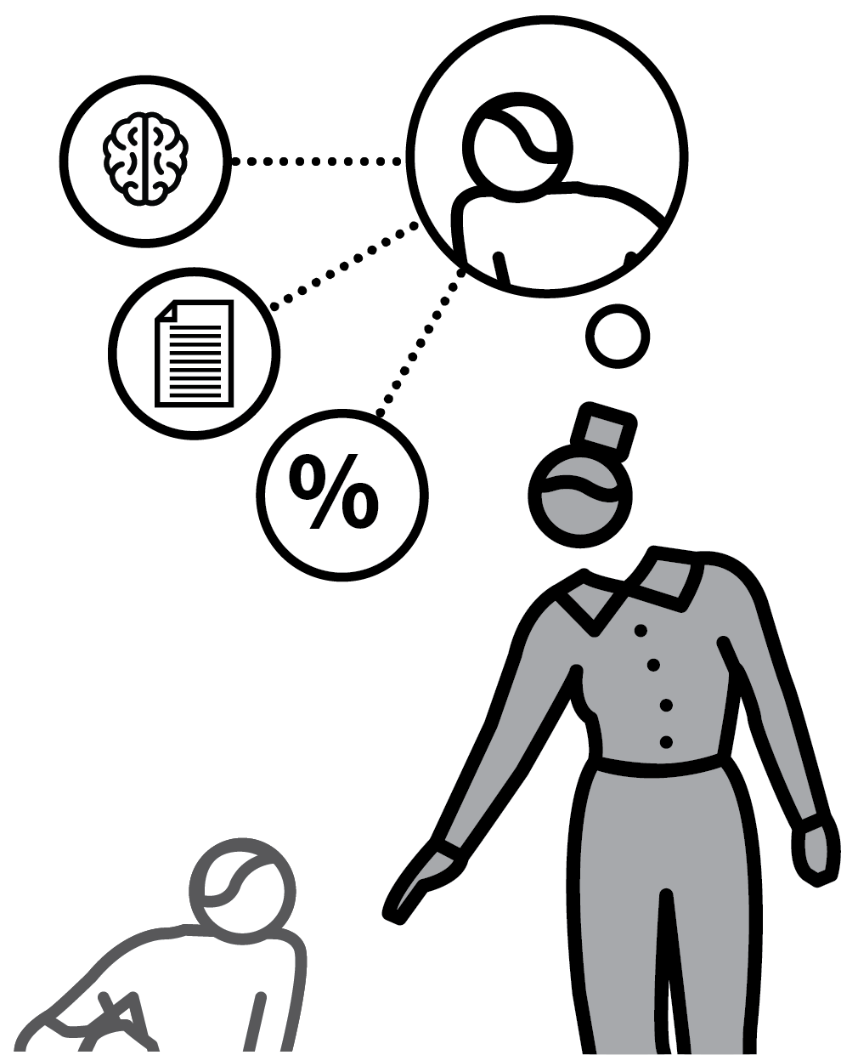
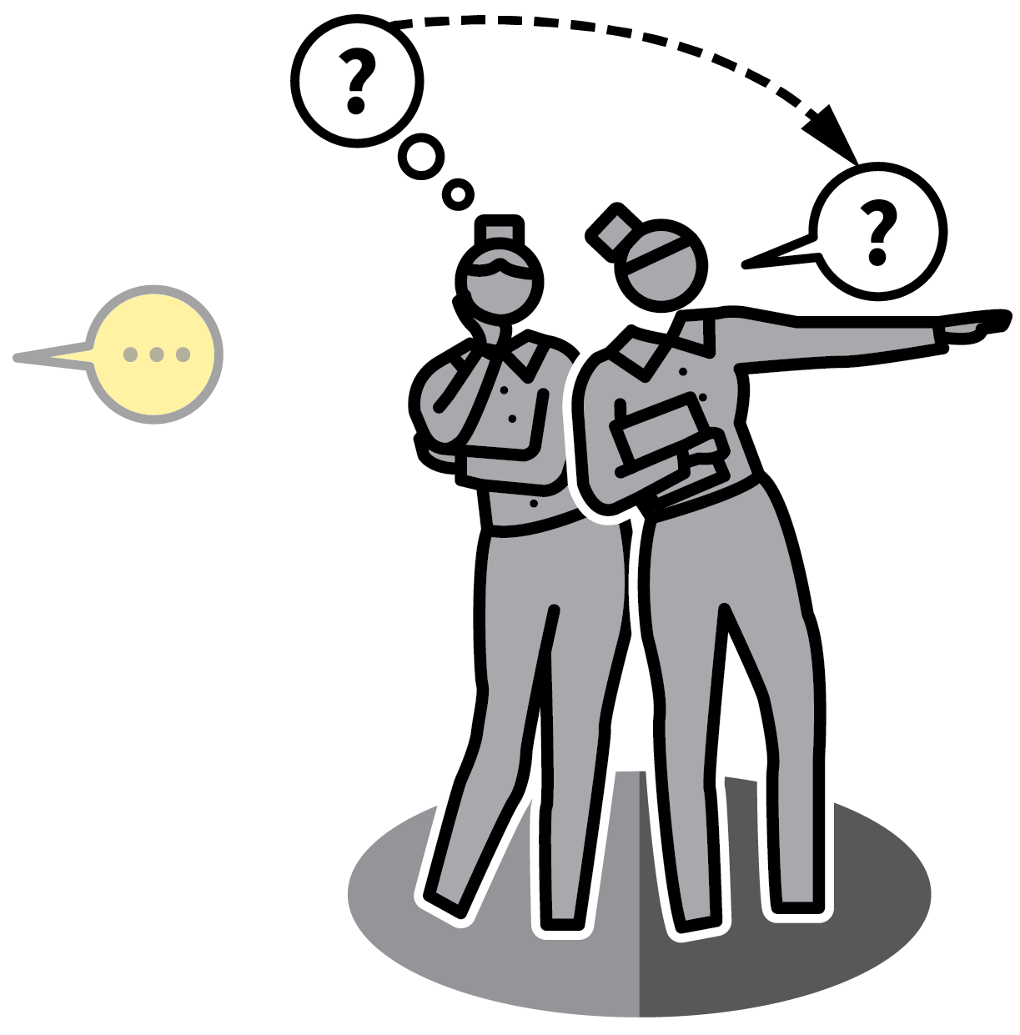
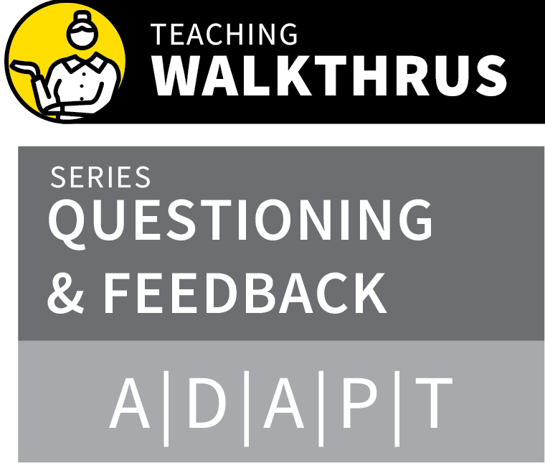
COLD CALLING
1
2
3
4
5
ASK THE CLASS THE QUESTION
GIVE THINKING TIME
SELECT SOMEONE TO RESPOND
RESPOND TO THE ANSWERS
SELECT ANOTHER STUDENT AND RESPOND AGAIN
This technique helps address two main purposes of questioning: making all students think and providing feedback to the teacher about how things are going.
If you allow ‘hands up’ or calling out, you only get responses from volunteers.
Cold calling allows you to choose who answers, keeping the whole class involved and giving you better information to plan your next steps.

Slide 4
COLD CALLING
1
2
3
4
5
ASK THE CLASS THE QUESTION
Ask a question aimed at everyone in the room, giving them all a chance to consider the answer, checking their understanding.
Don’t accept hands up or calling out.
Cold Calling tells all students to be prepared to give their answers.

Slide 5
COLD CALLING
1
2
3
4
5
GIVE THINKING TIME
Allow students time to think in silence before seeking responses.
This could be 5–30 seconds or perhaps longer depending on the complexity.
Use thinking time to scan the room, checking students are focusing on the task.

Slide 6
COLD CALLING
1
2
3
4
5
SELECT SOMEONE TO RESPOND
Select a student to respond.
“James, what were you thinking?” This
invitational style allows James to present his half-formed thoughts or to say that he wasn’t sure.
If we over-stress correctness at an early stage, this can inhibit less confident students.

Slide 7
COLD CALLING
1
2
3
4
5
RESPOND TO THE ANSWERS
Turn each question into a short exchange.
Respond with an affirmation and a Probing Question or a Process Question.
If the answer isn’t quite right, respond with “Good try… but that’s not quite right…” before re-teaching .
The Say It Again Better strategy is useful as a response.

Slide 8
COLD CALLING
1
2
3
4
5
SELECT ANOTHER STUDENT AND
RESPOND AGAIN
Invite another student to respond to the exact same question or a slight extension.
Choose a range of students including those who are enthusiastic and those who are less confident.

Slide 9
COLD CALLING
1
2
3
4
5
ASK THE CLASS THE QUESTION
GIVE THINKING TIME
SELECT SOMEONE TO RESPOND
RESPOND TO THE ANSWERS
SELECT ANOTHER STUDENT AND RESPOND AGAIN
This technique helps address two main purposes of questioning: making all students think and providing feedback to the teacher about how things are going.
If you allow ‘hands up’ or calling out, you only get responses from volunteers.
Cold calling allows you to choose who answers, keeping the whole class involved and giving you better information to plan your next steps.

Slide 10

1
2
3
4
5
6
7
8
9
10
COLD
CALLING
THINK, PAIR, SHARE
SHOW-ME
BOARDS
CHECK FOR
UNDERSTANDING
SAY IT AGAIN
BETTER
PROBING
QUESTIONS
PROCESS
QUESTIONS
FEEDBACK
THAT MOVES
FORWARD
FEEDBACK
AS ACTIONS
WHOLE-
CLASS
FEEDBACK
NEXT UP
THINK, PAIR, SHARE

Slide 11

THINK, PAIR, SHARE
SERIES
EXPLAINING & MODELLING
1
ESTABLISH TALK PARTNERS FOR EVERY STUDENT
2
SET THE QUESTION WITH A GOAL AND A TIMEFRAME
3
BUILD IN THINKING TIME
4
CIRCULATE TO LISTEN AS PAIRS ARE TALKING
5
USE COLD CALL TO SAMPLE PAIRS’ RESPONSES

Slide 12
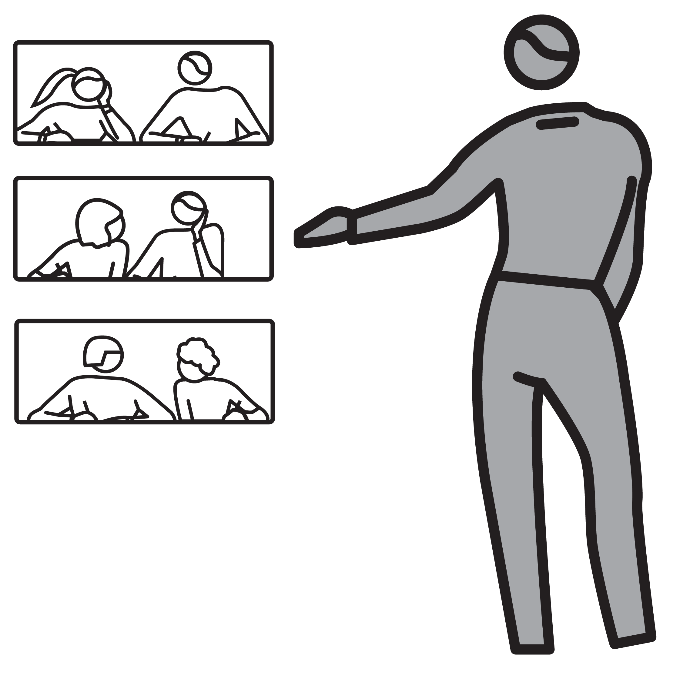
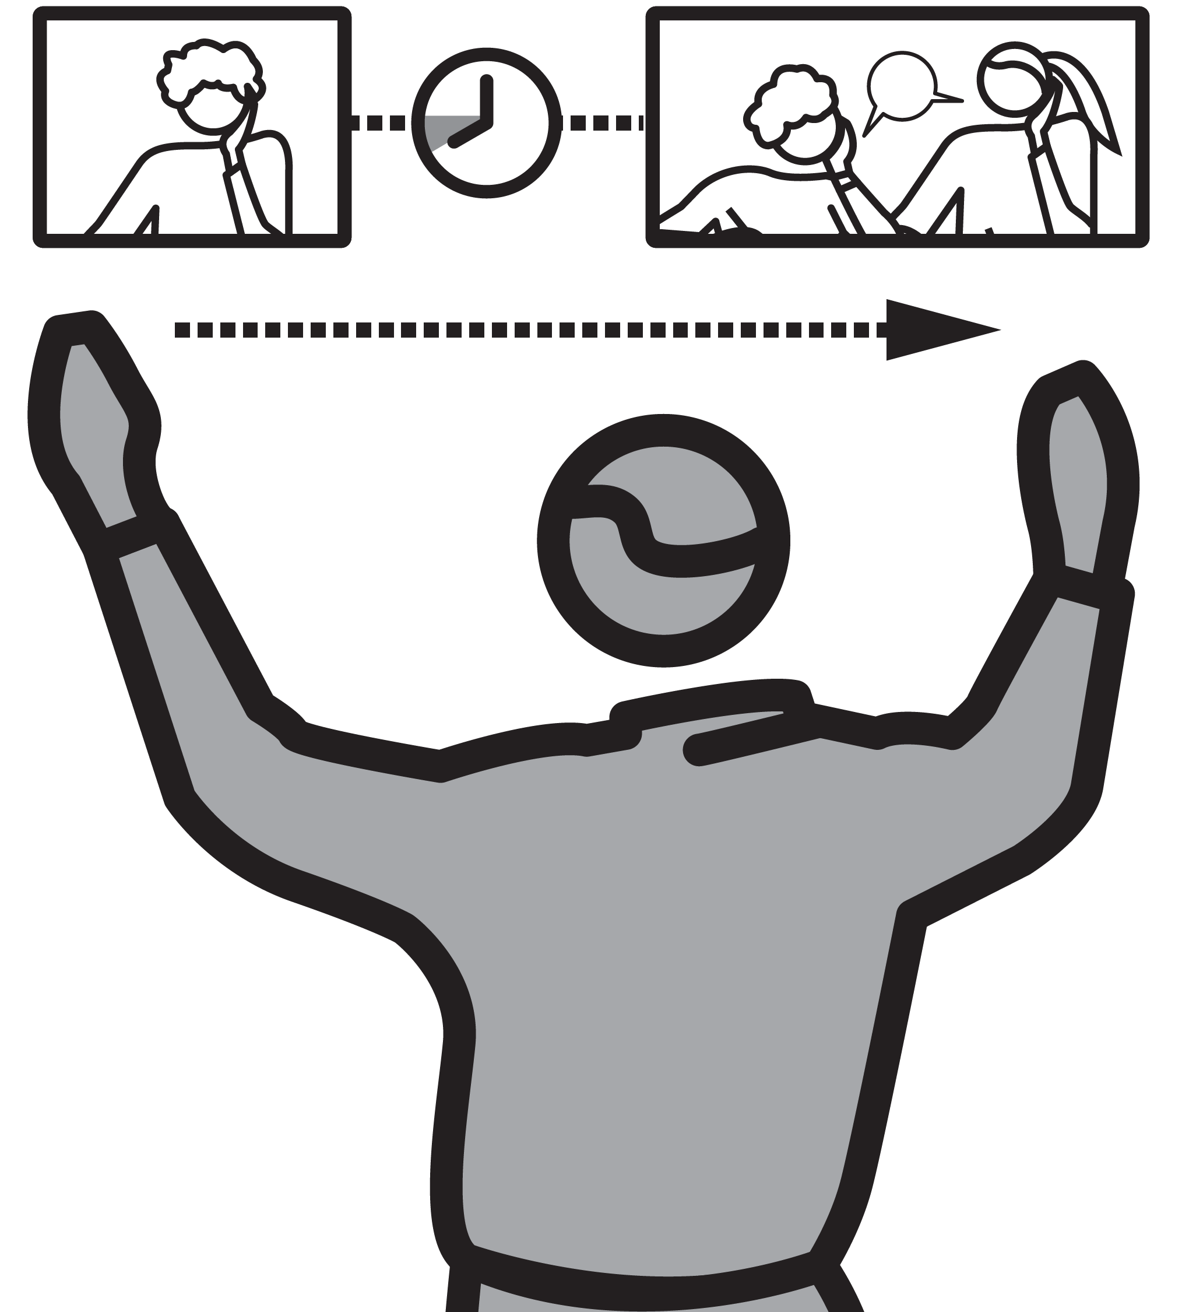


THINK, PAIR, SHARE
1
2
3
4
5
ESTABLISH TALK PARTNERS FOR EVERY STUDENT
SET THE QUESTION WITH A GOAL AND A TIMEFRAME
BUILD IN THINKING TIME
CIRCULATE TO LISTEN AS PAIRS ARE TALKING
USE COLD CALL TO SAMPLE PAIRS’ RESPONSES
There are many times when it is beneficial for students to engage in a structured discussion.
Pairs are a powerful way to involve all students in rehearsing and sharing ideas.
In conjunction with Signal, Pause, Insist, teachers can switch from whole-class listening and back to paired discussion in a dynamic orderly manner.

Slide 13
THINK, PAIR, SHARE
1
2
3
4
5
ESTABLISH TALK PARTNERS FOR EVERY STUDENT
Determine each person’s talk partner.
Odd students can form the one group of three.
Ideally pairs will be reasonably well matched so that one person in the pair does not dominate.

Slide 14
THINK, PAIR, SHARE
1
2
3
4
5
SET THE QUESTION WITH A GOAL AND A TIMEFRAME
In the same style as Cold Calling, set a
question for all students to discuss in their pairs.
Set a precise goal e.g. “List five key features of the character”; “Explain the process in four bullet points”.
Set a precise timeframe. This makes the short discussions purposeful.

Slide 15
THINK, PAIR, SHARE
1
2
3
4
5
BUILD IN THINKING TIME
Give students time to think individually before they turn to their talk partners to share their ideas.
This makes sure every member of the class engages in generative thinking.
If time is tight you might decide to go straight to the discussion.

Slide 16
THINK, PAIR, SHARE
1
2
3
4
5
CIRCULATE TO LISTEN AS PAIRS ARE TALKING
The power of this technique lies in hearing what students say, circulating as they share ideas…
This can help pick up interesting ideas or
important errors, misconceptions or subtle technicalities.
It also helps to keep the discussions focused.

Slide 17
THINK, PAIR, SHARE
1
2
3
4
5
USE COLD CALL TO SAMPLE PAIRS’
RESPONSES
Use Signal, Pause, Insist to bring the class to attention and sample the discussions as with Cold Calling.
Give them the option to reveal doubts as well as ideas: “Michael, what were you and Annie discussing?”
Select other pairs to contribute ideas or Check for Understanding.

Slide 18
THINK, PAIR, SHARE
1
2
3
4
5
ESTABLISH TALK PARTNERS FOR EVERY STUDENT
SET THE QUESTION WITH A GOAL AND A TIMEFRAME
BUILD IN THINKING TIME
CIRCULATE TO LISTEN AS PAIRS ARE TALKING
USE COLD CALL TO SAMPLE PAIRS’ RESPONSES
There are many times when it is beneficial for students to engage in a structured discussion.
Pairs are a powerful way to involve all students in rehearsing and sharing ideas.
In conjunction with Signal, Pause, Insist, teachers can switch from whole-class listening and back to paired discussion in a dynamic orderly manner.

Slide 19
1
2
3
4
5
6
7
8
9
10
COLD
CALLING
THINK, PAIR, SHARE
SHOW-ME
BOARDS
CHECK FOR
UNDERSTANDING
SAY IT AGAIN
BETTER
PROBING
QUESTIONS
PROCESS
QUESTIONS
FEEDBACK
THAT MOVES
FORWARD
FEEDBACK
AS ACTIONS
WHOLE-
CLASS
FEEDBACK
NEXT UP
SHOW-ME
BOARDS

Slide 20

SHOW-ME BOARDS
SERIES
EXPLAINING & MODELLING
1
ENSURE EVERY STUDENT HAS A BOARD AND PEN TO HAND
2
SET THE QUESTION WITH A GOAL AND A TIMEFRAME
3
BUILD IN THINKING TIME
4
SIGNAL: 3–2–1 AND SHOW ME
5
SAMPLE STUDENT RESPONSES AND FOLLOW UP

Slide 21

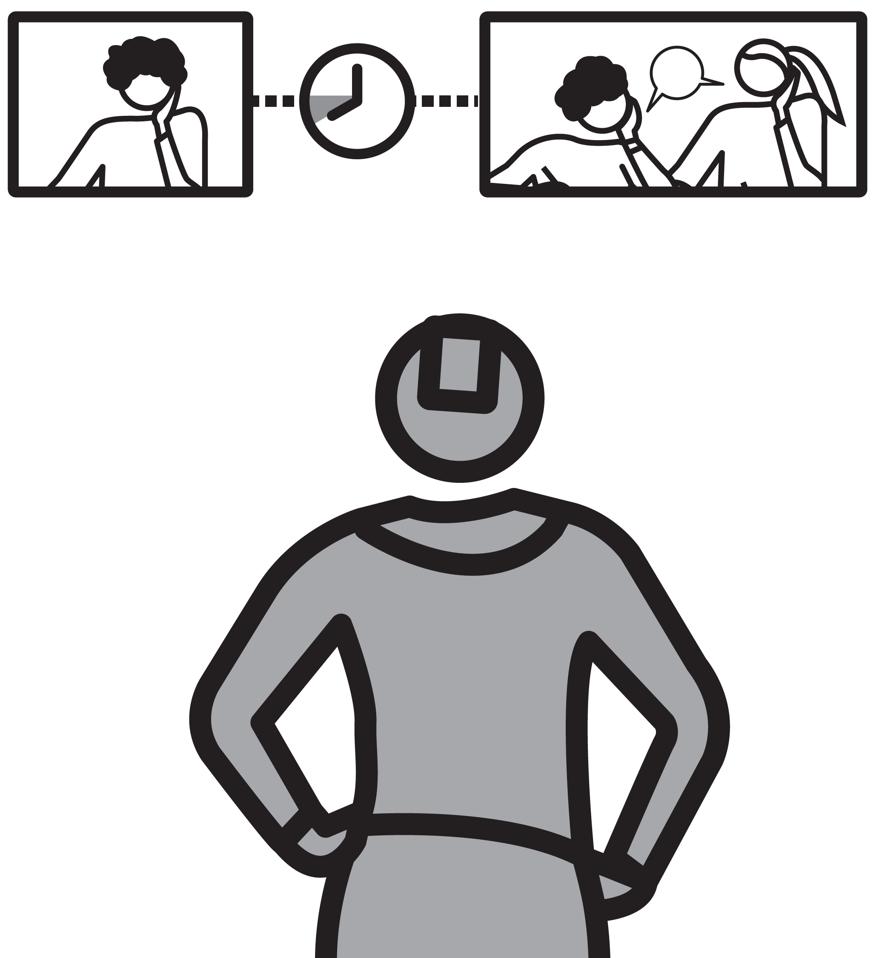

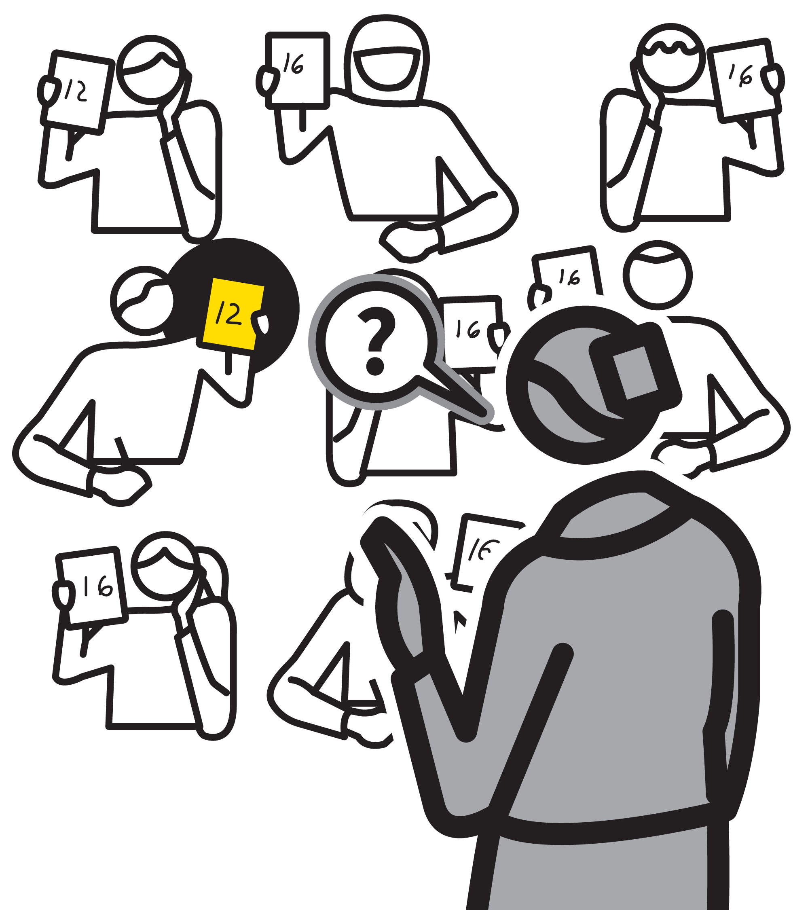
SHOW-ME BOARDS
1
2
3
4
5
ENSURE EVERY STUDENT HAS A BOARD AND PEN TO HAND
SET THE QUESTION WITH A GOAL AND A TIMEFRAME
BUILD IN THINKING TIME
SIGNAL: 3–2–1 AND SHOW ME
SAMPLE STUDENT RESPONSES AND FOLLOW UP
Sample responses from a whole class using mini-whiteboards.
Students write on boards in response to questions and simultaneously show their responses.
This gives feedback to the teacher about the range of student responses.
They also help where students generate ideas or practise making diagrams or short sentences.

Slide 22
SHOW-ME BOARDS
1
2
3
4
5
ENSURE EVERY STUDENT HAS A BOARD AND PEN TO HAND
Ideally, ready to use whenever you choose to use them spontaneously.
It can help to have sets of board+pen+wiper in wallets to speed up the logistics.

Slide 23
SHOW-ME BOARDS
1
2
3
4
5
SET THE QUESTION WITH A GOAL AND A TIMEFRAME
Ask students to produce the particular type of response you want with clear goals.
e.g. write out the maths solution, sketch a
diagram, write a balanced chemical equation.
Give students a timeframe for the task in
minutes.

Slide 24
SHOW-ME BOARDS
1
2
3
4
5
BUILD IN THINKING TIME
Before students show their responses, make sure every student has had time to think, exploring their own schema.
It can interrupt their thinking if another
student’s answer is shared prematurely.

Slide 25
SHOW-ME BOARDS
1
2
3
4
5
SIGNAL: 3–2–1 AND SHOW ME
Use a crisp, disciplined routine that makes every student show their boards at the same time.
e.g. ‘3-2-1 and Show Me’ — or a similar signal.
This tells students to stop writing and hold up their boards until you've finished engaging with responses.

Slide 26
SHOW-ME BOARDS
1
2
3
4
5
SAMPLE STUDENT RESPONSES AND FOLLOW UP
Scan boards for correct and incorrect
responses, interesting alternative responses, common errors or misconceptions.
Engage with a sample of students to discuss their responses, either to consolidate, deepen or correct as needed.

Slide 27
SHOW-ME BOARDS
1
2
3
4
5
ENSURE EVERY STUDENT HAS A BOARD AND PEN TO HAND
SET THE QUESTION WITH A GOAL AND A TIMEFRAME
BUILD IN THINKING TIME
SIGNAL: 3–2–1 AND SHOW ME
SAMPLE STUDENT RESPONSES AND FOLLOW UP
Sample responses from a whole class using mini-whiteboards.
Students write on boards in response to questions and simultaneously show their responses.
This gives feedback to the teacher about the range of student responses.
They also help where students generate ideas or practise making diagrams or short sentences.

Slide 28
1
2
3
4
5
6
7
8
9
10
COLD
CALLING
THINK, PAIR, SHARE
SHOW-ME
BOARDS
CHECK FOR
UNDERSTANDING
SAY IT AGAIN
BETTER
PROBING
QUESTIONS
PROCESS
QUESTIONS
FEEDBACK
THAT MOVES
FORWARD
FEEDBACK
AS ACTIONS
WHOLE-
CLASS
FEEDBACK
NEXT UP
CHECK FOR
UNDERSTANDING

Slide 29

CHECK FOR UNDERSTANDING
SERIES
EXPLAINING & MODELLING
1
COLD CALL, ASKING WHAT, NOT IF
2
PROBE WITH A SHORT DIALOGUE
3
FOLLOW-UP WITH MORE CHECKING DIALOGUES
4
EXPLORE DIFFERENCES AND DETAILS
5
RE-TEACH, DEFER OR MOVE ON

Slide 30
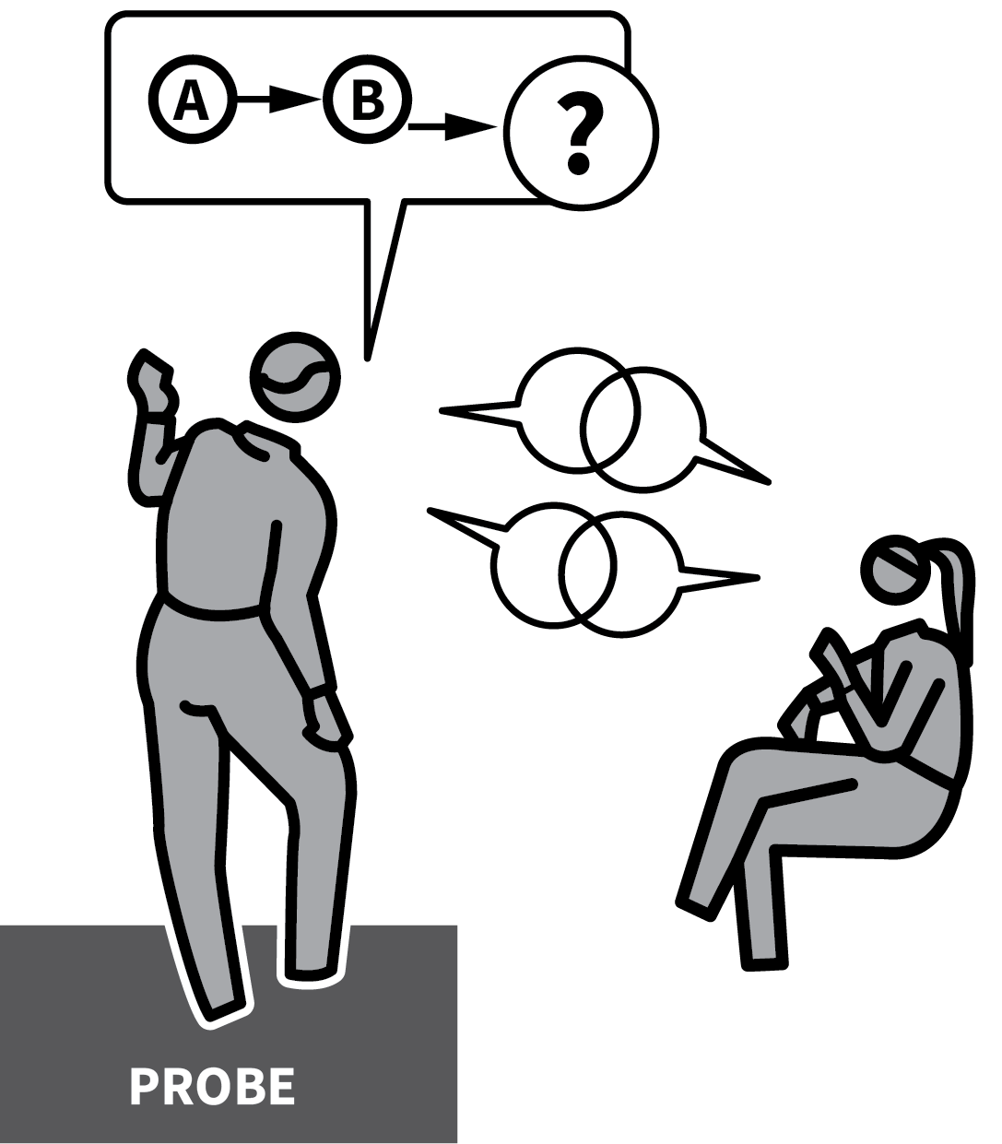
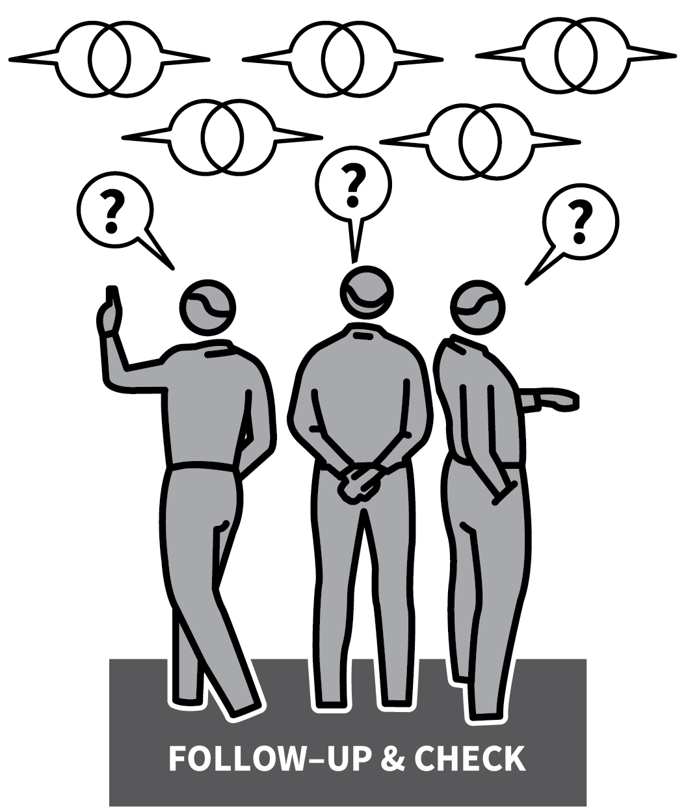
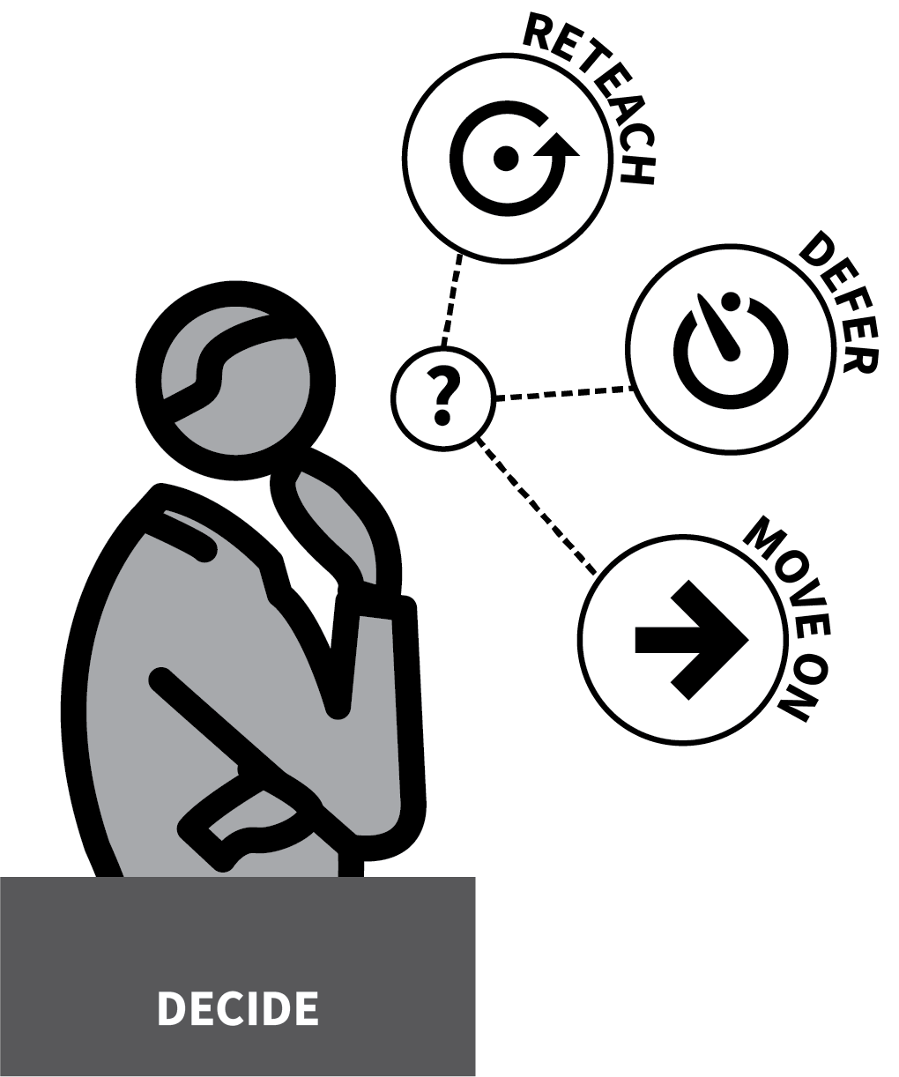
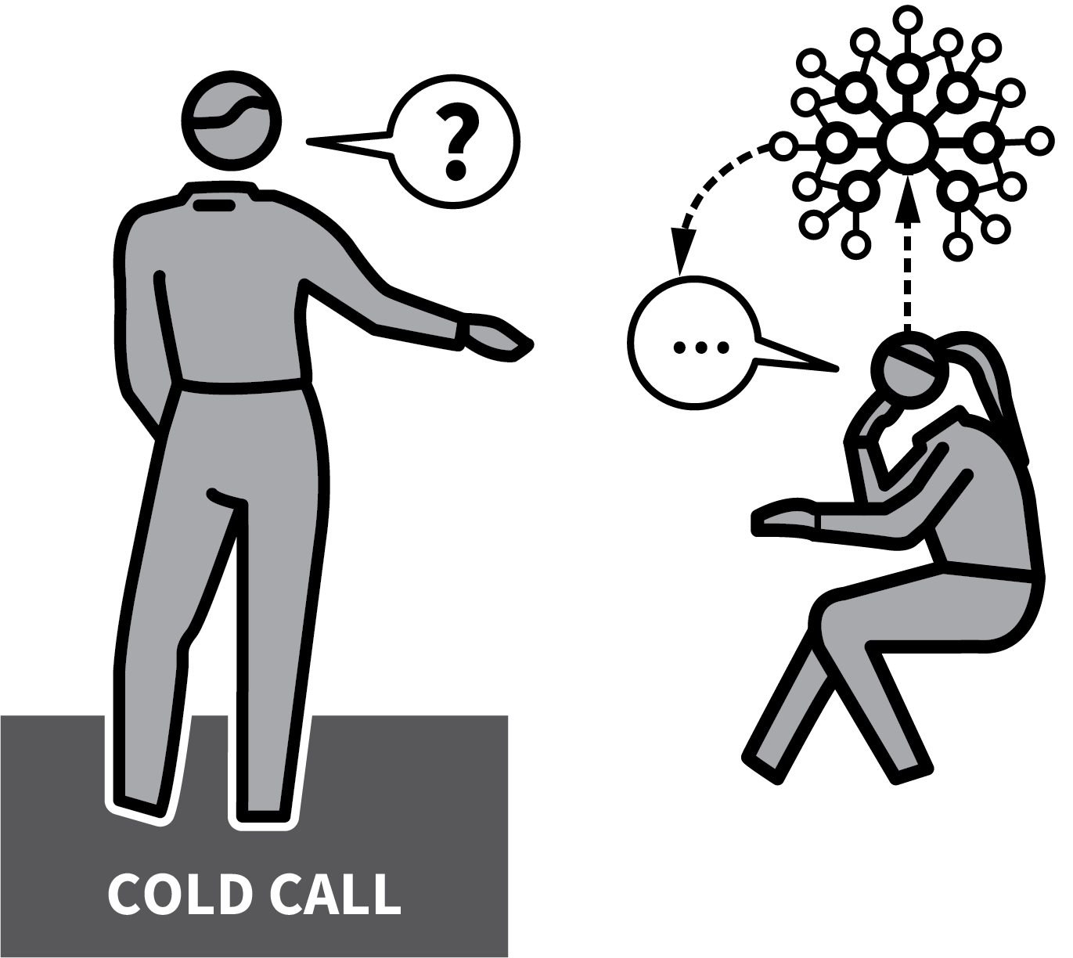
CHECK FOR UNDERSTANDING
1
2
3
4
5
COLD CALL, ASKING WHAT, NOT IF
PROBE WITH A SHORT DIALOGUE
FOLLOW-UP WITH MORE CHECKING DIALOGUES
EXPLORE DIFFERENCES AND DETAILS
RE-TEACH, DEFER OR
MOVE ON
A central idea in Rosenshine’s Principles is that more effective teachers systematically check for understanding from students.
We can’t assume students understand unless we get feedback telling us what they have understood.
The information we receive informs the next steps in a learning sequence.
The checking process itself also helps students to secure deeper understanding.

Slide 31
CHECK FOR UNDERSTANDING
1
2
3
4
5
COLD CALL, ASKING WHAT, NOT IF
Select a student to share their thinking. “Louisa, what have you understood?”
This is a much better question than asking “Has everyone understood?” or “Louisa, do you understand?”
Louisa now has to construct a response that shows what she has understood about the question.

Slide 32
CHECK FOR UNDERSTANDING
1
2
3
4
5
PROBE WITH A SHORT DIALOGUE
Go beyond accepting a short response. Find out more about what the student thinks, checking that they have understood the material in hand.
“That's interesting; what other reasons could there be; which is the most important; what would happen next?”

Slide 33
CHECK FOR UNDERSTANDING
1
2
3
4
5
FOLLOW-UP WITH MORE CHECKING DIALOGUES
Select another student and repeat the
process.
They should answer the same question using their previous thinking combined with ideas from the previous exchange.
Select more responses if you’re looking for a wider range, particularly if the material is challenging or open-ended.

Slide 34
CHECK FOR UNDERSTANDING
1
2
3
4
5
EXPLORE DIFFERENCES AND DETAILS
There is rich material in the exploring
differences between student explanations.
Which answer is more accurate, appropriate or sophisticated? Are there any errors or misconceptions?
Is each alternative answer equally valid?

Slide 35
CHECK FOR UNDERSTANDING
1
2
3
4
5
RE-TEACH, DEFER OR MOVE ON
Decide whether students seem to have
understood to sufficient depth.
If they have, move on or elect to give more challenging questions.
If they have not, go back to re-teach key
aspects or provide more practice.

Slide 36
CHECK FOR UNDERSTANDING
1
2
3
4
5
COLD CALL, ASKING WHAT, NOT IF
PROBE WITH A SHORT DIALOGUE
FOLLOW-UP WITH MORE CHECKING DIALOGUES
EXPLORE DIFFERENCES AND DETAILS
RE-TEACH, DEFER OR
MOVE ON
A central idea in Rosenshine’s Principles is that more effective teachers systematically check for understanding from students.
We can’t assume students understand unless we get feedback telling us what they have understood.
The information we receive informs the next steps in a learning sequence.
The checking process itself also helps students to secure deeper understanding.

Slide 37
1
2
3
4
5
6
7
8
9
10
COLD
CALLING
THINK, PAIR, SHARE
SHOW-ME
BOARDS
CHECK FOR
UNDERSTANDING
SAY IT AGAIN
BETTER
PROBING
QUESTIONS
PROCESS
QUESTIONS
FEEDBACK
THAT MOVES
FORWARD
FEEDBACK
AS ACTIONS
WHOLE-
CLASS
FEEDBACK
NEXT UP
SAY IT AGAIN
BETTER

Slide 38
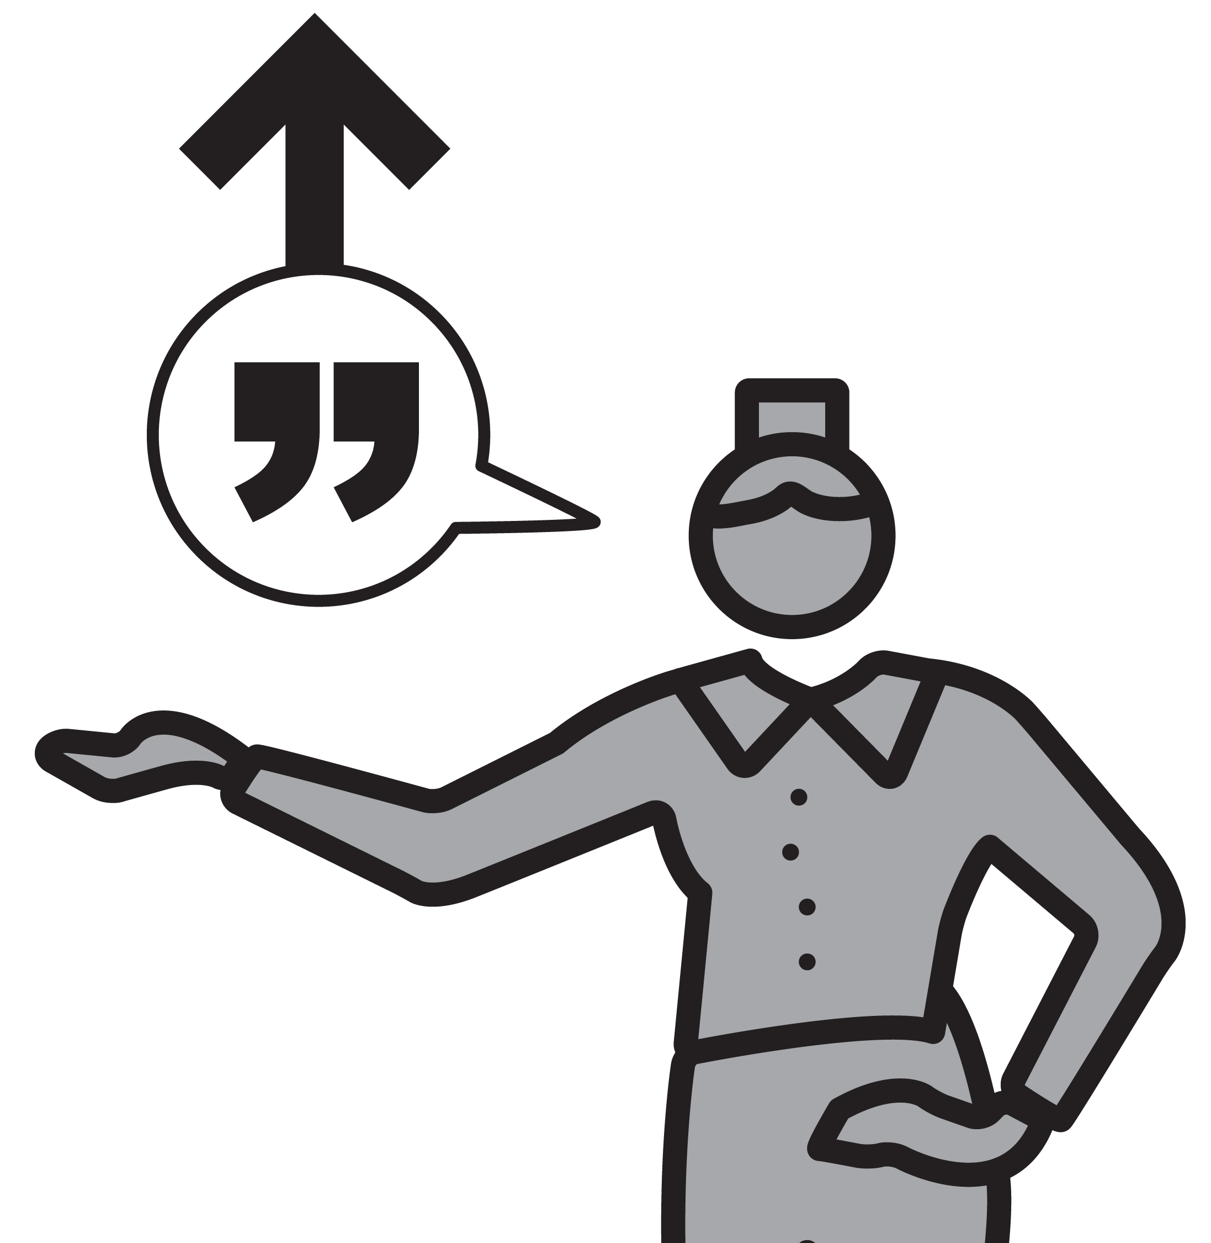
SAY IT AGAIN BETTER
SERIES
EXPLAINING & MODELLING
1
ASK A STUDENT A QUESTION
2
ACKNOWLEDGE THE FIRST RESPONSE
3
GIVE SUPPORTIVE FORMATIVE FEEDBACK
4
INVITE STUDENT TO “SAY IT AGAIN BETTER”
5
RESPOND TO THE IMPROVED RESPONSE

Slide 39
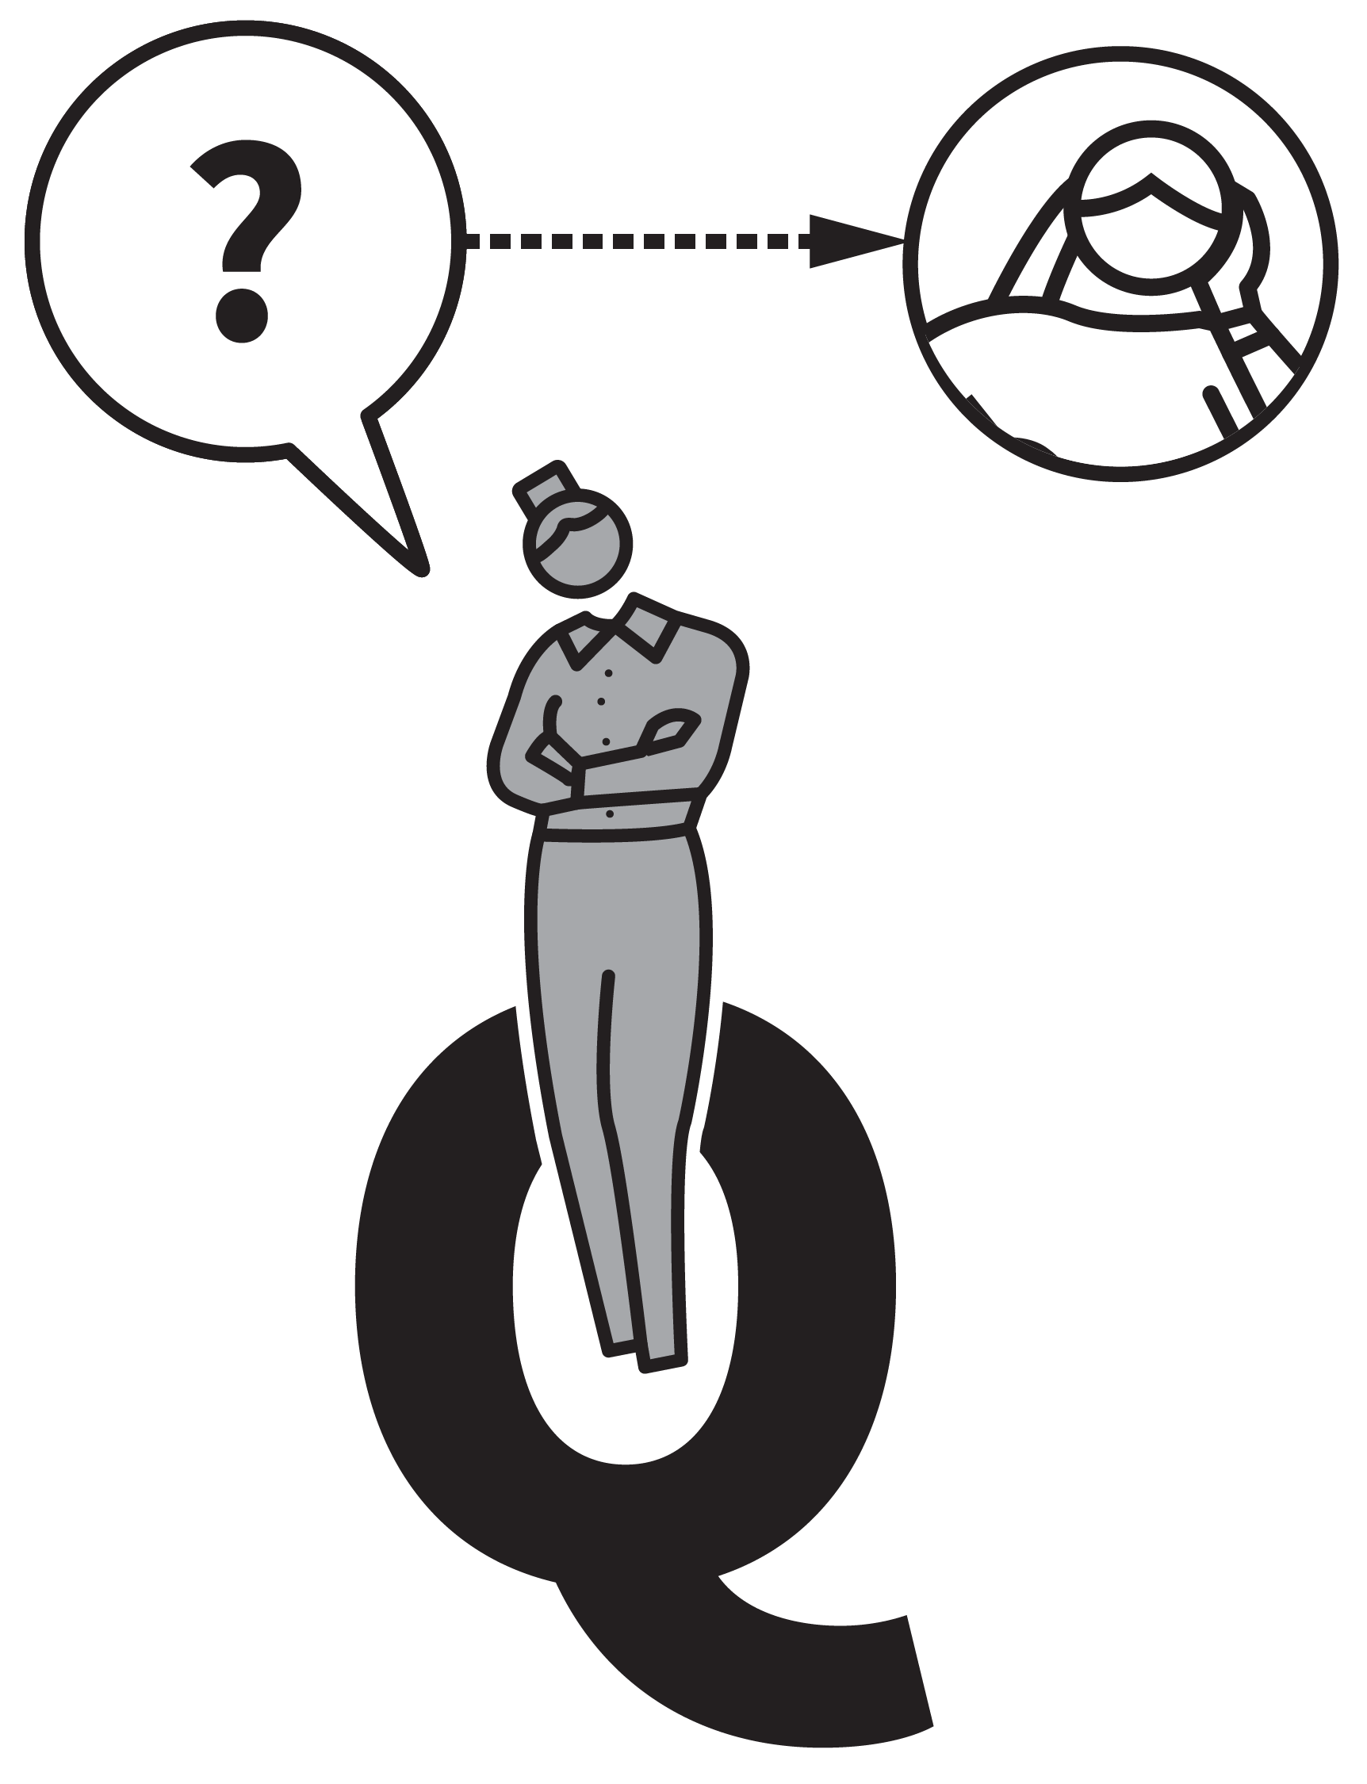


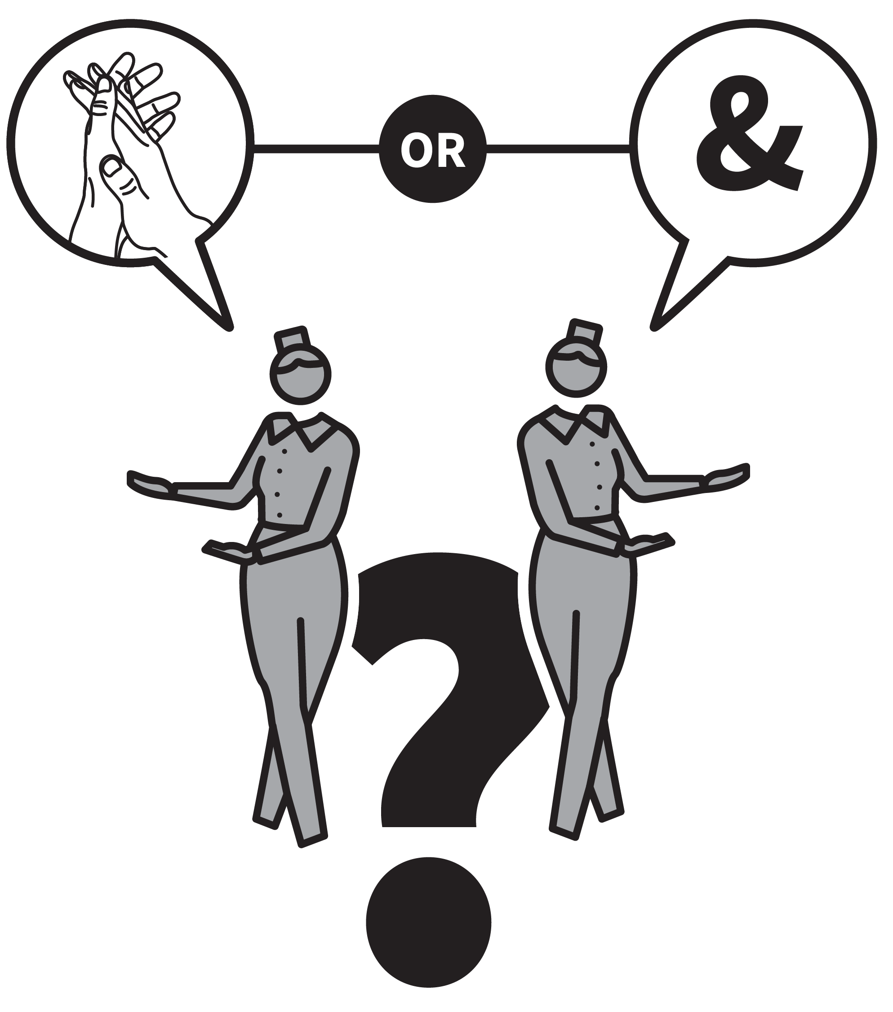
SAY IT AGAIN BETTER
1
2
3
4
5
ASK A STUDENT A QUESTION
ACKNOWLEDGE THE FIRST RESPONSE
GIVE SUPPORTIVE FORMATIVE FEEDBACK
INVITE STUDENT TO “SAY IT AGAIN BETTER”
RESPOND TO THE IMPROVED RESPONSE
This supports students to produce high quality verbal responses.
If you accept shallow responses without further development, students will assume half-formed answers are the norm.
However, unless you allow students to offer their more basic ideas, you can deter them from trying in future.
With Say It Again Better, you accept initial responses but develop them each time.

Slide 40
SAY IT AGAIN BETTER
1
2
3
4
5
ASK A STUDENT A QUESTION
Use one of the questioning techniques to invite students to think about the material and to prepare to respond. This might include Cold Calling; Think, Pair, Share; Check for Understanding.
The more demanding the question, the more important this technique will be.

Slide 41
SAY IT AGAIN BETTER
1
2
3
4
5
ACKNOWLEDGE THE FIRST RESPONSE
When a student gives a response, be as
positive as possible about their offering.
If it is a half-formed answer: “Yes, OK, that’s a good start. But let’s develop it further.”
If they are simply wrong: “Good try but that’s not quite it; let’s see how we can get it right.”

Slide 42
SAY IT AGAIN BETTER
1
2
3
4
5
GIVE SUPPORTIVE FORMATIVE FEEDBACK
Invite the student to consider specific ways the response could be improved.
“What's the more formal/technical term for that idea?”
“Does the graph just ‘go up’ or is there a more complex pattern you could describe?”

Slide 43
SAY IT AGAIN BETTER
1
2
3
4
5
INVITE STUDENT TO “SAY IT AGAIN BETTER”
Explore what a better answer might include then ask the same student to have another attempt — “OK, now, try to say it again better.”
In giving the improved answer, you can check they’ve understood at the same time as giving them an opportunity for practice.

Slide 44
SAY IT AGAIN BETTER
1
2
3
4
5
RESPOND TO THE IMPROVED RESPONSE
Decide if the improved response is sufficiently improved to warrant simple affirmative praise before moving on or whether there is value in adding more detail.
The effect is to demonstrate to students that they are capable of excellent responses; in time it is likely to become more common to produce them first time around.

Slide 45
SAY IT AGAIN BETTER
1
2
3
4
5
ASK A STUDENT A QUESTION
ACKNOWLEDGE THE FIRST RESPONSE
GIVE SUPPORTIVE FORMATIVE FEEDBACK
INVITE STUDENT TO “SAY IT AGAIN BETTER”
RESPOND TO THE IMPROVED RESPONSE
This supports students to produce high quality verbal responses.
If you accept shallow responses without further development, students will assume half-formed answers are the norm.
However, unless you allow students to offer their more basic ideas, you can deter them from trying in future.
With Say It Again Better, you accept initial responses but develop them each time.

Slide 46
1
2
3
4
5
6
7
8
9
10
COLD
CALLING
THINK, PAIR, SHARE
SHOW-ME
BOARDS
CHECK FOR
UNDERSTANDING
SAY IT AGAIN
BETTER
PROBING
QUESTIONS
PROCESS
QUESTIONS
FEEDBACK
THAT MOVES
FORWARD
FEEDBACK
AS ACTIONS
WHOLE-
CLASS
FEEDBACK
NEXT UP
PROBING
QUESTIONS

Slide 47
PROBING QUESTIONS
SERIES
EXPLAINING & MODELLING
1
ASK A STUDENT A QUESTION
2
FOLLOW–UP WITH A PROBING QUESTION
3
LISTEN AND PROBE FURTHER
4
ASK ANOTHER STUDENT TO CONTINUE
5
CHECK FOR UNDERSTANDING FROM OTHERS

Slide 48

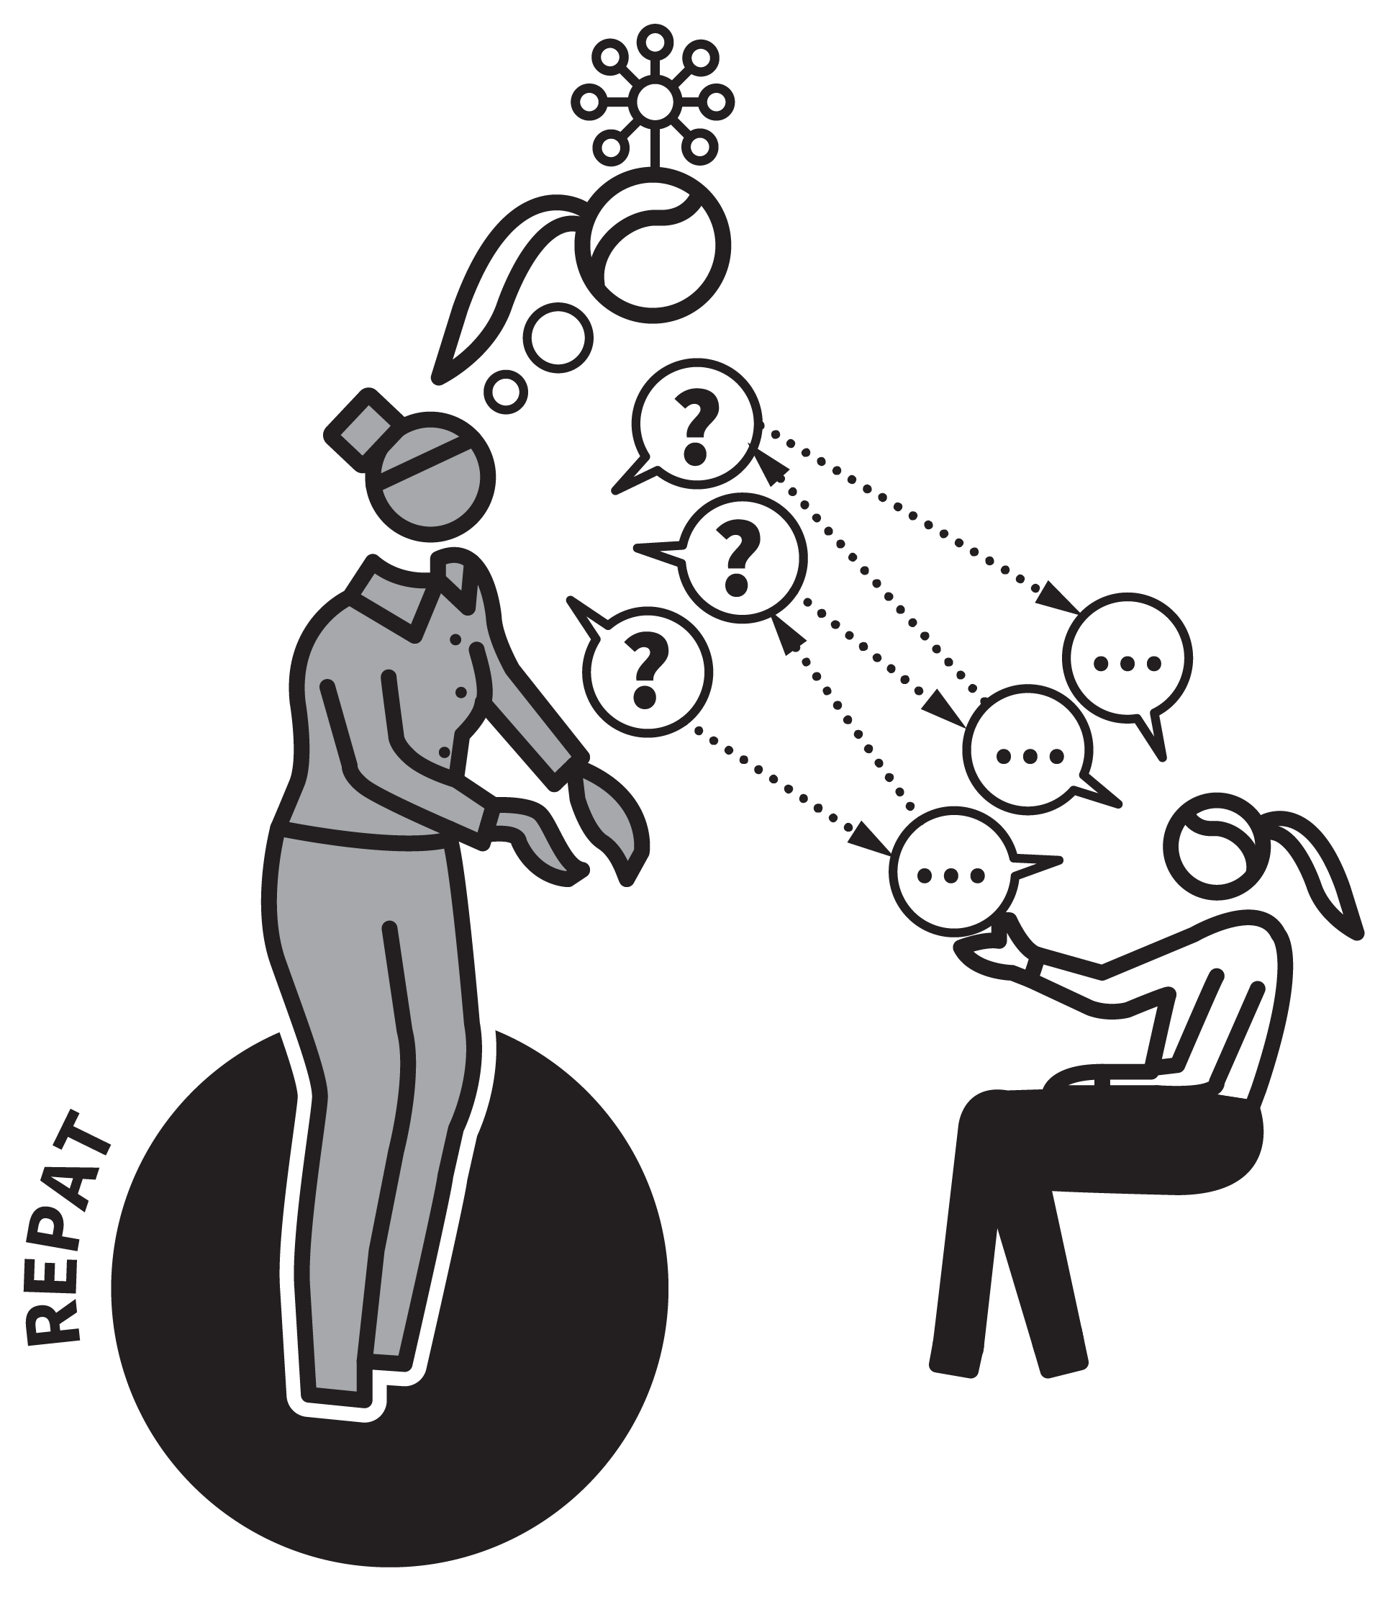
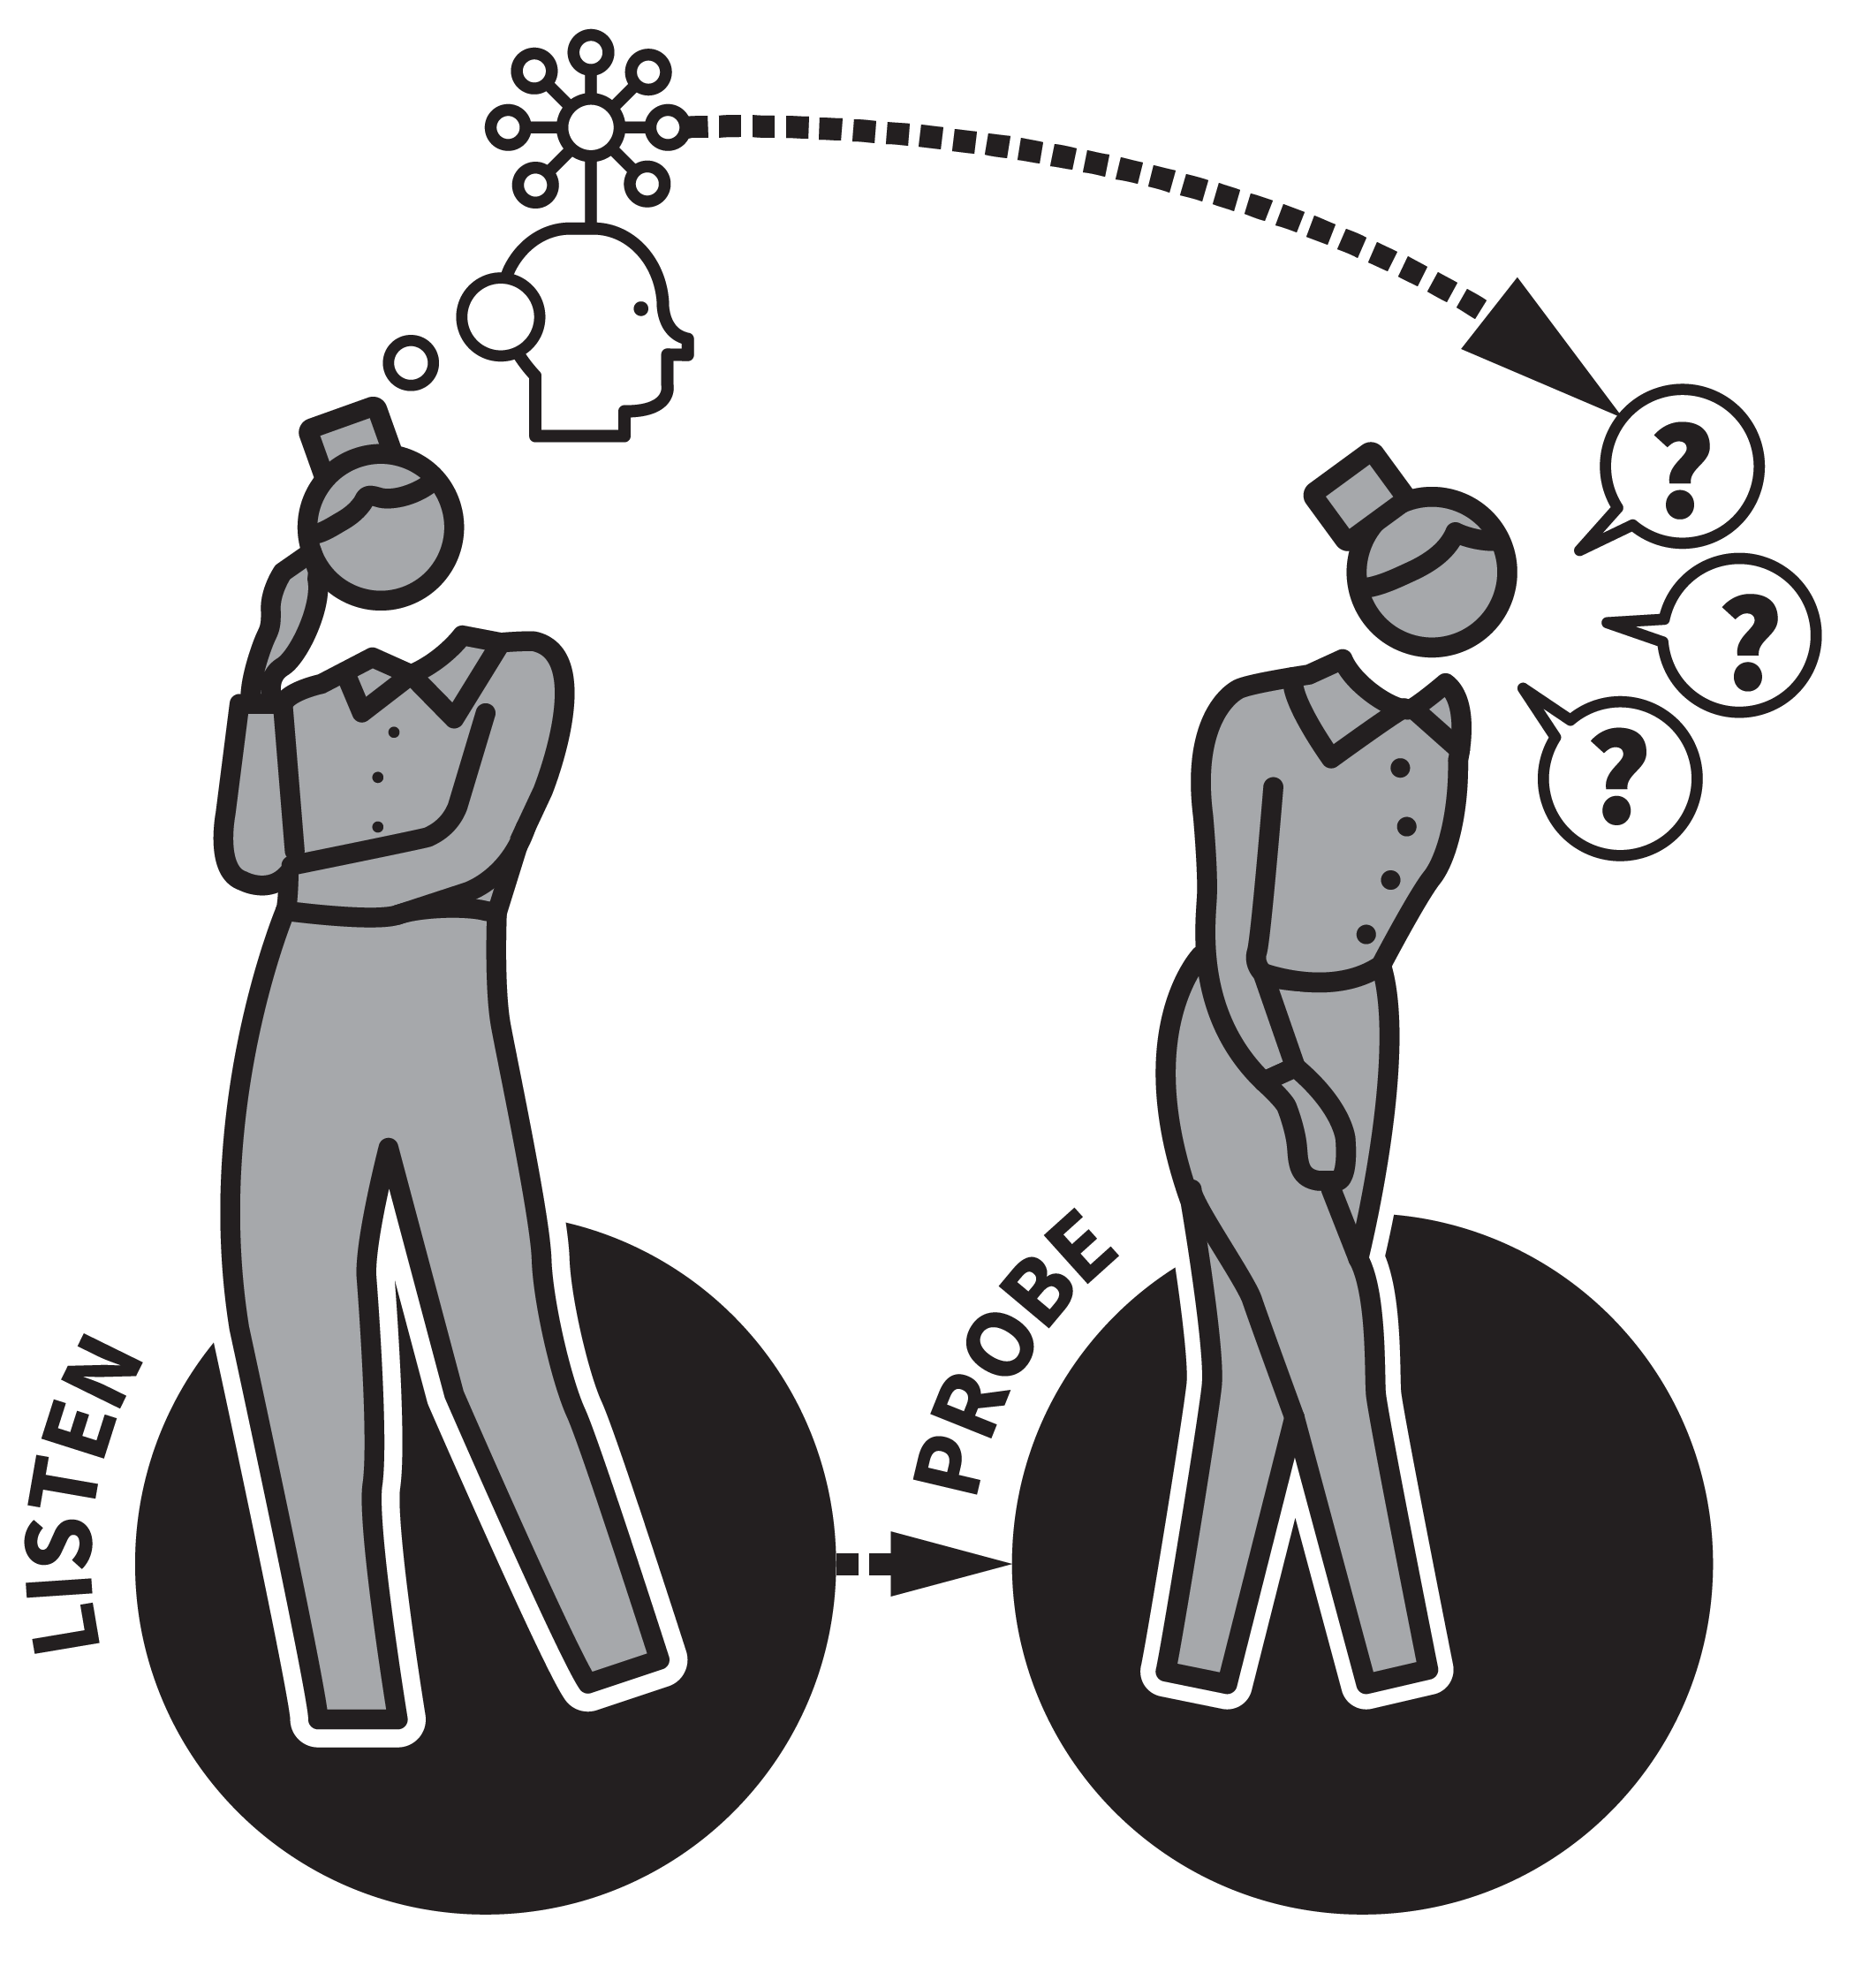
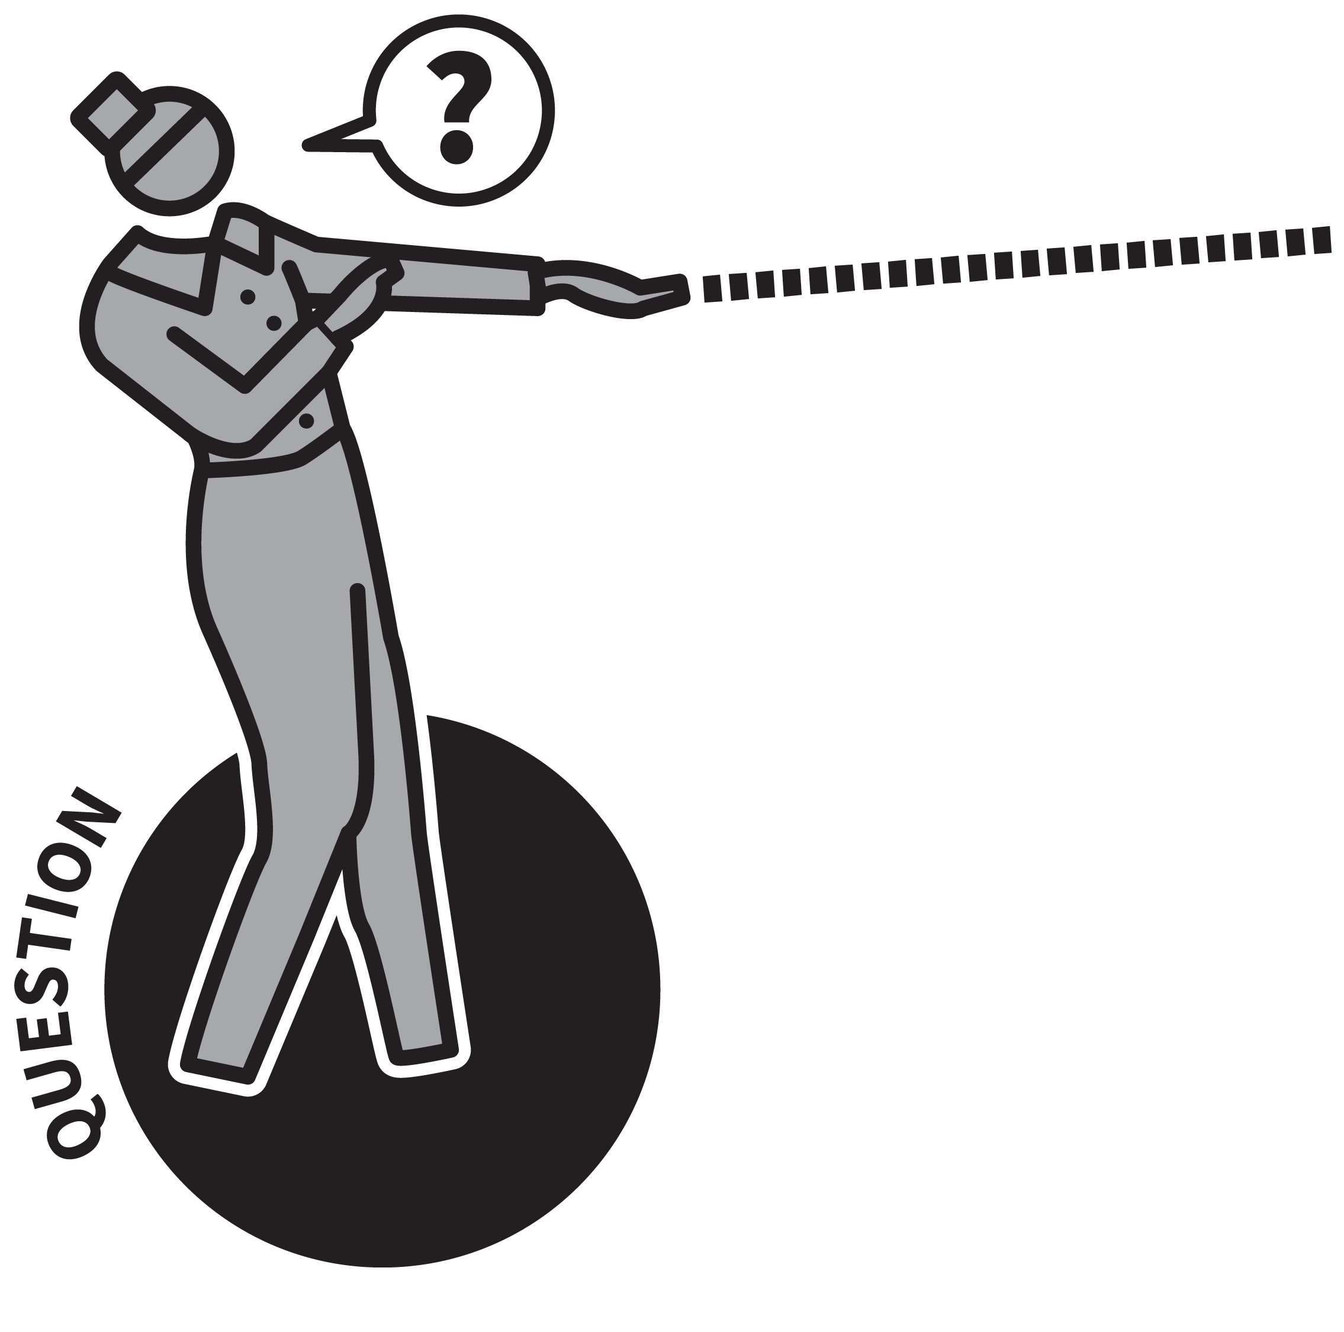
PROBING QUESTIONS
1
2
3
4
5
ASK A STUDENT A QUESTION
FOLLOW–UP WITH A PROBING QUESTION
LISTEN AND PROBE FURTHER
ASK ANOTHER STUDENT TO CONTINUE
CHECK FOR UNDERSTANDING FROM OTHERS
It is important to ask questions that make students probe their schema for the n ideas being discussed.
Well-chosen questions can support students to make links between ideas, to rehearse explanations to support long-term memory, to connect abstract and concrete examples and to identify knowledge gaps and misconceptions.
Probing questioning can develop into a habitual questioning style.

Slide 49
PROBING QUESTIONS
1
2
3
4
5
ASK A STUDENT A QUESTION
Use one of the questioning techniques to invite students to think about the material and to prepare to respond. This might include Cold Calling; Think, Pair, Share; Check for Understanding.
The more demanding the question, the more important this technique will be.

Slide 50
PROBING QUESTIONS
1
2
3
4
5
FOLLOW–UP WITH A PROBING QUESTION
“What's the connection between A and B? Is that always true or just in this case?”
“Is there another example? What are the main reasons?”
“What would be the most important factor? If we change variable C what happens to variable D? How does that idea explain this phenomenon?”

Slide 51
PROBING QUESTIONS
1
2
3
4
5
LISTEN AND PROBE FURTHER
Continue exploring the student’s schema,
listening carefully and responding
accordingly.
“OK, so if that’s true what about this? Is there another way you can explain it?”
“If A is true and B is false, what might we say about C? In what ways is that similar or
different to the previous example?”

Slide 52
PROBING QUESTIONS
1
2
3
4
5
ASK ANOTHER STUDENT TO CONTINUE
The rhythm of the questioning between Teacher T and students A, B and C might be:
T-A-T-A-T-A
T-B-T-B-T-B-T-B
T-C-T-C-T-C
Each student engages in a probing exchange.

Slide 53
PROBING QUESTIONS
1
2
3
4
5
CHECK FOR UNDERSTANDING FROM OTHERS
After a probing exchange, Check for
Understanding.
“What did you understand from Joe’s
response?”
This is useful as a check for student and teacher and supports the idea that all
students should listen in when a probing
dialogue is taking place.

Slide 54
PROBING QUESTIONS
1
2
3
4
5
ASK A STUDENT A QUESTION
FOLLOW–UP WITH A PROBING QUESTION
LISTEN AND PROBE FURTHER
ASK ANOTHER STUDENT TO CONTINUE
CHECK FOR UNDERSTANDING FROM OTHERS
It is important to ask questions that make students probe their schema for the n ideas being discussed.
Well-chosen questions can support students to make links between ideas, to rehearse explanations to support long-term memory, to connect abstract and concrete examples and to identify knowledge gaps and misconceptions.
Probing questioning can develop into a habitual questioning style.

Slide 55
1
2
3
4
5
6
7
8
9
10
COLD
CALLING
THINK, PAIR, SHARE
SHOW-ME
BOARDS
CHECK FOR
UNDERSTANDING
SAY IT AGAIN
BETTER
PROBING
QUESTIONS
PROCESS
QUESTIONS
FEEDBACK
THAT MOVES
FORWARD
FEEDBACK
AS ACTIONS
WHOLE-
CLASS
FEEDBACK
NEXT UP
PROCESS
QUESTIONS

Slide 56

PROCESS QUESTIONS
SERIES
EXPLAINING & MODELLING
1
MODEL YOUR THINKING
2
EMPHASISE HOW AND WHY
3
ASK STUDENTS TO EXPLAIN THEIR METHODS AND REASONING
4
ASK STUDENTS TO EXPLAIN THEIR IDEAS AND CHOICES
5
ASK HOW SIMILAR ALTERNATIVE QUESTIONS OR PROBLEMS MIGHT BE APPROACHED

Slide 57
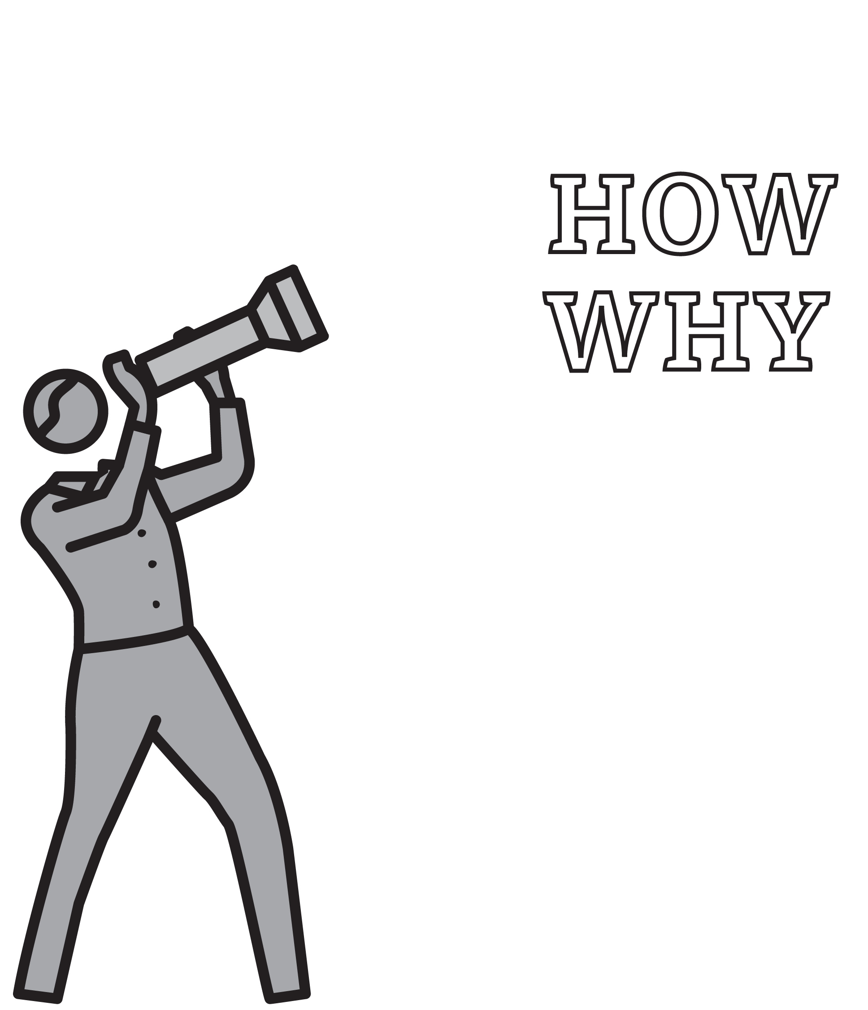



PROCESS QUESTIONS
1
2
3
4
5
MODEL YOUR THINKING
EMPHASISE HOW AND WHY
ASK STUDENTS TO EXPLAIN THEIR METHODS AND REASONING
ASK STUDENTS TO EXPLAIN THEIR IDEAS AND CHOICES
ASK HOW SIMILAR ALTERNATIVE QUESTIONS OR PROBLEMS MIGHT BE APPROACHED
Rosenshine says that more effective teachers typically ask process questions.
The EEF suggests teachers should encourage metacognitive talk during lessons.
Discussions should focus on questions such as ‘how do we know?’ or ‘how do we work it out?’
Modelling dialogue around these questions helps students to think in this way independently.

Slide 58
PROCESS QUESTIONS
1
2
3
4
5
MODEL YOUR THINKING
During an instructional phase, narrate your thought processes.
As you talk through a problem, make your thinking explicit, including where you:
draw on recall of knowledge, make choices, use a routine strategy, plan ideas, check answers for accuracy.

Slide 59
PROCESS QUESTIONS
1
2
3
4
5
EMPHASISE HOW AND WHY
Routinely place an emphasis on how we know what we know and why the answer is the answer.
e.g. we might learn that 7-squared is 49 as a number fact but we probably work out 7-cubed by multiplying 49 by 7. This could be done in various ways.

Slide 60
PROCESS QUESTIONS
1
2
3
4
5
ASK STUDENTS TO EXPLAIN THEIR METHODS AND REASONING
When a student has given a response, follow up with a process question:
“Thanks James, that’s correct — what method did you use?”
“That's interesting Sherin — why did you put them in that order?”

Slide 61
PROCESS QUESTIONS
1
2
3
4
5
ASK STUDENTS TO EXPLAIN THEIR IDEAS AND CHOICES
When students are asked to volunteer ideas or select an option from a set of choices, ask them to justify them:
“Great idea Taran. What made you think of that?”
“Interesting suggestion Alice. Why do you think that would work?”

Slide 62
PROCESS QUESTIONS
1
2
3
4
5
ASK HOW SIMILAR ALTERNATIVE
QUESTIONS OR PROBLEMS MIGHT
BE APPROACHED
It’s important to show how a range of
approaches can be valid.
“Naureen, can you suggest a different way of approaching this question?”
“Is there another way we could explain Macbeth's response... Andy?”

Slide 63
PROCESS QUESTIONS
1
2
3
4
5
MODEL YOUR THINKING
EMPHASISE HOW AND WHY
ASK STUDENTS TO EXPLAIN THEIR METHODS AND REASONING
ASK STUDENTS TO EXPLAIN THEIR IDEAS AND CHOICES
ASK HOW SIMILAR ALTERNATIVE QUESTIONS OR PROBLEMS MIGHT BE APPROACHED
Rosenshine says that more effective teachers typically ask process questions.
The EEF suggests teachers should encourage metacognitive talk during lessons.
Discussions should focus on questions such as ‘how do we know?’ or ‘how do we work it out?’
Modelling dialogue around these questions helps students to think in this way independently.

Slide 64
1
2
3
4
5
6
7
8
9
10
COLD
CALLING
THINK, PAIR, SHARE
SHOW-ME
BOARDS
CHECK FOR
UNDERSTANDING
SAY IT AGAIN
BETTER
PROBING
QUESTIONS
PROCESS
QUESTIONS
FEEDBACK
THAT MOVES
FORWARD
FEEDBACK
AS ACTIONS
WHOLE-
CLASS
FEEDBACK
NEXT UP
FEEDBACK THAT MOVES FORWARD

Slide 65
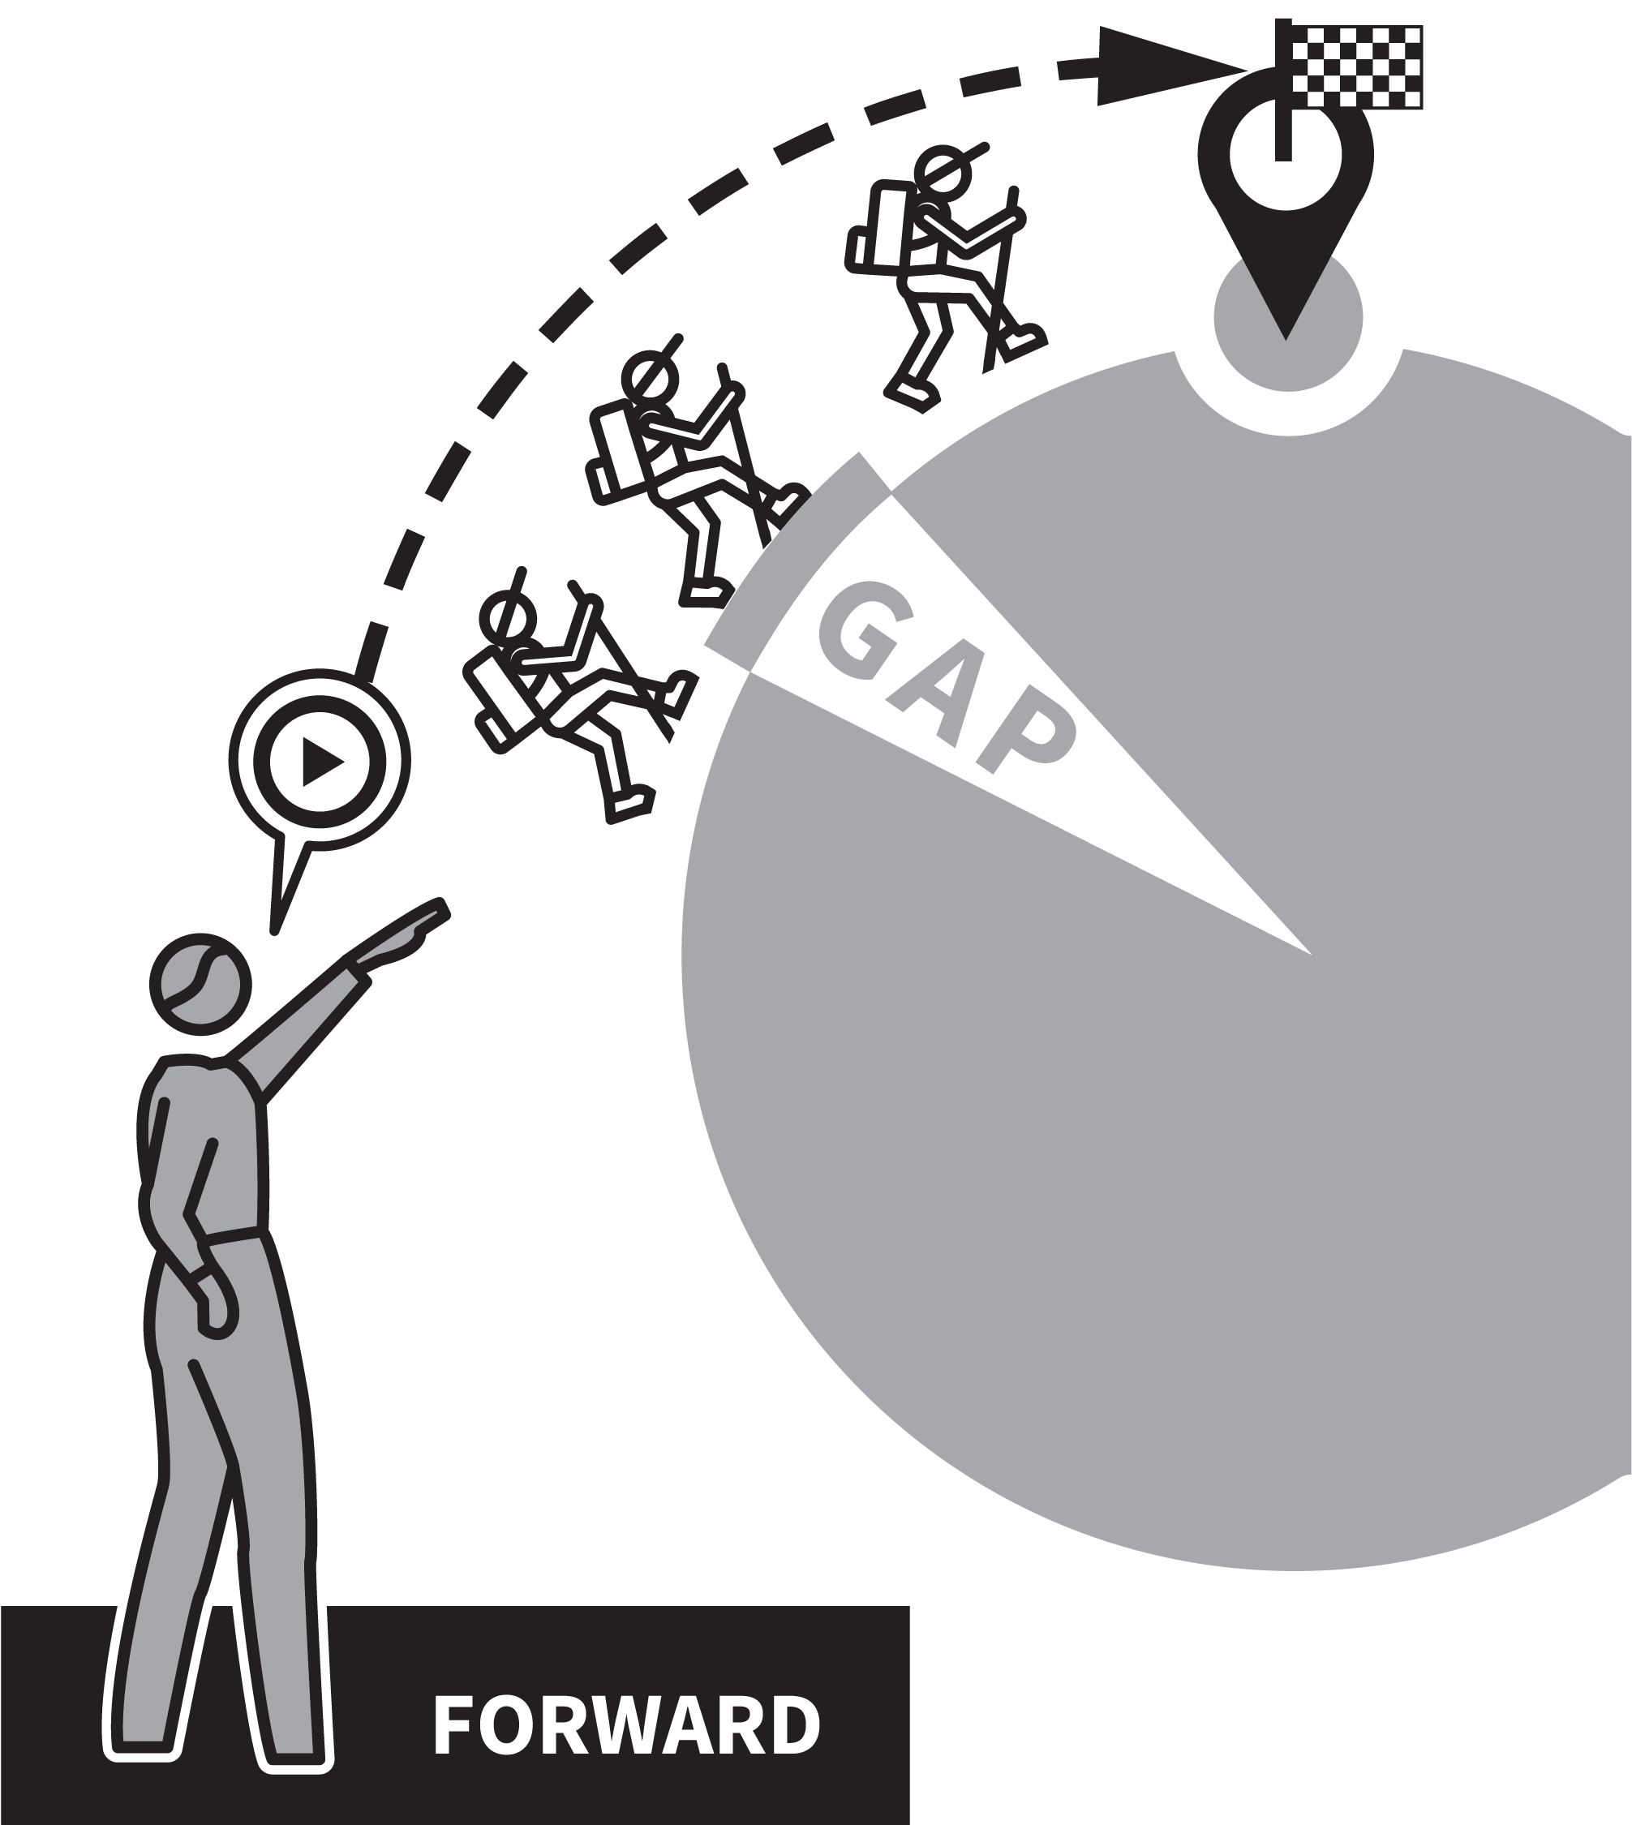
FEEDBACK THAT MOVES FORWARD
SERIES
EXPLAINING & MODELLING
1
FOCUS FORWARDS
2
KEEP IT POSITIVE AND SPECIFIC
3
MATCH THE MESSAGE TO THE STUDENT
4
AVOID SATNAV SYNDROME
5
REDUCE FEEDBACK OVER TIME

Slide 66

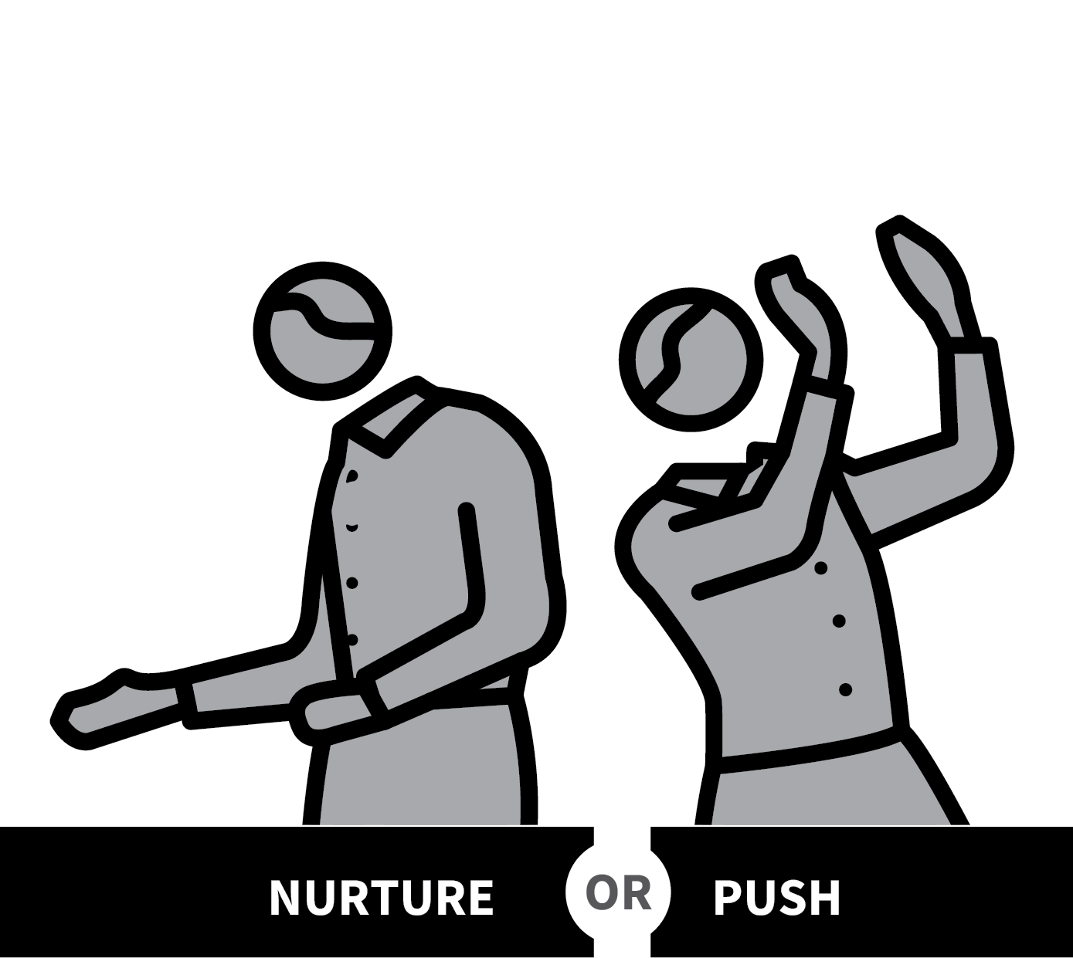
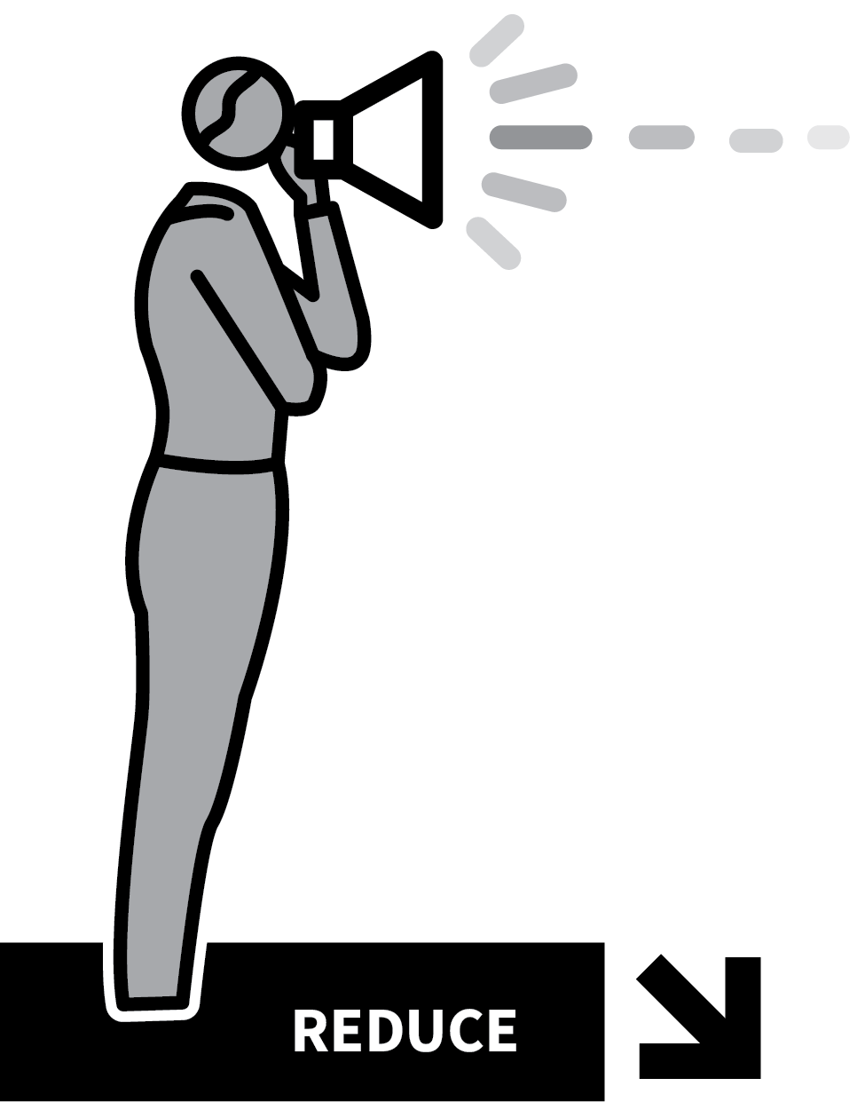

FEEDBACK THAT MOVES FORWARD
1
2
3
4
5
FOCUS FORWARDS
KEEP IT POSITIVE AND SPECIFIC
MATCH THE MESSAGE TO THE STUDENT
AVOID SATNAV SYNDROME
REDUCE FEEDBACK OVER TIME
Feedback plays a central role in securing students’ learning, supporting them to know how to deepen knowledge and understanding or improve performance.
Effective feedback needs to be understood and accepted and to be actionable n so that students can use it to secure improvements.
Part of this relies on feedback providing motivation to apply effort alongside specific strategies.

Slide 67
FEEDBACK THAT MOVES FORWARD
1
2
3
4
5
FOCUS FORWARDS
Use assessments to identify areas for
improvement in performance or gaps in
understanding.
Rather than describing past performance, focus on actions they can take to improve in future.
Feedback needs to be given part-way through a learning cycle, not at the end.

Slide 68
FEEDBACK THAT MOVES FORWARD
1
2
3
4
5
KEEP IT POSITIVE AND SPECIFIC
Feedback should largely be framed in
language that is positive and encouraging.
Tell students all the things they are succeeding at.
Be as as specific as possible, e.g. rather than suggesting a student should ‘write a better conclusion’, specify how the conclusion could be improved.

Slide 69
FEEDBACK THAT MOVES FORWARD
1
2
3
4
5
MATCH THE MESSAGE TO THE STUDENT
Feedback only succeeds if students trust it and use it to increase their effort or raise their aspirations to improve their performance.
Some students need careful nurturing and
respond badly to perceived crticisim.
Others need a strong push to lead them to
increase their effort.

Slide 70
FEEDBACK THAT MOVES FORWARD
1
2
3
4
5
AVOID SATNAV SYNDROME
A Sat Nav system gives continuous directions making it possible to travel from A to B without learning the route.
Give feedback focusing on changing students’ capacity to produce excellent work and less on producing a specific exemplary piece.
Give prompts but leave students to take
improvement steps independently.

Slide 71
FEEDBACK THAT MOVES FORWARD
1
2
3
4
5
REDUCE FEEDBACK OVER TIME
As students engage in Independent Practice and gain confidence, reduce detail in the feedback given, allowing more struggle time before offering feedback.
Train students to generate as much
self-assessed feedback as possible
referencing success criteria, exemplars of stamdards, and worked answers.

Slide 72
FEEDBACK THAT MOVES FORWARD
1
2
3
4
5
FOCUS FORWARDS
KEEP IT POSITIVE AND SPECIFIC
MATCH THE MESSAGE TO THE STUDENT
AVOID SATNAV SYNDROME
REDUCE FEEDBACK OVER TIME
Feedback plays a central role in securing students’ learning, supporting them to know how to deepen knowledge and understanding or improve performance.
Effective feedback needs to be understood and accepted and to be actionable n so that students can use it to secure improvements.
Part of this relies on feedback providing motivation to apply effort alongside specific strategies.

Slide 73
1
2
3
4
5
6
7
8
9
10
COLD
CALLING
THINK, PAIR, SHARE
SHOW-ME
BOARDS
CHECK FOR
UNDERSTANDING
SAY IT AGAIN
BETTER
PROBING
QUESTIONS
PROCESS
QUESTIONS
FEEDBACK
THAT MOVES
FORWARD
FEEDBACK
AS ACTIONS
WHOLE-
CLASS
FEEDBACK
NEXT UP
FEEDBACK
AS ACTIONS

Slide 74

FEEDBACK AS ACTIONS
SERIES
EXPLAINING & MODELLING
1
REDRAFT OR RE–DO
2
REHEARSE OR REPEAT
3
REVISIT AND RESPOND TO MORE QUESTIONS
4
RE–LEARN MATERIAL AND RE–TEST
5
RESEARCH AND RECORD

Slide 75

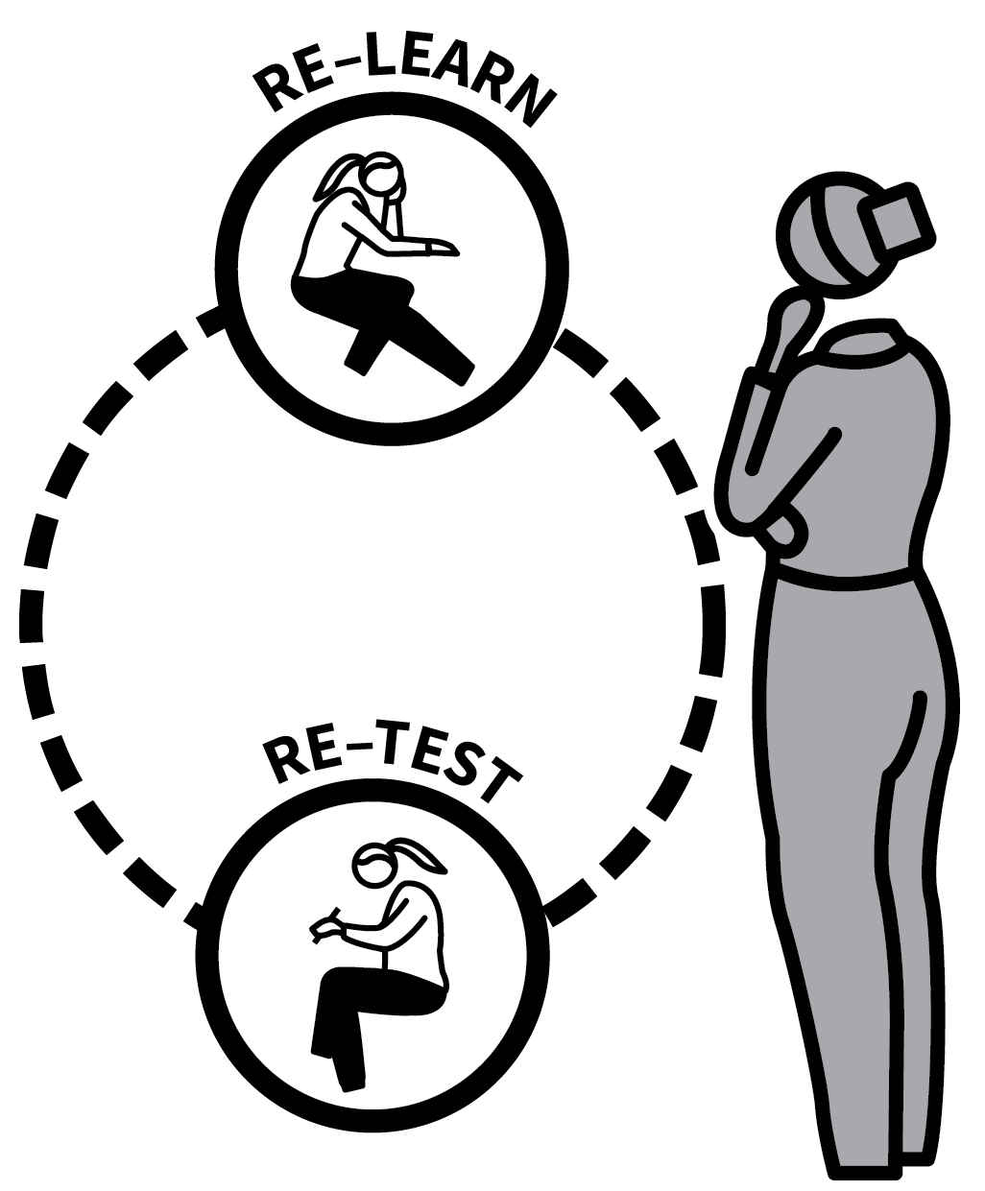


FEEDBACK AS ACTIONS
1
2
3
4
5
REDRAFT OR RE–DO
REHEARSE OR REPEAT
REVISIT AND RESPOND TO MORE QUESTIONS
RE–LEARN MATERIAL AND RE–TEST
RESEARCH AND RECORD
If feedback is to move students forward in their learning, it can be helpful to frame it as an instruction to do something.
This can be more useful and easier to understand than focusing on describing work that has been done previously.
In giving feedback as actions, the feedback is embedded in the selection of the task.

Slide 76
FEEDBACK AS ACTIONS
1
2
3
4
5
REDRAFT OR RE–DO
Give opportunities to improve a piece of work by repeating it one or more times.
Ideas might come from Whole-Class
Feedback, specific actionable comments or giving students exemplar work to compare to their own.
Sometimes it’s enough just to say “do it again better”.

Slide 77
FEEDBACK AS ACTIONS
1
2
3
4
5
REHEARSE OR REPEAT
Students focus on certain aspects of learning that they have already encountered with a view to improve their confidence and fluency.
e.g. repeating sets of problems, rehearsing explanations or performances.
Improvement through repetition and
rehearsal can be secured in a range of
subjects.

Slide 78
FEEDBACK AS ACTIONS
1
2
3
4
5
REVISIT AND RESPOND TO MORE QUESTIONS
Instead of going back to make corrections on previous questions, it can be more productive to re-teach key elements where common errors were occuring and then set a fresh set of questions to respond to.
The feedback is essentially “do these
questions”.

Slide 79
FEEDBACK AS ACTIONS
1
2
3
4
5
RE–LEARN MATERIAL AND RE–TEST
Where students are required to learn a
specific set of knowledge but have gaps in their recall, feedback can be to identify which details they found hard to recall and to engage in retrieval practice activities.
If the knowledge and the retrieval technique are very specific, this works well as feedback.

Slide 80
FEEDBACK AS ACTIONS
1
2
3
4
5
RESEARCH AND RECORD
Where students’ work would be improved by making reference to a wider range of ideas, texts, case studies, examples or contain more details, feedback can be that they should do some focused research and record their findings.

Slide 81
FEEDBACK AS ACTIONS
1
2
3
4
5
REDRAFT OR RE–DO
REHEARSE OR REPEAT
REVISIT AND RESPOND TO MORE QUESTIONS
RE–LEARN MATERIAL AND RE–TEST
RESEARCH AND RECORD
If feedback is to move students forward in their learning, it can be helpful to frame it as an instruction to do something.
This can be more useful and easier to understand than focusing on describing work that has been done previously.
In giving feedback as actions, the feedback is embedded in the selection of the task.

Slide 82
1
2
3
4
5
6
7
8
9
10
COLD
CALLING
THINK, PAIR, SHARE
SHOW-ME
BOARDS
CHECK FOR
UNDERSTANDING
SAY IT AGAIN
BETTER
PROBING
QUESTIONS
PROCESS
QUESTIONS
FEEDBACK
THAT MOVES
FORWARD
FEEDBACK
AS ACTIONS
WHOLE-
CLASS
FEEDBACK
NEXT UP
WHOLE-CLASS
FEEDBACK

Slide 83

WHOLE-CLASS
FEEDBACK
SERIES
EXPLAINING & MODELLING
1
READ THROUGH STUDENTS’ WORK
2
NOTE THE STRENGTHS
3
NOTE AREAS FOR IMPROVEMENT
4
GIVE THE FEEDBACK
5
GIVE IMPROVEMENT TIME

Slide 84


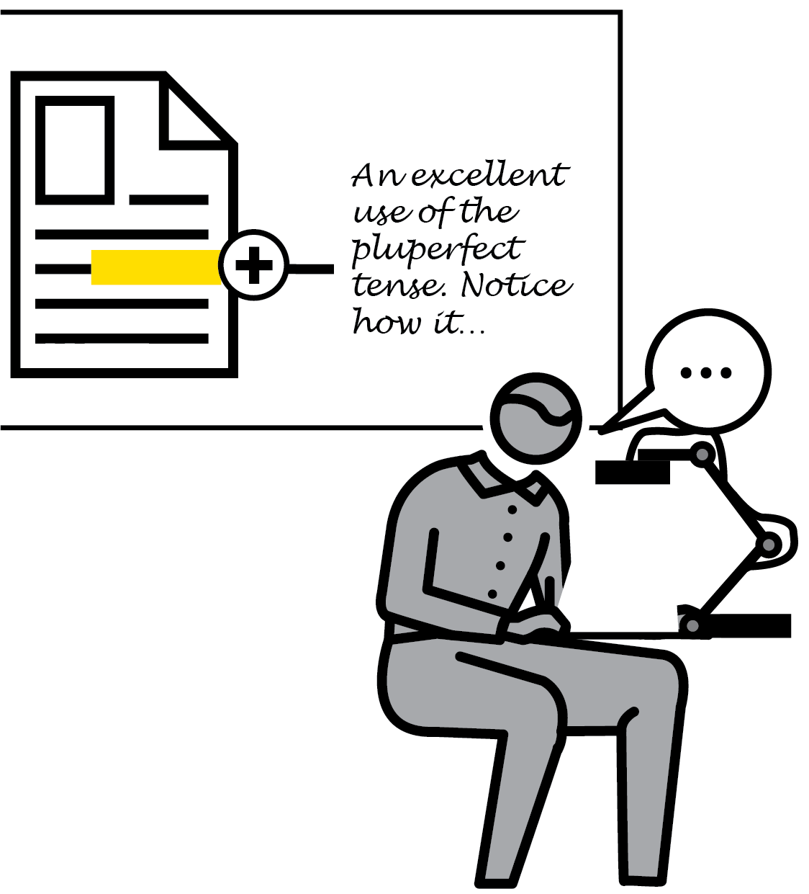
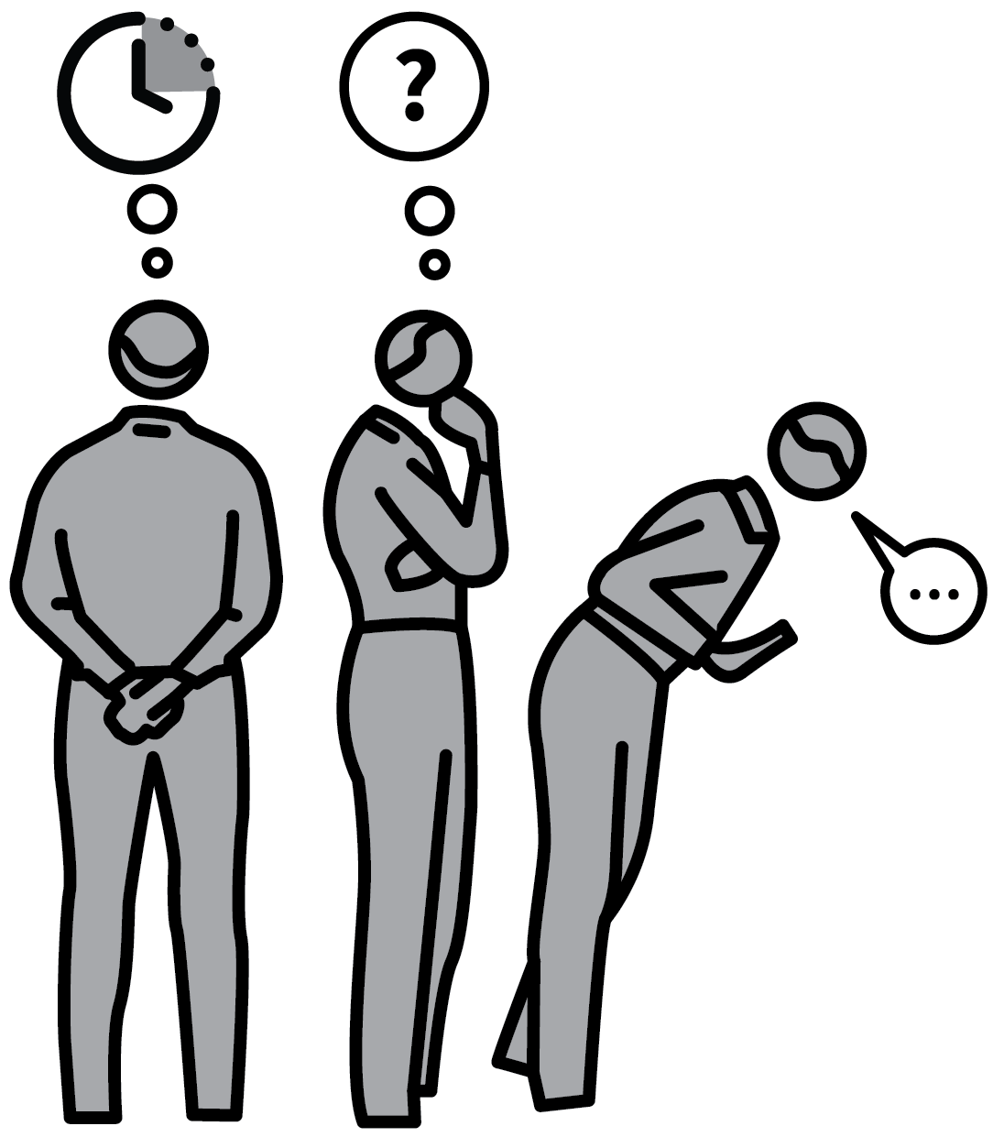
WHOLE-CLASS FEEDBACK
1
2
3
4
5
READ THROUGH STUDENTS’ WORK
NOTE THE STRENGTHS
NOTE AREAS FOR IMPROVEMENT
GIVE THE FEEDBACK
GIVE IMPROVEMENT TIME
As part of a diet of feedback, this technique is an excellent way to give students timely, detailed formative feedback whilst minimising teacher workload.
It replaces writing individual comments in books with feedback given to the class as a whole.
This allows the teacher to engage with the details of the work students produce rapidly, to inform a short, effective feedback and improvement cycle.

Slide 85
WHOLE-CLASS FEEDBACK
1
2
3
4
5
READ THROUGH STUDENTS’ WORK
After collecting in a set of books, read through them, focusing on specific recent pieces of work.
It’s important that this happens before the next time you will see the students so it forms part of the flow of ideas in your teaching. Ideally read all the books but, if time is pressing, a sample can be sufficient.

Slide 86
WHOLE-CLASS FEEDBACK
1
2
3
4
5
NOTE THE STRENGTHS
Identify common areas of strength; when
reporting back to students, it will help to stress the things that are being done well so that they are reinforced as well as serving as a prompt to the few students not yet doing them.
Identify specific examples of excellent work with the intention of showcasing them as models.

Slide 87
WHOLE-CLASS FEEDBACK
1
2
3
4
5
NOTE AREAS FOR IMPROVEMENT
Reading through, make a manageable list of common misconceptions, spelling errors, technical errors and any other areas for improvement.
As the feedback will be public, don’t attach errors to individuals.
Note students who you might need to speak to individually because of specific issues.

Slide 88
WHOLE-CLASS FEEDBACK
1
2
3
4
5
GIVE THE FEEDBACK
The next lesson, give the work back and
present the feedback to the whole class,
running over the strengths and areas for
improvement.
Use a one-slide presentation or a visualiser to show your notes.
Highlight examples of excellence using a
visualiser or other appropriate showcase method.

Slide 89
WHOLE-CLASS FEEDBACK
1
2
3
4
5
GIVE IMPROVEMENT TIME
After the feedback, give students time to make immediate improvements.
They need to identify where in their work common errors occur and where they have improvements to make in line with the
feedback.
This makes them think hard about the quality of their work, fostering a stronger
understanding of standards.

Slide 90
WHOLE-CLASS FEEDBACK
1
2
3
4
5
READ THROUGH STUDENTS’ WORK
NOTE THE STRENGTHS
NOTE AREAS FOR IMPROVEMENT
GIVE THE FEEDBACK
GIVE IMPROVEMENT TIME
As part of a diet of feedback, this technique is an excellent way to give students timely, detailed formative feedback whilst minimising teacher workload.
It replaces writing individual comments in books with feedback given to the class as a whole.
This allows the teacher to engage with the details of the work students produce rapidly, to inform a short, effective feedback and improvement cycle.

