Slide 1

John Catt Educational
MODE B TEACHING
TEACHING
WALKTHRUs
PRESENTATION
SLIDES
TOM SHERRINGTON & OLIVER CAVIGLIOLI
COLLABORATIVE LEARNING
HOMEWORK AS GUIDED STUDY
ENQUIRY PROJECTS
OPEN RESPONSE TASKS
ORACY: DEBATING
ORACY: TALK FOR WRITING
ORACY: INSTRUCTIONAL INPUTS
INDEPENDENT LEARNING: PRE-READING

Slide 2

COLLABORATIVE
LEARNING:
GENERAL PRINCIPLES
SERIES
MODE B TEACHING
1
ESTABLISH INDIVIDUAL LEARNING GOALS
2
ESTABLISH A ROLE FOR EACH MEMBER OF THE GROUP
3
GROUP SUCCESS DEPENDS ON INDIVIDUALS’ SUCCESS
4
MONITOR GROUP BEHAVIOURS
5
CHECK INDIVIDUAL AND GROUP OUTCOMES

Slide 3


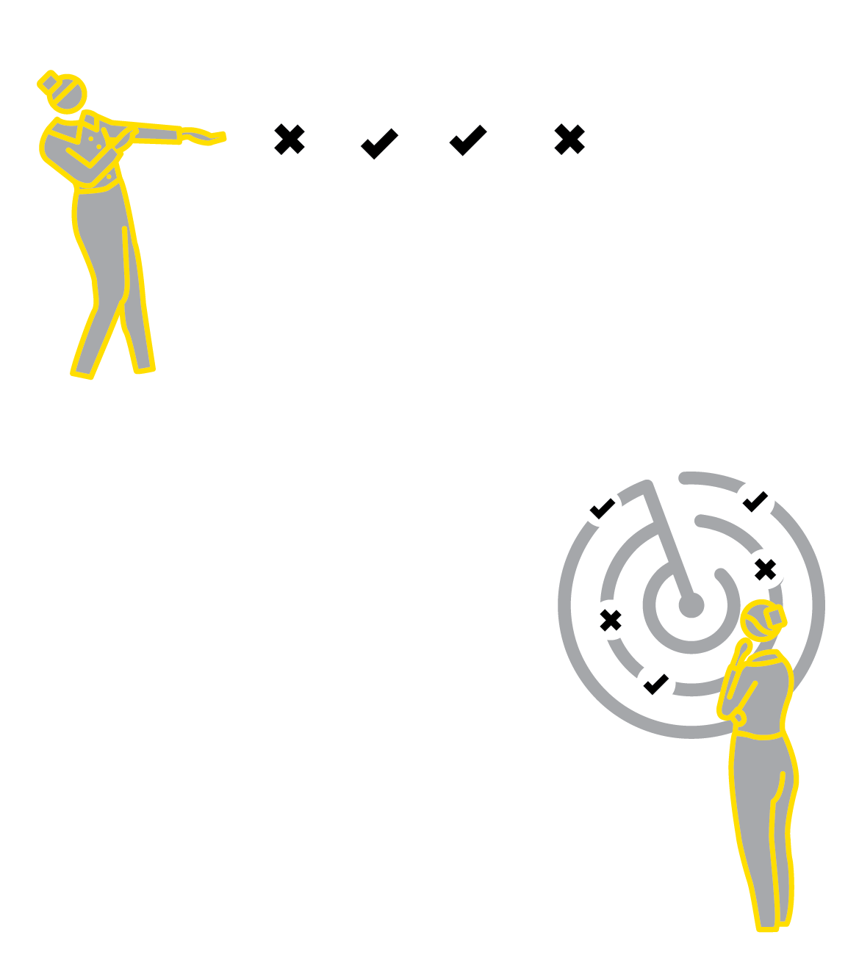

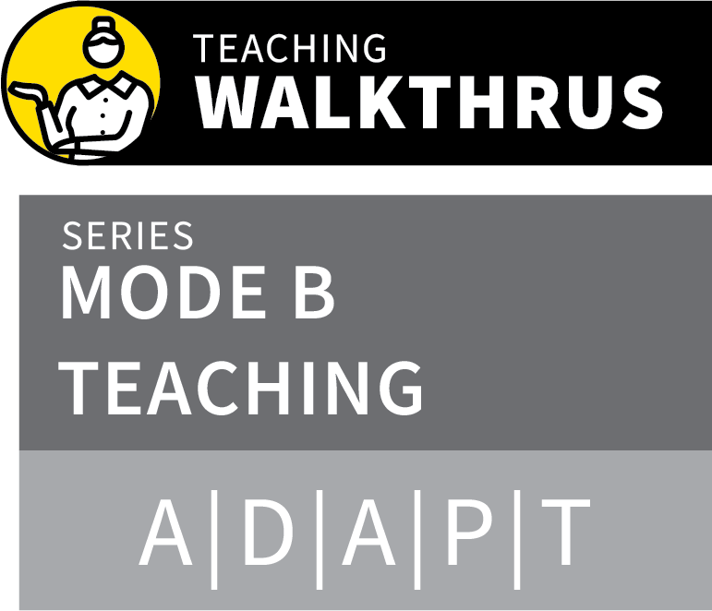
COLLABORATIVE LEARNING: GENERAL PRINCIPLES
1
2
3
4
5
ESTABLISH INDIVIDUAL LEARNING GOALS
ESTABLISH A ROLE FOR EACH MEMBER OF
THE GROUP
GROUP SUCCESS DEPENDS ON INDIVIDUALS’ SUCCESS
MONITOR GROUP BEHAVIOURS
CHECK INDIVIDUAL AND GROUP OUTCOMES
Studies have shown that collaborative learning can yield significant learning gains for students.
In addition to social benefits, students can support each other in various forms of practice and feedback.
Unstructured ‘group work’ can be ineffective; it’s essential that the success of a group task depends on the success of each individual.

Slide 4
COLLABORATIVE LEARNING: GENERAL PRINCIPLES
1
2
3
4
5
ESTABLISH INDIVIDUAL LEARNING GOALS
Establish the goals for each individual in a group in terms of the knowledge, skills and understanding they must acquire.
This could be the same for all members or
different for each individual.
The group task must support each individual to meet their learning goals.

Slide 5
COLLABORATIVE LEARNING: GENERAL PRINCIPLES
1
2
3
4
5
ESTABLISH A ROLE FOR EACH MEMBER OF THE GROUP
Engage groups in a process of establishing the specific role each individual will play.
They might agree roles between them or the teacher might need to allocate roles.
It’s important that one or two individuals do not dominate and nobody can opt out.

Slide 6
COLLABORATIVE LEARNING: GENERAL PRINCIPLES
1
2
3
4
5
GROUP SUCCESS DEPENDS ON INDIVIDUALS’ SUCCESS
Establish success criteria for the group which embeds the need for each individual to have met their learning goals.
e.g. each person needs to share equal time in a presentation; each person’s score in a test will be added up or must be above a minimum level; each participant must complete their piece of the problem.

Slide 7
COLLABORATIVE LEARNING: GENERAL PRINCIPLES
1
2
3
4
5
MONITOR GROUP BEHAVIOURS
Establish ground rules for group behaviours and then monitor the group during their activities so that these are honoured.
These might include: taking turns to speak; making sure everyone’s voice is heard; making sure an individual’s contributions are not taken over by others.

Slide 8
COLLABORATIVE LEARNING: GENERAL PRINCIPLES
1
2
3
4
5
CHECK INDIVIDUAL AND GROUP OUTCOMES
On completing the task, review performance at both individual and group level.
Does everyone have secure knowledge of the material? Have they all individually improved their fluency?
Did the group function well? Did the
collaborative aspect support the success of individuals?

Slide 9
COLLABORATIVE LEARNING: GENERAL PRINCIPLES
1
2
3
4
5
ESTABLISH INDIVIDUAL LEARNING GOALS
ESTABLISH A ROLE FOR EACH MEMBER OF
THE GROUP
GROUP SUCCESS DEPENDS ON INDIVIDUALS’ SUCCESS
MONITOR GROUP BEHAVIOURS
CHECK INDIVIDUAL AND GROUP OUTCOMES
Studies have shown that collaborative learning can yield significant learning gains for students.
In addition to social benefits, students can support each other in various forms of practice and feedback.
Unstructured ‘group work’ can be ineffective; it’s essential that the success of a group task depends on the success of each individual.

Slide 10

1
2
3
4
5
6
7
8
COLLABORATIVE LEARNING
HOMEWORK AS GUIDED STUDY
ENQUIRY
PROJECTS
OPEN RESPONSE TASKS
ORACY:
DEBATING
ORACY: TALK FOR WRITING
ORACY: INSTRUCTIONAL INPUTS
INDEPENDENT LEARNING:
PRE-READING
NEXT UP
HOMEWORK AS
GUIDED STUDY

Slide 11
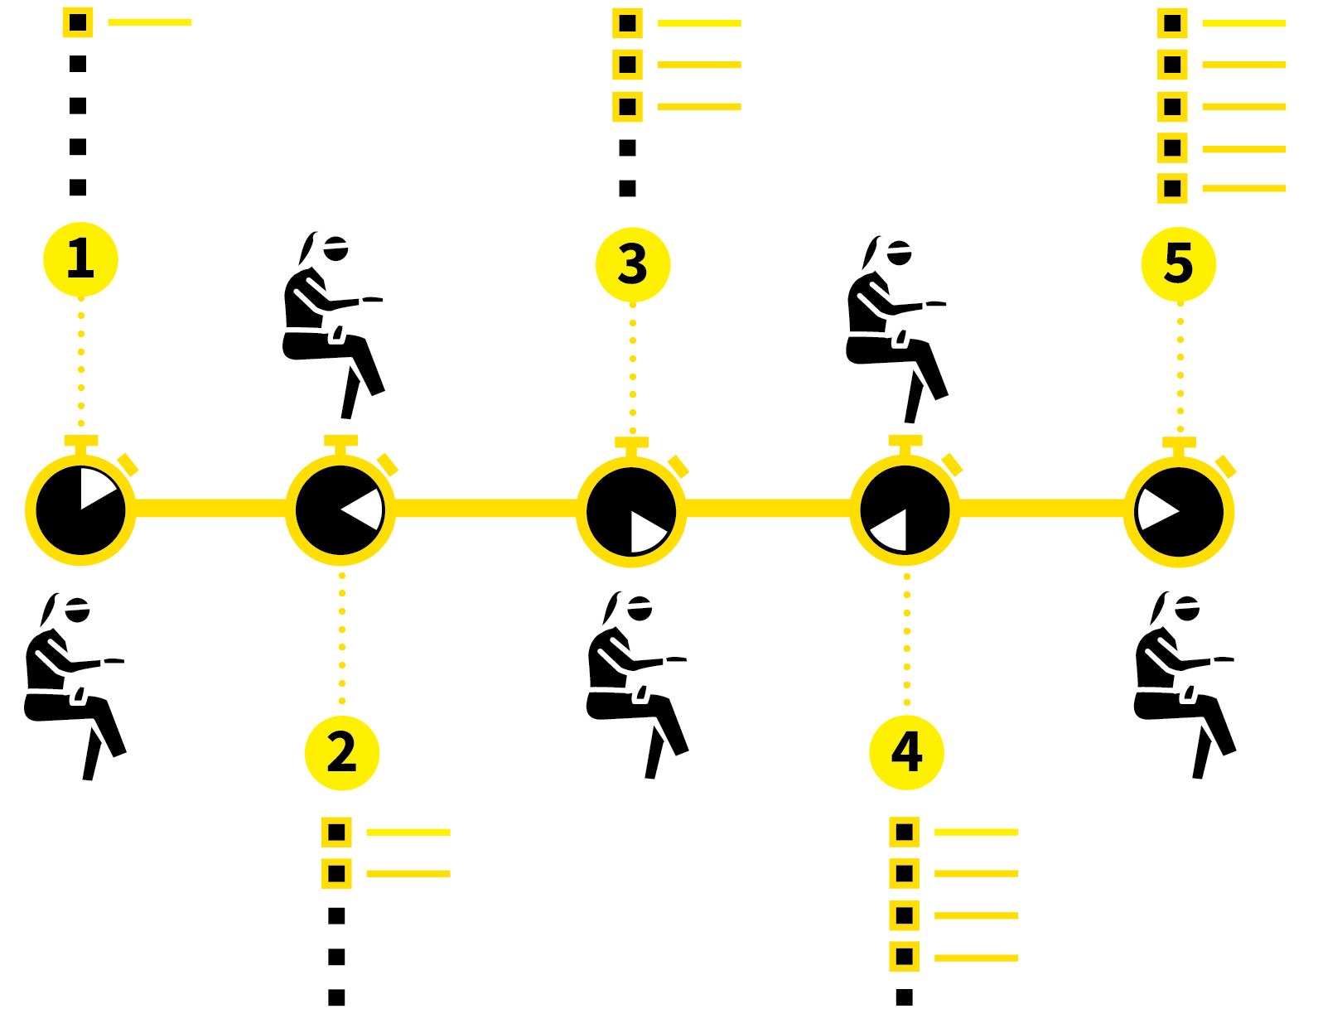
HOMEWORK AS
GUIDED STUDY
SERIES
MODE B TEACHING
1
ESTABLISH CLEAR LEARNING GOALS
2
TEACH STUDY STRATEGIES EXPLICITLY
3
PROVIDE SUPPORTING RESOURCES
4
SET STUDY TASKS WITH TIMELINES
5
EVALUATE SUCCESS

Slide 12

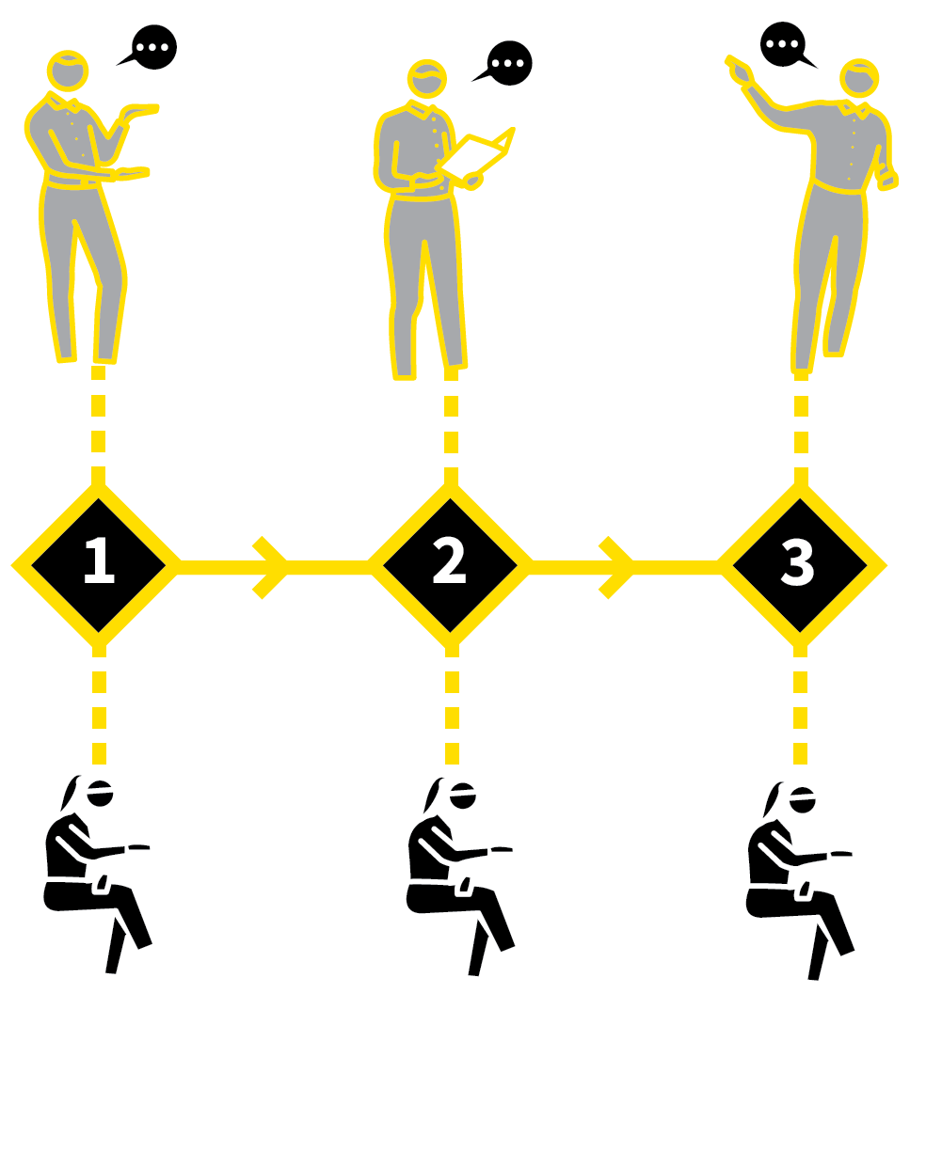


HOMEWORK AS GUIDED STUDY
1
2
3
4
5
ESTABLISH CLEAR LEARNING GOALS
TEACH STUDY STRATEGIES EXPLICITLY
PROVIDE SUPPORTING RESOURCES
SET STUDY TASKS WITH TIMELINES
EVALUATE SUCCESS
As students mature they are increasingly expected to prepare for assessments, some with high stakes such as public examinations.
Homework can train students to learn the skills and habits needed.
To pursue a programme of study, deepen their knowledge, improve their fluency and confidence, demonstate their knowledge and understanding.

Slide 13
HOMEWORK AS GUIDED STUDY
1
2
3
4
5
ESTABLISH CLEAR LEARNING GOALS
Specific learning goals focused on specific sets of knowledge.
This is especially important with younger or less confident students, with lower prior
attainment.
Set out what knowledge, writing skills or practical skills they should acquire through completing the homework tasks.

Slide 14
HOMEWORK AS GUIDED STUDY
1
2
3
4
5
TEACH STUDY STRATEGIES EXPLICITLY
Identify all the study strategies you want your students to use and teach them all explicitly with modelling and practice opportunities during class time.
This might include: reading comprehension; making notes; summarising and mind-mapping; Retrieval practice methods; checking answers and making corrections; practice routines.

Slide 15
HOMEWORK AS GUIDED STUDY
1
2
3
4
5
PROVIDE SUPPORTING RESOURCES
Ensure students have all resources needed to complete a task: texts, online tools, materials.
Don’t set tasks that depend on students’ access to resources that cost money unless you provide them.
Making resources available online is not the same as being sure that every student can and will access them.

Slide 16
HOMEWORK AS GUIDED STUDY
1
2
3
4
5
SET STUDY TASKS WITH TIMELINES
For every task, provide guidance, resources and set a clear timeline.
Establish success criteria and set the
standards for completed tasks using
exemplars where appropriate.
Provide guidance about what students should do if they are stuck and how long tasks should take.

Slide 17
HOMEWORK AS GUIDED STUDY
1
2
3
4
5
EVALUATE SUCCESS
The key measure of success in a task will not be whether the task appears complete: it will be whether the students have met the learning goals.
This could be assessed through various forms of retrieval practice or by looking at the quality of the work that has been produced.

Slide 18
HOMEWORK AS GUIDED STUDY
1
2
3
4
5
ESTABLISH CLEAR LEARNING GOALS
TEACH STUDY STRATEGIES EXPLICITLY
PROVIDE SUPPORTING RESOURCES
SET STUDY TASKS WITH TIMELINES
EVALUATE SUCCESS
As students mature they are increasingly expected to prepare for assessments, some with high stakes such as public examinations.
Homework can train students to learn the skills and habits needed.
To pursue a programme of study, deepen their knowledge, improve their fluency and confidence, demonstate their knowledge and understanding.

Slide 19
1
2
3
4
5
6
7
8
COLLABORATIVE LEARNING
HOMEWORK AS GUIDED STUDY
ENQUIRY
PROJECTS
OPEN RESPONSE TASKS
ORACY:
DEBATING
ORACY: TALK FOR WRITING
ORACY: INSTRUCTIONAL INPUTS
INDEPENDENT LEARNING:
PRE-READING
NEXT UP
ENQUIRY PROJECTS

Slide 20
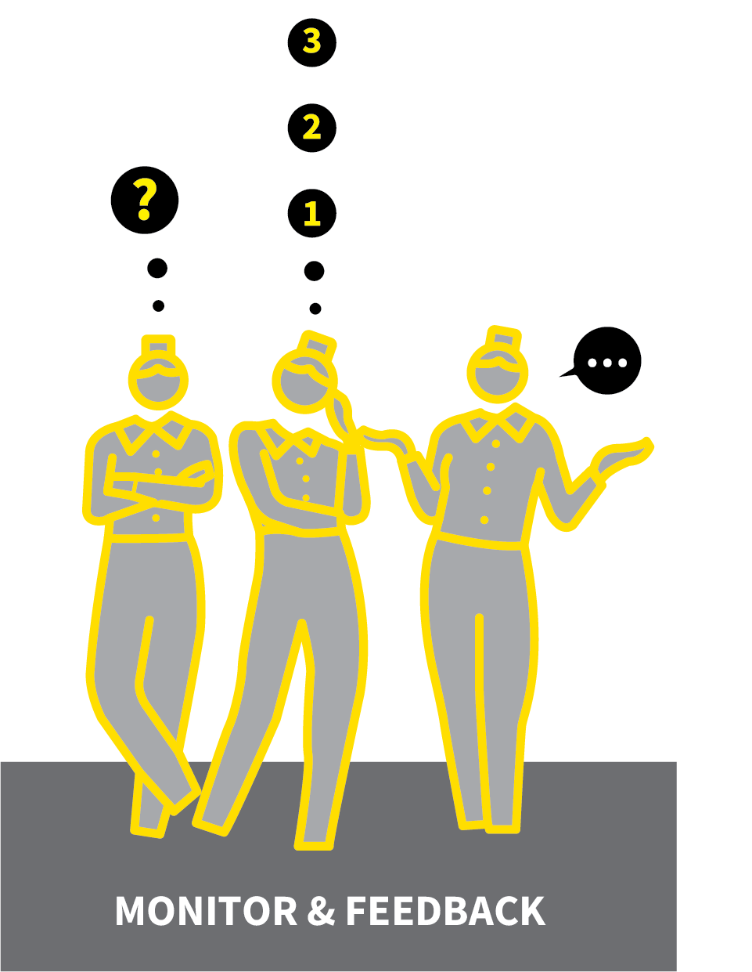
ENQUIRY PROJECTS
SERIES
MODE B TEACHING
1
ESTABLISH THE ENQUIRY QUESTION
2
TEACH THE ENQUIRY SKILLS NEEDED IN ADVANCE
3
PROVIDE RESOURCES AND SCAFFOLDING; SET TIMEFRAMES
4
MONITOR AND PROVIDE INTERIM FEEDBACK
5
SHOWCASE THE RESULTS

Slide 21




ENQUIRY PROJECTS
1
2
3
4
5
ESTABLISH THE ENQUIRY QUESTION
TEACH THE ENQUIRY SKILLS NEEDED IN ADVANCE
PROVIDE RESOURCES AND SCAFFOLDING; SET TIMEFRAMES
MONITOR AND PROVIDE INTERIM FEEDBACK
SHOWCASE THE RESULTS
In a rich curriculum, enquiry will be important over time even if it is not a routine approach.
If students have sufficient knowledge, it is powerful to pursue an enquiry process; asking questions that lead them to some answers or more questions.
This needs structure and guidance and the appropriate level of prior knowledge.

Slide 22
ENQUIRY PROJECTS
1
2
3
4
5
ESTABLISH THE ENQUIRY QUESTION
Give students a sense of the nature of the
enquiry, e.g. the type, range and depth of knowledge; the nature of good questions; the general format of the enquiry process; the typical format of a report.
Model the standards by showing completed examples.
Students should now construct a headline
enquiry question.

Slide 23
ENQUIRY PROJECTS
1
2
3
4
5
TEACH THE ENQUIRY SKILLS NEEDED IN ADVANCE
Identify the skills students need to pursue their enquiry. This will depend on the subject:
e.g. pre-requisite knowledge; measurement or observation techniques; online research and filtering skills; how to record and process data.
Model the individual skills you expect
students to use; check for understanding
and do some guided practice.

Slide 24
ENQUIRY PROJECTS
1
2
3
4
5
PROVIDE RESOURCES AND SCAFFOLDING; SET TIMEFRAMES
Make sure all students have the resources to complete the enquiry process, especially if undertaken outside of class time.
Provide them with the appropriate level of scaffolding so that they are guided enough to complete the task without being over-guided.
Map out a timeframe for completing the
project.

Slide 25
ENQUIRY PROJECTS
1
2
3
4
5
MONITOR AND PROVIDE INTERIM FEEDBACK
Monitor students’ progress with their enquiry project at key points.
e.g. deciding on an interesting and realistic enquiry question; data collection/ information gathering; analysis.
Give Feedback That Moves Forward; the
earlier you identify areas to improve, the better.

Slide 26
ENQUIRY PROJECTS
1
2
3
4
5
SHOWCASE THE RESULTS
Provide a space to showcase completed
project reports; give lesson time for students to talk about the work they did.
This is important for focusing on what
students understand.
The goal of enquiry is to deepen understanding; not only to produce nice-looking artefacts, even if this is also
important.

Slide 27
ENQUIRY PROJECTS
1
2
3
4
5
ESTABLISH THE ENQUIRY QUESTION
TEACH THE ENQUIRY SKILLS NEEDED IN ADVANCE
PROVIDE RESOURCES AND SCAFFOLDING; SET TIMEFRAMES
MONITOR AND PROVIDE INTERIM FEEDBACK
SHOWCASE THE RESULTS
In a rich curriculum, enquiry will be important over time even if it is not a routine approach.
If students have sufficient knowledge, it is powerful to pursue an enquiry process; asking questions that lead them to some answers or more questions.
This needs structure and guidance and the appropriate level of prior knowledge.

Slide 28
1
2
3
4
5
6
7
8
COLLABORATIVE LEARNING
HOMEWORK AS GUIDED STUDY
ENQUIRY
PROJECTS
OPEN RESPONSE TASKS
ORACY:
DEBATING
ORACY: TALK FOR WRITING
ORACY: INSTRUCTIONAL INPUTS
INDEPENDENT LEARNING:
PRE-READING
NEXT UP
OPEN RESPONSE
TASKS

Slide 29

OPEN RESPONSE TASKS
SERIES
MODE B TEACHING
1
ENSURE PRE-REQUISITE KNOWLEDGE IS SECURE
2
AMPLIFY THE POSSIBILITIES
3
ENCOURAGE EXCELLENCE
4
SHOWCASE THE RESULTS
5
CHECK THAT DEEPER LEARNING GOALS ARE MET

Slide 30



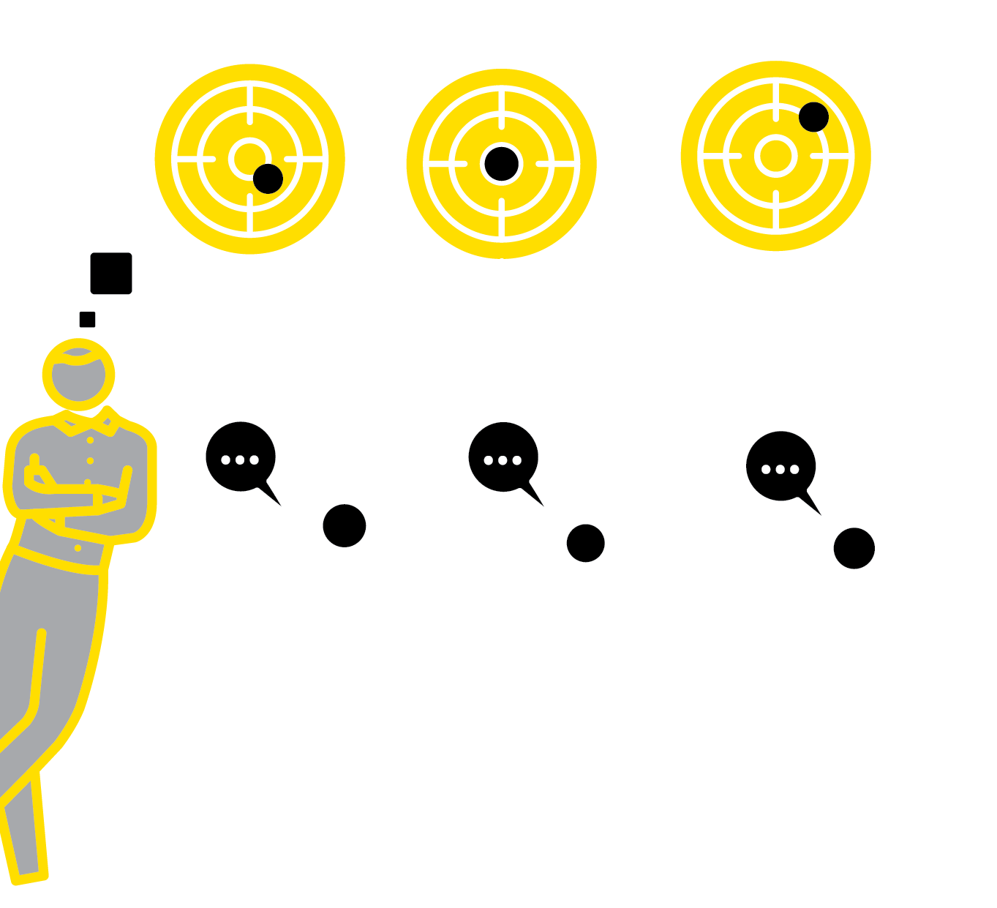
OPEN RESPONSE TASKS
1
2
3
4
5
ENSURE PRE-REQUISITE KNOWLEDGE IS SECURE
AMPLIFY THE POSSIBILITIES
ENCOURAGE EXCELLENCE
SHOWCASE THE RESULTS
CHECK THAT DEEPER LEARNING GOALS ARE MET
When students have explored a topic, accumulating new knowledge, it is rewarding for them to showcase what they have learned.
The precise form of response is not critical; it is a powerful opportunity for students to shape their learning experience if they are given the choice.
This can result in a satisfying array of responses, personal to the students.

Slide 31
OPEN RESPONSE TASKS
1
2
3
4
5
ENSURE PRE-REQUISITE KNOWLEDGE IS SECURE
Ensure students have a good platform of knowledge to base their responses on through the normal flow of lessons and
formative assessments.
Keep knowledge content in the forefront of their thinking when deciding on a
presentational format.
We don’t want elaborate multimedia
presentations without substance.

Slide 32
OPEN RESPONSE TASKS
1
2
3
4
5
AMPLIFY THE POSSIBILITIES
Give the instruction: Showcase your knowledge of this topic in any form you choose. Encourage diversity: a video, a booklet, a website, an essay or news report, a detailed summary poster, a presentation, make some artefacts…
Show multiple examples focusing on depth of understanding, not just visual features. Modelling one response can influence students' choices unduly.

Slide 33
OPEN RESPONSE TASKS
1
2
3
4
5
ENCOURAGE EXCELLENCE
Show a range of examples so students pitch high in their attempts to capture their
learning. Discuss features of excellence in
contrasting exemplars.
Promote two messages:
1: Be bold in making a choice about the format in which knowledge is presented.
2: Ensure that everything is done to a high standard.

Slide 34
OPEN RESPONSE TASKS
1
2
3
4
5
SHOWCASE THE RESULTS
Give time to showcase students’ responses.
A good reason to encourage diversity is so you only have a few videos or PowerPoint presentations to show alongside other
paper-based responses, creating an
interesting range that can be explored in a time-efficient manner.

Slide 35
OPEN RESPONSE TASKS
1
2
3
4
5
CHECK THAT DEEPER LEARNING GOALS ARE MET
Return to the core knowledge, keeping the focus on securing deeper learning.
Use formative assessment tools to check that students can recall and apply the knowledge they’ve gathered.
Invite students to talk through their
responses, taking questions from the teacher and the class. This helps build speaking confidence at the same time.

Slide 36
OPEN RESPONSE TASKS
1
2
3
4
5
ENSURE PRE-REQUISITE KNOWLEDGE IS SECURE
AMPLIFY THE POSSIBILITIES
ENCOURAGE EXCELLENCE
SHOWCASE THE RESULTS
CHECK THAT DEEPER LEARNING GOALS ARE MET
When students have explored a topic, accumulating new knowledge, it is rewarding for them to showcase what they have learned.
The precise form of response is not critical; it is a powerful opportunity for students to shape their learning experience if they are given the choice.
This can result in a satisfying array of responses, personal to the students.

Slide 37
1
2
3
4
5
6
7
8
COLLABORATIVE LEARNING
HOMEWORK AS GUIDED STUDY
ENQUIRY
PROJECTS
OPEN RESPONSE TASKS
ORACY:
DEBATING
ORACY: TALK FOR WRITING
ORACY: INSTRUCTIONAL INPUTS
INDEPENDENT LEARNING:
PRE-READING
NEXT UP
ORACY: DEBATING

Slide 38
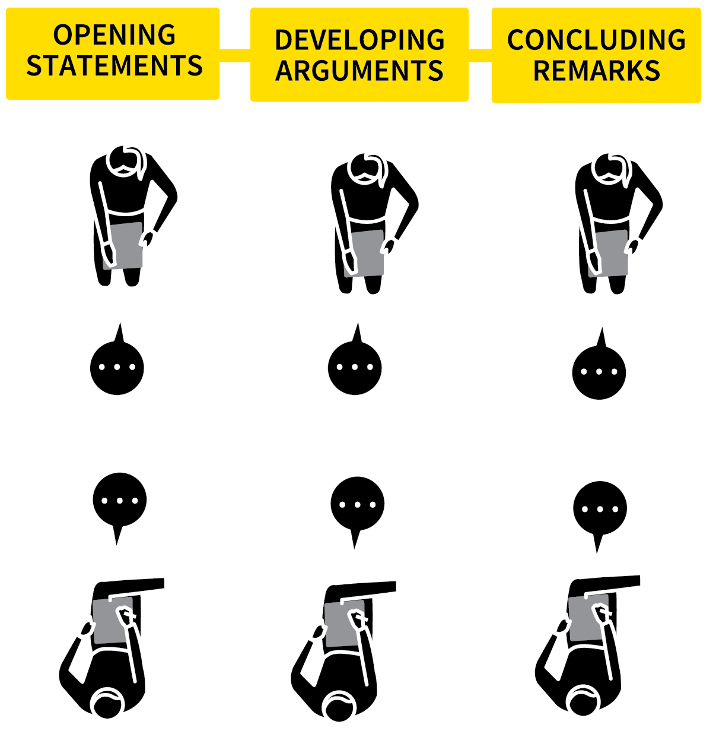
ORACY: DEBATING
SERIES
MODE B TEACHING
1
ENSURE PRE-REQUISITE KNOWLEDGE IS SECURE
2
MODEL AND PRACTISE THE LANGUAGE OF DEBATING
3
TEACH A SIMPLE DEBATE STRUCTURE
4
RUN THE DEBATE FOLLOWING THE AGREED STUCTURE
5
REVIEW THE CONTENT AND PROCESS

Slide 39




ORACY: DEBATING
1
2
3
4
5
ENSURE PRE-REQUISITE KNOWLEDGE IS SECURE
MODEL AND PRACTISE THE LANGUAGE OF DEBATING
TEACH A SIMPLE DEBATE STRUCTURE
RUN THE DEBATE
FOLLOWING THE AGREED STUCTURE
REVIEW THE CONTENT
AND PROCESS
An excellent way to deepen students’ understanding is to teach them how to engage in structured exchanges of ideas through various forms of debating.
This has the benefit of enhancing their confidence with speaking whilst also teaching them to consider the validity of alternative perspectives, how to make a persuasive argument and how to respond to challenges.

Slide 40
ORACY: DEBATING
1
2
3
4
5
ENSURE PRE-REQUISITE KNOWLEDGE IS SECURE
Ensure the knowledge basis of any debate is taught securely. Debates based on poor knowledge are counterproductive.
Establish parameters for a debate so the
process deepens students’ understanding.
e.g. Would a nuclear power station or
windfarm be a better solution in a given
context? Is it ever morally acceptable to kill?

Slide 41
ORACY: DEBATING
1
2
3
4
5
MODEL AND PRACTISE THE LANGUAGE OF DEBATING
Teach key phrases that help frame a debate exchange. Model them and engage students in practice:
I believe that…; In our opinion…; Firstly…,
secondly…; What’s more; moreover…
Our opponents have claimed that…
however…; That may be the case, however…; To recap the main points…

Slide 42
ORACY: DEBATING
1
2
3
4
5
TEACH A SIMPLE DEBATE STRUCTURE
One to one: Pairs, exchanging ideas and
practising the language.
Team debates: 2 vs 2 or 3 vs 3, each team
allocated to propose or oppose a motion, with rehearsal time before the exchanges.
Multi-voice: A range of inputs making a case for a different position or proposal.
Give all debaters roles. Where needed, have a moderator to monitor exchanges and keep timings.

Slide 43
ORACY: DEBATING
1
2
3
4
5
RUN THE DEBATE FOLLOWING THE AGREED STUCTURE
Debates can be run simultaneously or by using the rest of the class as an audience.
The role of observers can be to adjudicate or express opinions based on the arguments presented.
Keep to time so students learn to perform within the discipline of a time structure, sharpening their case accordingly.

Slide 44
ORACY: DEBATING
1
2
3
4
5
REVIEW THE CONTENT
AND PROCESS
Provide instructional input and feedback to highlight the key learning points, to challenge obvious misconceptions, to separate fact from opinion and to ensure deeper
understanding is consolidated.
Review the debate process so lessons can be learned to improve subsequent debate
activities and individual contributions.

Slide 45
ORACY: DEBATING
1
2
3
4
5
ENSURE PRE-REQUISITE KNOWLEDGE IS SECURE
MODEL AND PRACTISE THE LANGUAGE OF DEBATING
TEACH A SIMPLE DEBATE STRUCTURE
RUN THE DEBATE
FOLLOWING THE AGREED STUCTURE
REVIEW THE CONTENT
AND PROCESS
An excellent way to deepen students’ understanding is to teach them how to engage in structured exchanges of ideas through various forms of debating.
This has the benefit of enhancing their confidence with speaking whilst also teaching them to consider the validity of alternative perspectives, how to make a persuasive argument and how to respond to challenges.

Slide 46
1
2
3
4
5
6
7
8
COLLABORATIVE LEARNING
HOMEWORK AS GUIDED STUDY
ENQUIRY
PROJECTS
OPEN RESPONSE TASKS
ORACY:
DEBATING
ORACY: TALK FOR WRITING
ORACY: INSTRUCTIONAL INPUTS
INDEPENDENT LEARNING:
PRE-READING
NEXT UP
ORACY: TALK
FOR WRITING

Slide 47

ORACY: TALK
FOR WRITING
SERIES
MODE B TEACHING
1
SET THE WRITING FOCUS AND ESTABLISH SUCCESS CRITERIA WITH EXEMPLARS
2
IN PAIRS, ASK STUDENTS TO TALK THROUGH THEIR IDEAS … STEP BY STEP
3
SCAFFOLD THE CONTENT OF THE TALK TO MATCH THE WRITING
4
ASK STUDENTS TO PRODUCE A PLAN
5
GIVE TIME TO PRODUCE THE WRITING ACCORDING TO THE PLAN

Slide 48



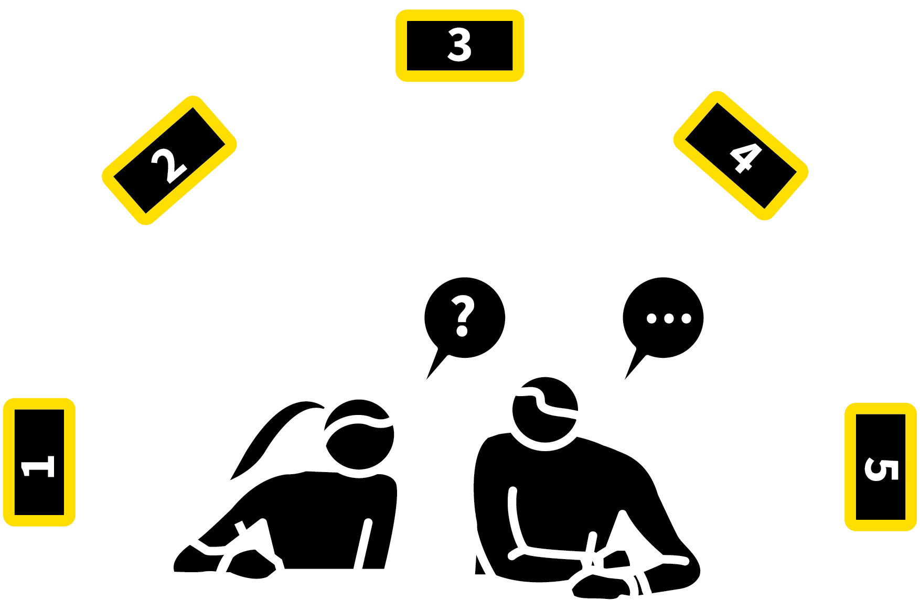
ORACY: TALK FOR WRITING
1
2
3
4
5
SET THE WRITING FOCUS AND ESTABLISH SUCCESS CRITERIA WITH EXEMPLARS
IN PAIRS, ASK STUDENTS TO TALK THROUGH THEIR IDEAS … STEP BY STEP
SCAFFOLD THE CONTENT OF THE TALK TO MATCH THE WRITING
ASK STUDENTS TO PRODUCE A PLAN
GIVE TIME TO PRODUCE THE WRITING ACCORDING TO THE PLAN
Engage students in a process of oral rehearsal prior to a writing task.
Talk for writing is where students run through their ideas, exploring lines of reasoning, retrieving elements of knowledge and planning the structure for a writing task.
The talk informs the plan which, in turn, informs the actual writing.

Slide 49
ORACY: TALK FOR WRITING
1
2
3
4
5
SET THE WRITING FOCUS AND ESTABLISH SUCCESS CRITERIA WITH EXEMPLARS
Set out the general structure and content of the discussion. This helps the talk for writing to have depth, related to the material.
There can be more or less structure
depending on the task.
A creative writing task will need to be more open-ended than an analytical essay.

Slide 50
ORACY: TALK FOR WRITING
1
2
3
4
5
IN PAIRS, ASK STUDENTS TO TALK THROUGH THEIR IDEAS … STEP BY STEP
Initiate pair discussions with some structure:
Explore all the possible ideas and concepts freely.
Use Elaborative Interrogation to explore why and how ideas are connected.
Take turns to ask the questions about each other’s ideas.

Slide 51
ORACY: TALK FOR WRITING
1
2
3
4
5
SCAFFOLD THE CONTENT OF THE TALK TO MATCH THE WRITING
Provide guidance so that the talk mirrors the demands of the writing task.
For an analytical essay: the key thesis,
supporting points and conclusion.
For a speech: how to embed some features of persausive rhetoric.
For a story: the narrative structure, use of
dramatic devices, beginning and ending.

Slide 52
ORACY: TALK FOR WRITING
1
2
3
4
5
ASK STUDENTS TO PRODUCE A PLAN
Make it explicit that the talk has to be
purposeful. The initial product might be a free mindmap of the range of ideas explored. This can then be turned into a more ordered
sequence that will form the basis of a plan.
Use structure headings to help organise ideas. Ask students to review each other’s plans; circulate to provide guidance and
feedback.

Slide 53
ORACY: TALK FOR WRITING
1
2
3
4
5
GIVE TIME TO PRODUCE THE WRITING ACCORDING TO THE PLAN
Complete the sequence by setting the task of following through with the plan.
Once complete, ask students to review each other’s writing to verify whether it matched the ideas explored in their discussion.
Compare what is said when talking compared to what is recorded in writing, refining the process for the next time.

Slide 54
ORACY: TALK FOR WRITING
1
2
3
4
5
SET THE WRITING FOCUS AND ESTABLISH SUCCESS CRITERIA WITH EXEMPLARS
IN PAIRS, ASK STUDENTS TO TALK THROUGH THEIR IDEAS … STEP BY STEP
SCAFFOLD THE CONTENT OF THE TALK TO MATCH THE WRITING
ASK STUDENTS TO PRODUCE A PLAN
GIVE TIME TO PRODUCE THE WRITING ACCORDING TO THE PLAN
Engage students in a process of oral rehearsal prior to a writing task.
Talk for writing is where students run through their ideas, exploring lines of reasoning, retrieving elements of knowledge and planning the structure for a writing task.
The talk informs the plan which, in turn, informs the actual writing.

Slide 55
1
2
3
4
5
6
7
8
COLLABORATIVE LEARNING
HOMEWORK AS GUIDED STUDY
ENQUIRY
PROJECTS
OPEN RESPONSE TASKS
ORACY:
DEBATING
ORACY: TALK FOR WRITING
ORACY: INSTRUCTIONAL INPUTS
INDEPENDENT LEARNING:
PRE-READING
NEXT UP
ORACY: INSTRUCTIONAL INPUTS

Slide 56
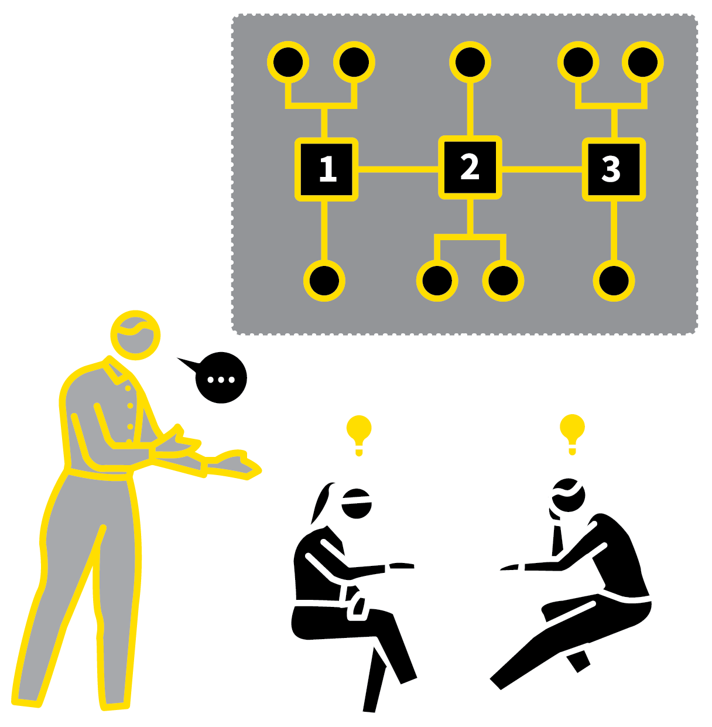
ORACY: INSTRUCTIONAL INPUTS
SERIES
MODE B TEACHING
1
IDENTIFY MATERIAL FOR STUDENTS TO EXPLAIN
2
ALLOCATE INSTRUCTIONAL TASKS
3
INVITE STUDENTS TO REHEARSE AND PRESENT MATERIAL
4
INCLUDE TASKS FOR THE REST OF THE CLASS
5
CHECK FOR RECALL AND UNDERSTANDING

Slide 57
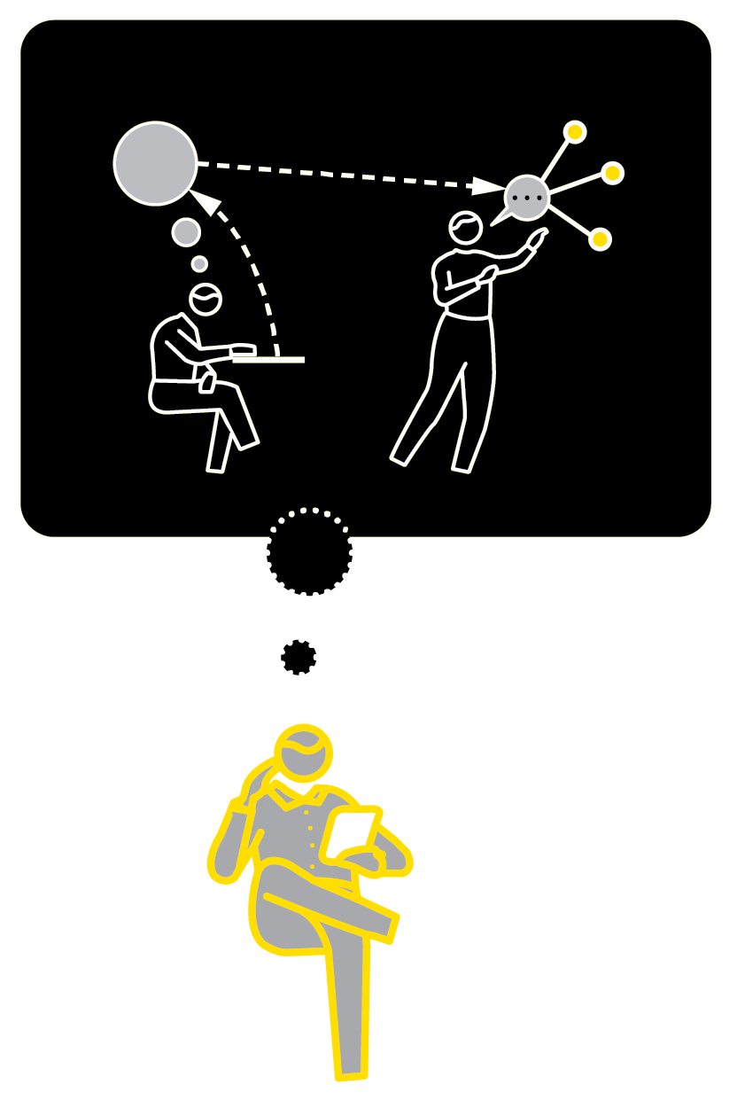



ORACY: INSTRUCTIONAL INPUTS
1
2
3
4
5
IDENTIFY MATERIAL FOR STUDENTS TO EXPLAIN
ALLOCATE INSTRUCTIONAL TASKS
INVITE STUDENTS TO REHEARSE AND PRESENT MATERIAL
INCLUDE TASKS FOR THE REST OF THE CLASS
CHECK FOR RECALL AND UNDERSTANDING
Shimamura suggests students should “Think it, say it, teach it!” leading to significant gains in long-term recall.
It is also good personal development to address peers to explain something.
Preparing instructions or explanatory steps is a good challenge in terms of language and speech.
Organise lessons so that all students are given this opportunity.

Slide 58
ORACY: INSTRUCTIONAL INPUTS
1
2
3
4
5
IDENTIFY MATERIAL FOR STUDENTS TO EXPLAIN
Identify instructional inputs that a student could deliver without too much support.
e.g. a concept in maths or science; a case study scenario in geography; a specific event in history; or a particular section of a text in English.
Alternatively find questions or problems for them to present model solutions to.

Slide 59
ORACY: INSTRUCTIONAL INPUTS
1
2
3
4
5
ALLOCATE INSTRUCTIONAL TASKS
Allocate tasks to an individual or pair of
students and ask them to prepare their
instructional input on a specific date.
Walk through the timeframe and content; check that they have the resources needed.
Provide guidance, e.g. not to read text from PowerPoint slide; to include diagrams and demonstration aids; to keep explanations short, broken down in small steps.

Slide 60
ORACY: INSTRUCTIONAL INPUTS
1
2
3
4
5
INVITE STUDENTS TO REHEARSE AND PRESENT MATERIAL
Give students the opportunity to practise their input; when ready, invite the students to address the class with their material.
Stand at the back of the room to encourage them to project their voices clearly, making eye contact with students.
Where needed, give instructions to keep the class on track listening to their classmates’ input.

Slide 61
ORACY: INSTRUCTIONAL INPUTS
1
2
3
4
5
INCLUDE TASKS FOR THE REST OF THE CLASS
A good instructional input will go beyond a presentation developing into a mini lesson.
Ask students to design tasks for their class which follow from the input, e.g. practice questions, problems, writing tasks or
discussion tasks.
Clarify this in advance so students all pay
attention intently during the instructional input.

Slide 62
ORACY: INSTRUCTIONAL INPUTS
1
2
3
4
5
CHECK FOR RECALL AND UNDERSTANDING
Encourage your ‘student teachers’ to engage the class in Check for Understanding procedures.
Feel free to interject, offering additional
instructional input, correcting errors or
misconceptions and generally supporting.
All the while, check for student
understanding.

Slide 63
ORACY: INSTRUCTIONAL INPUTS
1
2
3
4
5
IDENTIFY MATERIAL FOR STUDENTS TO EXPLAIN
ALLOCATE INSTRUCTIONAL TASKS
INVITE STUDENTS TO REHEARSE AND PRESENT MATERIAL
INCLUDE TASKS FOR THE REST OF THE CLASS
CHECK FOR RECALL AND UNDERSTANDING
Shimamura suggests students should “Think it, say it, teach it!” leading to significant gains in long-term recall.
It is also good personal development to address peers to explain something.
Preparing instructions or explanatory steps is a good challenge in terms of language and speech.
Organise lessons so that all students are given this opportunity.

Slide 64
1
2
3
4
5
6
7
8
COLLABORATIVE LEARNING
HOMEWORK AS GUIDED STUDY
ENQUIRY
PROJECTS
OPEN RESPONSE TASKS
ORACY:
DEBATING
ORACY: TALK FOR WRITING
ORACY: INSTRUCTIONAL INPUTS
INDEPENDENT LEARNING:
PRE-READING
NEXT UP
INDEPENDENT
LEARNING:
PRE-READING

Slide 65
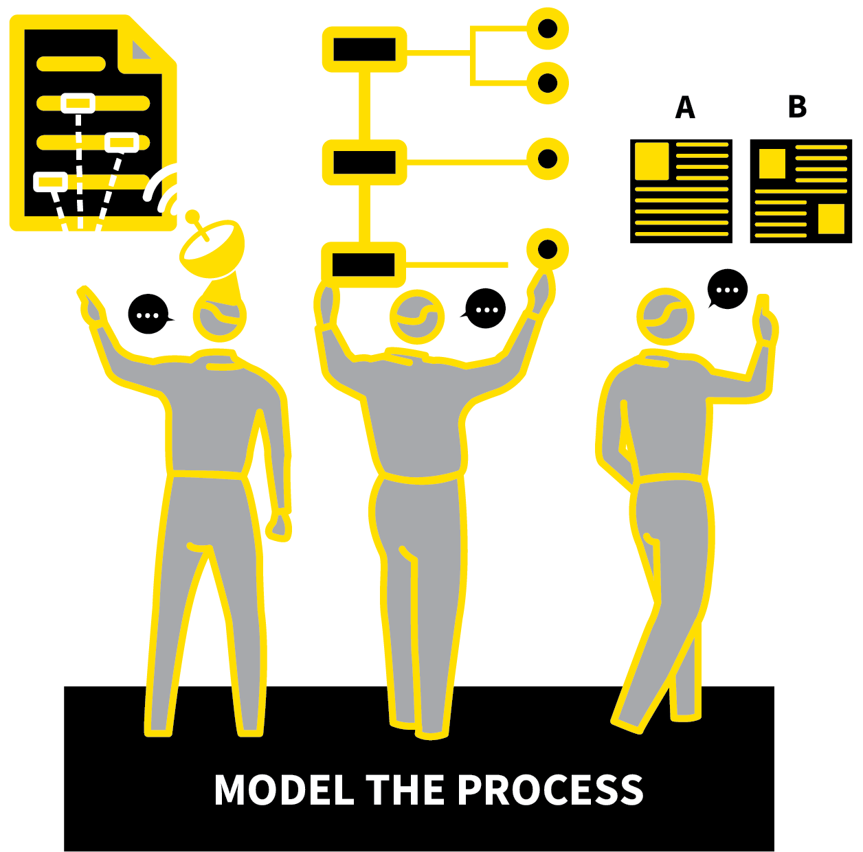
INDEPENDENT LEARNING:
PRE-READING
SERIES
MODE B TEACHING
1
CONSTRUCT STRUCTURED COMPREHENSION OR RESEARCH TASKS
2
MODEL THE COMPLETION OF THE TASKS
3
SET TASKS FOR INDEPENDENT COMPLETION
4
INVITE RESPONSES AND CHECK FOR UNDERSTANDING
5
REVIEW THE PROCESS AND REPEAT

Slide 66




INDEPENDENT LEARNING: PRE-READING
1
2
3
4
5
CONSTRUCT STRUCTURED COMPREHENSION OR RESEARCH TASKS
MODEL THE COMPLETION OF THE TASKS
SET TASKS FOR INDEPENDENT COMPLETION
INVITE RESPONSES AND CHECK FOR UNDERSTANDING
REVIEW THE PROCESS AND REPEAT
‘Flipped learning’ probably began when books were invented. When students are ready, it is possible for them to read material in advance of a lesson.
This puts the teacher’s emphasis on checking for understanding, exploring misconceptions and applying knowledge to new contexts.
The more students do this, the more routine it becomes. It creates a sense of ownership and responsibility.

Slide 67
INDEPENDENT LEARNING: PRE-READING
1
2
3
4
5
CONSTRUCT STRUCTURED COMPREHENSION OR RESEARCH TASKS
Make sure that pre-reading tasks are
conducted to the appropriate level of depth by setting students specific goals.
e.g. to find certain words and concepts in order to explore their meaning; to gain an overview of the narrative of events;
to generate structured summarised notes.

Slide 68
INDEPENDENT LEARNING: PRE-READING
1
2
3
4
5
MODEL THE COMPLETION OF THE TASKS
Model each aspect of the pre-reading task completion explicitly.
Show students how you skim and scan text to find key words and definitions; how to
organise notes.
Set the standard for the record you expect students to keep of what they have learned, using standard formats that can be used often as part of students’ study routines.

Slide 69
INDEPENDENT LEARNING: PRE-READING
1
2
3
4
5
SET TASKS FOR INDEPENDENT COMPLETION
Give students tasks to complete relating to specific concepts or texts.
Set a timeframe for the lesson where they need to come ready to share what they have learned.
As with Homework as Guided Study, ensure that all students have access to all the materials and technology they need.

Slide 70
INDEPENDENT LEARNING: PRE-READING
1
2
3
4
5
INVITE RESPONSES AND CHECK FOR UNDERSTANDING
Students present the fruits of their reading tasks:
Cold Calling: select students to give an
exposition of the key points.
Paired Presentations: students pool ideas and then present.
Retrieval Challenges: generative quizzes to test the depth of reading.
Problems and Errors: problems and mock
responses containing errors, which students are invited to solve correctly.

Slide 71
INDEPENDENT LEARNING: PRE-READING
1
2
3
4
5
REVIEW THE PROCESS AND REPEAT
This area of independent study needs early guidance before students become adept at selecting the right information for note-taking and learn the level of depth and rigour expected.
Review the success of each episode of pre-reading, returning to exemplars and
modelling; give students further direction as needed.

Slide 72
INDEPENDENT LEARNING: PRE-READING
1
2
3
4
5
CONSTRUCT STRUCTURED COMPREHENSION OR RESEARCH TASKS
MODEL THE COMPLETION OF THE TASKS
SET TASKS FOR INDEPENDENT COMPLETION
INVITE RESPONSES AND CHECK FOR UNDERSTANDING
REVIEW THE PROCESS AND REPEAT
‘Flipped learning’ probably began when books were invented. When students are ready, it is possible for them to read material in advance of a lesson.
This puts the teacher’s emphasis on checking for understanding, exploring misconceptions and applying knowledge to new contexts.
The more students do this, the more routine it becomes. It creates a sense of ownership and responsibility.

