Slide 1

John Catt Educational
CURRICULUM PLANNING
TEACHING
WALKTHRUs
PRESENTATION
SLIDES
TOM SHERRINGTON & OLIVER CAVIGLIOLI
DESIGNING A KNOWLEDGE-RICH CURRICULUM
SEQUENCE CONCEPTS IN SMALL STEPS
COHERENT MAPPING
BLEND KNOWLEDGE & EXPERIENCE
PITCH IT UP
PLAN FOR READING
TIERED QUESTIONS & PROBLEMS
DELIVER CORE; SIGNPOST HINTERLAND

Slide 2


DESIGNING A KNOWLEDGE-RICH
CURRICULUM
SERIES
CURRICULUM PLANNING
1
LET KNOWLEDGE DRIVE YOUR PHILOSOPHY
2
CONSIDER A BROAD RANGE OF KNOWLEDGE FORMS
3
SPECIFY THE KNOWLEDGE IN DETAIL
4
SEQUENCE AND MAP THE KNOWLEDGE COHERENTLY
5
TEACH KNOWLEDGE TO BE REMEMBERED, NOT MERELY ENCOUNTERED

Slide 3

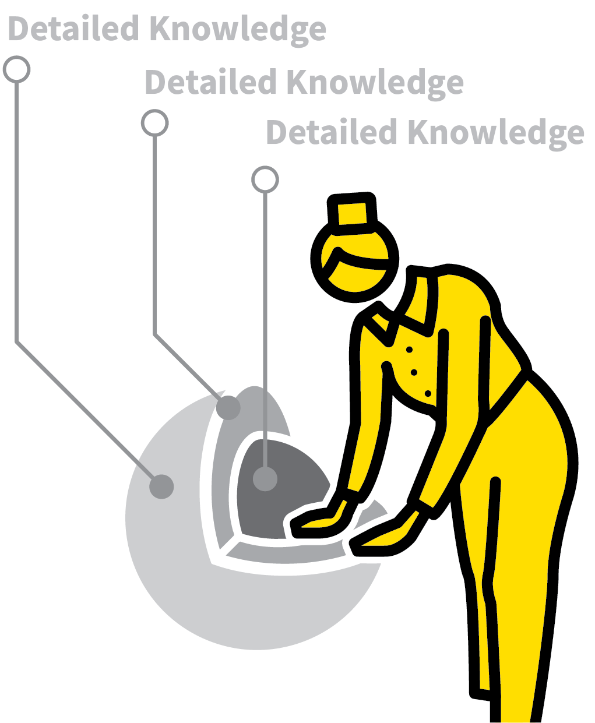


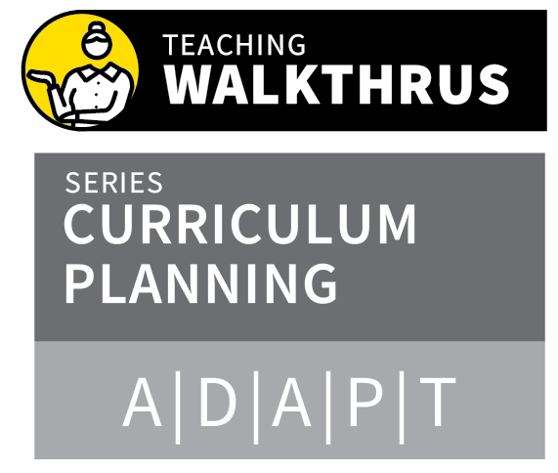
DESIGNING A KNOWLEDGE-RICH CURRICULUM
1
2
3
4
5
LET KNOWLEDGE DRIVE YOUR PHILOSOPHY
CONSIDER A BROAD RANGE OF KNOWLEDGE FORMS
SPECIFY THE KNOWLEDGE IN DETAIL
SEQUENCE AND MAP THE KNOWLEDGE COHERENTLY
TEACH KNOWLEDGE TO BE REMEMBERED, NOT MERELY ENCOUNTERED
The concept of a knowledge-rich curriculum is not tightly defined.
But it provides teachers with a useful lens through which to review and construct a curriculum.
Embrace a breadth of knowledge in many forms.
Be deliberate in planning what students will learn in order to support them constructing rich, extensive schema.

Slide 4
DESIGNING A KNOWLEDGE-RICH CURRICULUM
1
2
3
4
5
LET KNOWLEDGE DRIVE YOUR PHILOSOPHY
Knowledge is empowering, unlocking doors, a foundation for achieving success,
understanding and being creative.
The more children know, the more they
can learn.
The challenge is to identify which areas of knowledge to focus on.

Slide 5
DESIGNING A KNOWLEDGE-RICH CURRICULUM
1
2
3
4
5
CONSIDER A BROAD RANGE OF KNOWLEDGE FORMS
Consider all of the knowledge you think
is important:
Declarative: What key facts should all
children know?
Procedural: What things should all children be able to do?
Experiential: What knowledge can only be gained first-hand?

Slide 6
DESIGNING A KNOWLEDGE-RICH CURRICULUM
1
2
3
4
5
SPECIFY THE KNOWLEDGE IN DETAIL
Specify what students should know in as much detail as is possible, appropriate for their stage of learning:
What, exactly, should every child know
about the Romans? Of Mice and Men?
Sound and light?

Slide 7
DESIGNING A KNOWLEDGE-RICH CURRICULUM
1
2
3
4
5
SEQUENCE AND MAP THE KNOWLEDGE COHERENTLY
Sequence content such that there is a
coherent flow.
Ensure ideas build on secure foundations, staged towards challenging goals.
Map this out so everyone can see how
content is sequenced.

Slide 8
DESIGNING A KNOWLEDGE-RICH CURRICULUM
1
2
3
4
5
TEACH KNOWLEDGE TO BE REMEMBERED, NOT MERELY ENCOUNTERED
Plan sequencing so that elements are
regularly returned to, supporting students to accumulate knowledge over time.
Feed previous topics into current topics
supported by Practice and Retrieval
strategies.

Slide 9
DESIGNING A KNOWLEDGE-RICH CURRICULUM
1
2
3
4
5
LET KNOWLEDGE DRIVE YOUR PHILOSOPHY
CONSIDER A BROAD RANGE OF KNOWLEDGE FORMS
SPECIFY THE KNOWLEDGE IN DETAIL
SEQUENCE AND MAP THE KNOWLEDGE COHERENTLY
TEACH KNOWLEDGE TO BE REMEMBERED, NOT MERELY ENCOUNTERED
The concept of a knowledge-rich curriculum is not tightly defined.
But it provides teachers with a useful lens through which to review and construct a curriculum.
Embrace a breadth of knowledge in many forms.
Be deliberate in planning what students will learn in order to support them constructing rich, extensive schema.

Slide 10

1
2
3
4
5
6
7
8
DESIGNING A
KNOWLEDGE-RICH
CURRICULUM
SEQUENCE CONCEPTS IN SMALL STEPS
COHERENT
MAPPING
BLEND KNOWLEDGE & EXPERIENCE
PITCH IT UP
PLAN FOR
READING
TIERED QUESTIONS & PROBLEMS
DELIVER CORE; SIGNPOST HINTERLAND
NEXT UP
SEQUENCE CONCEPTS IN SMALL STEPS

Slide 11
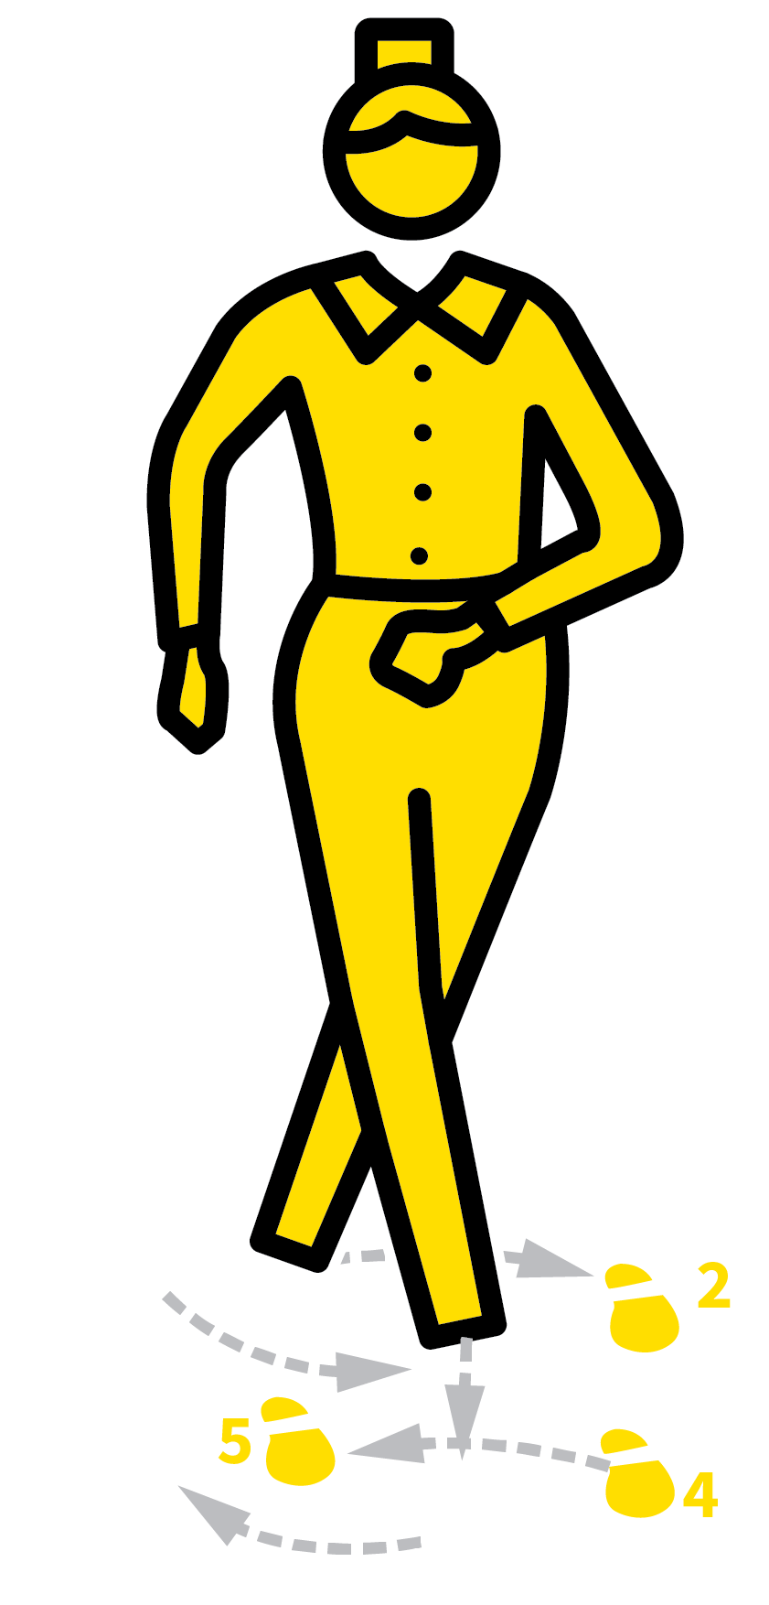
SEQUENCE CONCEPTS IN SMALL STEPS
SERIES
CURRICULUM PLANNING
1
IDENTIFY PRE-REQUISITE KNOWLEDGE
2
IDENTIFY THE MOST BASIC FIRST STEPS
3
IDENTIFY THE SERIES OF NEXT STEPS
4
DESIGN INSTRUCTIONAL INPUTS
5
DESIGN PRACTICE TASKS

Slide 12

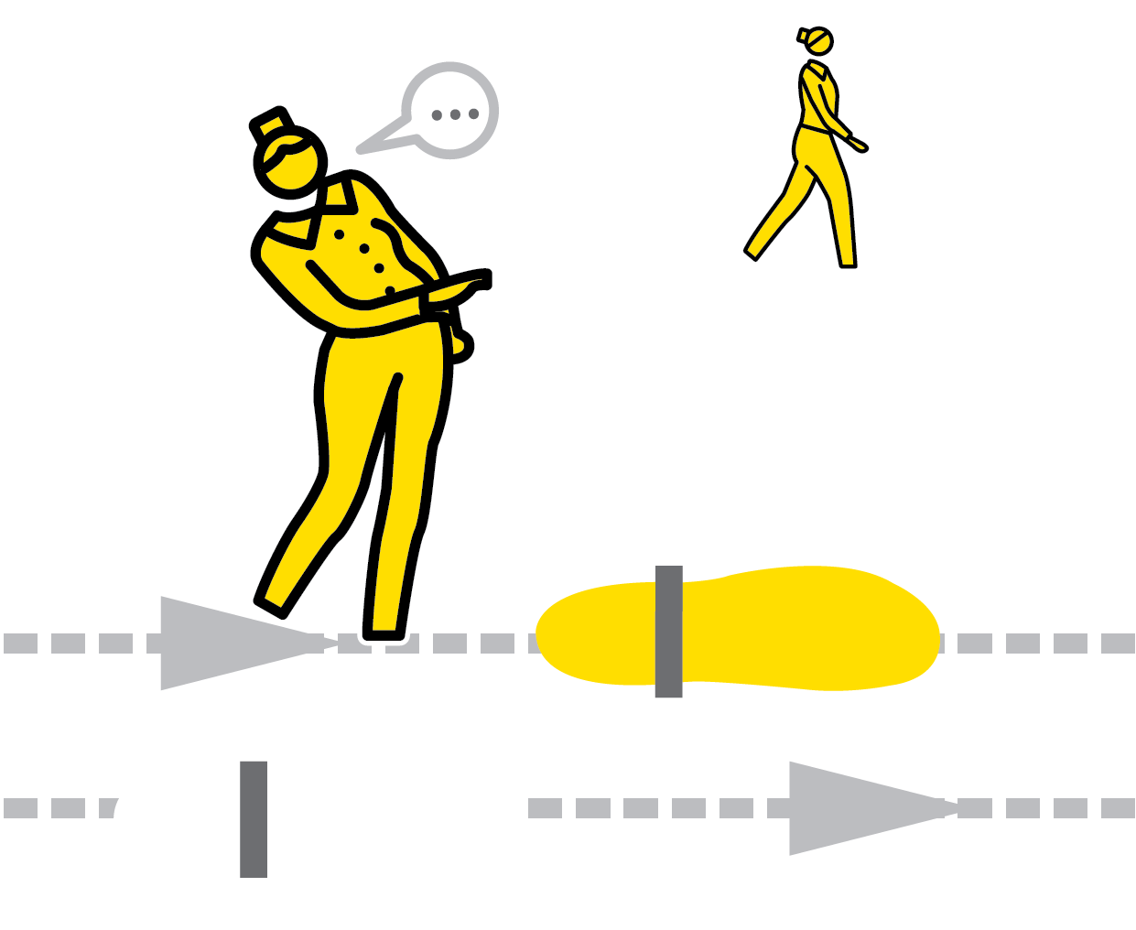

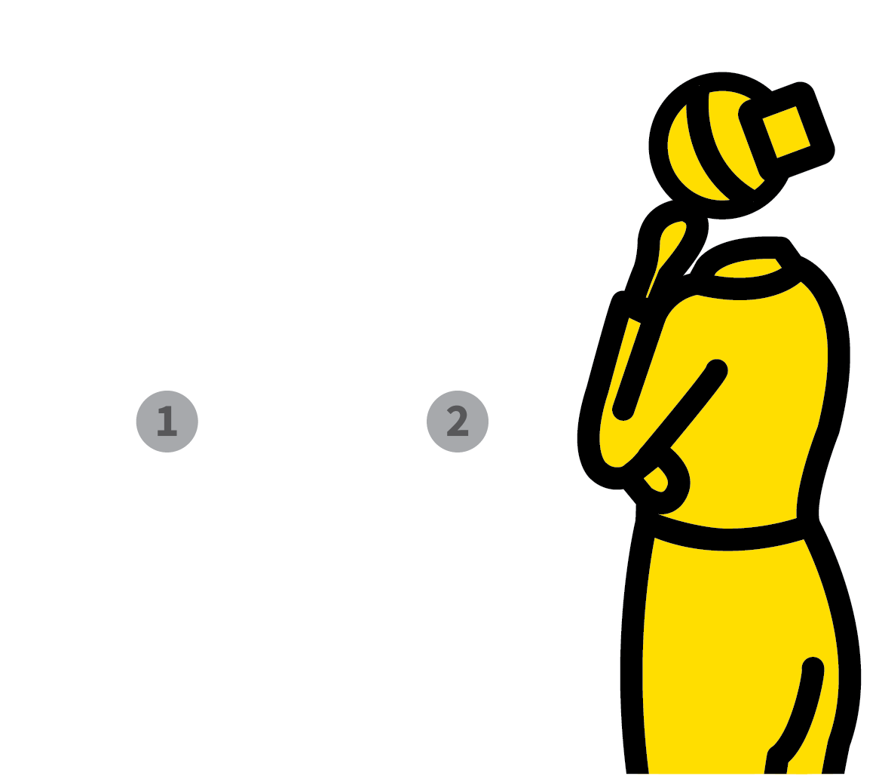
SEQUENCE CONCEPTS IN SMALL STEPS
1
2
3
4
5
IDENTIFY PRE-REQUISITE KNOWLEDGE
IDENTIFY THE MOST BASIC FIRST STEPS
IDENTIFY THE SERIES OF NEXT STEPS
DESIGN INSTRUCTIONAL INPUTS
DESIGN PRACTICE TASKS
To form secure schema, students assimilate new learning with what they already know.
Extent of prior knowledge and limitations of working memory are constraints.
Learning often forms around a logical set of ideas or steps building on each other.
The more knowledgeable students are, the bigger these steps can be.

Slide 13
SEQUENCE CONCEPTS IN SMALL STEPS
1
2
3
4
5
IDENTIFY PRE-REQUISITE KNOWLEDGE
Consider how new learning could be broken down into a series of steps.
Consider what your assumptions are about students’ prior knowledge.
Check that students all have this knowledge before proceeding.

Slide 14
SEQUENCE CONCEPTS IN SMALL STEPS
1
2
3
4
5
IDENTIFY THE MOST BASIC FIRST STEPS
Often the most important decision: where to begin?
What are the ideas on which all the rest
depends?
This could be some vocabulary, a mental or spatial model or the ‘big picture’.

Slide 15
SEQUENCE CONCEPTS IN SMALL STEPS
1
2
3
4
5
IDENTIFY THE SERIES OF NEXT STEPS
Build on the first steps, breaking down the concepts and skills further.
Look for common misconceptions and the more difficult stages.
Run through the steps to check students could understand a concept or perform the task to the level required.

Slide 16
SEQUENCE CONCEPTS IN SMALL STEPS
1
2
3
4
5
DESIGN INSTRUCTIONAL INPUTS
Students will need to practise each step one by one and then in short sequences before attempting to practise the whole sequence.
Select the appropriate Practice and Retrieval tools to support students in gaining the level of fluency they need.

Slide 17
SEQUENCE CONCEPTS IN SMALL STEPS
1
2
3
4
5
DESIGN PRACTICE TASKS
It is easier to sustain high expectations if they become part of a set of routines.
Routines need to be rehearsed multiple times before becoming literally routine.

Slide 18
SEQUENCE CONCEPTS IN SMALL STEPS
1
2
3
4
5
IDENTIFY PRE-REQUISITE KNOWLEDGE
IDENTIFY THE MOST BASIC FIRST STEPS
IDENTIFY THE SERIES OF NEXT STEPS
DESIGN INSTRUCTIONAL INPUTS
DESIGN PRACTICE TASKS
To form secure schema, students assimilate new learning with what they already know.
Extent of prior knowledge and limitations of working memory are constraints.
Learning often forms around a logical set of ideas or steps building on each other.
The more knowledgeable students are, the bigger these steps can be.

Slide 19
1
2
3
4
5
6
7
8
DESIGNING A
KNOWLEDGE-RICH
CURRICULUM
SEQUENCE CONCEPTS IN SMALL STEPS
COHERENT
MAPPING
BLEND KNOWLEDGE & EXPERIENCE
PITCH IT UP
PLAN FOR
READING
TIERED QUESTIONS & PROBLEMS
DELIVER CORE; SIGNPOST HINTERLAND
NEXT UP
COHERENT MAPPING

Slide 20

COHERENT MAPPING
SERIES
CURRICULUM PLANNING
1
IDENTIFY CORE CONCEPTS AND BIG QUESTIONS
2
MAP THE BIG PICTURE
3
MAP THE SPIRALLING OF CONCEPTS
4
GO DEEPER
5
MAKE AUTHENTIC CONNECTIONS

Slide 21




COHERENT MAPPING
1
2
3
4
5
IDENTIFY CORE CONCEPTS AND BIG QUESTIONS
MAP THE BIG PICTURE
MAP THE SPIRALLING OF CONCEPTS
GO DEEPER
MAKE AUTHENTIC CONNECTIONS
A coherent curriculum weaves learning experiences, knowledge and skills.
Students form a deep understanding within and between various knowledge domains.
Requires vertical planning so new knowledge builds on secure foundations.
Requires horizontal planning so links between areas of concurrent learning are made deliberately.

Slide 22
COHERENT MAPPING
1
2
3
4
5
IDENTIFY CORE CONCEPTS AND BIG QUESTIONS
Express curriculum goals as a set of big
questions and fundamental concepts.
This might include: particles, energy and rate of change in science; chronology and change and continuity in history.

Slide 23
COHERENT MAPPING
1
2
3
4
5
MAP THE BIG PICTURE
Scope out the main areas of learning that will provide the overall structure of knowledge to be covered.
Organise units into a sequence that makes sense in terms of conceptual flow and
hierarchy of core concepts.
For example: the broad science topics;
periods of history; range of music genres.

Slide 24
COHERENT MAPPING
1
2
3
4
5
MAP THE SPIRALLING OF CONCEPTS
Scope out opportunities to space concepts and themes spiralling vertically over time.
Revisit topics at incremental levels of
difficulty.
Students can build schema as they mature, integrating prior knowledge with new learning each time a topic comes around.

Slide 25
COHERENT MAPPING
1
2
3
4
5
GO DEEPER
Plan the next level of depth; the more specific content of each topic or unit.
Check each unit links to prior knowledge and builds towards units that lie ahead.
Ensure that you Pitch It Up and
Blend Knowledge and Experience.

Slide 26
COHERENT MAPPING
1
2
3
4
5
MAKE AUTHENTIC CONNECTIONS
Look to the maps in other areas to see where you can make connections that allow knowledge areas to be mutually reinforcing and enriching.
Don’t force artificial links where none exist.
Highlight authentic connections between subjects and concepts that arise.

Slide 27
COHERENT MAPPING
1
2
3
4
5
IDENTIFY CORE CONCEPTS AND BIG QUESTIONS
MAP THE BIG PICTURE
MAP THE SPIRALLING OF CONCEPTS
GO DEEPER
MAKE AUTHENTIC CONNECTIONS
A coherent curriculum weaves learning experiences, knowledge and skills.
Students form a deep understanding within and between various knowledge domains.
Requires vertical planning so new knowledge builds on secure foundations.
Requires horizontal planning so links between areas of concurrent learning are made deliberately.

Slide 28
1
2
3
4
5
6
7
8
DESIGNING A
KNOWLEDGE-RICH
CURRICULUM
SEQUENCE CONCEPTS IN SMALL STEPS
COHERENT
MAPPING
BLEND KNOWLEDGE & EXPERIENCE
PITCH IT UP
PLAN FOR
READING
TIERED QUESTIONS & PROBLEMS
DELIVER CORE; SIGNPOST HINTERLAND
NEXT UP
BLEND KNOWLEDGE & EXPERIENCE

Slide 29
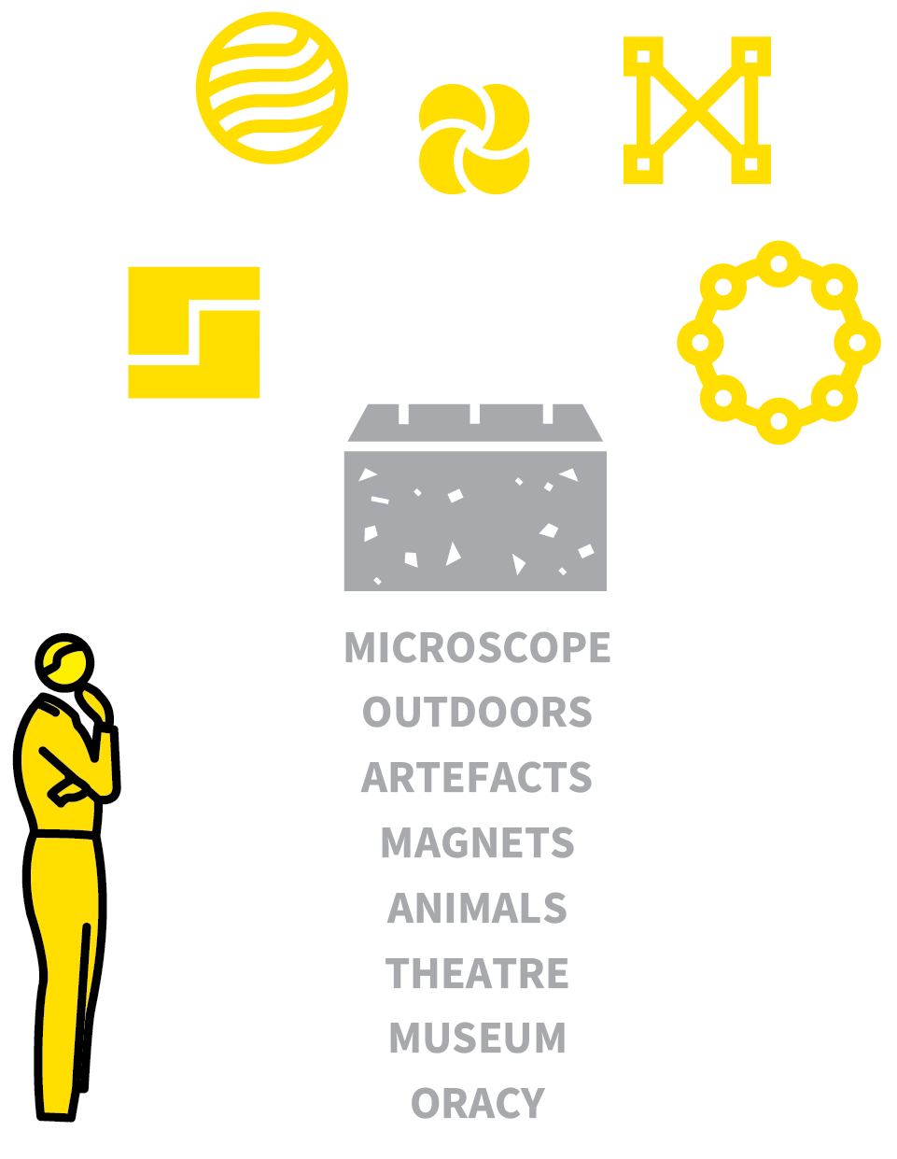
BLEND KNOWLEDGE & EXPERIENCE
SERIES
CURRICULUM PLANNING
1
EXAMINE LEARNING GOALS THROUGH THE LENS OF EXPERIENCES
2
IDENTIFY WHERE EXPERIENTIAL LEARNING HAS INTRINSIC VALUE
3
IDENTIFY WHERE CONCRETE EXPERIENCE IS THE FOUNDATION FOR ABSTRACT IDEAS
4
IDENTIFY WHERE CONCEPTUAL UNDERSTANDING IS PREREQUISITE
5
MAP THE EXPERIENTAL ELEMENTS INTO THE WIDER FRAMEWORK

Slide 30




BLEND KNOWLEDGE & EXPERIENCE
1
2
3
4
5
EXAMINE LEARNING GOALS THROUGH THE LENS OF EXPERIENCES
IDENTIFY WHERE EXPERIENTIAL LEARNING HAS INTRINSIC VALUE
IDENTIFY WHERE CONCRETE EXPERIENCE IS THE FOUNDATION FOR
ABSTRACT IDEAS
IDENTIFY WHERE
CONCEPTUAL
UNDERSTANDING IS
PREREQUISITE
MAP THE EXPERIENTAL
ELEMENTS INTO THE WIDER FRAMEWORK
Some knowledge has to be developed through experience including anything n that requires physical skill.
Also reading a poem aloud; taking measurements; seeing artefacts in a museum or a play at a theatre; feeling attraction between magnets.
This kind of knowledge needs planning like any other.

Slide 31
BLEND KNOWLEDGE & EXPERIENCE
1
2
3
4
5
EXAMINE LEARNING GOALS THROUGH THE LENS OF EXPERIENCES
Establish where students will need to have hands-on experiences in order to develop a secure schema.
Think about the assumptions you make about experiences they would ideally have had.

Slide 32
BLEND KNOWLEDGE & EXPERIENCE
1
2
3
4
5
IDENTIFY WHERE EXPERIENTIAL LEARNING HAS INTRINSIC VALUE
What hands-on experiences are part of the curriculum on their own terms?
e.g. aspects of performance and oracy, visits to specific places, practical activities in science or technology.
Where is the experience of performing the task a learning goal in itself?

Slide 33
BLEND KNOWLEDGE & EXPERIENCE
1
2
3
4
5
IDENTIFY WHERE CONCRETE EXPERIENCE IS THE FOUNDATION FOR ABSTRACT IDEAS
Highlight areas where hands-on experience is a pre-requisite for deeper conceptual understanding.
e.g. using manipulatives such as Cuisenaire rods in maths; handling artefacts or materials or living things in order to appreciate their physical properties.

Slide 34
BLEND KNOWLEDGE & EXPERIENCE
1
2
3
4
5
IDENTIFY WHERE CONCEPTUAL
UNDERSTANDING IS PREREQUISITE
Where might it be better for students to
acquire a level of foundational knowledge prior to engaging in experiential learning?
e.g. learning the terminology and underlying model for a science experiment before attempting it; studying a play before seeing a live performance of it.

Slide 35
BLEND KNOWLEDGE & EXPERIENCE
1
2
3
4
5
MAP THE EXPERIENTAL ELEMENTS INTO THE WIDER FRAMEWORK
With these three categories of experiential learning in mind, map them into your wider curriculum plan in the appropriate place.
Write them into schemes of learning,
ensuring they become entitlements for
all students.

Slide 36
BLEND KNOWLEDGE & EXPERIENCE
1
2
3
4
5
EXAMINE LEARNING GOALS THROUGH THE LENS OF EXPERIENCES
IDENTIFY WHERE EXPERIENTIAL LEARNING HAS INTRINSIC VALUE
IDENTIFY WHERE CONCRETE EXPERIENCE IS THE FOUNDATION FOR
ABSTRACT IDEAS
IDENTIFY WHERE
CONCEPTUAL
UNDERSTANDING IS
PREREQUISITE
MAP THE EXPERIENTAL
ELEMENTS INTO THE WIDER FRAMEWORK
Some knowledge has to be developed through experience including anything n that requires physical skill.
Also reading a poem aloud; taking measurements; seeing artefacts in a museum or a play at a theatre; feeling attraction between magnets.
This kind of knowledge needs planning like any other.

Slide 37
1
2
3
4
5
6
7
8
DESIGNING A
KNOWLEDGE-RICH
CURRICULUM
SEQUENCE CONCEPTS IN SMALL STEPS
COHERENT
MAPPING
BLEND KNOWLEDGE & EXPERIENCE
PITCH IT UP
PLAN FOR
READING
TIERED QUESTIONS & PROBLEMS
DELIVER CORE; SIGNPOST HINTERLAND
NEXT UP
PITCH IT UP

Slide 38

PITCH IT UP
SERIES
CURRICULUM PLANNING
1
AIM FOR DEPTH BEFORE SPEED
2
EXPECT SOPHISTICATION, ACCURACY AND PRECISION
3
SELECT THE MORE DEMANDING CURRICULUM OPTIONS
4
ELIMINATE MEDIOCRITY — e.g. LOW-LEVEL TASKS
5
INCREASE THE INTENSITY

Slide 39
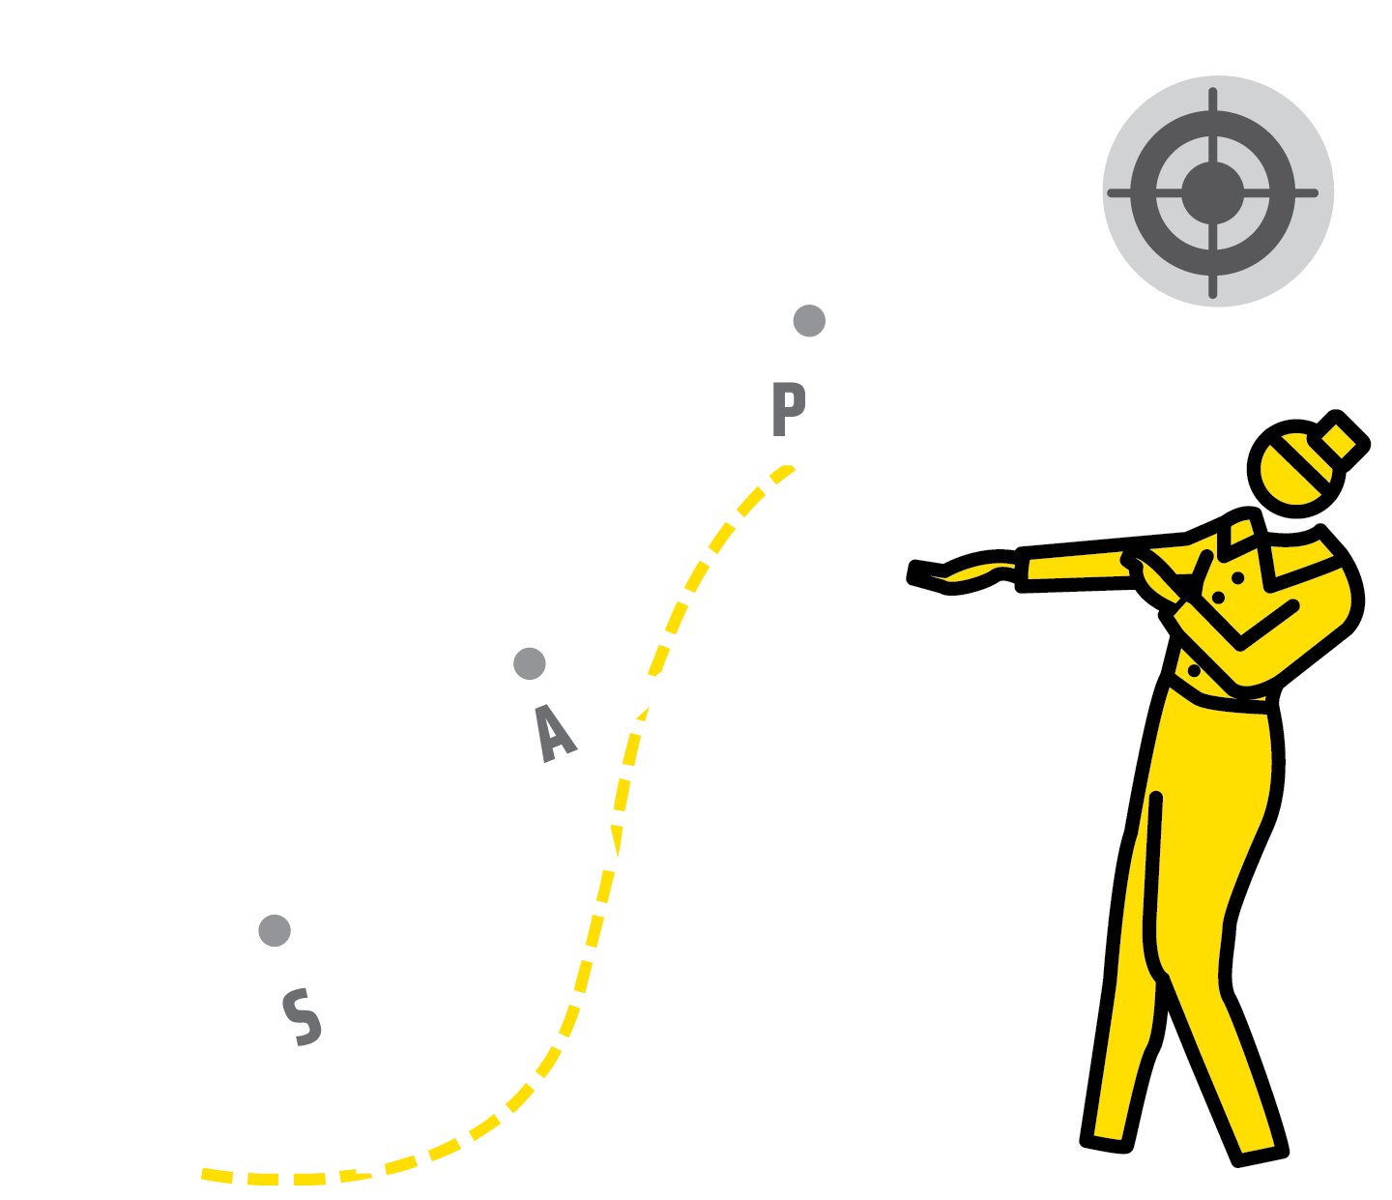


PITCH IT UP
1
2
3
4
5
AIM FOR DEPTH BEFORE SPEED
EXPECT SOPHISTICATION, ACCURACY AND PRECISION
SELECT THE MORE DEMANDING CURRICULUM OPTIONS
ELIMINATE MEDIOCRITY —
e.g. LOW-LEVEL TASKS
INCREASE THE INTENSITY
High expectations of the standards students should reach are vital. If you don’t expect students to reach a certain standard, they probably won’t.
Pitching it up entails exploring all the possible opportunities for taking a more challenging path.
Eliminate low-level tasks and balance challenge with the need for practice and consolidation.

Slide 40
PITCH IT UP
1
2
3
4
5
AIM FOR DEPTH BEFORE SPEED
Give students a wider range of problems to explore within a topic
Aim for deeper levels of analysis or
sophistication in writing or providing
explanations
Apply knowledge to unfamiliar scenarios to test depth of understanding.
Speed can be useful in developing fluency but aim for depth first.

Slide 41
PITCH IT UP
1
2
3
4
5
EXPECT SOPHISTICATION, ACCURACY AND PRECISION
Insist students produce higher level of
accuracy and precision.
Insist on: correct formal terminology;
expressing ideas in a focused logical manner; appropriate formal speech codes; drawing graphs and diagrams with precision; saying words with an authentic accent.

Slide 42
PITCH IT UP
1
2
3
4
5
SELECT THE MORE DEMANDING CURRICULUM OPTIONS
Go for a more challenging option instead of a more accessible one.
Students do not learn to read difficult texts if they don’t get the chance.
Build confidence but if, at any point, a more demanding option would be within reach, make that choice.

Slide 43
PITCH IT UP
1
2
3
4
5
ELIMINATE MEDIOCRITY —
e.g. LOW-LEVEL TASKS
Do your tasks require students to think hard; to engage in generative recall of foundational knowledge, consciously making connections with prior knowledge to solve problems?
Can tasks be easily done without much recall or cognitive processing? If so, ditch them.

Slide 44
PITCH IT UP
1
2
3
4
5
INCREASE THE INTENSITY
Could deeper levels of learning be achieved by increasing the intensity of the processes in hand?
e.g. the rate of completion of questions; the level of focus and intensity in carrying out a practical task; the number of repetitions in a routine with knowledge retrieval or practice on an instrument.
Not more difficult but more intense.

Slide 45
PITCH IT UP
1
2
3
4
5
AIM FOR DEPTH BEFORE SPEED
EXPECT SOPHISTICATION, ACCURACY AND PRECISION
SELECT THE MORE DEMANDING CURRICULUM OPTIONS
ELIMINATE MEDIOCRITY —
e.g. LOW-LEVEL TASKS
INCREASE THE INTENSITY
High expectations of the standards students should reach are vital. If you don’t expect students to reach a certain standard, they probably won’t.
Pitching it up entails exploring all the possible opportunities for taking a more challenging path.
Eliminate low-level tasks and balance challenge with the need for practice and consolidation.

Slide 46
1
2
3
4
5
6
7
8
DESIGNING A
KNOWLEDGE-RICH
CURRICULUM
SEQUENCE CONCEPTS IN SMALL STEPS
COHERENT
MAPPING
BLEND KNOWLEDGE & EXPERIENCE
PITCH IT UP
PLAN FOR
READING
TIERED QUESTIONS & PROBLEMS
DELIVER CORE; SIGNPOST HINTERLAND
NEXT UP
PLAN FOR
READING

Slide 47
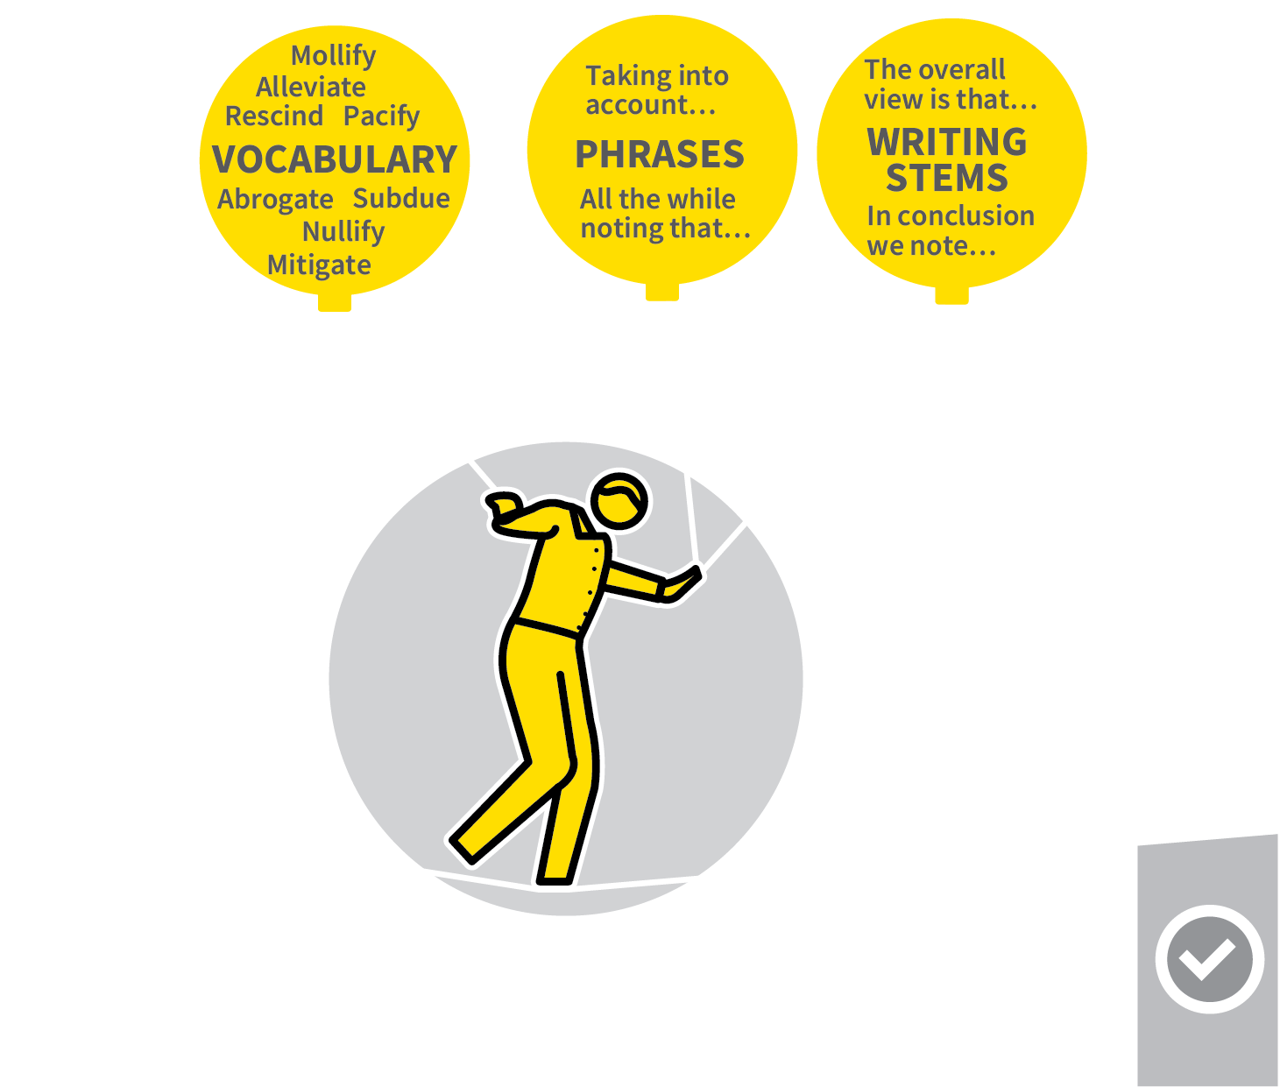
PLAN FOR READING
SERIES
CURRICULUM PLANNING
1
MAKE READING CENTRAL TO YOUR PLANNING
2
IDENTIFY KEY VOCABULARY, PHRASES AND WRITING STEMS
3
PLAN READING RESOURCES
4
PLAN COMPREHENSION ACTIVITIES
5
BUILD TOWARDS INDEPENDENT READING

Slide 48
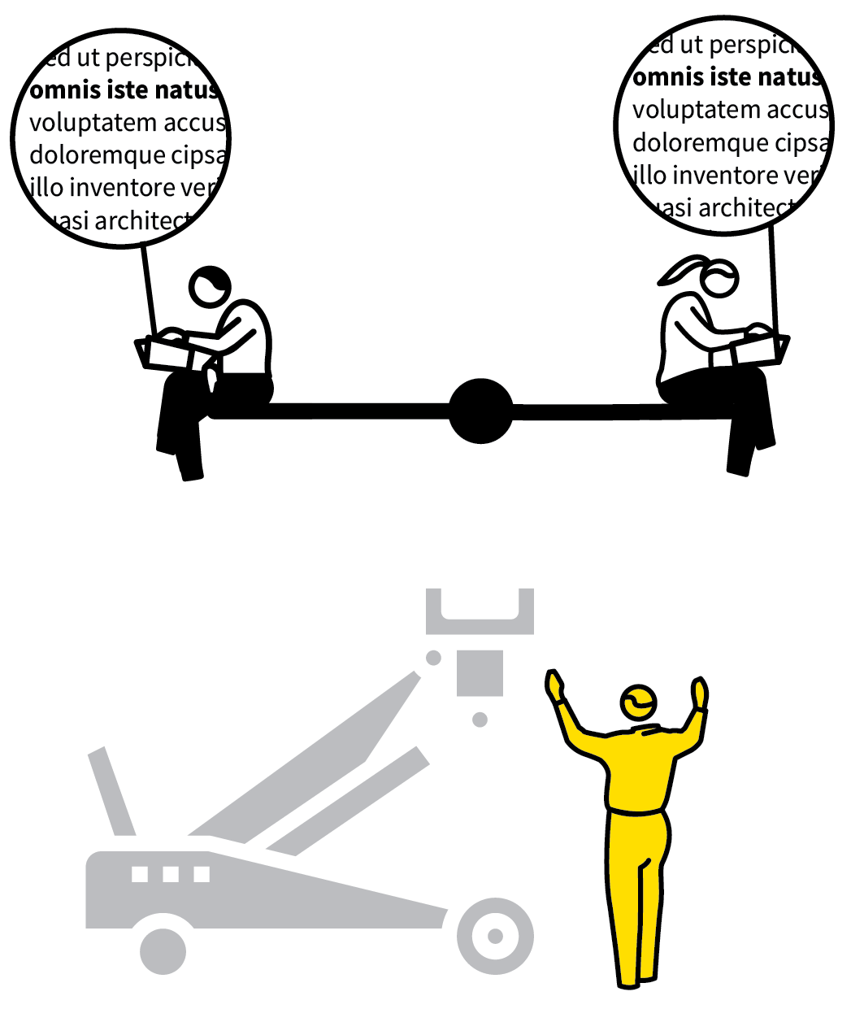



PLAN FOR READING
1
2
3
4
5
MAKE READING CENTRAL TO YOUR PLANNING
IDENTIFY KEY VOCABULARY, PHRASES AND WRITING STEMS
PLAN READING RESOURCES
PLAN COMPREHENSION ACTIVITIES
BUILD TOWARDS INDEPENDENT READING
Improving students’ reading confidence is central to the curriculum.
Most teachers have a role to play through their curriculum planning.
Examine how students’ fluency in reading and their subject knowledge can be mutually reinforcing.
Select appropriate reading material and embed reading in lesson routines.

Slide 49
PLAN FOR READING
1
2
3
4
5
MAKE READING CENTRAL TO YOUR PLANNING
Integrate reading into your planning from the beginning.
e.g. students’ capacity to read scientific texts goes alongside the science concepts
themselves.
Locate opportunities for students to learn about the topics you cover through reading about them.

Slide 50
PLAN FOR READING
1
2
3
4
5
IDENTIFY KEY VOCABULARY, PHRASES AND WRITING STEMS
Teach all words and phrases needed to
understand a text ­— as explicitly as possible.
Include common terminology, writing stems for paragraphs and phrases for linking ideas.
Focus on a tight list to practise rather than a comprehensive list.

Slide 51
PLAN FOR READING
1
2
3
4
5
PLAN READING RESOURCES
Select texts for students to read about the topic in hand, setting aside the time to do the reading in lessons.
Link text to the vocab lists so that students encounter the words and phrases in context.
Pitch to get a balance of challenge and
accessibility.

Slide 52

PLAN FOR READING
1
2
3
4
5
PLAN COMPREHENSION ACTIVITIES
Develop students’ capacity to decode and say words with confidence.
Engage them in comprehension activities: comprehension questions; summarising key points; re-phrasing in their own words
verbally or in writing; applying the content
to problem-solving.

Slide 53
PLAN FOR READING
1
2
3
4
5
BUILD TOWARDS INDEPENDENT READING
Students’ goal is to be able to read relevant texts independently as part of their overall learning journey.
Design reading tasks to be completed as part of students’ study time.
Could include retrieval practice, comprehension tasks or structured discussions.

Slide 54
PLAN FOR READING
1
2
3
4
5
MAKE READING CENTRAL TO YOUR PLANNING
IDENTIFY KEY VOCABULARY, PHRASES AND WRITING STEMS
PLAN READING RESOURCES
PLAN COMPREHENSION ACTIVITIES
BUILD TOWARDS INDEPENDENT READING
Improving students’ reading confidence is central to the curriculum.
Most teachers have a role to play through their curriculum planning.
Examine how students’ fluency in reading and their subject knowledge can be mutually reinforcing.
Select appropriate reading material and embed reading in lesson routines.

Slide 55
1
2
3
4
5
6
7
8
DESIGNING A
KNOWLEDGE-RICH
CURRICULUM
SEQUENCE CONCEPTS IN SMALL STEPS
COHERENT
MAPPING
BLEND KNOWLEDGE & EXPERIENCE
PITCH IT UP
PLAN FOR
READING
TIERED QUESTIONS & PROBLEMS
DELIVER CORE; SIGNPOST HINTERLAND
NEXT UP
TIERED QUESTIONS & PROBLEMS

Slide 56
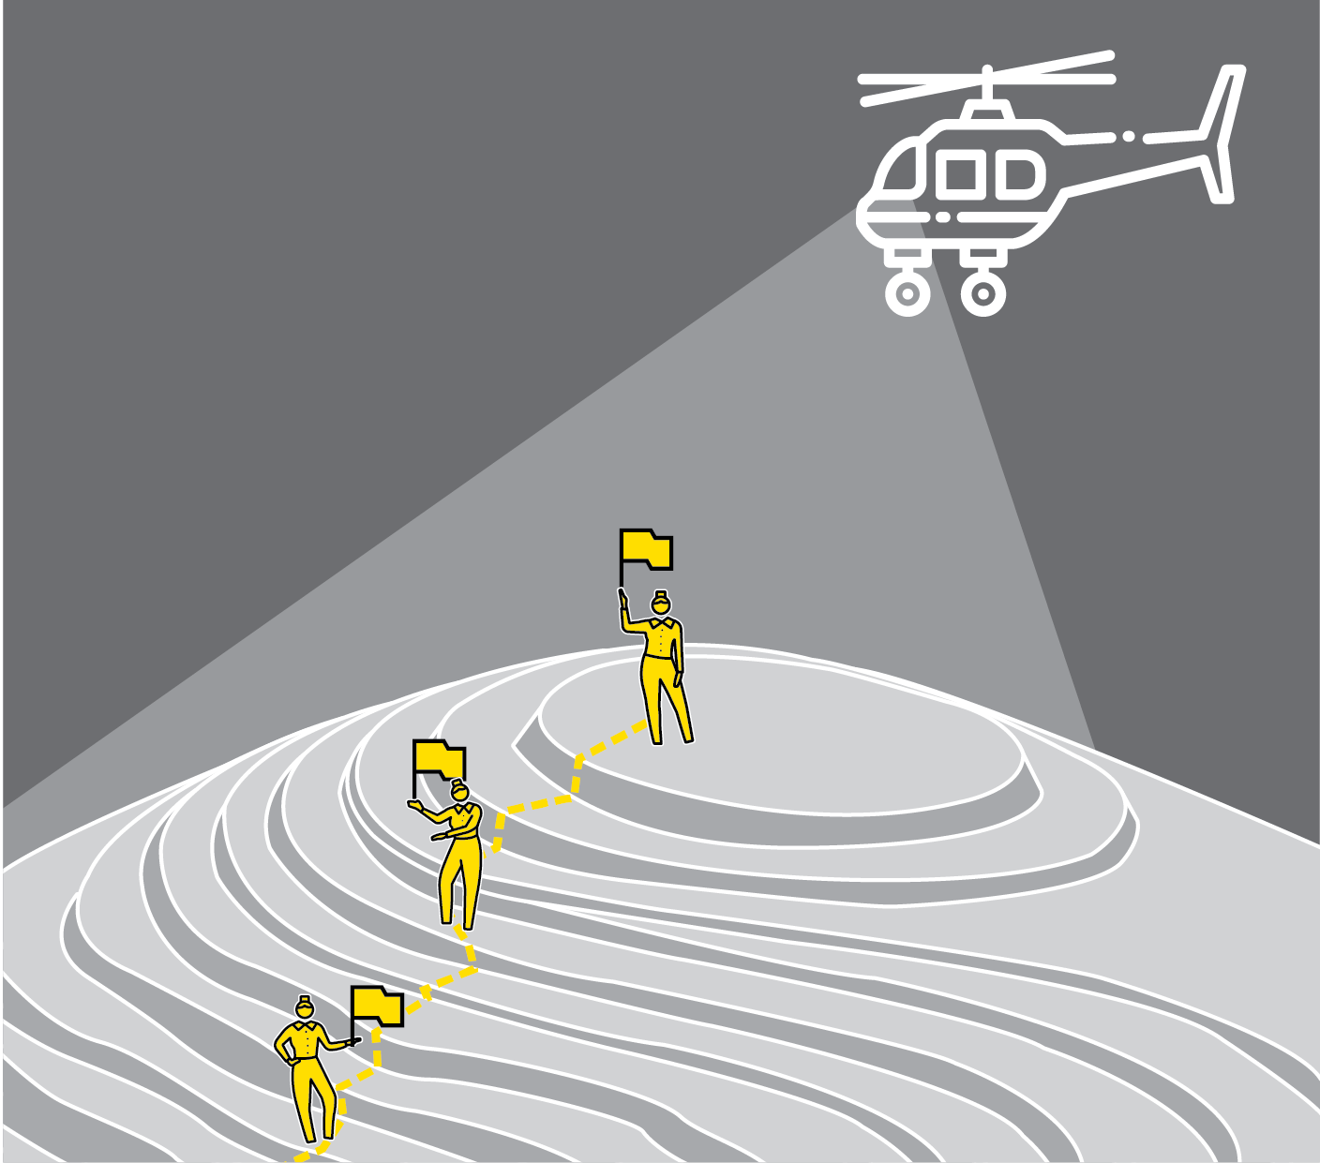
TIERED QUESTIONS & PROBLEMS
SERIES
CURRICULUM PLANNING
1
MAP THE STAGES OF DIFFICULTY IN A TOPIC
2
ASSEMBLE QUESTIONS TO SUPPORT PRACTICE AT EACH LEVEL OF DIFFICULTY
3
PRODUCE TIERED QUESTION SETS THAT STEP UP THROUGH THE LEVELS
4
DESIGN OPEN TASKS THAT ALLOW RESPONSES AT A RANGE OF LEVELS
5
DESIGN ‘WHAT NEXT’ ROUTINES

Slide 57
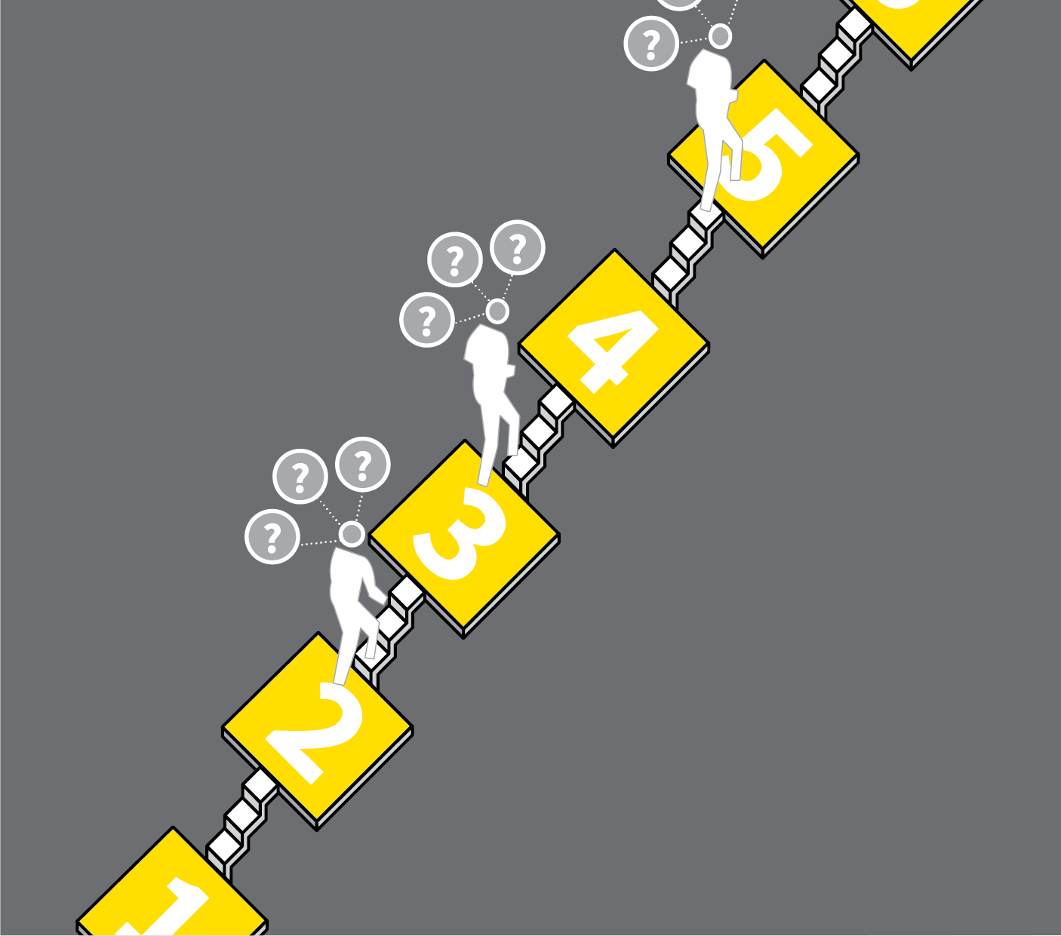
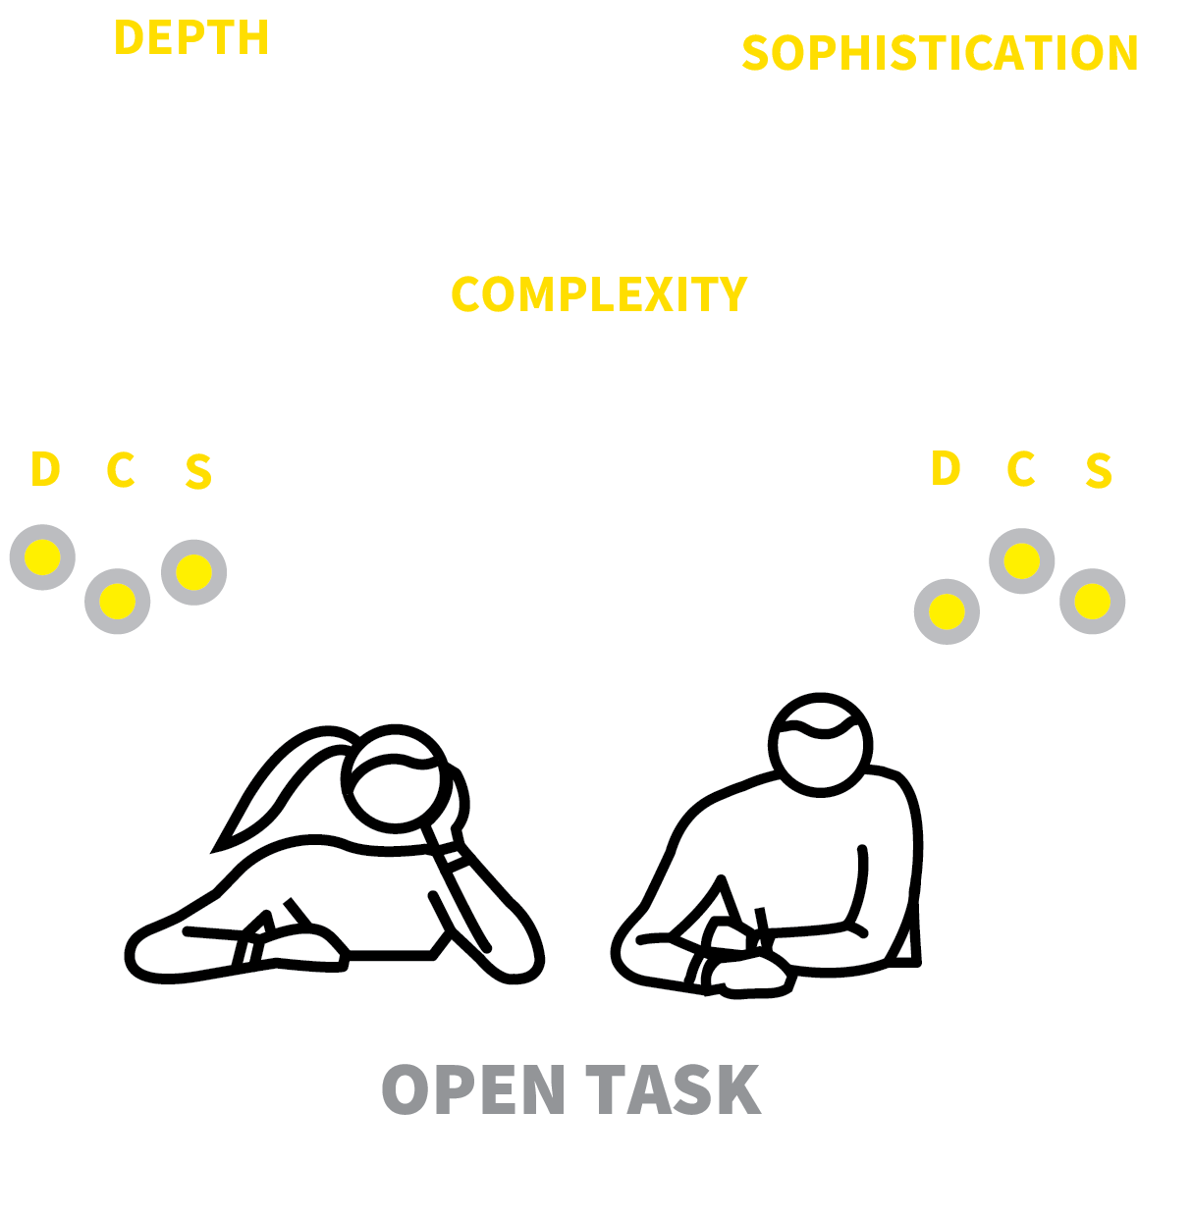

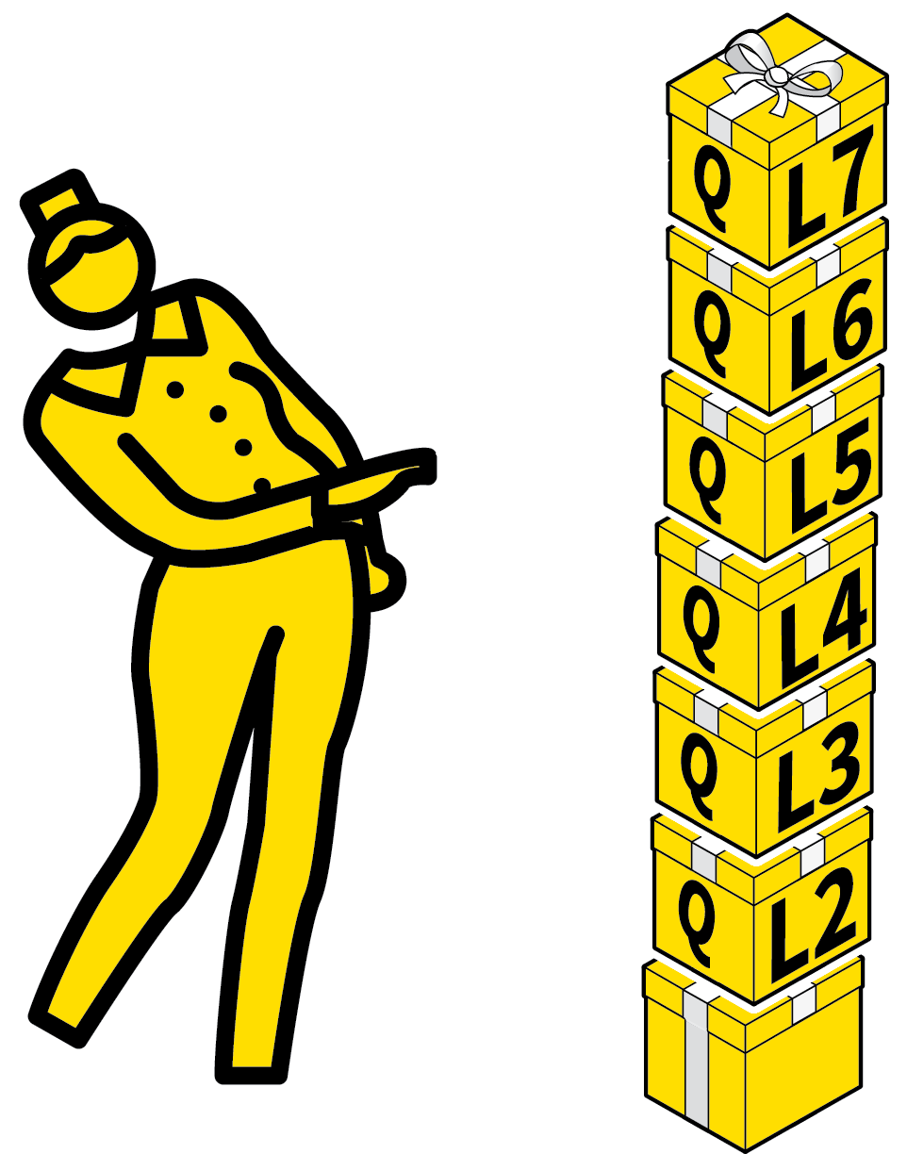
TIERED QUESTIONS & PROBLEMS
1
2
3
4
5
MAP THE STAGES OF DIFFICULTY IN A TOPIC
ASSEMBLE QUESTIONS TO SUPPORT PRACTICE AT EACH LEVEL OF DIFFICULTY
PRODUCE TIERED QUESTION SETS THAT STEP UP THROUGH THE LEVELS
DESIGN OPEN TASKS THAT ALLOW RESPONSES AT A RANGE OF LEVELS
DESIGN ‘WHAT NEXT’ ROUTINES
We have common challenging goals in mind for all students but they will not all progress in the same way.
Set students appropriate levels of practice without lowering longer-term expectations.
Tier challenges and problems sets so all students can progress through the steps in different ways whilst keeping longer-term goals in mind.

Slide 58
TIERED QUESTIONS & PROBLEMS
1
2
3
4
5
MAP THE STAGES OF DIFFICULTY IN A TOPIC
Identify the stages in the hierarchy of
difficulty as students progress through
a topic.
This could be: depth of knowledge or level of proficiency; the specific question-types that they should be able to answer.
Reference exemplar material to illustrate
the stages.

Slide 59
TIERED QUESTIONS & PROBLEMS
1
2
3
4
5
ASSEMBLE QUESTIONS TO SUPPORT PRACTICE AT EACH LEVEL OF DIFFICULTY
Gather questions or tasks that provide
practice in a very specific aspect of the
curriculum.
To develop fluency, give students repeated opportunities to succeed at each level.
Give the least confident students enough questions to continue their practice.

Slide 60
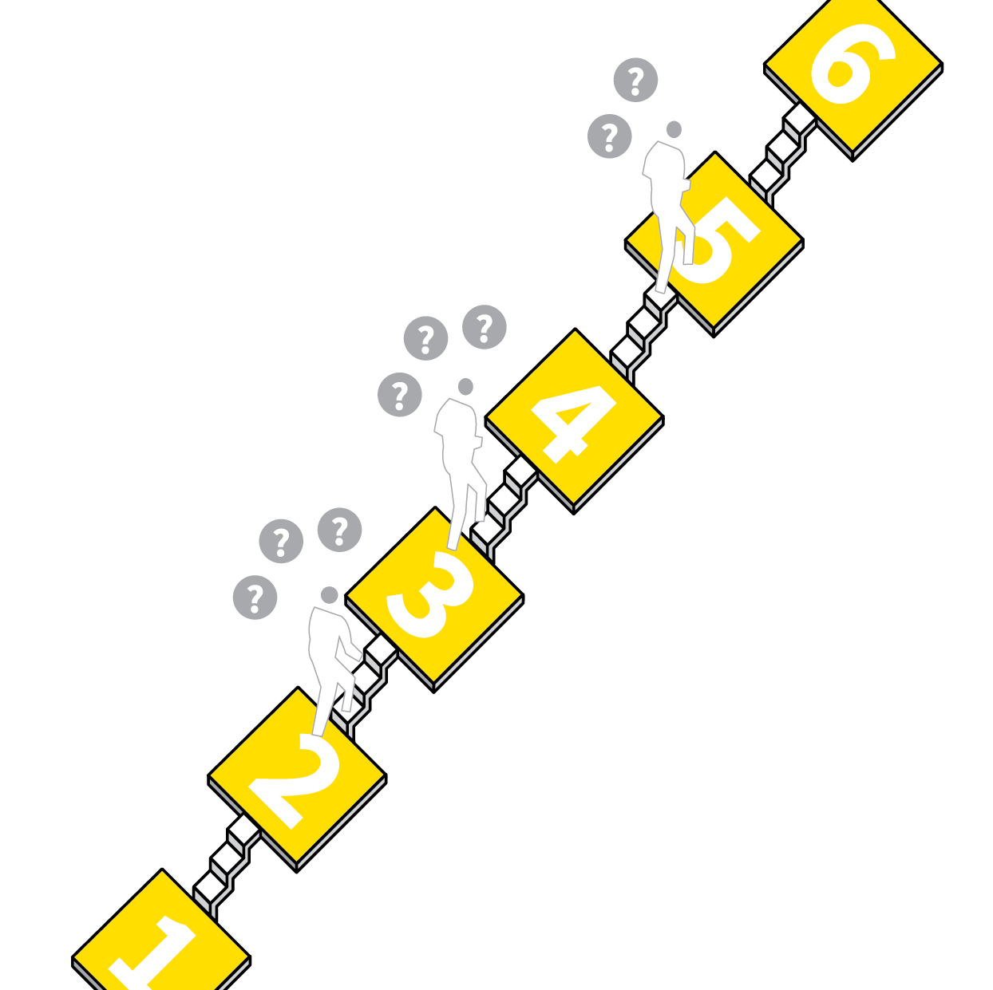
TIERED QUESTIONS & PROBLEMS
1
2
3
4
5
PRODUCE TIERED QUESTION SETS THAT STEP UP THROUGH THE LEVELS
Compile sets of questions that take several questions from each of the tiers starting with the easiest, moving up to the most difficult.
Include enough questions at each level to support practice.
Make the hardest questions a genuine stretch for your highest attaining students.

Slide 61
TIERED QUESTIONS & PROBLEMS
1
2
3
4
5
DESIGN OPEN TASKS THAT ALLOW RESPONSES AT A RANGE OF LEVELS
Design tasks that allow students to produce responses to varying levels of depth and sophistication with the same stimulus.
Set the Standards supported by exemplar material.
Make certain every student can achieve within the task and every student will be challenged.

Slide 62
TIERED QUESTIONS & PROBLEMS
1
2
3
4
5
DESIGN ‘WHAT NEXT’ ROUTINES
Rehearse routines students should follow when they are ready to move up to the next level of difficulty:
Check answers; demonstrate fluency;
self-directed review of work against the agreed success criteria.
Ideally students are never waiting having
finished or having got stuck; they will know what to do next.

Slide 63
TIERED QUESTIONS & PROBLEMS
1
2
3
4
5
MAP THE STAGES OF DIFFICULTY IN A TOPIC
ASSEMBLE QUESTIONS TO SUPPORT PRACTICE AT EACH LEVEL OF DIFFICULTY
PRODUCE TIERED QUESTION SETS THAT STEP UP THROUGH THE LEVELS
DESIGN OPEN TASKS THAT ALLOW RESPONSES AT A RANGE OF LEVELS
DESIGN ‘WHAT NEXT’ ROUTINES
We have common challenging goals in mind for all students but they will not all progress in the same way.
Set students appropriate levels of practice without lowering longer-term expectations.
Tier challenges and problems sets so all students can progress through the steps in different ways whilst keeping longer-term goals in mind.

Slide 64
1
2
3
4
5
6
7
8
DESIGNING A
KNOWLEDGE-RICH
CURRICULUM
SEQUENCE CONCEPTS IN SMALL STEPS
COHERENT
MAPPING
BLEND KNOWLEDGE & EXPERIENCE
PITCH IT UP
PLAN FOR
READING
TIERED QUESTIONS & PROBLEMS
DELIVER CORE; SIGNPOST HINTERLAND
NEXT UP
DELIVER CORE;
SIGNPOST HINTERLAND

Slide 65
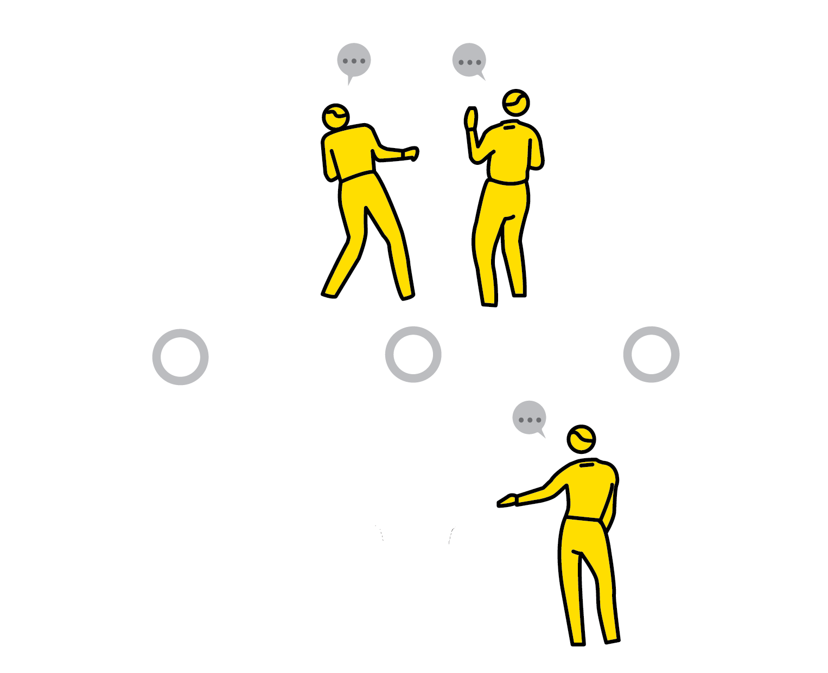
DELIVER CORE;
SIGNPOST HINTERLAND
SERIES
CURRICULUM PLANNING
1
ESTABLISH THE CORE
2
MAP OUT THE HINTERLAND IN BROAD TERMS
3
PLAN HINTERLAND REFERENCES AS CONTEXT FOR THE CORE
4
ENGAGE STUDENTS IN HINTERLAND RESEARCH TASKS
5
ADOPT A RESPONSIVE ORGANIC APPROACH

Slide 66


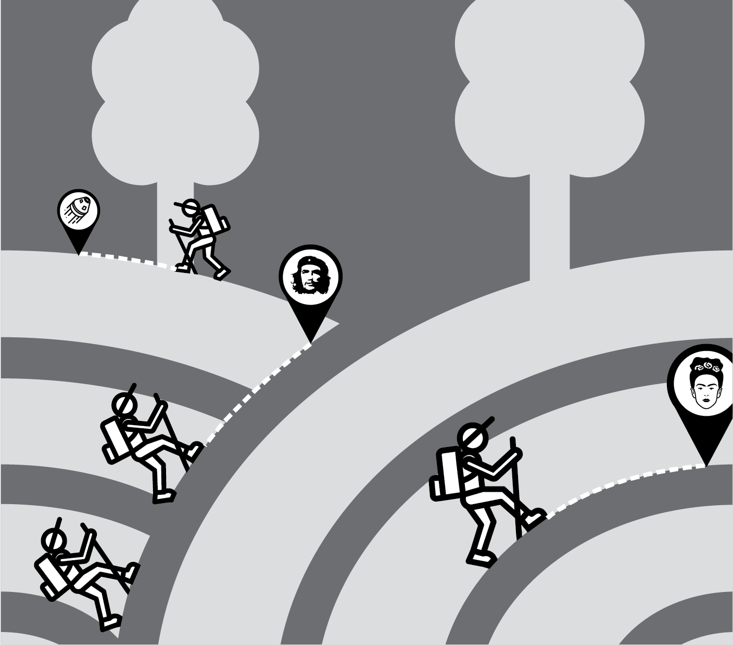

DELIVER CORE; SIGNPOST HINTERLAND
1
2
3
4
5
ESTABLISH THE CORE
MAP OUT THE HINTERLAND IN BROAD TERMS
PLAN HINTERLAND REFERENCES AS CONTEXT FOR THE CORE
ENGAGE STUDENTS IN
HINTERLAND RESEARCH TASKS
ADOPT A RESPONSIVE ORGANIC APPROACH
We have to make choices: what is core and taught and what do we leave out?
Christine Counsell promotes the idea that teachers view this in terms of the concept of ‘hinterland’.
Beyond the core material lies the hinterland providing the background against n which the core content exists.
The idea is not to forget it but to signpost it explicitly.

Slide 67
DELIVER CORE; SIGNPOST HINTERLAND
1
2
3
4
5
ESTABLISH THE CORE
Go through the exercise described in
Coherent Mapping.
Be conscious of the alternative choices you might have made.
Which literary texts, case studies, places,
artists, historical figures and events, areas of science or musical genres are not in the core but remain highly significant?

Slide 68
DELIVER CORE; SIGNPOST HINTERLAND
1
2
3
4
5
MAP OUT THE HINTERLAND IN BROAD TERMS
Survey the range of curriculum elements you decided not to include and prioritise within that list the areas that might play a
supporting role to the core.
Keep it as general as you can, including:
literary genres, areas of science; the life
histories of key figures in your core
curriculum; periods of history you can't
deliver directly.

Slide 69
DELIVER CORE; SIGNPOST HINTERLAND
1
2
3
4
5
PLAN HINTERLAND REFERENCES AS CONTEXT FOR THE CORE
Make explicit links between the hinterland areas you’ve highlighted and the core
spiralled curriculum.
e.g. historical contexts to the texts you study in literature; historical events in other
countries in parallel to those you are
studying; similar climate change events in other countries to those you are studying.

Slide 70

DELIVER CORE; SIGNPOST HINTERLAND
1
2
3
4
5
ENGAGE STUDENTS IN HINTERLAND RESEARCH TASKS
Set structured research tasks to find out about areas of the related curriculum beyond the core.
e.g. additional case study examples about geographical features or cities; poems they find interesting; historical events in other countries; examples of artists, authors and musicians and their work.
Share these as a class.

Slide 71
DELIVER CORE; SIGNPOST HINTERLAND
1
2
3
4
5
ADOPT A RESPONSIVE ORGANIC APPROACH
It is always worthwhile adding depth to
learning by telling stories, responding to events and sharing ideas as they come up.
e.g. a news story; the history behind a
scientific discovery; a passage from a
contrasting novel.
Hinterland references tell students all these exciting things are out there to learn about.

Slide 72
DELIVER CORE; SIGNPOST HINTERLAND
1
2
3
4
5
ESTABLISH THE CORE
MAP OUT THE HINTERLAND IN BROAD TERMS
PLAN HINTERLAND REFERENCES AS CONTEXT FOR THE CORE
ENGAGE STUDENTS IN
HINTERLAND RESEARCH TASKS
ADOPT A RESPONSIVE ORGANIC APPROACH
We have to make choices: what is core and taught and what do we leave out?
Christine Counsell promotes the idea that teachers view this in terms of the concept of ‘hinterland’.
Beyond the core material lies the hinterland providing the background against n which the core content exists.
The idea is not to forget it but to signpost it explicitly.

