Slide 1
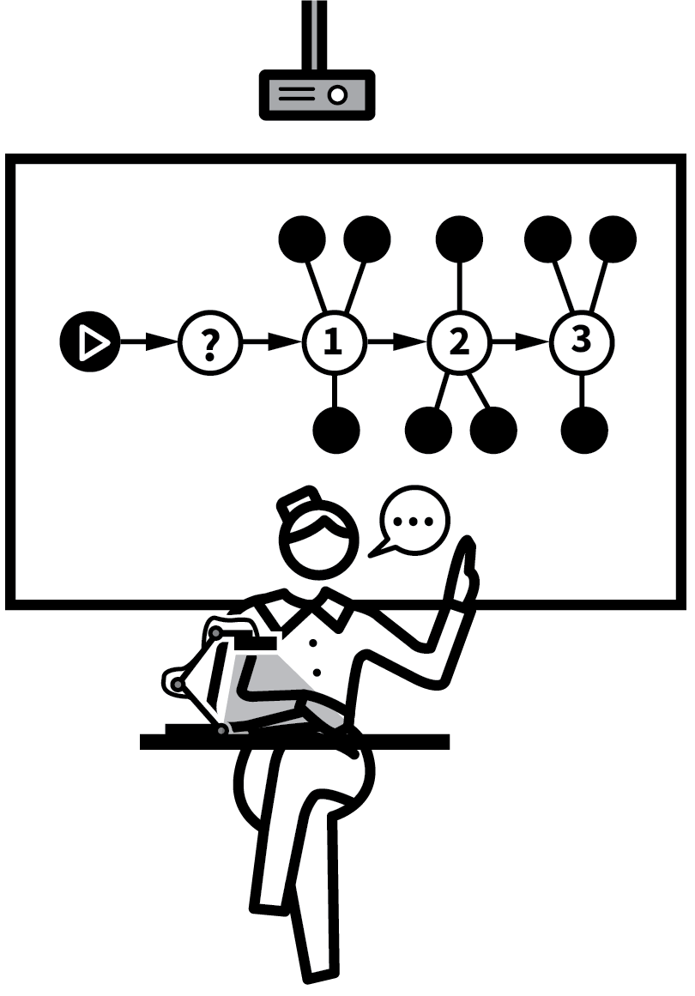
John Catt Educational
EXPLAINING & MODELLING
TEACHING
WALKTHRUs
PRESENTATION
SLIDES
TOM SHERRINGTON & OLIVER CAVIGLIOLI
WORKED EXAMPLES & BACKWARD FADING
DUAL CODING
DELIBERATE VOCABULARY DEVELOPMENT
BIG PICTURE, SMALL PICTURE
ABSTRACT MODEL WITH CONCRETE EXAMPLES
LIVE MODELLING
SCAFFOLDING
METACOGNITIVE TALK
SET THE STANDARDS
HEAD-ON MISCONCEPTIONS

Slide 2
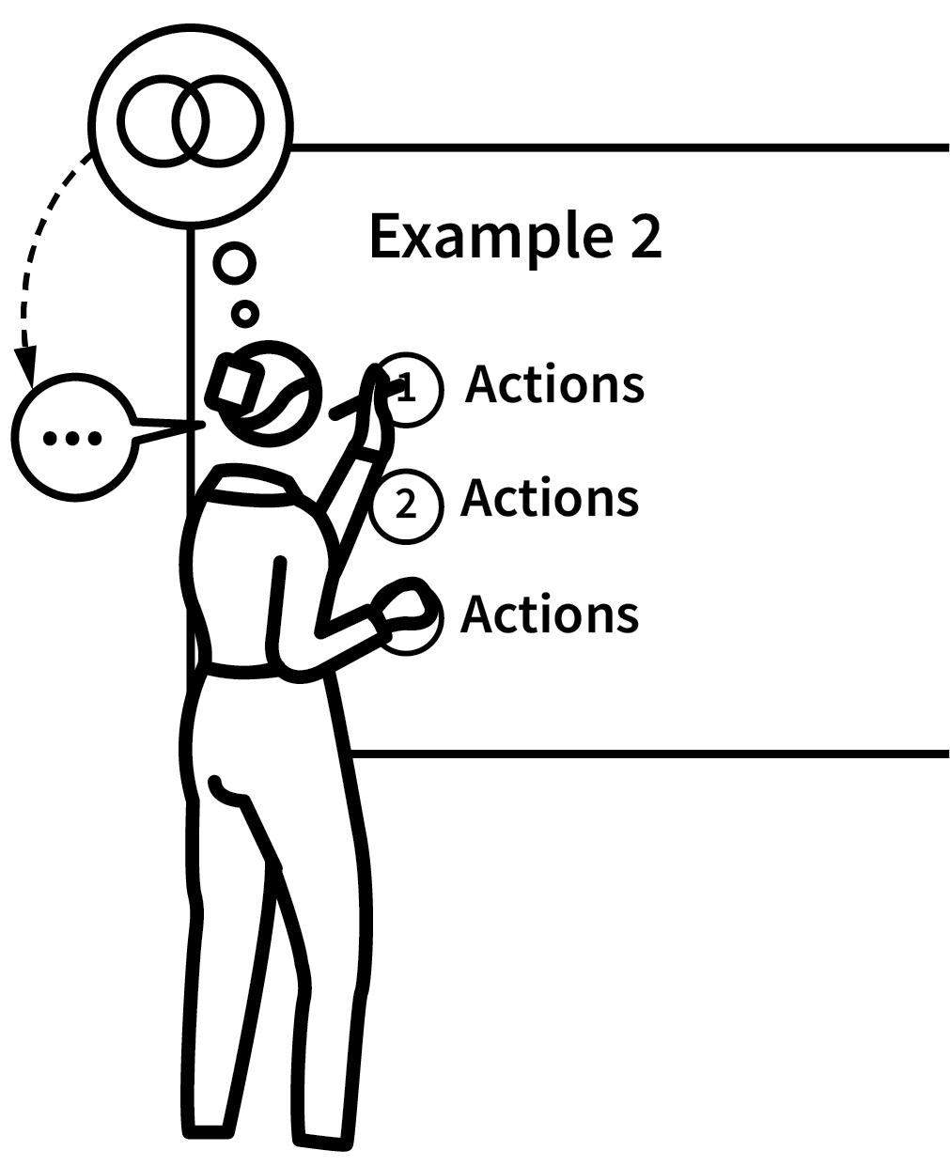

WORKED EXAMPLES & BACKWARD FADING
SERIES
EXPLAINING & MODELLING
1
FULLY WORKED TO INTRODUCE THE METHOD OR IDEAS
2
FULLY WORKED FOR REINFORCEMENT
3
PARTIALLY WORKED FOR STUDENTS TO FINISH OFF
4
CUED START FOR STUDENT COMPLETION
5
COMPLETED INDEPENDENTLY

Slide 3
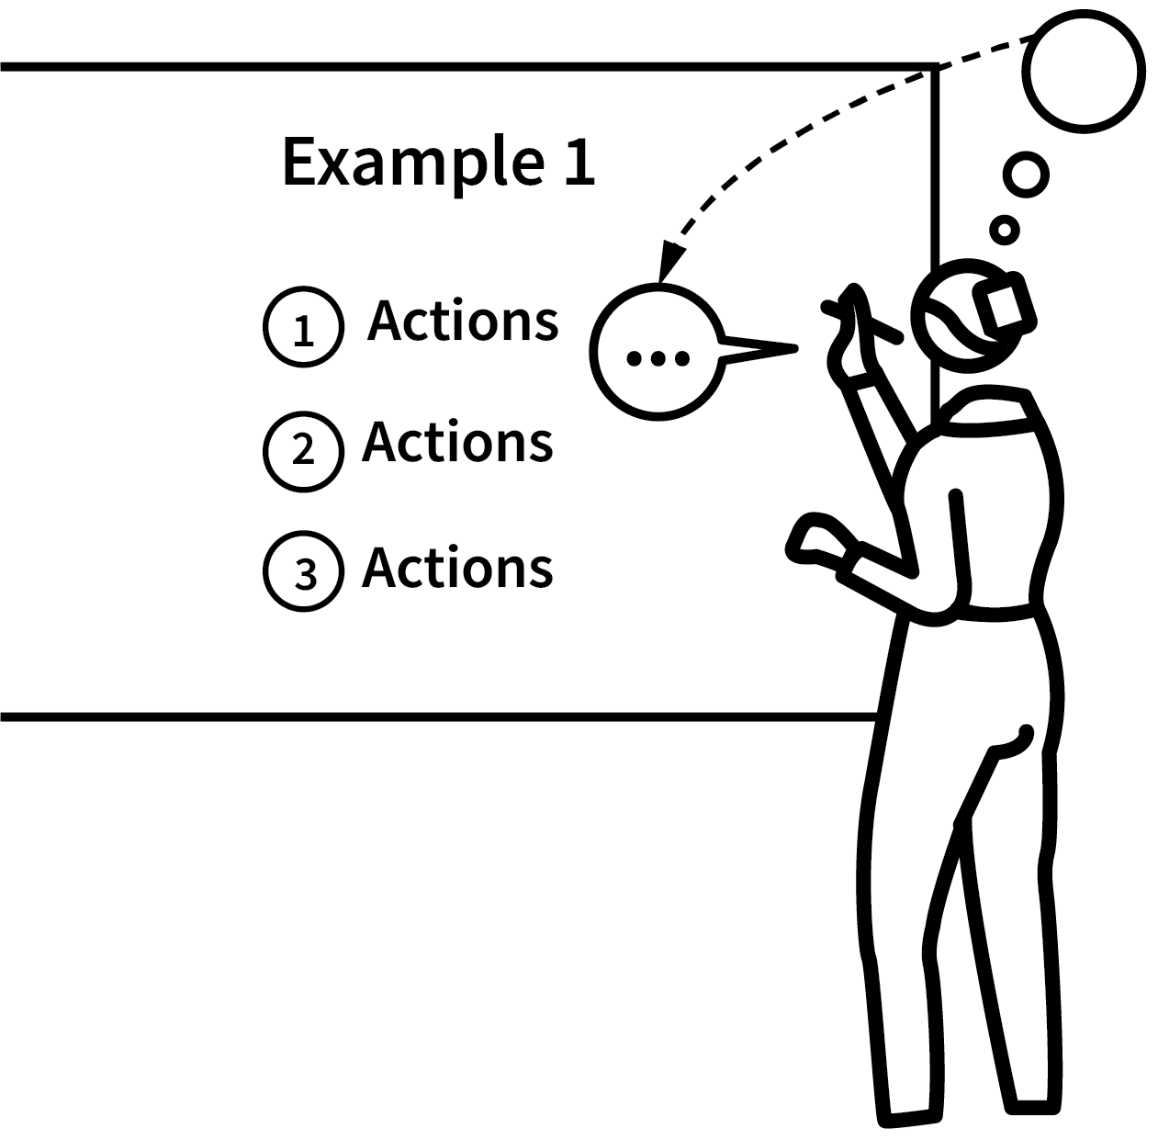
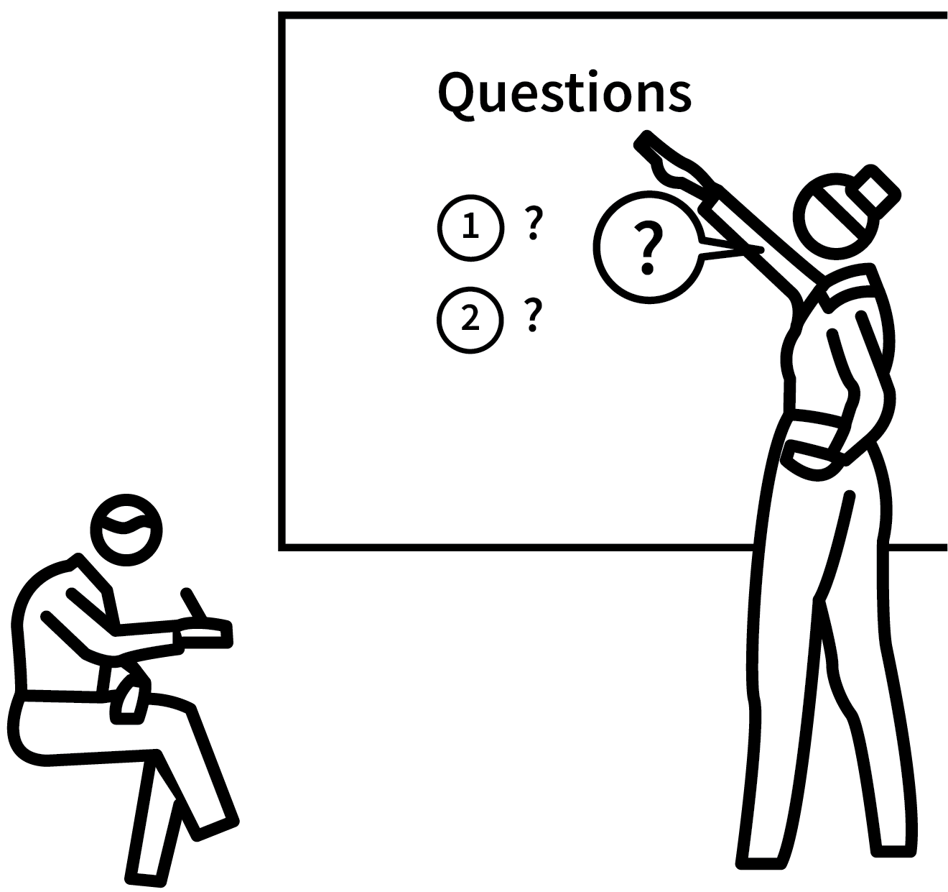
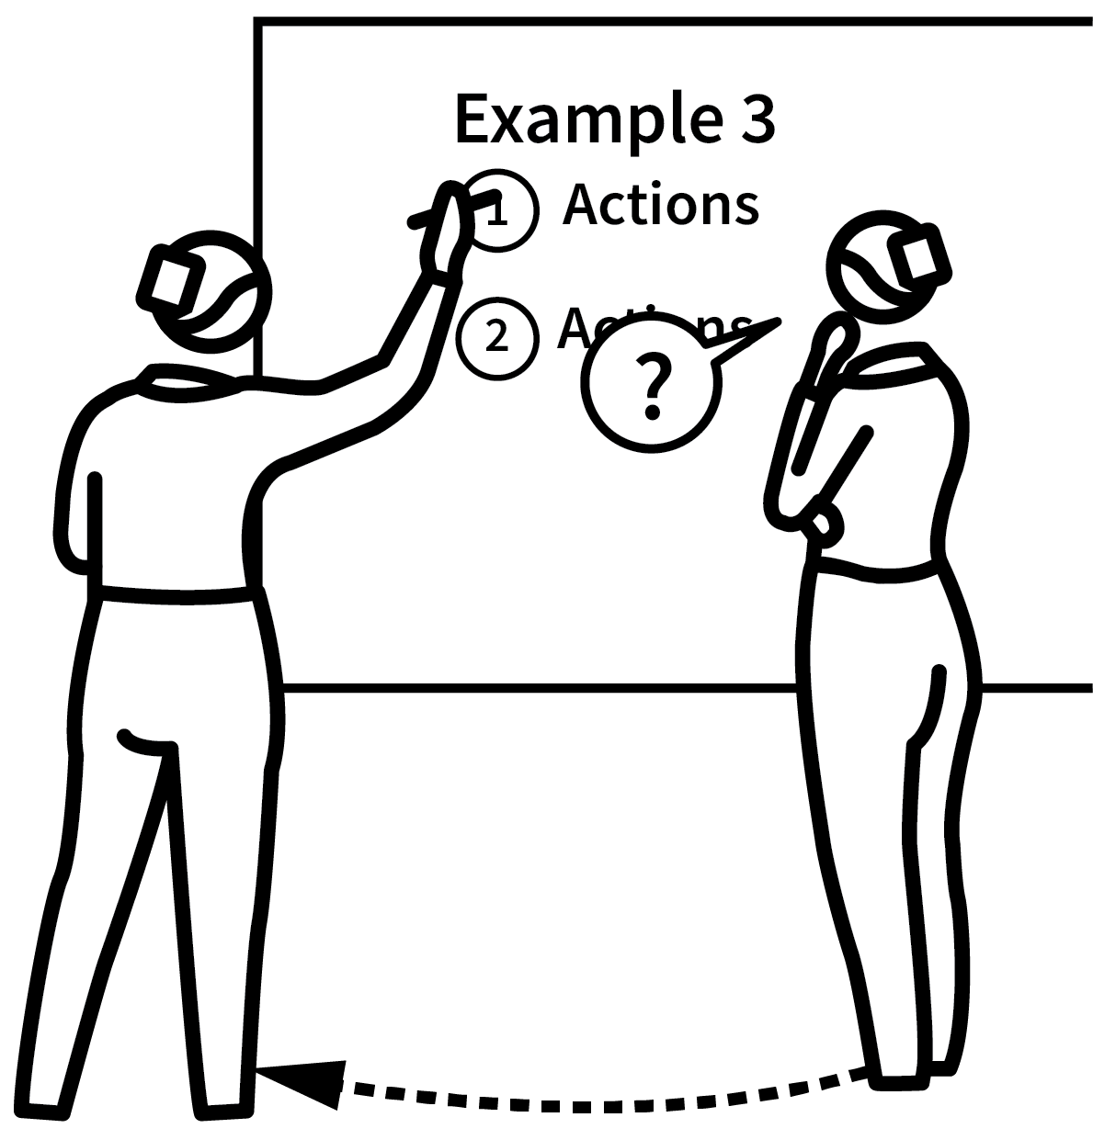

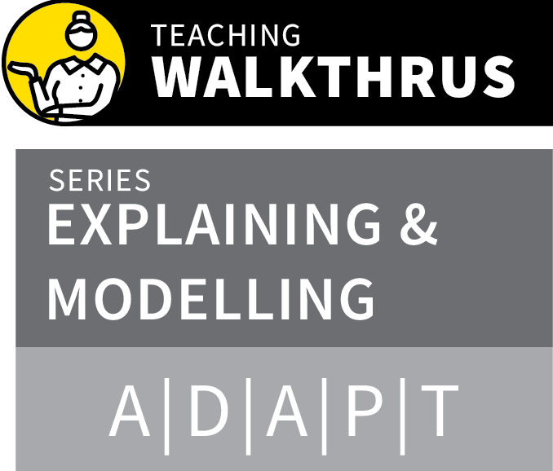
WORKED EXAMPLES & BACKWARD FADING
1
2
3
4
5
FULLY WORKED TO INTRODUCE THE METHOD OR IDEAS
FULLY WORKED FOR REINFORCEMENT
PARTIALLY WORKED FOR STUDENTS TO FINISH OFF
CUED START FOR STUDENT COMPLETION
COMPLETED INDEPENDENTLY
Cognitive Load Theory suggests novices learn more successfully studying complete worked examples than if asked to problem-solve independently.
Cognitive load is reduced if we learn the overall method separately from trying to apply it.
Often teachers do not model sufficient worked examples.
Backward fading is good for moving from guided to independent practice.

Slide 4
WORKED EXAMPLES & BACKWARD FADING
1
2
3
4
5
FULLY WORKED TO INTRODUCE THE METHOD OR IDEAS
Introduce the first example of a question you are aiming for students to answer.
Go through the problem on the board,
producing a model answer, talking through what you are doing as you write.
Talk through each of your steps:
“What did I do here?”
“Why did I choose to write that phrase?”

Slide 5
WORKED EXAMPLES & BACKWARD FADING
1
2
3
4
5
FULLY WORKED FOR REINFORCEMENT
Repeat the process with another example.
The similarities should serve to reinforce the general idea or method you are teaching.
The differences should illustrate how the method works with different cases.

Slide 6
WORKED EXAMPLES & BACKWARD FADING
1
2
3
4
5
PARTIALLY WORKED FOR STUDENTS TO FINISH OFF
This time, introduce a question and begin to answer it, following the pattern or procedure you introduced in the first two examples.
Give students time to complete the question and then check for answers, errors and any variations or misunderstanding.

Slide 7
WORKED EXAMPLES & BACKWARD FADING
1
2
3
4
5
CUED START FOR STUDENT COMPLETION
Students should now be ready for a practice phase.
Set one or more questions of the same type as the examples.
Start them off or signal the way to begin.

Slide 8
WORKED EXAMPLES & BACKWARD FADING
1
2
3
4
5
COMPLETED INDEPENDENTLY
When ready, set one or more questions of the same type that you have modelled where students have to undertake the whole thinking process independently.
Follow the details of the modelled examples.
Check for accuracy to verify that the methods are understood as well as being copied.

Slide 9
WORKED EXAMPLES & BACKWARD FADING
1
2
3
4
5
FULLY WORKED TO INTRODUCE THE METHOD OR IDEAS
FULLY WORKED FOR REINFORCEMENT
PARTIALLY WORKED FOR STUDENTS TO FINISH OFF
CUED START FOR STUDENT COMPLETION
COMPLETED INDEPENDENTLY
Cognitive Load Theory suggests novices learn more successfully studying complete worked examples than if asked to problem-solve independently.
Cognitive load is reduced if we learn the overall method separately from trying to apply it.
Often teachers do not model sufficient worked examples.
Backward fading is good for moving from guided to independent practice.

Slide 10

1
2
3
4
5
6
7
8
9
10
WORKED EXAMPLES & BACKWARD FADING
DUAL
CODING
DELIBERATE VOCABULARY DEVELOPMENT
BIG PICTURE, SMALL PICTURE
ABSTRACT MODELS WITH CONCRETE EXAMPLES
LIVE MODELLING
SCAFFOLDING
METACOGNITIVE TALK
SET THE STANDARDS
HEAD-ON MISCONCEPTIONS
NEXT UP
DUAL CODING

Slide 11
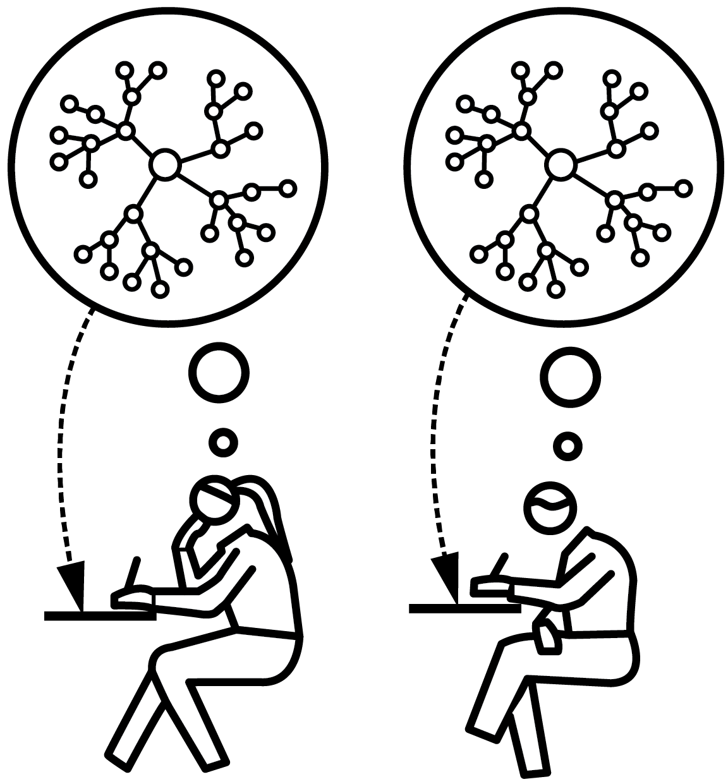
DUAL CODING:
RECOUNT & RECALL
SERIES
EXPLAINING & MODELLING
1
CONSTRUCT & EXPLAIN YOUR DIAGRAM
2
COPY & EXPLAIN THE BRANCH WITH TRACING OF THE LINES
3
REPEAT THE SAME PROCESS UNTIL THE WHOLE DIAGRAM IS COMPLETE
4
RECOUNT THE WHOLE DIAGRAM TO PARTNER, WITH TRACING
5
REDRAW THE WHOLE DIAGRAM FROM MEMORY

Slide 12
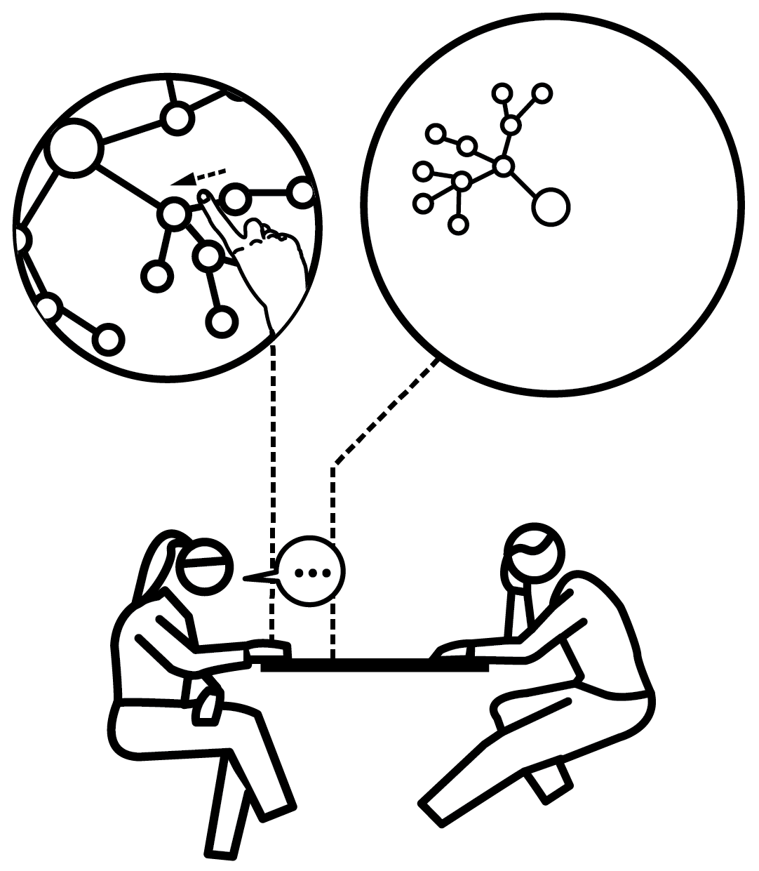
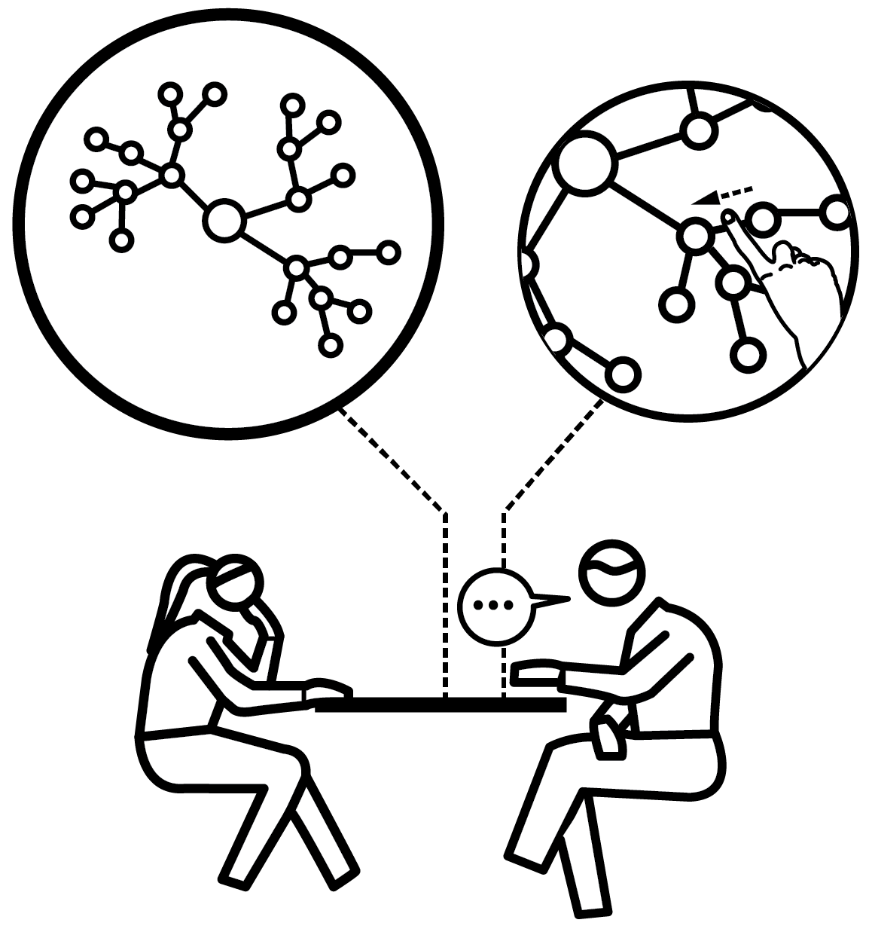
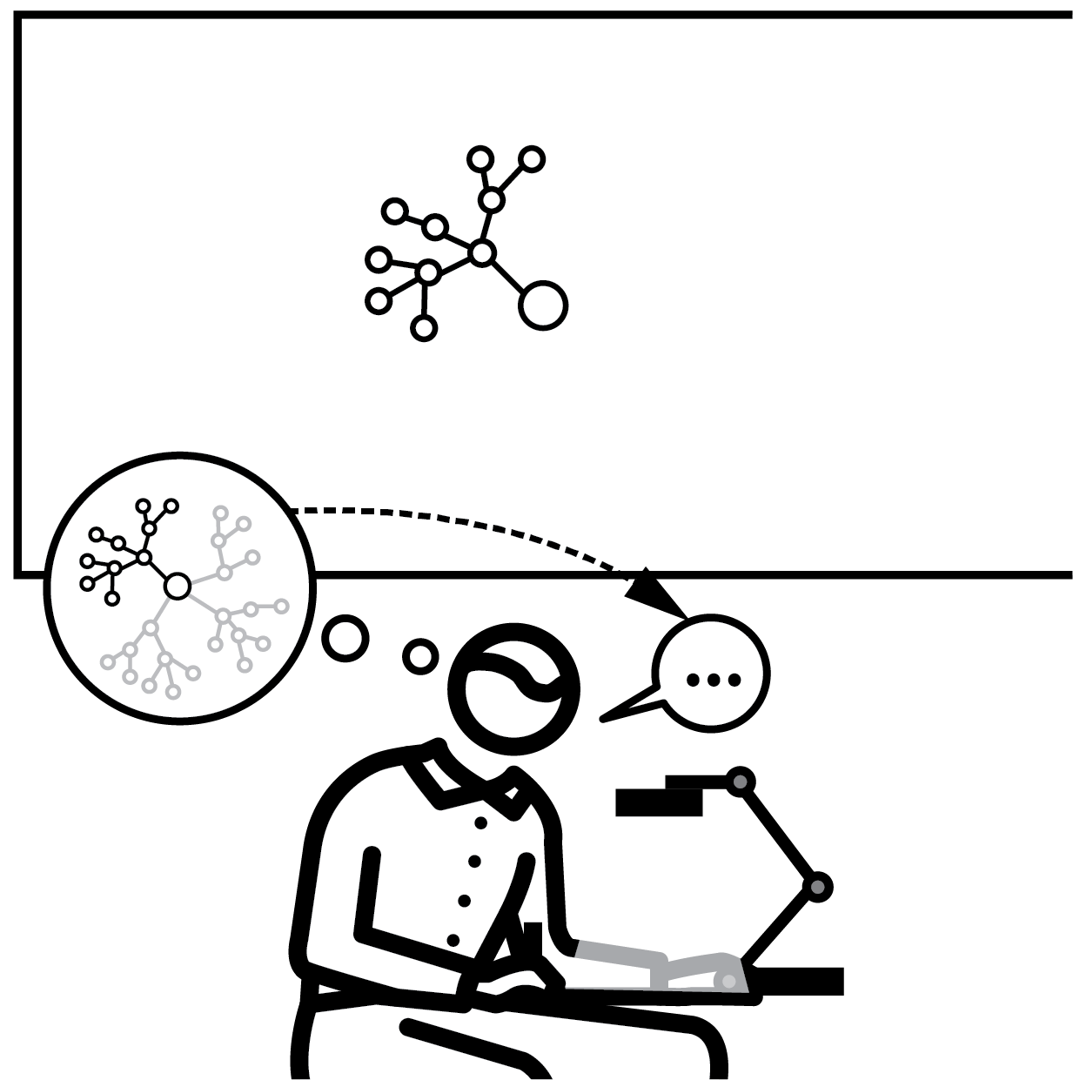
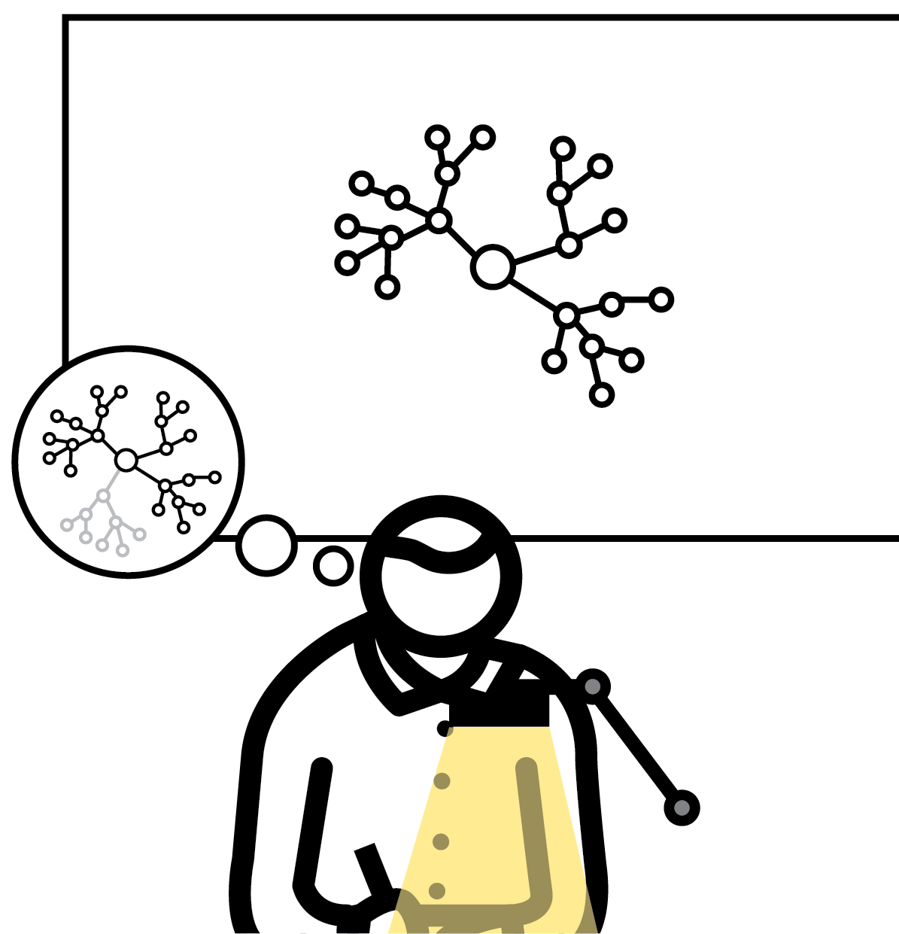
DUAL CODING: RECOUNT & RECALL
1
2
3
4
5
CONSTRUCT & EXPLAIN YOUR DIAGRAM
COPY & EXPLAIN THE BRANCH WITH TRACING OF THE LINES
REPEAT THE SAME PROCESS UNTIL THE WHOLE DIAGRAM IS COMPLETE
RECOUNT THE WHOLE
DIAGRAM TO PARTNER, WITH TRACING
REDRAW THE WHOLE DIAGRAM FROM MEMORY
Paivio’s Dual Coding Theory dealt only with the recall of cognitively simple material. Later, others developed his work to cover more complex content.
This method allows teachers to share their schema visually and with words.
Using drawing and tracing bypasses many constraints of working memory.
Understanding is strengthened through peer explanation and provides a superb opportunity for oral rehearsal.

Slide 13
DUAL CODING: RECOUNT & RECALL
1
2
3
4
5
CONSTRUCT & EXPLAIN YOUR DIAGRAM
Start by saying that the diagram you are about to build on the whiteboard is a model of your schema.
You are aiming for each student to have the same schema in their head by the end of the process.
You can do this through live drawing with a visualiser, or through the gradual display with a prepared slide presentation

Slide 14
DUAL CODING: RECOUNT & RECALL
1
2
3
4
5
COPY & EXPLAIN THE BRANCH WITH TRACING OF THE LINES
After explaining the organisation and meaning of the first part of the diagram, direct students to explain it back to their partner.
While doing so, the students trace the line
related to the area being summarised.
Student listeners also trace the corresponding line on their diagram.
When complete, switch roles.

Slide 15
DUAL CODING: RECOUNT & RECALL
1
2
3
4
5
REPEAT THE SAME PROCESS UNTIL THE WHOLE DIAGRAM IS COMPLETE
Continue in this way until the whole diagram has been copied, then summarised to a partner and every line traced.
To ensure students aren’t merely reading the words copied, establish a rule that every keyword needs to be explained in sentences.
Listening partners can ask questions related to details and, also, to any potential cross–diagram connection.

Slide 16
DUAL CODING: RECOUNT & RECALL
1
2
3
4
5
RECOUNT THE WHOLE DIAGRAM TO PARTNER, WITH TRACING
If time allows, give students an opportunity to explain the whole map — in the same
fashion — to their partner.
Repeat roles when the first is finished.

Slide 17
DUAL CODING: RECOUNT & RECALL
1
2
3
4
5
REDRAW THE WHOLE DIAGRAM FROM MEMORY
Finally, remove the diagrams from sight.
Ask students to play back their explanations silently in their head whilst tracing the diagram with their index finger.
Once they realise they have a solid memory, direct them to pick up their pens and redraw the diagram from memory.
When complete, ask them to compare their diagram with their original and search out any gaps or inaccuracies.

Slide 18
DUAL CODING: RECOUNT & RECALL
1
2
3
4
5
CONSTRUCT & EXPLAIN YOUR DIAGRAM
COPY & EXPLAIN THE BRANCH WITH TRACING OF THE LINES
REPEAT THE SAME PROCESS UNTIL THE WHOLE DIAGRAM IS COMPLETE
RECOUNT THE WHOLE
DIAGRAM TO PARTNER, WITH TRACING
REDRAW THE WHOLE DIAGRAM FROM MEMORY
Paivio’s Dual Coding Theory dealt only with the recall of cognitively simple material. Later, others developed his work to cover more complex content.
This method allows teachers to share their schema visually and with words.
Using drawing and tracing bypasses many constraints of working memory.
Understanding is strengthened through peer explanation and provides a superb opportunity for oral rehearsal.

Slide 19
1
2
3
4
5
6
7
8
9
10
WORKED EXAMPLES & BACKWARD FADING
DUAL
CODING
DELIBERATE VOCABULARY DEVELOPMENT
BIG PICTURE, SMALL PICTURE
ABSTRACT MODELS WITH CONCRETE EXAMPLES
LIVE MODELLING
SCAFFOLDING
METACOGNITIVE TALK
SET THE STANDARDS
HEAD-ON MISCONCEPTIONS
NEXT UP
DELIBERATE VOCABULARY DEVELOPMENT

Slide 20

DELIBERATE VOCABULARY DEVELOPMENT
SERIES
EXPLAINING & MODELLING
1
SPECIFY AND DEFINE THE WORDS
2
SAY THE WORDS
3
READ WORDS IN CONTEXT
4
PRACTISE USING THE WORDS VERBALLY AND IN WRITING
5
ENGAGE IN WORD-BASED RETRIEVAL PRACTICE

Slide 21


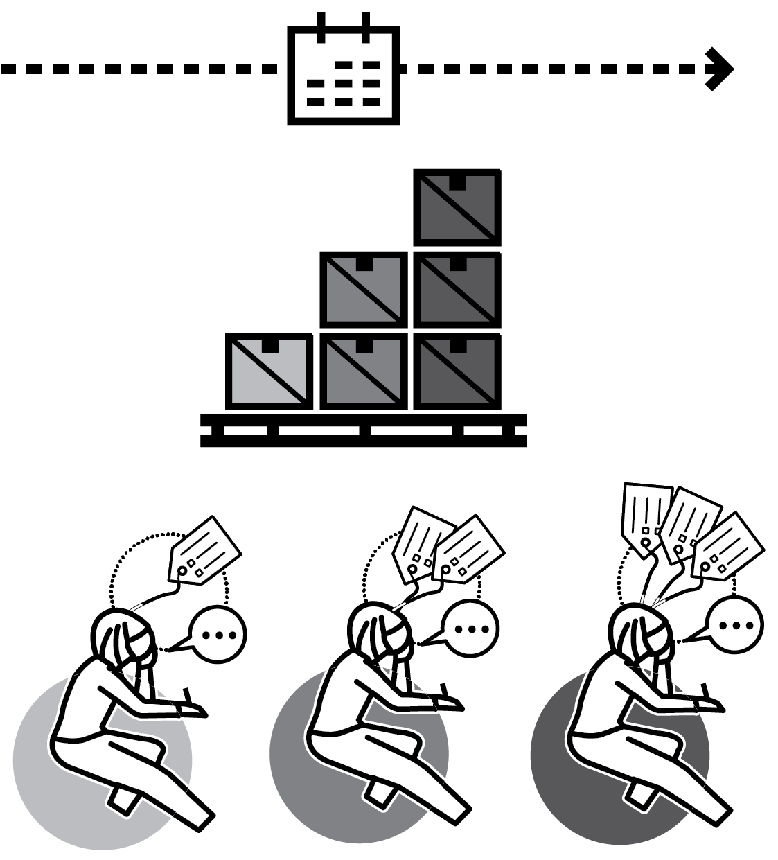
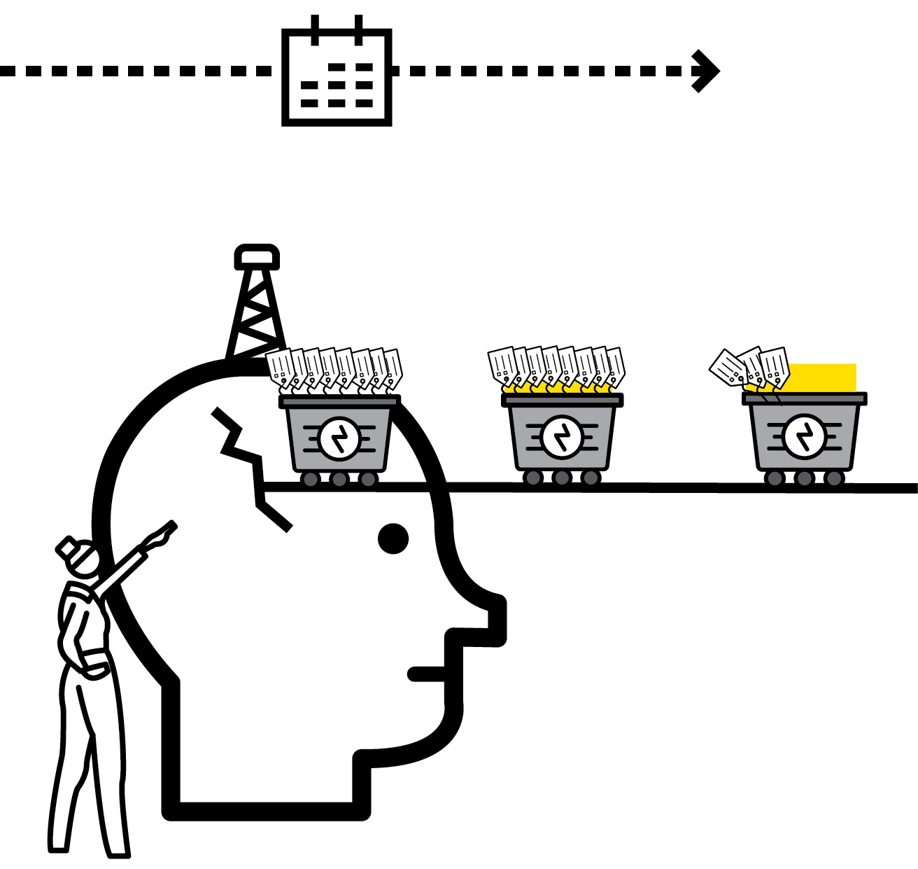
DELIBERATE VOCABULARY DEVELOPMENT
1
2
3
4
5
SPECIFY AND DEFINE THE WORDS
SAY THE WORDS
READ WORDS IN CONTEXT
PRACTISE USING THE WORDS VERBALLY AND IN WRITING
ENGAGE IN WORD-BASED RETRIEVAL PRACTICE
The process of learning new words needs to be considered deliberately and explicitly as part of teacher instruction.
Students with the weakest prior knowledge and most limited vocabulary will find this more difficult; new words do not just ‘sink in’.
Without deliberate practice, new words are likely to be forgotten easily.
These steps support a deliberate vocabulary development process for all learners.

Slide 22
DELIBERATE VOCABULARY DEVELOPMENT
1
2
3
4
5
SPECIFY AND DEFINE THE WORDS
Highlight or compile lists of words you know students will need to know.
Define the words so students can explain in terms they know.
Impossible to learn terminology that has no meaning in terms students already
understand.

Slide 23
DELIBERATE VOCABULARY DEVELOPMENT
1
2
3
4
5
SAY THE WORDS
Chorally: All students repeat the words in call and response style.
In pairs: Engineer paired discussions or
question exchanges so students need to use the words they are learning.
Rapid fire: Check individual students can use the words through individual questioning or call and response.

Slide 24
DELIBERATE VOCABULARY DEVELOPMENT
1
2
3
4
5
READ WORDS IN CONTEXT
Ensure that the target vocabulary is
encountered embedded in texts that students will read.
This give the words a context that supports understanding and recall.
Either pre-learn words prior to reading or
interrupt reading when new words arise to ensure that they are explored.

Slide 25
DELIBERATE VOCABULARY DEVELOPMENT
1
2
3
4
5
PRACTISE USING THE WORDS VERBALLY AND IN WRITING
Students must practise words so they form part of their own repetoire.
Set practice tasks that require words to be used in writing and in discussions.
Reinforce expectation that students use new terminology when relevant, rather than reverting to basic terms.

Slide 26
DELIBERATE VOCABULARY DEVELOPMENT
1
2
3
4
5
ENGAGE IN WORD-BASED RETRIEVAL PRACTICE
Use glossaries and knowledge organisers to support regular retrieval practice using the target vocabulary.
Students must recall words from memory — not rely on looking them up.
Test students know meanings and can use words in speech and in writing.

Slide 27
DELIBERATE VOCABULARY DEVELOPMENT
1
2
3
4
5
SPECIFY AND DEFINE THE WORDS
SAY THE WORDS
READ WORDS IN CONTEXT
PRACTISE USING THE WORDS VERBALLY AND IN WRITING
ENGAGE IN WORD-BASED RETRIEVAL PRACTICE
The process of learning new words needs to be considered deliberately and explicitly as part of teacher instruction.
Students with the weakest prior knowledge and most limited vocabulary will find this more difficult; new words do not just ‘sink in’.
Without deliberate practice, new words are likely to be forgotten easily.
These steps support a deliberate vocabulary development process for all learners.

Slide 28
1
2
3
4
5
6
7
8
9
10
WORKED EXAMPLES & BACKWARD FADING
DUAL
CODING
DELIBERATE VOCABULARY DEVELOPMENT
BIG PICTURE, SMALL PICTURE
ABSTRACT MODELS WITH CONCRETE EXAMPLES
LIVE MODELLING
SCAFFOLDING
METACOGNITIVE TALK
SET THE STANDARDS
HEAD-ON MISCONCEPTIONS
NEXT UP
BIG PICTURE,
SMALL PICTURE

Slide 29

BIG PICTURE,
SMALL PICTURE—
ZOOM IN, ZOOM OUT
SERIES
EXPLAINING & MODELLING
1
SET OUT THE BIG PICTURE
2
ZOOM IN — ORIENTATE!
3
ZOOM IN AND ZOOM OUT STEP BY STEP
4
REHEARSE AND CHECK FOR UNDERSTANDING
5
USE THE ZOOM IN/ZOOM OUT PROCESS ROUTINELY

Slide 30
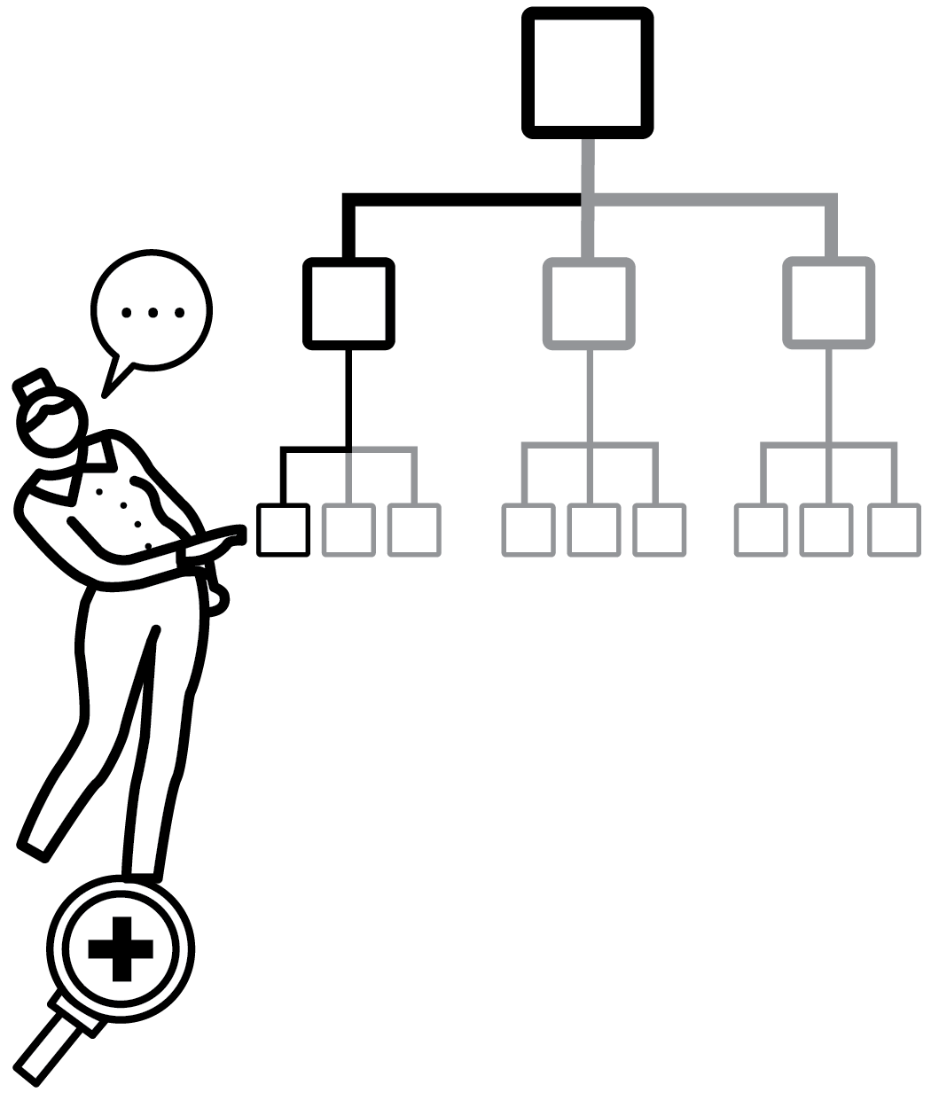
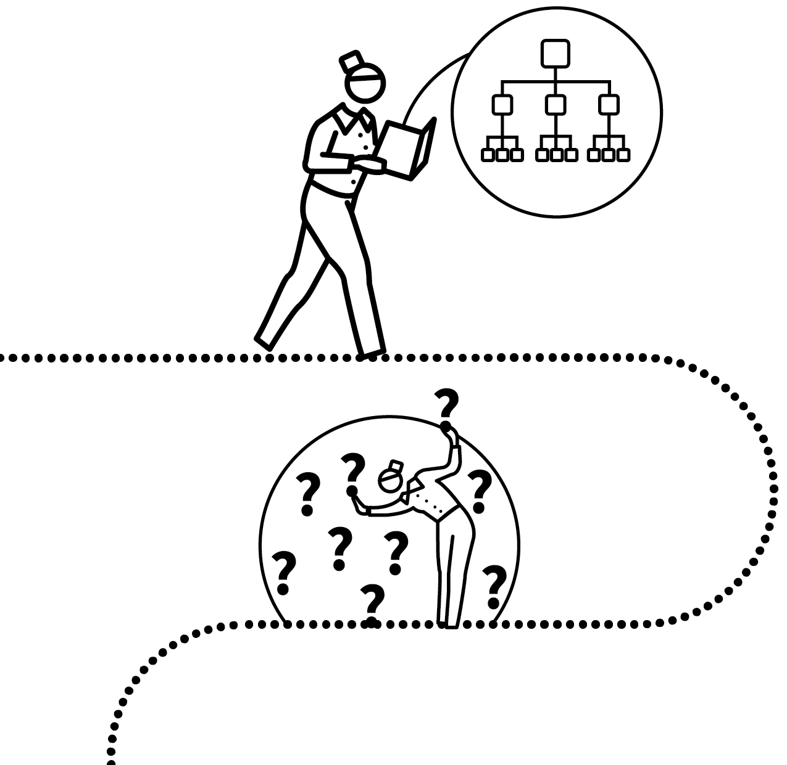
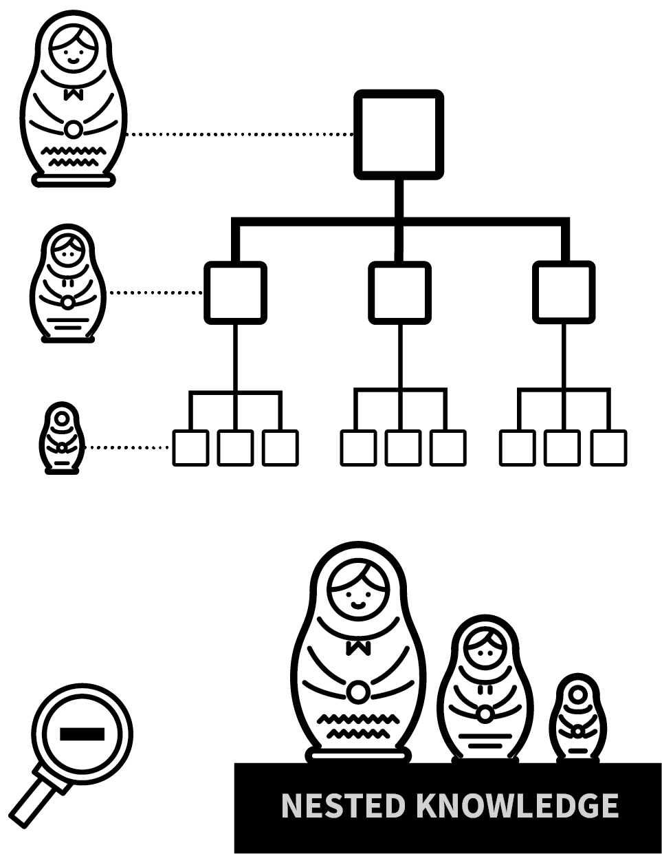

BIG PICTURE, SMALL PICTURE
1
2
3
4
5
SET OUT THE BIG PICTURE
ZOOM IN — ORIENTATE!
ZOOM IN AND ZOOM OUT STEP BY STEP
REHEARSE AND CHECK FOR
UNDERSTANDING
USE THE ZOOM IN/ZOOM OUT PROCESS ROUTINELY
As described by the R of Shimamura’s MARGE model, it can help students to form coherent schema if teachers front-load organising information in the way ideas are introduced.
Illustrate how ideas are connected; that specific ideas form part of a bigger picture.
Categorise, compare and contrast related ideas in order to deepen our understanding.

Slide 31
BIG PICTURE, SMALL PICTURE
1
2
3
4
5
SET OUT THE BIG PICTURE
Present a broad overview of a topic. Highlight the sub-divisions; the range of sub-categories in a wider category.
e.g. Organ systems:
Circulatory/Digestive/Nervous/
Muscular-skeletal.
Categories of energy sources: fossil fuels/
renewable and non-renewable.

Slide 32
BIG PICTURE, SMALL PICTURE
1
2
3
4
5
ZOOM IN — ORIENTATE!
Focus on a specific element but make
connection to the Big Picture very explicit.
A cell in the body is always part of a bigger organ system.
A specific example of a fossil fuel fits in a wider category.
Students see where the knowledge in hand belongs in relation to other knowledge.

Slide 33
BIG PICTURE, SMALL PICTURE
1
2
3
4
5
ZOOM IN AND ZOOM OUT STEP BY STEP
Continually make the link to and from details of knowledge to a bigger frame and back again.
e.g. “Full of scorpions is my mind” ←→ Macbeth's guilt ←→ Macbeth's character ←→ complex Shakespearean 'heroes'?

Slide 34
BIG PICTURE, SMALL PICTURE
1
2
3
4
5
REHEARSE AND CHECK FOR
UNDERSTANDING
Explore the links explicitly yourself but then make sure that students can make the links themselves.
Follow through with Check for Understanding routines.
Engage students in Think Pair Share or
Elaborative Interrogation.

Slide 35
BIG PICTURE, SMALL PICTURE
1
2
3
4
5
USE THE ZOOM IN/ZOOM OUT PROCESS ROUTINELY
Establish the routine that you consciously,
explicitly look at layers of detail within a wider frame.
This helps form sound schema, to make
connections as new knowledge is
encountered.
Use resources like number lines and timelines as visual displays.

Slide 36
BIG PICTURE, SMALL PICTURE
1
2
3
4
5
SET OUT THE BIG PICTURE
ZOOM IN — ORIENTATE!
ZOOM IN AND ZOOM OUT STEP BY STEP
REHEARSE AND CHECK FOR
UNDERSTANDING
USE THE ZOOM IN/ZOOM OUT PROCESS ROUTINELY
As described by the R of Shimamura’s MARGE model, it can help students to form coherent schema if teachers front-load organising information in the way ideas are introduced.
Illustrate how ideas are connected; that specific ideas form part of a bigger picture.
Categorise, compare and contrast related ideas in order to deepen our understanding.

Slide 37
1
2
3
4
5
6
7
8
9
10
WORKED EXAMPLES & BACKWARD FADING
DUAL
CODING
DELIBERATE VOCABULARY DEVELOPMENT
BIG PICTURE, SMALL PICTURE
ABSTRACT MODELS WITH CONCRETE EXAMPLES
LIVE MODELLING
SCAFFOLDING
METACOGNITIVE TALK
SET THE STANDARDS
HEAD-ON MISCONCEPTIONS
NEXT UP
ABSTRACT MODELS
WITH CONCRETE
EXAMPLES

Slide 38

ABSTRACT MODELS WITH CONCRETE EXAMPLES
SERIES
EXPLAINING & MODELLING
1
DEMONSTRATE AN EXAMPLE
2
DEFINE THE CONCEPT IN GENERAL TERMS
3
PROVIDE FURTHER CONCRETE EXAMPLES
4
CHECK FOR UNDERSTANDING
5
ENGAGE IN RETRIEVAL PRACTICE

Slide 39


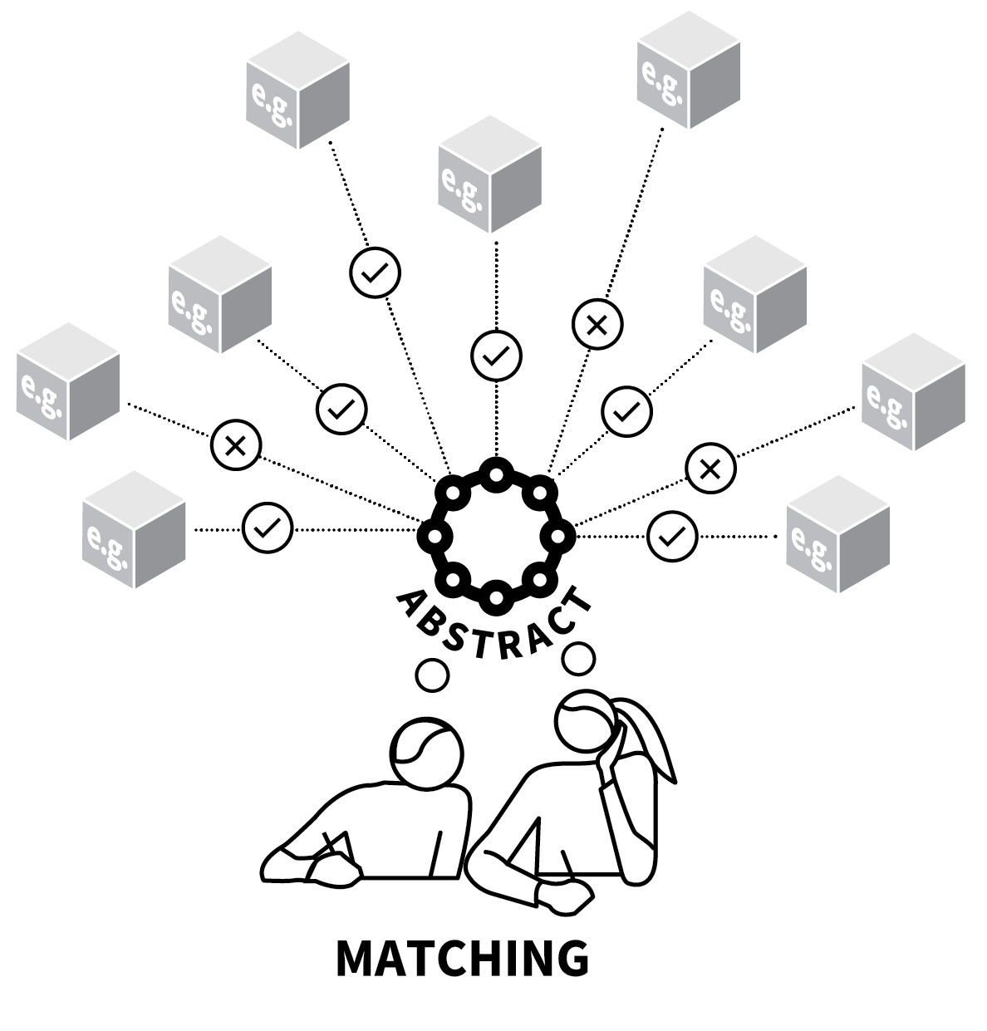
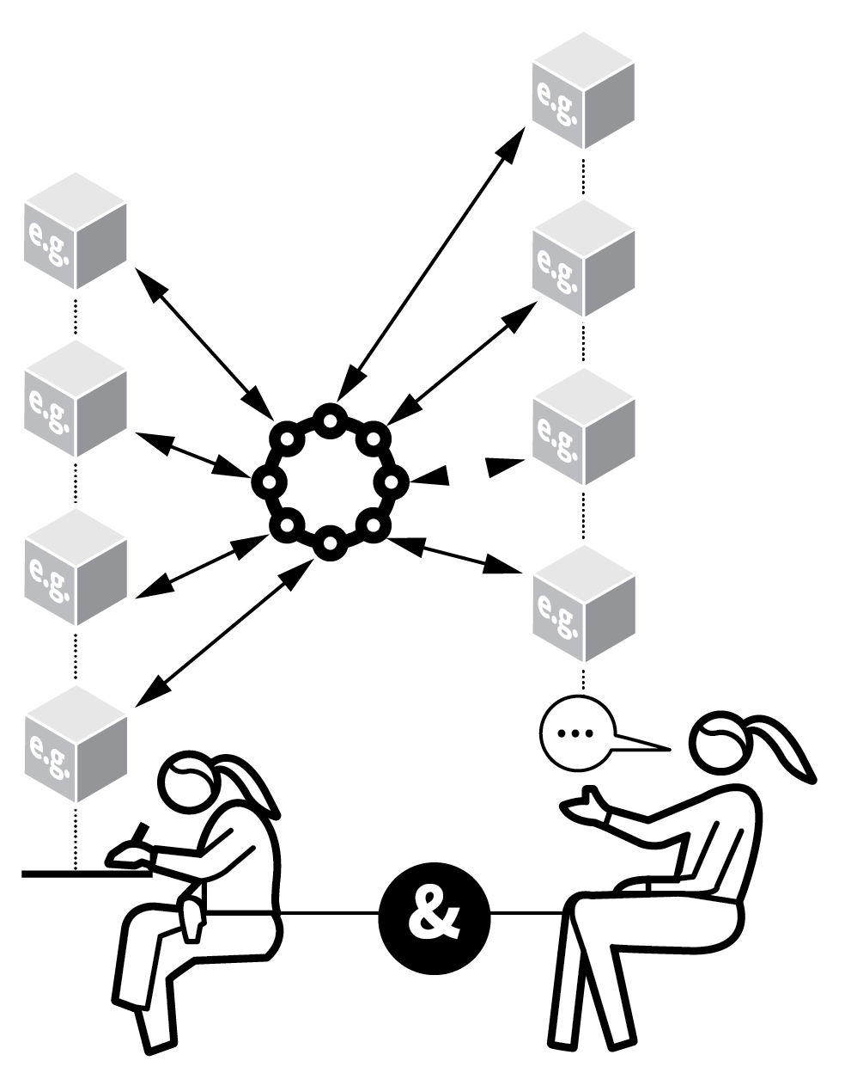
ABSTRACT MODELS WITH CONCRETE EXAMPLES
1
2
3
4
5
DEMONSTRATE AN EXAMPLE
DEFINE THE CONCEPT IN GENERAL TERMS
PROVIDE FURTHER CONCRETE EXAMPLES
CHECK FOR UNDERSTANDING
ENGAGE IN RETRIEVAL PRACTICE
Students need to make connections between concrete examples and abstract conceptualisations.
e.g. how material properties relate to their particle structures; how simplified diagrams relate to the complex real world.
Teachers can help through linking examples and models deliberately and explicitly.

Slide 40
ABSTRACT MODELS WITH CONCRETE EXAMPLES
1
2
3
4
5
DEMONSTRATE AN EXAMPLE
Introduce an idea with a specific example.
Michael’s room was a disaster area.
This is a metaphor.
Suzanne hung her head like a dying flower. This is a simile.

Slide 41
ABSTRACT MODELS WITH CONCRETE EXAMPLES
1
2
3
4
5
DEFINE THE CONCEPT IN GENERAL TERMS
Provide a general definition or rule that
applies in all cases.
A metaphor is… whereas a simile is…
The combustion of metals: Metal + Oxygen → Metal Oxide.
Show how the examples and the general
abstract expression or model are connected.

Slide 42
ABSTRACT MODELS WITH CONCRETE EXAMPLES
1
2
3
4
5
PROVIDE FURTHER CONCRETE EXAMPLES
For each abstract concept, provide multiple concrete examples highlighting the
connection. Further examples of metaphors:
The wheels of justice turn slowly. She was all at sea.
Zinc + oxygen --> Zinc Oxide; Iron + oxygen --> Iron Oxide

Slide 43
ABSTRACT MODELS WITH CONCRETE EXAMPLES
1
2
3
4
5
CHECK FOR UNDERSTANDING
How do different examples fit the general
abstract definition?
Engage students in a process where they have to think about whether some examples match the general pattern.
Set tasks that make them generate examples, look for errors, spot the exceptions or the odd-one-out.

Slide 44
ABSTRACT MODELS WITH CONCRETE EXAMPLES
1
2
3
4
5
ENGAGE IN RETRIEVAL PRACTICE
Check students can recall and explain specific concrete examples fluently for the concepts they have learned — and vice versa.
Students cannot be said to have fully
understood what a metaphor is or how a metal reacts with oxygen if they cannot
remember any examples.

Slide 45
ABSTRACT MODELS WITH CONCRETE EXAMPLES
1
2
3
4
5
DEMONSTRATE AN EXAMPLE
DEFINE THE CONCEPT IN GENERAL TERMS
PROVIDE FURTHER CONCRETE EXAMPLES
CHECK FOR UNDERSTANDING
ENGAGE IN RETRIEVAL PRACTICE
Students need to make connections between concrete examples and abstract conceptualisations.
e.g. how material properties relate to their particle structures; how simplified diagrams relate to the complex real world.
Teachers can help through linking examples and models deliberately and explicitly.

Slide 46
1
2
3
4
5
6
7
8
9
10
WORKED EXAMPLES & BACKWARD FADING
DUAL
CODING
DELIBERATE VOCABULARY DEVELOPMENT
BIG PICTURE, SMALL PICTURE
ABSTRACT MODELS WITH CONCRETE EXAMPLES
LIVE MODELLING
SCAFFOLDING
METACOGNITIVE TALK
SET THE STANDARDS
HEAD-ON MISCONCEPTIONS
NEXT UP
SCAFFOLDING
LIVE MODELLING

Slide 47
LIVE MODELLING
SERIES
EXPLAINING & MODELLING
1
MODEL EACH STAGE STEP BY STEP
2
MODEL HOW YOU ORGANISE MESSY THINKING
3
REVIEW THE SUCCESS OR QUALITY OF YOUR OWN WORK
4
MODEL ALTERNATIVES AND FURTHER EXAMPLES
5
SET TASKS TO EMULATE THE MODEL

Slide 48
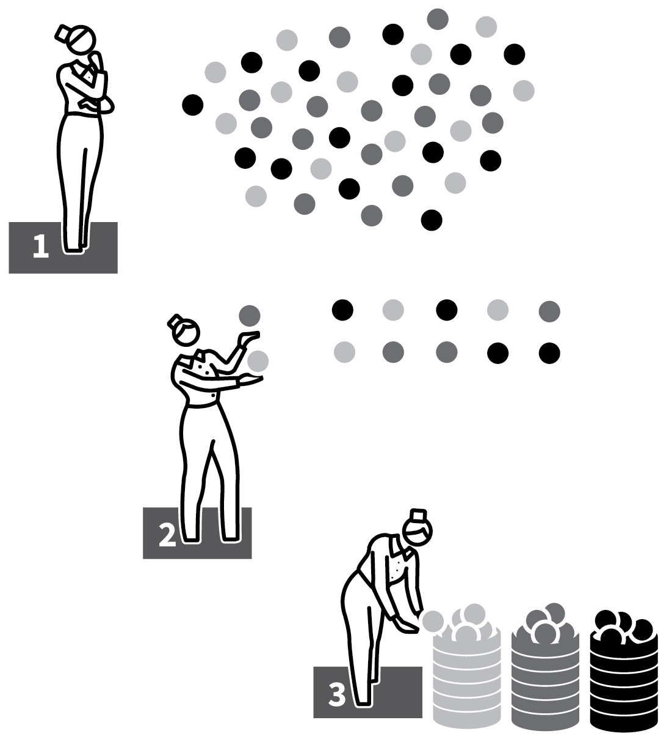
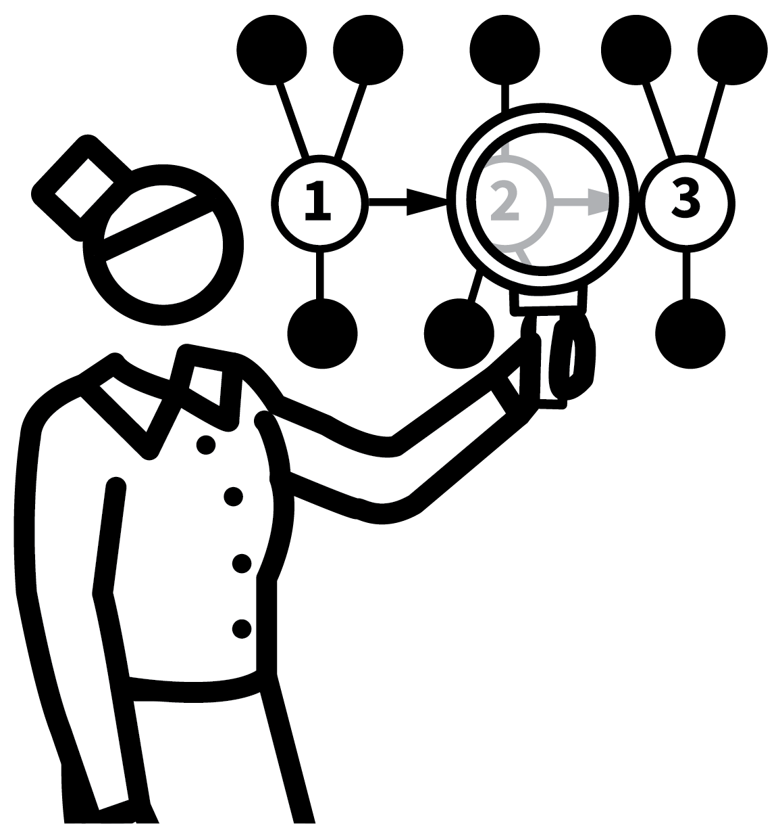
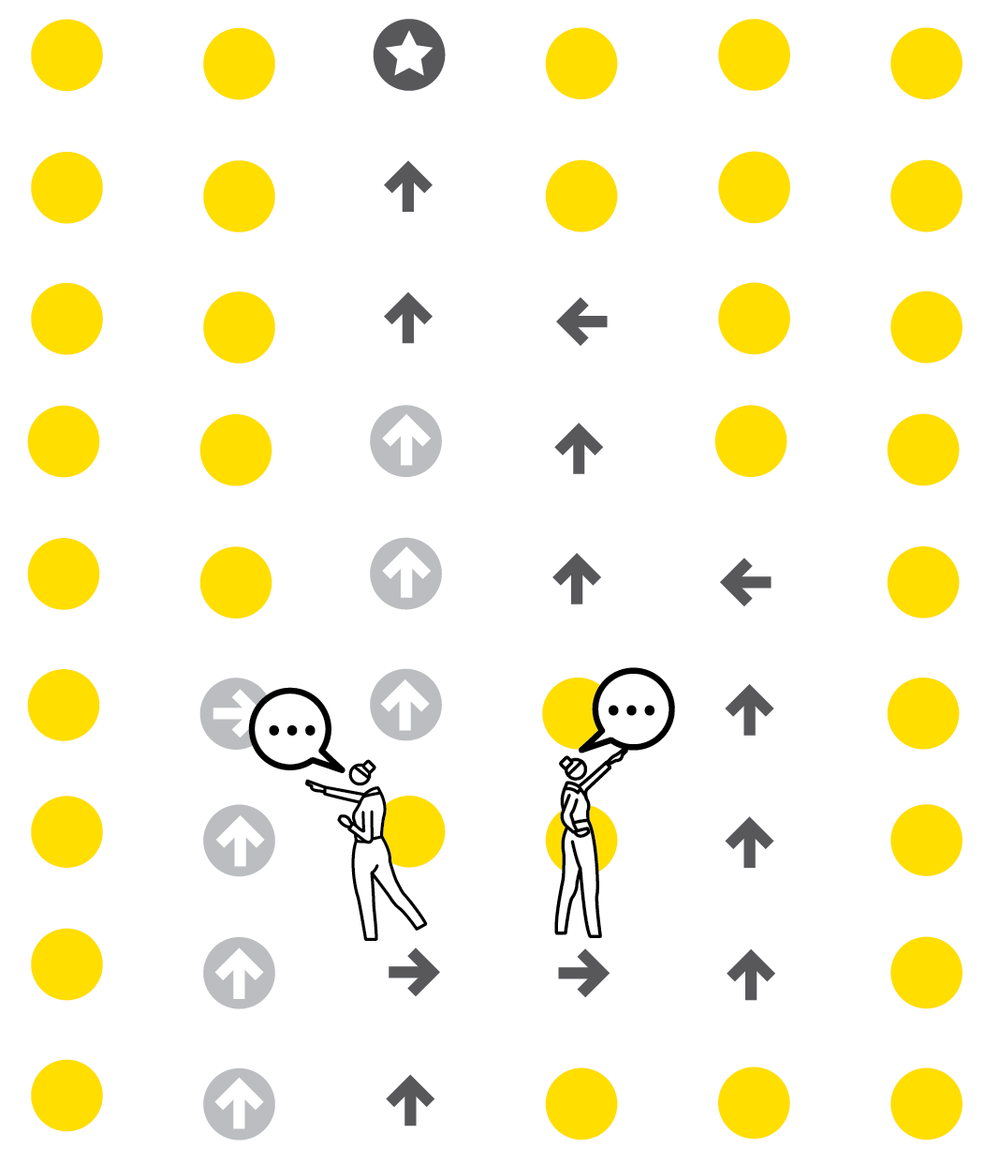

LIVE MODELLING
1
2
3
4
5
MODEL EACH STAGE STEP BY STEP
MODEL HOW YOU ORGANISE MESSY THINKING
REVIEW THE SUCCESS OR QUALITY OF YOUR
OWN WORK
MODEL ALTERNATIVES AND
FURTHER EXAMPLES
SET TASKS TO EMULATE THE MODEL
For effective instructional teaching, teachers need to walk through a learning process themselves, highlighting key procedures and the thinking that underpins them.
The metacognitive aspect is important, making implicit decision-making explicit.
Provide examples of completed work that can serve as scaffolds for students.

Slide 49
LIVE MODELLING
1
2
3
4
5
IDENTIFY PRE-REQUISITE KNOWLEDGE
Talk through the preliminary thinking; narrate how you think through the problem: What is being asked? What information do we already have?
Undertake the task yourself, talking through each step one action at a time.
Use a visualiser or other method to ensure all students see what is being done.

Slide 50
LIVE MODELLING
1
2
3
4
5
MODEL HOW YOU ORGANISE MESSY THINKING
Part of the modelling narrative should include your decision-making process. How do you decide what to do next?
Model how: you float possible ideas before selecting one; you edit or improve your work; you put an array of ideas into a logical sequence.

Slide 51
LIVE MODELLING
1
2
3
4
5
REVIEW THE SUCCESS OR QUALITY OF YOUR OWN WORK
Stand back from your example to review it and check for understanding of each step.
Evaluate whether your model is correct,
complete or meets the success criteria.
Make this explicit: Have I done it well? Am I correct? Discuss ways it could be improved.

Slide 52
LIVE MODELLING
1
2
3
4
5
MODEL ALTERNATIVES AND
FURTHER EXAMPLES
It is important not to confine students’
thinking by basing their responses on just
one example.
Model multiple alternatives, highlighting how they each meet the success criteria or provide valid alternative routes to success.
One example is rarely sufficient.

Slide 53
LIVE MODELLING
1
2
3
4
5
SET TASKS TO EMULATE THE MODEL
Modelling is just the beginning of the process; it is important that students now try to put the ideas that have been modelled into practice themselves.
Initially Guided Practice will be important.
Then students should move towards
Independent Practice.

Slide 54
LIVE MODELLING
1
2
3
4
5
MODEL EACH STAGE STEP BY STEP
MODEL HOW YOU ORGANISE MESSY THINKING
REVIEW THE SUCCESS OR QUALITY OF YOUR
OWN WORK
MODEL ALTERNATIVES AND
FURTHER EXAMPLES
SET TASKS TO EMULATE THE MODEL
For effective instructional teaching, teachers need to walk through a learning process themselves, highlighting key procedures and the thinking that underpins them.
The metacognitive aspect is important, making implicit decision-making explicit.
Provide examples of completed work that can serve as scaffolds for students.

Slide 55
1
2
3
4
5
6
7
8
9
10
WORKED EXAMPLES & BACKWARD FADING
DUAL
CODING
DELIBERATE VOCABULARY DEVELOPMENT
BIG PICTURE, SMALL PICTURE
ABSTRACT MODELS WITH CONCRETE EXAMPLES
LIVE MODELLING
SCAFFOLDING
METACOGNITIVE TALK
SET THE STANDARDS
HEAD-ON MISCONCEPTIONS
NEXT UP
SCAFFOLDING

Slide 56
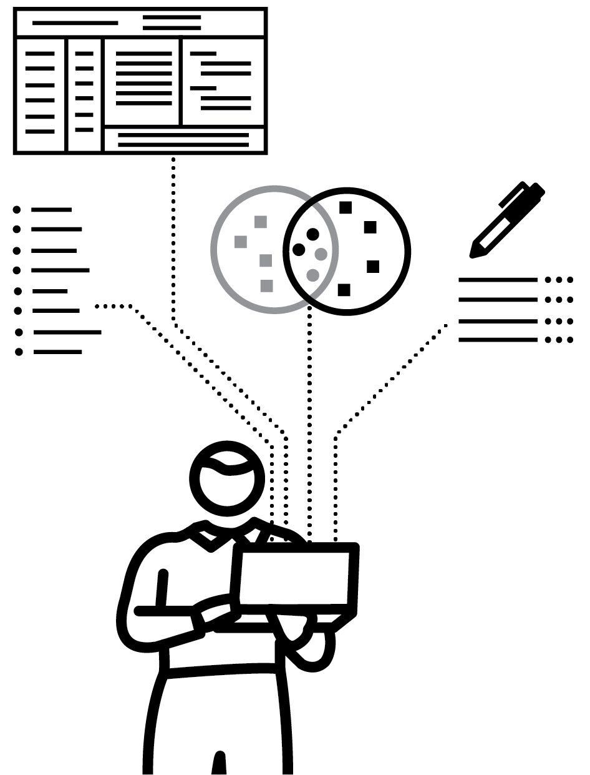
SCAFFOLDING
SERIES
EXPLAINING & MODELLING
1
MAP OUT THE COMPONENTS OF A TASK
2
PROVIDE SUPPORTS AT A DETAILED LEVEL
3
PROVIDE SUPPORTS AT OVERVIEW LEVEL
4
PREPARE SCAFFOLDING SETS OFFERING VARYING LEVELS OF SUPPORT
5
TAKE THE SCAFFOLDING DOWN

Slide 57

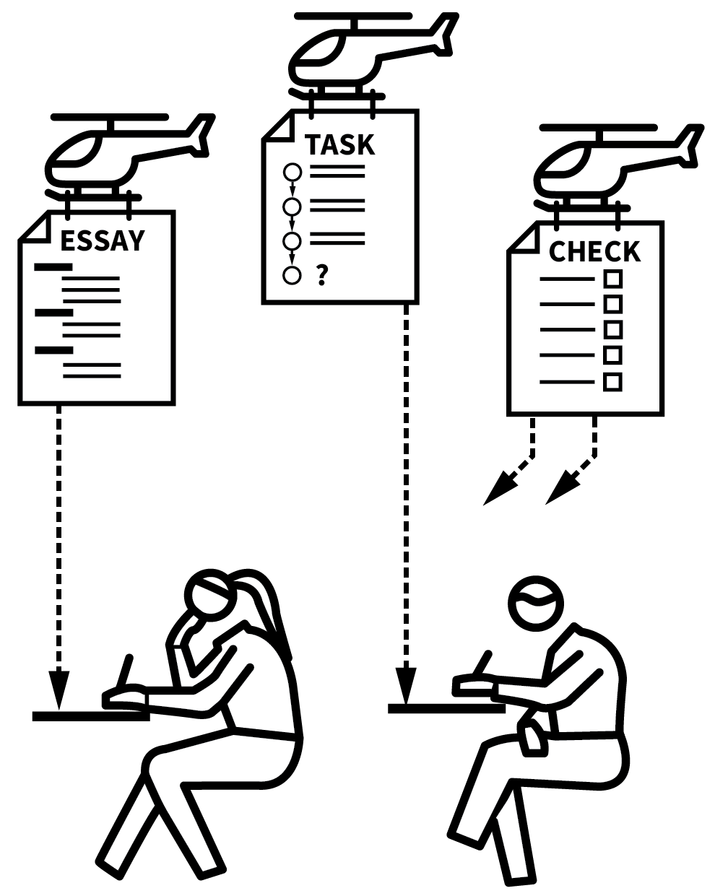
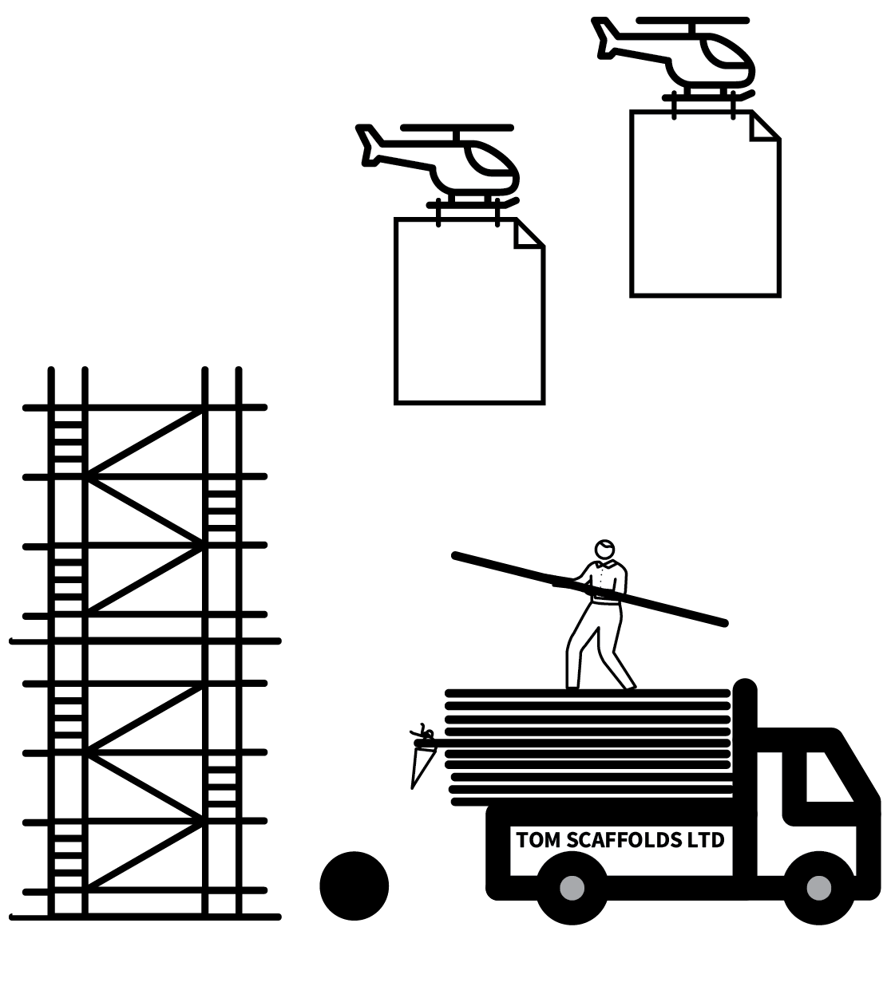
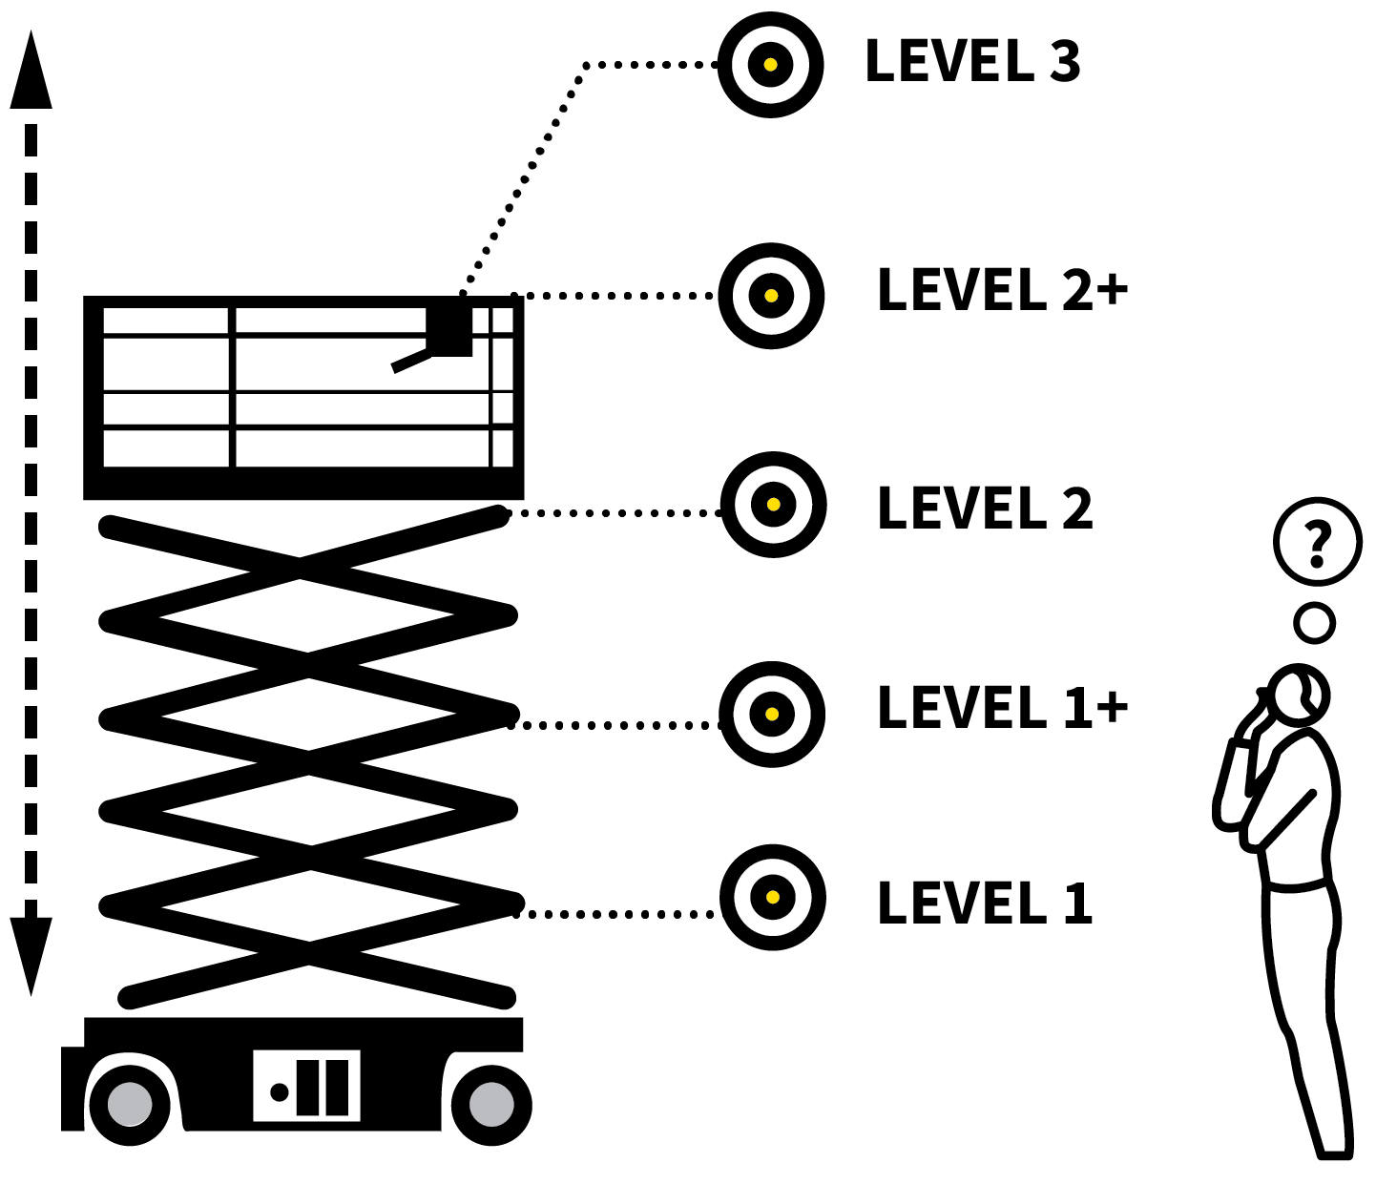
SCAFFOLDING
1
2
3
4
5
MAP OUT THE COMPONENTS OF A TASK
PROVIDE SUPPORTS AT A DETAILED LEVEL
PROVIDE SUPPORTS AT OVERVIEW LEVEL
PREPARE SCAFFOLDING SETS OFFERING VARYING LEVELS OF SUPPORT
TAKE THE SCAFFOLDING DOWN
Rosenshine suggests that more effective teachers successfully provide scaffolds for difficult tasks.
Rather than setting lower expectations for students, they support them to reach ambitious goals using a range of scaffolding processes that guide them forward.
Crucially, the metaphor embeds the idea that, when ready, scaffolding always comes down.

Slide 58
SCAFFOLDING
1
2
3
4
5
MAP OUT THE COMPONENTS OF A TASK
Break down a task into steps that students will need to follow in order to achieve
success.
Consider the difficulties that students will
encounter moving through the steps.
Design resources that support them to make those steps successfully.

Slide 59
SCAFFOLDING
1
2
3
4
5
PROVIDE SUPPORTS AT A DETAILED LEVEL
Detailed scaffolding might include:
Word lists, sentence starters or sentence builders, useful phrases and connectives.
Diagrams, concept maps or other forms of dual coding.
Knowledge organisers or exemplars of
different elements.

Slide 60
SCAFFOLDING
1
2
3
4
5
PROVIDE SUPPORTS AT OVERVIEW LEVEL
Whole-task scaffolds might include:
Essay structure strips.
Checklists of success criteria and prompts: e.g. Have you checked your full stops and capital letters?
Exemplars of completed or partially
completed tasks.

Slide 61
SCAFFOLDING
1
2
3
4
5
PREPARE SCAFFOLDING SETS OFFERING VARYING LEVELS OF SUPPORT
Set everyone a common goal of producing work to a high standard but give students the level of scaffolding appopriate for their level of confidence.
It can work for students to select their own level but this needs careful monitoring.

Slide 62
SCAFFOLDING
1
2
3
4
5
TAKE THE SCAFFOLDING DOWN
The classic sequence in modelling and
scaffolding is: I do it; We do it; You do it.
The culmination of an instruction and
practice phase should be that students
attempt a task independently.
If the scaffolding has achieved its purpose, this can be a confidence boosting moment.

Slide 63
SCAFFOLDING
1
2
3
4
5
MAP OUT THE COMPONENTS OF A TASK
PROVIDE SUPPORTS AT A DETAILED LEVEL
PROVIDE SUPPORTS AT OVERVIEW LEVEL
PREPARE SCAFFOLDING SETS OFFERING VARYING LEVELS OF SUPPORT
TAKE THE SCAFFOLDING DOWN
Rosenshine suggests that more effective teachers successfully provide scaffolds for difficult tasks.
Rather than setting lower expectations for students, they support them to reach ambitious goals using a range of scaffolding processes that guide them forward.
Crucially, the metaphor embeds the idea that, when ready, scaffolding always comes down.

Slide 64
1
2
3
4
5
6
7
8
9
10
WORKED EXAMPLES & BACKWARD FADING
DUAL
CODING
DELIBERATE VOCABULARY DEVELOPMENT
BIG PICTURE, SMALL PICTURE
ABSTRACT MODELS WITH CONCRETE EXAMPLES
LIVE MODELLING
SCAFFOLDING
METACOGNITIVE TALK
SET THE STANDARDS
HEAD-ON MISCONCEPTIONS
NEXT UP
METACOGNITIVE
TALK

Slide 65
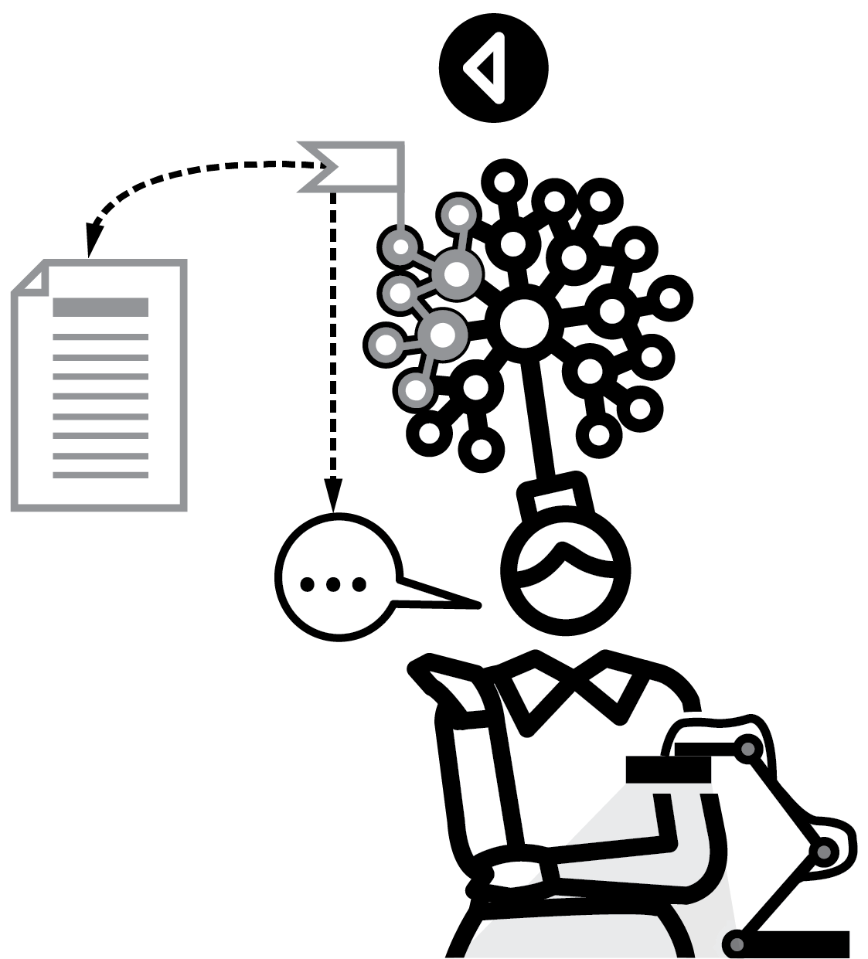
METACOGNITIVE
TALK
SERIES
EXPLAINING & MODELLING
1
SET A PROBLEM AND EXPLORE IT
2
WHAT DO WE ALREADY KNOW?
3
WHERE DO WE START?
4
MAKE A PLAN AND MONITOR
5
HAVE WE BEEN SUCCESSFUL?

Slide 66

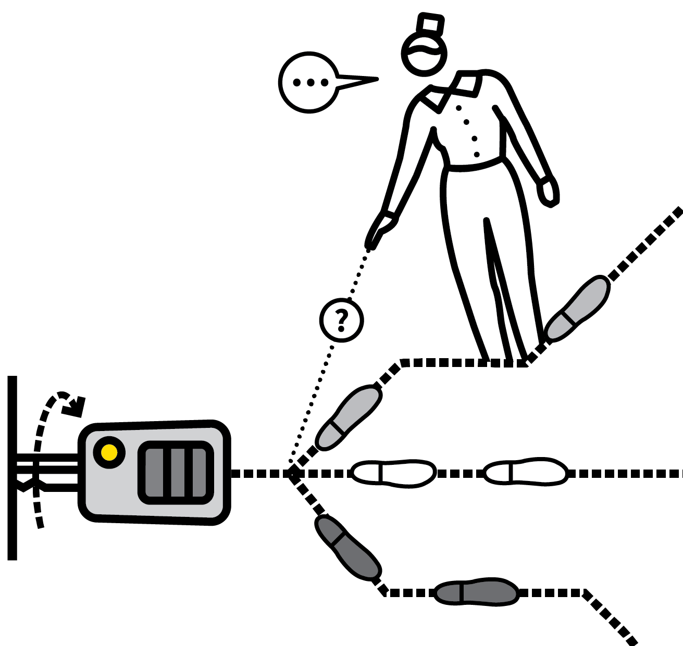
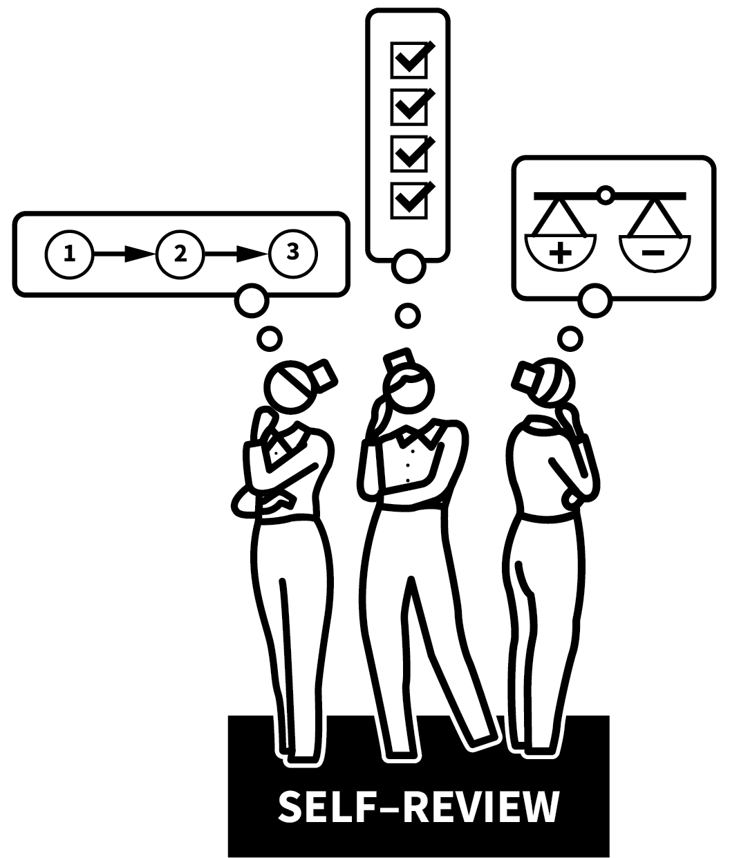
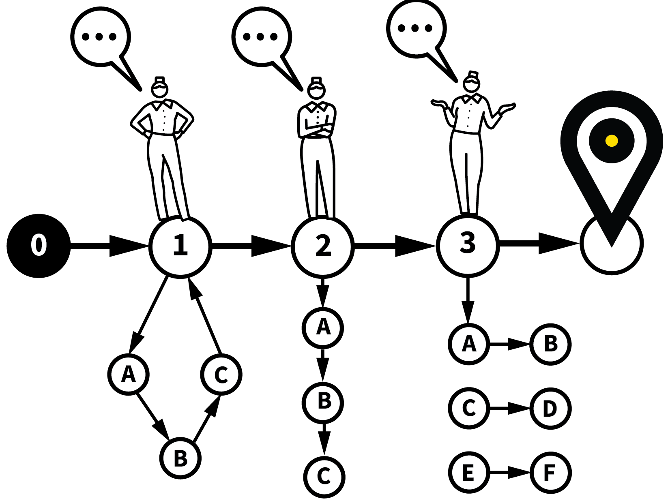
METACOGNITIVE TALK
1
2
3
4
5
SET A PROBLEM AND
EXPLORE IT
WHAT DO WE ALREADY KNOW?
WHERE DO WE START?
MAKE A PLAN AND MONITOR
HAVE WE BEEN
SUCCESSFUL?
There is evidence successful students also have good metacognitive abilities.
They are able to plan, monitor and evaluate their progress through a task; to think strategically about how to go about solving a problem and to articulate their thought processes.
Teachers can support students in developing their capacity for metacognitive thinking by modelling it and promoting metacognitive talk in lessons.

Slide 67
METACOGNITIVE TALK
1
2
3
4
5
SET A PROBLEM AND EXPLORE IT
Read through a question; establish what the question is asking or what the task might entail.
The initial process is to establish which
problem-type it is.
This allows you and students to draw on
relevant past experience and prior
knowledge.

Slide 68
METACOGNITIVE TALK
1
2
3
4
5
WHAT DO WE ALREADY KNOW?
Talk through the information that is available in the question and supporting resources.
What do we already know from the question?
What do we also know from previous learning that might be relevant?
Make notes so that this becomes explicit.

Slide 69
METACOGNITIVE TALK
1
2
3
4
5
WHERE DO WE START?
Talk through the first steps in solving the problem or completing the task.
Explore explicitly why you choose a particular strategy in this case. If any path is as good as another, make this explicit.
Aim to demystify the whole process.

Slide 70
METACOGNITIVE TALK
1
2
3
4
5
MAKE A PLAN AND MONITOR
Model the process of setting out an overview plan.
Be as explicit as possible about every choice, every step, providing a logical reason for each one.
As you go through the task, narrate your
progress through each of the steps.

Slide 71
METACOGNITIVE TALK
1
2
3
4
5
HAVE WE BEEN SUCCESSFUL?
When the task has been completed or the problem solved, model the process of
self-review.
Check back over it to see if it is correct,
complete, accurate, finished to a high
standard.
Explore ways of knowing if an answer is
correct within the context of the subject.

Slide 72
METACOGNITIVE TALK
1
2
3
4
5
SET A PROBLEM AND
EXPLORE IT
WHAT DO WE ALREADY KNOW?
WHERE DO WE START?
MAKE A PLAN AND MONITOR
HAVE WE BEEN
SUCCESSFUL?
There is evidence successful students also have good metacognitive abilities.
They are able to plan, monitor and evaluate their progress through a task; to think strategically about how to go about solving a problem and to articulate their thought processes.
Teachers can support students in developing their capacity for metacognitive thinking by modelling it and promoting metacognitive talk in lessons.

Slide 73
1
2
3
4
5
6
7
8
9
10
WORKED EXAMPLES & BACKWARD FADING
DUAL
CODING
DELIBERATE VOCABULARY DEVELOPMENT
BIG PICTURE, SMALL PICTURE
ABSTRACT MODELS WITH CONCRETE EXAMPLES
LIVE MODELLING
SCAFFOLDING
METACOGNITIVE TALK
SET THE STANDARDS
HEAD-ON MISCONCEPTIONS
NEXT UP
SET THE STANDARDS

Slide 74

SET THE
STANDARDS
SERIES
EXPLAINING & MODELLING
1
MAKE WHAT DOES EXCELLENCE LOOK LIKE? A ROUTINE
2
DECONSTRUCT EXEMPLARS
3
CO-CONSTRUCT SUCCESS CRITERIA
4
REFERENCE CONTRASTING EXEMPLARS
5
BLEND TEACHER ASSESSMENT AND SELF-ASSESSMENT

Slide 75
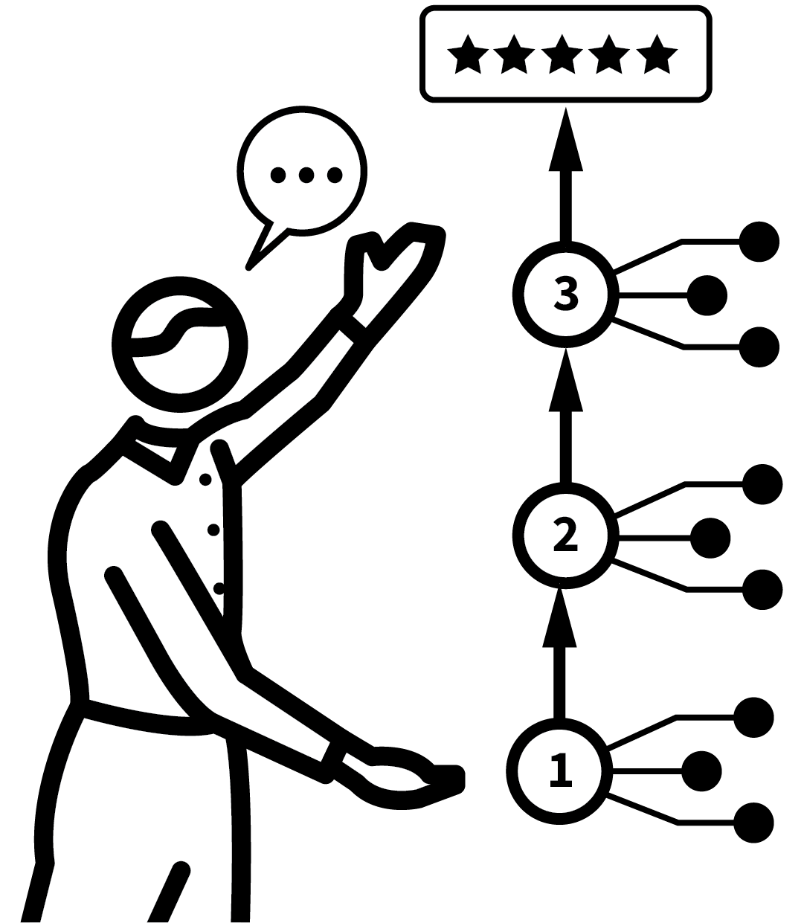
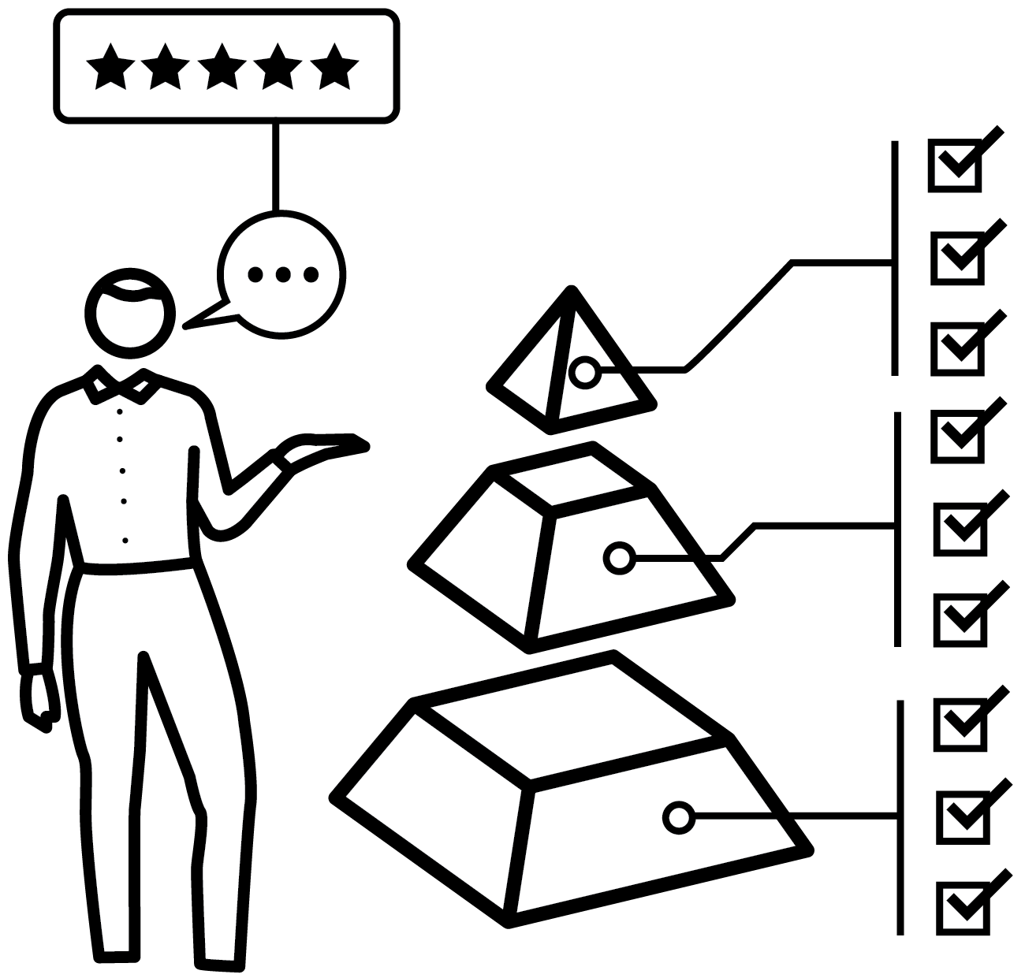

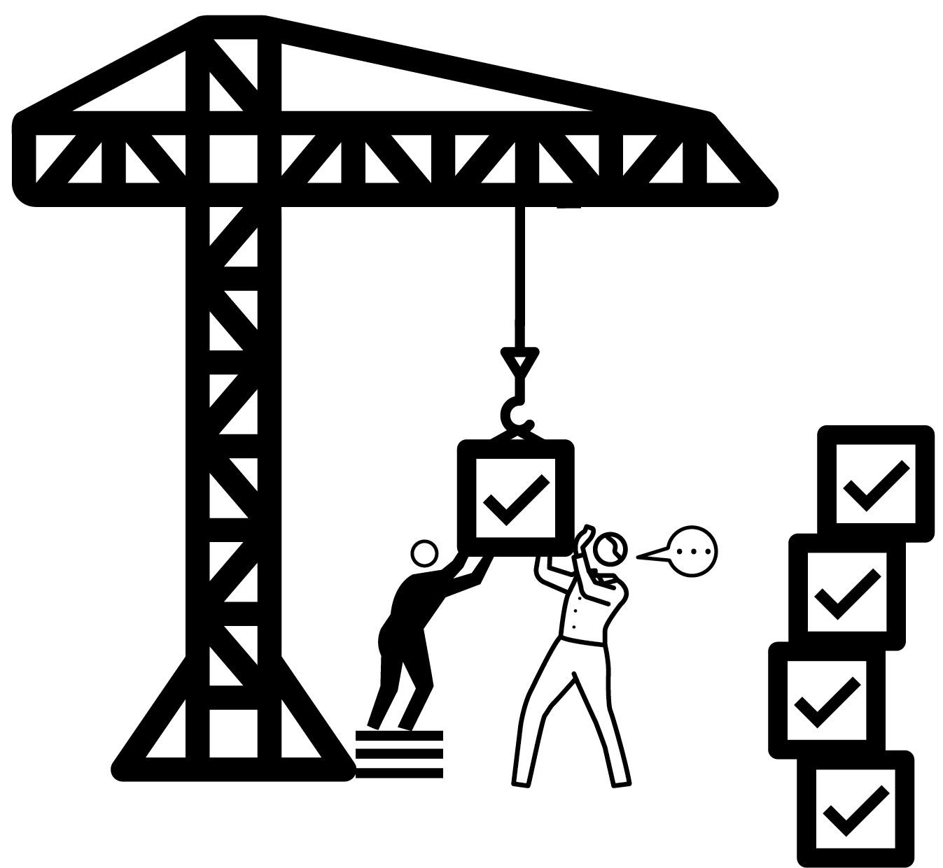
SET THE STANDARDS
1
2
3
4
5
MAKE WHAT DOES EXCELLENCE LOOK LIKE? A ROUTINE
DECONSTRUCT EXEMPLARS
CO-CONSTRUCT SUCCESS CRITERIA
REFERENCE CONTRASTING EXEMPLARS
BLEND TEACHER ASSESSMENT AND
SELF-ASSESSMENT
Dylan Wiliam suggests that, in approaching a learning goal, unless we know where we are going we will never get there.
Teachers should engage students in a process of clarfiying the learning goals.
Part of this is to set the standards for the work that will be completed.
If students are not aiming for a high standard, they are unlikely to reach it.

Slide 76
SET THE STANDARDS
1
2
3
4
5
MAKE WHAT DOES EXCELLENCE LOOK LIKE? A ROUTINE
Always include a discussion about the nature of excellence in the work that students will produce.
e.g. the features of excellent writing;
an excellent composition or performance.
Make it so routine that students themselves begin to ask the question.

Slide 77
SET THE STANDARDS
1
2
3
4
5
DECONSTRUCT EXEMPLARS
Present exemplars of excellence and engage students in a process of evaluation so they understand the constituent elements.
e.g. pieces of writing, examples of art work, exercise books with excellent presentation; efficient maths solutions; performances
recorded from drama, music and PE.

Slide 78
SET THE STANDARDS
1
2
3
4
5
CO-CONSTRUCT SUCCESS CRITERIA
List the features of excellence that emerge from the discussion.
These can form success criteria for students' subsequent work.
Where judgements of quality are involved, make the link from criteria to the exemplars as explicitly as you can.

Slide 79
SET THE STANDARDS
1
2
3
4
5
REFERENCE CONTRASTING EXEMPLARS
Alongside exemplars of the highest
standards, show a range of others.
Explore and discuss the differences
supported by Check for Understanding
routines.
Often differences between an average piece and an excellent piece only become clear when compared side by side.

Slide 80
SET THE STANDARDS
1
2
3
4
5
BLEND TEACHER ASSESSMENT AND
SELF-ASSESSMENT
Provide feedback on completed work
referencing exemplars as a comparison,
teasing out successes and areas for
improvement.
You are modelling assessment processes
students can use themselves.
Ask students to compare their work to the
exemplars and identify their own areas of
improvement.

Slide 81
SET THE STANDARDS
1
2
3
4
5
MAKE WHAT DOES EXCELLENCE LOOK LIKE? A ROUTINE
DECONSTRUCT EXEMPLARS
CO-CONSTRUCT SUCCESS CRITERIA
REFERENCE CONTRASTING EXEMPLARS
BLEND TEACHER ASSESSMENT AND
SELF-ASSESSMENT
Dylan Wiliam suggests that, in approaching a learning goal, unless we know where we are going we will never get there.
Teachers should engage students in a process of clarfiying the learning goals.
Part of this is to set the standards for the work that will be completed.
If students are not aiming for a high standard, they are unlikely to reach it.

Slide 82
1
2
3
4
5
6
7
8
9
10
WORKED EXAMPLES & BACKWARD FADING
DUAL
CODING
DELIBERATE VOCABULARY DEVELOPMENT
BIG PICTURE, SMALL PICTURE
ABSTRACT MODELS WITH CONCRETE EXAMPLES
LIVE MODELLING
SCAFFOLDING
METACOGNITIVE TALK
SET THE STANDARDS
HEAD-ON MISCONCEPTIONS
NEXT UP
HEAD-ON
MISCONCEPTIONS

Slide 83
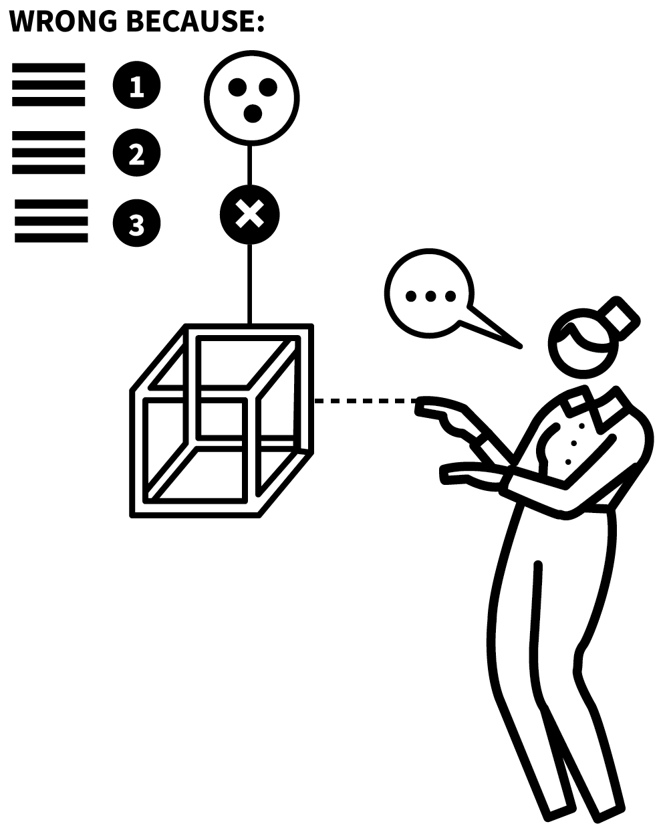
HEAD-ON
MISCONCEPTIONS
SERIES
EXPLAINING & MODELLING
1
IDENTIFY COMMON MISCONCEPTIONS
2
INTRODUCE A MISCONCEPTION EXPLICITLY: WHY IS IT WRONG?
3
REINFORCE A CORRECT UNDERLYING CONCEPTUAL MODEL
4
CHECK FOR UNDERSTANDING OF THE MISCONCEPTION AND THE CORRECTION
5
PRACTISE THE CORRECT VERSION

Slide 84
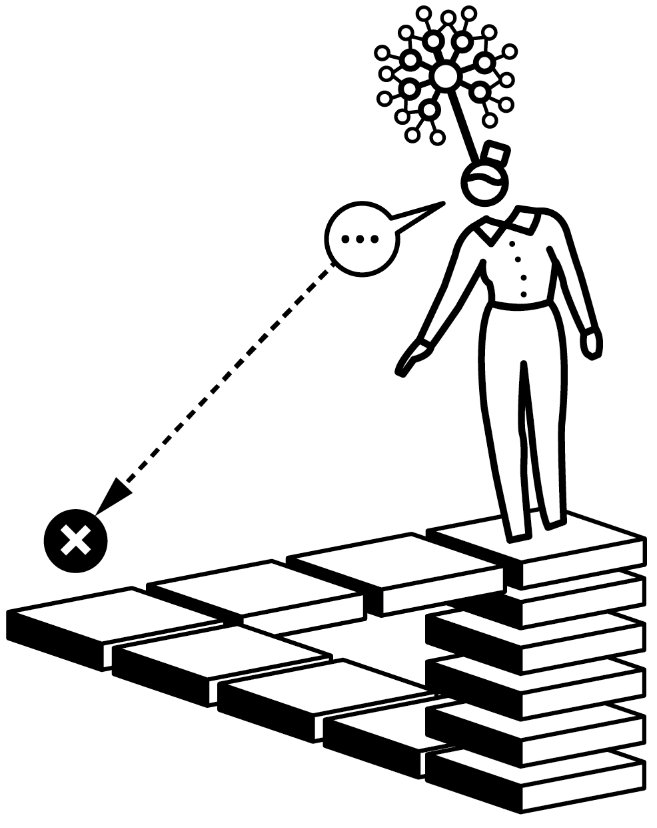
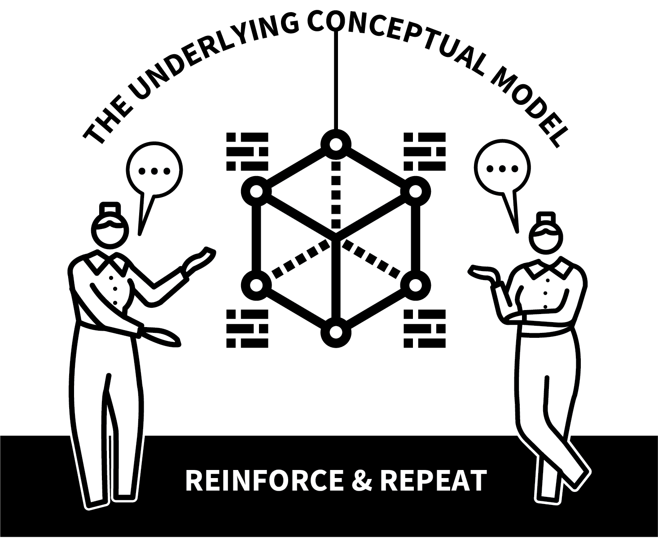
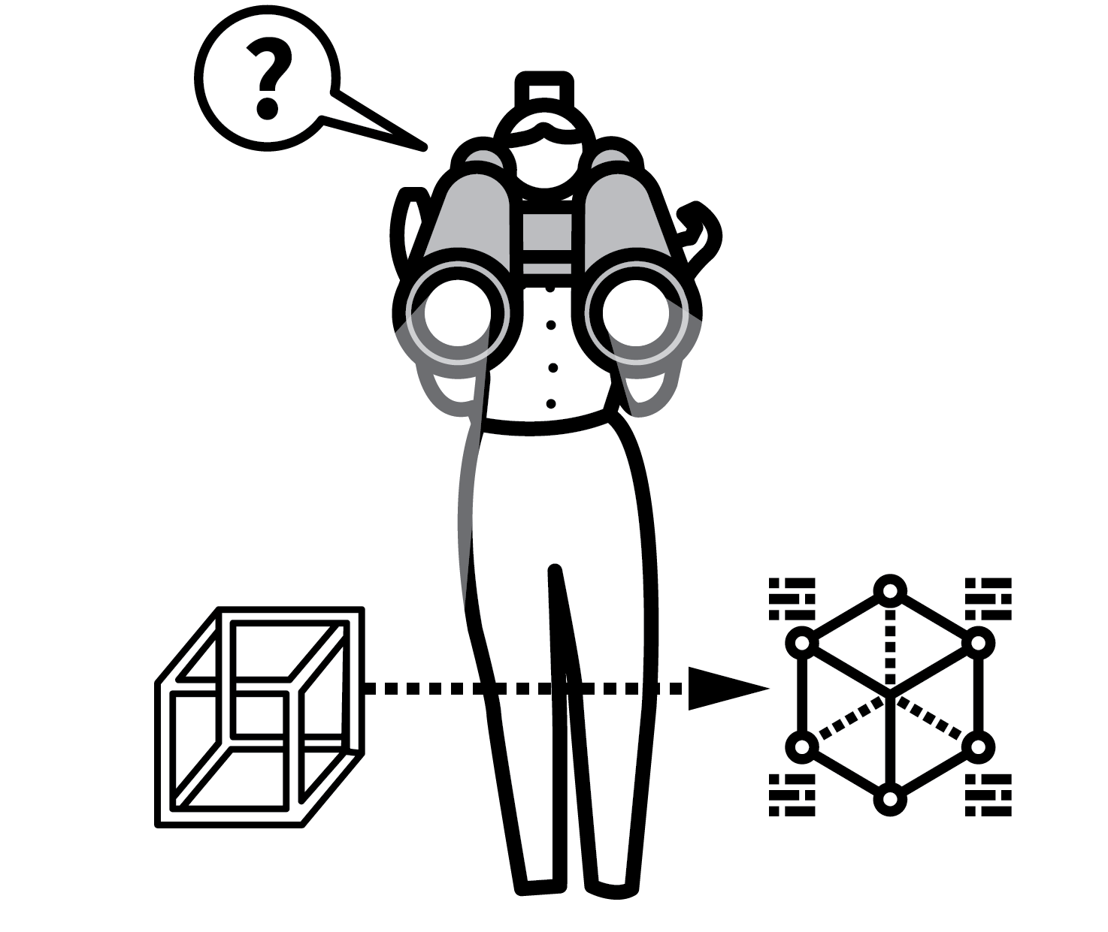
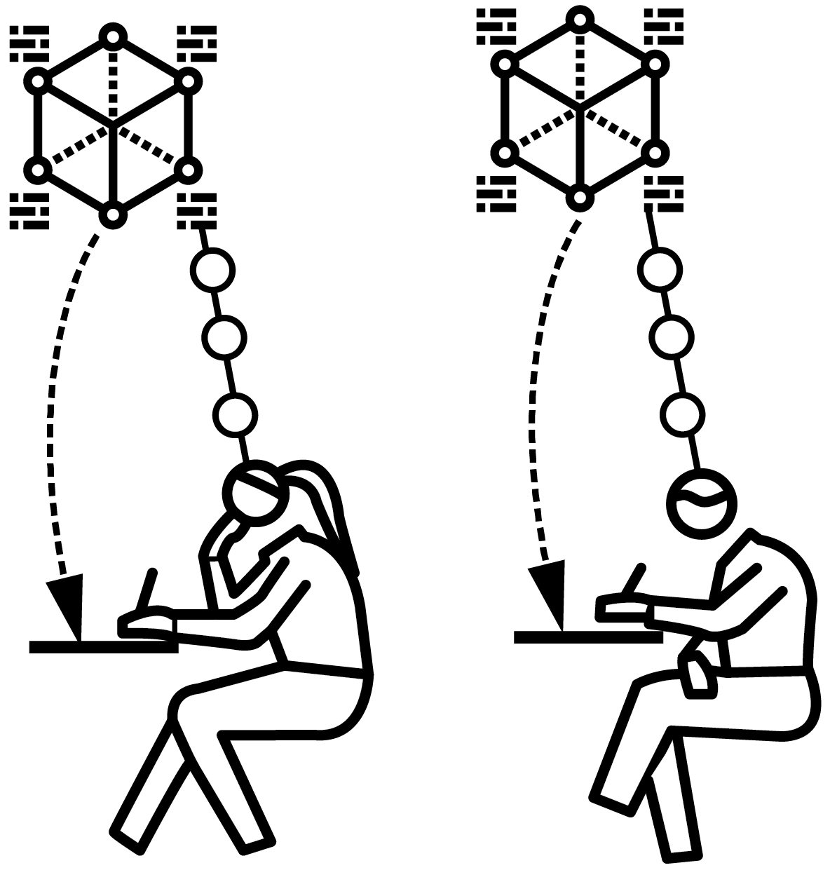
HEAD-ON MISCONCEPTIONS
1
2
3
4
5
IDENTIFY COMMON MISCONCEPTIONS
INTRODUCE A MISCONCEPTION EXPLICITLY: WHY IS IT WRONG?
REINFORCE A CORRECT UNDERLYING
CONCEPTUAL MODEL
CHECK FOR UNDERSTANDING OF THE MISCONCEPTION AND THE CORRECTION
PRACTISE THE CORRECT VERSION
In many subjects several errors or misconceptions crop up repeatedly.
If students have developed a schema around a misconception, it is not sufficient to continually re-teach the correct version because, unless the faulty schema is unpicked, it can remain to surface later.
This ‘re-wiring’ needs effort and deliberate re-thinking.

Slide 85
SET THE STANDARDS
1
2
3
4
5
IDENTIFY COMMON MISCONCEPTIONS
Identify common errors and misconceptions for each topic.
Analyse possible underlying reasons for those misconceptions arising.
Plan opportunities to teach students about them directly and prepare questions and other resources that explore them.

Slide 86
SET THE STANDARDS
1
2
3
4
5
INTRODUCE A MISCONCEPTION EXPLICITLY: WHY IS IT WRONG?
Present examples of the misconception, making it clear that the material presented is not fully correct — or is completely wrong:
e.g. Tyler writes: ¹∕4 + ²⁄3 = ³⁄7 What mistake has he made?
Jennifer says: The candle disappears
because the wax melted. Why is this wrong?

Slide 87
SET THE STANDARDS
1
2
3
4
5
REINFORCE A CORRECT UNDERLYING
CONCEPTUAL MODEL
Introduce or re-teach the underlying model that explains why the misconceptions and errors must be wrong.
Link this back to the errors that you
introduced.
It may be necessary to go right back to basics without making any assumptions.

Slide 88
SET THE STANDARDS
1
2
3
4
5
CHECK FOR UNDERSTANDING OF THE MISCONCEPTION AND THE CORRECTION
Engage students in Check for Understanding routines to ensure that they understand both the misconception and the correction.
It will not be sufficient to merely talk it through.
Ensure students can explain back to you what the errors are and how to correct them.

Slide 89
SET THE STANDARDS
1
2
3
4
5
PRACTISE THE CORRECT VERSION
Give students opportunities to strengthen a correct schema through practice.
Repeatedly use ideas that support the
corrected schema to support the process of making this the default without reverting back to the misconceptions.
Test students’ knowledge and understanding over time.

Slide 90
HEAD-ON MISCONCEPTIONS
1
2
3
4
5
IDENTIFY COMMON MISCONCEPTIONS
INTRODUCE A MISCONCEPTION EXPLICITLY: WHY IS IT WRONG?
REINFORCE A CORRECT UNDERLYING
CONCEPTUAL MODEL
CHECK FOR UNDERSTANDING OF THE MISCONCEPTION AND THE CORRECTION
PRACTISE THE CORRECT VERSION
In many subjects several errors or misconceptions crop up repeatedly.
If students have developed a schema around a misconception, it is not sufficient to continually re-teach the correct version because, unless the faulty schema is unpicked, it can remain to surface later.
This ‘re-wiring’ needs effort and deliberate re-thinking.

