Slide 1

John Catt Educational
PRACTICE & RETRIEVAL
TEACHING
WALKTHRUs
PRESENTATION
SLIDES
TOM SHERRINGTON & OLIVER CAVIGLIOLI
QUIZZING
ELABORATIVE INTERROGATION
USING A KNOWLDEGE ORGANISER
REHEARSAL & PERFORMANCE
PEER-SUPPORTED RETRIEVAL
WEEKLY & MONTHLY REVIEW
CONCRETE EXAMPLES
GUIDED PRACTICE
INDEPENDENT PRACTICE
BUILDING FLUENCY

Slide 2
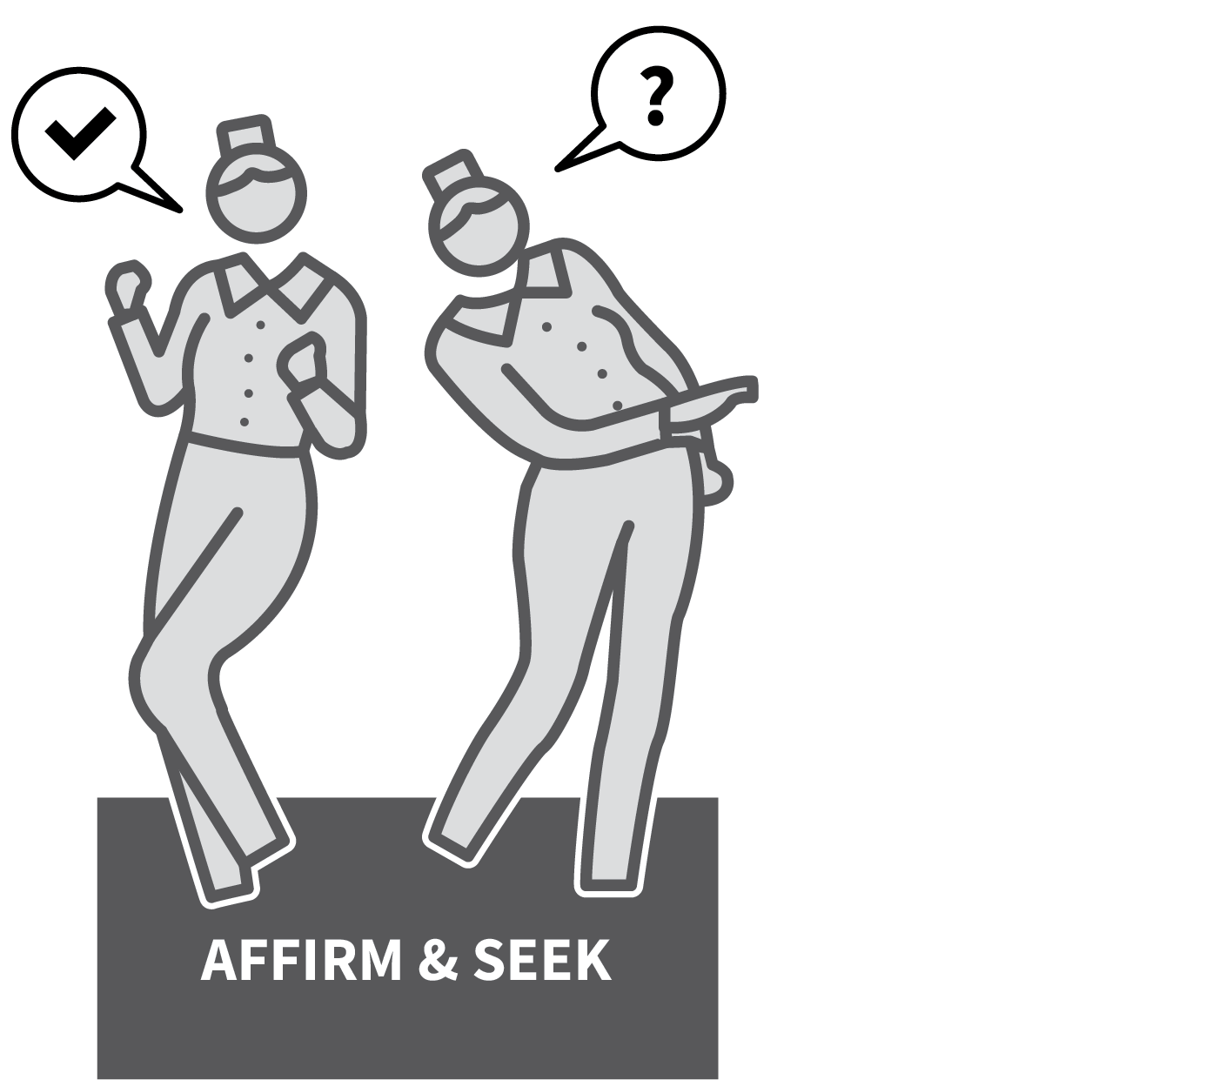

QUIZZING
SERIES
PRACTICE & RETRIEVAL
1
SPECIFY THE MATERIAL IN ADVANCE
2
ASK A SET OF SHORT FACTUAL RECALL QUESTIONS, VARYING IN STYLE
3
GIVE ALL STUDENTS TIME TO ANSWER ALLOF THE QUESTIONS
4
PROVIDE THE ANSWERS FOR STUDENTS TOSELF OR PEER-CHECK
5
AFFIRM GOOD PERFORMANCE AND SEEK OUT WRONG ANSWERS

Slide 3
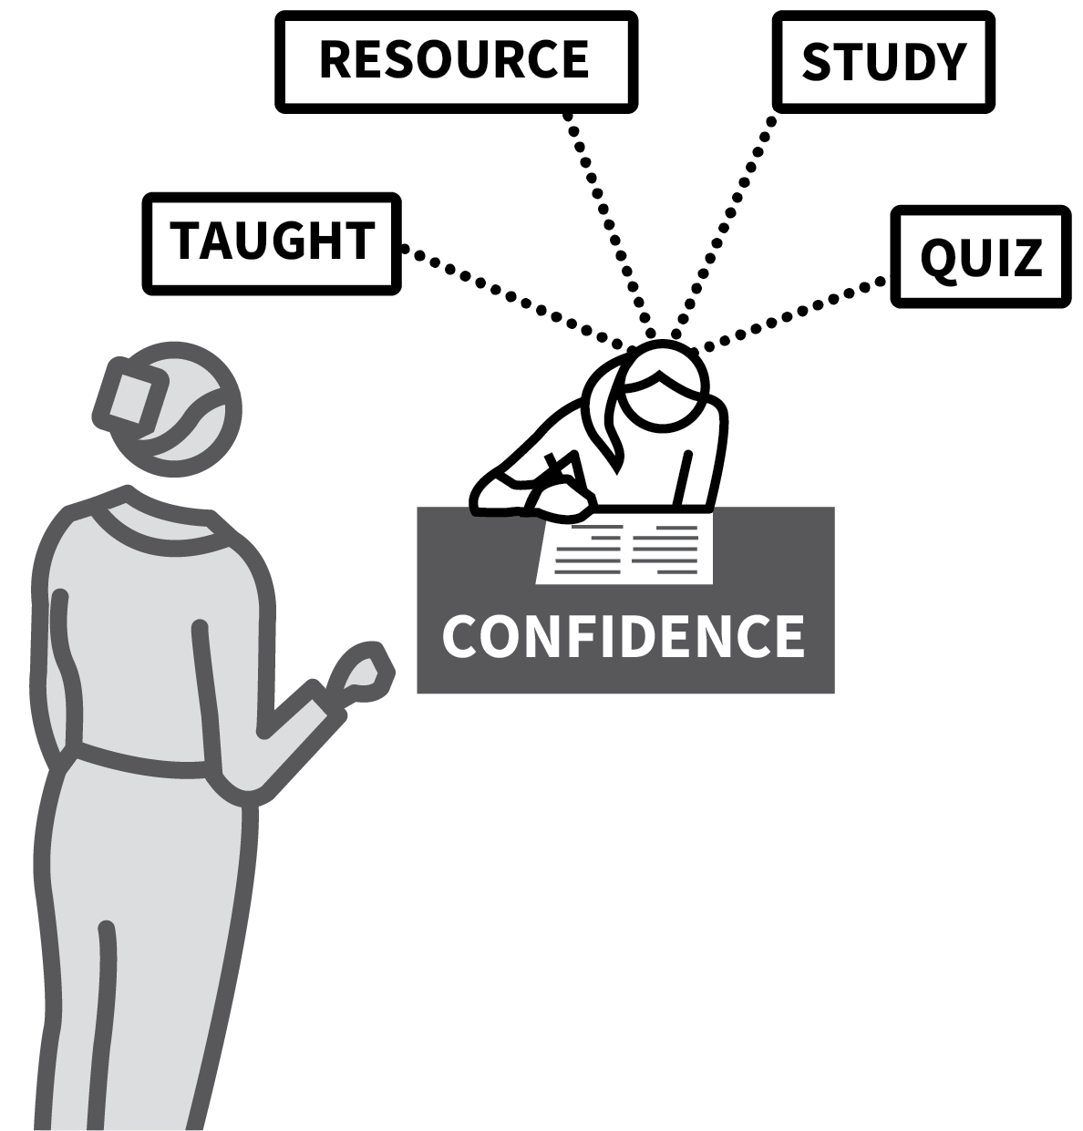



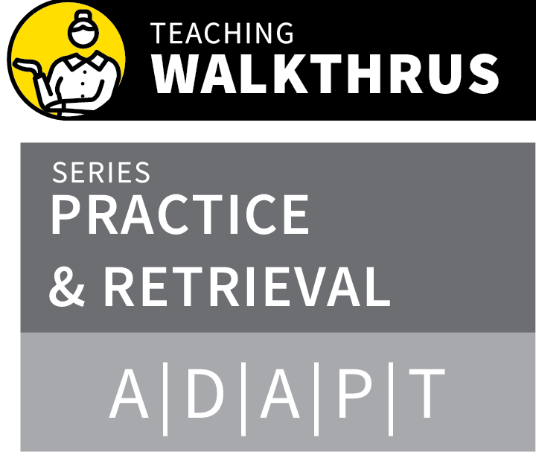
QUIZZING
1
2
3
4
5
SPECIFY THE MATERIAL IN ADVANCE
ASK A SET OF SHORT FACTUAL RECALL QUESTIONS, VARYING IN STYLE
GIVE ALL STUDENTS TIME TO ANSWER ALL
OF THE QUESTIONS
PROVIDE THE ANSWERS FOR STUDENTS TO
SELF OR PEER-CHECK
AFFIRM GOOD PERFORMANCE AND SEEK OUT WRONG ANSWERS
A routine quiz helps check that students have learned the material.
Quizzing provides information to student and teacher about where gaps exist.
It reinforces the retrieval strength of the material so it’s easier to remember later.
Quizzing is a form of practice; the more it is done, the more fluently students remember.

Slide 4
QUIZZING
1
2
3
4
5
SPECIFY THE MATERIAL IN ADVANCE
Ensure the material that will be the focus of future quizzing has already been taught.
Give students resources they can use to study from in advance, allowing them to prepare.
A good quiz should be designed to build
confidence with every student aiming at a high success rate.

Slide 5
QUIZZING
1
2
3
4
5
ASK A SET OF SHORT FACTUAL RECALL QUESTIONS, VARYING IN STYLE
Ask 5–10 questions checking for recall in a
variety of styles: short answer fact check; short problem solving.
Multiple choice questions; True/False; error spotting; labelling diagrams/image
recognition.
Recitation of quotes or definitions; short
bullet-point lists.

Slide 6
QUIZZING
1
2
3
4
5
GIVE ALL STUDENTS TIME TO ANSWER ALL OF THE QUESTIONS
The goal is to check that all students know all the material in question.
A quiz should allow all students to answer all the questions, not giving them a selection or hearing answers before they’ve been able to check their own recall.
Can be done as mini paper test, asked
verbally one by one or presented all at once for students to answer in their own time.

Slide 7
QUIZZING
1
2
3
4
5
PROVIDE THE ANSWERS FOR STUDENTS TO SELF OR
PEER-CHECK
Once the students have completed the quiz, provide the answers for them to check.
A time-efficient process is to reveal all
answers simultaneously on a slide or
visualiser.
The key is that students see or hear the
answers so they can compare their own for accuracy. Peer checking is a useful alternative.

Slide 8
QUIZZING
1
2
3
4
5
AFFIRM GOOD PERFORMANCE AND SEEK OUT WRONG ANSWERS
In addition to the retrieval practice itself, the most useful outcome from a quiz is that each student learns where they have gaps in their knowledge and the teacher learns what the common gaps are.
After answers have been checked, ask
students for examples of questions they got wrong. Explore the reasons,
re-teaching as needed.

Slide 9
QUIZZING
1
2
3
4
5
SPECIFY THE MATERIAL IN ADVANCE
ASK A SET OF SHORT FACTUAL RECALL QUESTIONS, VARYING IN STYLE
GIVE ALL STUDENTS TIME TO ANSWER ALL
OF THE QUESTIONS
PROVIDE THE ANSWERS FOR STUDENTS TO
SELF OR PEER-CHECK
AFFIRM GOOD PERFORMANCE AND SEEK OUT WRONG ANSWERS
A routine quiz helps check that students have learned the material.
Quizzing provides information to student and teacher about where gaps exist.
It reinforces the retrieval strength of the material so it’s easier to remember later.
Quizzing is a form of practice; the more it is done, the more fluently students remember.

Slide 10

1
2
3
4
5
6
7
8
9
10
QUIZZING
ELABORATIVE
INTERROGATION
USING A
KNOWLEDGE
ORGANISER
REHEARSAL &
PERFORMANCE
PEER-SUPPORTED RETRIEVAL
WEEKLY & MONTHLY REVIEW
CONCRETE EXAMPLES
GUIDED
PRACTICE
INDEPENDENT PRACTICE
BUILDING FLUENCY
NEXT UP
ELABORATIVE
INTERROGATION

Slide 11
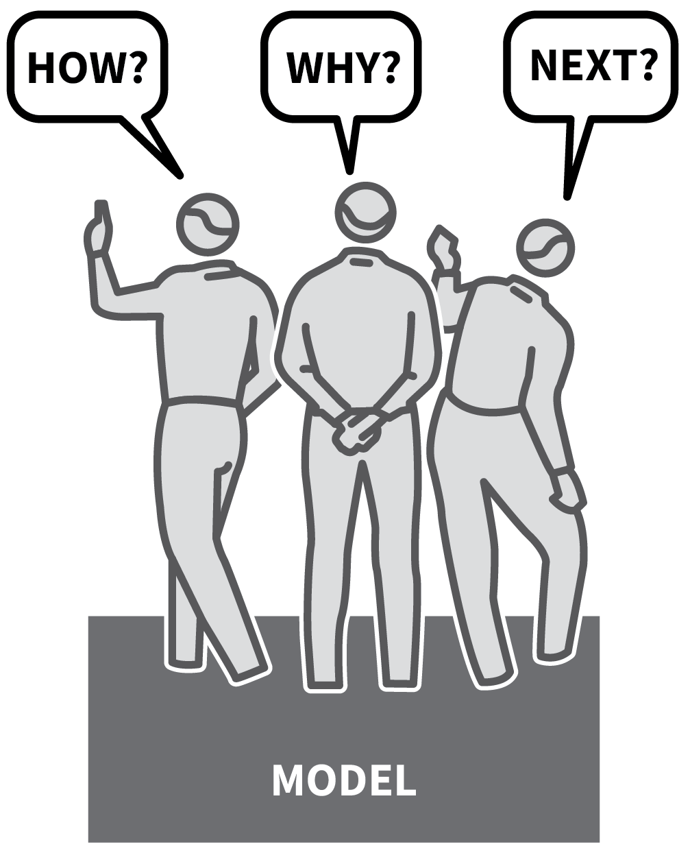
ELABORATIVE
INTERROGATION
SERIES
PRACTICE & RETRIEVAL
1
MODEL HOW TO GENERATE HOW, WHY AND WHAT NEXT QUESTIONS
2
EITHER USE PAIRED ELABORATIVE INTERROGATION
3
OR USE INDIVIDUAL ELABORATIVE INTERROGATION
4
CHECK FOR ACCURACY
5
CONSOLIDATE WITH QUIZZING OR OTHER FORMS OF ASSESSMENT

Slide 12
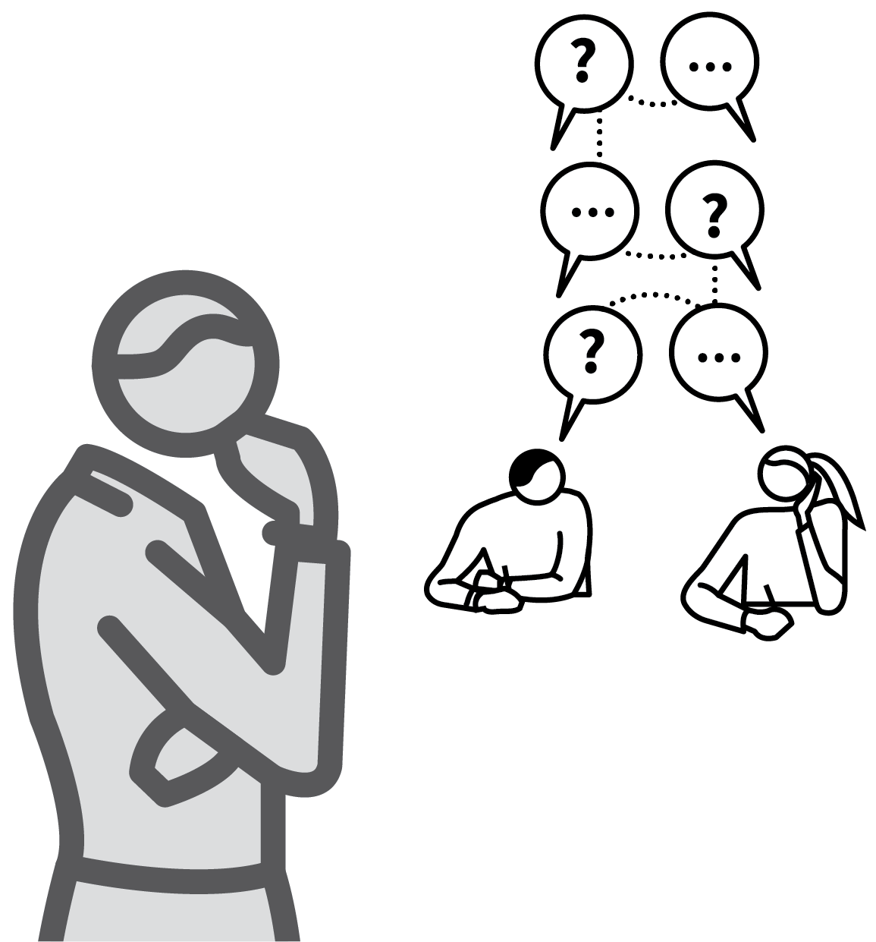
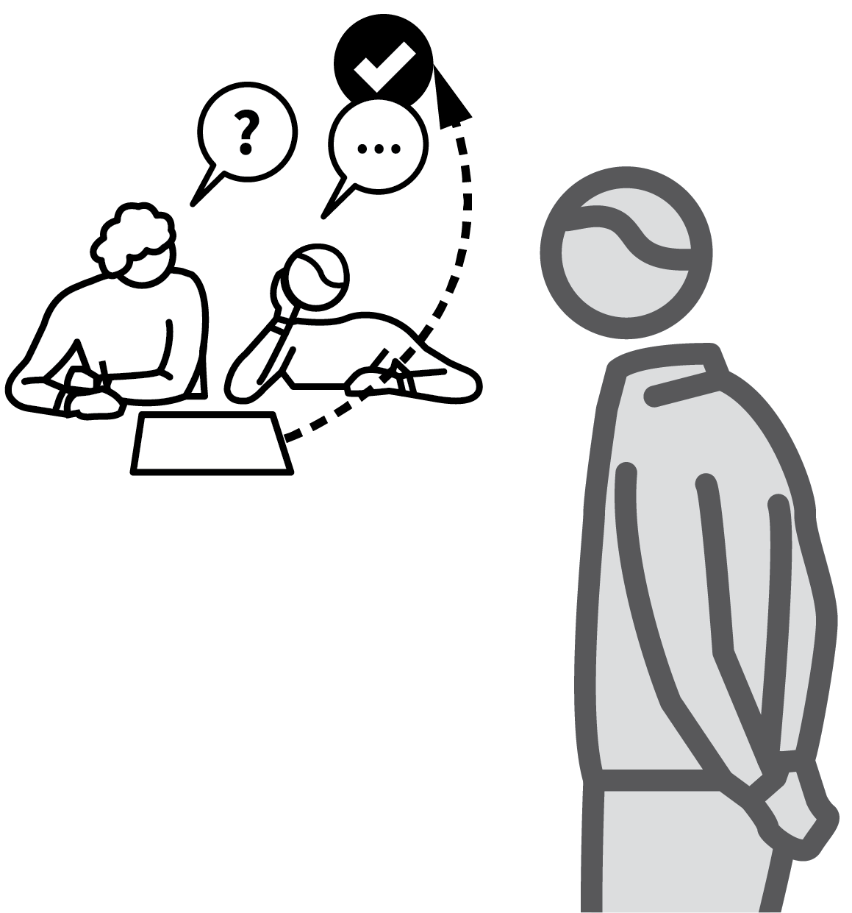
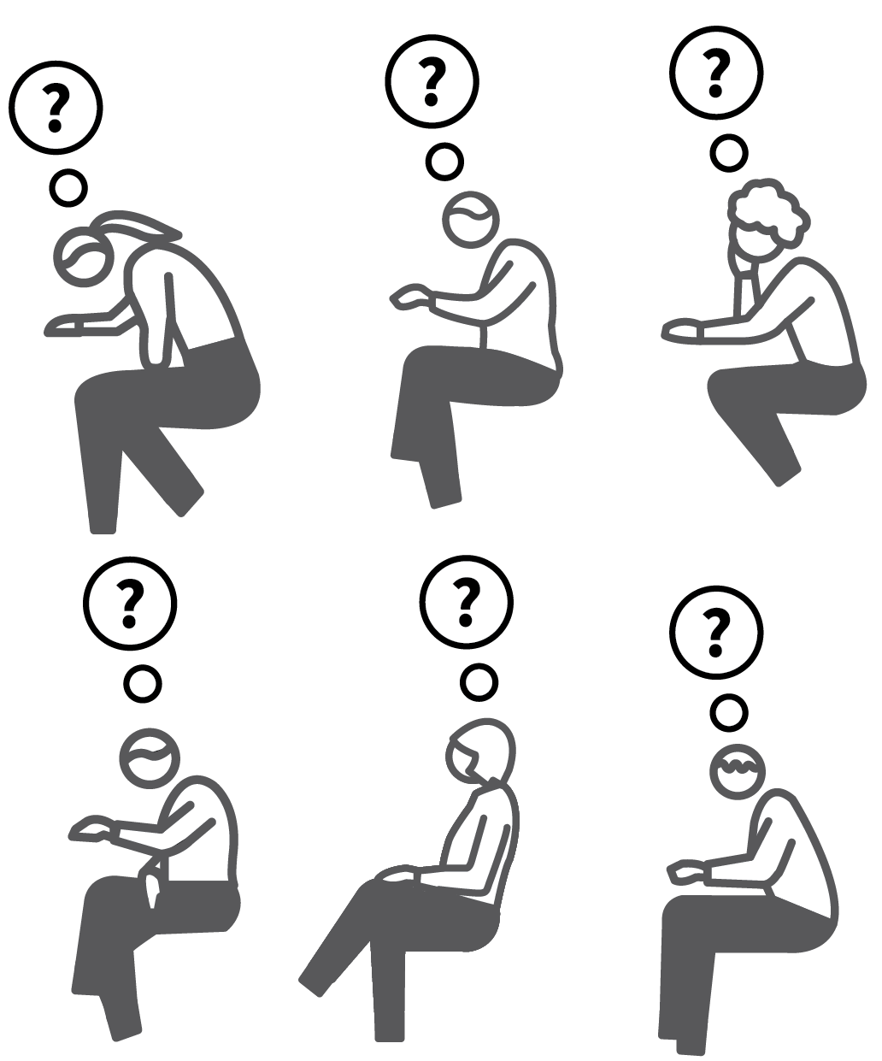

ELABORATIVE INTERROGATION
1
2
3
4
5
MODEL HOW TO GENERATE HOW, WHY AND WHAT NEXT QUESTIONS
EITHER USE PAIRED ELABORATIVE
INTERROGATION
OR USE INDIVIDUAL ELABORATIVE
INTERROGATION
CHECK FOR ACCURACY
CONSOLIDATE WITH QUIZZING OR OTHER FORMS OF ASSESSMENT
The aim here is for students to explore connections within their schema by asking ‘how?’, ‘why?’ and ‘what happens next?’
Research shows that students can improve their long-term retention and deepen their understanding if a peer asks them elaborative interrogative questions.
They can also mentally interrogate themselves using the same style of questions.

Slide 13
ELABORATIVE INTERROGATION
1
2
3
4
5
MODEL HOW TO GENERATE HOW, WHY AND WHAT NEXT QUESTIONS
Model elaborative interrogation explicitly, showing how different question stems lead to different responses:
How does…? Explanations of processes.
Why did…? Explorations of reasoning, cause and effect; rationale and motivation.
What happens if…? Explorations of variables and their effects, making predictions.

Slide 14
ELABORATIVE INTERROGATION
1
2
3
4
5
EITHER USE PAIRED ELABORATIVE
INTERROGATION
Allocate students to quiz each other in pairs.
Give students asking the questions a resource to help them, prompting deeper questions.
The students answering should give answers that are as expansive as possible; stress the value of exploring chains of connections within their schema.

Slide 15
ELABORATIVE INTERROGATION
1
2
3
4
5
OR USE INDIVIDUAL ELABORATIVE
INTERROGATION
Set time for students to engage in silent
individual elaborative interrogation, testing their own knowledge.
They should generate their own questions and answer them themselves.
This is hidden from the teacher, so it’s
important students know a follow-up process will require them to demonstrate their knowledge.

Slide 16
ELABORATIVE INTERROGATION
1
2
3
4
5
CHECK FOR ACCURACY
Ensure that students in pairs provide corrective feedback to their partners, referencing a resource to ensure their feedback is accurate.
Where students engage in a period of
self-interrogation, they should refer to their notes or sources to check the accuracy of their recall.
This ensures that subsequent consolidation and recall is more accurate and detailed.

Slide 17
ELABORATIVE INTERROGATION
1
2
3
4
5
CONSOLIDATE WITH QUIZZING OR OTHER FORMS OF ASSESSMENT
Elaborative interrogation supports
schema-building but is largely hidden so it is useful to provide further opportunities to demonstrate the results in other forms of
assessment.
Self-interrogation is useful preparation for written tests or assessments. Teachers can infer from students’ performance how
effective their retreival strategies were.

Slide 18
ELABORATIVE INTERROGATION
1
2
3
4
5
MODEL HOW TO GENERATE HOW, WHY AND WHAT NEXT QUESTIONS
EITHER USE PAIRED ELABORATIVE
INTERROGATION
OR USE INDIVIDUAL ELABORATIVE
INTERROGATION
CHECK FOR ACCURACY
CONSOLIDATE WITH QUIZZING OR OTHER FORMS OF ASSESSMENT
The aim here is for students to explore connections within their schema by asking ‘how?’, ‘why?’ and ‘what happens next?’
Research shows that students can improve their long-term retention and deepen their understanding if a peer asks them elaborative interrogative questions.
They can also mentally interrogate themselves using the same style of questions.

Slide 19
1
2
3
4
5
6
7
8
9
10
QUIZZING
ELABORATIVE
INTERROGATION
USING A
KNOWLEDGE
ORGANISER
REHEARSAL &
PERFORMANCE
PEER-SUPPORTED RETRIEVAL
WEEKLY & MONTHLY REVIEW
CONCRETE EXAMPLES
GUIDED
PRACTICE
INDEPENDENT PRACTICE
BUILDING FLUENCY
NEXT UP
USING A KNOWLEDGE
ORGANISER

Slide 20
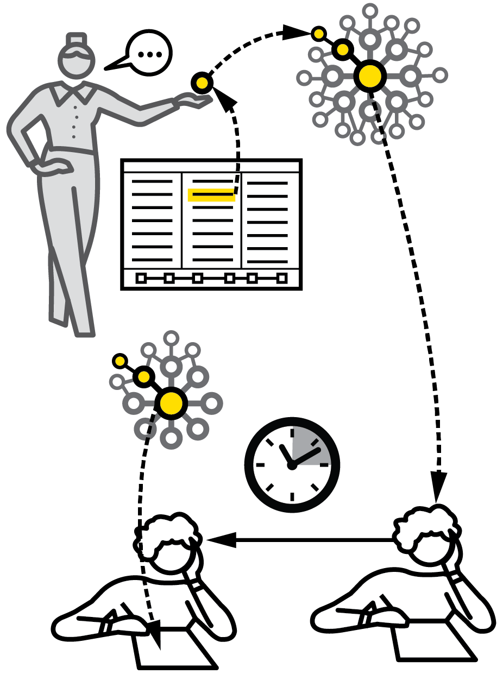
USING A KNOWLEDGE ORGANISER
SERIES
PRACTICE & RETRIEVAL
1
DESIGN KNOWLEDGE ORGANISERS TO BE QUIZZABLE
2
FOCUS ON SPECIFIC ELEMENTS
3
READ AND REHEARSE
4
CLOSE OR COVER FOR GENERATIVE RECALL
5
CHECK FOR ACCURACY

Slide 21
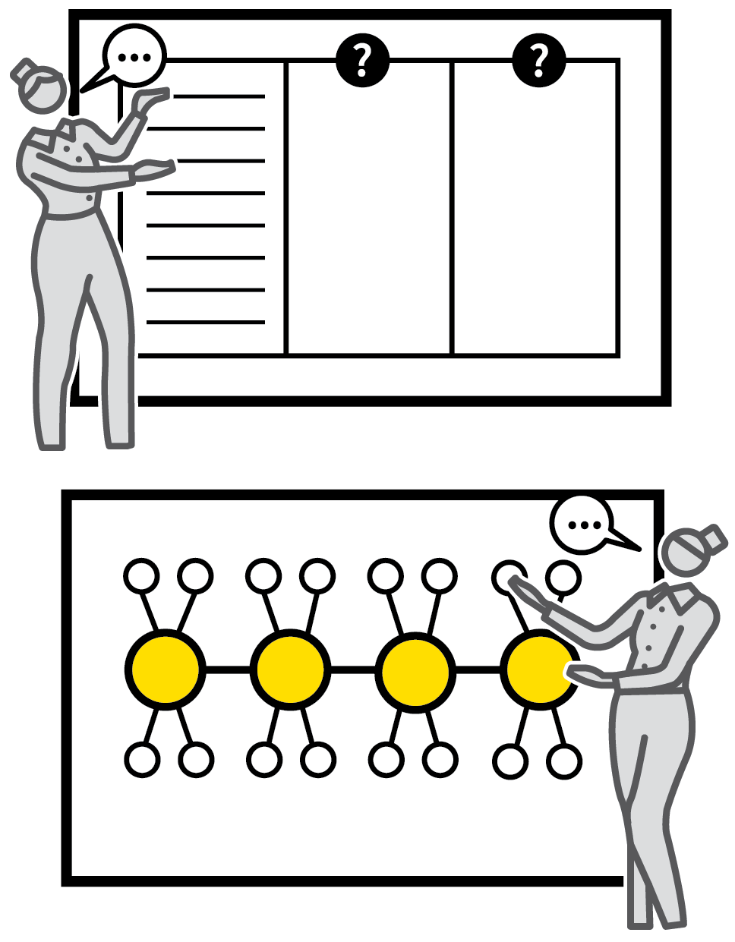

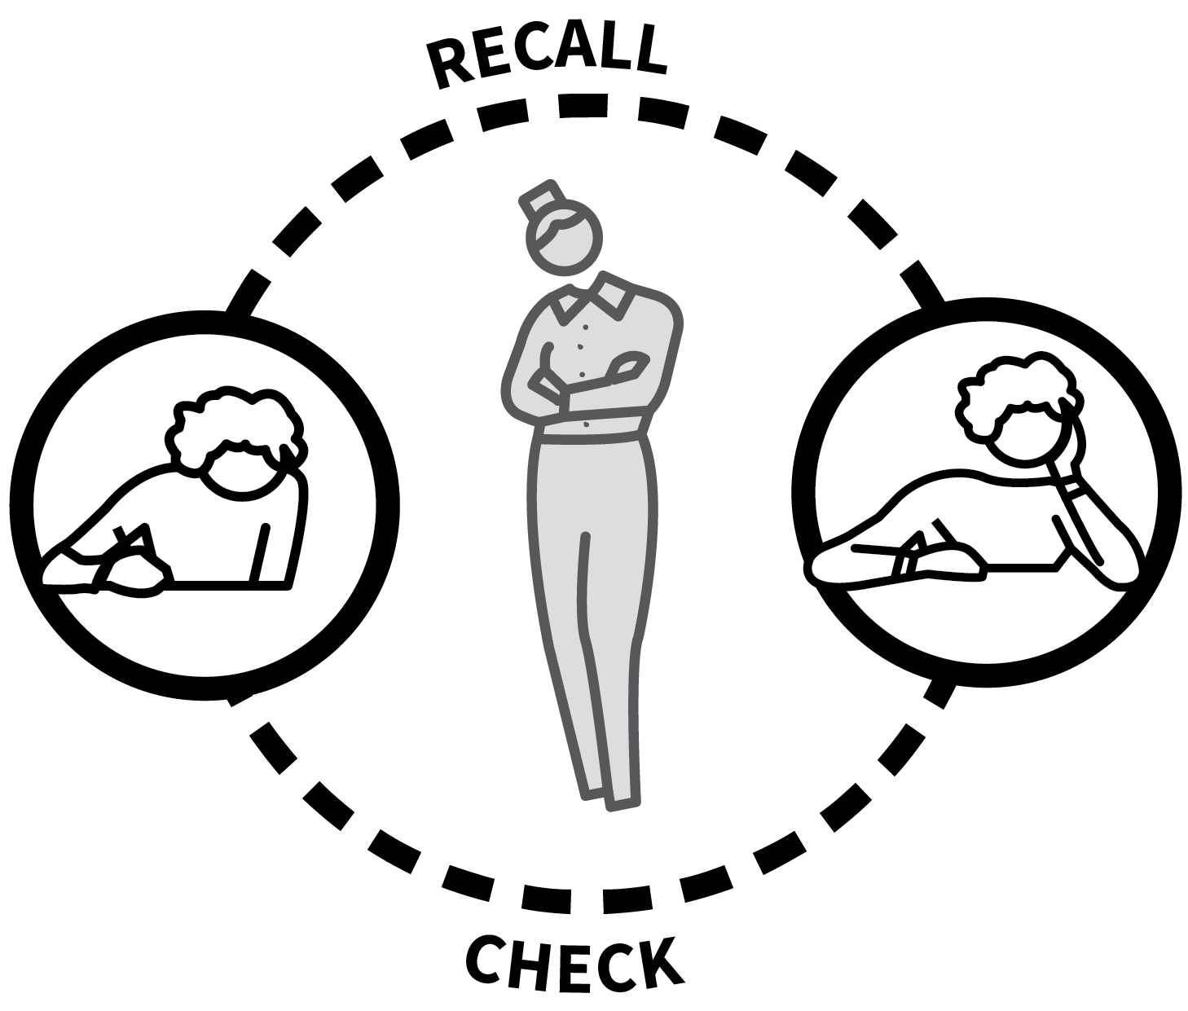
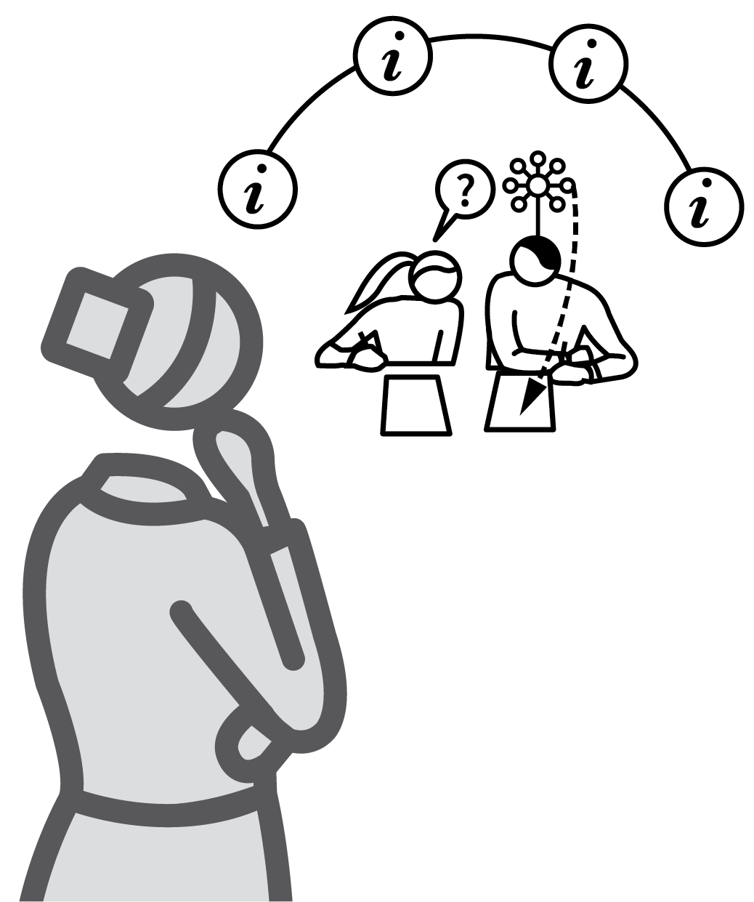
USING A KNOWLEDGE ORGANISER
1
2
3
4
5
DESIGN KNOWLEDGE ORGANISERS TO BE QUIZZABLE
FOCUS ON SPECIFIC ELEMENTS
READ AND REHEARSE
CLOSE OR COVER FOR GENERATIVE RECALL
CHECK FOR ACCURACY
The purpose of a knowledge organiser is to provide students with accessible guidance about knowledge that they can study on their own; a secure schema with strong recall.
They are intended as a summary; not a comprehenisve, exhaustive list of all that could be known.
They only serve a purpose if they are used effectively, linked to retrieval techniques.

Slide 22
USING A KNOWLEDGE ORGANISER
1
2
3
4
5
DESIGN KNOWLEDGE ORGANISERS TO BE QUIZZABLE
Present the key information you want students to learn in a format that supports self-quizzing.
Useful features include:
Tables with columns of related information;
Bullet point lists of key ideas;
Sequences show in flow diagrams;
Labelled and unlabeled versions of
diagrams;
Clear mindmaps or timelines

Slide 23
USING A KNOWLEDGE ORGANISER
1
2
3
4
5
FOCUS ON SPECIFIC ELEMENTS
Typically, knowledge organisers span much more information than can be quizzed on sensibly at any one time.
Direct students to read specific elements in advance of any retrieval practice acitivities.
Highlight how this fits into a bigger schema; quizzing should support building connections rather than isolating facts so they lose meaning.

Slide 24
USING A KNOWLEDGE ORGANISER
1
2
3
4
5
READ AND REHEARSE
Ask students to read through their knowledge organiser, saying the words, reading through equations, tracking through any visuals.
Rehearse using the organiser, asking
questions based on the content whilst
students are looking at it.
Ask them to do this themselves or in pairs so they are engaging with the information.

Slide 25
USING A KNOWLEDGE ORGANISER
1
2
3
4
5
CLOSE OR COVER FOR GENERATIVE RECALL
This is the active step.
Students need to remove the information from view and engage in a generative recall process: completing a table, listing the bullet points, adding labels to a diagram, placing ideas in the correct sequence, remembering definitions.

Slide 26
USING A KNOWLEDGE ORGANISER
1
2
3
4
5
CHECK FOR ACCURACY
After a short generative process, students should reveal the covered information to check the accuracy of their recall.
Repeat Steps 4 and 5 in an iterative loop,
filling in gaps of knowledge, adding fluency each time until students feel confident that they can recall the information.

Slide 27
USING A KNOWLEDGE ORGANISER
1
2
3
4
5
DESIGN KNOWLEDGE ORGANISERS TO BE QUIZZABLE
FOCUS ON SPECIFIC ELEMENTS
READ AND REHEARSE
CLOSE OR COVER FOR GENERATIVE RECALL
CHECK FOR ACCURACY
The purpose of a knowledge organiser is to provide students with accessible guidance about knowledge that they can study on their own; a secure schema with strong recall.
They are intended as a summary; not a comprehenisve, exhaustive list of all that could be known.
They only serve a purpose if they are used effectively, linked to retrieval techniques.

Slide 28
1
2
3
4
5
6
7
8
9
10
QUIZZING
ELABORATIVE
INTERROGATION
USING A
KNOWLEDGE
ORGANISER
REHEARSAL &
PERFORMANCE
PEER-SUPPORTED RETRIEVAL
WEEKLY & MONTHLY REVIEW
CONCRETE EXAMPLES
GUIDED
PRACTICE
INDEPENDENT PRACTICE
BUILDING FLUENCY
NEXT UP
REHEARSAL &
PERFORMANCE

Slide 29

REHEARSAL & PERFORMANCE
SERIES
PRACTICE & RETRIEVAL
1
ESTABLISH THE CRITERIA FOR EXCELLENCE IN PERFORMANCE
2
INITIATE LOW STAKES REHEARSAL
3
GENERATE FEEDBACK
4
DELIVER THE PERFORMANCE
5
EVALUATE AND REPEAT

Slide 30

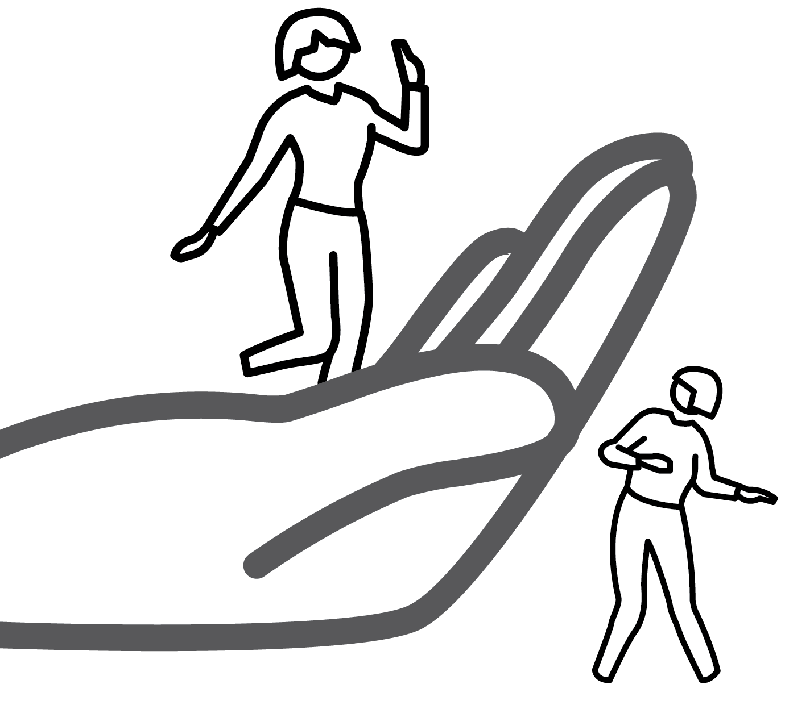
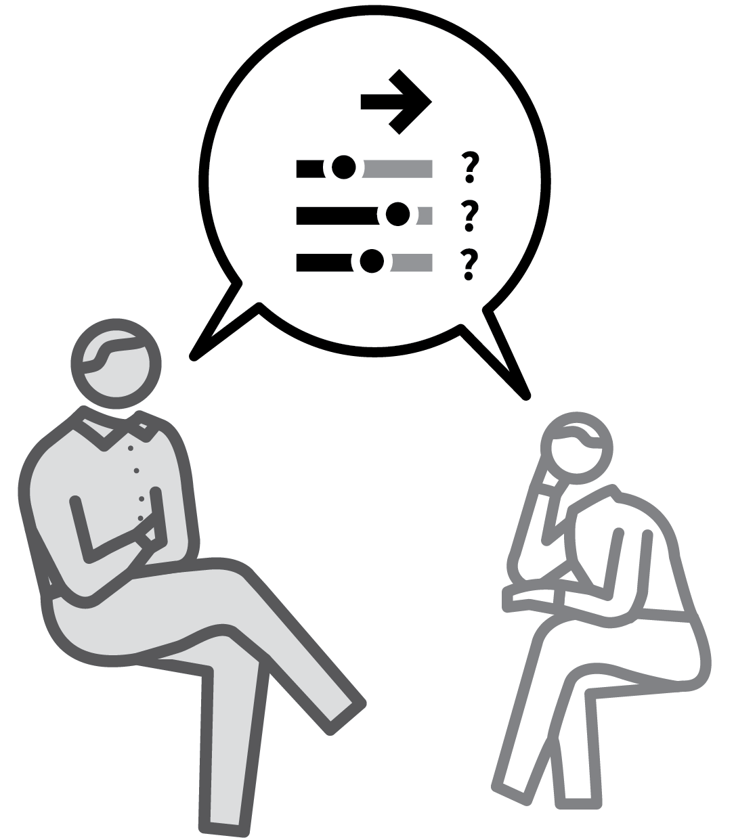

REHEARSAL & PERFORMANCE
1
2
3
4
5
ESTABLISH THE CRITERIA FOR EXCELLENCE IN PERFORMANCE
INITIATE LOW STAKES REHEARSAL
GENERATE FEEDBACK
DELIVER THE PERFORMANCE
EVALUATE AND REPEAT
There are wide areas of the curriculum where rehearse-perform-evaluate cycles are a useful way to consider retrieval practice.
This might be where students need to apply a technical skill or manual procedure; where a performance is the goal — such as in music or drama.
It can also apply to giving explanations of events, concepts or phenomena.

Slide 31
REHEARSAL & PERFORMANCE
1
2
3
4
5
ESTABLISH THE CRITERIA FOR EXCELLENCE IN PERFORMANCE
Set success criteria at the beginning, using rubrics and exemplars as in Set the Standard. Where original outcomes are important, reinforce a diverse range of possible ways to achieve excellence.
Highlight key elements that are common
tipping points for achieving next level
success.

Slide 32
REHEARSAL & PERFORMANCE
1
2
3
4
5
INITIATE LOW STAKES REHEARSAL
Give all students the opportunity to rehearse the performance, or explanation or demonstration.
Initially allow students a period of private practice so the stakes are low and they are
essentially rehearsing for their own
self-review.
Use pairs or small groups to provide a source of feedback if needed.

Slide 33
REHEARSAL & PERFORMANCE
1
2
3
4
5
GENERATE FEEDBACK
After each rehearsal, engage students in a review process. What went well? What could be improved?
Ideally feedback would be self generated as this will have high impact. It could also be generated from a Peer Critique process.
Ensure that feedback relates to the
established criteria.

Slide 34
REHEARSAL & PERFORMANCE
1
2
3
4
5
DELIVER THE PERFORMANCE
When ready, students should deliver a
performance aiming to embed the feedback in achieving the success criteria.
This might be with pairs or groups working in parallel or by presenting to the whole class.

Slide 35
REHEARSAL & PERFORMANCE
1
2
3
4
5
EVALUATE AND REPEAT
Compare students’ performances — or
explanations or success in employing skills — to the success criteria.
Use techniques such as Check for
Understanding to establish whether students can see where they succeeded and where to improve.
Repeat Steps 2–4 to secure incremental
improvements.

Slide 36
REHEARSAL & PERFORMANCE
1
2
3
4
5
ESTABLISH THE CRITERIA FOR EXCELLENCE IN PERFORMANCE
INITIATE LOW STAKES REHEARSAL
GENERATE FEEDBACK
DELIVER THE PERFORMANCE
EVALUATE AND REPEAT
There are wide areas of the curriculum where rehearse-perform-evaluate cycles are a useful way to consider retrieval practice.
This might be where students need to apply a technical skill or manual procedure; where a performance is the goal — such as in music or drama.
It can also apply to giving explanations of events, concepts or phenomena.

Slide 37
1
2
3
4
5
6
7
8
9
10
QUIZZING
ELABORATIVE
INTERROGATION
USING A
KNOWLEDGE
ORGANISER
REHEARSAL &
PERFORMANCE
PEER-SUPPORTED RETRIEVAL
WEEKLY & MONTHLY REVIEW
CONCRETE EXAMPLES
GUIDED
PRACTICE
INDEPENDENT PRACTICE
BUILDING FLUENCY
NEXT UP
PEER-SUPPORTED RETRIEVAL

Slide 38

PEER-SUPPORTED RETRIEVAL
SERIES
PRACTICE & RETRIEVAL
1
PROVIDE QUESTION AND ANSWER PROMPTS
2
ALLOCATE CHECKING PARTNERS
3
STUDENT 1 ASSESSES STUDENT 2
4
STUDENT 2 TESTS STUDENT 1
5
DISCUSS COMMON DIFFICULTIES

Slide 39


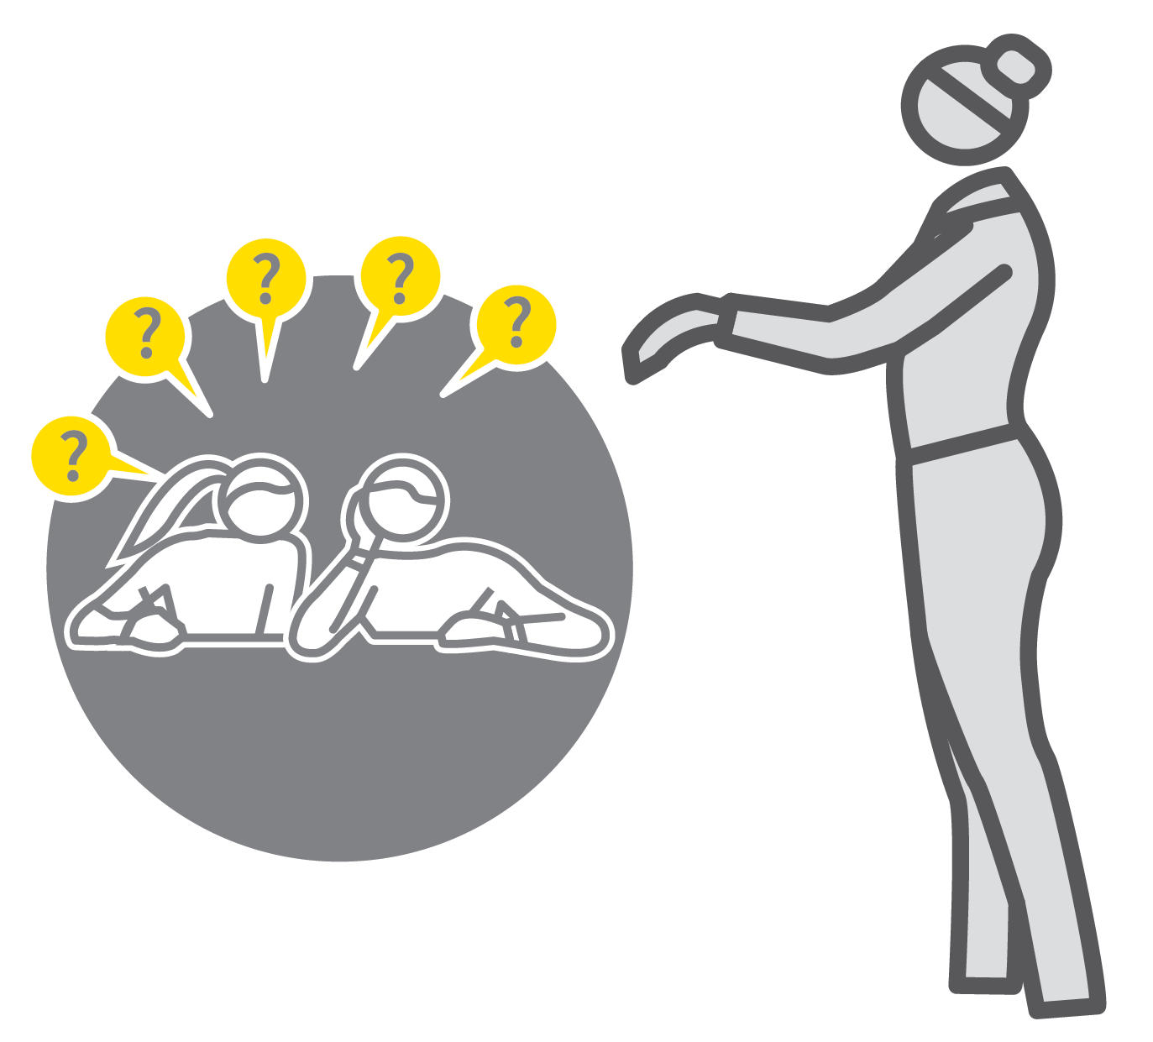
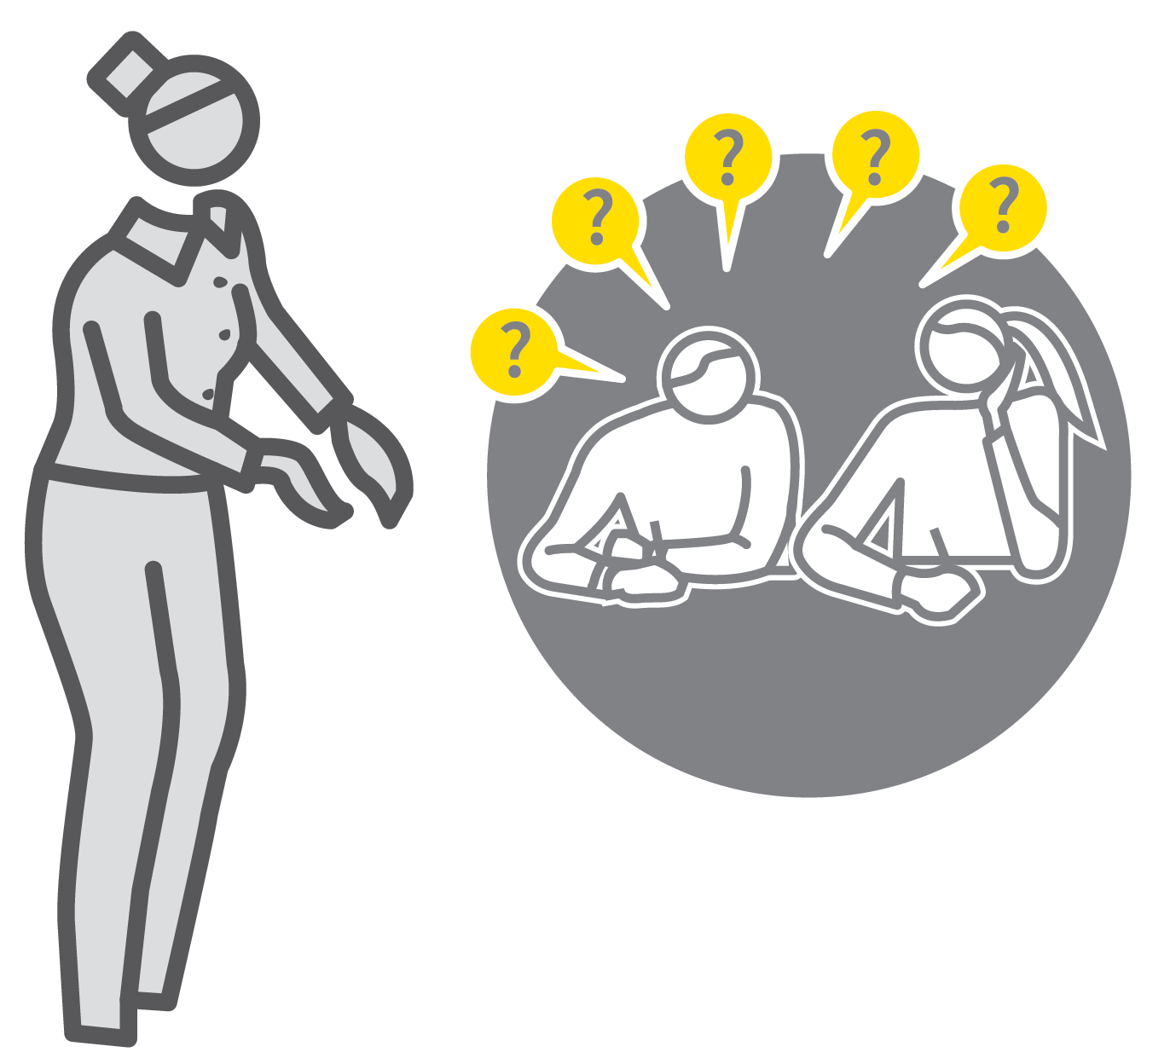
PEER-SUPPORTED RETRIEVAL
1
2
3
4
5
PROVIDE QUESTION AND ANSWER PROMPTS
ALLOCATE CHECKING PARTNERS
STUDENT 1 ASSESSES STUDENT 2
STUDENT 2 TESTS STUDENT 1
DISCUSS COMMON DIFFICULTIES
As Wiliam et al. suggest, a powerful formative assessment strategy is to ‘activate learners as resources for one another’.
Peer-supported retrieval means asking students to test each other’s knowledge and provide corrective feedback, supported by resources to ensure the feedback is accurate.
This helps teachers to amplify the feedback students receive.

Slide 40
PEER-SUPPORTED RETRIEVAL
1
2
3
4
5
PROVIDE QUESTION AND ANSWER PROMPTS
Teach students how to ask each other
questions by modelling them explicitly. This might include Elaborative Interrogation or Using a Knowledge Organiser.
Include the need to ask questions in a variety of forms and the goal of providing complete answers rather than fragments.

Slide 41
PEER-SUPPORTED RETRIEVAL
1
2
3
4
5
ALLOCATE CHECKING PARTNERS
As with any collaborative process, be explicit about expected behaviours. If students quiz in pairs or use a more elaborate group structure, ensure that everyone has a clear role and learning goal.
Manage the allocation of checking partners to prevent ineffective behaviours where more confident students dominate and less confident students give way.

Slide 42
PEER-SUPPORTED RETRIEVAL
1
2
3
4
5
STUDENT 1 ASSESSES STUDENT 2
Invite a student in each pair to ask a series of questions to check their partner’s knowledge.
e.g. pre-prepared quiz questions; running through an extended explanation; rehearsing the narrative in a story; describing a series of processes; adding labels to a diagram or flow chart.
Student 1 should verify answers, confirming complete responses and providing feedback.

Slide 43
PEER-SUPPORTED RETRIEVAL
1
2
3
4
5
STUDENT 2 TESTS STUDENT 1
Swap the roles of the students and repeat Step 3.
It is likely that Student 1, having asked the questions in Step 3, will be in a stronger
position to give good answers having just studied the material.
Multiple iterations of these steps can lead to excellent fluency building.

Slide 44
PEER-SUPPORTED RETRIEVAL
1
2
3
4
5
DISCUSS COMMON DIFFICULTIES
Follow up the paired quizzing process with a discussion of common errors, difficulties with recall, gaps in knowledge and
misconceptions.
Instead of asking “does everyone
understand?”, ask “does anyone still not
understand?”
Re-teach material as necessary.

Slide 45
PEER-SUPPORTED RETRIEVAL
1
2
3
4
5
PROVIDE QUESTION AND ANSWER PROMPTS
ALLOCATE CHECKING PARTNERS
STUDENT 1 ASSESSES STUDENT 2
STUDENT 2 TESTS STUDENT 1
DISCUSS COMMON DIFFICULTIES
As Wiliam et al. suggest, a powerful formative assessment strategy is to ‘activate learners as resources for one another’.
Peer-supported retrieval means asking students to test each other’s knowledge and provide corrective feedback, supported by resources to ensure the feedback is accurate.
This helps teachers to amplify the feedback students receive.

Slide 46
1
2
3
4
5
6
7
8
9
10
QUIZZING
ELABORATIVE
INTERROGATION
USING A
KNOWLEDGE
ORGANISER
REHEARSAL &
PERFORMANCE
PEER-SUPPORTED RETRIEVAL
WEEKLY & MONTHLY REVIEW
CONCRETE EXAMPLES
GUIDED
PRACTICE
INDEPENDENT PRACTICE
BUILDING FLUENCY
NEXT UP
WEEKLY & MONTHLY REVIEW

Slide 47

WEEKLY & MONTHLY REVIEW
SERIES
PRACTICE & RETRIEVAL
1
GENERATE STUDY RESOURCES
2
PLAN FOR SPACED PRACTICE
3
SET A RETRIEVAL PRACTICE ACTIVITY
4
EXPLORE GAPS AND ERRORS
5
MAKE CONNECTIONS

Slide 48

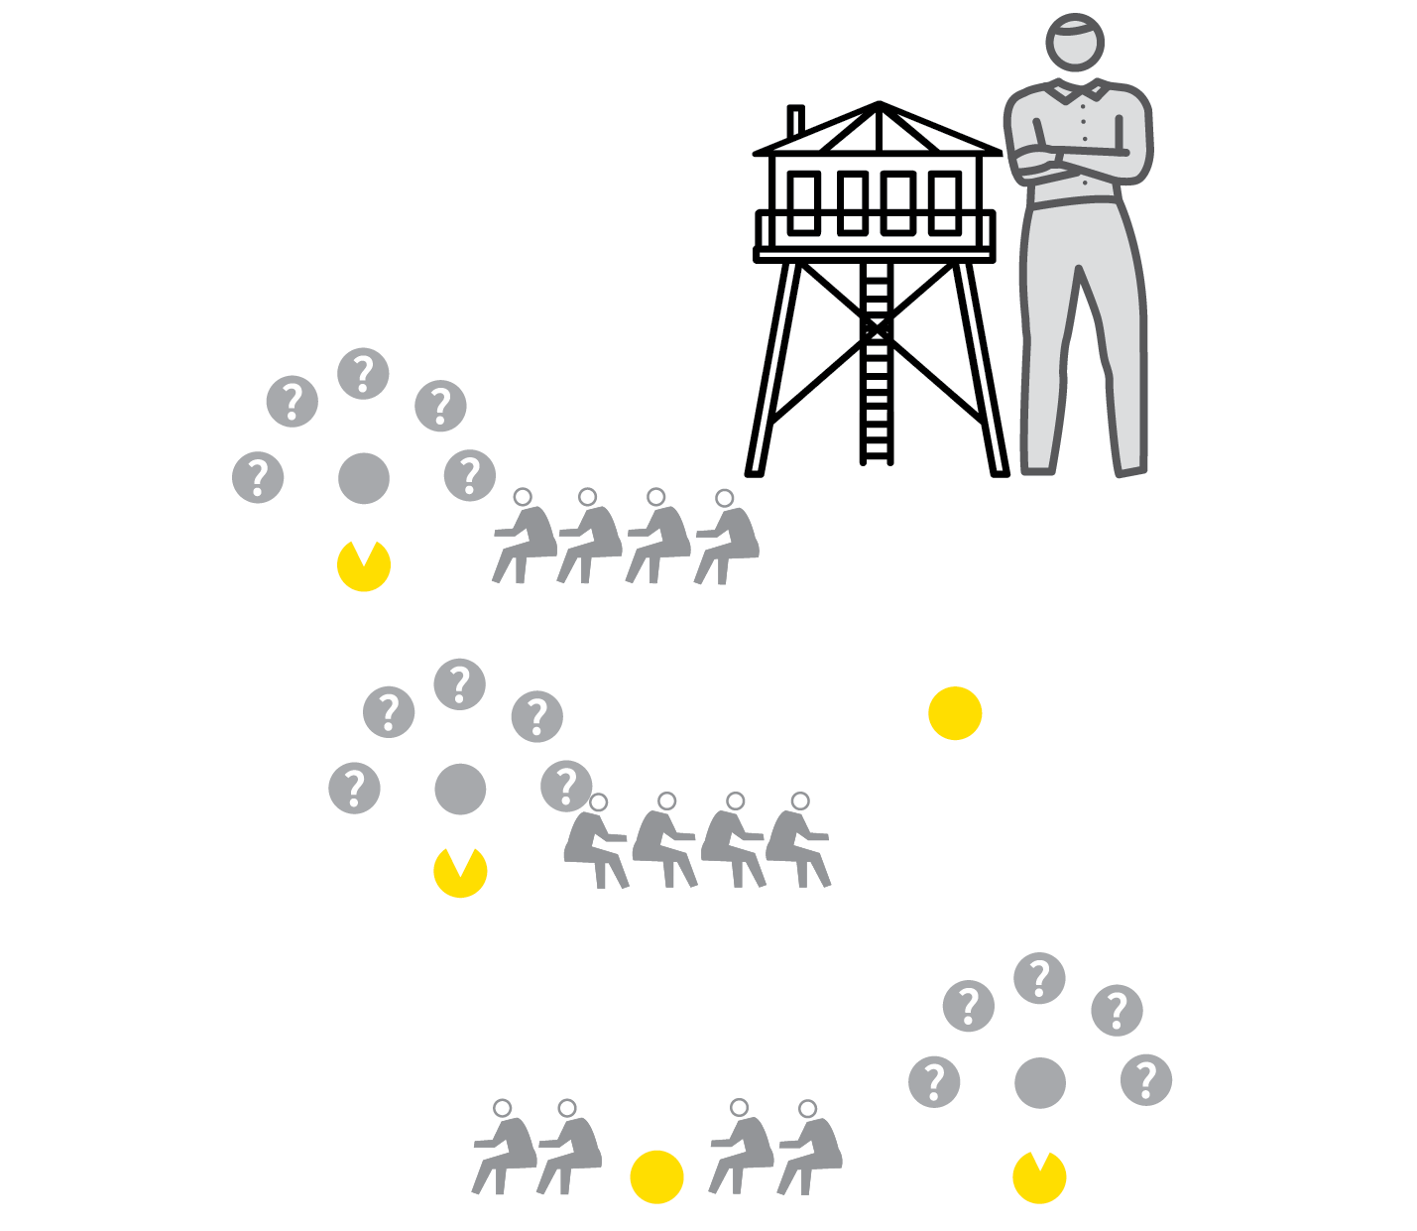

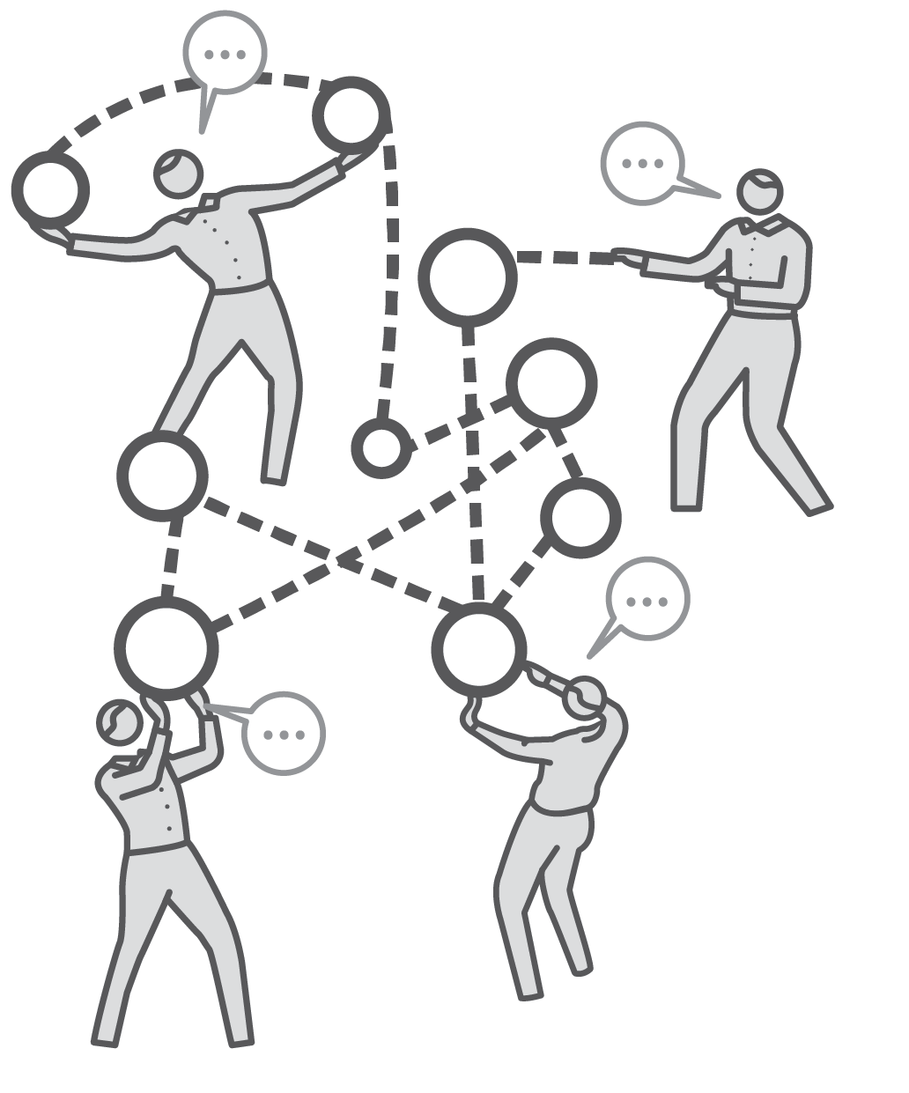
WEEKLY & MONTHLY REVIEW
1
2
3
4
5
GENERATE STUDY RESOURCES
PLAN FOR SPACED PRACTICE
SET A RETRIEVAL PRACTICE ACTIVITY
EXPLORE GAPS AND ERRORS
MAKE CONNECTIONS
Students secure stronger long-term recall engaging in retrieval practice with ideas after time has passed since first learning them.
Rosenshine suggests effective teachers periodically review material to attenuate forgetting and make connections between ideas.
Embed review processes into your routines whilst also keeping track of the path through the curriculum.

Slide 49
WEEKLY & MONTHLY REVIEW
1
2
3
4
5
GENERATE STUDY RESOURCES
Provide or engage students in producing
resources that will support them in building secure schema in the long term.
This might include reading material,
Knowledge Organisers or making structured notes in exercise books.
It is easier to engage in evaluation of a review if there are clear resources that the retrieval tasks relate to.

Slide 50
WEEKLY & MONTHLY REVIEW
1
2
3
4
5
PLAN FOR SPACED PRACTICE
As well as planning lessons taking students forward, plan pauses to look back over material that was explored previously.
A weekly review and a monthly review are only loose guides. You might choose to review material covered much longer ago.
It can help to build in a routine, e.g. a 15-minute slot once per week to build a rhythm to your reviews.

Slide 51
WEEKLY & MONTHLY REVIEW
1
2
3
4
5
SET A RETRIEVAL PRACTICE ACTIVITY
Choose an activity to test students’ recall of the previous learning:
Quizzing; Peer-Supported Retrieval;
Elaborative Interrogation; Rehearsal and Performance.
Mind-mapping, problem-solving or writing tasks using elements of recall; reciprocal teaching, where students explain ideas to their peers.

Slide 52
WEEKLY & MONTHLY REVIEW
1
2
3
4
5
EXPLORE GAPS AND ERRORS
Engage all students in checking their recall of all the relevant knowledge, then establish the common gaps.
If students have forgotten, give time to
reconsolidate their knowledge by
re-examining the material.
If they can no longer perform tasks or explain concepts, re-teach the key ideas.

Slide 53
WEEKLY & MONTHLY REVIEW
1
2
3
4
5
MAKE CONNECTIONS
Whilst reviewing previously learned material, show students how it connects to other topics they’ve covered including the current one.
This helps to strengthen their wider
schema-buiding, linking ideas together rather than making them seem disconnected.

Slide 54
WEEKLY & MONTHLY REVIEW
1
2
3
4
5
GENERATE STUDY RESOURCES
PLAN FOR SPACED PRACTICE
SET A RETRIEVAL PRACTICE ACTIVITY
EXPLORE GAPS AND ERRORS
MAKE CONNECTIONS
Students secure stronger long-term recall engaging in retrieval practice with ideas after time has passed since first learning them.
Rosenshine suggests effective teachers periodically review material to attenuate forgetting and make connections between ideas.
Embed review processes into your routines whilst also keeping track of the path through the curriculum.

Slide 55
1
2
3
4
5
6
7
8
9
10
QUIZZING
ELABORATIVE
INTERROGATION
USING A
KNOWLEDGE
ORGANISER
REHEARSAL &
PERFORMANCE
PEER-SUPPORTED RETRIEVAL
WEEKLY & MONTHLY REVIEW
CONCRETE EXAMPLES
GUIDED
PRACTICE
INDEPENDENT PRACTICE
BUILDING FLUENCY
NEXT UP
CONCRETE
EXAMPLES

Slide 56

CONCRETE EXAMPLES
SERIES
PRACTICE & RETRIEVAL
1
MAKE ABSTRACT–CONCRETE CONNECTIONS EXPLICIT
2
HIGHLIGHT A RANGE OF USEFUL CONCRETE EXAMPLES TO LEARN
3
QUIZ ON CONCRETE EXAMPLES FOR A GIVEN ABSTRACT IDEA
4
QUIZ ON ABSTRACT IDEAS FOR GIVEN CONCRETE EXAMPLES
5
EXTEND THE RANGE OF EXAMPLES

Slide 57

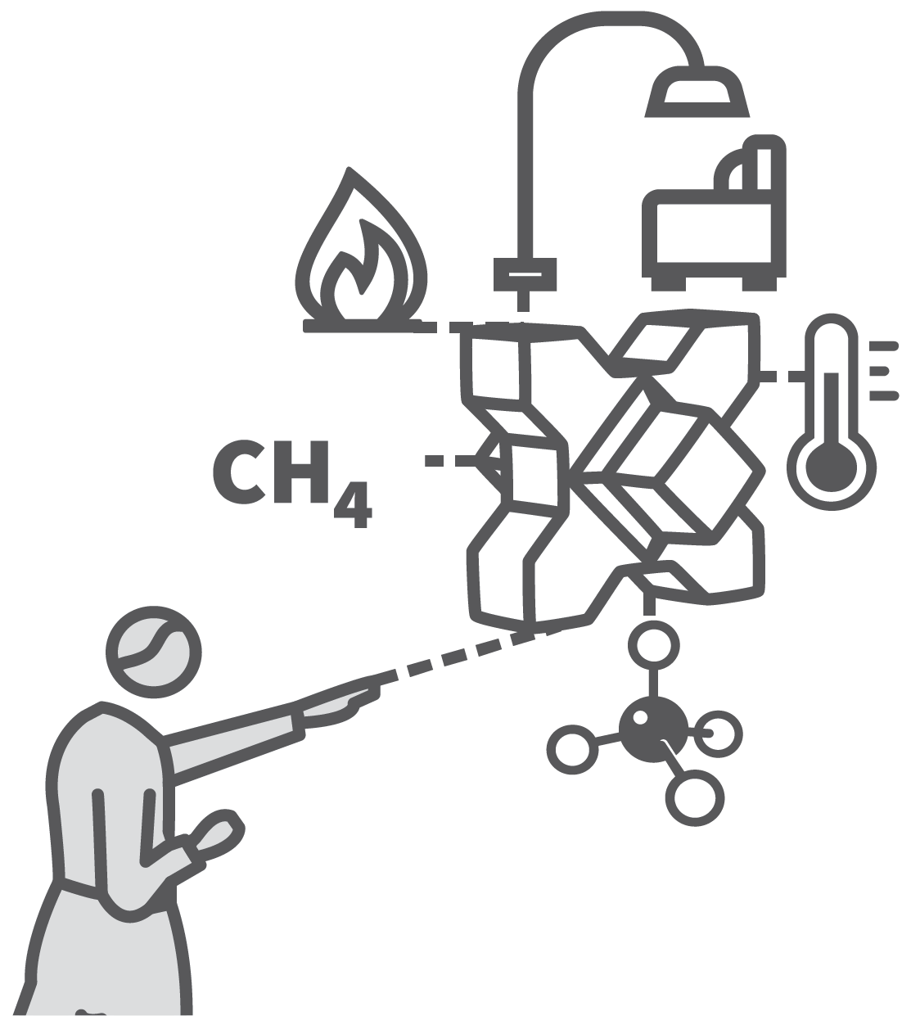

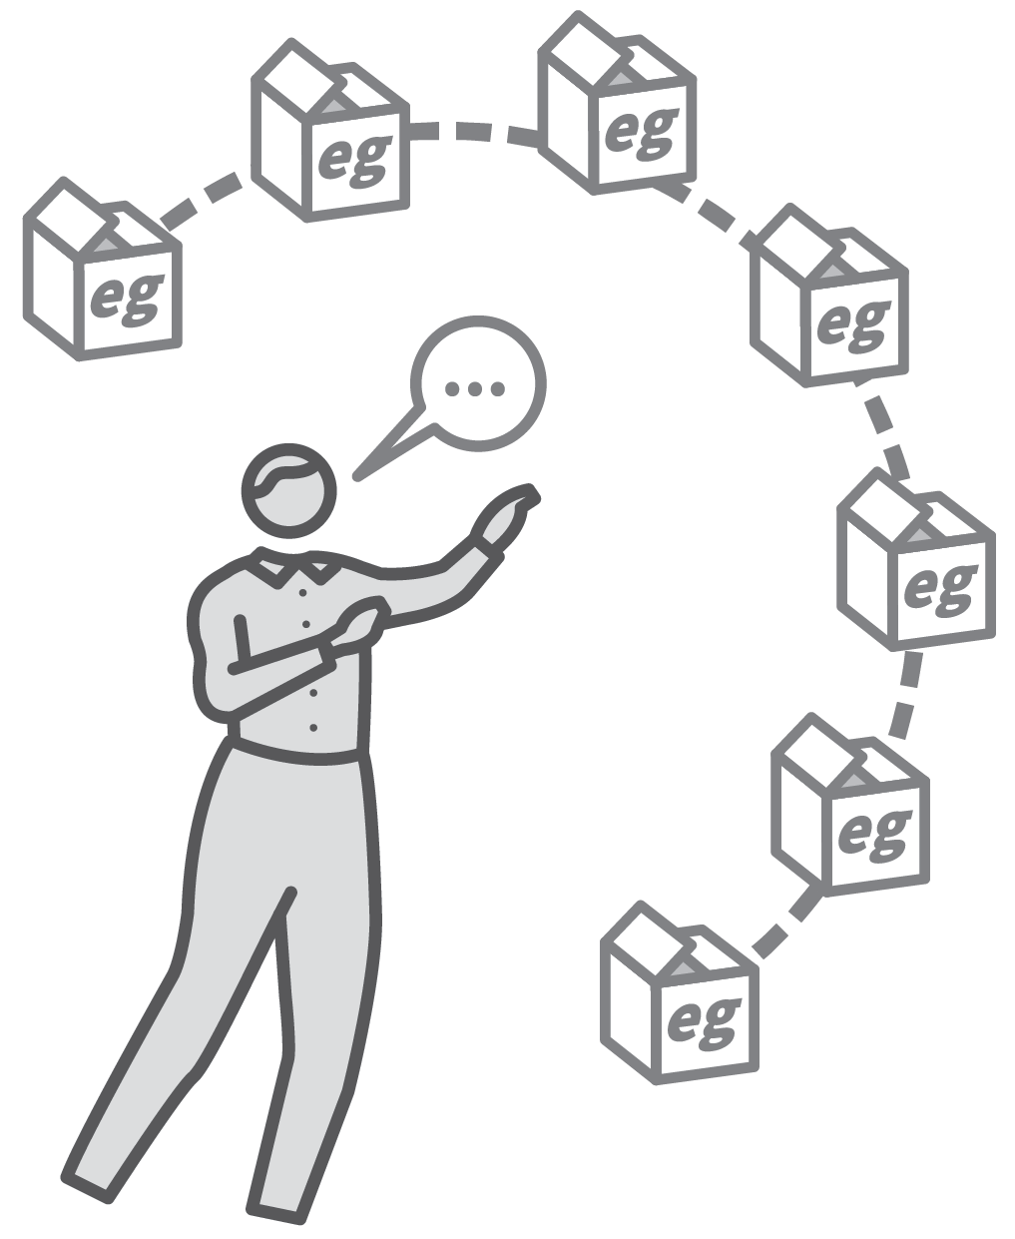
CONCRETE EXAMPLES
1
2
3
4
5
MAKE ABSTRACT–CONCRETE CONNECTIONS EXPLICIT
HIGHLIGHT A RANGE OF USEFUL CONCRETE EXAMPLES TO LEARN
QUIZ ON CONCRETE EXAMPLES FOR A GIVEN ABSTRACT IDEA
QUIZ ON ABSTRACT IDEAS FOR GIVEN CONCRETE EXAMPLES
EXTEND THE RANGE OF EXAMPLES
An important step in forming detailed schema is students’ capacity to link a set of specific concrete examples to some general rules or abstract ideas.
Students should illustrate abtract ideas with specific concrete examples.
If material is studied and can be recalled both ways round, students form more secure schema and become more fluent.

Slide 58
CONCRETE EXAMPLES
1
2
3
4
5
MAKE ABSTRACT–CONCRETE CONNECTIONS EXPLICIT
During instruction, make abstract-concrete connections a focus of your explanations.
e.g. definitions of language features —
metaphor, simile — and specific examples of each.
e.g. patterns and trends in the period table — and specific examples with particular
elements.

Slide 59
CONCRETE EXAMPLES
1
2
3
4
5
HIGHLIGHT A RANGE OF USEFUL CONCRETE EXAMPLES TO LEARN
Choose concrete examples that typify the
abstract idea in hand. Provide resources
explaining them so students can include them in their retrieval activities:
Methane, formula CH⁴, shortest chain
hydrocarbon, has low boiling point and is a gas at 25°C.
Jakarta, large slum areas and wealthy
neighbourhoods, typical of megacities in NEEs.

Slide 60
CONCRETE EXAMPLES
1
2
3
4
5
QUIZ ON CONCRETE EXAMPLES FOR A GIVEN ABSTRACT IDEA
Engage students in retrieval activities where the focus is to recall concrete examples of an abstract idea:
Give an example of a metaphor; a metal + acid reaction.
Write a sentence using a fronted adverbial; give an example of an empire and emperor.

Slide 61
CONCRETE EXAMPLES
1
2
3
4
5
QUIZ ON ABSTRACT IDEAS FOR GIVEN CONCRETE EXAMPLES
Invert Step 3 focusing retrieval on linking
specific examples to a general case or
abstract idea:
“She glowed with pride, soaking up the
applause.” What language features are used?
Your body keeps its temperature constant. What is this an example of? (Homeostasis)

Slide 62
CONCRETE EXAMPLES
1
2
3
4
5
EXTEND THE RANGE OF EXAMPLES
Develop their range, adding more concrete examples of the abstract ideas encountered in the curriculum.
Add to the element of quizzing in Step 3 and Step 4, varying the type of questions used.
Mix up the links — abstract to concrete and concrete to abstract; support students to check this type of recall in self-quizzing
routines.

Slide 63
CONCRETE EXAMPLES
1
2
3
4
5
MAKE ABSTRACT–CONCRETE CONNECTIONS EXPLICIT
HIGHLIGHT A RANGE OF USEFUL CONCRETE EXAMPLES TO LEARN
QUIZ ON CONCRETE EXAMPLES FOR A GIVEN ABSTRACT IDEA
QUIZ ON ABSTRACT IDEAS FOR GIVEN CONCRETE EXAMPLES
EXTEND THE RANGE OF EXAMPLES
An important step in forming detailed schema is students’ capacity to link a set of specific concrete examples to some general rules or abstract ideas.
Students should illustrate abtract ideas with specific concrete examples.
If material is studied and can be recalled both ways round, students form more secure schema and become more fluent.

Slide 64
1
2
3
4
5
6
7
8
9
10
QUIZZING
ELABORATIVE
INTERROGATION
USING A
KNOWLEDGE
ORGANISER
REHEARSAL &
PERFORMANCE
PEER-SUPPORTED RETRIEVAL
WEEKLY & MONTHLY REVIEW
CONCRETE EXAMPLES
GUIDED
PRACTICE
INDEPENDENT PRACTICE
BUILDING FLUENCY
NEXT UP
GUIDED
PRACTICE

Slide 65
GUIDED PRACTICE
SERIES
PRACTICE & RETRIEVAL
1
EXPLAIN AND MODEL THE NEW LEARNING
2
SET SHORT TASK USING MODELLED KNOWLEDGE OR SKILL
3
CIRCULATE ACTIVELY CHECKING FOR SUCCESS
4
CHECK FOR ERROR; AFFIRM SUCCESS
5
RE-TEACH OR EXTEND THE PRACTICE

Slide 66
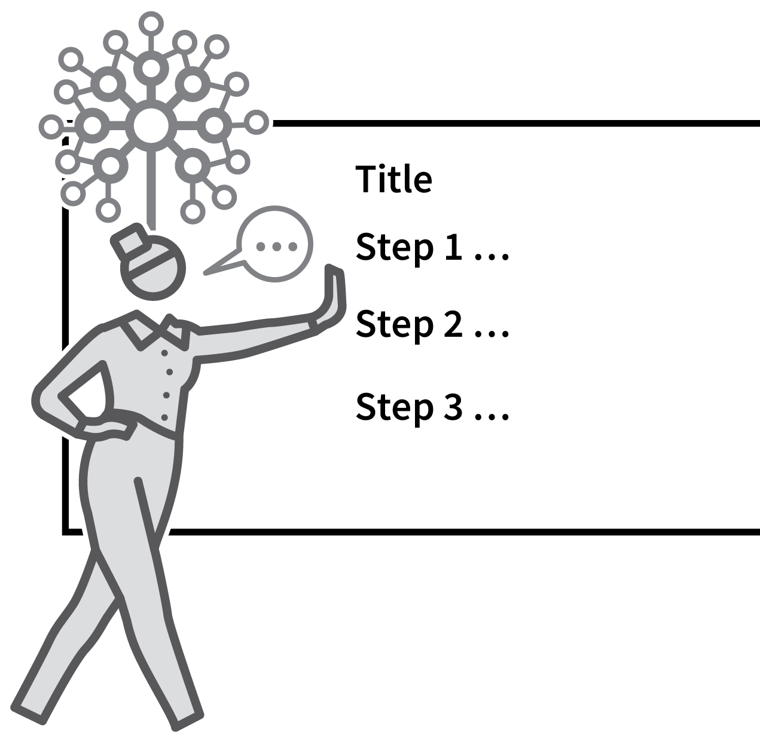

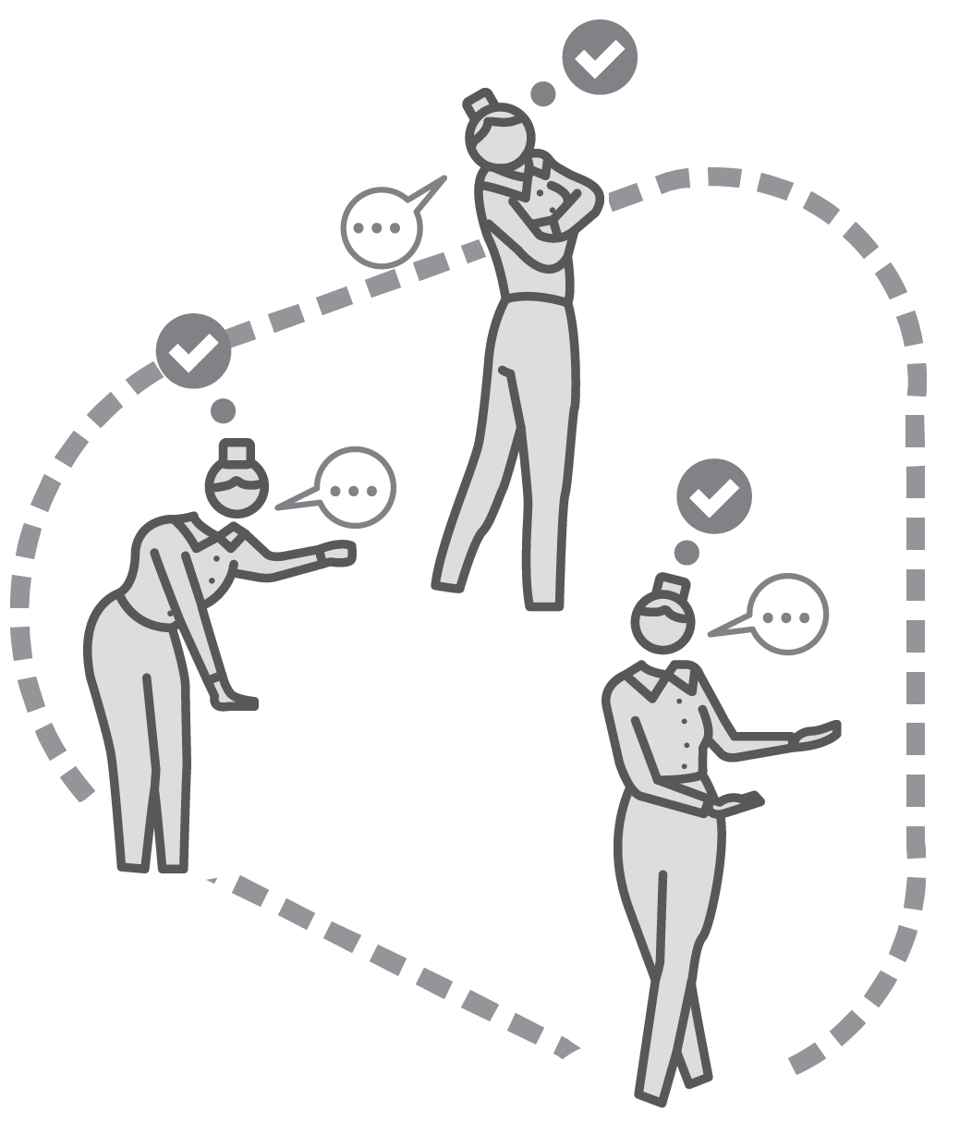

GUIDED PRACTICE
1
2
3
4
5
EXPLAIN AND MODEL THE NEW LEARNING
SET SHORT TASK USING MODELLED KNOWLEDGE
OR SKILL
CIRCULATE ACTIVELY CHECKING FOR SUCCESS
CHECK FOR ERROR; AFFIRM SUCCESS
RE-TEACH OR EXTEND THE PRACTICE
Rosenshine suggests students need a high success rate when learning new material.
This requires clear models and scaffolds with teachers guiding early stages of practice, making sure students get details right, practising doing things right.
Re-teach material if students are struggling or, conversely, move students onto n independent practice if they are gaining fluency.

Slide 67
GUIDED PRACTICE
1
2
3
4
5
EXPLAIN AND MODEL THE NEW LEARNING
Introduce the new idea or skill using the range of Explaining and Modelling techniques.
Take accout of students’ prior knowledge and confidence levels in highlighting the most important steps, common difficulties and misconceptions.
Make it seem achievable.

Slide 68
GUIDED PRACTICE
1
2
3
4
5
SET SHORT TASK USING MODELLED KNOWLEDGE
OR SKILL
Initiate practice tasks in which students are asked to follow the method or use the ideas that have been modelled.
Where needed, keep the worked examples or exemplars in view as students engage in the practice.

Slide 69
GUIDED PRACTICE
1
2
3
4
5
CIRCULATE ACTIVELY CHECKING FOR SUCCESS
Move around the teaching space looking for success with the modelled knowledge or skill.
Walk amongst students rather than relying on observing from the front of the class and asking questions.
Engage in individual feedback conversations as you circulate; gather information to inform whole-class feedback.

Slide 70
GUIDED PRACTICE
1
2
3
4
5
CHECK FOR ERROR; AFFIRM SUCCESS
Identify early successes to reinforce the ideas or elements of performance to build
confidence.
Highlight key elements of weak performance or errors in understanding.
Where these are common to the class,
address the whole group to restate or
remodel aspects of the material.

Slide 71
GUIDED PRACTICE
1
2
3
4
5
RE-TEACH OR EXTEND THE PRACTICE
Be vigilant in detecting students who are struggling and students who are flying through the material. In either case, initiate an appropriate response:
Re-teach or provide more modelled answers to reinforce first steps.
Or, extend the practice to include a wider range of examples or more challenging
content.

Slide 72
GUIDED PRACTICE
1
2
3
4
5
EXPLAIN AND MODEL THE NEW LEARNING
SET SHORT TASK USING MODELLED KNOWLEDGE
OR SKILL
CIRCULATE ACTIVELY CHECKING FOR SUCCESS
CHECK FOR ERROR; AFFIRM SUCCESS
RE-TEACH OR EXTEND THE PRACTICE
Rosenshine suggests students need a high success rate when learning new material.
This requires clear models and scaffolds with teachers guiding early stages of practice, making sure students get details right, practising doing things right.
Re-teach material if students are struggling or, conversely, move students onto n independent practice if they are gaining fluency.

Slide 73
1
2
3
4
5
6
7
8
9
10
QUIZZING
ELABORATIVE
INTERROGATION
USING A
KNOWLEDGE
ORGANISER
REHEARSAL &
PERFORMANCE
PEER-SUPPORTED RETRIEVAL
WEEKLY & MONTHLY REVIEW
CONCRETE EXAMPLES
GUIDED
PRACTICE
INDEPENDENT PRACTICE
BUILDING FLUENCY
NEXT UP
INDEPENDENT
PRACTICE

Slide 74
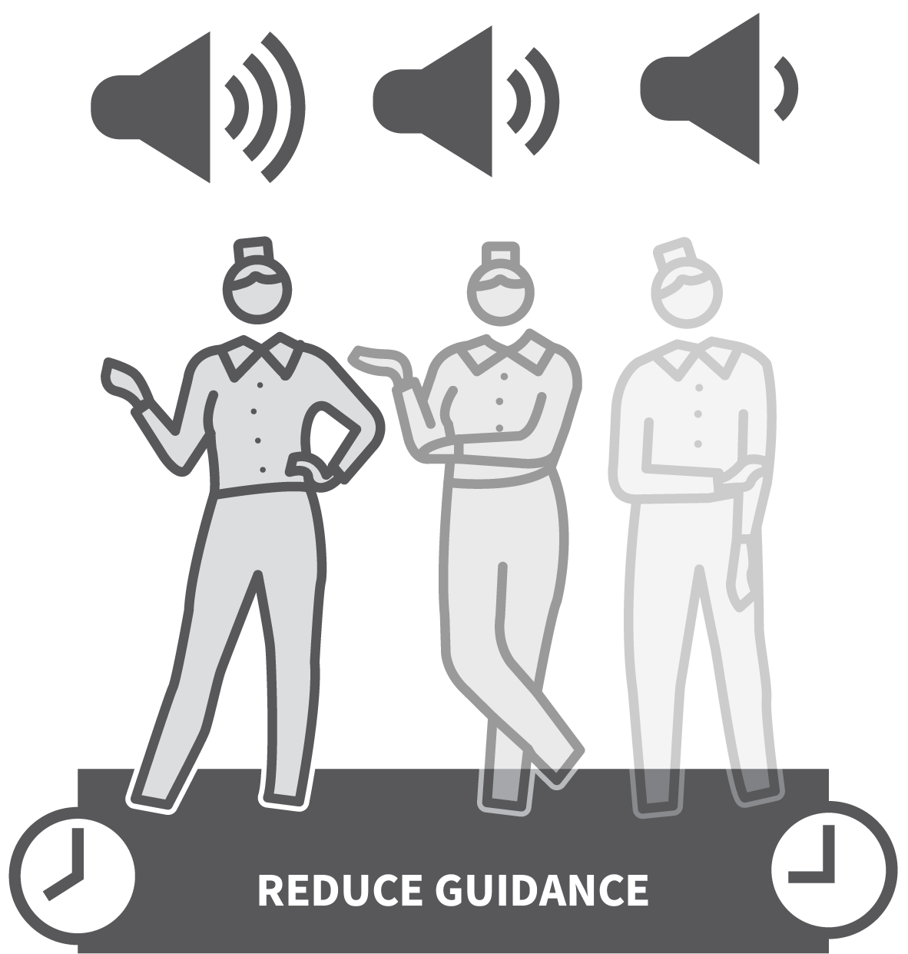
INDEPENDENT PRACTICE
SERIES
PRACTICE & RETRIEVAL
1
SECURE GUIDED SUCCESS
2
REMOVE SCAFFOLDS AND INITIATE PRACTICE
3
CHECK AND FEEDBACK
4
REDUCE GUIDANCE OVER TIME
5
INCREASE CHALLENGE OVER TIME

Slide 75

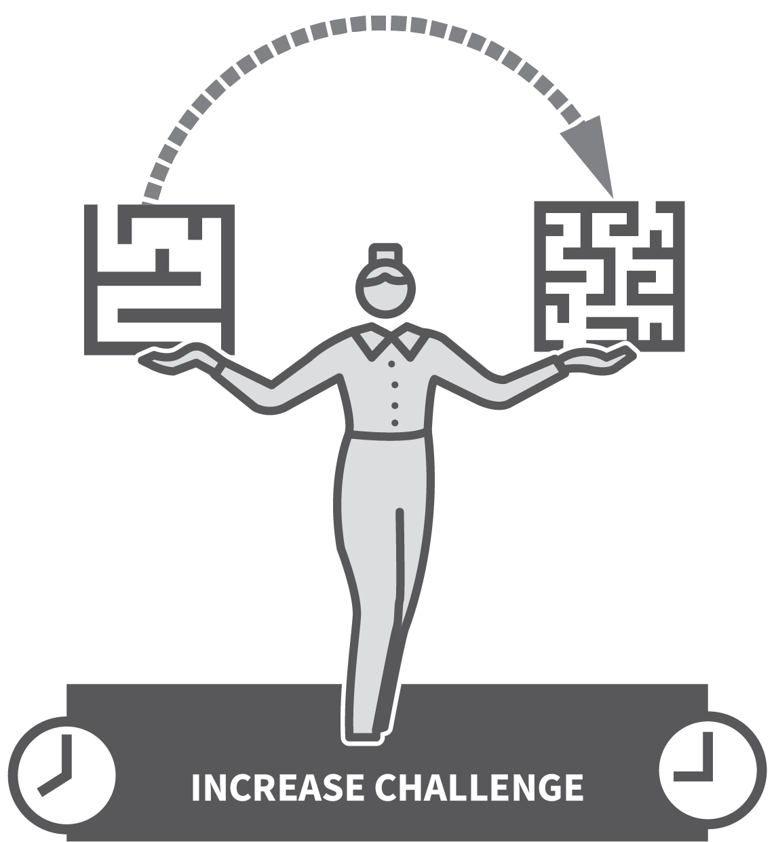


INDEPENDENT PRACTICE
1
2
3
4
5
SECURE GUIDED SUCCESS
REMOVE SCAFFOLDS AND INITIATE PRACTICE
CHECK AND FEEDBACK
REDUCE GUIDANCE OVER TIME
INCREASE CHALLENGE OVER TIME
For students to apply learning independently with a level of fluency requires extensive practice.
Independent practice supports the overlearning essential to develop the automaticity needed for fluent application and recall in future.
Moving from guided practice to independent practice is a continuum as teachers gradually reduce the level of guidance.

Slide 76
INDEPENDENT PRACTICE
1
2
3
4
5
SECURE GUIDED SUCCESS
Before students engage in independent
practice, make sure that they have reached a certain level of confidence.
If students are to succeed and build
confidence, they need to be getting things mostly right, with practice aimed at
improving fluency.
If they are not ready, it can back-fire. Teacher judgement is critical here.

Slide 77
INDEPENDENT PRACTICE
1
2
3
4
5
REMOVE SCAFFOLDS AND INITIATE PRACTICE
Set tasks that use the same material featured during guided practice, e.g. near identical questions and activities to those that were previously modelled and supported with scaffolds.
Or set an extension of those activites with
increasing levels of challenge as students’
fluency develops.

Slide 78
INDEPENDENT PRACTICE
1
2
3
4
5
CHECK AND FEEDBACK
Evaluate the success of students’
independent practice, providing feedback to ensure they are continuing to produce
accurate responses and their level of fluency is improving.
Unchecked practice can result in drift from the original standards or a rate of
improvement below the level expected.

Slide 79
INDEPENDENT PRACTICE
1
2
3
4
5
REDUCE GUIDANCE OVER TIME
Use Feedback That Moves Forward avoiding ‘SatNav syndrome’.
Make it explicit that students must
self-evaluate the quality of their performance or their success rate, using answer sheets or success criteria and exemplars.
Independent performance is achieved when students self-diagnose gaps in their learning and take steps to address them.

Slide 80
INDEPENDENT PRACTICE
1
2
3
4
5
INCREASE CHALLENGE OVER TIME
As students’ confidence and success rate
improves, direct them towards tasks with a greater level of challenge.
e.g. attempting more synoptic questions, spanning multiple concepts; writing more
extended pieces; attempting more difficult
or more abstract problems; increasing the scope, pace or stamina in performance.

Slide 81
INDEPENDENT PRACTICE
1
2
3
4
5
SECURE GUIDED SUCCESS
REMOVE SCAFFOLDS AND INITIATE PRACTICE
CHECK AND FEEDBACK
REDUCE GUIDANCE OVER TIME
INCREASE CHALLENGE OVER TIME
For students to apply learning independently with a level of fluency requires extensive practice.
Independent practice supports the overlearning essential to develop the automaticity needed for fluent application and recall in future.
Moving from guided practice to independent practice is a continuum as teachers gradually reduce the level of guidance.

Slide 82
1
2
3
4
5
6
7
8
9
10
QUIZZING
ELABORATIVE
INTERROGATION
USING A
KNOWLEDGE
ORGANISER
REHEARSAL &
PERFORMANCE
PEER-SUPPORTED RETRIEVAL
WEEKLY & MONTHLY REVIEW
CONCRETE EXAMPLES
GUIDED
PRACTICE
INDEPENDENT PRACTICE
BUILDING FLUENCY
NEXT UP
BUILDING
FLUENCY

Slide 83

BUILDING FLUENCY
SERIES
PRACTICE & RETRIEVAL
1
DESIGN DRILLABLE ELEMENTS
2
ENGAGE STUDENTS IN REPEATED LOW–STAKES PRACTICE
3
CHECK FOR ACCURACY AND PRECISION
4
INCREASE THE RANGE, PACE AND VARIETY
5
INTEGRATE THE ELEMENTS BACK INTO MORE COMPLEX TASKS

Slide 84
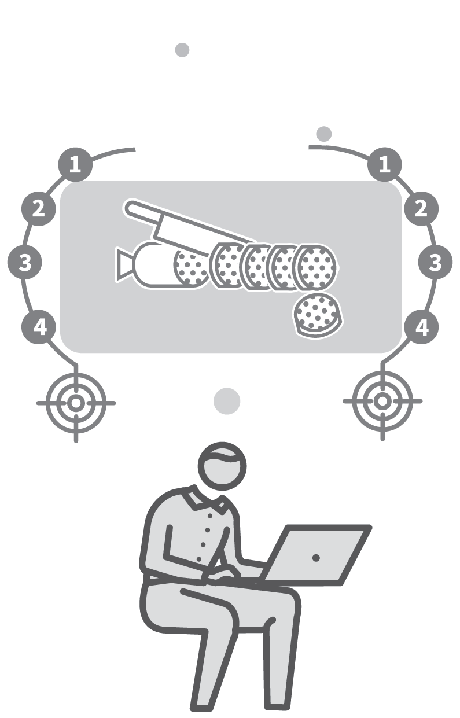
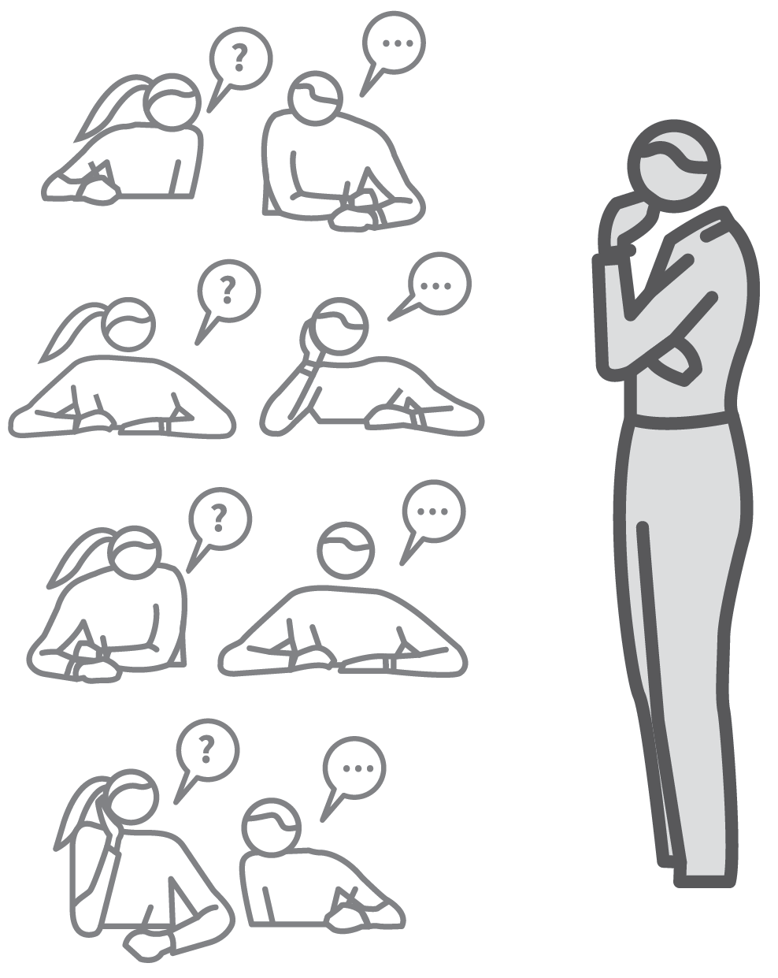


BUILDING FLUENCY
1
2
3
4
5
DESIGN DRILLABLE ELEMENTS
ENGAGE STUDENTS IN REPEATED LOW–STAKES PRACTICE
CHECK FOR ACCURACY AND PRECISION
INCREASE THE RANGE, PACE AND VARIETY
INTEGRATE THE ELEMENTS BACK INTO MORE COMPLEX TASKS
Fluency suggests recall from memory with miminal effort and a level of automaticity.
e.g. physical aspects of playing sport or an instrument; performing a manual task; reading and using language; performing computational tasks; retrieving factual knowledge.
Fluency is secured through repeated practice with high success rate.

Slide 85
BUILDING FLUENCY
1
2
3
4
5
DESIGN DRILLABLE ELEMENTS
Examine knowledge and skills you want
students to learn and break them down,
identifying what can be performed
repeatedly.
Desconstruct complex tasks like speaking a language, playing sport or writing an essay into small, specific drillable elements.
This provides the building blocks of building fluency. Model each of the elements to your students.

Slide 86
BUILDING FLUENCY
1
2
3
4
5
ENGAGE STUDENTS IN REPEATED LOW–STAKES PRACTICE
This will be very context specific but might
include:
Repeating words and phrases in a language; repeating mathematical operations; repeating a mechanical/physical skill or process.
Repeating the explanation of an idea;
repeating a quote or the sequence of a set of facts.

Slide 87
BUILDING FLUENCY
1
2
3
4
5
CHECK FOR ACCURACY AND PRECISION
While students perform their repeated
practice routines, focusly sharply on accuracy and precision.
If it matters that words are pronounced
correctly or that every single detail in a
procedure is recalled or performed, then
highlight them as areas for students to
practise.

Slide 88
BUILDING FLUENCY
1
2
3
4
5
INCREASE THE RANGE, PACE AND VARIETY
Ensure practice routines include variety so that physical skills or knowledge-recall
activities require students to become agile in the way their fluency develops.
After an initial level of fluency is achieved, add complexity, increasing the range of
material involved.
Increase expectations of pace where
appropriate and extend the material’s
difficulty.

Slide 89
BUILDING FLUENCY
1
2
3
4
5
INTEGRATE THE ELEMENTS BACK INTO MORE COMPLEX TASKS
Once students are developing fluency in the component drills, put them back into their wider context by setting tasks combining the elements into a whole.
e.g. playing a basketball match, producing
extended writing, engaging in a French
conversation.

Slide 90
BUILDING FLUENCY
1
2
3
4
5
DESIGN DRILLABLE ELEMENTS
ENGAGE STUDENTS IN REPEATED LOW–STAKES PRACTICE
CHECK FOR ACCURACY AND PRECISION
INCREASE THE RANGE, PACE AND VARIETY
INTEGRATE THE ELEMENTS BACK INTO MORE COMPLEX TASKS
Fluency suggests recall from memory with miminal effort and a level of automaticity.
e.g. physical aspects of playing sport or an instrument; performing a manual task; reading and using language; performing computational tasks; retrieving factual knowledge.
Fluency is secured through repeated practice with high success rate.

