Slide 1
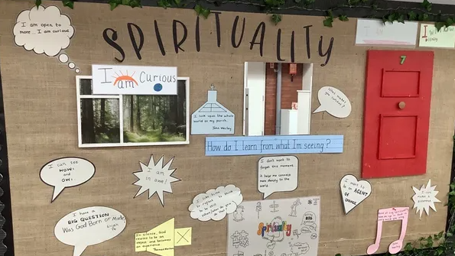
Embedding Spirituality across our schools.
Autumn 2025

Slide 2
Aim for the session
To understand how the new policy is to be enacted across the Trust.
To have some reminders of key methods and questions to support you in developing pupils' spirituality across the school day.
Be confident with the use of the new DGAT tools to support you with developing pupils spirituality across the Trust.

Slide 3

What is Spirituality ?
Spirituality is the act of being fully human by discovering and revealing ourselves through love. We realise this through the personal stories that hold meaning for us and help us to become who we are.”
Andrew Ricketts Spiritual Development Interpretations of spiritual development in the classroom May 2019.

Slide 4
Why is this important to us as a school and Trust.
Legal Framework - The Education Act 2005 says that education of children should include supporting them to develop their spiritual moral, social and culture understanding.
Both Ofsted and SIAMS will evaluate the impact of leaders work in ensuring that this is being delivered.

Slide 5

A re-articulation of who we are

Slide 6


Slide 7

What is Spirituality
We believe that in order to support and develop children’s spirituality we have three lens that we view this through ;
Self understanding self as the unique human they were created to be.
Others – becoming increasingly aware of others and a growing empathy, concern and compassion for how we treat others.
Beyond- a growing relationship with the transcendental and the ability to explore experiences beyond every day.

Slide 8

Benefits of Spiritual flourishing
Support their mental health and wellbeing, enabling a sense of calm and peace.
To appreciate the beautiful world, we live in and to be alive to experiences of awe and wonder.
To develop that toddler-like curiosity and questioning (why, what, where, how etc)
To stop, reflect and be grateful. To heighten our senses and pay attention to detail.
To understand that when times are tough or when we make mistakes that we are forgiven and we can move forward positively to grow.
To develop perseverance and self-efficacy building confidence and supporting our children to achieve goals.
To marvel at the simple and beautiful. To enjoy sound, colour, structure and form.
To think about other people, places and see the wider picture.
To enable us to better value our place in this world.

Slide 9
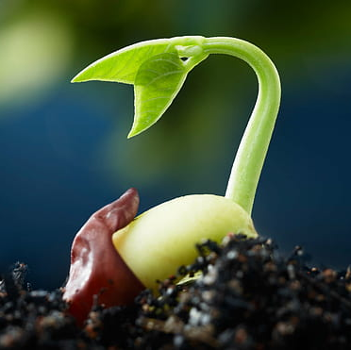
DGAT’s approach to spirituality
Living out our vision enables us to support mutual spiritual flourishing in our communities.
Self awareness
Empathy
Curiosity
Creativity
Reflection

Slide 10
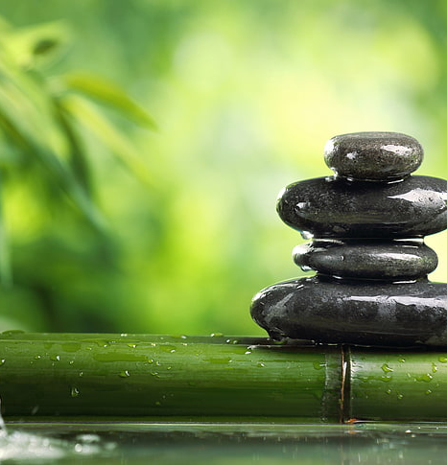
Getting the Culture right to enable all to flourish
We create the right culture by ensuring that our Trust vision and values are lived out in all our interactions
Allowing space to think and reflect.
Use of non-verbal ways to elicit and draw out response from children especially important for pupils who are non-verbal or who have SEND.
Create the space and climate to allow pupils to be mindful of how this makes others feel.
Using the learning environment to support and enhance pupils' reflections
Encouraging stillness and contemplation,

Slide 11

Checking our culture, prompts for staff…
Questions to ask …
Are our pupils encouraged to ask questions about the meaning and purpose of life.
In what sense is there an ethos in our school/class which values imagination, inspiration and contemplation?
In what way does prayer permeate the life of our school ?
Are we providing opportunities for pupils to develop empathy and understanding of others ?
Can we identify moments for spiritual development within our planning ?
How do we know that pupils are responding to the spiritual development that we provide them ?
How does the way our curriculum is organised, support /hinder spiritual development ?
What does this look like for you ?

Slide 12
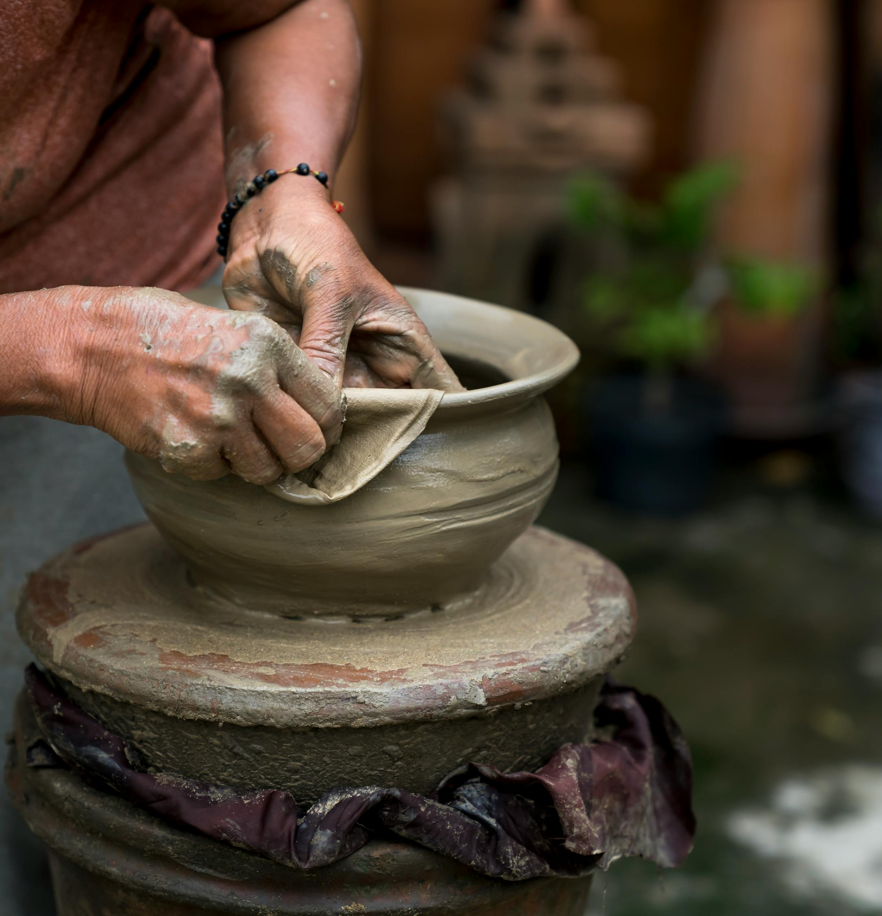
Language of Spirituality
To talk about spirituality is, essentially, to talk about something which is beyond words.
To make conversations about spirituality more accessible to every member of our school community, each school will have identified a language that supports pupils understanding of spirituality. This might be for example “Ow’s Wow’s and Now’s” which are ideas developed by the Education Department at the Diocese of Gloucester.
This language of spirituality begins from a Christian understanding that everyone is a valued creation, individually and uniquely made by God, like pots made by a potter (Isaiah 64:8).
Using this language helps give our children a framework on which to support their spiritual understanding.

Slide 13

Change the next slide if your language of spirituality is not Ow’s Wow’s and Now’s.

Slide 14
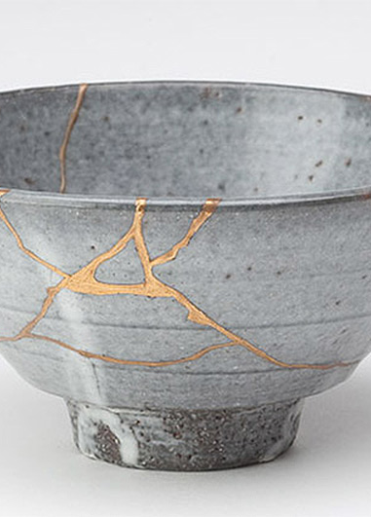
Ow’s Wow’s and Now’s
In life things happen that impact on the physical pot of life and create cracks that provide a glimpse of something beyond the tangible.
Cracks may be caused when something so good and breath taking happens that the pot expands and cracks - this is the wows of life.
Cracks can also happen in the stillness and ordinariness of everyday – the nows of life, when a moment of stillness, a pause or prayer creates a crack in the normal, physical every day.
In these special moments there is a spiritual opportunity. Kintsugi, the Japanese art of mending broken ceramics with golden joinery or glue, creates something that has been broken into something even more beautiful. Using this metaphor, the wows, ows and nows of life offer the possibility of cracks that are filled with gold and make the pot even more beautiful. The gold in the cracks reflect a little of the wonder of spirituality.

Slide 15

How do we use Ow’s in our daily practice?
Ow moments might be...
Thinking about a time when we felt sad,
Responding to a challenging world situation
Making a mistake in maths.

Slide 16
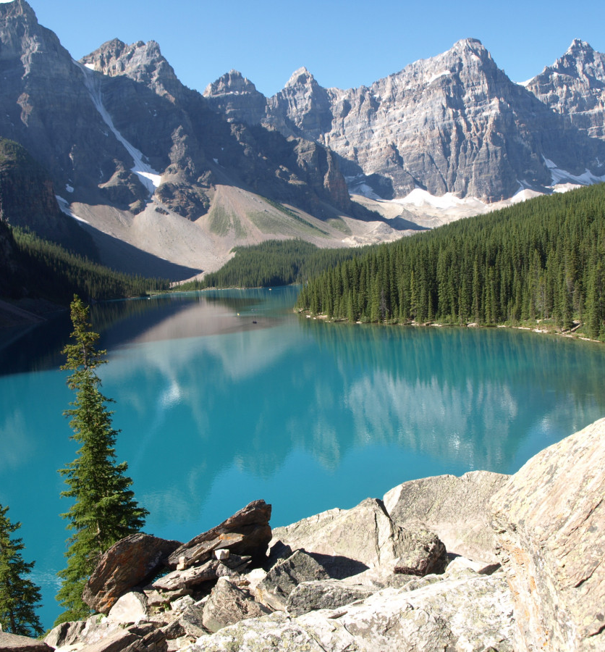
How do we use Wow’s in our daily practice?
Wow moments might be…
Celebrating an achievement ?
Wonder at an outcome of an experiment ?
Just appreciate the beauty of where you are .

Slide 17
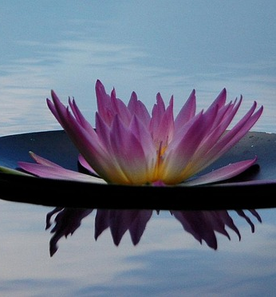
How do we use Now’s in our daily practice?
Now moments are the everyday ordinary times, being present in the moment and being open and receptive to life.
Valuing opportunities for stillness and reflection as part of collective worship or through a lesson.
Noticing how something makes you feel in a piece of art or music.
A moment for quiet reading

Slide 18
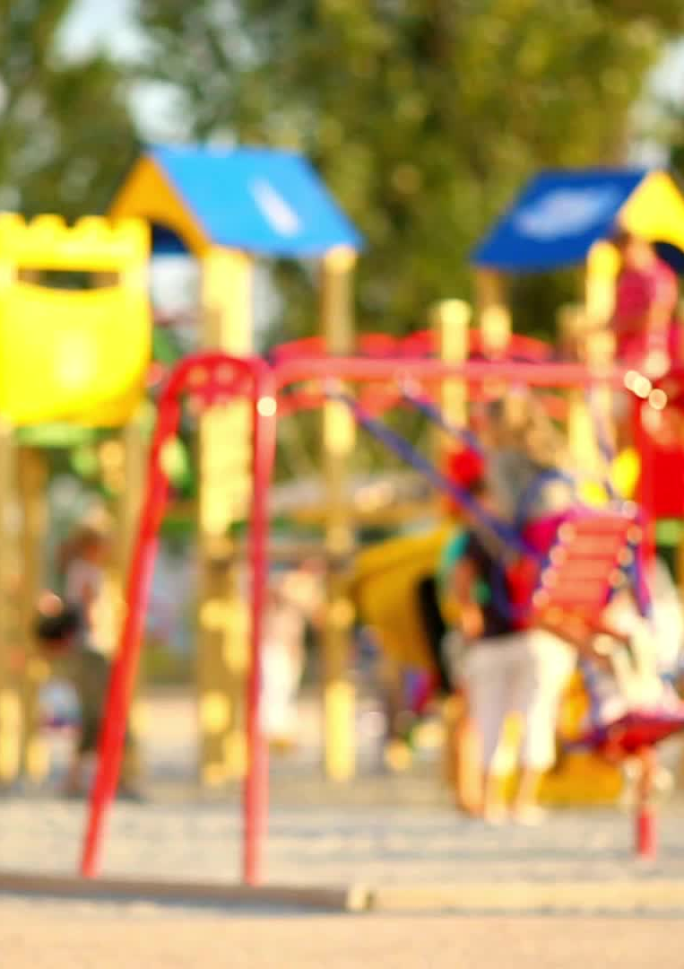
Supporting pupils' development in Spirituality
Opportunities for the spiritual growth of pupils is developed in every aspect of our school day.
This might be on the playground when there is a falling out, or you notice something beautiful. It might be a quiet moment of reflection in the class or in collective worship, or it could be when a mistake has been made in a piece of learning. Whatever it is, we need to recognise how to stop and help our children to grow from these opportunities.
To help you with this, we have created a document to support your understanding, which gives some stem sentences and questions you can use to deepen pupils spiritual flourishing, through understanding themselves and others and then asking questions about life beyond.
This is the DGAT and Spirituality Document . This provides all DGAT staff with a core understanding of what Spirituality is and what it means to our Trust. It offers a range of tools including stem sentences and tips to use and support staff .

Slide 19

Tips for using Stem Sentences to develop pupils' spirituality:
Model the language: Read the sentences aloud and model how to use them in conversation.
Provide a variety of options: Offer different stem sentences to cater to various interests and ages.
Encourage sharing: Ask children to share their thoughts and feelings after using the stem sentences.
Make it a regular activity: Integrate stem sentences into daily routines, such as during bedtime, walks in nature, or family discussions.
Adapt to the child's needs: Adjust the language and complexity of the sentences based on the child's developmental stage.

Slide 20
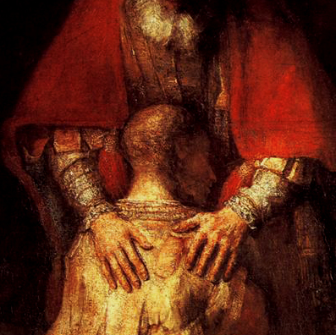
Try it out…
This is Rembrandt’s Prodigal Son…
What do you notice ?
How does it make you feel?
3 mins individually . 2 mins feedback to a partner.
This Photo by Unknown Author is licensed under CC BY-NC-ND

Slide 21
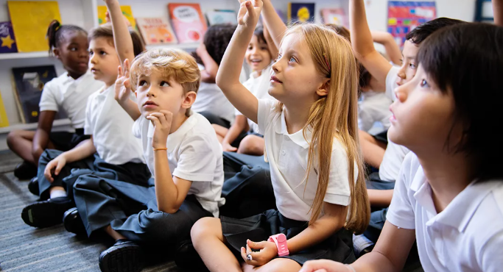
Practical strategies for Collective Worship
They are many ways that the daily act of collective worships allows pupils to deepen their spiritual understanding.
provides the opportunity for pupils to become aware of the importance of reflection and how our positive and negative experiences can be formative. It also provides a real sense of being present (now moments) which are often linked to invitations to pray.
Reflection also allows pupils to consider big questions and their response to them. It supports their understanding in how they are called to act, and their responsibilities to others.
Opportunities to reflect on the wows of life such as beauty and joy of the world are given, as well as time to reflect and empathise with the ow moments of disappointment or pain.
Celebrations allow pupils time to reflects on some of the wow moments in life. This might be through the seasonal Christian festivals and celebrations in the calendars of other faiths. It might also be the accomplishments of school members. In this way pupils are offered time to be able to contemplate and develop spiritually.
Question for staff. How are you ensuring that your CW is allowing opportunities to deepen pupils spiritual understanding ?

Slide 22

Spirituality in Religious Education
RE curriculum should enable pupils to have a rich and deep knowledge and understanding of Christian belief and practice and the ways in which it is unique and diverse. It should also allow pupils to engage in meaningful and informed dialogue with those of all religions and world views.
Learning should provide for the needs of all pupils.
Pupils should have a safe space to explore and reflect on their own religious, spiritual and philosophical ways of seeing, living, thinking, believing and belonging.
The curriculum gives a myriad of opportunities to reflect, discuss, debate respectfully and should be used as ways to promote pupils understanding of themselves, others and beyond.
Question for staff - Are you confident that you are using this to deepen pupil’s spiritual awareness ?

Slide 23
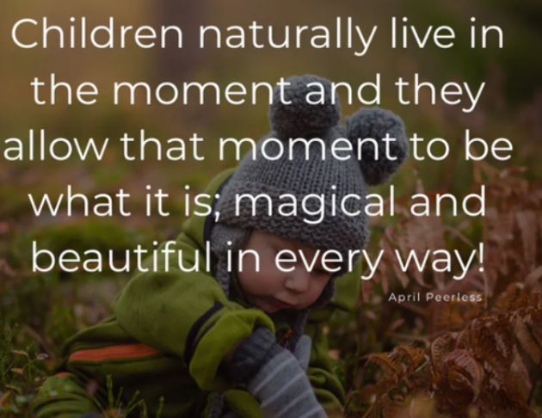
Spirituality across the curriculum
To support the DGAT Spirituality document, we have also produced a document that gives an overview of the curriculum and some potential opportunities that are within this. This document looks at spirituality through the three lenses of self, others and beyond.
The next few slides highlight some generic practical opportunities for the classroom and some individual subject areas. But there are more…
Key is listening and giving space for children to respond… let them understand and support them through questioning in making sense of the world around them.

Slide 24
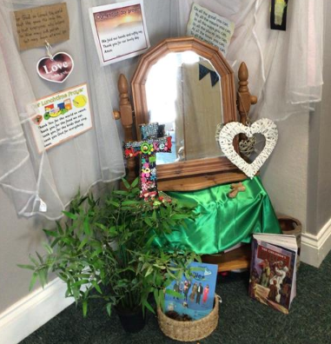
Practical strategies in the classroom
Through the taught curriculum, maximising moments of beauty, mistakes and learning from “ow” of the moment
Use of music and non-verbal ways to elicit and draw out responses from children especially important for pupils who are non-verbal or who have SEND.
Reflective spaces, giving opportunity for pupils to consider and respond, and even pray if moved to do so.
Encouraging stillness and contemplation when listening or responding to a thought or provocation, encouraging to think about self, others and beyond.
The next few slides look at the wider curriculum and give an understanding of how self, others and beyond is developed.
Question for Staff - What do your reflective spaces look like ? How are they supporting pupils to interact with them?

Slide 25
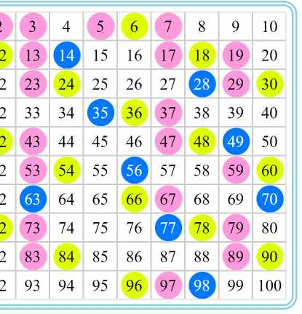
Maths
The awe of number patterns – WOW!
Reminder that there are things that can’t be measured e.g. sacrificial love
Reminder that there are things that can’t be counted e.g. the difference an act of kindness can make
Question to support understanding of the beyond…
“I wonder if we ever stop counting… “

Slide 26

Reading
Responding to poems stories and rhymes and appreciating the beauty of language and the stories it tells us that allows us to be transported to other worlds.
Stories about responding to trials or achievements that go beyond the expected.
Positive and negative examples of responding to wows and ows provide discussion points.
Which texts offer the beauty of language or opportunities for empathy?
“How did this make you feel ? “
“Which texts inspire you?” “ Why?”

Slide 27
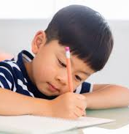
Writing
What sort of things do you encourage pupils to write about?
Are there any opportunities to write about things that have profound value or matter deeply to pupils?
How is this content valued?
E.g. should a poem or story about a family member be reduced to an evaluation of SPAG?
Are there opportunities to be involved in collaborative writing to encourage a greater awareness of their own and other’s skills?

Slide 28
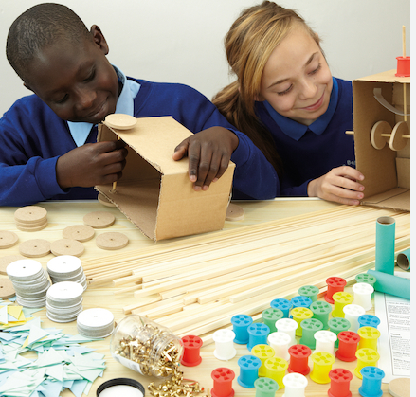
DT
Enjoying and celebrating personal creativity.
Learning from mistakes and improving our designs.
How can we create something that will help someone else ?
What motivates designers?
Explore the decisions that influence what we design.

Slide 29
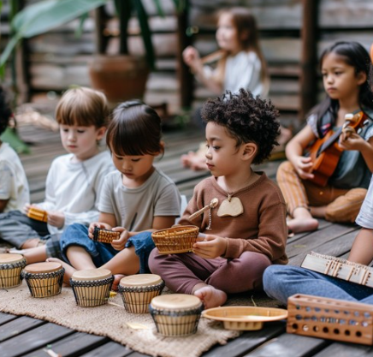
Music
Music invites you to explore the mystery that dances within your soul. Be aware of what types of music "speak to you" and what types of music drain you.
(Dr. Kathleen Hall, Preventive Medicine Specialist)
Give pupils space to think and create their own sounds as well as to appreciate the beauty of sounds others make.
Sound bathing and listening to music allows us to think worlds beyond.
Questions such as I wonder what you can hear ?
How does it make you feel ?

Slide 30


Geography
How do we celebrate the excitement of amazing physical geography?
How do we deal with the discovery that different geographical areas do not provide the same opportunities?
How can these ideas be linked to the language of spirituality and our response and responsibility in a challenging world?
How do we use our global links and connectivity to understand how others live ?

Slide 31
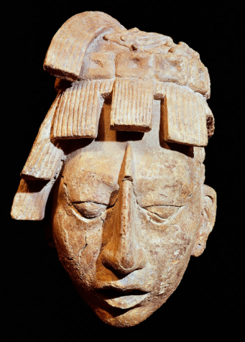

History
What are the stories that tell historical wows?
Which stories reflect the ows in history?
What lessons for future decisions and choices do they provide?

Slide 32

MFL
Appreciate the beauty of language.
Excitement of communication in another language and connecting with others.
It’s great to be able to buy an ice cream on holiday – but what about being able to welcome, support and comfort someone in another language?

Slide 33
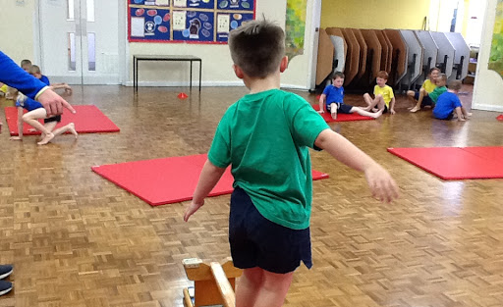
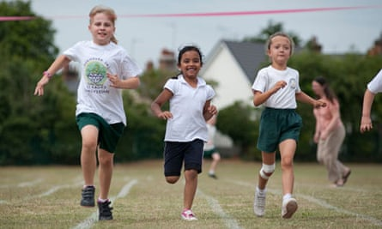
PE
Wow – the celebration of learning a new skill, being really proud of your whole self
Now – being completely focused in the now
Delight in movement, connectedness and creativity
Being aware of one’s own strength and limitations,
PE can offer equality, freedom, respect, trust

Slide 34
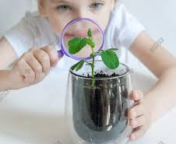
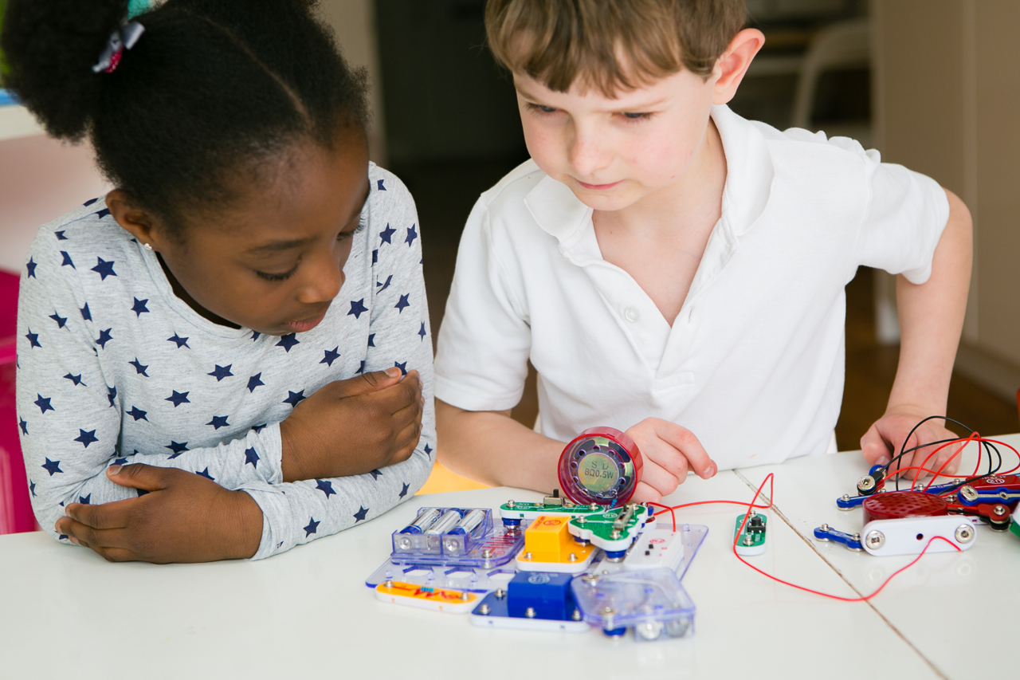
Science
Discovering how things work, linger longer on the wonder!
Creating opportunities for pupils to ask questions about how living things rely on and contribute to their environment.
Are there questions that can’t be answered by science ?

Slide 35
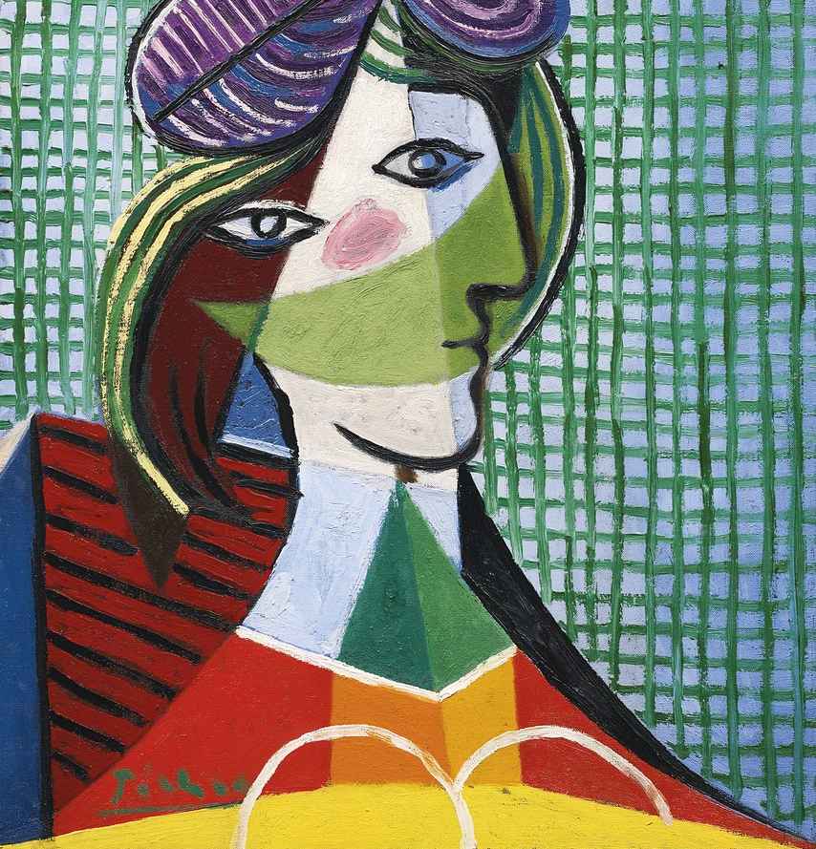
Art
Art invites you to explore the mystery that dances within your soul. Be aware of what types of art "speak to you" and what types of art drain you.
Which artists do you celebrate? What are the wows and ows in their stories?
How do you celebrate and respect different responses to art?
Allowing space for pupil's creativity to respond through different medias to express their feelings as well as evaluating their work.
To consider how other might feel when exploring others art.
This Photo by Unknown Author is licensed under CC BY-SA-NC

Slide 36
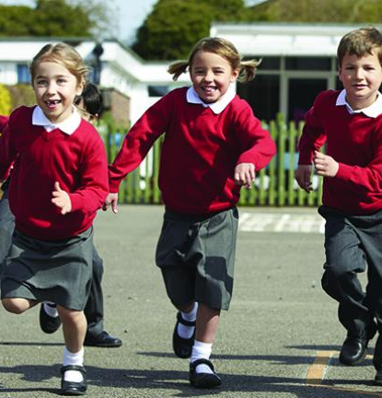
Spirituality across the wider school
Appreciating a moment of space in a busy day.
Time to practice a skill – skipping, learning a dance routine etc and taking pride in it.
Playing with others and taking enjoyment from others happiness.
Cloud watching and appreciation of the world around us.

Slide 37
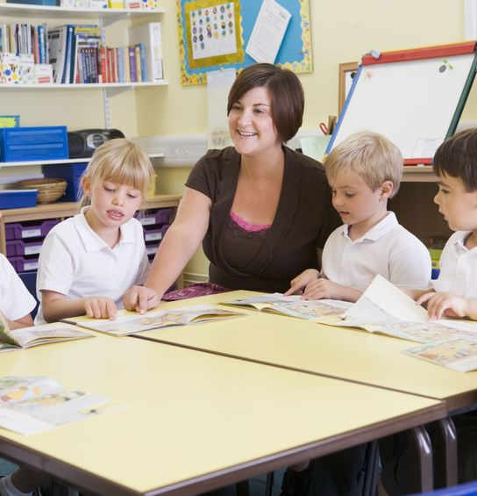
Key Takeaways…
Ensure that the policy is read and understood by all.
All staff to have read the DGAT spirituality and Spirituality across the curriculum to support them in their work.
Consider how you as staff are going to use these tools in your daily work so that you are supporting our pupils to flourish.

